Slide 1
Human-in-the-Loop Reservation Approval
Stage 2 of 4: administrator agent, REST service and escalation
Edupuganti Likhith
github.com/likhithe2204/parking-chatbot
Notes:
Stage 1 built the chatbot. Stage 2 adds a human administrator who approves or refuses every reservation.

Slide 2
What the task asked and what was delivered
Requirement | What was built | Proof
Second agent with LangChain | Admin agent writes the note and sends the request | Slide 5
Send request, get confirm or refuse | REST service plus an administrator console | Slides 4 and 6
Integrate with the first agent | Chatbot escalates after the customer confirms | Slide 7
Receive the response | Customer asks for the status, decision text comes from code | Slides 7 and 8
Reliable and safe | API key, one decision per request, fallback note | Slide 3
Extra artifacts | README, 142 pytest tests, GitHub Actions CI, this deck | Slide 9
Parking Reservation Chatbot | Stage 2
Notes:
Go row by row. Every Stage 2 requirement has a working feature and proof.

Slide 3
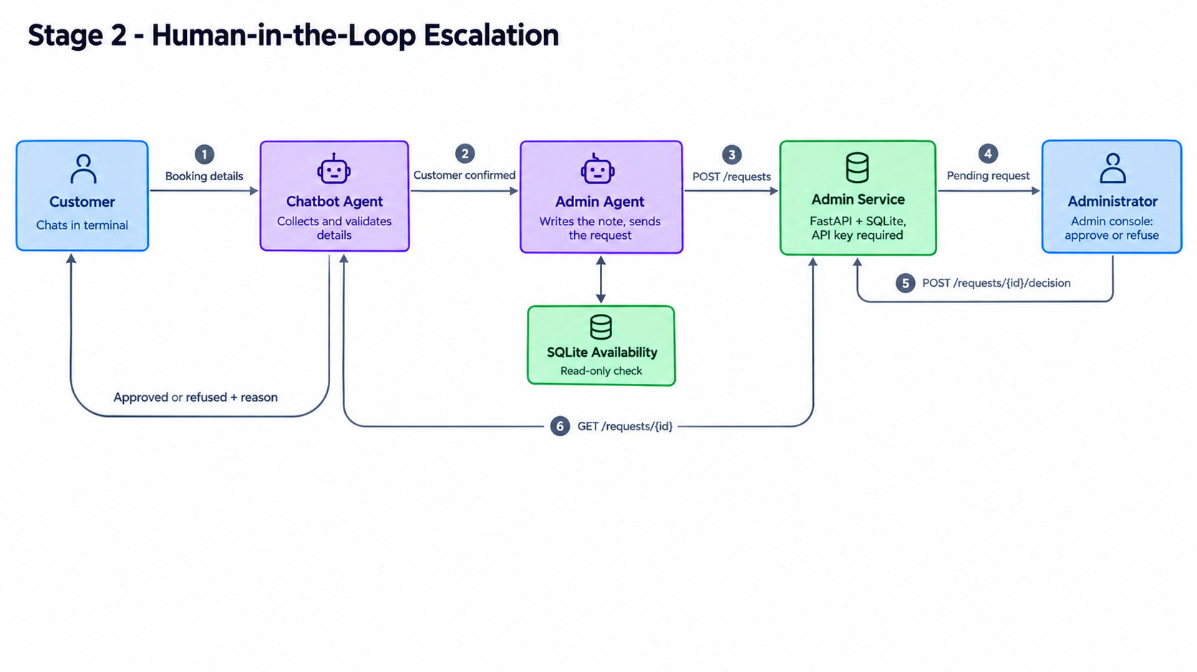
Architecture of the escalation
Parking Reservation Chatbot | Stage 2
Notes:
Follow the numbers: details, confirmation, request, pending, decision, status.

Slide 4
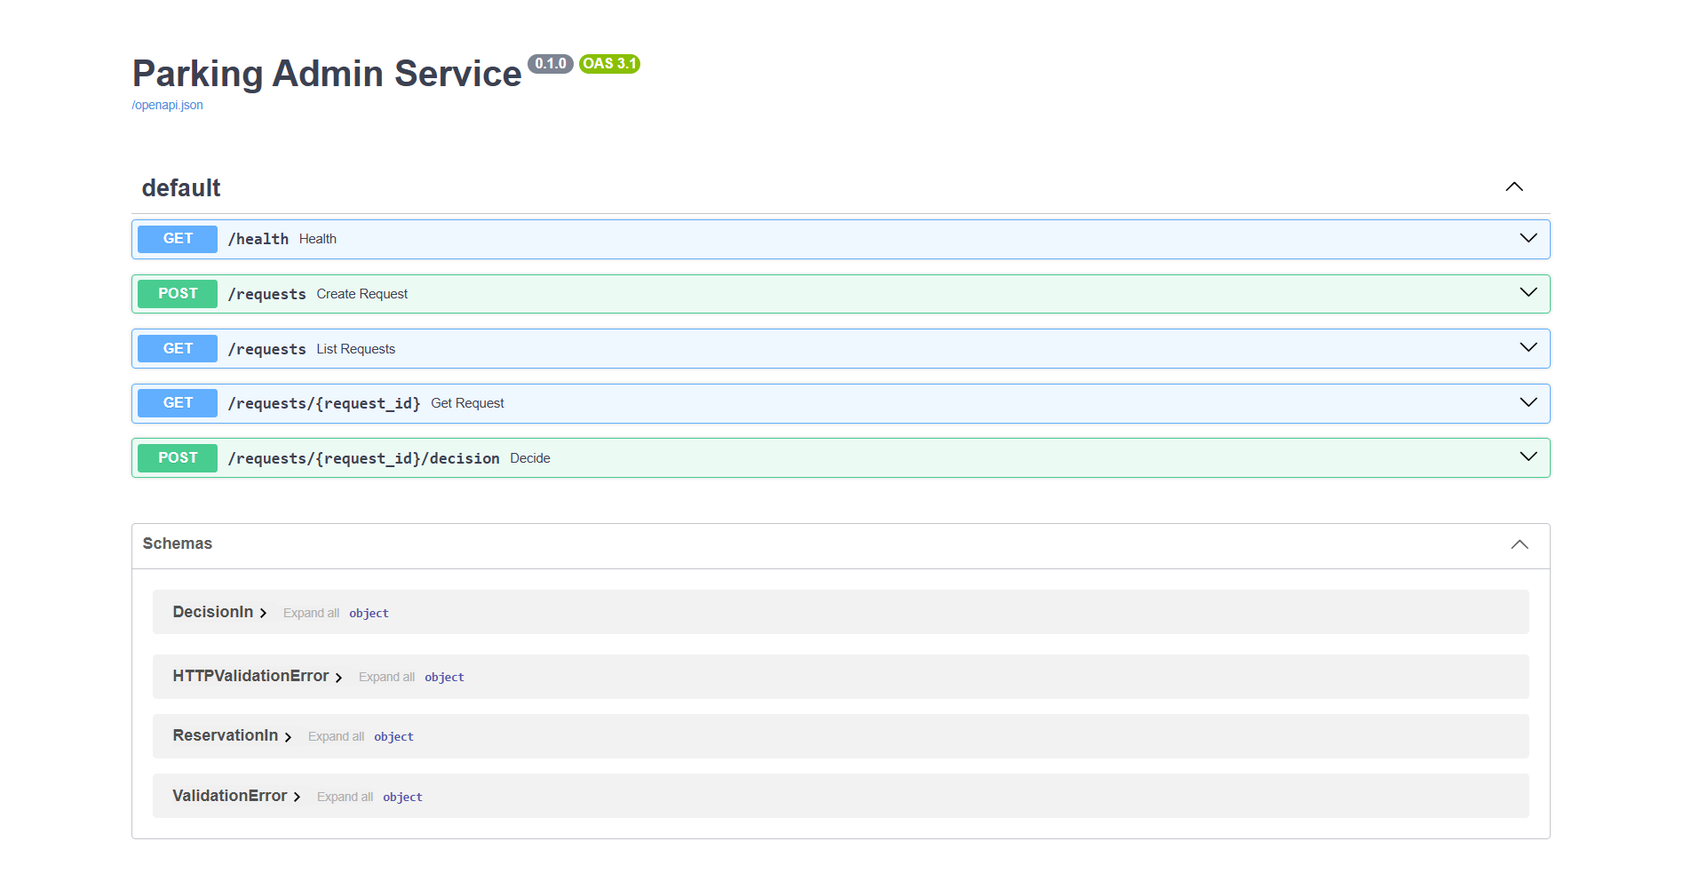
Admin service: the manager's inbox
• A small FastAPI service stores every reservation request.
• Every call needs an API key. Requests are validated again on arrival.
• A request can be decided only once.
Parking Reservation Chatbot | Stage 2
Notes:
The interactive API page lists the five endpoints.

Slide 5
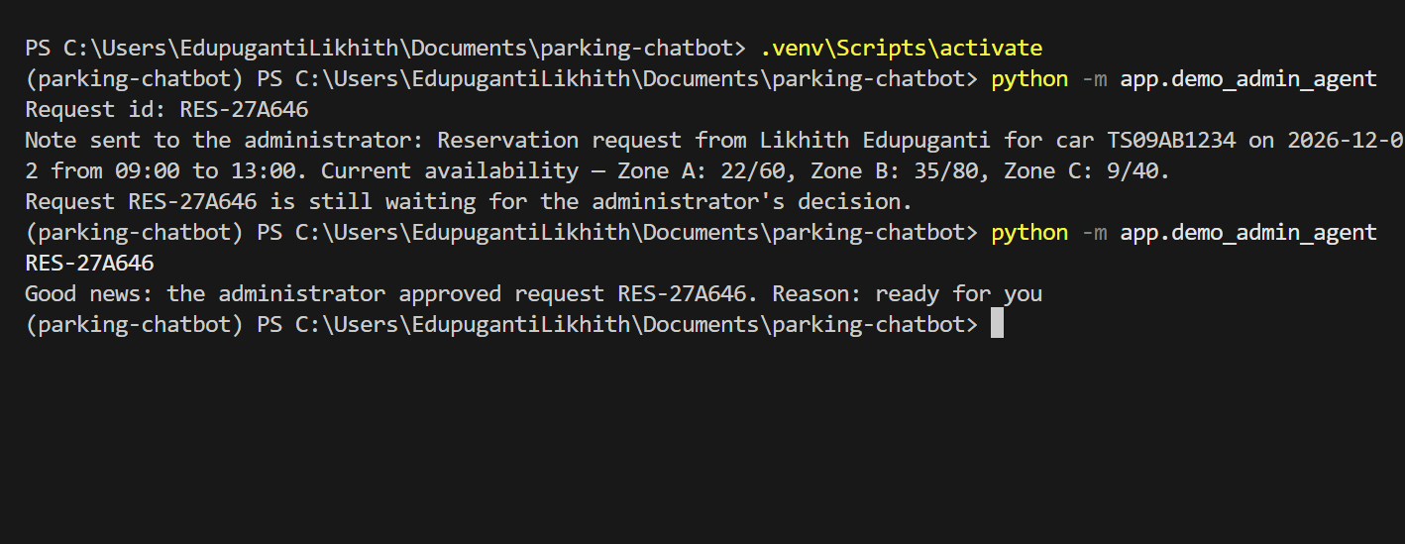
Admin agent: the second LangChain agent
• The model only writes the note, using the live availability.
• Customer details are attached by code, so the model cannot change them.
• If the model fails, the request is still sent with a default note.
Parking Reservation Chatbot | Stage 2
Notes:
First run sends the request with the note. Second run reads the decision.

Slide 6
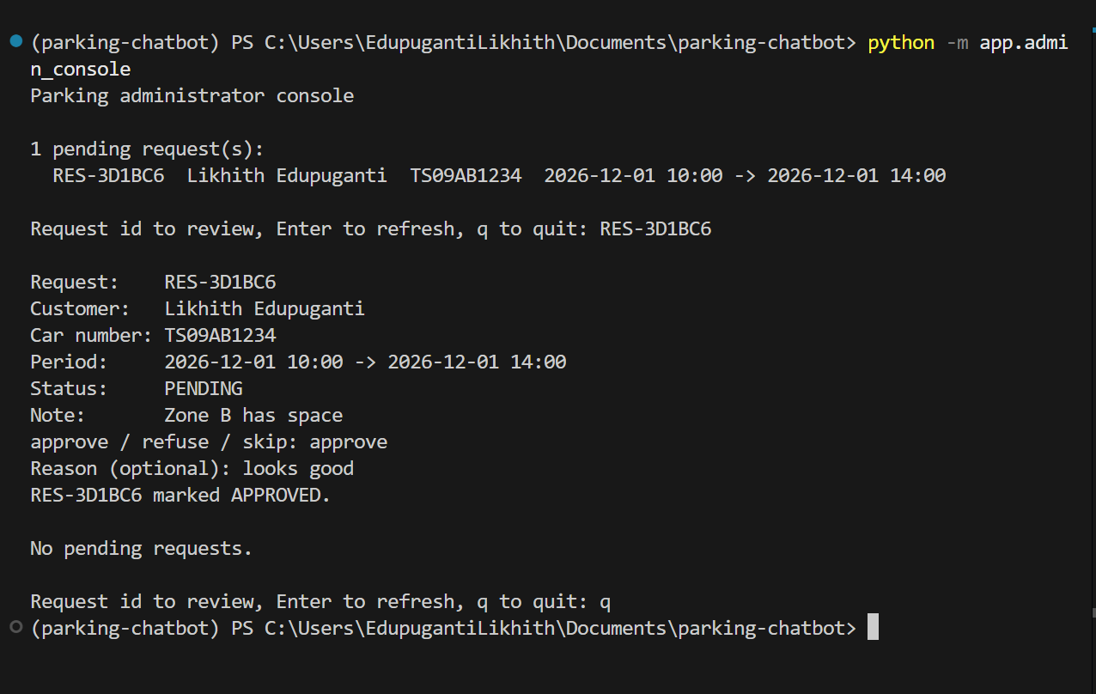
Administrator console: the human decision
• The administrator sees pending requests and the customer's note.
• Approve or refuse, with an optional reason.
• The decision is saved and the customer can read it.
Parking Reservation Chatbot | Stage 2
Notes:
The human stays in control of every reservation.

Slide 7
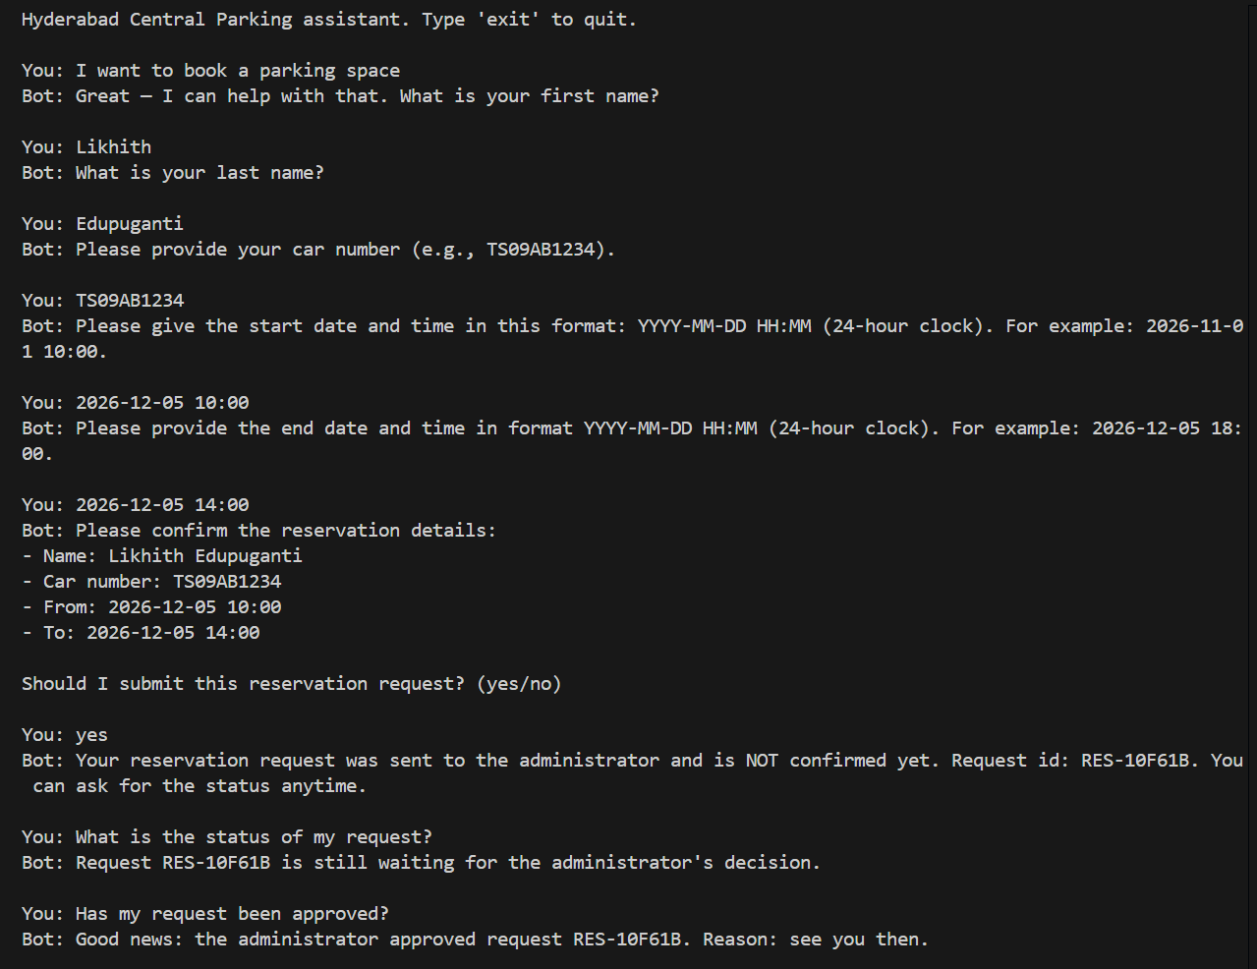
End to end: approved
• Every detail must come from the customer's own words. Made-up values are rejected.
• After confirmation the request is sent and the customer gets an id.
• The bot says it is not confirmed until the administrator decides.
Parking Reservation Chatbot | Stage 2
Notes:
Request sent, pending, then approved with the administrator's reason.

Slide 8
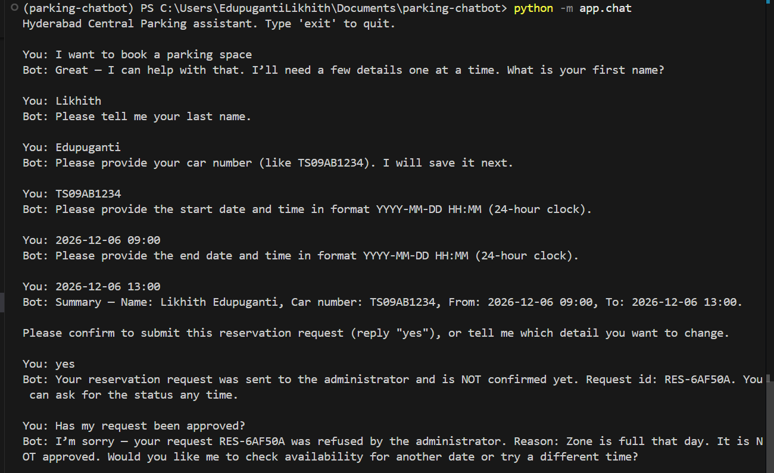
End to end: refused
• A refusal is shown to the customer with the administrator's reason.
• The decision text comes from code, so a refusal is never worded as an approval.
• If the admin service is down, the customer is told the request was not sent.
Parking Reservation Chatbot | Stage 2
Notes:
This proves the confirm or refuse requirement in both directions.

Slide 9
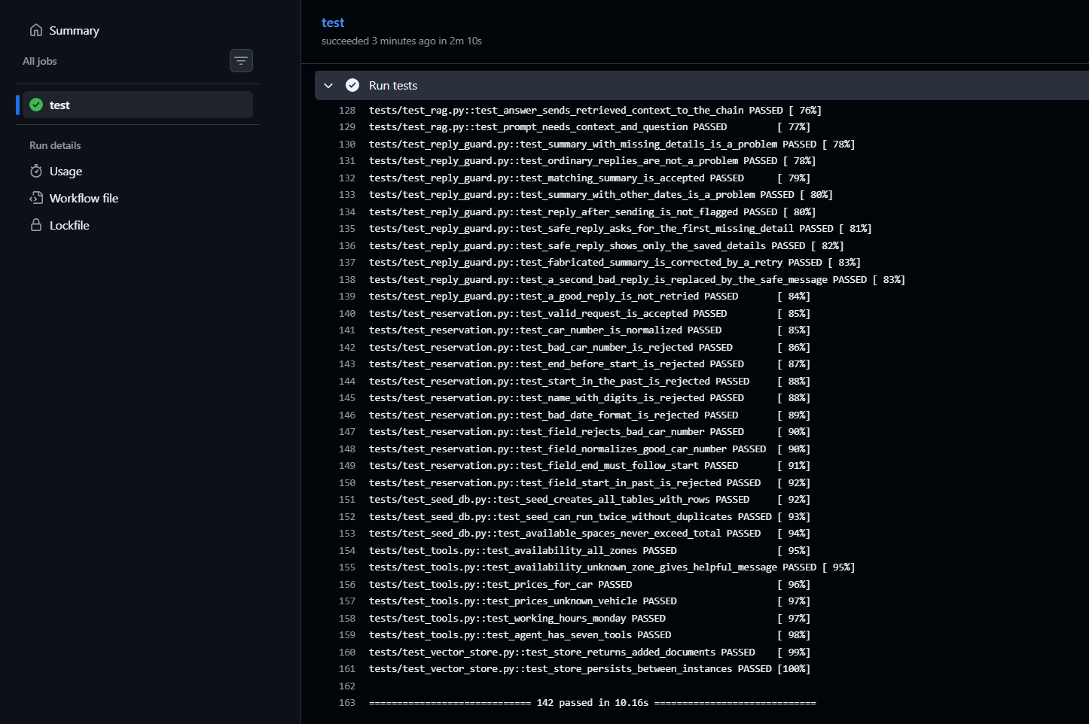
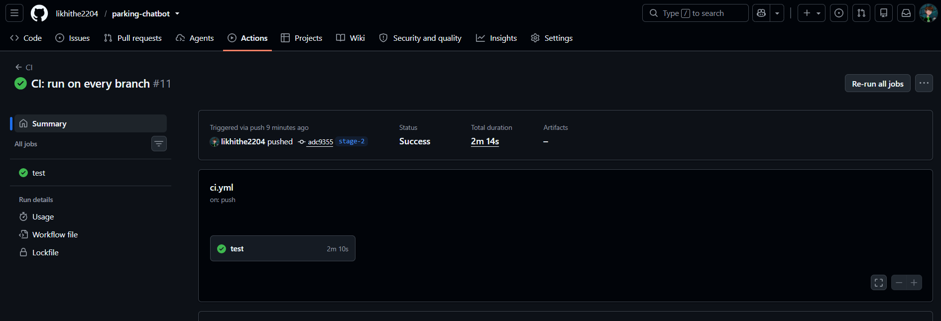
Tests, CI/CD and documentation
• 142 pytest tests across the project, at least 2 per core module, no API key needed.
• GitHub Actions runs them on every push. The README documents setup, usage and structure.
Parking Reservation Chatbot | Stage 2
Notes:
Left: the pytest result. Right: the green pipeline run.

Slide 10
Outcomes and next stages
• Automated system that connects a human administrator for reservation approval.
• Requests, decisions and status flow between the two agents.
• Next: Stage 3 MCP server writes approved reservations to a file.
• Then: Stage 4 LangGraph orchestrates all components.
• Repository: github.com/likhithe2204/parking-chatbot (tag stage-2)
Parking Reservation Chatbot | Stage 2
Notes:
Close with the outcome and the roadmap.

