Slide 1
MCP Server for Approved Reservations
Stage 3 of 4: secure recording of approved bookings
Edupuganti Likhith
github.com/likhithe2204/parking-chatbot
Notes:
Stage 2 added the administrator. Stage 3 saves every approved booking to a text file through a secured MCP server.

Slide 2
What the task asked and what was delivered
Requirement | What was built | Proof
MCP server with Python and FastAPI | MCP tool mounted in a FastAPI app | Slide 3
Write after the administrator approves | Approving in the console saves the booking | Slides 4 and 5
Entry: Name, Car, Period, Approval Time | One line per booking, four columns | Slide 6
Secure against unauthorized access | API key on every route, strict validation | Slide 7
Reliable service | File lock, flush to disk, no duplicates, retry command | Slides 6 and 7
Extra artifacts | README, 179 pytest tests, GitHub Actions CI, this deck | Slide 8
Parking Reservation Chatbot | Stage 3
Notes:
Go row by row. Every Stage 3 requirement has a working feature and proof.

Slide 3
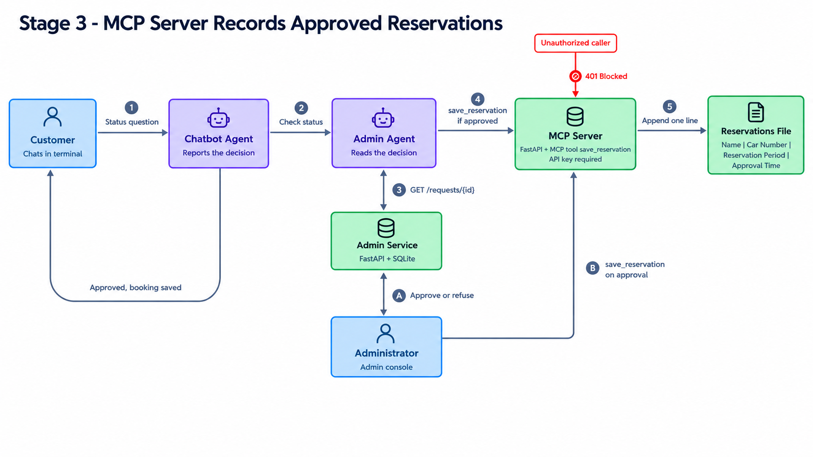
Architecture of the recording step
Parking Reservation Chatbot | Stage 3
Notes:
Two ways in: the console on approval, and the customer's status check. Both go through the same secured MCP server.

Slide 4
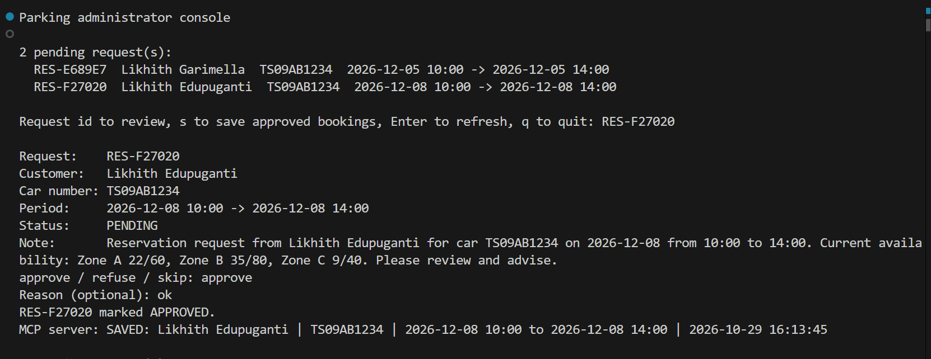
Approval saves the booking
• The administrator approves in the console.
• The console calls the MCP server, which saves the booking at once.
• If saving fails, the decision is kept and the console says so.
• Typing s retries every approved booking that was not saved.
Parking Reservation Chatbot | Stage 3
Notes:
The human decision triggers the write. The model is not involved.

Slide 5
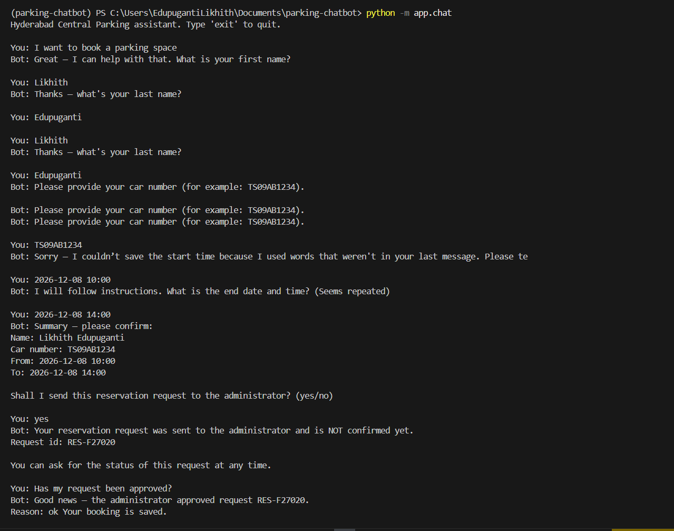
End to end: approved and saved
• The customer books, the request goes to the administrator, the administrator approves.
• The customer's status check confirms the booking is saved.
• The code decides what is saved, never the language model.
Parking Reservation Chatbot | Stage 3
Notes:
Request id, pending, approval and the saved booking in one conversation.

Slide 6
The reservations file
• One line per booking: Name | Car Number | Reservation Period | Approval Time.
• Writes are locked, flushed to disk and appended.
• The same booking is never written twice.
• The file holds customer data, so it is kept out of Git.
Parking Reservation Chatbot | Stage 3
Notes:
This is the exact format the task asked for.

Slide 7
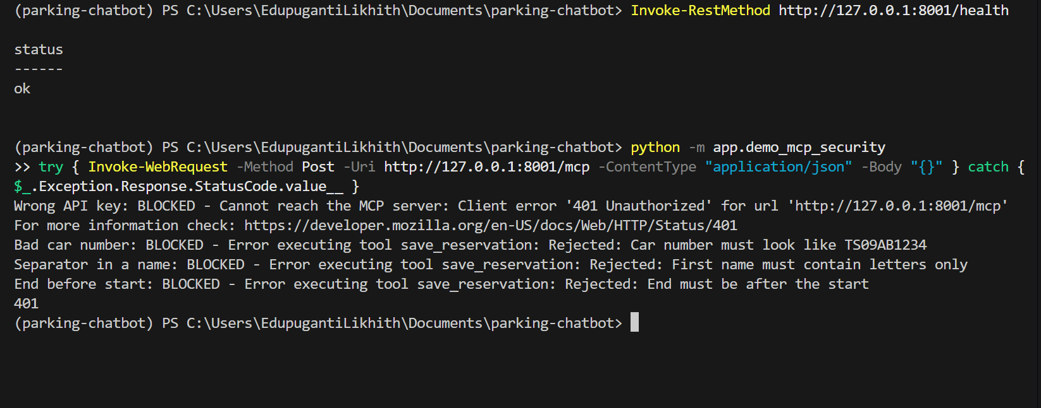
Security checks
• Every route except the health check needs the API key.
• Wrong key, bad car number, a separator in a name and an end before the start are all blocked.
• The server exposes one tool only and validates every field again.
Parking Reservation Chatbot | Stage 3
Notes:
Four blocked requests and a 401 for a caller without the key.

Slide 8
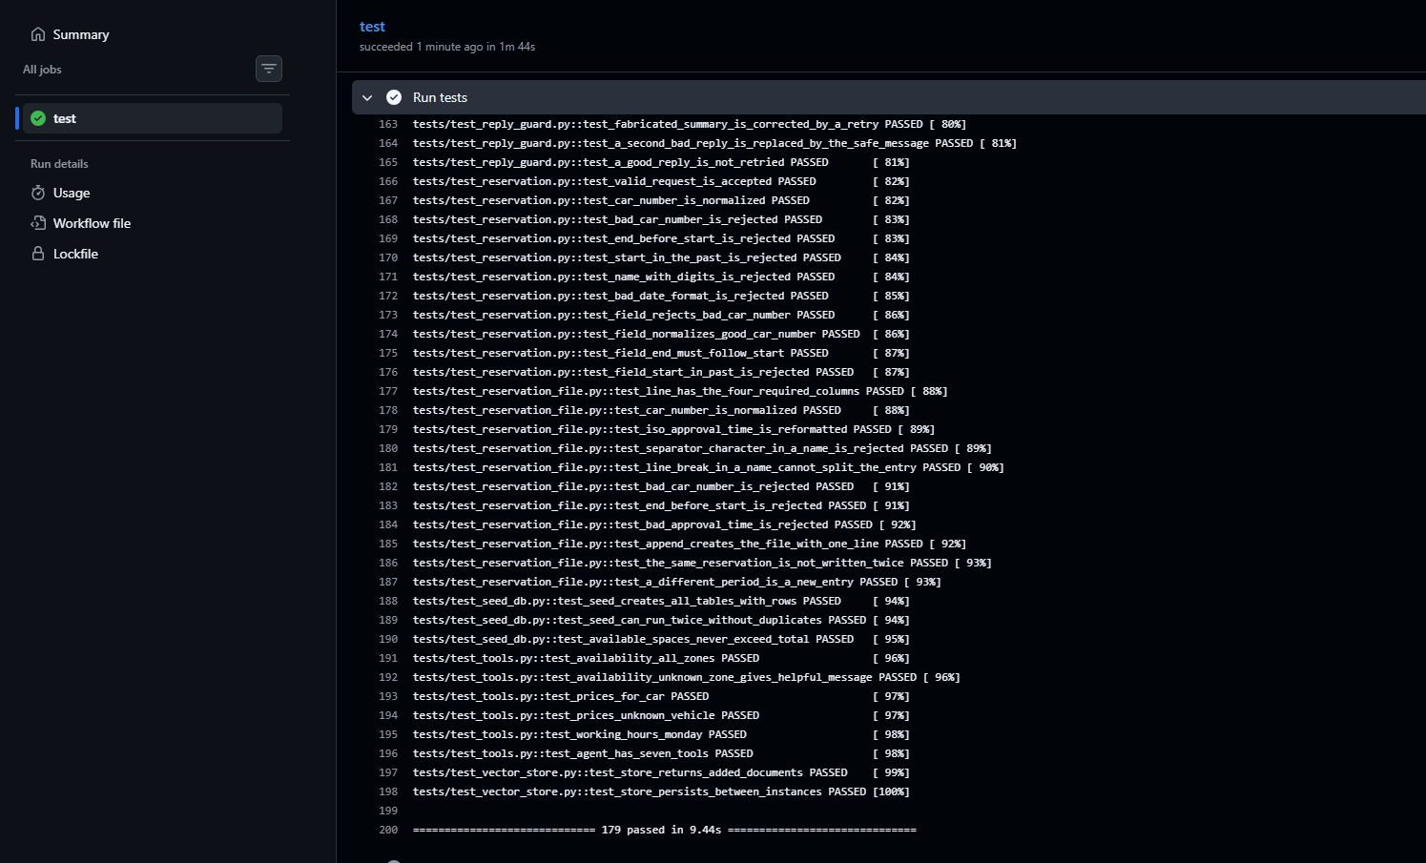
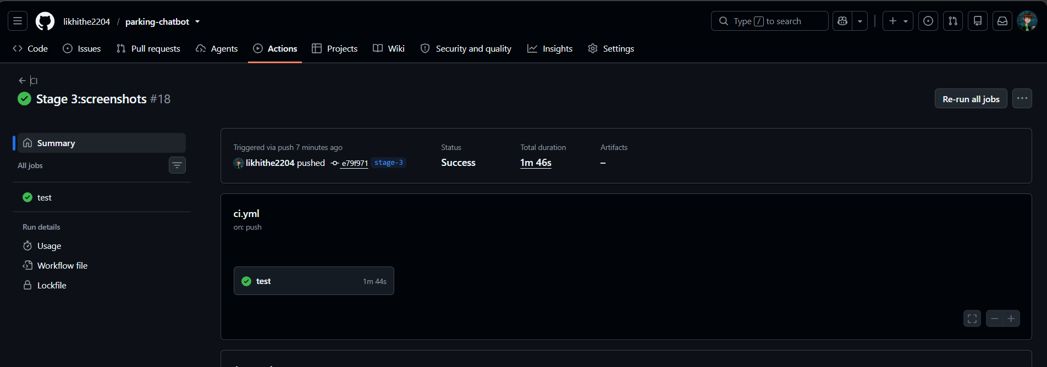
Tests, CI/CD and documentation
• 179 pytest tests across the project, at least 2 per core module, no API key needed.
• GitHub Actions runs them on every push. The README documents setup, usage and structure.
Parking Reservation Chatbot | Stage 3
Notes:
Left: the pytest result. Right: the green pipeline run.

Slide 9
Outcomes and next stage
• A working MCP server integrated with the administrator and the chatbot.
• Approved bookings are saved to a text file in the required format.
• The server rejects unauthorized and invalid requests.
• Next: Stage 4 LangGraph orchestrates the chatbot, the administrator and the server.
• Repository: github.com/likhithe2204/parking-chatbot (tag stage-3)
Parking Reservation Chatbot | Stage 3
Notes:
Close with the outcome and the roadmap.

