Slide 1
LangGraph Orchestration
Stage 4 of 4: one workflow for chatbot, administrator and MCP server
Edupuganti Likhith
github.com/likhithe2204/parking-chatbot
Notes:
Stages 1 to 3 built the parts. Stage 4 connects them in one LangGraph workflow and tests the whole pipeline.

Slide 2
What the task asked and what was delivered
Requirement | What was built | Proof
Orchestrate with LangGraph | One graph: chatbot, escalate, await_approval, record, notify | Slides 3 and 4
Chatbot interacts with users | RAG, SQL tools and guardrails in the chatbot node | Slides 5 and 8
Escalate to the administrator | Admin agent sends the request, the graph pauses for the human | Slides 5 and 6
MCP server processes the data | The record node saves the booking, with retries | Slides 5 and 7
Workflow logic for the pipeline | Approve, refuse and failure paths, all tested | Slides 5, 6 and 10
Load tests | Chatbot, administrator confirmation and MCP recording | Slide 9
Integration tests | Real services, scripted model | Slide 10
Documentation | README: architecture, agent and server logic, deployment | Slide 12
Parking Reservation Chatbot | Stage 4
Notes:
Go row by row. Every Stage 4 requirement has a working feature and proof.

Slide 3
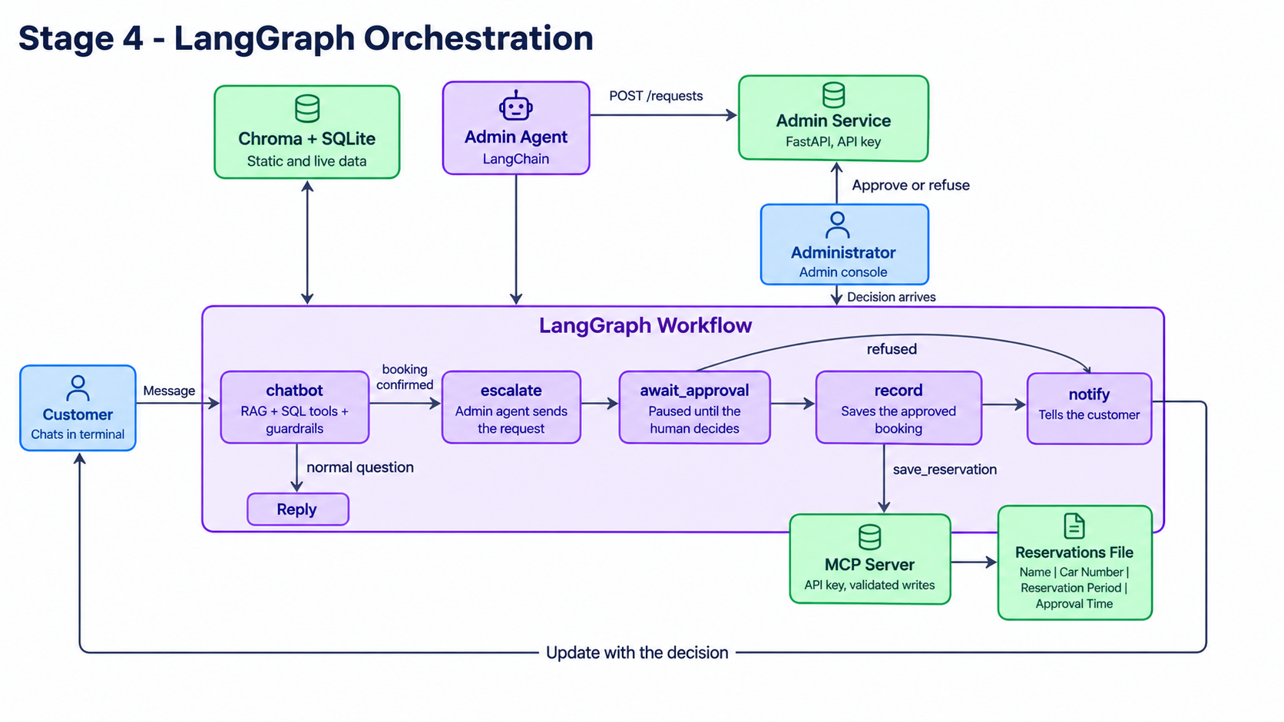
Architecture
Parking Reservation Chatbot | Stage 4
Notes:
The five workflow nodes in the middle, the services around them.

Slide 4
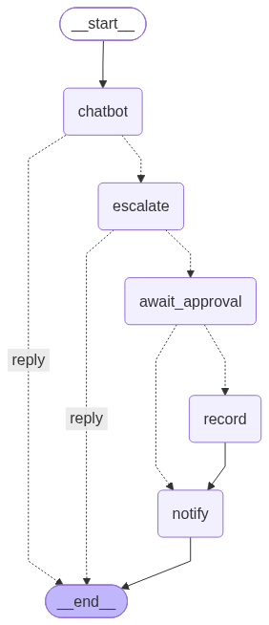
One graph for the whole pipeline
• chatbot answers and collects the booking.
• escalate: the admin agent sends the request.
• await_approval: the graph pauses until the human decides.
• record saves an approved booking, notify tells the customer.
Parking Reservation Chatbot | Stage 4
Notes:
A normal question ends after the chatbot node. A booking continues through the other nodes.

Slide 5
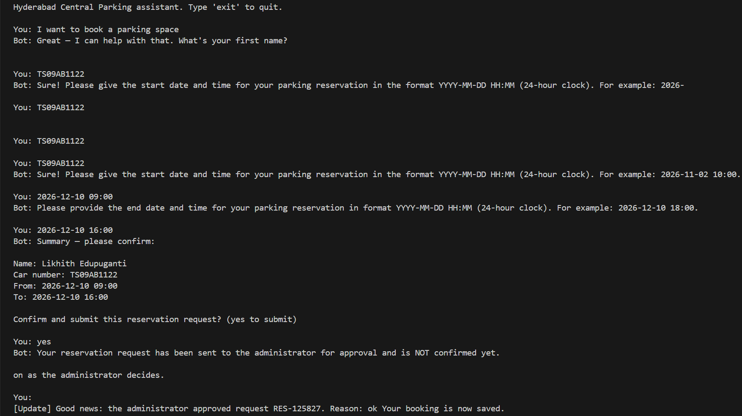
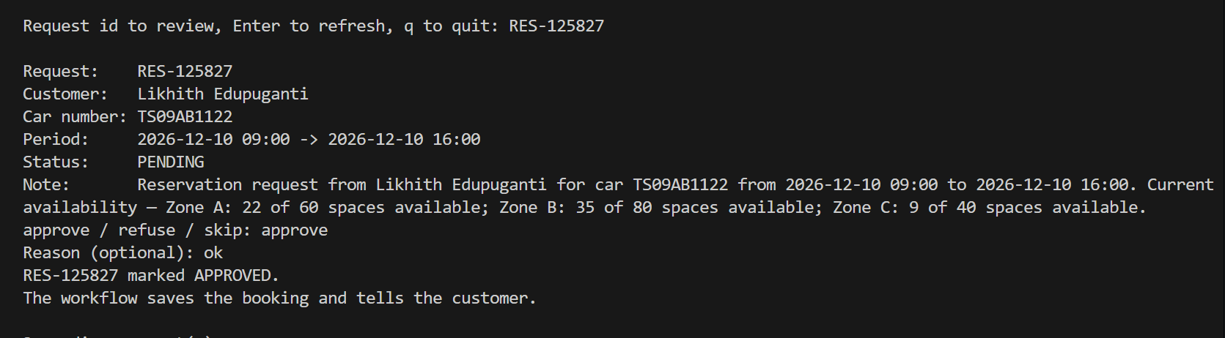
End to end: approved
• The customer books, the administrator approves in the console.
• The customer is told by itself that the booking is saved.
Parking Reservation Chatbot | Stage 4
Notes:
Left: the chat with the automatic update. Right: the administrator console.

Slide 6
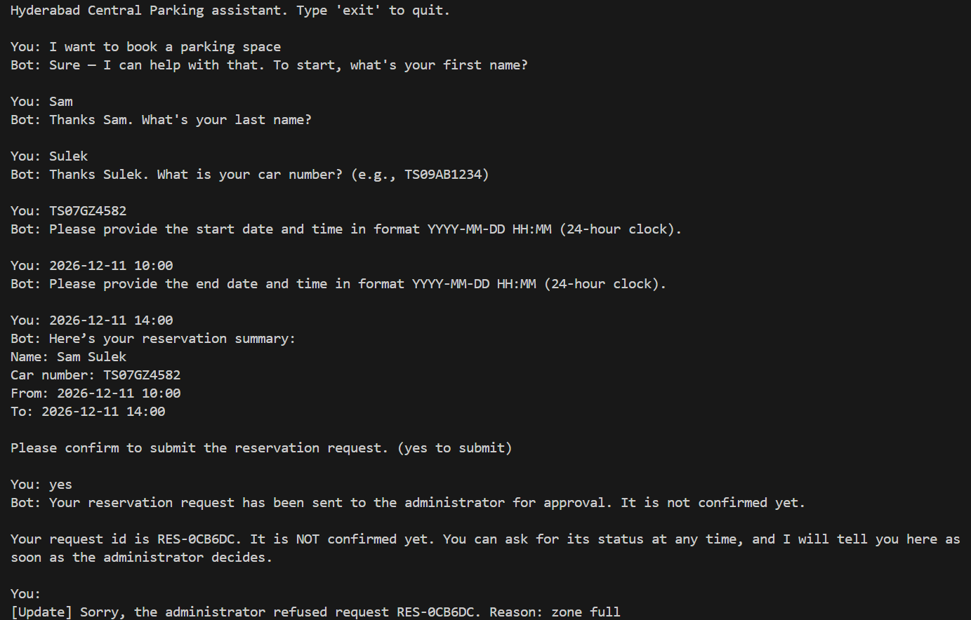
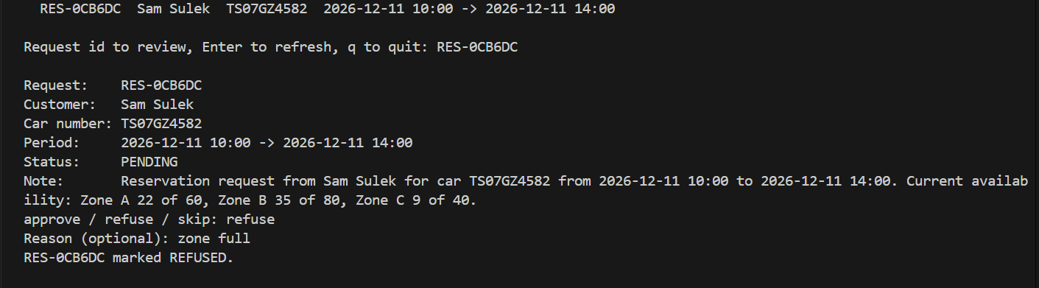
End to end: refused
• A refusal reaches the customer with the reason.
• Nothing is saved and no space is taken.
Parking Reservation Chatbot | Stage 4
Notes:
Left: the chat. Right: the administrator console.

Slide 7
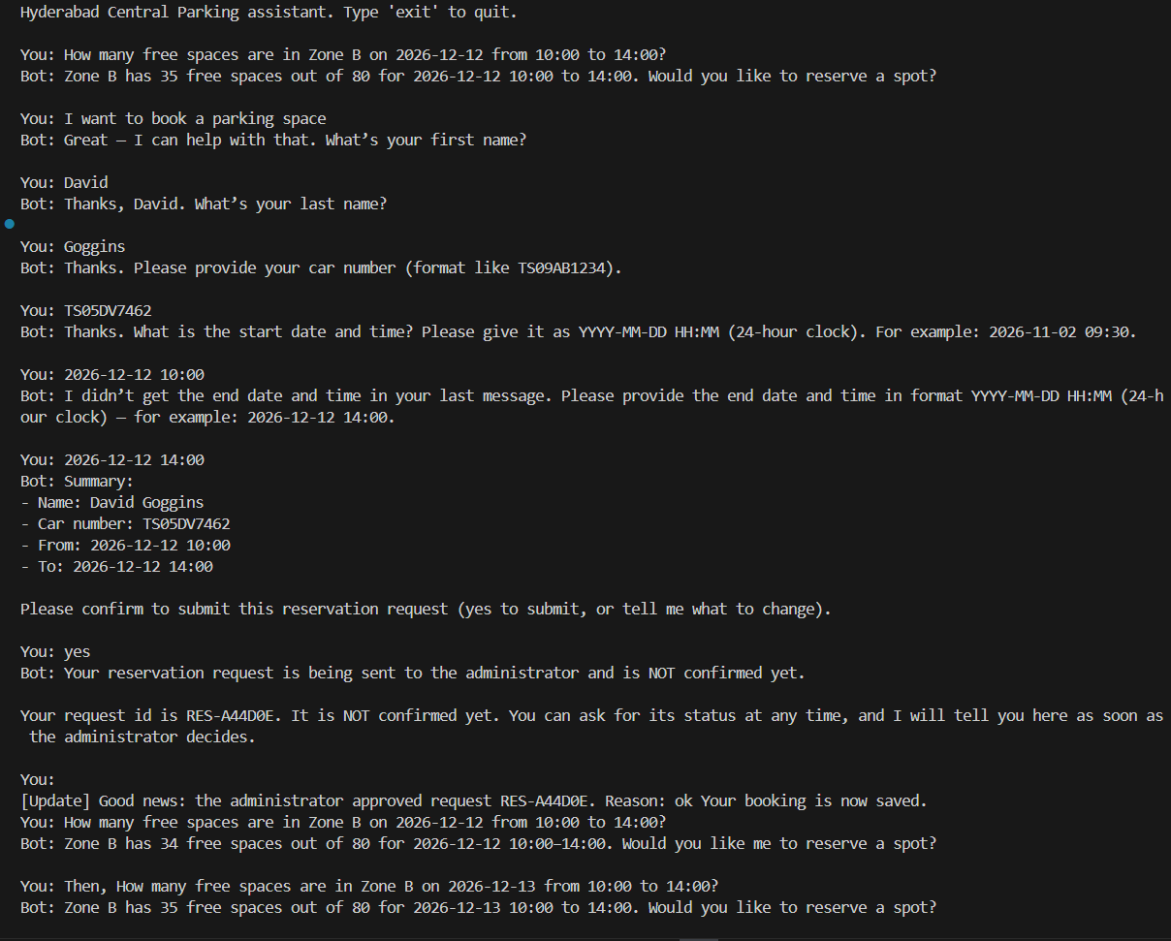
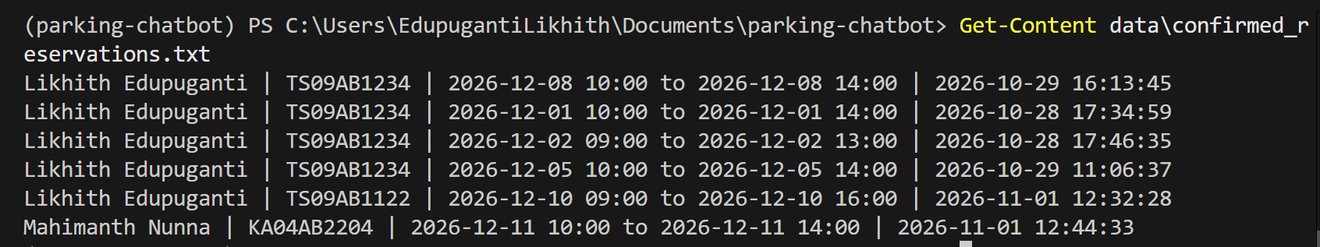
Saved booking and live availability
• One line per approved booking: Name | Car Number | Reservation Period | Approval Time.
• An approval takes a space, so free spaces drop for that period only.
Parking Reservation Chatbot | Stage 4
Notes:
Left: the reservations file. Right: availability before and after an approval.

Slide 8
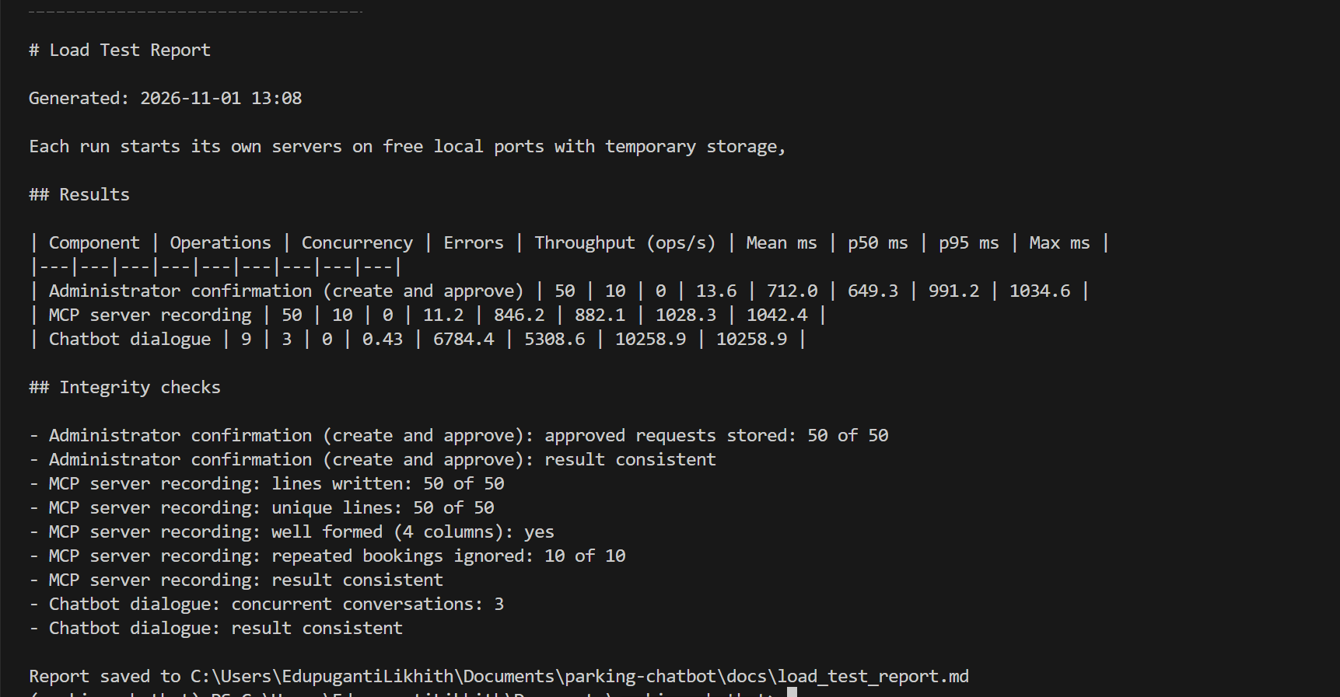
Load tests
0
50 / 50
Errors in all tests
Bookings written once
11 ops/s
11.5 ops/s
Admin confirmations
MCP recordings
• 50 concurrent operations per server test, 10 workers.
• Chatbot: 3 conversations, 9 messages, about 6 s each (model time).
Parking Reservation Chatbot | Stage 4
Notes:
Three components, tested under concurrent load with their own temporary servers.

Slide 9
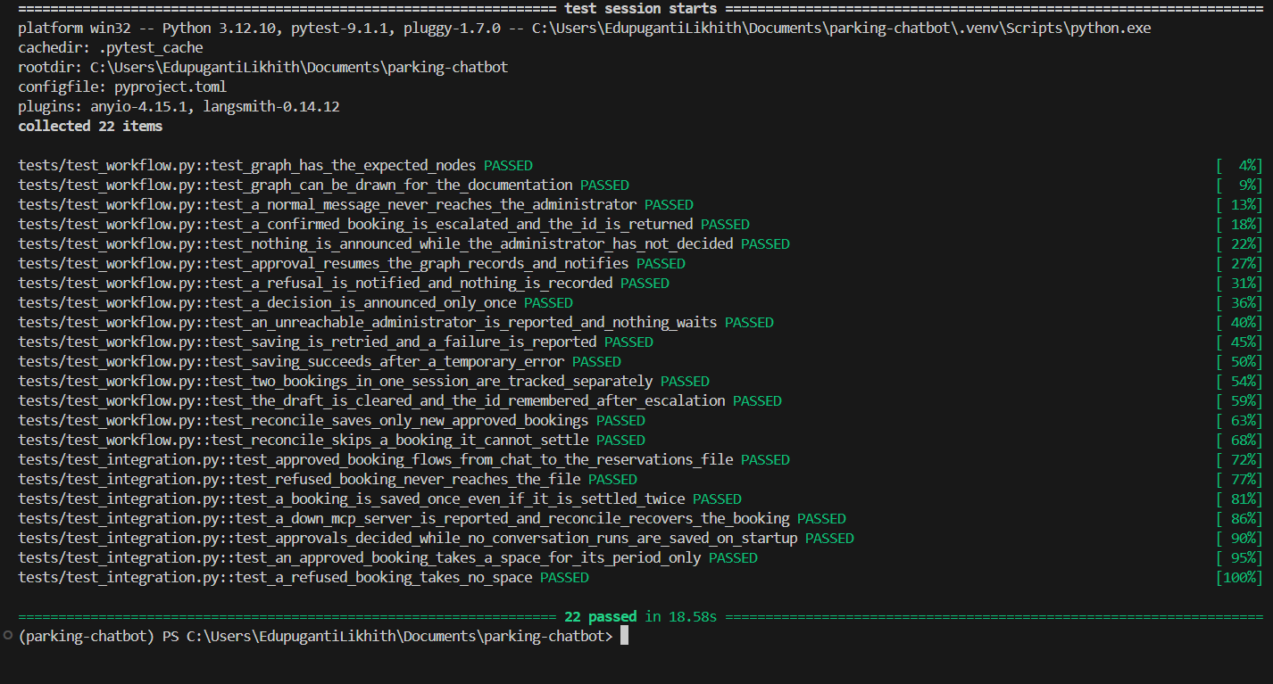
Integration tests
• The real admin service and the real MCP server, only the model is scripted.
• Approval, refusal, a down MCP server and recovery after a restart.
• An approved booking takes a space for its period only.
Parking Reservation Chatbot | Stage 4
Notes:
These tests prove the components work together through the workflow.

Slide 10
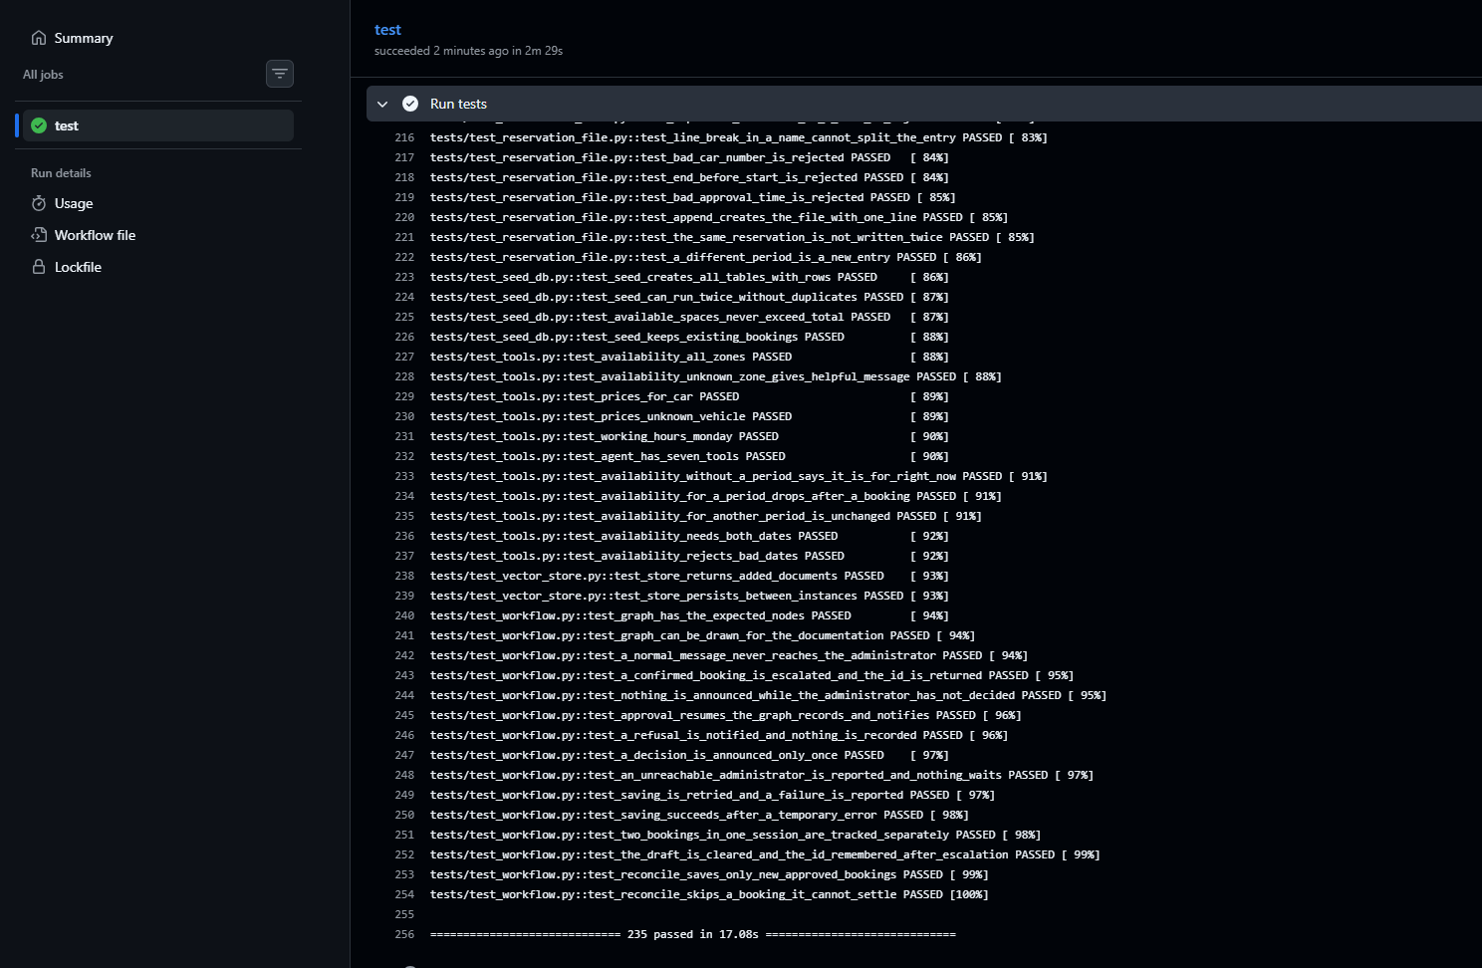
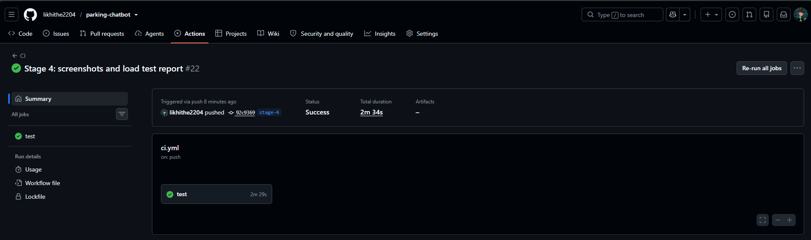
Tests, CI/CD and documentation
• 240 pytest tests, at least 2 per core module, no API key needed.
• GitHub Actions runs them on every push. The README covers architecture, logic and deployment.
Parking Reservation Chatbot | Stage 4
Notes:
Left: the pytest result. Right: the green pipeline run.

Slide 11
Outcomes
• One workflow connects the chatbot, the administrator and the MCP server.
• Approved bookings are saved once, in the required format, and take a space.
• The pipeline is tested end to end and under load.
• Repository: github.com/likhithe2204/parking-chatbot (tag stage-4)
Parking Reservation Chatbot | Stage 4
Notes:
Close with the outcome, then take questions.

