Slide 1
Data Analyst
A person who analyses and rearrange the data accordingly.
Presentation By:
Bala Likhith Kanigolla

Slide 2
TABLE OF CONTENTS
01
04
02
05
03
06
About the company
Roles and responsibilities
Work Done By Me
Future Perspective
Activities done
Conclusion

Slide 3

About The Company
Lions Clubs International (LCI) is an international non-political service organization established originally in 1917 in Chicago, Illinois, by Melvin Jones.[1] It is now headquartered in Oak Brook, Illinois. As of January 2020, it had over 46,000 local clubs and more than 1.4 million members (including the youth wing Leo) in more than 200 countries around the world

Slide 4
ABOUT THE PROJECT
A data analyst collects, processes and performs statistical analyses on large dataset. They discover how data can be used to answer questions and solve problems. With the development of computers and an ever increasing move toward technological intertwinement, data analysis has evolved.

Slide 5
Work Done By Me
The main work of the data analyst is to analyses the Company given data which is called as Data Analysis. Data analysis is a process of inspecting, cleansing, transforming and modeling data with the goal of discovering useful information, informing conclusions and supporting decision-making.
A person from the company gives me the data by on paper or through some physical copies. As said above I used to analyse and transform the data as per the requirements of the company and send the transformed data through the email.

Slide 6
Activities Done
01
02
03
Analysis
First I analyse the given data and get an idea about it.
Divide
Now I will clean and transform the data.
Save
Now Once the work is completed will save the data and send to them

Slide 7
Work Allotment
27%
70%
52%
Storing
Storing in a database or a file as per the classification
Data Classify
Data cleaning, Checking for dupilicates etc.
Re-Processing of data
When the new data is arrived we also need to check for the previous data storage

Slide 8
Roles and Responsibilities
I should not corrupt the data.
Make sure no dupilicate data is present.
Should not disclose the data to others.
Make sure the work is completed on time.
Data should be neat and clean.

Slide 9
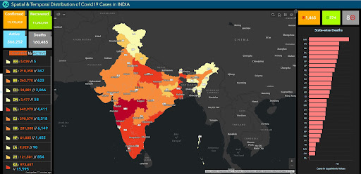
MY DASHBOARDS
We have taken out the data from the different websites, official conformations, Corporation office

Slide 10
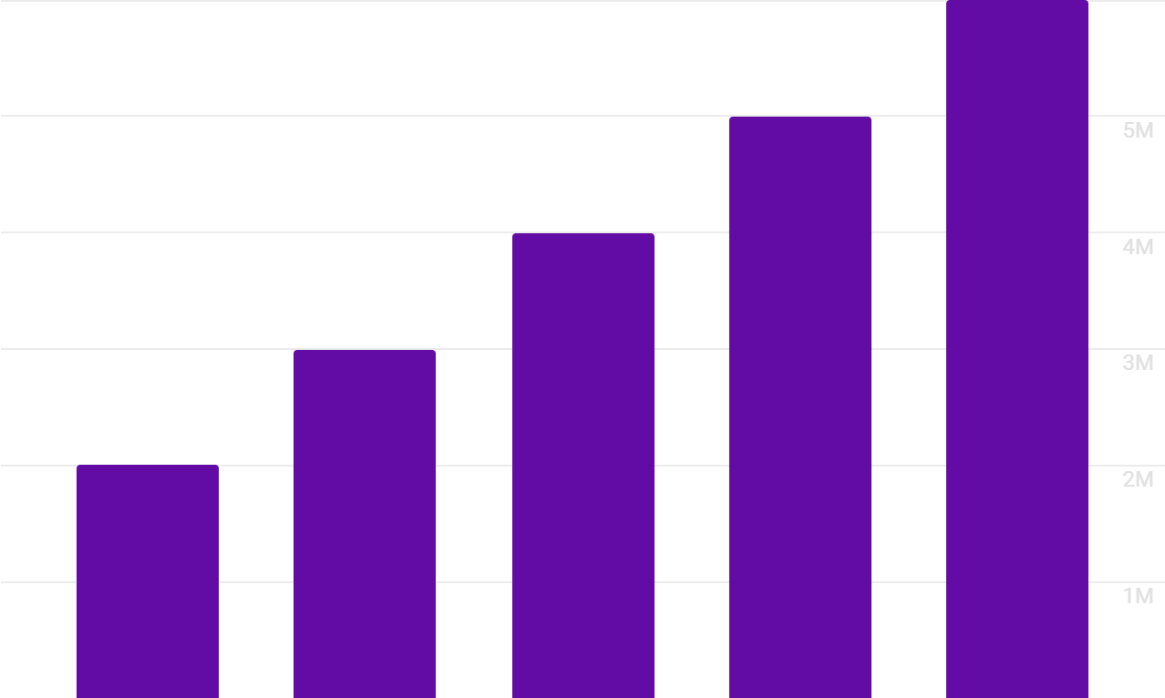
FUTURE SCOPE
2012
2015
2018
2020
2022
$4367.90
Average salary of data analyst
Every Company
Needs a data analyst to manage their data
Graph showing the growth of data analysts

Slide 11
THANKS
Do you have any questions?
Bala Likhith Kanigolla
Registration No:11903700

