Slide 1

April, Greg, Leo, Marinos, and Marissa

Slide 2


"It's about how we treat our veterans every single day of the year. It's about making sure they have the care they need and the benefits that they've earned when they come home. It's about serving all of you as well as you've served the United States of America." - Barack Obama

Slide 3


The Problem
Hard for Veterans to find resources
Need a more concise database of resources

Slide 4

Our Ideas
We wanted:
Make a survey
Simple Design
Show resources relevant to the individual
Dashboard with a to do list
Client engagement
All-inclusive website

Slide 5



Capabilities

Slide 6
How Vet++ Does This
User account and data
Answer series of questions for personalization
Guide users to the right places and applications
Can apply through database
Mobile app syncing

Slide 7







Slide 8
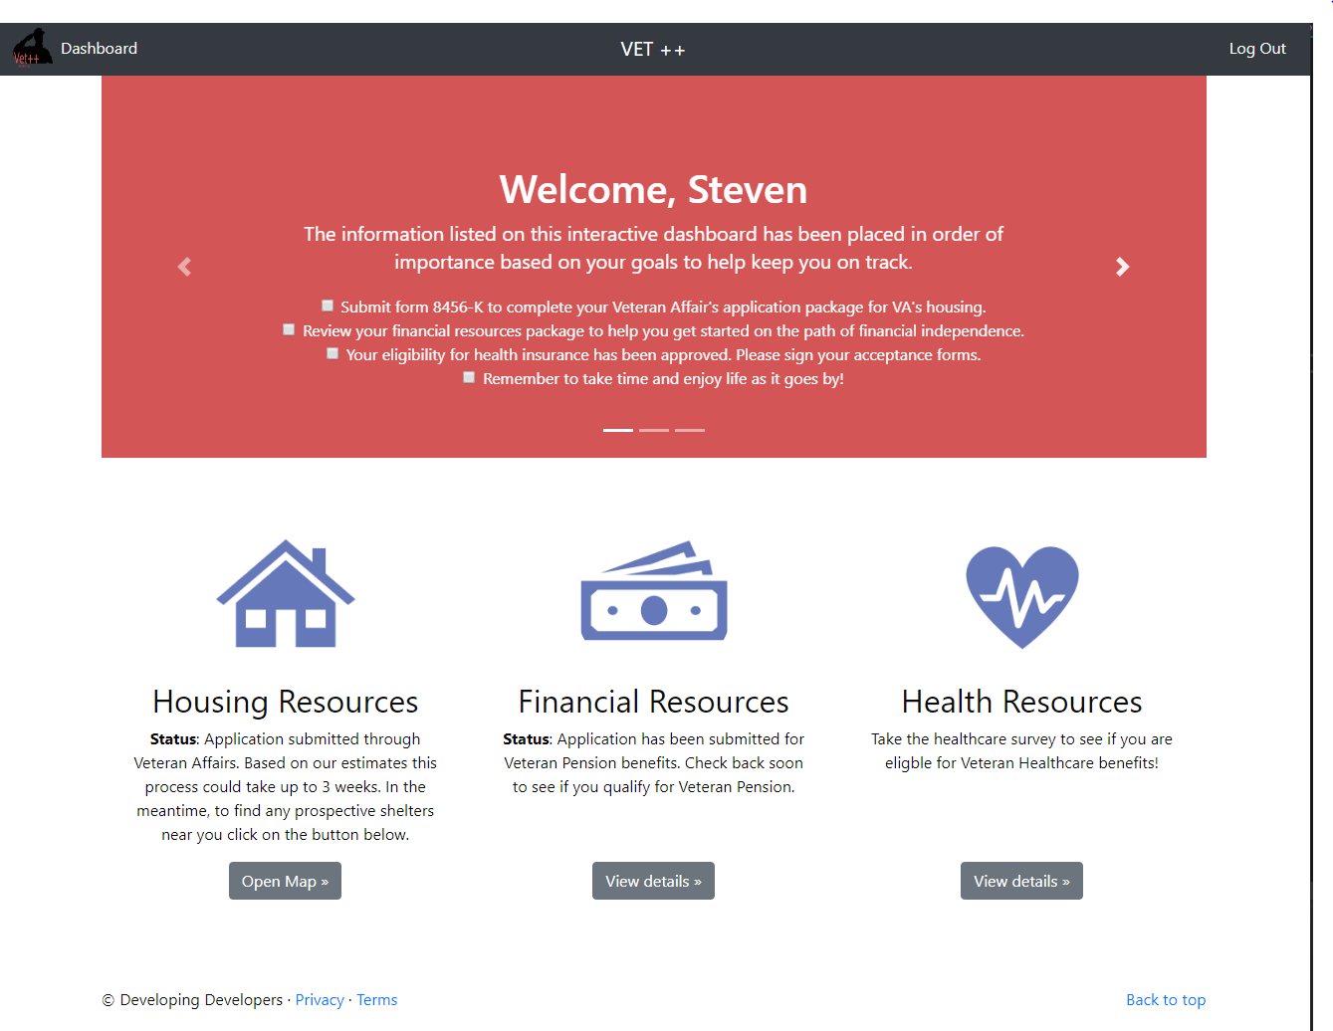

Slide 9






For the Future
More stylistic
Client engagement
Read user text input
3rd party submissions

