Slide 1
Rooftop solar:
which customers, and how big
The load profile does not decide whether a business should install solar. It decides how large a system it can absorb before the surplus stops paying for itself.
Hourly generation: PVGIS (European Commission JRC), 2023. Wholesale prices: Fraunhofer ISE. Retail price: Eurostat.
Generated 20 September 2026

Slide 2
A kilowatt-hour used on site is worth three sold
A 2,000 MWh/year site in Plzeň, roof-mounted system facing south.
SELF-CONSUMED vs EXPORTED kWh
PROFILE SPREAD AT A 10% SYSTEM
AT A 60% SYSTEM
SYSTEM SIZE THAT STILL PAYS BACK
3.4x
5 pts
30 pts
1.7x
0.128 EUR/kWh avoided against 0.038 earned
at this size the profile barely matters
at this size it decides the project
970 kWp for a daytime customer against 582 kWp for a night one
THE FINDING
A kilowatt-hour the site consumes itself replaces one it would have bought at 0.128 EUR/kWh. A kilowatt-hour it exports earns 0.038 — solar generates exactly when wholesale prices are lowest. So the share the site consumes itself decides the investment.
That share depends on when the business runs, not on the roof. Which makes it a sales question: the customer's own metering answers it before anyone visits the site.
Sources: PVGIS (EC JRC), energy-charts.info (Fraunhofer ISE), Eurostat | 2023 hourly, 2,000 MWh/year site
2

Slide 3
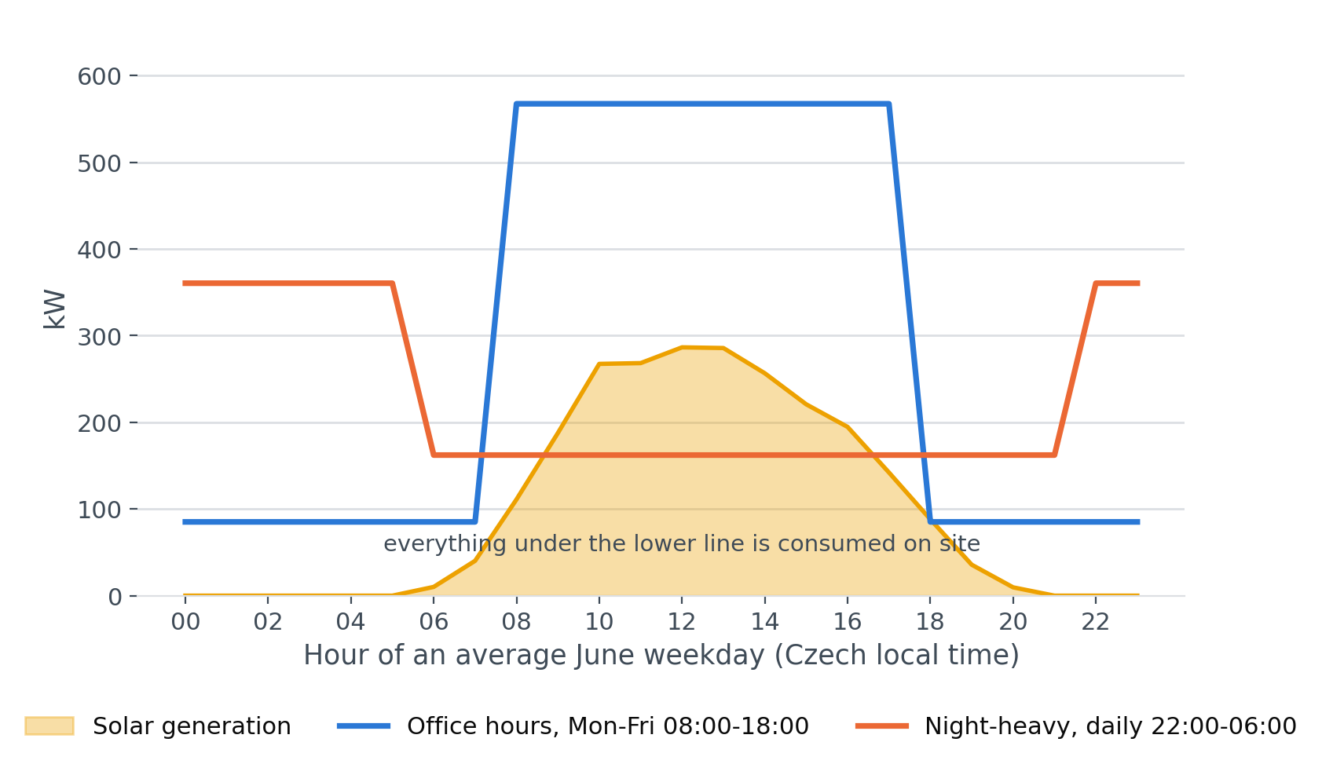
One June day, two customers, the same system
An average June weekday: a 582 kWp system against two customers with identical annual consumption.
WHAT THIS SHOWS
The daytime customer's load sits above the generation curve all day, so nothing is exported and every kilowatt-hour is worth the full retail price.
The night-heavy customer draws 162 kW at noon against 286 kW of generation. The difference leaves the site at the wholesale price — or at nothing, when that price is negative.
Sources: PVGIS (EC JRC), energy-charts.info (Fraunhofer ISE), Eurostat | 2023 hourly, 2,000 MWh/year site
3

Slide 4
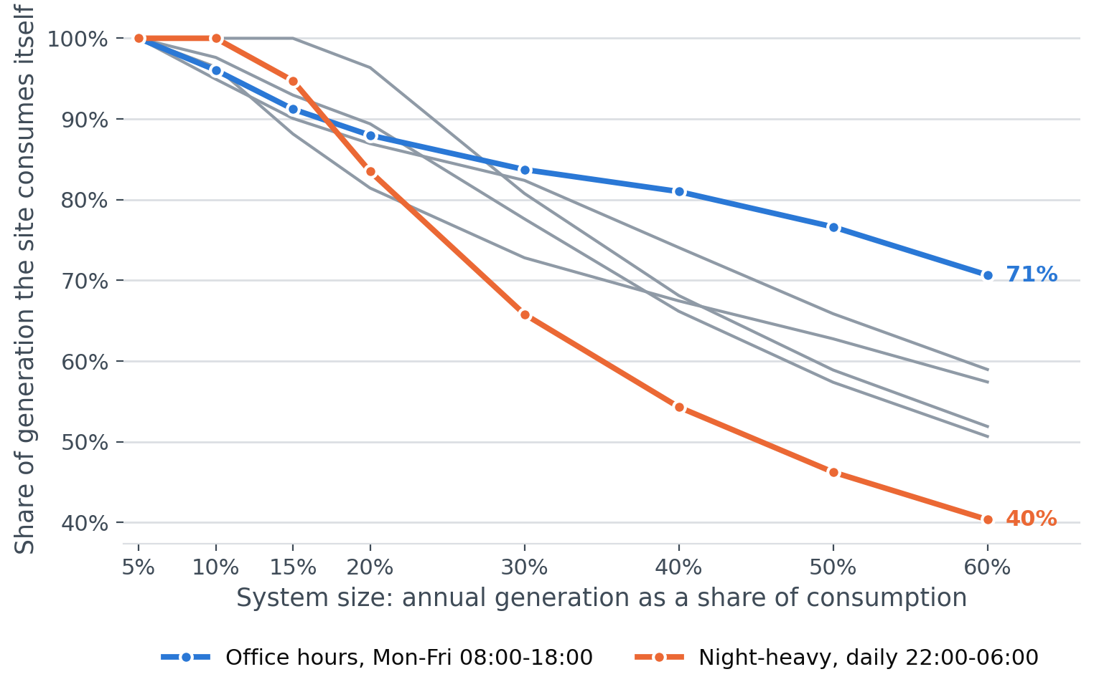
The profile sets the size, not whether to build
Share of generation consumed on site, as the system grows.
WHAT THIS SHOWS
At a system covering 10% of consumption every profile absorbs almost everything — only 5 points separate them.
At 60% the gap is 30 points: 71% against 40%.
So the qualifying question is how many kilowatt-peak this particular customer can absorb. Whether to offer solar at all is rarely the interesting part.
Sources: PVGIS (EC JRC), energy-charts.info (Fraunhofer ISE), Eurostat | 2023 hourly, 2,000 MWh/year site
4

Slide 5
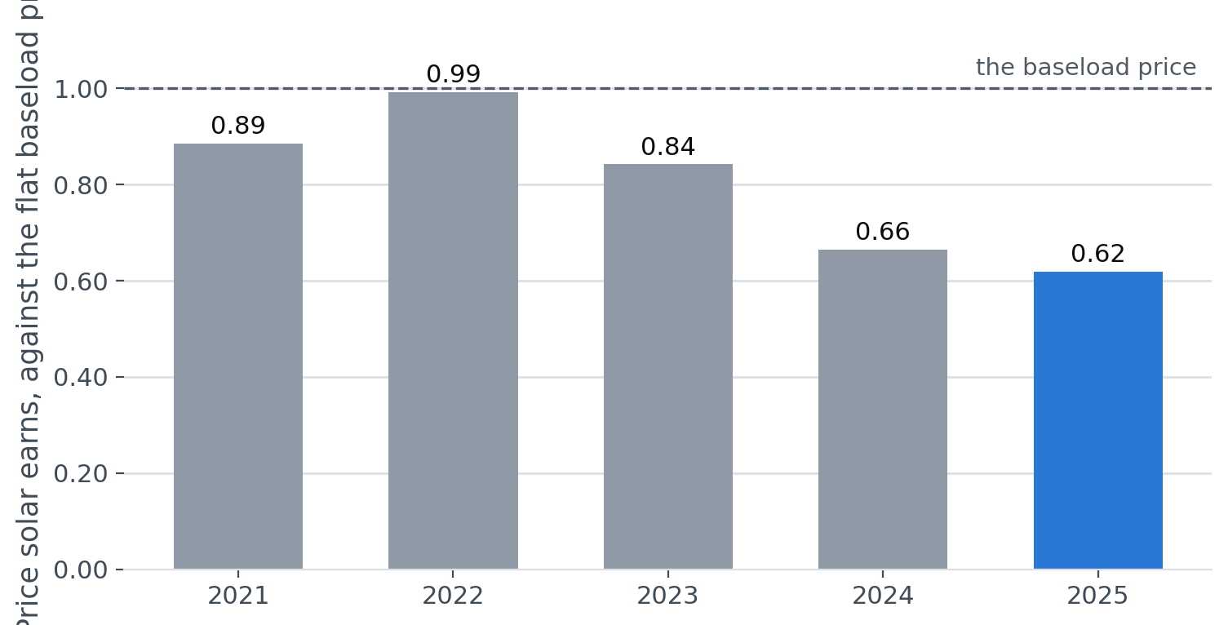
The exported half is worth less every year
Modelled: a PVGIS generation shape weighted against each year's actual day-ahead prices, compared with the flat baseload price of the same year.
WHAT THIS SHOWS
On this basis solar earned 0.89 of the baseload price in 2021 and 0.62 in 2025.
More solar on the system depresses the price in exactly the hours solar generates. Every year the half of the output that leaves the site is worth less, and the half that stays matters more.
Sources: PVGIS (EC JRC), energy-charts.info (Fraunhofer ISE), Eurostat | 2023 hourly, 2,000 MWh/year site
5

Slide 6
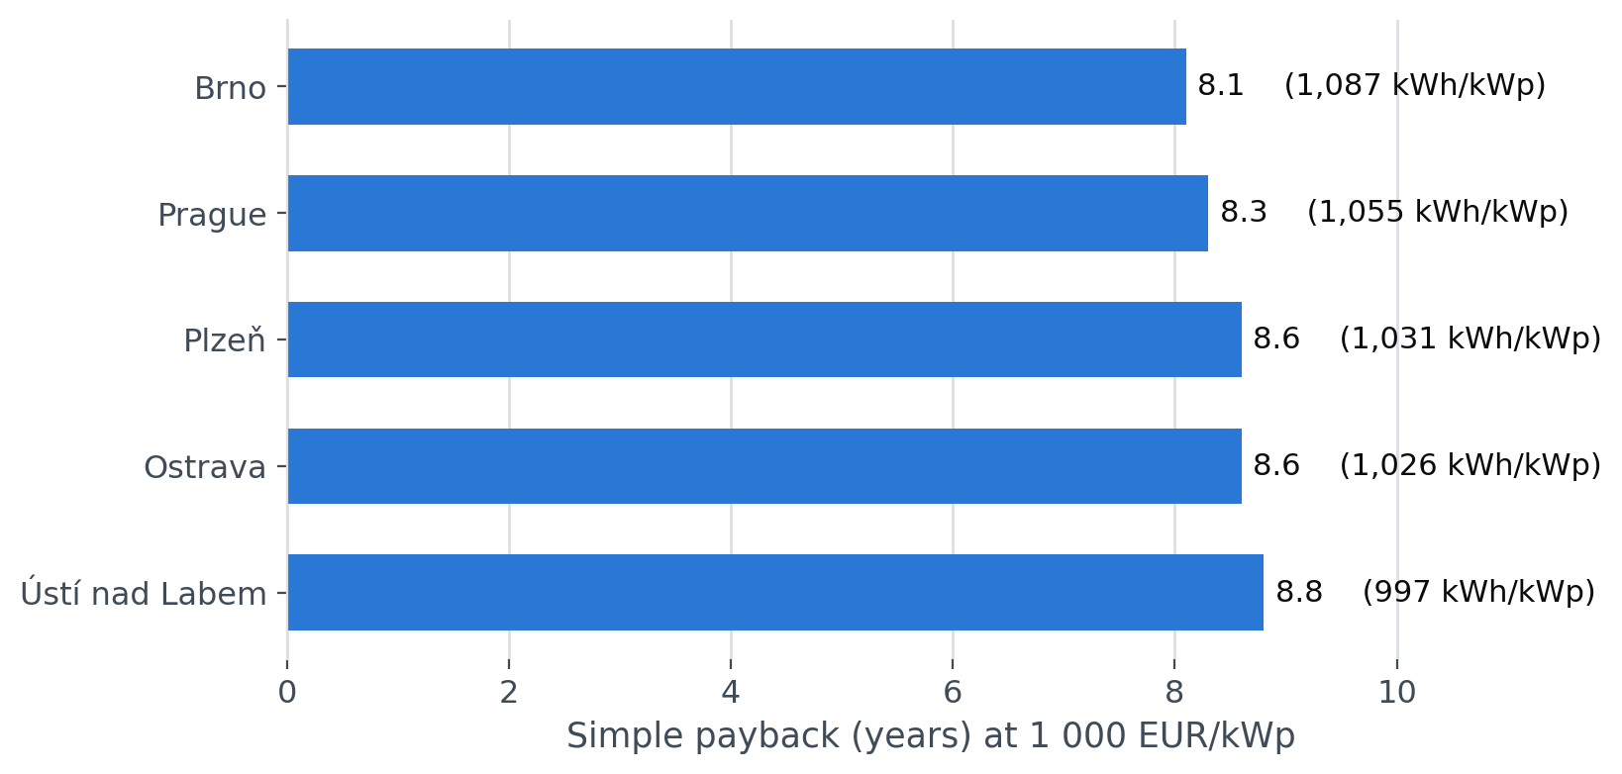
Where in Czechia barely matters
Same daytime profile, same system size, five Czech locations.
WHAT THIS SHOWS
Brno yields 1,087 kWh/kWp against 997 in Ústí nad Labem — 9% across the whole country, worth 0.7 years of payback.
At a fixed system size the customer's shape moves payback by a similar amount (0.6 years). The difference is that geography does not change how large a system the site can absorb, and the profile does — by 1.7x.
So region is a tie-breaker. Operating hours decide the project.
Sources: PVGIS (EC JRC), energy-charts.info (Fraunhofer ISE), Eurostat | 2023 hourly, 2,000 MWh/year site
6

Slide 7
What this changes for who we approach
Three things follow for how solar is sold to business customers.
01
02
03
Qualify on operating hours before roof area
Sell the size the customer can absorb
For the wrong shape, sell something that moves the load
Two customers with the same consumption and the same roof support systems 1.7x apart within the same payback. Operating hours are already in the CRM, or one question away. Payback alone would not separate these customers; the size they can absorb does.
Oversizing does not fail loudly. It quietly converts 0.128 EUR/kWh of avoided cost into 0.038 EUR/kWh of export revenue. The right answer is the largest system that still lands inside the customer's own payback hurdle.
A night-heavy site does not become a good solar customer by buying fewer panels. It becomes one by shifting load into the day, or by storing it. Different product, and this analysis says which customers need it.
Sources: PVGIS (EC JRC), energy-charts.info (Fraunhofer ISE), Eurostat | 2023 hourly, 2,000 MWh/year site
7

Slide 8
How the numbers were made, and where they stop
Every figure is computed from the cached responses in this repository and can be reproduced with one command.
HOURLY PERIODS MODELLED
RETAIL PRICE AVOIDED
PAYBACK SPAN ACROSS THE CAPEX RANGE
43,800
0.128
6.0-11.1
5 locations x a full year, hour by hour
EUR/kWh: energy 0.110 plus taxes 0.018
years, at 700 to 1 300 EUR/kWp
HOW THE NUMBERS WERE CHECKED
WHAT THIS ANALYSIS CANNOT TELL YOU
• Self-consumption is computed hour by hour as min(generation, load). Netting over a month would let August sunshine cancel a February night.
• PVGIS timestamps are UTC. That was verified, not assumed: June output peaks at the hour solar noon falls for that longitude.
• Generation and prices are joined on the UTC hour, so the clock change cannot silently drop an hour.
• Network charges are partly capacity-based and do not fall when consumption does, so the model runs three avoided-cost scenarios and reports all three.
• Stylised load profiles, not metered customer data. A real site has shutdowns, seasonality and production peaks.
• Simple payback, undiscounted, before any subsidy, grant or tax treatment. The ranking between customers is the durable result; the absolute years move with the quote.
• Generation is from 2023, the most recent year PVGIS publishes hourly. The solar resource varies about 5% year to year.
• City-centre coordinates stand in for a site in that region. A real project uses the roof's own orientation, pitch and shading survey.
Sources: PVGIS (EC JRC), energy-charts.info (Fraunhofer ISE), Eurostat | 2023 hourly, 2,000 MWh/year site
8

