Slide 1
Spot or fixed?
The answer changed
What a business customer's own consumption shape does to the price it pays on the Czech day-ahead market — and why the recommendation for a daytime customer has reversed since 2021.
Source: energy-charts.info (Fraunhofer ISE), day-ahead auction, licence CC BY 4.0. 73,775 settlement periods, 2021-2026, Czech local time.
Generated 19 September 2026

Slide 2
The cheap customer and the expensive one swapped places
Profile factor: what a customer's shape does to its average price, against a flat 24/7 load = 1.00.
DAYTIME OFFICE PROFILE, 2021
THE SAME PROFILE, 2026
NIGHT-HEAVY PROFILE, 2021 → 2026
WORTH, AT 10,000 MWh A YEAR
1.12
0.92
0.94 → 1.03
157k
paid 12% above the market average
now 8% below it — a 20 point swing
the cheap shape became the expensive one
EUR a year between the best and worst shape in 2026
THE FINDING
Two customers can buy the same volume, from the same supplier, in the same year, on the same spot contract — and pay 15.7 EUR/MWh differently. The only difference is when they consume.
That was always true. What changed is the sign. In 2021 the night-heavy customer had the cheap shape, 18 points below the daytime one. In 2026 it is 11 points above. A sales playbook written before 2023 now recommends the wrong product to both of them.
Source: energy-charts.info (Fraunhofer ISE), CC BY 4.0 | Czech day-ahead market | 2021-2026
2

Slide 3
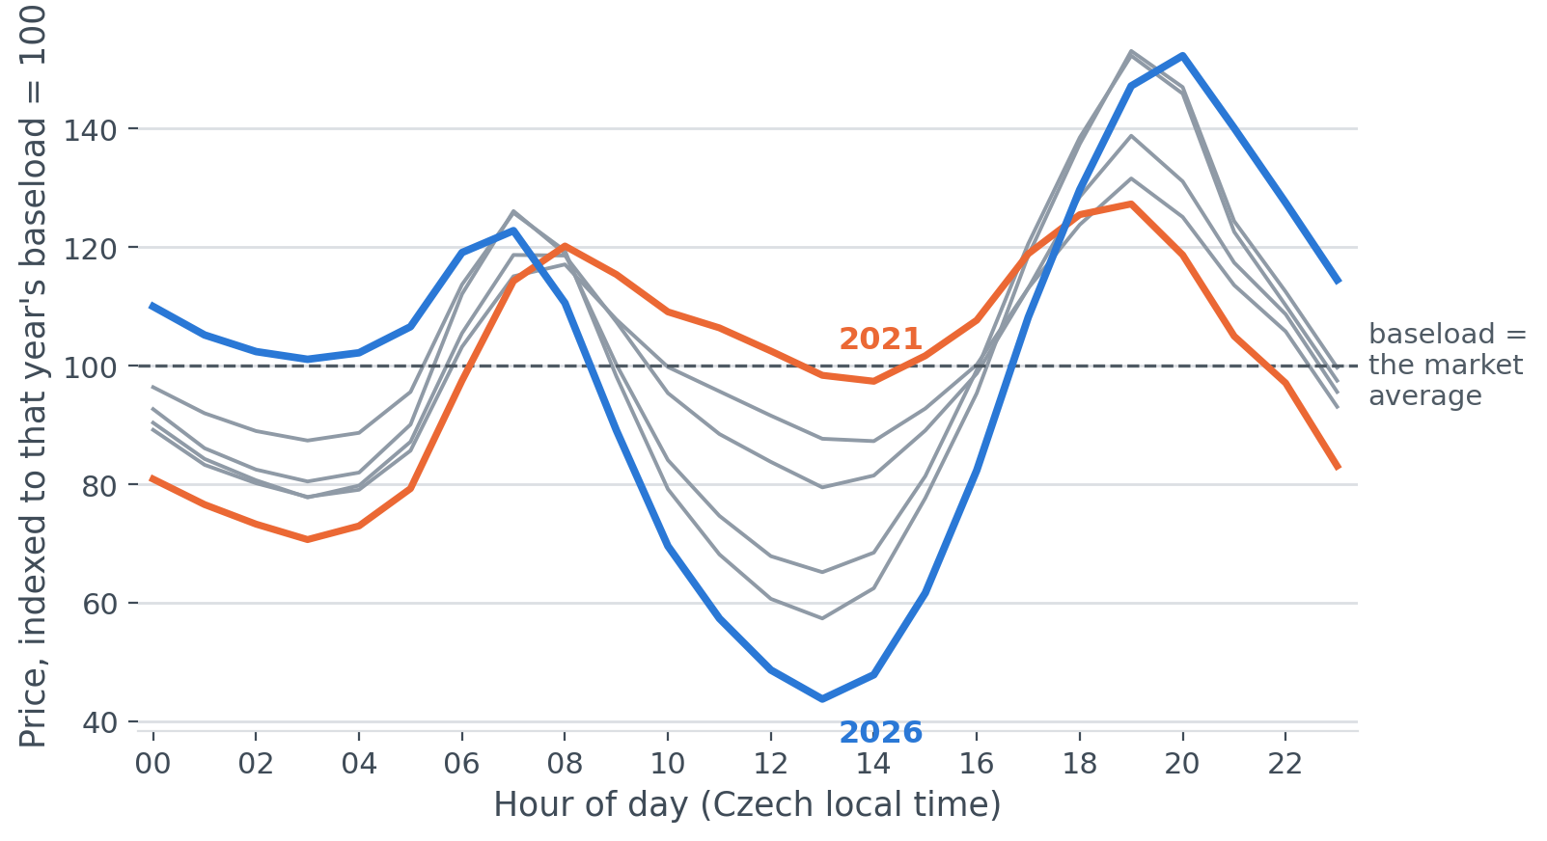
Midday stopped being expensive
Average price by hour of day, each year indexed to its own baseload so the shape can be compared across years.
WHAT THIS SHOWS
In 2021 midday cost +38% against the small hours. In 2026 it is -52%.
The cheapest hour of the day is now 13:00; in 2021 it was 03:00.
The expensive hours moved to the evening peak, 20:00, when solar output has gone and demand has not.
Source: energy-charts.info (Fraunhofer ISE), CC BY 4.0 | Czech day-ahead market | 2021-2026
3

Slide 4
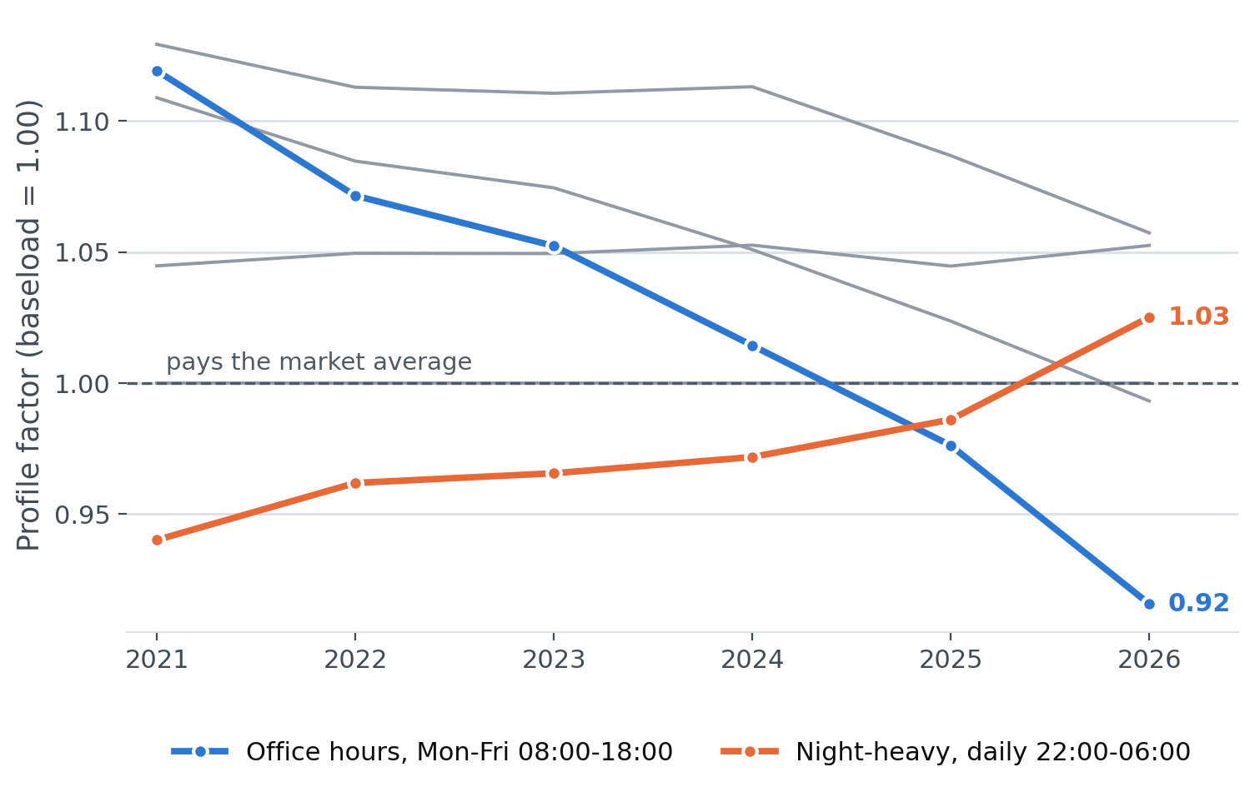
Who the market rewards now, and who it used to
Profile factor by year. Above 1.00 the shape costs the customer money; below 1.00 it earns them money.
WHAT THIS SHOWS
The daytime office profile crossed below the market average in 2025. The night-heavy profile crossed above it in 2026.
A continuous 24/7 load sits at 1.00 by definition. It is the benchmark everything else is measured against.
The annual figure hides a season. In 2026 the office profile is 0.84 across the summer and 1.13 across the winter: the advantage is a solar advantage, and it reverses when the sun does.
Source: energy-charts.info (Fraunhofer ISE), CC BY 4.0 | Czech day-ahead market | 2021-2026
4

Slide 5
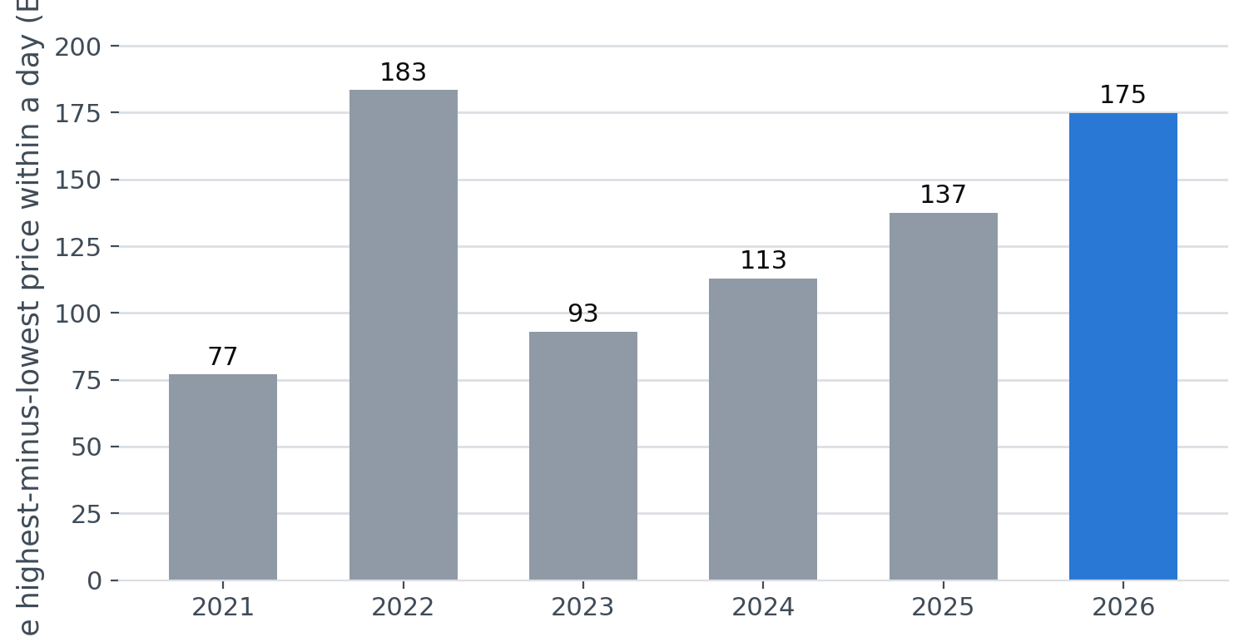
The gap inside a single day keeps widening
Average spread between the highest and lowest price within a single day.
WHAT THIS SHOWS
The gap between the cheapest and dearest moment of an average day went from 77 EUR/MWh in 2021 to 175 in 2026.
That is the shape effect getting stronger, independently of the price level: 2021 and 2026 had similar averages (101 against 111 EUR/MWh).
The worst single day in 2026 spanned 707 EUR/MWh.
Source: energy-charts.info (Fraunhofer ISE), CC BY 4.0 | Czech day-ahead market | 2021-2026
5

Slide 6
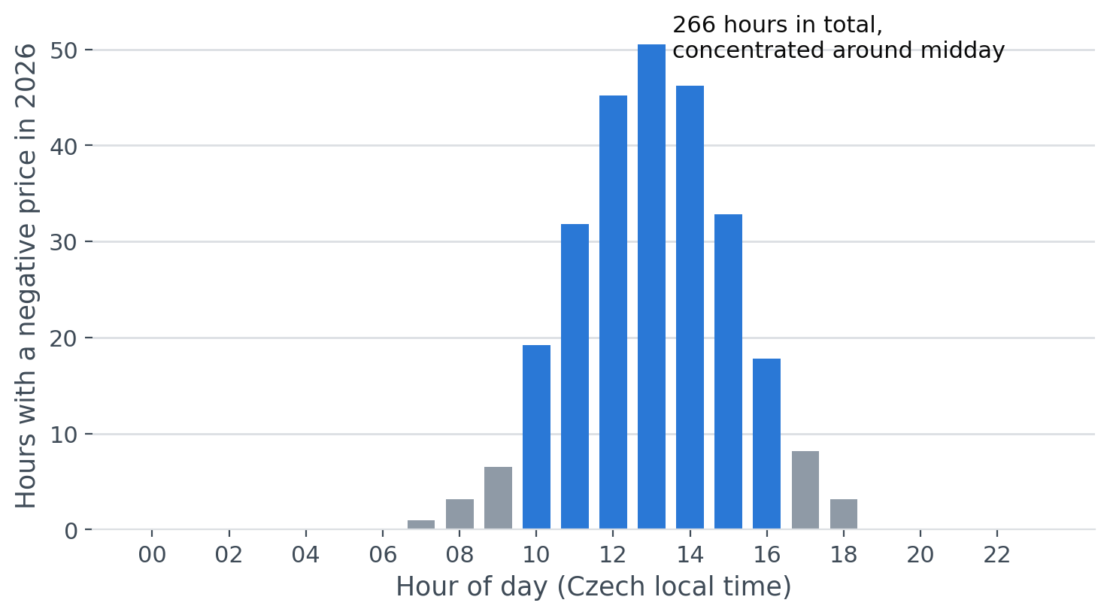
Negative prices happen at midday now
Hours of negative day-ahead prices in 2026, by hour of day.
WHAT THIS SHOWS
266 hours of negative prices so far in 2026 (4.6% of the period), against 33 hours in 2021.
The lowest settlement price recorded in 2026 was -500 EUR/MWh.
A customer able to move load into these hours is paid to consume. There is a product in that for anyone with flexible demand.
Source: energy-charts.info (Fraunhofer ISE), CC BY 4.0 | Czech day-ahead market | 2021-2026
6

Slide 7
What this changes for how we sell
Three things follow for how a supplier sells to business customers.
01
02
03
Price the shape, not just the volume
The daytime customer is the one to approach about spot
Certainty is worth more than it was
Two customers with identical annual volume are worth 156,846 EUR a year apart at 10,000 MWh. A fixed-price offer quoted off the baseload for both mis-prices both: too dear for the daytime customer, too cheap for the night one.
Single-shift and office-hours loads now sit below the market average and are still moving. But the gain is seasonal — 0.84 in summer against 1.13 in winter — so the honest product is a seasonal or hybrid one. A flat promise is the kind of thing a customer resents every January.
The average day now spans 175 EUR/MWh against 77 in 2021. For a customer who cannot move load, that is the case for a fixed product — and the risk premium is easier to justify.
Source: energy-charts.info (Fraunhofer ISE), CC BY 4.0 | Czech day-ahead market | 2021-2026
7

Slide 8
How the numbers were made, and where they stop
Every figure is computed from the cached price downloads in this repository and can be reproduced with one command.
SETTLEMENT PERIODS
COMPLETE YEARS
IF THE BASE LOAD IS IGNORED
73,775
5
0.87
Czech day-ahead prices, 2021-2026
checked hour by hour against the calendar
the office factor instead of 0.92 — same direction, twice the size
HOW THE NUMBERS WERE CHECKED
WHAT THIS ANALYSIS CANNOT TELL YOU
• Prices are converted from UTC to Czech local time, so shifts and nights line up with when a factory actually runs.
• The market moved from hourly to 15-minute settlement on 1 October 2025; every average here is weighted by period length.
• Load profiles keep a realistic base load overnight rather than dropping to zero, which halves the measured effect.
• Delivered hours were checked against the calendar year, so a missing day could not pass as a complete year.
• The profile factor isolates the shape effect. A real fixed offer also contains a forward price, a risk premium and balancing costs, none of which are public.
• These are stylised profiles rather than metered customer data. A real site has seasonality, shutdowns and production peaks.
• Past shapes are history. They show where the market has moved; where it goes by the end of a three-year contract is another question.
• Seasonal factors are computed against each season's own baseload, so what they measure is shape. The fact that winter power costs more is already divided out.
• 2026 covers January to August only and is labelled as such throughout.
Source: energy-charts.info (Fraunhofer ISE), CC BY 4.0 | Czech day-ahead market | 2021-2026
8

