Slide 1
What a Czech industrial
electricity bill is made of
And how much of it a supplier can actually compete on. Czechia benchmarked against its five neighbouring markets and the EU average.
Source: Eurostat, last updated 2026-08-11. Band 2 000-19 999 MWh, excluding VAT.
Generated 19 September 2026

Slide 2
Two thirds of the bill is ours to price
Mid-size industrial consumers (2 000-19 999 MWh a year), 2025-S2, excluding VAT.
CZECH PRICE
RANK AMONG NEIGHBOURS
COMMODITY SHARE OF THE BILL
STILL ABOVE PRE-CRISIS
16.4c
1 of 6
66%
+64.9%
EUR cents per kWh, +2.5% vs the EU average
cheapest is Czechia, dearest is Germany
the part a supplier sets; EU average 62%
against 2021-S2, after peaking in 2023-S1
THE FINDING
Czech industry pays 16.4 cents per kWh — the lowest of the six markets compared, 15% below Germany, though still +2.5% against the EU average.
The level matters less to a supplier than the composition. 66% of that bill is energy and supply — the highest share in the group, against 46% in Poland. Network charges and taxes are set by the regulator and the state and are identical whichever supplier a customer signs with.
Source: Eurostat | 2025-S2 | Non-household consumers, excluding VAT
2

Slide 3
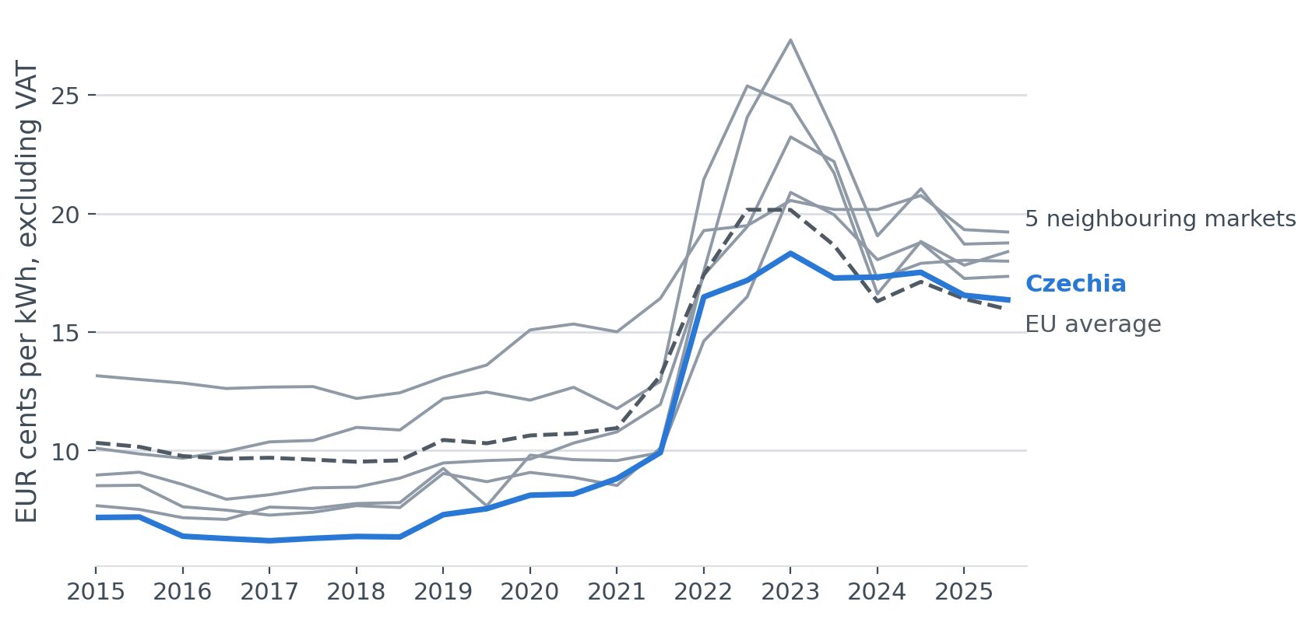
Prices came down, but not all the way back
Business electricity price, band 2 000-19 999 MWh, since 2015.
WHAT THIS SHOWS
Czech prices peaked in 2023-S1 at 18.3c, +84.7% on 2021-S2.
They have since fallen 11%, but remain +64.9% above pre-crisis levels.
Czechia moved less violently than its neighbours through 2022-2023. That is worth saying to a customer comparing offers across the border.
Source: Eurostat | 2025-S2 | Non-household consumers, excluding VAT
3

Slide 4
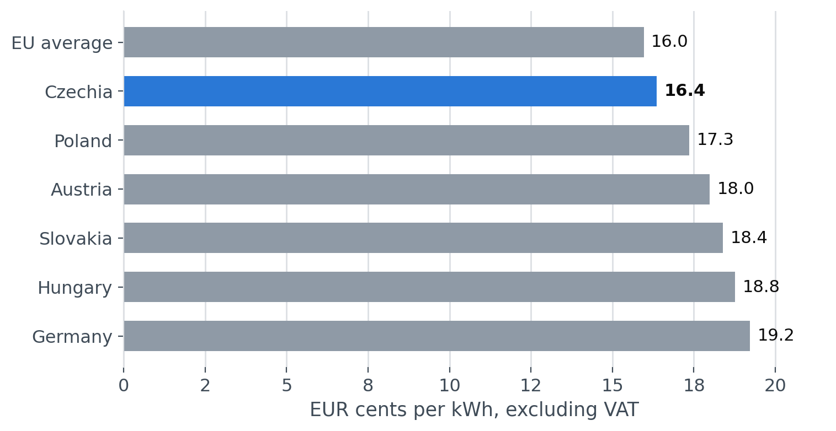
Czechia is the cheapest of its neighbours
Price per kWh, 2025-S2, excluding VAT.
WHAT THIS SHOWS
Czechia 16.4c against Germany 19.2c — a gap of 15%.
The EU average sits below Czechia. So 'cheap' here means cheap against the neighbours a Czech plant competes with for orders. Against Europe as a whole it is a little above the middle.
Source: Eurostat | 2025-S2 | Non-household consumers, excluding VAT
4

Slide 5
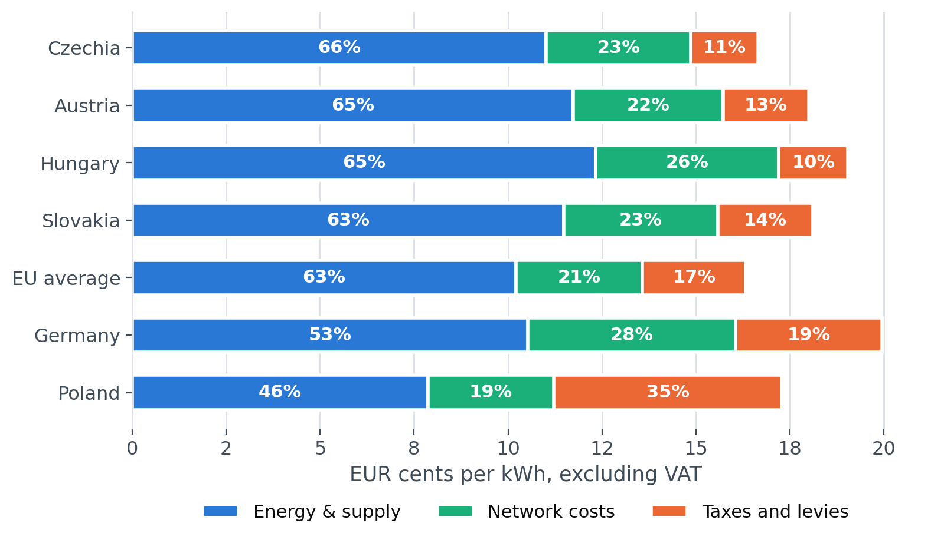
Where the money in the bill goes
Price split into energy & supply, network costs and taxes, 2025. Countries ordered by the share a supplier controls.
WHAT THIS SHOWS
In Czechia 66% of the bill is the commodity. In Poland it is 46%: nearly half that bill is tax, and no supplier can discount it.
A 10% cut on the commodity is worth 6.6% off a Czech customer's total bill, against 5.3% in Germany.
Source: Eurostat | 2025-S2 | Non-household consumers, excluding VAT
5

Slide 6
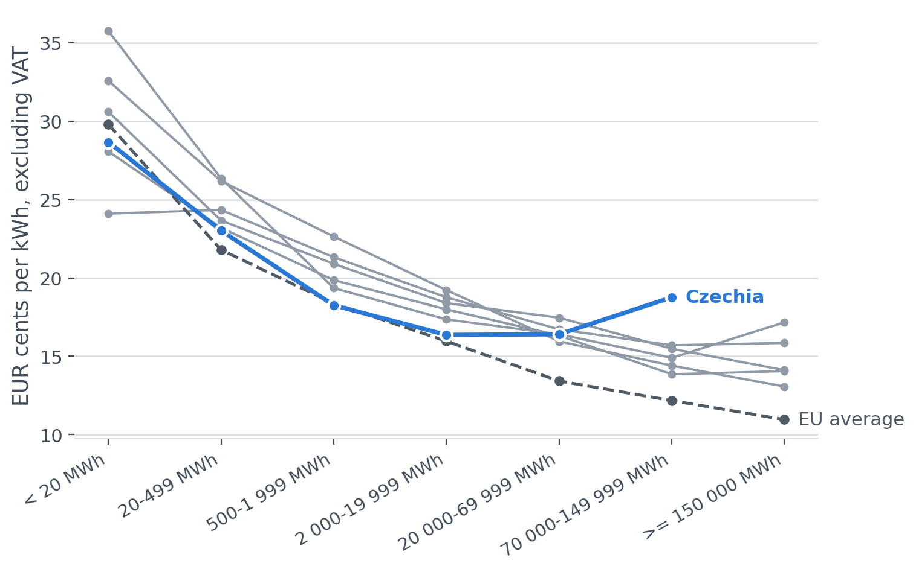
Big customers get less of a discount here
Price by annual consumption band, 2025-S2. Measured between < 20 MWh and 70 000-149 999 MWh, the largest band every country reports.
WHAT THIS SHOWS
Across the EU the large band pays 59% less per kWh than the smallest. In Czechia the gap is 34%.
The Czech curve also turns back up: consumers above 20 000 MWh pay more per kWh than the 2 000-19 999 MWh band, the only market here where that happens at that point on the curve.
Czechia does not report the >= 150 000 MWh band at all, so its very largest consumers are invisible in this data.
Source: Eurostat | 2025-S2 | Non-household consumers, excluding VAT
6

Slide 7
What this changes for how we price
Three things follow for anyone selling electricity to Czech industry.
01
02
03
Price competition works better here than next door
The largest consumers are the exposed segment
A German parent needs a different argument from everyone else
With 66% of the bill in the supplier's hands, a discount reaches the customer's total cost more directly than in Poland (46%) or Germany. The same headline discount buys more visible saving — and costs the same margin.
The Czech size curve is flat — 34% between the smallest and largest comparable band against 59% EU-wide — and above 20 000 MWh it turns back up. Large industrial accounts get less volume benefit than their EU peers, and they are the group most able to tender across borders.
Czechia is 15% below Germany but +2.5% against the EU average. The credible argument to a German-owned plant is the cross-border gap; the credible argument elsewhere is that Czech prices moved less through the crisis.
Source: Eurostat | 2025-S2 | Non-household consumers, excluding VAT
7

Slide 8
How the numbers were made, and where they stop
Every figure here is computed from the cached Eurostat responses in this repository and can be reproduced with one command.
OBSERVATIONS USED
COMPONENT RECONCILIATION
IF THAT CHECK IS SKIPPED
2,775
0.8%
21%
electricity and gas prices, 2007 onwards
median gap between components and the headline series
how far the naive component sum overstates the price
HOW THE NUMBERS WERE CHECKED
WHAT THIS ANALYSIS CANNOT TELL YOU
• Prices exclude VAT: VAT is recoverable for a business, so the VAT-inclusive series overstates what a company pays.
• The component breakdown is annual, the price series half-yearly; the two were reconciled before anything was built on them.
• Eurostat's tax total already contains VAT. Subtracting it is the difference between a 0.8% and a 21% error.
• Raw API responses are cached in the repository, so the numbers are reproducible even after Eurostat revises a series.
• These are national averages. An individual contract depends on the load profile, the hedging strategy and the date it was signed.
• Band boundaries are consumption-based, so a country's mix of industry affects its average within a band.
• Czechia does not report the >= 150 000 MWh band, so size comparisons stop at 70 000-149 999 MWh — the largest band every country publishes.
• Half-yearly data cannot show what a spot-exposed customer paid in a particular month.
• Nothing here says what any supplier's margin is; the commodity share is what a supplier prices, not what it earns.
Source: Eurostat | 2025-S2 | Non-household consumers, excluding VAT
8

