Slide 1
Retention
A casual approach
2017-03-23

Slide 2
Key Objectives
Markov-based Approach
Deep Learning Approach

Slide 3
Retention
“Another thing that got me interested is Matthew Winter mentioning that he would be very interested in figuring out retention …”

Slide 4
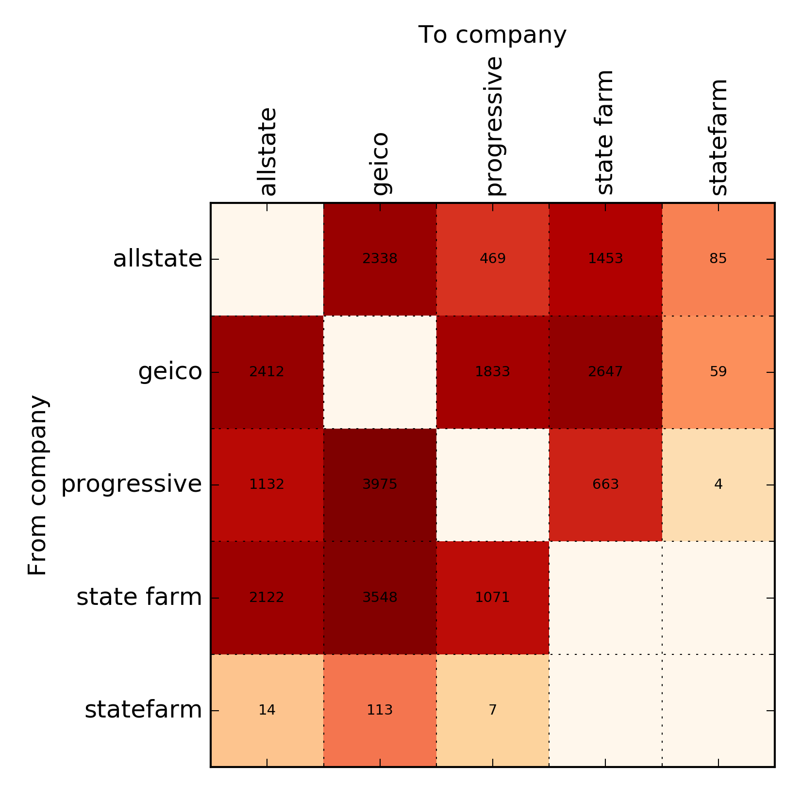
Retention - Transition

Slide 5
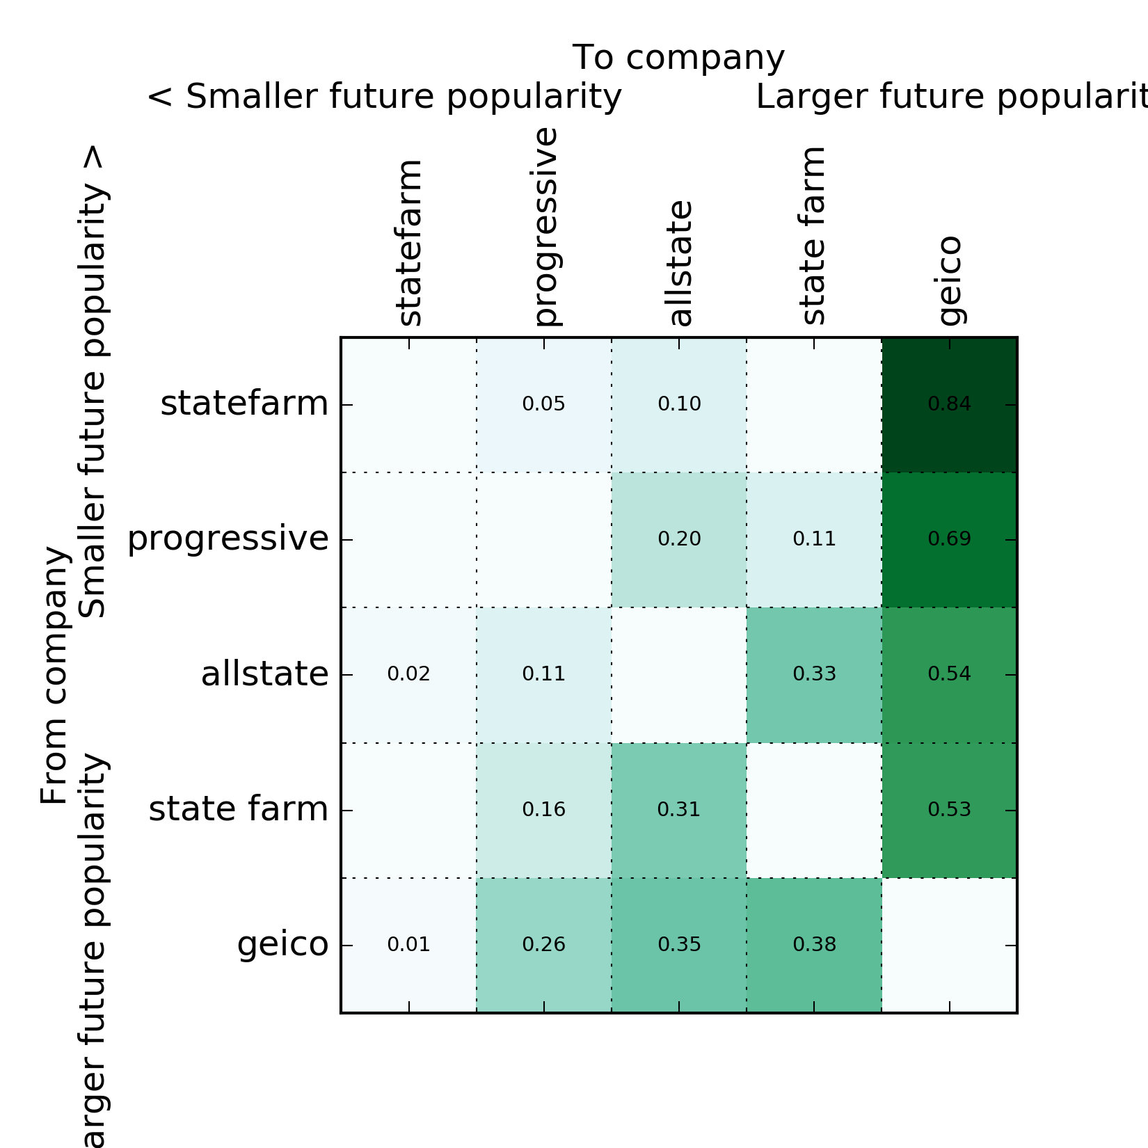
Retention – Eventual Transitions Matrix

Slide 6
Retention – Final State
allstate 10025
state farm 11504
statefarm 282
progressive 9154
geico 16925
| 36.51% | geico |
| 23.52% | state farm |
| 23.28% | allstate |
| 15.92% | progressive |
| 0.78% | statefarm |

Slide 7
Retention - Individuals
So, my original suggestion was to build a matrix of probabilities (using Markov chain approach). That would not involve any Deep Learning, or ML. It is computationally easy, and I believe may give interesting results, but getting good data for transition probabilities may be challenging.
On the other hand, we, probably, can easily get data from switches of individual AllState customers, with the state machine looking something like that: in, allstate car, allstate home, allstate car and home, out, etc. etc., include a lot of parameters (you know: age, gender, hair color, what not) and use Deep Learning (that it what NVIDIA people were using with mortgage statuses on that slide). It’s quite possible that somebody at AllState is doing it already.
What, perhaps, may be an original idea is to marry retention from above with UBI: the idea is that you may want to reduce insurance premium for low-retention category, but only if they are safe-drivers. High-retention will stay anyway, so you can keep high rates. Low-retention and drivers that are worse than average can go anyway unless they pay a higher rate. And so on.

