Slide 1
WebSocket Real-Time Communication
UTS Individu — Communication Protocol
Rizky Dwi Saputra
25120500017 | Kelas ComP2
Case 8: WebSocket Echo Protocol
P3 WebSocket — Demo App localhost:8088
07 Juni 2026 | github.com/likicop/communication-protocol-uts

Slide 2
Tujuan & Skenario API
Tujuan Praktikum
Skenario Bisnis
Memahami WebSocket handshake
(HTTP Upgrade → 101)
Kirim & terima pesan JSON
via WebSocket echo pattern
POST event via HTTP REST
/api/realtime/events
GET events tersimpan
di server
Analisis traffic Wireshark
(TCP Stream & packets)
Channel: dashboard
Event dashboard_refresh untuk update
tampilan dashboard secara real-time
Channel: orders
Event order_created dengan payload: orderId: ORD-2026-001
amount: 450000 | priority: normal
Endpoint: ws://localhost:8088/ws/echo?channel={channel}

Slide 3
Endpoint & Request Design
# | Tipe | Endpoint / Action | Expected Response
1 | WS Connect | ws://.../ws/echo?channel=dashboard | 101 Switching Protocols
2 | WS Send | Send JSON {event:dashboard_refresh} | RECV echo response
3 | POST | POST /api/realtime/events (dashboard) | 201 Created
4 | GET | GET /api/realtime/events?channel=dashboard | 200 OK + events array
5 | WS Connect | ws://.../ws/echo?channel=orders | 101 Switching Protocols
6 | POST | POST /api/realtime/events (order_created) | 201 Created
7 | GET | GET /api/realtime/events?channel=orders | 200 OK + events array
POST body: {"event":"dashboard_refresh","value":1}
POST body: {"event":"order_created","orderId":"ORD-2026-001","amount":450000}

Slide 4
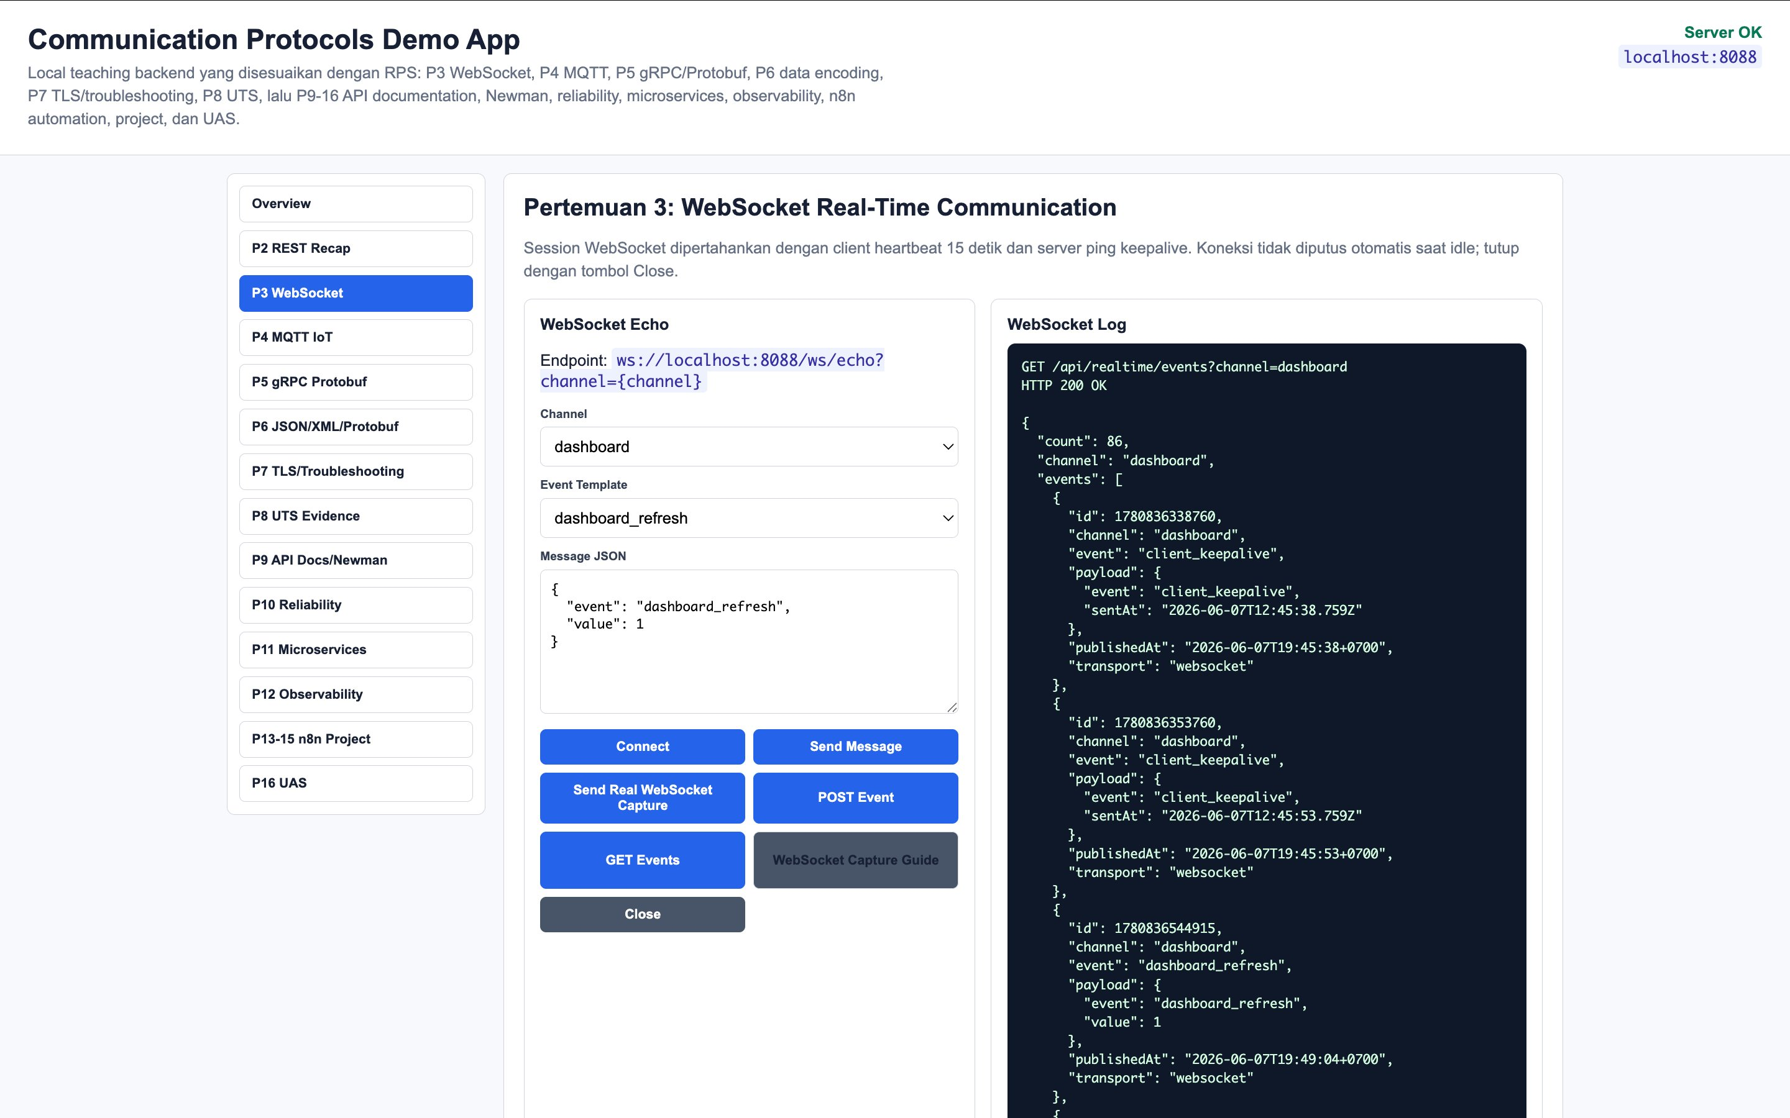
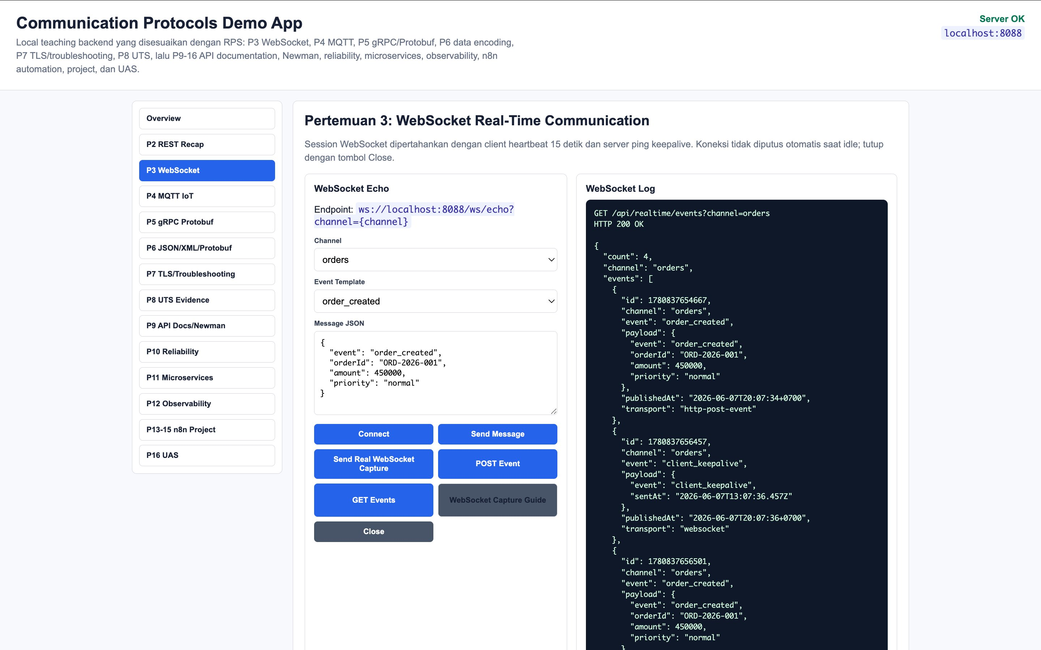
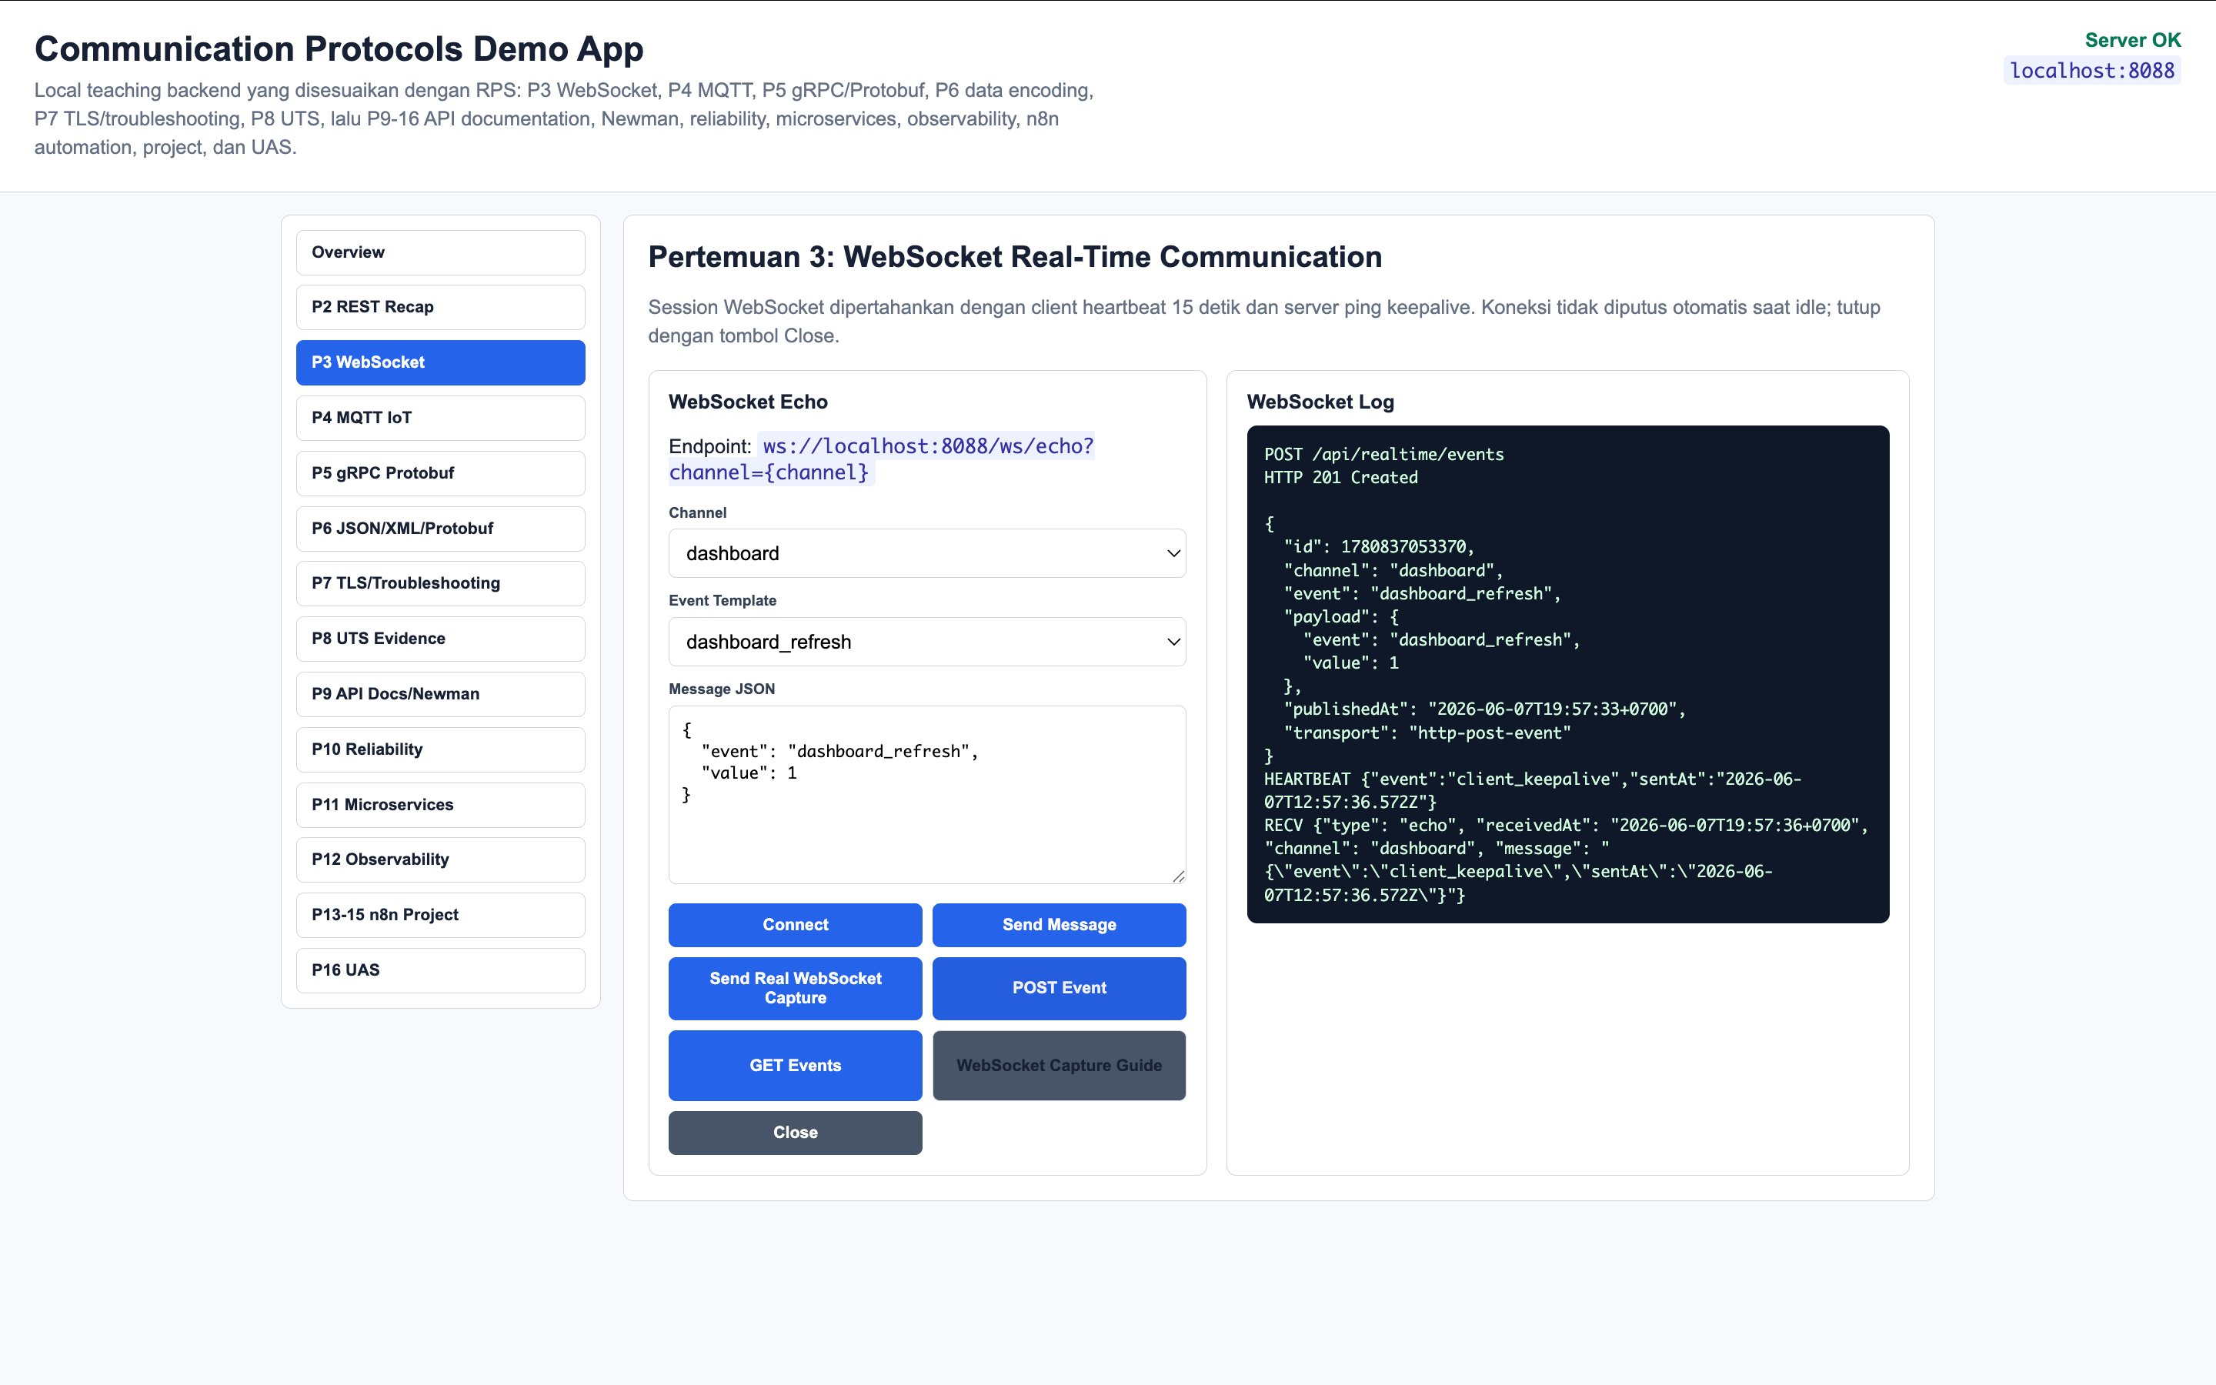
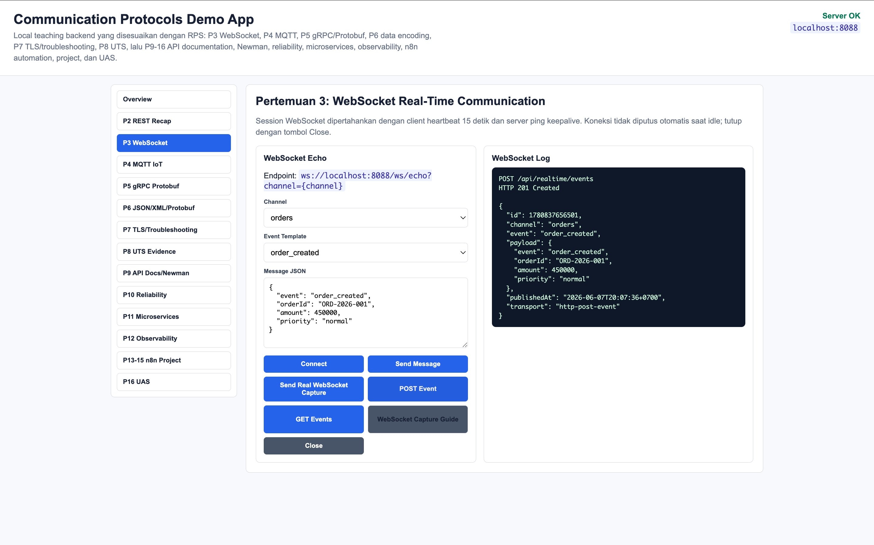
Evidence GET & POST Request
GET #1
HTTP 200 OK | channel: dashboard | count: 86 events
GET #2
HTTP 200 OK | channel: orders | order_created events
POST #1
HTTP 201 Created | dashboard_refresh event
POST #2
HTTP 201 Created | order_created event

Slide 5
Analisis Response & Encoding
Status Codes
Struktur JSON Response
101
Switching Protocols WebSocket upgrade berhasil
{
"count": 86,
"channel": "dashboard",
"events": [{
"id": 1780837053370,
"event": "dashboard_refresh",
"payload": {
"value": 1
},
"publishedAt": "2026-06-07T...",
"transport": "http-post-event"
}]
}
200
OK GET events sukses
201
Created POST event berhasil dibuat
Field transport: websocket vs http-post-event
websocket
Dari koneksi WS
http-post-event
Dari HTTP POST

Slide 6
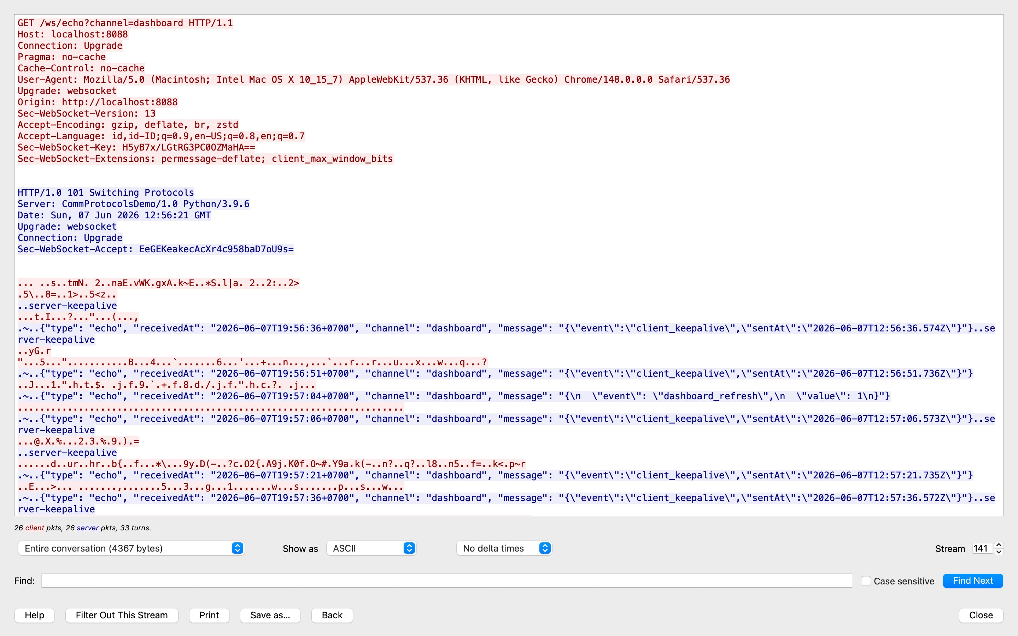
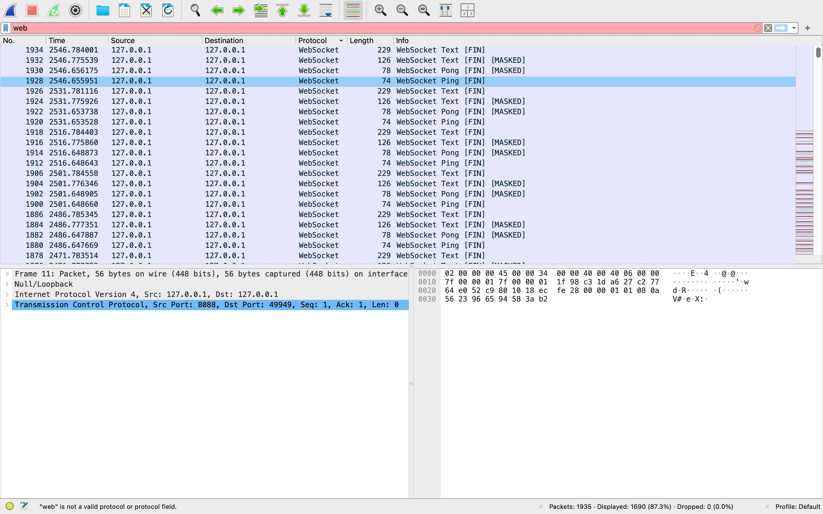
Analisis Traffic — Wireshark
WebSocket packet list: Text, Ping, Pong
Temuan Wireshark
HTTP GET + Upgrade header
101 Switching Protocols
Sec-WebSocket-Accept valid
WS Text: echo JSON payload
Ping (74B) / Pong (78B MASKED)
26 client + 26 server packets
TCP Stream: HTTP Upgrade → WebSocket

Slide 7
Kendala, Solusi & Kesimpulan
Kendala & Solusi
Kesimpulan
Endpoint /api/events → 404 Solusi: gunakan /api/realtime/events melalui demo app browser Interface Wireshark: lo0 Solusi: pilih Loopback (lo0) bukan
en0 untuk capture localhost
WebSocket: full-duplex, persistent, efisien
HTTP 101 Upgrade = awal koneksi WS
Heartbeat Ping/Pong = keepalive koneksi
JSON = format encoding ringan & readable
transport field bedakan WS vs HTTP POST
Pembelajaran Protocol
WebSocket sangat efisien untuk real-time communication karena hanya butuh 1x HTTP handshake, overhead per pesan minimal, support server push, dan full-duplex. Wireshark mengkonfirmasi bahwa WebSocket berjalan di atas TCP dengan frame yang compact.
github.com/likicop/communication-protocol-uts | Rizky Dwi Saputra | 25120500017

