Slide 1
Operations and Supply Chain Management

Slide 2
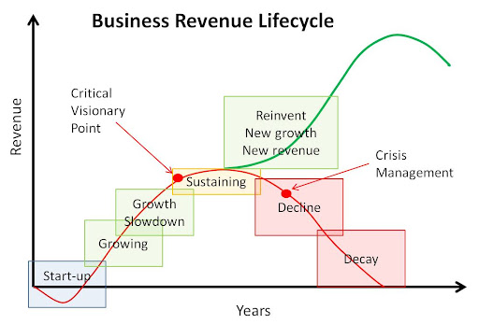
Source: TOMI Consultancy

Slide 3
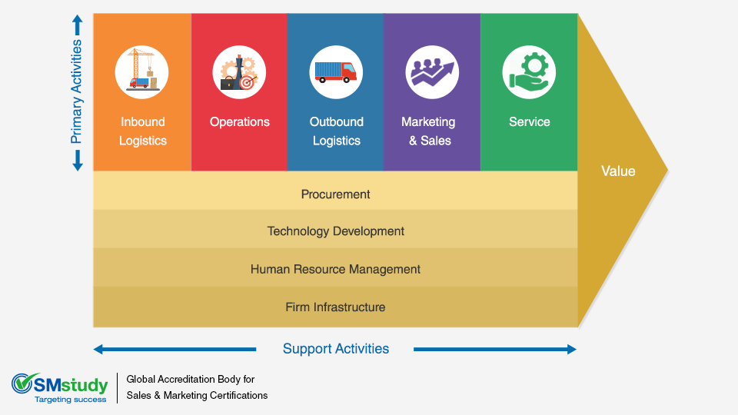
Porter’s Value Chain Model
Source: SM Study

Slide 4
Nike’s Failure
Nike had a phenomenal growth spurt from 1996 – 1999.
In 2000, its annual sales reached $9 billion.
However, it encountered a financial problem in 2001 and had huge lost sales.

Slide 5
Asos and the case of the disappearing inventory
85,000 total SKUs.
Nearing the peak sales month of July, the supply chain system failed.
Registered a YoY profit reduction of 68%.

Slide 6
Semiconductor Conundrum
Manufacturing a chip takes close to 3 months and requires advanced technological capabilities.
Surge in sales.
Tense relationship between America and China.
Maruti Suzuki could see a 68% cut in the production.

Slide 7
Supply Chain
Manufacturers
Distributors
Wholesalers
Retailers
The main goal of a supply chain is to meet the customer’s demand.
Demand

Slide 8

Importance of Forecast
Nike had a phenomenal growth spurt from 1996 – 1999.
In 2000, its annual sales reached $9 billion.
However, it encountered a financial problem in 2001 and had huge lost sales.
Michael Jordan, Nike spokesperson retired.
There was an economic slowdown in 2000 – 2001.
What do you think was the possible reason for the debacle?

Slide 9
Nike Case
Overproduction of unpopular shoe.
Underproduction of popular shoes.
Inefficient logistics.
Right products were not available at the right place at the right time
All these were attributed to improper forecasting.

Slide 10
Importance of Forecast
Needed for inventory planning.
Needed for optimal facility location for efficient distribution of products across the echelons.
Need to make optimal supply chain contracts with partners both horizontally and vertically.

Slide 11
Definition
A forecast is characterised by two parameters:
The lead time.
Number of independent variables
How many attributes influence the forecast?

Slide 12
Types of Forecast
Qualitative Forecasts: Based on expert’s opinion.
Diffusion Models.
Causal Models: Eg. Regression
Time Series Methods.
Aggregation of detailed forecasts.

Slide 13
Factors for choosing a method
A New Product to be launched:
Qualitative methods.
Diffusion methods.
Availability and accuracy of the available data.
Computational complexity.
Factors affecting the sale.
Level of aggregation.
Old Product:
Time Series forecasting.
Causal Models

Slide 14
Moving Average method
All the time stamps within the window are given the same weightage.
However, in some cases, recent data may be given higher weightage.

Slide 15

Exponential Smoothing method
$S_{t}=αD_{t}+\left(1−α\right)S_{t−1}$

Slide 16
Bass-Diffusion Method
The whole population is divided into two segments.
Innovators or Early adopters.
Imitators

Slide 17


Bass-Diffusion Method
Innovators
Imitators
Coefficient of buying $=p$
Coefficient of buying $=q×\frac{N_{t−1}}{N}$
At a given time $t$, number of new adopters $=n_{t}=(N−N_{t−1})(p+q\frac{N_{t−1}}{N})$

Slide 18
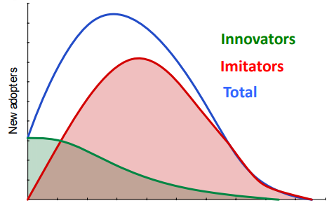
Bass-Diffusion Method
Time
Courtesy: Stephen C Graves (ocw.mit.edu)

Slide 19
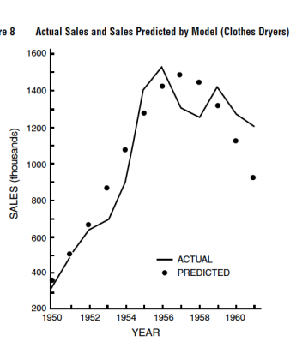
Courtesy: Stephen C Graves (ocw.mit.edu)

Slide 20
But Remember
Forecasts are always wrong and should include a measure of error.
The longer the lead time, higher is the error.
Method to be chosen based on the need and context

Slide 21
References
Taylor, J. (2003). Short-term electricity demand forecasting using double seasonal exponential smoothing. Journal of the Operational Research Society, 54, 799-805.
Taylor, J. (2008). An evaluation of methods for very short-term load forecasting using minute-by-minute British data. International Journal of Forecasting, 24, 645-658.
Taylor, J. (2010). Triple seasonal methods for short-term electricity demand forecasting. European Journal of Operational Research, 204, 139-152.
Vaughan, A. (2017, October 4). Time to shine: Solar power is fastest-growing source of new energy. The Guardian.
Wang, J., Chi, D., Wu, J., & Lu, H.-y. (2011). Chaotic time series method combined with particle swarm optimization and trend adjustment for electricity demand forecasting. Expert Systems with Applications, 38, 8419-8429.
(2017). World Energy Investment 2017. International Energy Agency.
Zhu, S., Wang, J., Zhao, W., & Wang, J. (2011). A seasonal hybrid procedure for electricity demand forecasting in China. Applied Energy, 88, 3807-3815.

Slide 22
Thank You

