Slide 1
Employee Attrition Prediction
-Likita J. Raikar

Slide 2
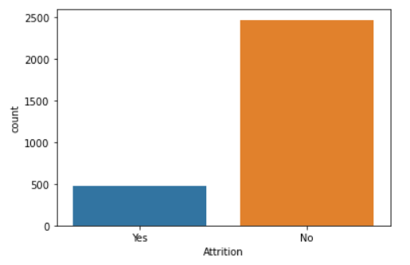
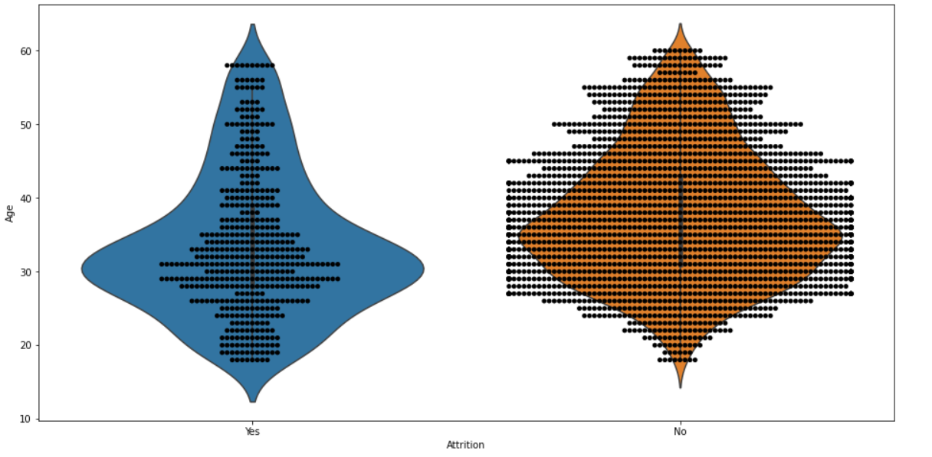

Attrition in the company Attrition with respect to Age
Maximum number of people working in the company are in the age range of 25 to 45
The Attrition is maximum for the age range of 25 to 35.

Slide 3
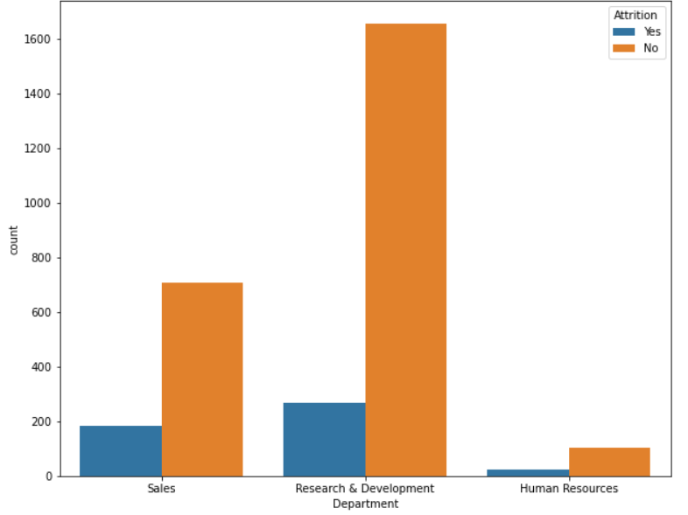
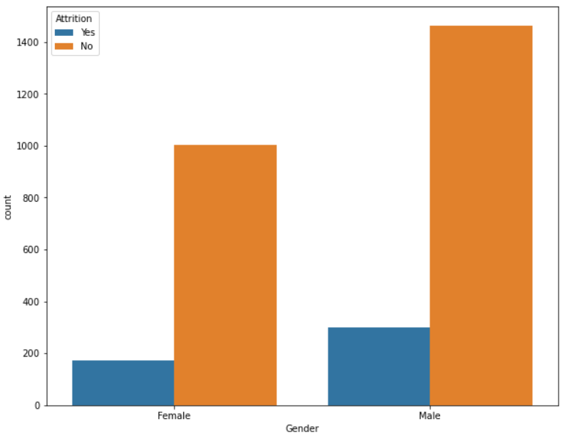

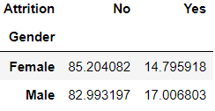
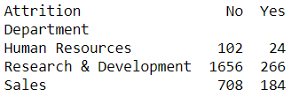
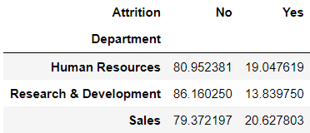
Attrition with respect to Department Attrition with respect to Gender
Attrition is the highest in the Sales Department and the lowest in the Research and Development Department.
Males have higher Attrition percentage than the Females.

Slide 4
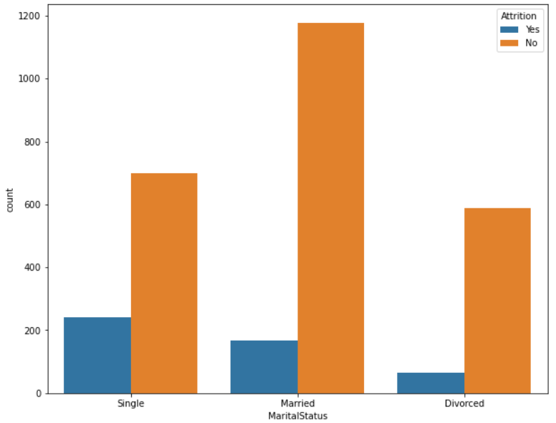
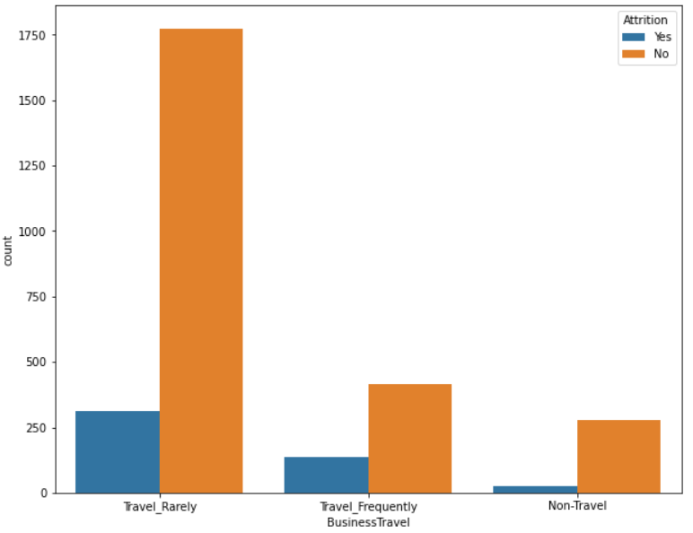
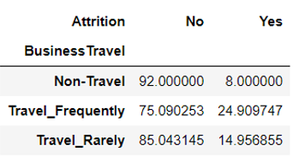
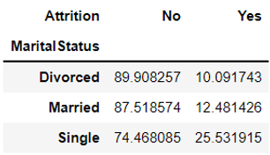
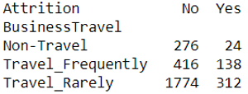
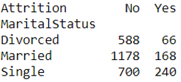
Attrition with respect to Marital Status Attrition with respect to Business Travel
Singles have the highest Attrition while the Divorced have the lowest Attrition.
Employees who travel frequently have the highest Attrition while the lowest is for the non travel employees

Slide 5
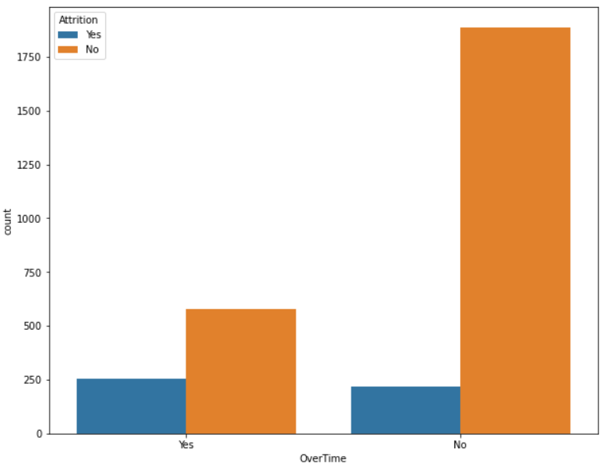
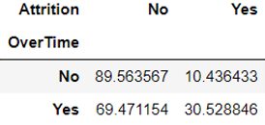

Attrition with respect to Over Time
Employees who work over-time have higher Attrition than the employees who don’t work over-time.

Slide 6
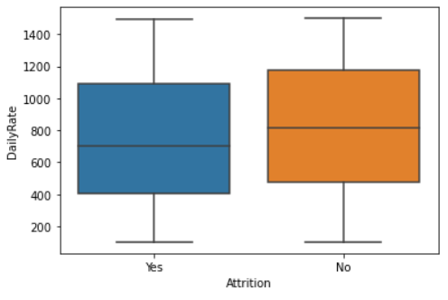
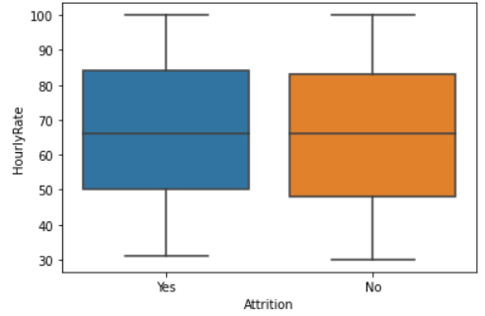
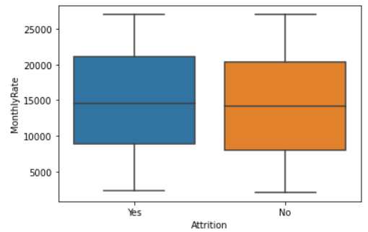
Comparison of Daily Rate, Hourly Rate and Monthly Rates with Attrition
The mean daily rate, hourly rate and the monthly rate for employees with attrition is statistically similar to the mean for the employees with no attrition.
Hence these features do not contribute much in determining the Attrition for the employees.

Slide 7
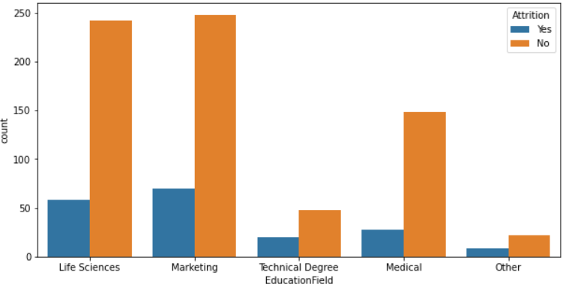
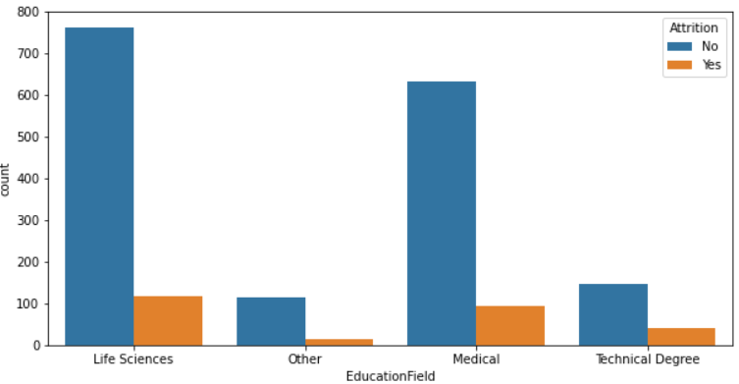
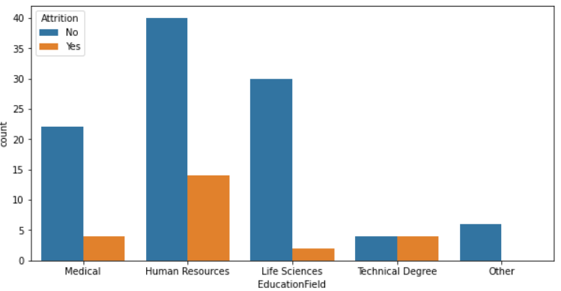
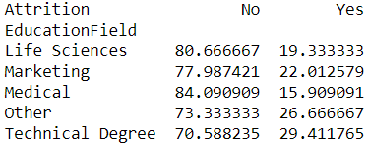
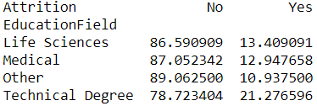
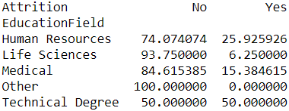
Comparison of Education Field in Sales,R&D and HR Departments with Attrition
Sales Research & Development Human Resources
- Most of the people in Sales have the Education Field of Marketing.
- Most of the people in Research & Development have the Education Field of Life Sciences.
- Most of the people in Human Resources have the Education Field of Human Resources .
- Comparing all the departments, Technical Degree has the highest Attrition.

Slide 8
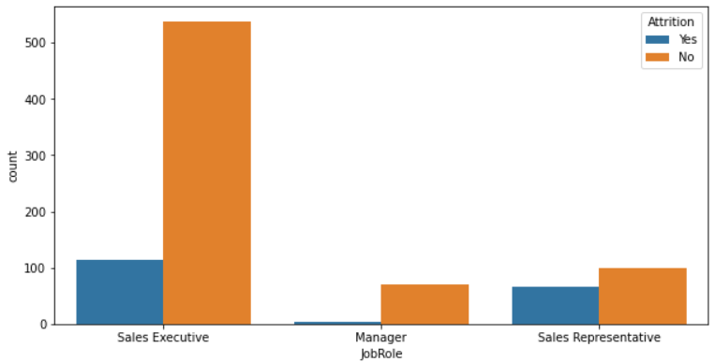
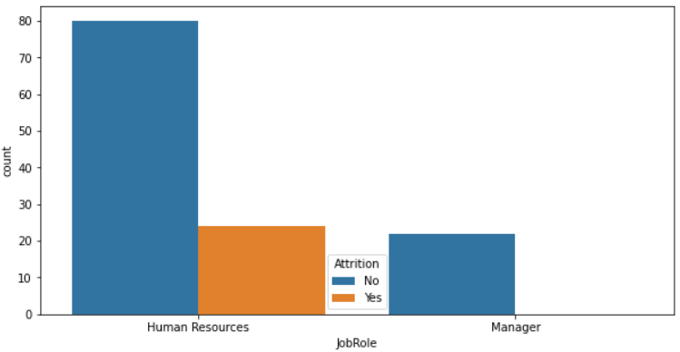
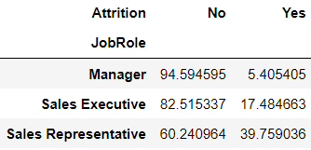
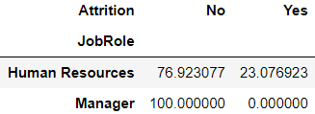
Comparison of Job Role in Sales,R&D and HR Departments with Attrition
Sales
HR

Slide 9
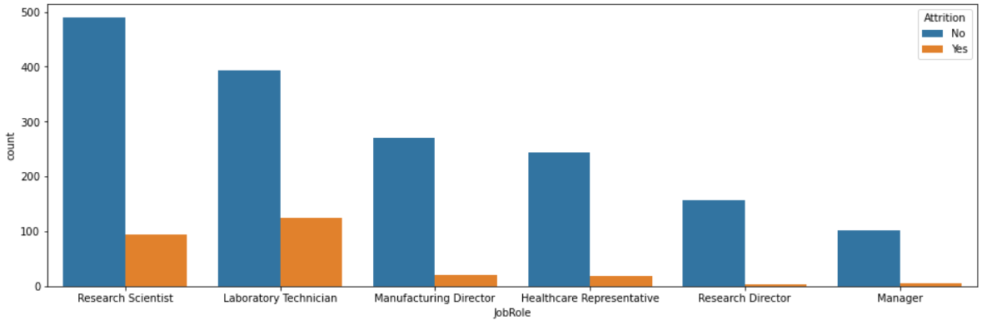
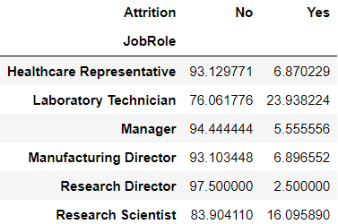
Comparison of Job Role in Sales,R&D and HR Departments with Attrition
Sales Representative, Human Resources and Laboratory Technician have the highest attrition rates.
R&D

Slide 10
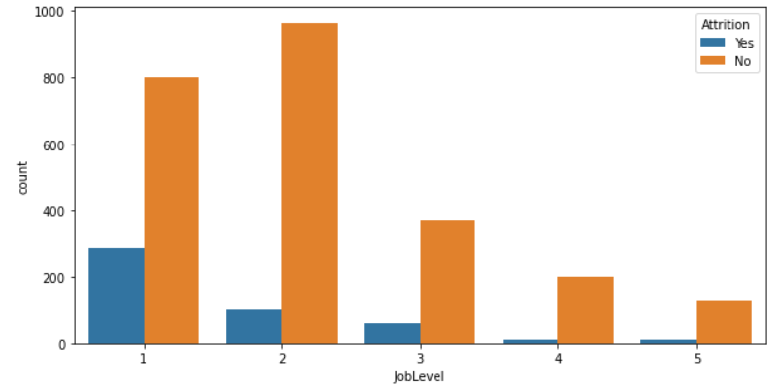
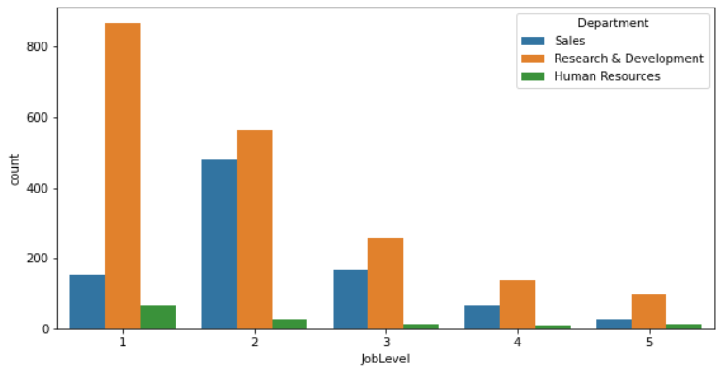

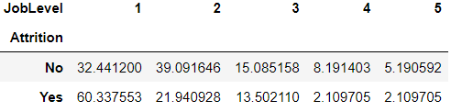
Attrition with respect to job level
As the job level increases the attrition decreases. Attrition is greater at job levels of 1,2,3.

Slide 11
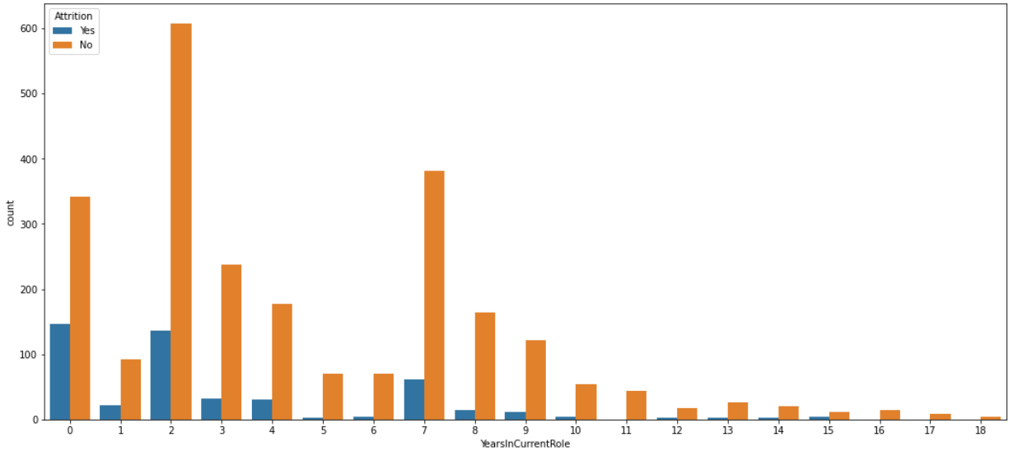
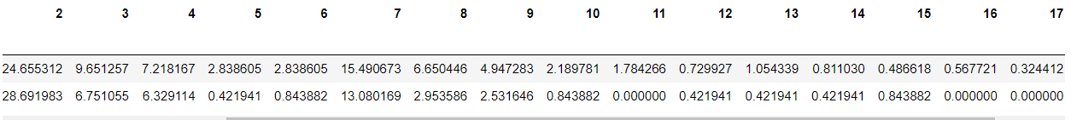
Attrition with respect to years in current role
As the years in the current role increases, the attrition decreases.

Slide 12
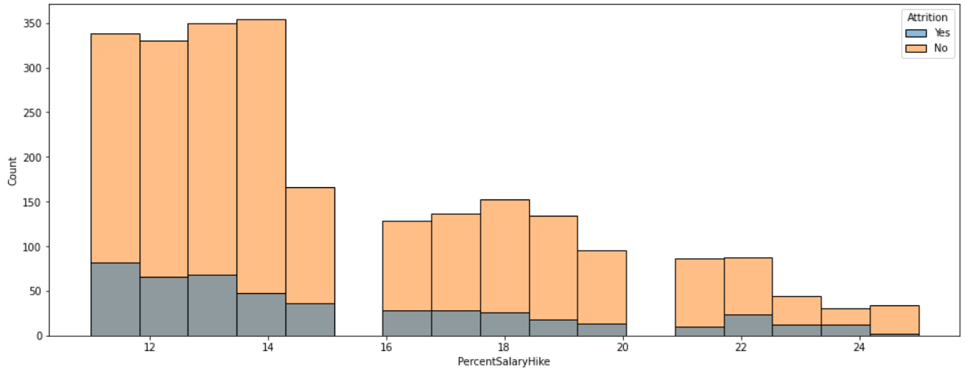
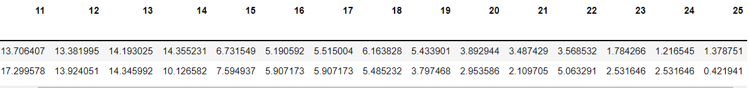
Attrition based on the percent salary hike
As the percentage salary hike increases the attrition decreases.

Slide 13
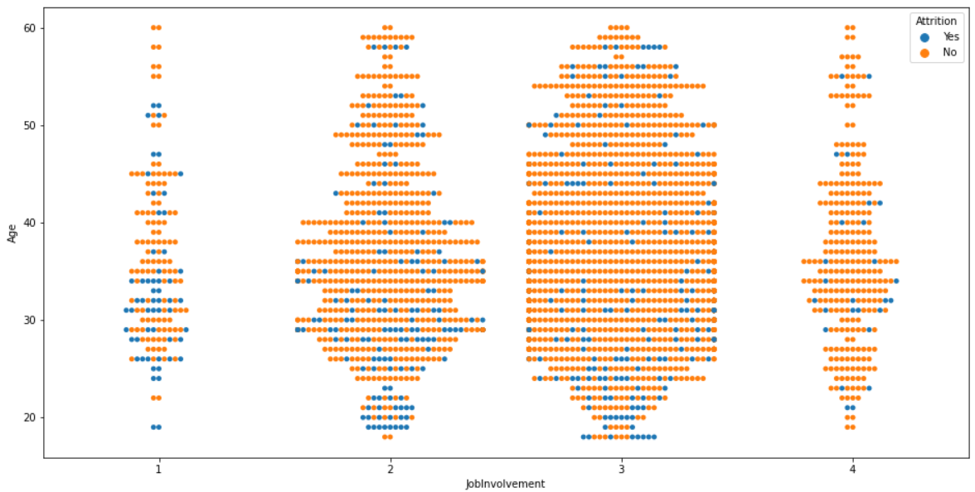
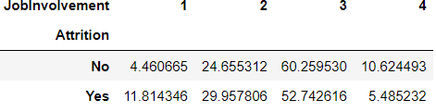
Attrition based on job involvement
Job involvement of 3 as the highest employees.
Also job involvement of 3 has the highest attrition.

Slide 14
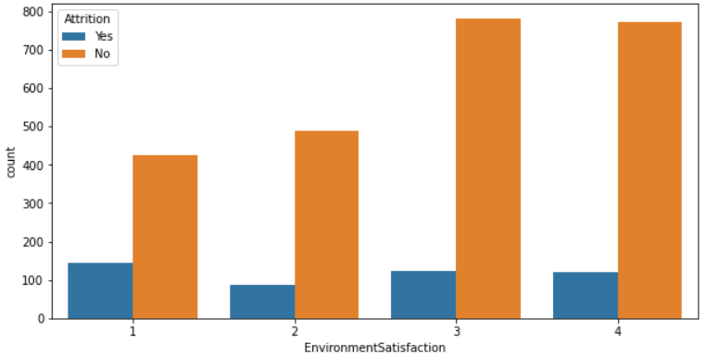
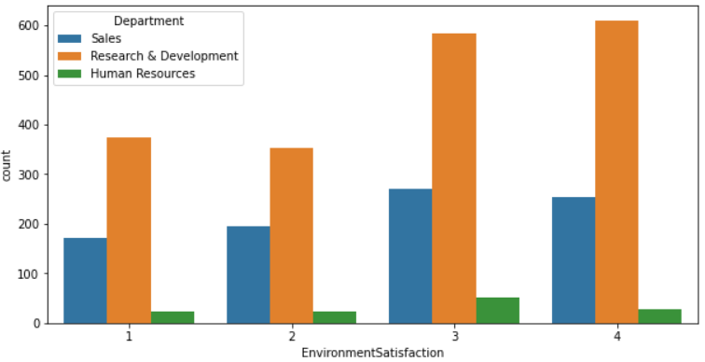
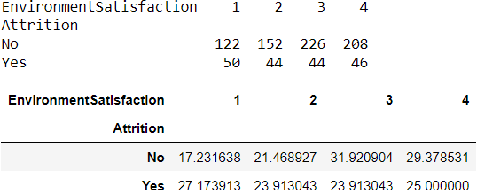
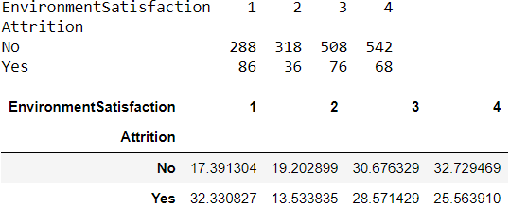
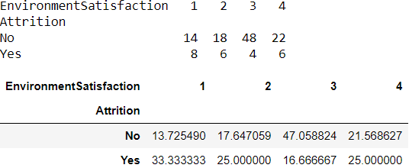
Comparison of Environment Satisfaction in Sales,R&D and HR Departments with Attrition
Sales R&D HR

Slide 15
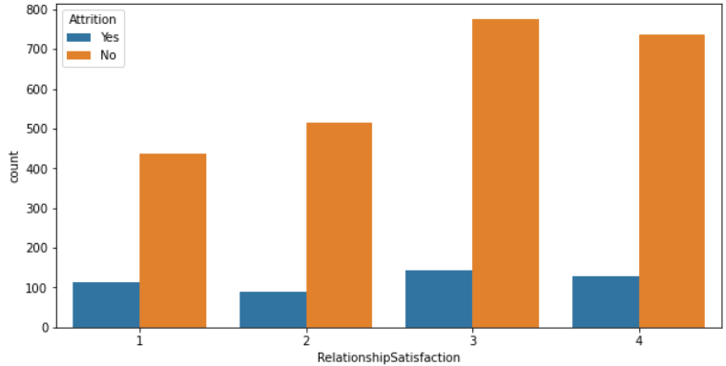
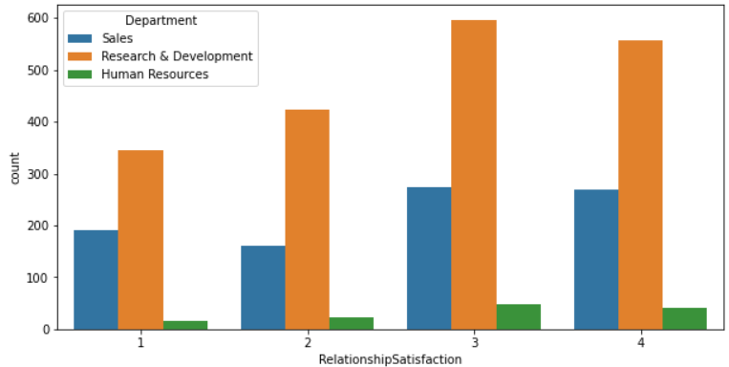
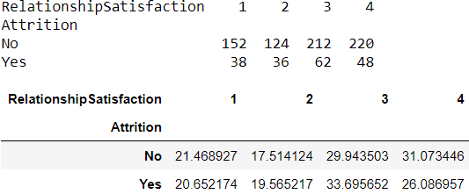
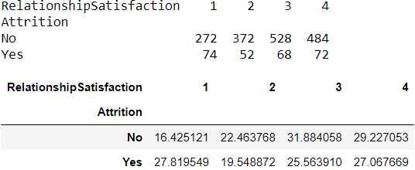
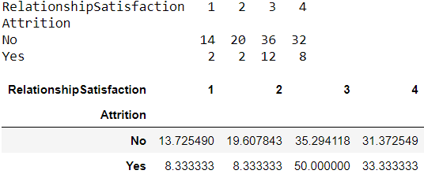
Comparison of Relationship Satisfaction in Sales,R&D and HR Departments with Attrition
Sales R&D HR

Slide 16
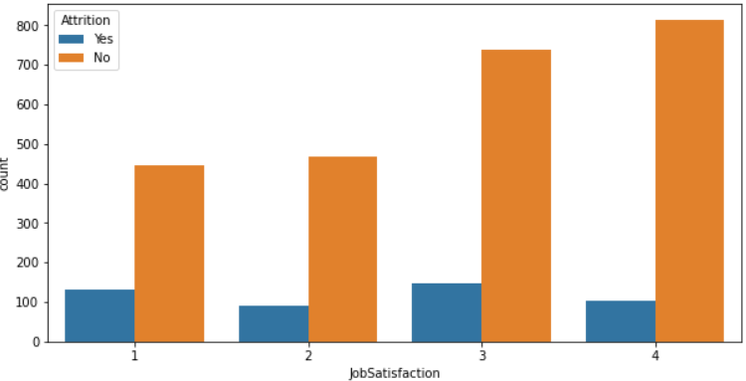




Comparison of Job Satisfaction in Sales,R&D and HR Departments with Attrition
Sales R&D HR

Slide 17


Relation between performance rating and monthly income Relation between Number of Companies Worked and age
Most of the employees have the performance rating of 3.
The monthly income of a huge number of employees lie between 2500 and 7500.
Number of Companies Worked and age have linear relationship.

Slide 18


Relation between job role and business travel

Slide 19



Relation between years at company and percent salary hike Relation between job satisfaction and gender
As the years at the company increases, the percentage salary hike slightly decreases

Slide 20




Relation between business travel and department Relation between business travel and gender
All the 3 departments have statistically equal business travel percentages.
Travel frequently and travel rarely percentage of women is slightly higher than men.
Non-travel percentage of men is higher than women.

Slide 21



Relation between work life balance and marital status Relation between years at company and monthly income
Years at company and monthly income have linear relationship.
As the years at company increases, the monthly income increases.

Slide 22


Relation between years at company and gender Relation between percent salary hike and performance rating
The percent salary hike is higher for employees with performance rating of 4

Slide 23




Random Forest Algorithm

Slide 24


AUC-ROC Curve Feature Importance

Slide 25
Thank You

