Slide 1
Elements of computing – 2 mathematics for computing - 2
- Y . LIKITHA REDDY
CB.SC.U4AIE24361

Slide 2
Fault Localization in Solar panels using YOLO models by Object detection
WITH YOLO V11

Slide 3
INTRODUCTION
Fault localization in solar panels is crucial for maintaining efficiency and reducing maintenance costs. It involves detecting and identifying faulty areas in solar panels to prevent energy loss. Traditional inspection methods are time-consuming and less accurate, making automation essential. YOLO (You Only Look Once) object detection, a deep learning model, provides a fast and accurate way to detect and locate faults in real-time. This project aims to develop an automated system using YOLO models to identify solar panel defects, enhancing reliability and performance while reducing manual inspection efforts.

Slide 4
YOLO V11 IMPLEMENTATION OVERVIEW
This presentation outlines the implementation of YOLOv11 for defect detection in solar panels . It covers dataset preparation , model training and result analysis.

Slide 5
Objective of the project
To detect and classify defects in solar panel images using YOLOv11. The objective is to achieve high accuracy and reliability in defect detection

Slide 6
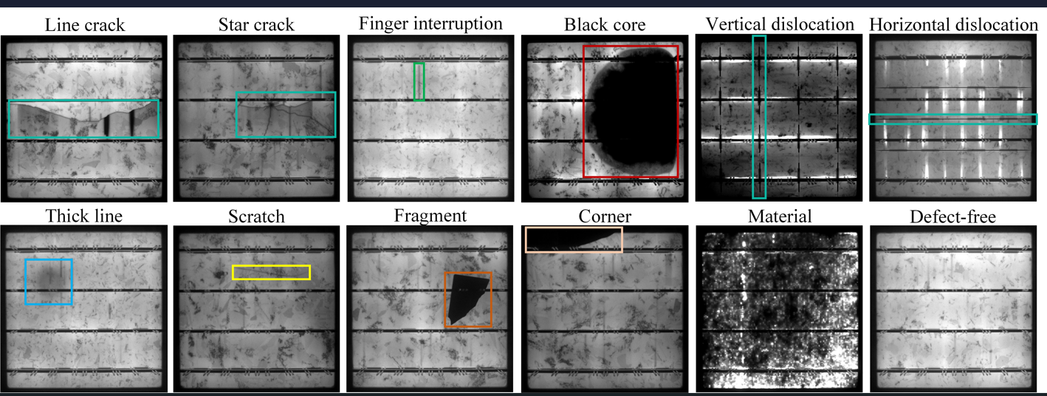
Dataset preparation - overview
Dataset consist of annotated solar panel images, organized into 12 defect classes

Slide 7
Data augmentation techniques
Augmentation techniques applied to balance dataset and improve model robustness
We perform some techniques like:
Random flipping (horizontal and vertical)
Brightness adjustment
Image resizing and normalization

Slide 8
Dataset splitting
Dataset split ratios:
Train : 70%
Validation : 20%
Test : 10%
Ensure all classes had a uniform distribution across splits

Slide 9
Yolo v11 configuration
YOLOv11 configuration details:
Number of classes (nc): 12
Input image size: 640x640
Optimizer: SGD
Learning rate: 0.01
Batch size: 16

Slide 10
Test results and performance metrics
Test results:
- Overall mAP : 81.01%
- High precision in detecting 'Crack' and 'Black Core'.
- Slight underperformance in 'Horizontal Dislocation'.

Slide 11
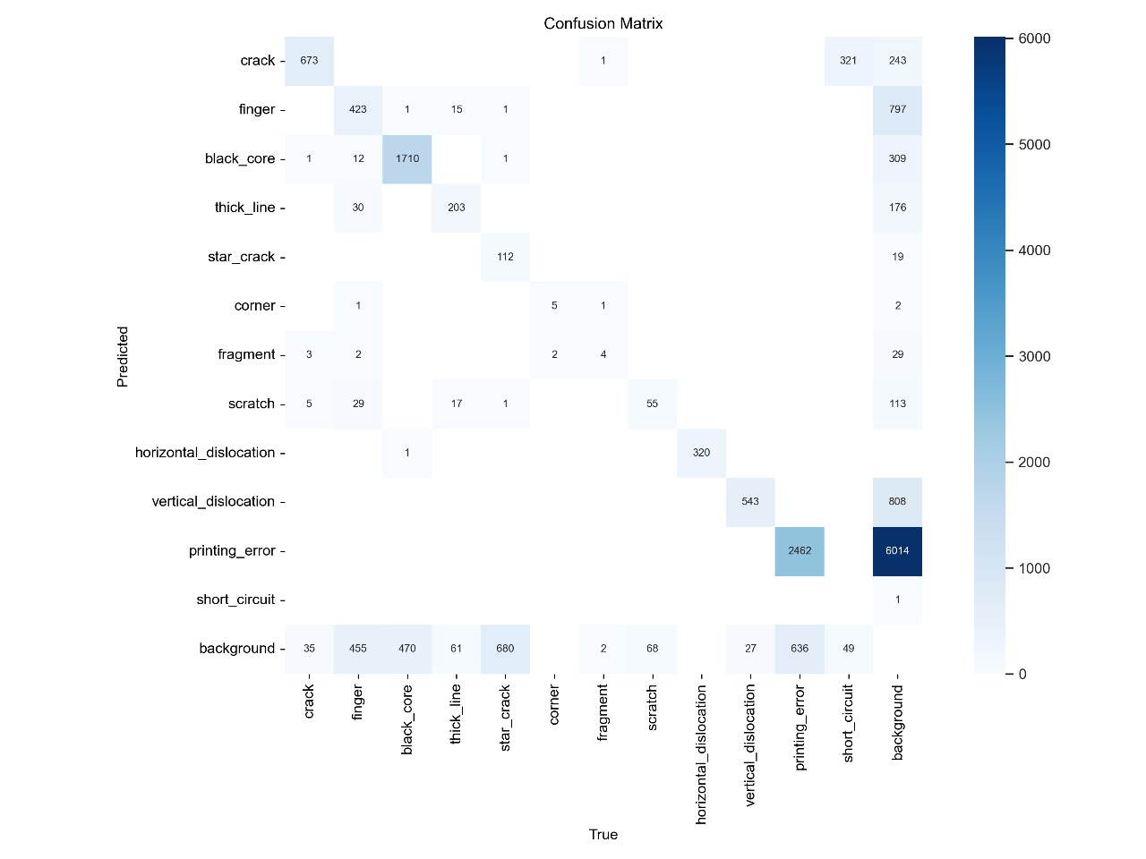

Slide 12
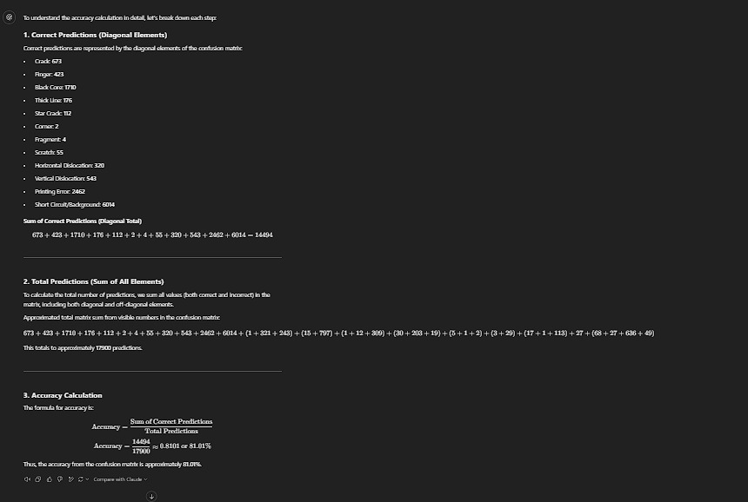

Slide 13
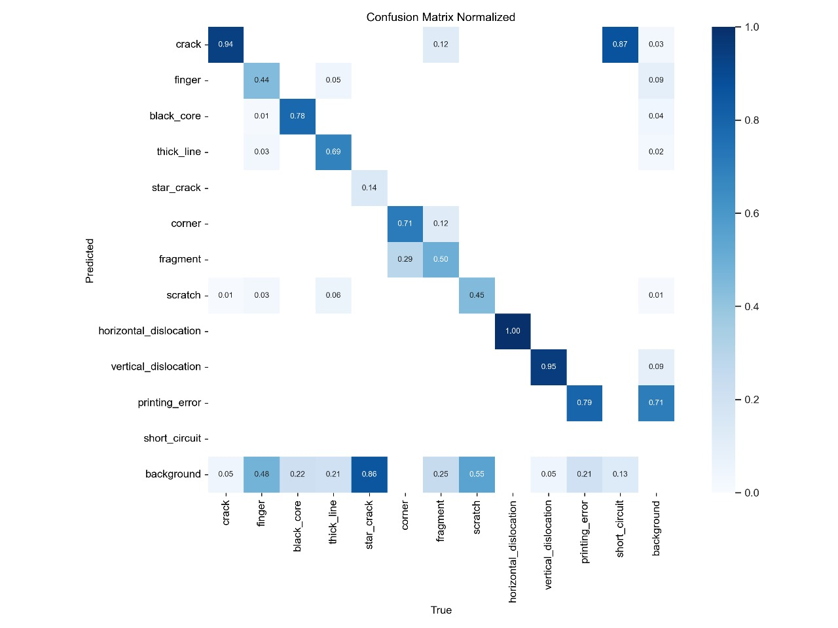

Slide 14
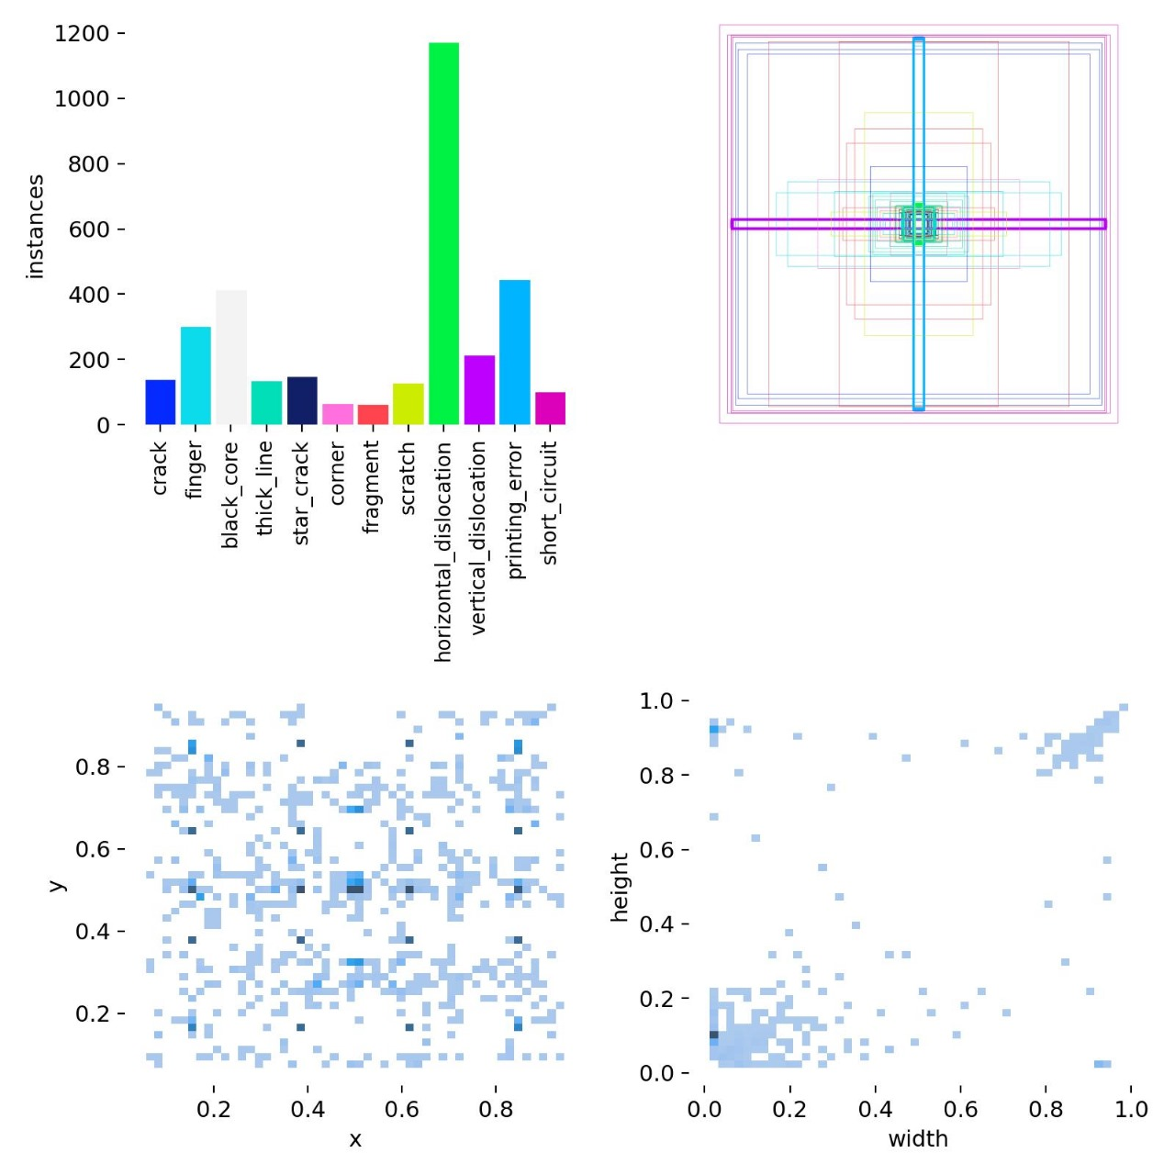

Slide 15
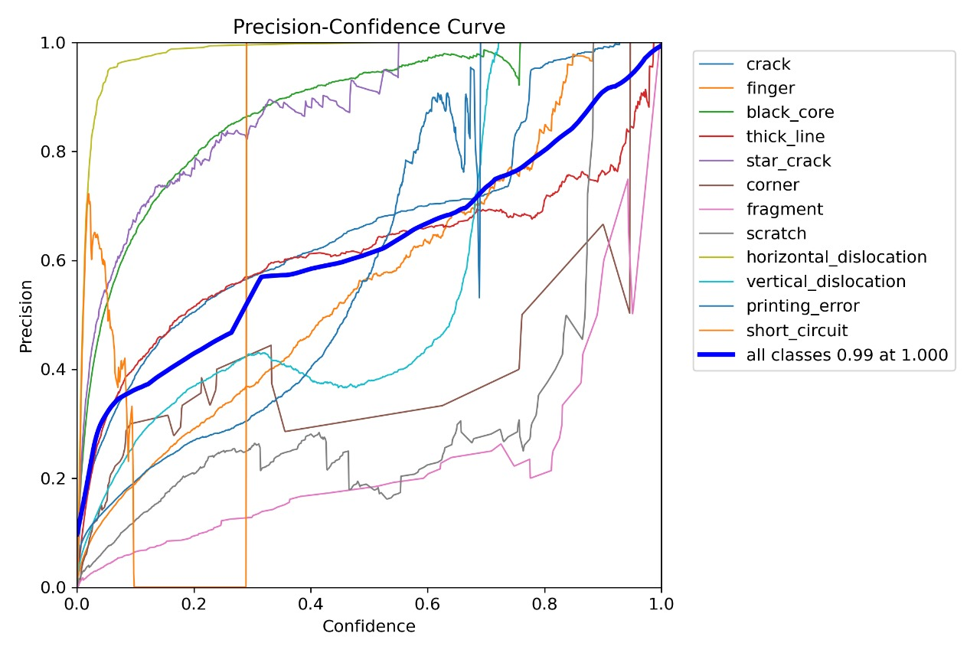

Slide 16
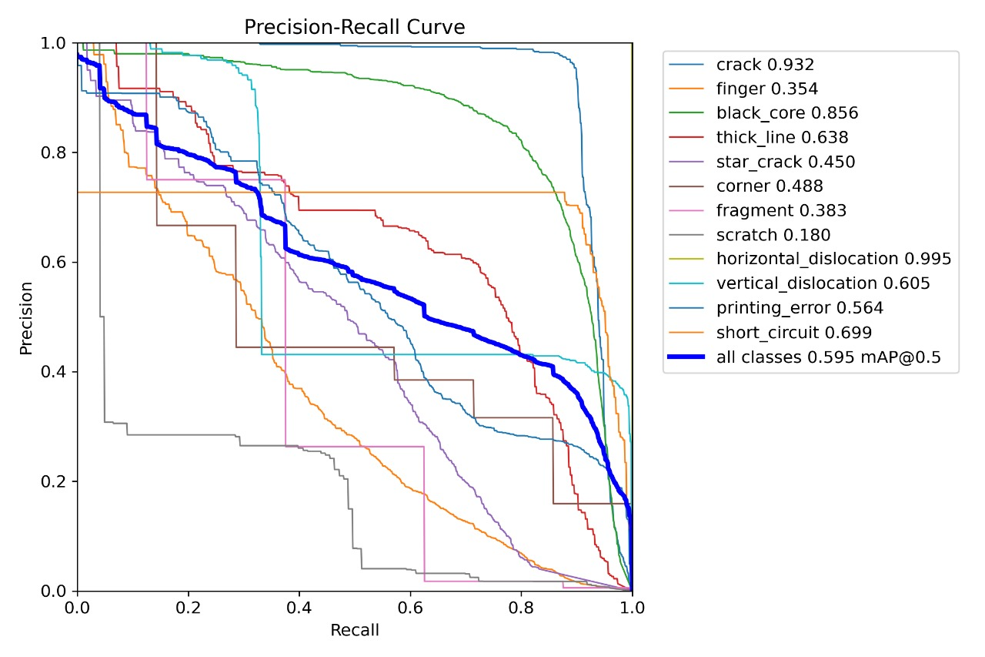
Validation accuracy is 59.5%

Slide 17
Challenges faced and solution
Challenges:
Imbalanced dataset
Annotation inconsistencies
Solutions:
Augmentation for balance
Manual correction of annotations

Slide 18
Conclusion and future work
Conclusion:
YOLOv11 proved effective for defect detection.
Future work includes:
Increasing dataset diversity.
Exploring real-time deployment.
Optimizing for edge devices.

Slide 19
Validation accuracy is 59.5%

