Slide 1
P. SREE LIKITHAA
  T8966.
TELECOM NETWORK PERFORMANCE AND OPERQATIONAL PLATFORM

Slide 2
  PROBLEM STATEMENT
  Telecom network operations generate large volumes of heterogenous data across tower infrastructure, network equipment, performance KPIs, alarm events, customer complaints, operational costs and RF compliance systems. These data sources often exist in silos and lack standardization, making it difficult to integrate, validate and analyze them collectively for end-to-end network visibility.
  The absence of centralized, analytics-ready data architecture limits effective KPI monitoring and decision-making. Without a unified data pipeline and curated data layer, stakeholders struggle to assess network reliability, service quality, operational efficiency and compliance risks in a timely manner, leading to reactive issue resolution and suboptimal resource utilization.

Slide 3
  TOOLS & TECHNOLOGY
Operation | Tools
Data Ingestion | Azure Data Factory
Storage | Azure Data Lake
Processing | Azure Databricks
Analytics | Azure Synapse Analytics
Visualization | Power BI

Slide 4
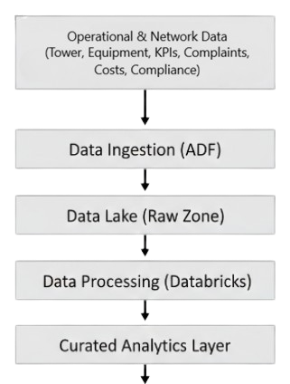

  FUNCTIONAL DIAGRAM

Slide 5
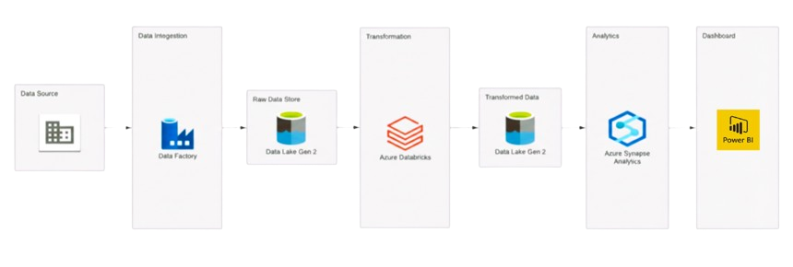
  ARCHITECTURE

Slide 6
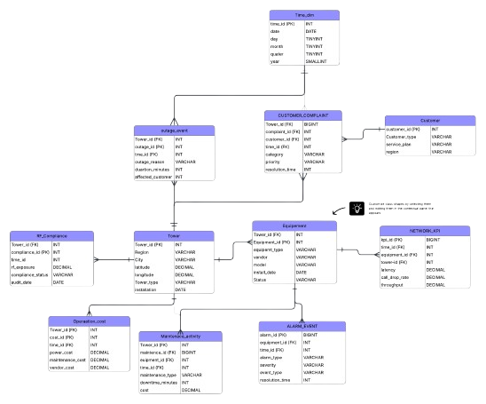
  SCHEMA

Slide 7
  DIMENSIONS TABLE
TOWER
tower_id (PK)
Region
City
Latitude
Longitude
Tower_type
Installation_date
EQUIPMENT
Equipment_id (PK)
Tower_id (FK)
Equipment_type
Vendor
Model
Install_date
Status
CUSTOMER
Customer_id (PK)
Customer_type (Enterprise/individual)
Service_plan
Region
TIME_DIM
Time_id (PK)
Date
Day
Month
Quarter
Year

Slide 8
  FACT TABLE
NETWORK_KPI
Kpi_id (PK)
Time_id (FK)
Eqipment_id (FK)
Tower_id (FK)
Latency
Call_drop_rate
Throughput
ALARM_EVENT
Alarm_id (PK)
Equipment_id (FK)
Time_id (FK)
Alarm_type
Severity
Event_time
Resolution_time
CUSTOMER_COMPLIANT
Compliant_id (PK)
Customer_id (FK)
Tower_id (FK)
Category
Priority
Resolution_time
OPERATIONAL_COST
Cost_id (PK)
Tower_id (FK)
Time_id (FK)
Power_cost
Maintenance_cost
Vendor_cost

Slide 9
  FACT TABLE
RF_COMPLIANCE
Compliance_id (PK)
Tower_id (FK)
Time_id (FK)
Rf_exposure
Compliance_status
Audit_date
MAINTENANCE_ACTIVITY
Maintenance_id (PK)
Equipment_id (FK)
Tower_id (FK)
Time_id (FK)
Maintenance_minutes
Downtime_minutes
Cost
OUTAGE_EVENT
Outage_id (PK)
Tower_id (FK)
Time_id (FK)
Outage_reason
Duration_minutes
Affected_customers

Slide 10
  KPI
Positive KPI
Network Availability Score
Customer Service Efficiency Index
Cost Efficiency Ratio
Negative KPI
Netork Degradation Index
Incident Frequency Rate
Compliance Risk Indicator

Slide 11
  THANK YOU

