Slide 1
MULTI-LABEL EMOTION DETECTION IN TEXT USING RoBERTa WITH IMBALANCE-AWARE OPTIMIZATION
PRESENTED BY :
NAMALA LAKSHMI PRASANNA(23BTRCL224)
I LEELA VYSHNAVI(23BTRCL103)
LIKITHA H(23BTRCL051)
KEERTHI KM(23BTRCL106)
JEEVAN M(23BTRCL194)
JAI BALAJI (23BTRCL104)
GUIDED BY : DR P RENUKADEVI
Assistant Professor / CSE- AIML

Slide 2
CONTENTS
ABSTRACT
INTRODUCTION
PROBLEM STATEMENT
EXISTING SYSTEM
BLOCK DIAGRAM
LITERATURE SURVEY
PROPOSED SYSTEM
BLOCK DIAGRAM
PROPOSED SYSTEM OVERVIEW
CONCLUSION
REFERENCE

Slide 3
ABSTRACT
Emotion detection in text has evolved into a multi-label classification problem, where a single sentence can express multiple emotions simultaneously.
This work proposes a transformer-based framework using RoBERTa-large for fine-grained emotion detection on the GoEmotions dataset (121K samples, 27 emotions + neutral).
To address class imbalance, the model uses Binary Cross-Entropy with class-balanced pos_weight, improving performance on minority emotions.
An adaptive threshold tuning approach is applied to optimize the Micro F1-score instead of using a fixed threshold.
The model is evaluated using F1-score, precision, and recall, demonstrating strong performance and scalability for real-world applications.

Slide 4
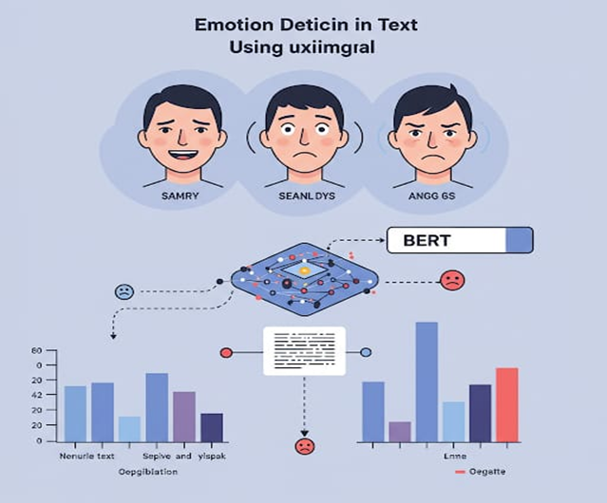
INTRODUCTION
Rapid growth of social media and online text has increased the need for emotion detection
Unlike sentiment analysis, emotion detection identifies multiple emotions such as joy, anger, sadness, etc.
Real-world text often expresses multiple emotions simultaneously, making it a multi-label classification problem
Traditional methods (lexicon-based, SVM, CNN) lack deep contextual understanding
Transformer models like RoBERTa capture rich semantic and contextual relationships
However, challenges like class imbalance and threshold selection still affect performance
This work focuses on building an imbalance-aware, transformer-based emotion detection system

Slide 5
PROBLEM STATEMENT
Existing systems mainly focus on single-label or basic sentiment classification, missing fine-grained emotions
Real-world text often contains multiple overlapping emotions, requiring multi-label classification
The GoEmotions dataset is highly imbalanced, where some emotions are frequent and others are rare
Traditional and basic deep learning models fail to handle context, imbalance, and label dependencies effectively
Using a fixed threshold (e.g., 0.5) leads to suboptimal prediction performance

Slide 6
EXISTING SYSTEM
Traditional emotion detection systems rely on rule-based approaches or shallow machine learning models like SVM and Naïve Bayes, which lack contextual understanding.
Many existing models fail to capture the nuances of human emotions due to limited contextual awareness.
Existing systems often struggle with multilingual text and informal language (e.g., social media posts).
Lack of real-time usability and user-friendly interfaces for non-technical users.
Limited scalability and computational efficiency in handling large datasets.

Slide 7
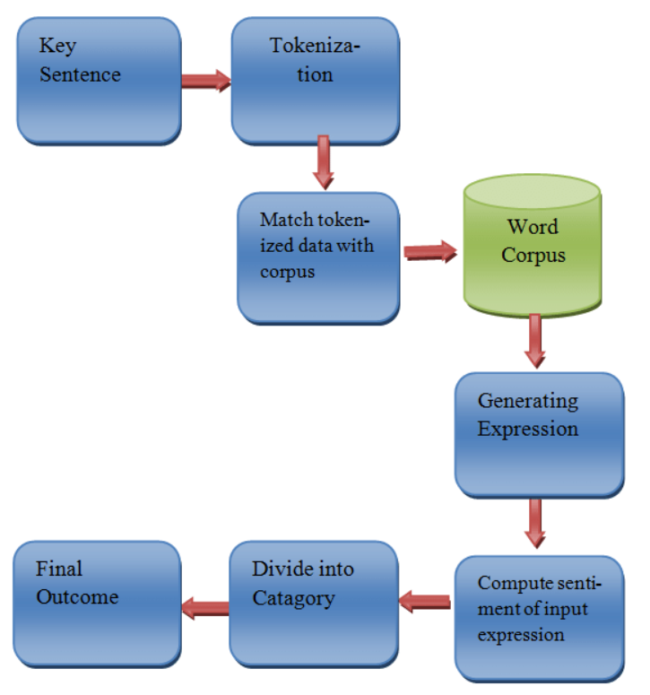
BLOCK DIAGRAM

Slide 8
LITERATURE SURVEY
PAPER | METHODOLOGY | DASET USED | EVALUATION METRICS
1. RoBERTa (Liu et al.) | Improved BERT with dynamic masking, no NSP, larger training | Large-scale text corpora (BookCorpus, Wikipedia, CC-News, etc.) | GLUE benchmark, accuracy, F1 (varies per task)
2. BERT (Devlin et al.) | Bidirectional Transformer pre-training (MLM + NSP) | BookCorpus + Wikipedia | Accuracy, F1-score, GLUE score
3. Demszky et al. (GoEmotions) | Emotion dataset creation + transformer evaluation | GoEmotions (58k Reddit comments, 28 emotions) | F1-score, Precision, Recall
4. Emotion-Aware RoBERTa | RoBERTa + Emotion-Specific Attention (ESA) + TF-IDF gating | Kaggle Emotion Dataset (~21,000 samples, 6 emotions) | Accuracy, Precision, Recall, F1-score, MCC, Confusion Matrix
5. GoEmotions Comparison Study | Logistic Regression (TF-IDF), BiLSTM + Attention, BERT | GoEmotions dataset (58k Reddit comments) | Micro-F1, Macro-F1, Hamming Loss, Subset Accuracy

Slide 9
PROPOSED SYSTEM
Developed a multi-label fine-grained emotion detection framework using RoBERTa-large to capture deep contextual relationships through transformer-based bidirectional self-attention.
The model is trained on the GoEmotions dataset (121,000 comments, 27 emotions + neutral) to improve generalization and robustness.
Unlike traditional BERT-based systems, this approach leverages a larger pre-trained model (RoBERTa-large) for enhanced semantic understanding and feature representation.
Adaptive threshold tuning (0.2 – 0.6 range) is applied to maximize Micro F1-score, instead of using a fixed threshold.
.

Slide 10
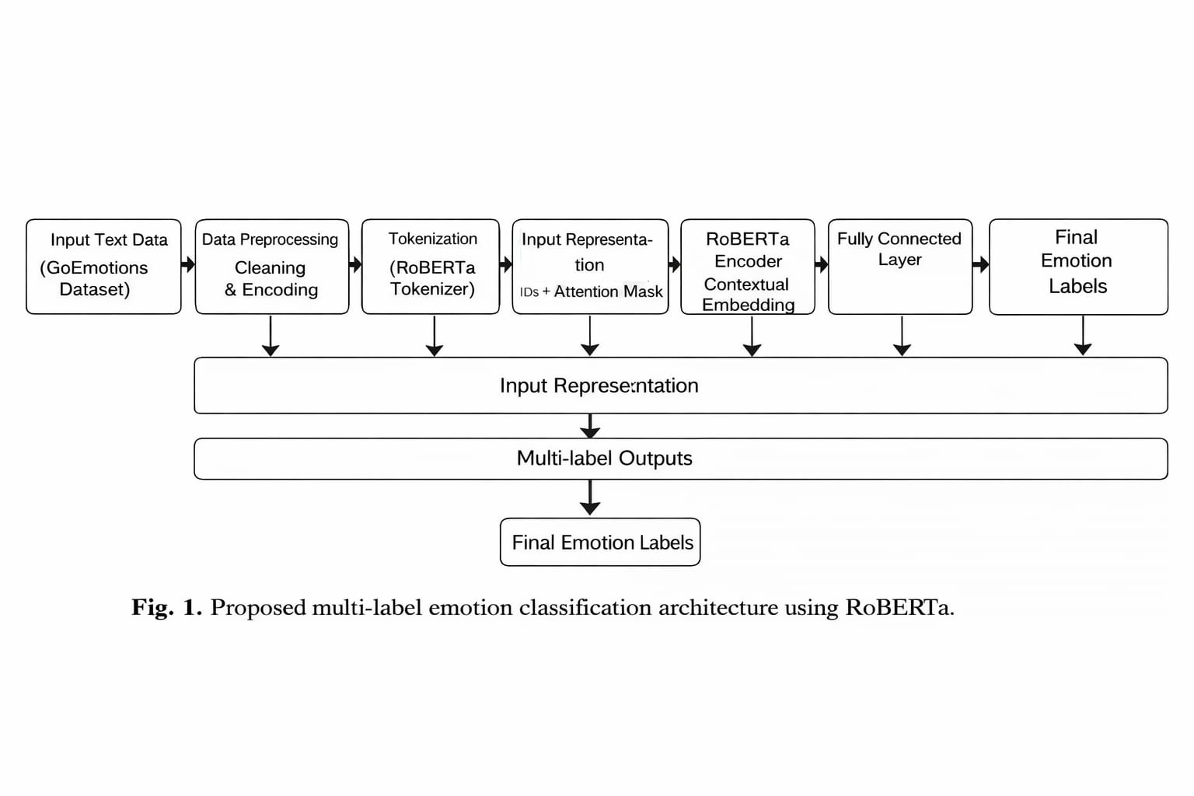
BLOCK DIAGRAM

Slide 11
PROPOSED SYSTEM OVERVIEW
We propose:
Transformer-based multi-label classification using RoBERTa-large
Imbalance-aware optimization using pos_weight (class balancing)
Dynamic threshold tuning for optimal F1-score
End-to-end training using HuggingFace Trainer
Scalable architecture for large datasets (121K samples)
Performance metrices:
Micro F1 Score
Macro F1 Score
Precision
Recall

Slide 12
PROCEDURE
Data Preprocessing
Dataset shuffled randomly for better generalization
Unnecessary columns removed
Labels converted into multi-label numerical format
2. Tokenization & Input Representation
Text tokenized using RoBERTa tokenizer
Converted into:
Input IDs
Attention Masks
Sequences padded/truncated to max length = 100
.

Slide 13
3. Model Architecture
RoBERTa-large transformer model
Outputs contextual embeddings
Final classification layer predicts multi-label probabilities
4. Loss Function & Imbalance Handling
Binary Cross-Entropy with Logits Loss
pos_weight applied for handling class imbalance
Improves learning for minority emotion classes
5. . Training Strategy
Training using HuggingFace Trainer API
Hyperparameters:
Learning rate: 2e-5
Batch size: 4
Epochs: 4
Mixed precision for faster training

Slide 14
6.Threshold Tuning & Prediction
Sigmoid applied to logits
Threshold varied from 0.2 to 0.6
Best threshold selected based on maximum Micro F1-score
Final multi-label predictions generated

Slide 15
CONCLUSION
Proposed a multi-label emotion detection system using RoBERTa-large for deep contextual understanding
Handled class imbalance using BCEWithLogitsLoss with pos_weight
Applied adaptive threshold tuning to improve Micro F1-score
Trained on full GoEmotions dataset (121K samples) for better performance
Achieved results in F1-score, precision, and recall
Demonstrated a scalable and efficient solution for real-world emotion detection

Slide 16
REFERENCES
Demszky, D., Movshovitz-Attias, D., Ko, J., Cowen, A., Nemade, G., & Ravi, S. (2020). GoEmotions: A Dataset of Fine-Grained Emotions. In Proceedings of the 58th Annual Meeting of the Association for Computational Linguistics (ACL), 4040–4054. 🔗 https://aclanthology.org/2020.acl-main.372/
Devlin, J., Chang, M.-W., Lee, K., & Toutanova, K. (2019). BERT: Pre-training of Deep Bidirectional Transformers for Language Understanding. In Proceedings of NAACL-HLT. 🔗 https://arxiv.org/abs/1810.04805
Harutyunyan, A. & Kumar, S. (2026). Fine-Grained Emotion Detection on GoEmotions: Experimental Comparison of Classical ML, BiLSTM, and Transformer Models. arXiv:2601.18162. 🔗 https://arxiv.org/abs/2601.18162
Sitoula, R. S., Pramanik, M., & Panigrahi, R. (2024). Fine-Grained Classification for Emotion Detection Using Advanced Neural Models and GoEmotions Dataset. Journal of Soft Computing and Data Mining, Vol. 5(2). 🔗 https://publisher.uthm.edu.my/ojs/index.php/jscdm/article/view/17843

Slide 17
THANK YOU

