Slide 1
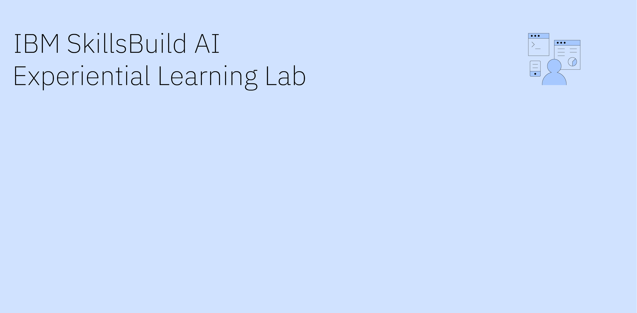
Solution Design
Bridge
The thirty days after a patient leaves hospital
Team Name: FDU AI Experiential Learning Lab team
Team Leader: Likitha Seepelly

Slide 2
How to Use This Guide
Purpose: This guide offers a template for teams to capture essential information. It aims to help you move from week to week, completing essential exercises to deliver an innovative, user-centric solution at the end of week 10.
Important Notes:
!! Each slide has an indication of by when we recommend that you complete these assignments – however, you are free to advance or delay work according to your schedule.
!! Teams are expected to organized themselves, share tasks, find time to meet and complete the assignments and exercises.
!! Your hard deadline is the end of week 10 – by then, your team must submit a functioning MVP, project documentation and solution demonstration.
!! Submit your weekly deliverables in the forms: https://wkf.ms/4sDluV8
Tips:
✅ Keep language user-focused, avoid technical jargon, and write in short, clear sentences.
✅ Use images and illustrations – one image says more than 1000 words. Copy here images of your boards, designs, etc. or use illustrative images.
✅ Customize according to your needs – feel free to change or adapt the templates.

Slide 3
FDU AI Experiential Learning Lab team
Fairleigh Dickinson University
Track 1, Smart Healthcare
Likitha Seepelly
Team Lead
—
likithaseepelly02@gmail.com
Sriram Gurram
Communications Lead
—
s.gurram@student.fdu.edu
Gyana Lakshmi Priyanka Ede
Technical Lead
—
g.ede@student.fdu.edu
Tulasi Nama
Solution Designer
—
t.nama@student.fdu.edu
Kusuma Phani Sree Karri
Research Lead
—
k.karri@student.fdu.edu

Slide 4
Opportunity Framing
From industry problem to user-centered opportunity
What we did first
Empathy map for the transitional care nurse, built from published accounts of care transitions work and from the discharge instructions patients are actually given.
As-is scenario map of the thirty days after discharge, step by step, with the point at which each step fails.
Stakeholder map covering the nurse, the patient, the family caregiver, the discharging physician, primary care, the community pharmacist and the hospital quality team.
Desk research across published readmission rates, CMS follow up data and a review of medication errors after discharge.
No patient was interviewed and no real record was used at any point. Every figure in this deck is from public sources, and every patient in the system we built is synthetic.

Slide 5
Industry Problem Context
Purpose: Define the industry-level challenge and why it matters
When: By week 1
What we used
Industry Problem Statements, Track 1 Smart Healthcare.
Published readmission and follow up statistics.
Empathy map and as-is scenario built by the team.
Industry challenge statement
Why this problem matters
Track 1, Smart Healthcare. How might we use agentic AI to expand access to healthcare services and improve patient care?
We took the thirty days after a patient leaves hospital.
Hospitals manage the stay, and they manage the follow up visit. The four weeks in between belong to nobody. Readmission risk is scored on the day the patient leaves and is never recalculated.
Impact and urgency
Thirty day readmissions sit near 13.9 per 100 index admissions.
Only 57.5 percent of Medicare patients discharged home received primary care follow up within thirty days in 2022.
A review of 54 studies found a median medication error rate of 53 percent after discharge.
Economic and operational consequences
Avoidable readmissions carry direct cost and, under CMS readmission penalties, lost reimbursement. One transitional care nurse can carry eighty patients at once and reach most of them only once.
Strategic relevance
Value based care ties payment to what happens after the patient goes home, which is exactly the window nobody is watching.
Who is under pressure to solve it
Hospitals facing readmission penalties, payers carrying the cost, and the transitional care teams asked to cover a caseload they cannot physically call.

Slide 6
Who Is Experiencing the Problem?
Purpose: Identify the people most affected.
When: By week 1
Primary user
User environment
Secondary stakeholders
The transitional care nurse.
An experienced registered nurse, usually with years on a ward before this role. She is not at the bedside any more.
She sits with a list of everyone discharged in the last thirty days, often around eighty people, and decides who to call today.
She is held accountable for readmissions she currently has no way of seeing coming.
An office, not a ward. A desk, a telephone and a screen.
Tools and systems in use today
The electronic health record, the discharge summary, a spreadsheet or worklist of recent discharges, and the telephone.
The work is a call list. Calls are made in discharge date order, most reach voicemail, and nothing in the system changes when a patient does not answer.
The patient, recovering at home and unsure what counts as serious.
The family caregiver, who often answers the phone and notices the change first.
The discharging physician and the primary care practice, who inherit the patient.
The community pharmacist, who can see whether the prescription was ever collected.
The hospital quality and readmissions team, measured on the outcome.
The payer, carrying the cost of an avoidable admission.
What we used
Empathy map for the transitional care nurse.
Stakeholder map across seven roles.
Desk research only. No patient was interviewed and no real record was used.

Slide 7
Core User Tension
Purpose: Capture the heart of the opportunity
When: By week 1
What we used
Empathy map
As-is scenario
How we checked it
Mapped the journey step by step and marked where each step fails, then tested the map against published follow up and medication error data rather than against our own assumptions.
User goal
Get to the patients who are deteriorating before they end up back in the emergency department.
Current User Experience
As-Is Snapshot
Map the existing journey and key steps users take now
Trigger
Discharge day. New medicines, an appointment, and fifteen minutes of teaching at the bedside.
Days 1 to 3
The prescription may or may not be collected. Nobody checks.
Day 4
One callback attempt. It usually reaches voicemail. There is no second.
Days 5 to 20
Symptoms drift. Nobody is watching, and the patient is unsure it is serious.
Day 21
The patient or their family finally decides it is bad enough to act.
Ends here
The emergency department. The team learns only now, as a readmission.
Key pains / frustrations
Max 3
1. She cannot tell who is deteriorating. Risk was scored at discharge and never updated.
2. One callback attempt per patient, mostly voicemail, and silence looks exactly the same as being fine.
3. She finds out it went wrong when the patient comes back through the emergency department.
Ordered by date, not by risk
The list she opens each morning is sorted by when people left hospital, so the patient deteriorating today can sit at position thirty.
Silence reads as safety
A patient who has stopped answering is indistinguishable from a patient who is doing well. Nothing in the process treats the gap as information.
Where friction occurs
Days 1 to 3, nobody confirms the prescription was collected.
Day 4, the single callback reaches voicemail and is not retried.
Days 5 to 20, symptoms drift with nobody watching.
Throughout, the worklist is ordered by discharge date rather than by what has changed.

Slide 8
Why Current Solutions Fail
Purpose: Understand gaps in existing tools/processes
When: By Week 1/2
Key insight, why the problem exists
The information that would tell you a patient is sliding arrives in ordinary words, in small pieces, over weeks, from people who are not clinicians. It is unstructured, scattered across phone calls, pharmacy systems and the patient's own memory, and no single piece is alarming enough to raise a flag on its own.
More automation does not solve it, because the task is not sending more messages. A better dashboard does not solve it either, because the problem is not display. The problem is that nothing reads the replies and re-decides who matters today.
That is what makes this an agentic problem rather than an interface problem: it needs something that interprets, re-ranks and escalates every day, not a faster way to dial.
Existing tools and processes used today
Telephone callback lists run by transitional care teams.
Automated SMS and interactive voice outreach platforms.
Risk scores calculated at discharge, such as LACE and HOSPITAL.
Remote patient monitoring using connected devices.
Patient portals and post discharge surveys.
What they do well
Outreach platforms reach the whole cohort cheaply and reliably. Risk scores are quick, need no patient effort and are easy to act on at scale. Remote monitoring gives genuinely objective data for the patients who have it.
Where they break down
Outreach platforms send and store. Nothing reads the reply, so the next message goes out regardless of what the patient said yesterday.
Risk scores are a single number produced once, on the day of discharge, and never recalculated. They cannot tell the nurse why.
Remote monitoring needs a device, a setup and a willing patient, so it reaches a selected few.
Portals and surveys require the patient to come looking, which the patients most at risk do not do.
None of them treat silence as information.
What we used
Empathy map, as-is scenario, and a review of the five approaches in use today.
The question we kept asking: would more automation fix this? For every tool above, the answer was no.

Slide 9
Early AI Opportunity Hypothesis
Purpose: Understand opportunities to offer better solutions (No solution design yet)
When: By Week 1/2
Why Agentic AI?
What the system would understand better
Everyday wording. More out of breath getting dressed than I was last week is a comparison, not a keyword, and it only means something against what that patient said before.
What decisions could be improved
Who to call today. That decision has to be remade every day against each patient's own baseline, not once against a population average.
What coordination could be simplified
The loop itself. Ask, read, update the plan, escalate or wait, then re-rank the whole cohort. Every day, for everyone, without a person running it.
High-level hypothesis
An intelligent system could help transitional care nurses by reading what patients and their families actually say and re-deciding each morning who needs a call, because today risk is scored once at discharge and never recalculated, and one missed callback leaves a deteriorating patient invisible until they return through the emergency department.
An intelligent system could help patients and family caregivers by turning the thirty days after discharge into a short conversation that somebody is actually listening to, because today the only way to be heard is to decide for yourself that it has become bad enough to call.
What we used
Big idea vignettes
As-is scenario
No features, no tools and no architecture at this stage. That came in weeks 4 and 5.

Slide 10
✅ Checkpoint: Week 2
Checkpoint met
The problem is specific and human-centered: one nurse, eighty patients, one callback each.
The user and the current experience are mapped end to end.
The pain points are solvable and non-obvious: silence reading as safety is the one most systems miss.
The opportunity for agentic AI is clear, because the task is interpretation and daily re-decision, not sending.
At this stage, you should have a clear picture of the problem, the people affected, and why current solutions fail —without jumping into solution design.
The problem is specific and human-centered (experienced by real people)
The user and user experience is clear
The pain-points are solvable and non-obvious
There is a clear and valuable opportunity for Agentic AI to offer a better solution and experience
Open Questions & Assumptions
What we don't know yet
1. Will patients and caregivers keep replying to a short daily check in for thirty days, or does response fall away after the first week?
2. How many of the signals that matter arrive from a relative rather than from the patient?
3. What false positive rate will a nurse tolerate before she stops trusting the list?
4. Does reading a reply catch deterioration meaningfully earlier than the existing callback, and by how much?
Assumptions we are making
That the discharge record is structured enough to become a plan the system can track.
That a patient or their caregiver can answer a one question message in seconds.
That a nurse will act on a ranked list if every position carries a reason she can check.
That silence correlates with risk rather than simply with being busy and well.
Validation research
1. Run the loop against a seeded synthetic cohort where we know which patients deteriorate and when, and measure how many surface and how quickly.
2. Measure false positives explicitly, separating unexplained entries from entries that had a real reason.
3. Test interpretation against deliberately hard replies: misspellings, hedging, a caregiver's voice, and a reassuring opening with a worrying detail at the end.
4. Inject agent failures and confirm the affected patient is raised rather than silently skipped.
Status: all four were carried out. Results are on the week 5 checkpoint.

Slide 11
User-Centric Solution
From opportunity to concept – addressing user pain-points
What we did first
Ideation across the team, then clustering into three candidate directions: a smarter outreach schedule, a nurse facing risk dashboard, and a system that reads replies and re-ranks the cohort every day.
We chose the third. It was the only one that changes the decision the nurse makes, rather than the speed at which she makes the decision she already makes.

Slide 12
Target Core User
Purpose: Ensure that your solution is user-centered and solves real user problems
When: By Week 3
What we used
User persona
Note
Maria is a composite persona drawn from published accounts of care transitions work. She is not a real person, and no patient or staff data was used anywhere in this project.
Targeted User Persona
Illustrative persona.
Not a real person.
No patient or staff data was used
anywhere in this project.
Short Bio
Maria spent fourteen years on a medical ward before moving into care transitions. She took the role because she was tired of seeing the same patients come back.
She is responsible for every patient discharged in the last thirty days, usually around eighty people. Her day is a call list. She works down it in discharge date order and gets through perhaps fifteen calls, most of which reach voicemail.
She is fluent in the electronic health record and in spreadsheets. She has no interest in learning a new system and no time to configure one.
She is measured on thirty day readmissions, an outcome she is accountable for but cannot currently see coming.
Goals & Motivations
Reach the patients who are deteriorating while there is still time to act.
Spend her limited calls on the people who need them.
Be able to justify every call she makes, and every one she does not.
Bring the readmission number down for reasons she can point to.
Frustrations & Pain Points
A worklist ordered by discharge date, which tells her nothing about who is getting worse.
Voicemail. One attempt per patient, and nothing that notices the call was never returned.
Risk scores that give her a number and no reason.
Finding out through an emergency department admission.
The fear of missing someone. She would rather have five names with reasons than eighty names without.
Maria Alvarez, RN
Transitional Care Nurse
47, registered nurse, 19 years in practice.
Bachelor of Science in Nursing.
Care transitions team, 400 bed community hospital.
Office based, Monday to Friday.
Ideal Experience / Must Have
Open one screen each morning and see who needs her today, in order, with the reason written beside each name.
Be able to check that reason. She will not act on a score she cannot interrogate.
Keep control of anything that reaches a patient.
Never be told a patient is fine. She wants to be told who has changed.
Nothing new to learn and nothing to configure.
Skills & Capabilities
Strong
Clinical judgement, triage, patient communication, documentation, electronic health record and spreadsheet fluency.
Limited
No data science or AI background, and no appetite for probabilities or model confidence as an interface.
The gap this solution must cover
She cannot read eighty conversations a day, and she has no way to compare a patient against that same patient's earlier replies.
So the system does the reading and the comparing, and presents the result as a sentence with an evidence trail, never as a score.

Slide 13
Solution Concept (Part 2)
Purpose: Understand what your solution will do and how it will solve the user pain-points
When: By Week 3
What we used
Big idea vignettes
To-be scenario
How we chose
Three directions went into clustering. We kept the one that changes the decision the nurse makes, and dropped the two that only change how fast she makes the decision she already makes.
Idea Cluster Play Back
Top ideas the team chose to pursue
1. Turn the discharge record into a plan the system actively tracks, rather than a document nobody opens again.
2. Check in daily in short plain language, timed to that plan, answerable in seconds by the patient or a relative.
3. Read every reply, join it with whether the prescription was collected and the appointment booked, and re-rank the whole cohort each cycle against each patient's own baseline.
4. Escalate immediately on emergency wording, after one clarifying question on persistent ambiguity, and on silence beyond the plan limit.
5. Give the nurse five names a day, each with a one sentence reason and a traceable evidence trail.
Ideas we deliberately dropped
A patient facing symptom checker, because it puts the clinical judgement on the patient.
A risk score dashboard, because a number without a reason is what already fails.
A wearable integration, because it narrows the solution to the patients who have a device.
Early Concept (Low Fidelity Prototype)
The nurse opens one screen each morning.
Five names. Not in discharge date order. In order of what has changed.
Beside each name, one sentence. Reported weight up four pounds since Monday, which is worse than their own previous reply. No reply for four days and the prescription is still uncollected.
Next to each, an Evidence button that opens what was asked, what came back, what the plan expected, and what changed.
Two filters: open cases, and patients who have gone quiet.
One approval queue. Nothing reaches a patient until she approves it.
A banner whenever any part of the system failed, naming who was affected, so a degraded list never looks like a clean one.
Value Proposition & AI Justification
Outreach platforms already send messages. The value is not in the sending. It is in reading the answer and letting it change the order of the list.
This stays valuable even as the technology improves, because the hard parts are the loop, the per patient baseline, the evidence trail and the safety rules, none of which a better model removes. A better model makes the reading better. It does not make the loop unnecessary.

Slide 14
Innovation Intent
Purpose: Explain why this solution is different
When: By Week 3
What we used
Big idea vignettes
To-be scenario
The test we applied
Would this still be worth building if the language model got twice as good? Yes, because the loop, the per patient baseline, the evidence trail and the safety rules are the hard parts, and a better model does not remove any of them.
User goal
Get to the patients who are deteriorating before they end up back in the emergency department.
Proposed transformation
Today the nurse works a list ordered by the date people left hospital, calls about fifteen of eighty, and learns something went wrong when the patient returns through the emergency department.
With Bridge the thirty days become a tracked plan and a short daily conversation. Every reply is read and compared against what that same patient said before, and the cohort is re-ranked every cycle.
Her job does not change. What changes is the quality of the decision she makes at the start of each day.
Trigger
Discharge day. The record becomes a plan the system actively tracks.
Every day
A short check in, timed to the plan, answerable in seconds by patient or relative.
Every reply
Read, not just stored. Joined with prescription and appointment status.
Every cycle
The cohort is re-ranked on change against each patient's own baseline.
At any point
Emergency wording leaves the cycle at once. Silence opens a case.
Ends here
Five names each morning, each with a reason and the evidence behind it.
Why this solution
Outreach platforms send and store. Bridge reads the reply, and the reply reorders the list.
Risk scores are set once at discharge and expressed as a number. Bridge recalculates every cycle and states its reason in a sentence a nurse can act on.
Remote monitoring needs a device and reaches a selected few. Bridge needs none and covers the whole discharged cohort.
The core value of the AI
Interpretation and re-decision, not generation. It reads ordinary human wording, compares it with that patient's own history, and changes a priority order. That is beyond prompting and beyond automation, because there is no fixed rule to automate.
What makes this innovative
New workflow.
The thirty day window becomes a daily loop instead of a single callback.
New decision logic.
Ranking on change against each patient's own baseline, not a population score.
New coordination model.
Seven agents in one cycle, with escalation running independently of ranking so a safety case can never be out-prioritised.
New use of data.
Silence and an uncollected prescription are treated as signals, not as missing data.
New level of autonomy, bounded.
The system decides the order and raises the cases. The nurse decides every action, and nothing reaches a patient without approval.

Slide 15
✅ Checkpoint: Week 3
Checkpoint met
The concept is clear: read the reply, re-rank the cohort, give the nurse five names with reasons.
It is different from what exists: outreach platforms do not read, risk scores do not recalculate, and monitoring needs a device.
At this stage, you should have a clear picture of what your solution will look like – this is your first solution design.
Is the concept clear?
Is this solution different/innovative compared to what is already in the market?
Open Questions & Assumptions
What we don't know yet
1. Whether five names a day is right, or whether a nurse would want a longer list on quiet days.
2. How the ranking behaves on a cohort much larger than sixty.
3. Whether a caregiver replying on the patient's behalf should be weighted differently from the patient replying.
4. What should happen at the boundary of the thirty day window when a patient is still unwell on day thirty.
Assumptions we are making
That a one sentence reason plus an evidence trail is enough for a nurse to act without opening the full record.
That nurse approval on every outbound message is workable at this caseload rather than a bottleneck.
That heart failure, COPD and type 2 diabetes are representative enough to prove the approach generalises.
Validation research
1. Build the end to end loop and run it against a seeded cohort before adding any polish.
2. Measure detection rate, cycles to detection and false positives separately, so a good headline number cannot hide a bad one.
3. Stress the interpretation agent with deliberately hard replies.
4. Have a second condition added by a different team member, to see whether the design holds when the domain widens.
Status: all four carried out in weeks 4 to 8. Item 4 found a real cross component defect, recorded on the week 5 checkpoint.

Slide 16
Solution Blueprint
From idea to reality – building strong AI solutions

Slide 17
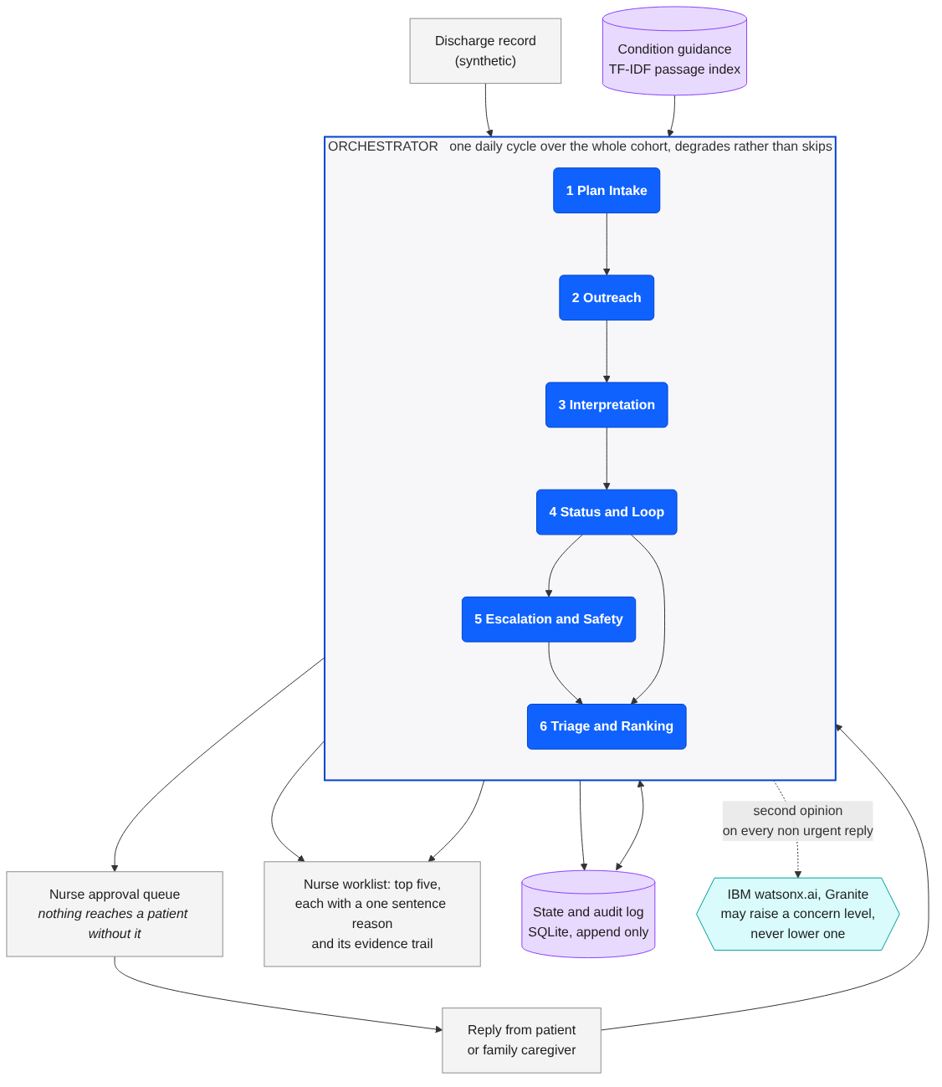
AI Agent Architecture
Purpose: Show the structural design of your agent – what major components it consists of and how they connect.
When: By week 4-5
What we used
IBM Bob IDE
IBM watsonx.ai, Granite
How to read the diagram
Blue boxes are agents. Purple cylinders are stores. The teal hexagon is IBM watsonx.ai. Everything inside the outlined box runs within one daily cycle.
Agent Overview
Bridge answers one question every morning: which patients need a nurse today, and why.
A multiple agent solution.
Seven agents run inside one daily cycle, in a fixed order. On any agent failure the orchestrator raises the affected patient to the nurse and marks the list degraded, rather than skipping them.
Architecture Diagram
Why this architecture?
Escalation is a separate agent from ranking and runs first, so a safety case can never be out-prioritised by a scoring decision. It also cannot close a case, and a test fails if that method ever appears in its source.
Interpretation is separate from status, so reading a reply and deciding what it means for the plan are distinct steps with distinct evidence.
State and the audit log are append only, so every ranked position traces back to the replies and plan steps that produced it.
watsonx.ai sits beside interpretation rather than inside the loop, so the cycle still completes if it is unavailable.

Slide 18
The seven agents
Purpose: who does what inside one daily cycle, and what each one decides
When: By week 4-5
What we used
IBM Bob IDE, one task per component
The rule the split exists to protect
Escalation is a separate agent from ranking and runs before it, so a safety case can never be out-prioritised by a scoring decision. It also cannot close a case: a test fails if that method ever appears in its source.
One cycle, seven responsibilities
Each agent has one job and its own evidence. Each was taken through IBM Bob as its own task.
Agent | Responsibility | Key decisions
1 Plan Intake | Turns the discharge record into a plan with steps, dates and limits | What the plan expects, and by when
2 Outreach | Composes one check in for one patient on one day | Is a check in due; patient or caregiver wording
3 Interpretation | Reads a free text reply and returns step status, concern level, ambiguity, confidence and the phrases used | Concern level; is this ambiguous; what changed
4 Status and Loop | Joins replies with plan steps and keeps the cycle moving | Is a step done, overdue or unknown
5 Escalation and Safety | Opens cases on urgent wording, persistent ambiguity and silence | Open a case now, or keep waiting. It can never close one.
6 Triage and Ranking | Orders the cohort each cycle on change against each patient's own baseline | Who is in the top five, and the reason beside them
7 Orchestrator | Runs one cycle over the whole cohort and degrades rather than skips | Run order; what happens when an agent fails

Slide 19
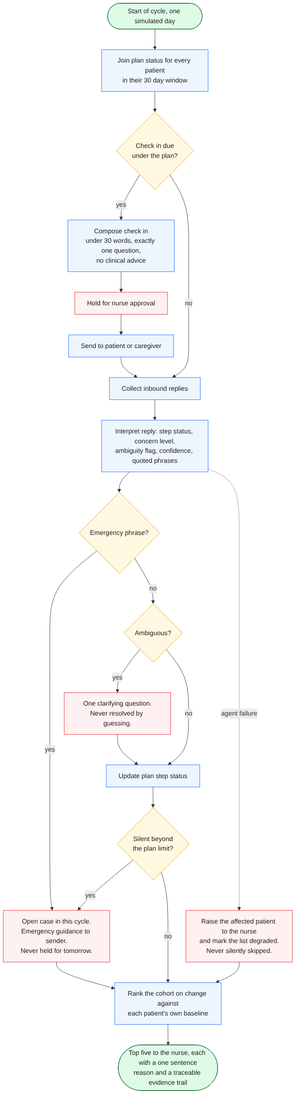
AI Agent Workflow
Purpose: Show the dynamic process your agent follows to achieve its goals — step by step.
When: By week 4-5
What we used
IBM Bob IDE
IBM watsonx.ai, Granite
Where the loop can branch
Emergency wording leaves the cycle immediately. Ambiguity gets one clarifying question and is never resolved by guessing. Silence beyond the plan limit opens a case. An agent failure raises the patient and marks the list degraded.
Workflow Description
One cycle is one day. Plan status is joined for every patient inside their thirty day window, check ins go out where the plan is due, inbound replies are collected and interpreted, escalation runs, and then the whole cohort is ranked.
Decision points
Is a check in due under this patient's plan?
Does the reply contain emergency wording? If so it leaves the cycle immediately.
Is the reply ambiguous? If so, one clarifying question. The ambiguity is never resolved by guessing.
Has the patient been silent beyond the plan limit? Silence opens a case. It is never read as reassurance.
Is this reply worse than this patient's own previous reply? That comparison drives the ranking, not an absolute threshold.
Human in the loop moments
Every outbound message waits in an approval queue. Nothing reaches a patient without the nurse.
Every escalation produces a case for a human. The system never closes one.
The system never states that a patient is safe. It ranks, and it raises.
Failure strategy
If an agent fails, the affected patient is raised to the nurse and the list is marked degraded, naming who was affected. A degraded list never looks like a clean one.
If data is missing, the step is recorded as unknown rather than assumed complete.
If watsonx.ai is unreachable, interpretation falls back to the rule engine and the cycle still completes.
Workflow Diagram

Slide 20
Tools & Integrations
Purpose: List the external systems your agent uses — APIs, data sources, models, or libraries.
When: By week 4-5
What we used
IBM Bob IDE
IBM watsonx.ai, Granite
Why so few tools
Python standard library only, with no third party packages, so the prototype clones and runs with one command and any evaluator can reproduce our published numbers without credentials.
Tools List & Purpose
Tool / Service | Used for | Integration type | Executed by agents, or verified by a human
IBM Bob IDE | Development environment. Six tasks, one per component, on the provisioned ibm-skillsbuild-ell instance | Bob IDE v2, Enterprise plan | Human directed. Session summaries committed to bob_sessions
IBM watsonx.ai, Granite | Second opinion on every non urgent reply. May raise a concern level, never lower one | REST, text generation, ibm/granite-4-h-small | Invoked by the interpretation agent. Falls back to rules on any error
Python 3 standard library | All seven agents, the cycle, the evaluation harness | In process | Invoked by the orchestrator
SQLite | Plan, messages, replies, interpretations, cases, rankings and an append only audit log | Local file, standard library | Written by agents, readable for the evidence trail
TF-IDF passage index | Grounding every warning sign in the condition guidance passage it came from | In process, built from knowledge/ | Invoked by the interpretation agent
Standard library HTTP server | The nurse worklist, approval queue, evidence trail and audit log | Local HTTP on port 8000 | Read and acted on by the nurse. Every send is a human approval
Notes on Constraints
No third party packages anywhere. The prototype clones and runs with one command on Python 3.9 or later, which is what makes the published evaluation reproducible by any evaluator.
watsonx.ai is optional by design. With credentials it adds roughly 550 calls over a thirty day run and about eight minutes. Without them the system runs on its rule engine and the headline numbers still reproduce.
Model availability changes. ibm/granite-3-8b-instruct was retired from us-south during the build, so scripts/check_watsonx.py verifies the connection and lists what the region actually serves.
Bobcoins are a shared team budget of 40. Six tasks consumed about 5.5, so prompts were written before each task was opened.
Security: no credential is stored in the repository. .env and key files are excluded, and the full git history was swept before submission.

Slide 21
Optional
Intelligence & Reasoning Design
Purpose: Define the technical depth – the brains of the agent apart from just architecture and workflow.
When: By week 5
Knowledge & Retrieval
What the agent needs to know
Discharge guidance for heart failure, COPD and type 2 diabetes: the warning signs, what a normal recovery looks like, and when to seek help.
Source type
Markdown passages in knowledge/, written from publicly available patient education guidance. No clinical database, no licensed content, no patient record.
Retrieval logic
A TF-IDF passage index over that corpus. Every warning sign the system uses carries the id of the passage it came from, so a nurse can see the source of any claim.
Freshness and accuracy controls
The corpus is version controlled with the code, so a guidance change is a reviewable commit. A warning sign with no passage id fails the test suite.
Reasoning & Decisions
Key decisions the agent makes
What a reply means for the plan. What concern level it carries. Whether it is ambiguous. Whether to escalate. Where the patient ranks today.
Reasoning patterns
Classification of concern level, multi step evaluation against the patient's own previous replies, and planning of the next check in from the plan.
Outcome evaluation
Every interpretation carries a confidence and the phrases it was based on. Low confidence does not silently become a decision: it becomes an ambiguity flag and one clarifying question.
Validation logic
Ground truth lives in eval/ground_truth.json and is never read by any agent. Detection rate, cycles to detection, deferred urgent replies, reason coverage and injected failure handling are measured separately, so a good headline cannot hide a bad one.
Multi-Agent Logic
Why multiple agents
Because the safety rules only hold if the components are genuinely separate. Escalation that could also rank could trade one against the other. Escalation that could close a case could close one wrongly.
Interaction pattern
Sequential within a cycle, under a supervisory orchestrator. Escalation runs before ranking, every cycle, without exception.
What separation buys
Each agent has one responsibility and its own evidence. A failure in one is visible as a degraded list rather than a quietly wrong answer.
It also made the build testable: each component was taken through IBM Bob as its own task, and the suite grew from 23 tests to 56.
Risks & Constraints
Technical risks
A cloud dependency could stop the cycle. Mitigated: watsonx.ai is optional and failure falls back to the rule engine.
An agent failure could silently drop a patient. Mitigated: failures raise the patient and mark the list degraded. Tested by injecting failures.
Data and model risks
A model could soften a genuine concern. Mitigated in code: Granite may raise a concern level, never lower one, and is never asked to resolve ambiguity.
A model could invent a clinical claim. Mitigated: it returns a concern level only, and every warning sign is grounded in a cited passage.
Autonomy versus supervision
Full autonomy over patient contact would be unsafe. Mitigated: the system is autonomous over ordering and raising, never over acting. Every outbound message is approved by the nurse, and the system cannot close a case or declare anyone safe.

Slide 22
Governance & Ethics
Purpose: Explain how your AI agent is designed to behave safely, responsibly, ethically and in compliance with privacy and governance expectations. Include mechanisms that prevent harm, protect users, and build trust.
When: by Week 5
Ethical Considerations
a) Fairness and anti-bias
The cohort is generated across three conditions with varied ages, caregiver arrangements and reply styles, including misspellings and hedged wording, so the interpreter is not tuned to articulate patients only. Ranking compares a patient against their own baseline rather than a population average, which avoids penalising anyone whose normal is different. Known gap: the synthetic cohort is English language only, recorded in Limitations.
b) Transparency and explainability
Every ranked position carries a one sentence reason and an evidence trail of what was asked, what came back and what changed. Across a thirty day run, all 1,075 ranked entries carried both. An append only audit log records every action.
c) Accountability and human oversight
The nurse is the decision maker on every escalation. The system never closes a case and never states that a patient is safe. Nothing reaches a patient without approval. If something goes wrong, the audit log shows what the system saw, what it decided and who approved it.
d) Respect for rights
No clinical advice and no diagnosis. Check ins are under thirty words with exactly one question, which keeps the burden on the patient low and the autonomy with them.
e) Privacy and security
Synthetic data throughout. No personal information, no client data, no real patient record. No credential is stored in the repository.
Governance & Compliance
Internal governance
Every change went through a reviewable commit, and the safety rules are enforced by tests rather than by convention, so a change that weakens one fails the suite rather than relying on a reviewer to notice.
Standards and frameworks referenced
Trustworthy AI principles of fairness, accountability and transparency. The IBM SkillsBuild data rules for this lab: no client data, no personal information, no social media data, public sources recorded.
Audit and monitoring
Append only audit log of every action. An evaluation harness that reports detection, latency, false positives, deferred urgent replies and reason coverage on every run, with ground truth held outside the agents' reach. Two full runs are committed so any evaluator can check our numbers rather than take them on trust.

Slide 23
Scope & Limitations of the MVP
Purpose: Explain what your MVP will and will not do.
When: by Week 5
MVP Scope
Limitations
What is next
MVP Scope
A working end to end system, not a mock up. By the end of week 10 we deliver:
The seven agent daily cycle running over a sixty patient cohort across thirty simulated days.
The nurse worklist: top five with reasons, evidence trail, open case and gone quiet filters, approval queue, audit log and degraded banner.
Interpretation grounded in a cited condition corpus, with IBM watsonx.ai Granite as a second opinion that may raise a concern level but never lower one.
An evaluation harness reporting detection rate, cycles to detection, false positives, deferred urgent replies and reason coverage, with two committed runs.
56 passing tests, and six IBM Bob task session records.
Why these
Each one is load bearing for the user value. Reading the reply, re-ranking on it, and showing the nurse why are the whole proposition. Everything else was cut.
Limitations
Not included
No integration with any electronic health record. Plan intake reads a synthetic discharge record.
No real messaging channel. Outbound messages stop at the approval queue rather than reaching a phone.
Not deployed to watsonx Orchestrate. The seven agents and the cycle run in bridge/orchestrator.py.
English only. No multi language check ins.
Three conditions: heart failure, COPD and type 2 diabetes.
Partially implemented
The nurse worklist is a working interface, not a production one. It has no authentication and is intended for a single user on a local machine.
Evidence, not claims
Every number we publish comes from a committed evaluation run. Nothing in this deck is estimated.
What is next
Immediately after the MVP
Test with practising transitional care nurses and measure whether five names a day is the right number.
Replay against de-identified real discharge data under appropriate approvals, rather than synthetic patients.
Then
Add conditions beyond the three modelled, using the same pattern of a cited guidance file plus pinned tests.
Multi language check ins, since the current cohort is English only.
Integrate with an electronic health record so plan intake reads the real discharge summary.
To scale
Host the cycle on IBM watsonx Orchestrate, move state off SQLite, and run cohorts in the thousands rather than sixty.
What we cut, and why
A patient facing symptom checker, a risk score dashboard and a wearable integration. Each would have added surface without changing the decision the nurse makes each morning.

Slide 24
✅ Checkpoint – Week 5
Checkpoint met
The architecture is modular: seven agents, one responsibility each, with the safety rules enforced by tests rather than convention. Workflows are user-centric and end at a decision the nurse makes. Tools are minimal and justified. The intelligence logic is grounded in cited guidance. Privacy holds because the data is synthetic throughout, and explainability holds because every ranked entry carries a reason and an evidence trail.
At this stage, you should be clear about the MVP that you are building and will submit at the end of the this program.
Is the architecture modular, scalable, and aligned with solution goals? Does it supports performance, scalability, and maintainability?
Are workflows clear, efficient, and user-centric? Does it aligns with user experience and business objectives?
Are tools and integrations secure, compitble (interoperable), and cost-effective?
Is the intelligence logic well-though and justified?
Does the design ensures data privacy, fairness, explainability, and bias mitigation?
Does the governance framework addresses compliance, and accountability?
Open Questions & Assumptions
What we don't know yet
1. How the system behaves on a cohort of thousands rather than sixty, where ranking cost and nurse capacity both change.
2. Whether real patients reply in the same shapes as our synthetic ones, particularly when they are frightened.
3. Whether nurse approval on every message survives contact with a real caseload.
4. What the right handover is at day thirty for a patient who is still unwell.
Assumptions we are making
That the three conditions modelled generalise to others by the same pattern of cited guidance plus pinned tests.
That an evaluation on a seeded synthetic cohort is a fair proxy for whether the loop works, while accepting it says nothing about real adherence.
That a nurse will trust a ranked list if, and only if, every position can be interrogated.
Validation research and tests carried out
Thirty day replay over sixty synthetic patients, nine with scripted deterioration, one agent failure injected on day twelve.
Rule engine: 89 percent detection, 8 of 9. Median 2.5 cycles. 83 of 145 top five slots on real deterioration. 0 deferred urgent replies. 0 of 1,075 entries missing a reason or evidence. 2 of 2 injected failures surfaced.
With IBM watsonx.ai Granite: 100 percent detection, 9 of 9. Median 2 cycles. 90 of 145 slots. 547 calls, 547 answered, none fell back. False positives unchanged at 5.
Adversarial replies through IBM Bob found four interpretation defects, all fixed and pinned by tests.
Adding a third condition exposed a cross component regression: detection latency rose from 1 to 4 cycles while the headline rate held at 89 percent and hid it. Found by the harness, fixed, and pinned.
The suite grew from 23 tests to 56, all passing. Both evaluation runs are committed.

Slide 25
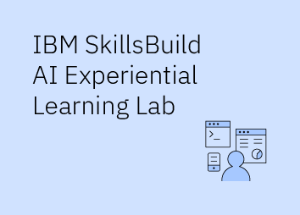
Bridge
Where this ended up
Seven agents inside one daily cycle, covering the thirty days after discharge.
56 tests, all passing, from a clean clone in under five seconds.
Two committed evaluation runs over sixty synthetic patients and thirty simulated days.
Detection 8 of 9 on the deterministic rule engine, and 9 of 9 with IBM watsonx.ai Granite, with false positives unchanged.
Six IBM Bob task sessions, one per component, recorded in bob_sessions.
Every number in this deck comes from a run that anyone can reproduce from the public repository.

