Slide 1
Department of AI&DS
COURSE NAME: OPINION MINING & RECOMMENDeR SYSTEMS
COURSE CODE: 22SDM3202R
TOPIC :
INTRODUCTION TO ASPECT EXTRACTION & OPINION MINING TECHNIQUIES
Session - 02

Slide 2



AIM OF THE SESSION
To familiarize students with the Aspect Extraction & Techniques
INSTRUCTIONAL OBJECTIVES
This Session is designed to:
Demonstrate the Aspect Extraction
Describe the Opinion Mining Techniques
LEARNING OUTCOMES
At the end of this session, you should be able to:
Define Aspect Extraction
Describe the opinion mining techniques

Slide 3
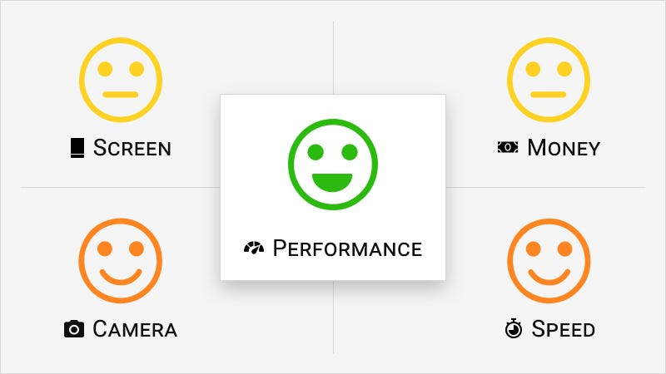
Aspect extraction
Aspect extraction is the process of identifying and categorizing specific aspects or features mentioned in text data, particularly in the context of opinion mining and sentiment analysis. In essence, it involves breaking down text into distinct components or attributes that people are expressing opinions about

Slide 4
1. Identification of Aspects:
Aspect extraction starts by identifying words or phrases within the text that refer to specific aspects, attributes, or features of a product, service, entity, or topic under discussion.
Aspects can vary depending on the domain or context of the text. For example, in product reviews, aspects might include features like performance, design, usability, reliability, price, customer service, etc.
2. Aspect Categorization:
Once aspects are identified, they are typically categorized into predefined or user-defined aspect categories or dimensions.
Categorization helps organize and structure the aspects for further analysis and interpretation. For example, aspects related to a mobile phone might be categorized into hardware, software, user experience, etc.

Slide 5
3. Techniques for Aspect Extraction:
a. Rule-Based Methods:
Rule-based approaches utilize predefined linguistic rules or patterns to identify aspect mentions within the text.
These rules may be based on syntactic structures, domain-specific knowledge, or regular expressions.
Example: Identifying aspect mentions by looking for specific keywords or phrases that commonly denote aspects (e.g., "battery life," "camera quality").
b. Machine Learning Algorithms:
Machine learning techniques, such as supervised or unsupervised learning, can be employed to automatically learn patterns and relationships from labeled data.
Supervised learning models are trained on annotated data where aspects are labeled, and features are extracted from the text.
Unsupervised learning methods, such as topic modeling (e.g., Latent Dirichlet Allocation), can discover latent topics or aspects from the text data.
Example: Training a classifier to classify sentences or phrases into aspect categories based on contextual features.

Slide 6
c. Hybrid Approaches:
Hybrid methods combine rule-based and machine learning techniques to leverage the strengths of both approaches.
Rule-based methods may be used for initial aspect identification, while machine learning models can help refine and improve aspect extraction accuracy.
Example: Using rule-based patterns to identify initial aspect mentions and then fine-tuning aspect extraction using a machine learning model.

Slide 7
Noun Phrases
Finding frequent noun phrases involves identifying combinations of words that act as nouns and occur frequently within a corpus of text. Noun phrases typically consist of a noun and other words that modify or describe it, such as adjectives, determiners, prepositions, and other nouns. Here's how you can approach this task:

Slide 8
Text Preprocessing:
Tokenization: Split the text into individual words or tokens.
Part-of-Speech (POS) Tagging: Tag each word with its grammatical category, such as noun (NN), adjective (JJ), preposition (IN), etc.
Chunking: Group consecutive words with specific POS tags into larger syntactic units, such as noun phrases.
2. Noun Phrase Extraction:
a. Rule-Based Approaches:
Define rules or patterns to identify noun phrases based on POS tags.
Common patterns include sequences of determiners (DT), adjectives (JJ), and nouns (NN).
Example: {<DT>?<JJ>*<NN>} matches noun phrases with optional determiners followed by zero or more adjectives and a noun.

Slide 9
b. Statistical Methods:
Use statistical measures to identify frequent noun phrases based on their occurrence frequencies.
Count the occurrences of each noun phrase in the text corpus.
Rank noun phrases by their frequency of occurrence to identify the most frequent ones.

Slide 10
Filtering and Ranking:
Frequency Threshold: Set a minimum threshold for the frequency of occurrence to filter out less frequent noun phrases.
Stopword Removal: Exclude common stopwords (e.g., "the," "is," "and") from noun phrases to focus on meaningful terms.
Normalization: Normalize noun phrases by converting them to lowercase and removing punctuation to ensure consistency.
Ranking: Sort noun phrases based on their frequency of occurrence in descending order to identify the most frequent ones.

Slide 11
Mining opinion patterns involves identifying recurring themes, trends, or patterns within a corpus of opinionated text data, such as product reviews, social media posts, or customer feedback. By analyzing these patterns, businesses can gain valuable insights into customer opinions, preferences, and sentiments. Here's a step-by-step approach to mining opinion patterns:
1. Data Collection and Preprocessing:
Gather a dataset containing opinionated text data relevant to your domain or topic of interest (e.g., product reviews, social media comments).
Preprocess the text data by tokenizing, removing stopwords, punctuation, and performing stemming or lemmatization to standardize the text.
2. Aspect Extraction:
Identify and extract aspects or features mentioned in the opinionated text data. Aspects represent the key topics or attributes that people express opinions about.
Techniques for aspect extraction include rule-based methods, machine learning algorithms, or a combination of both.
Aspect extraction helps in understanding the focus of opinions and forms the basis for analyzing opinion patterns.

Slide 12
3.Opinion Expression Identification:
Recognize expressions of opinions within the text data. Opinions can be expressed through sentiment-bearing words, phrases, or explicit statements conveying positive, negative, or neutral sentiments.
Utilize sentiment analysis techniques to classify opinion expressions into sentiment polarities (positive, negative, neutral).

Slide 13
. Opinion Pattern Mining:
a. Topic Modeling:
Apply topic modeling techniques, such as Latent Dirichlet Allocation (LDA), to identify latent topics or themes within the opinionated text data.
Topic modeling helps in uncovering prevalent themes or subjects that emerge from the opinions expressed by individuals.
b. Frequent Pattern Mining:
Use frequent pattern mining algorithms, such as Apriori or FP-Growth, to discover recurring patterns of opinions expressed across the dataset.
Identify combinations of aspects and sentiment expressions that frequently co-occur, revealing common opinion patterns.
c. Temporal Analysis:
Analyze how opinion patterns evolve over time by incorporating temporal aspects into the analysis.
Track changes in opinion patterns across different time periods to understand temporal trends and dynamics.

Slide 14
5. Visualization and Interpretation:
Visualize opinion patterns using techniques such as word clouds, bar charts, or network graphs to illustrate the relationships between aspects and sentiments.
Interpret the mined opinion patterns to gain insights into customer preferences, satisfaction levels, and areas for improvement.
Identify actionable insights and strategic recommendations based on the observed opinion patterns.
6. Iterative Refinement:
Iterate on the opinion pattern mining process by refining techniques, adjusting parameters, and incorporating feedback to improve the accuracy and relevance of mined patterns.
Continuously update and adapt the analysis as new data becomes available or as business objectives evolve.

Slide 15
Filtering out non-aspects
Filtering out non-aspects involves removing irrelevant or non-representative elements from a dataset of opinionated text, focusing only on the aspects or features that people express opinions about. This process is essential for refining the dataset and extracting meaningful insights from the opinions expressed. Here's how you can filter out non-aspects:
Define Aspect Criteria:
Establish criteria or guidelines for determining what constitutes an aspect or feature within the context of your analysis.
Consider aspects that are relevant to the domain or topic of interest, such as product features in the case of product reviews or service attributes in customer feedback.

Slide 16
2.Aspect Identification Techniques:
Utilize various techniques to identify aspects mentioned in the text data:
Keyword Matching: Define a list of keywords or phrases that represent aspects and search for their occurrences within the text.
Rule-Based Methods: Develop rules or patterns based on linguistic structures or domain-specific knowledge to identify aspect mentions.
Machine Learning Models: Train supervised learning models to classify text segments as aspect mentions or non-aspects based on labeled data.
3. Exclude Non-Aspect Mentions:
Filter out text segments that do not correspond to aspect mentions based on the identified criteria and techniques.
Remove sentences or phrases that contain generic or non-descriptive language unrelated to specific aspects.
Exclude stopwords or common words that are unlikely to represent aspects, such as articles, pronouns, and conjunctions.

Slide 17
4. Contextual Analysis:
Consider the context in which aspect mentions occur to determine their relevance:
Surrounding Words: Analyze the words and phrases surrounding aspect mentions to assess their context and relevance.
Sentence Structure: Evaluate the syntactic structure of sentences to identify whether aspect mentions are used in a descriptive or opinionated context.
5. Iterative Refinement:
Iterate on the filtering process by continuously assessing the effectiveness of the criteria and techniques used for aspect identification.
Adjust and refine the filtering criteria based on feedback, domain knowledge, or analysis of the filtered dataset.

Slide 18
6. Manual Review and Validation:
Conduct manual review and validation of the filtered dataset to ensure the accuracy and completeness of aspect identification.
Verify that the filtered dataset contains relevant aspect mentions that accurately represent the opinions expressed in the text.
7. Application of Aspect-Filtered Dataset:
Use the aspect-filtered dataset for further analysis, such as sentiment analysis, opinion mining, or pattern recognition.
Focus on extracting insights and patterns related to the identified aspects, as they are more likely to reflect the opinions and preferences of the target audience.

Slide 19
1. Aspect Representation:
Represent candidate aspects in a standardized format to facilitate grouping. This could involve using normalized forms of aspect mentions, such as lowercase tokens without punctuation or stopwords.
2. Similarity Measurement:
Define a measure of similarity between pairs of candidate aspects. Common similarity measures include:
Cosine Similarity: Measures the cosine of the angle between two aspect vectors in a multidimensional space.
Jaccard Similarity: Computes the intersection over union of two sets of aspect tokens.
Edit Distance: Calculates the minimum number of operations required to transform one aspect into another (e.g., insertion, deletion, substitution).
Grouping Candidate
Grouping candidate aspects involves organizing identified aspects or features into meaningful categories or clusters based on their similarity or relatedness. This process helps in structuring the analysis and gaining a deeper understanding of the various aspects mentioned in the opinionated text data. Here's how you can group candidate aspects:

Slide 20
3. Clustering Techniques:
Apply clustering algorithms to group candidate aspects based on their similarity:
K-Means Clustering: Divides aspects into K clusters by minimizing the sum of squared distances from each aspect to the centroid of its cluster.
Hierarchical Clustering: Constructs a hierarchy of clusters by iteratively merging or splitting clusters based on their pairwise similarities.
DBSCAN (Density-Based Spatial Clustering of Applications with Noise): Groups aspects into clusters based on density, where clusters are regions of high density separated by regions of low density.
4. Evaluation and Validation:
Evaluate the quality of aspect grouping using internal and external validation measures:
Silhouette Score: Measures the cohesion and separation of clusters based on the average distance of aspects within clusters and the distance between clusters.
External Validation Metrics: Compare the resulting aspect clusters against external ground truth or domain knowledge to assess their coherence and relevance.

Slide 21
5. Interpretation and Refinement:
Interpret the resulting aspect clusters to understand the underlying themes or categories represented by the grouped aspects.
Refine the aspect grouping process by adjusting parameters, such as the number of clusters or the similarity threshold, based on the interpretability and coherence of the resulting clusters.
6. Application of Aspect Groups:
Use the grouped aspects as a structured representation of the various dimensions or attributes relevant to the domain or topic of interest.
Analyze opinionated text data within the context of the aspect groups to uncover insights and patterns related to specific thematic categories.

Slide 22
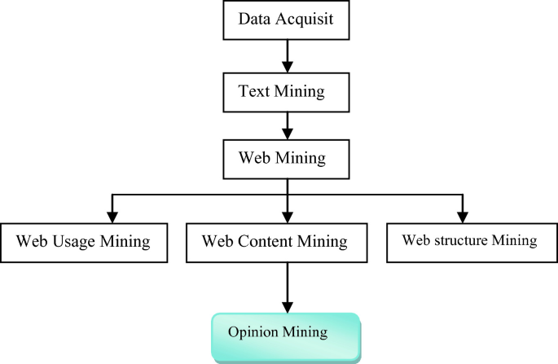
Opinion Mining Techniques
Opinion mining, also known as sentiment analysis, involves the use of various techniques to extract, identify, and analyze subjective information from text data. These techniques help determine the sentiment, emotion, or opinion expressed in the text. Here are some common techniques used in opinion mining:

Slide 23
1. Lexicon-Based Approaches
These methods use predefined lists of words (lexicons) that are associated with specific sentiments (positive, negative, neutral).
Sentiment Lexicons: Dictionaries containing words and their associated sentiment scores (e.g., SentiWordNet, AFINN, VADER).
Rule-Based Systems: Apply rules based on the presence of sentiment words, their intensity, and negation to determine the overall sentiment of a text.
2. Machine Learning Approaches
Supervised learning techniques that require labeled training data to learn sentiment classification models.
Feature Extraction: Convert text data into numerical features, such as:
Bag of Words (BoW): Represents text by the frequency of words.
TF-IDF (Term Frequency-Inverse Document Frequency): Reflects the importance of words in a document relative to a corpus.
Word Embeddings: Vector representations of words capturing semantic similarities (e.g., Word2Vec, GloVe).
Classification Algorithms: Train models using algorithms such as:
Naive Bayes
Support Vector Machines (SVM)
Logistic Regression
Random Forest
Deep Learning Models: Use neural networks, such as Recurrent Neural Networks (RNN), Long Short-Term Memory (LSTM) networks, and Convolutional Neural Networks (CNN), for more complex sentiment analysis tasks.

Slide 24
3. Hybrid Approaches
Combine lexicon-based and machine learning methods to leverage the strengths of both.
Lexicon-Augmented Machine Learning: Use sentiment lexicons to enhance feature sets for machine learning models.
Rule-Based Post-Processing: Apply rules to refine the output of machine learning models.
4. Aspect-Based Sentiment Analysis (ABSA)
Focuses on identifying sentiments expressed about specific aspects or features within the text.
Aspect Extraction: Identify and categorize aspects mentioned in the text.
Sentiment Classification: Determine the sentiment associated with each identified aspect.
Topic Modeling: Techniques such as Latent Dirichlet Allocation (LDA) can help discover aspects or topics within the text.
5. Deep Learning Approaches
Advanced neural network architectures to capture complex patterns in text data.
Recurrent Neural Networks (RNN): Suitable for sequential data, capturing dependencies between words.
Long Short-Term Memory Networks (LSTM): A type of RNN designed to remember long-term dependencies.
Convolutional Neural Networks (CNN): Effective for capturing local patterns and features in text.
Transformers: State-of-the-art models like BERT (Bidirectional Encoder Representations from Transformers) and GPT (Generative Pre-trained Transformer) that provide contextual word embeddings and achieve high performance in sentiment analysis.

Slide 25
6. Graph-Based Approaches
Represent text as a graph and analyze relationships between words or phrases.
Opinion Graphs: Construct graphs where nodes represent opinion targets (aspects) and edges represent sentiment relations.
Graph Neural Networks (GNN): Use neural networks designed for graph-structured data to perform sentiment analysis.
7. Emotion Detection
Identify specific emotions expressed in the text beyond just positive, negative, or neutral sentiments.
Emotion Lexicons: Dictionaries containing words associated with specific emotions (e.g., joy, anger, sadness).
Emotion Classification Models: Train models to classify text into multiple emotion categories.
8. Multimodal Sentiment Analysis
Combine text with other modalities such as images, audio, or video to analyze sentiments expressed through multiple channels.
Text and Image Analysis: Analyze textual comments alongside images in social media posts.
Audio and Speech Analysis: Analyze tone, pitch, and emotion in spoken language.

Slide 26

TERMINAL QUESTIONS
1.How Does Aspect Extraction Work?
2.What Techniques Are Used for Aspect Extraction?
3.What Are the Main Techniques Used in Opinion Mining?
What Techniques Are Used for Grouping Candidates?

Slide 27
REFERENCES FOR FURTHER LEARNING OF THE SESSION
Reference Books:
1. “Opinion Mining”, Greame Hrist, Bing Liu, Morgan Publications, 2012.
2. “Recommender Systems”, C.C. Aggarwal, Springer, 2016.
“Temporal Opinion Mining”, Haishi Bai, Boris Scholl, CRC Press, 2010.
“Recommender systems handbook”, Federico Pozzi, Elisabetta Fersini, Enza Messina, Bing Liu, 2016.
“New Opportunities for Sentiment Analysis and Information Processing”, Aakansha Sharaff, G. R. Sinha, Surbhi Bhatia, IGI Global, 2021.
Sites and Web links:
https://link.springer.com/book/10.1007/978-3-031-02145-9
https://www.mdpi.com/journal/applsci/special_issues/Sentiment_Social_Media
https://nlp.stanford.edu/sentiment

Slide 28

THANK YOU
Team – OMRS

