Slide 1
Department of AI&DS
COURSE NAME: OPINION MINING & RECOMMENDeR SYSTEMS
COURSE CODE: 22SDM3202R
TOPIC :
INTRODUCTION TO KNOWLEDGE BASED APPROACHES
Session - 03

Slide 2



AIM OF THE SESSION
To familiarize students with the Knowledge based approaches
INSTRUCTIONAL OBJECTIVES
This Session is designed to:
Demonstrate the Knowledge based approaches
Describe the Supervised Approaches- Naïve Bayes
LEARNING OUTCOMES
At the end of this session, you should be able to:
Define Knowledge based approaches
Describe the Supervised Approaches- Naïve Bayes

Slide 3
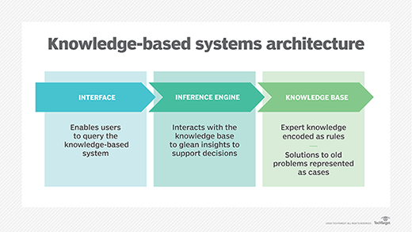
Knowledge-based Approaches
Knowledge-based approaches in opinion mining leverage domain-specific knowledge, ontologies, and semantic networks to analyze and interpret sentiments expressed in text. These approaches rely on structured information and predefined relationships to understand the context and meaning of words and phrases. Here's an overview of knowledge-based approaches, including their techniques and applications:

Slide 4
Key Components of Knowledge-Based Approaches
Lexicons and Dictionaries:
Sentiment Lexicons: Predefined lists of words with associated sentiment scores, such as SentiWordNet, AFINN, and VADER.
Domain-Specific Lexicons: Custom lexicons tailored to specific domains (e.g., medical, financial) containing words and phrases relevant to that domain.
Ontologies and Semantic Networks:
WordNet: A lexical database of English words grouped into sets of synonyms (synsets), along with their definitions and relationships.
Domain Ontologies: Structured representations of knowledge within a specific domain, defining entities, attributes, and relationships (e.g., SNOMED CT for healthcare, FIBO for finance).

Slide 5
3.Concept-Based Approaches:
Concept Extraction: Identifying and extracting key concepts from text based on domain knowledge and ontologies.
Concept-Level Sentiment Analysis: Analyzing sentiments at the level of concepts rather than individual words to capture deeper meanings and context.

Slide 6
Techniques in Knowledge-Based Approaches
Rule-Based Methods:
Pattern Matching: Using predefined rules and patterns to identify sentiment-bearing phrases and their associated sentiments.
Contextual Analysis: Applying rules to account for contextual factors such as negation, intensifiers, and domain-specific language.
Ontology-Based Sentiment Analysis:
Entity Recognition: Identifying entities (e.g., products, brands) and their attributes within the text using ontologies.
Relation Extraction: Determining the relationships between entities and their attributes to understand the sentiment context.
Semantic Role Labeling (SRL):
Role Identification: Assigning roles to words or phrases in a sentence to understand their semantic relationships (e.g., agent, action, target).
Sentiment Role Analysis: Analyzing sentiments based on the roles and relationships identified through SRL.

Slide 7
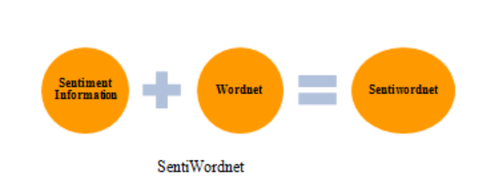
SentiWordNet
SentiWordNet is a lexical resource specifically designed for sentiment analysis. It extends WordNet, a well-known lexical database for the English language, by assigning sentiment scores to synsets (sets of synonyms) in WordNet. These sentiment scores help in determining the sentiment polarity (positive, negative, or objective) of words and phrases.

Slide 8
Key Features of SentiWordNet
Synset-Based Sentiment Scores:
Each synset in WordNet is assigned three sentiment scores: positivity, negativity, and objectivity.
The scores for each synset sum up to 1, reflecting the relative degrees of positive, negative, and objective sentiments.
Granularity:
SentiWordNet provides sentiment information at the synset level rather than the individual word level, capturing the context-dependent nature of word meanings.
Coverage:
It covers a large number of English words and their various senses, making it a comprehensive resource for sentiment analysis.
Example Synset Scores
For a synset containing the word "happy":
Positive Score: 0.75
Negative Score: 0.0
Objective Score: 0.25
For a synset containing the word "sad":
Positive Score: 0.0
Negative Score: 0.85
Objective Score: 0.15

Slide 9
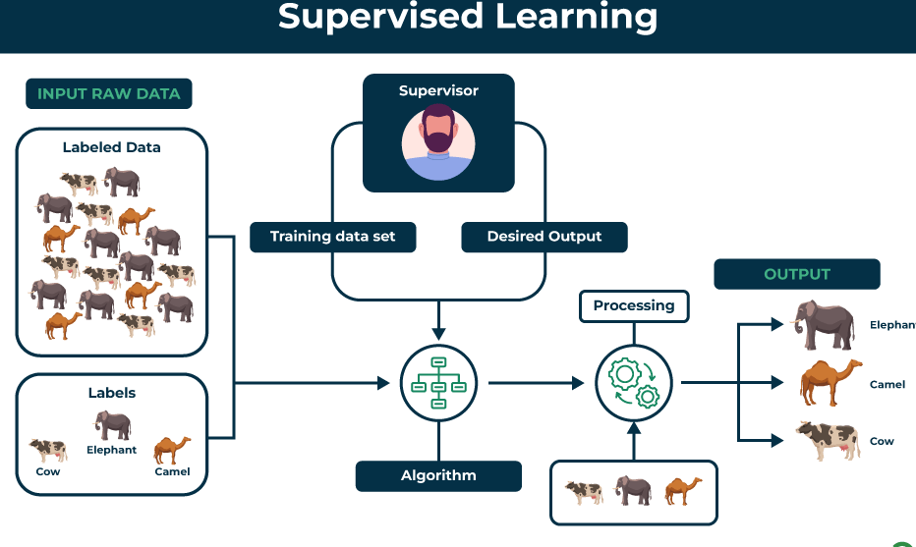
Supervised approaches in sentiment analysis
Supervised approaches in sentiment analysis involve training a machine learning model on a labeled dataset where each instance is annotated with its sentiment (e.g., positive, negative, or neutral). One of the most common and simple supervised learning algorithms used for this purpose is Naive Bayes. Naive Bayes is particularly effective for text classification problems due to its simplicity, efficiency, and often surprisingly good performance.

Slide 10
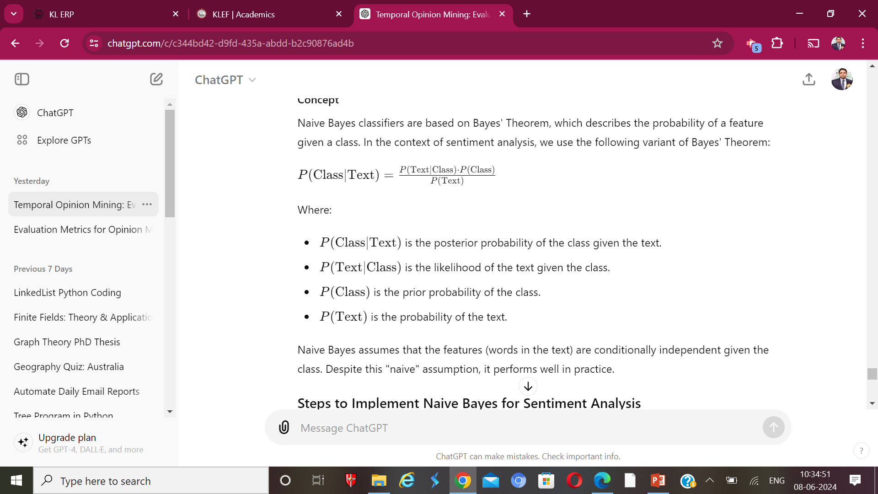

Slide 11
Steps to Implement Naive Bayes for Sentiment Analysis
1. Data Preparation
Prepare your dataset for training and testing. Ensure it contains labeled instances of text data.
2. Feature Extraction
Convert the text data into numerical features. The CountVectorizer is commonly used to convert a collection of text documents to a matrix of token counts.
3. Training the Naive Bayes Model
Train a Naive Bayes classifier using the features extracted from the text.
4. Model Evaluation
Evaluate the model's performance on the test set.
5. Using SentiWordNet with Naive Bayes (Optional)
Enhance the Naive Bayes classifier by incorporating SentiWordNet sentiment scores.

Slide 12
TERMINAL QUESTIONS
1. Why Use Knowledge-Based Approaches?
2.What are Common Knowledge-Based Resources?
3.What Are Common Supervised Learning Algorithms ?
4. What Are the Steps Involved in Supervised Learning?

Slide 13
REFERENCES FOR FURTHER LEARNING OF THE SESSION
Reference Books:
1. “Opinion Mining”, Greame Hrist, Bing Liu, Morgan Publications, 2012.
2. “Recommender Systems”, C.C. Aggarwal, Springer, 2016.
“Temporal Opinion Mining”, Haishi Bai, Boris Scholl, CRC Press, 2010.
“Recommender systems handbook”, Federico Pozzi, Elisabetta Fersini, Enza Messina, Bing Liu, 2016.
“New Opportunities for Sentiment Analysis and Information Processing”, Aakansha Sharaff, G. R. Sinha, Surbhi Bhatia, IGI Global, 2021.
Sites and Web links:
https://link.springer.com/book/10.1007/978-3-031-02145-9
https://www.mdpi.com/journal/applsci/special_issues/Sentiment_Social_Media
https://nlp.stanford.edu/sentiment

Slide 14

THANK YOU
Team – OMRS

