Slide 1
Department of AI&DS
COURSE NAME: OPINION MINING & RECOMMENDeR SYSTEMS
COURSE CODE: 22SDM3202R
TOPIC :
INTRODUCTION TO KNOWLEDGE BASED APPROACHES
Session - 04

Slide 2



AIM OF THE SESSION
To familiarize students with the Unsupervised Approaches
INSTRUCTIONAL OBJECTIVES
This Session is designed to:
Demonstrate the Unsupervised Approaches
Describe the Model Selection
LEARNING OUTCOMES
At the end of this session, you should be able to:
Define Unsupervised Approaches
Describe the Model Selection

Slide 3
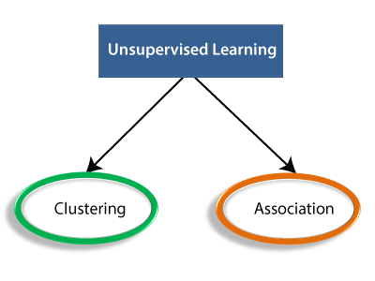
Unsupervised Approaches
Unsupervised approaches for sentiment analysis do not rely on labeled training data. Instead, they use techniques that automatically detect patterns, clusters, or relationships in the data. These methods are particularly useful when labeled data is scarce or unavailable. Here are some key unsupervised approaches for sentiment analysis:
Key Unsupervised Approaches
Lexicon-Based Methods
Clustering Methods
Topic Modeling

Slide 4
1. Lexicon-Based Methods
Lexicon-based methods use predefined lists of words (lexicons) associated with sentiment scores. These lexicons help determine the sentiment of a text by aggregating the sentiment scores of individual words.
Example: Sentiment Analysis with VADER
VADER (Valence Aware Dictionary and sentiment Reasoner) is a popular lexicon and rule-based sentiment analysis tool specifically attuned to sentiments expressed in social media.
2. Clustering Methods
Clustering techniques group similar texts together based on their content. Clustering can help identify common sentiment patterns or group texts into positive, negative, or neutral clusters.
Example: Sentiment Clustering with K-Means
K-Means clustering can be applied to text data by converting the text into numerical features (e.g., using TF-IDF).

Slide 5
3. Topic Modeling
Topic modeling algorithms, such as Latent Dirichlet Allocation (LDA), discover the underlying topics in a collection of texts. These topics can be analyzed to infer the overall sentiment.
Example: Topic Modeling with LDA
LDA can be used to identify topics in text data, which can then be manually or automatically labeled with sentiment.

Slide 6
Comparison and Use Cases
Lexicon-Based Methods:
Pros: Simple, interpretable, and quick to implement. Effective when lexicons are comprehensive and domain-specific.
Cons: May not handle context well. Performance depends on the quality and coverage of the lexicon.
Use Cases: Quick sentiment analysis on social media, customer reviews, and feedback where domain-specific lexicons are available.
Clustering Methods:
Pros: Can discover unknown sentiment patterns. Does not require labeled data.
Cons: Requires careful selection of the number of clusters. Clusters may not directly correspond to sentiment categories.
Use Cases: Grouping similar customer feedback, exploring sentiment patterns in large datasets.
Topic Modeling:
Pros: Uncovers hidden thematic structures in text data. Can be used to infer sentiments associated with topics.
Cons: Topics may need manual interpretation. Requires preprocessing and parameter tuning.
Use Cases: Analyzing large collections of documents, identifying sentiment-laden topics in news articles or forums.

Slide 7
Supervised Vs Unsupervised Approaches
Supervised and unsupervised learning are two fundamental approaches in machine learning, each with distinct methodologies and applications. Understanding their differences, strengths, and weaknesses is crucial for selecting the right approach for a given problem.
Supervised Learning
Definition: Supervised learning involves training a model on a labeled dataset, where the input data is paired with the correct output. The goal is to learn a mapping from inputs to outputs that can be generalized to unseen data.
Key Characteristics:
Labeled Data: Requires a dataset with input-output pairs.
Training Process: The model learns from the labeled examples to minimize error.
Evaluation: Performance is evaluated using metrics like accuracy, precision, recall, F1-score, etc.
Common Algorithms:
Classification: Logistic Regression, Naive Bayes, Support Vector Machines (SVM), Decision Trees, Random Forests, Neural Networks.
Regression: Linear Regression, Ridge Regression, Lasso Regression, Neural Networks.

Slide 8
Supervised Vs Unsupervised Approaches
Unsupervised Learning
Definition: Unsupervised learning involves training a model on unlabeled data, aiming to discover underlying patterns or structures without specific output guidance.
Key Characteristics:
Unlabeled Data: Uses data without predefined labels.
Training Process: The model identifies patterns, clusters, or latent structures in the data.
Evaluation: Often evaluated using metrics like silhouette score for clustering, or coherence for topic modeling.
Common Algorithms:
Clustering: K-Means, Hierarchical Clustering, DBSCAN.
Dimensionality Reduction: PCA (Principal Component Analysis), t-SNE.
Topic Modeling: Latent Dirichlet Allocation (LDA).
Example: K-Means Clustering for Sentiment Patterns

Slide 9
Comparison and Use Cases
Feature | Supervised Learning | Unsupervised Learning
Data Requirement | Labeled data | Unlabeled data
Goal | Predict known output | Discover hidden patterns
Common Algorithms | Naive Bayes, SVM, Decision Trees, Neural Networks | K-Means, PCA, LDA
Applications | Classification, Regression, Sentiment Analysis | Clustering, Anomaly Detection, Topic Modeling
Strengths | High accuracy, Predictable, Interpretable | No need for labeled data, Reveals hidden patterns, Flexible
Weaknesses | Needs large labeled datasets, Prone to overfitting | Hard to interpret, Challenging to evaluate, Parameter-sensitive

Slide 10
Parameter Estimation and Smoothing
Parameter estimation is a critical aspect of building machine learning models, especially in probabilistic models. One common challenge in parameter estimation is dealing with sparse data or unseen events. Smoothing techniques are used to address these challenges by adjusting the estimated probabilities to account for unseen events or to prevent zero probabilities.

Slide 11
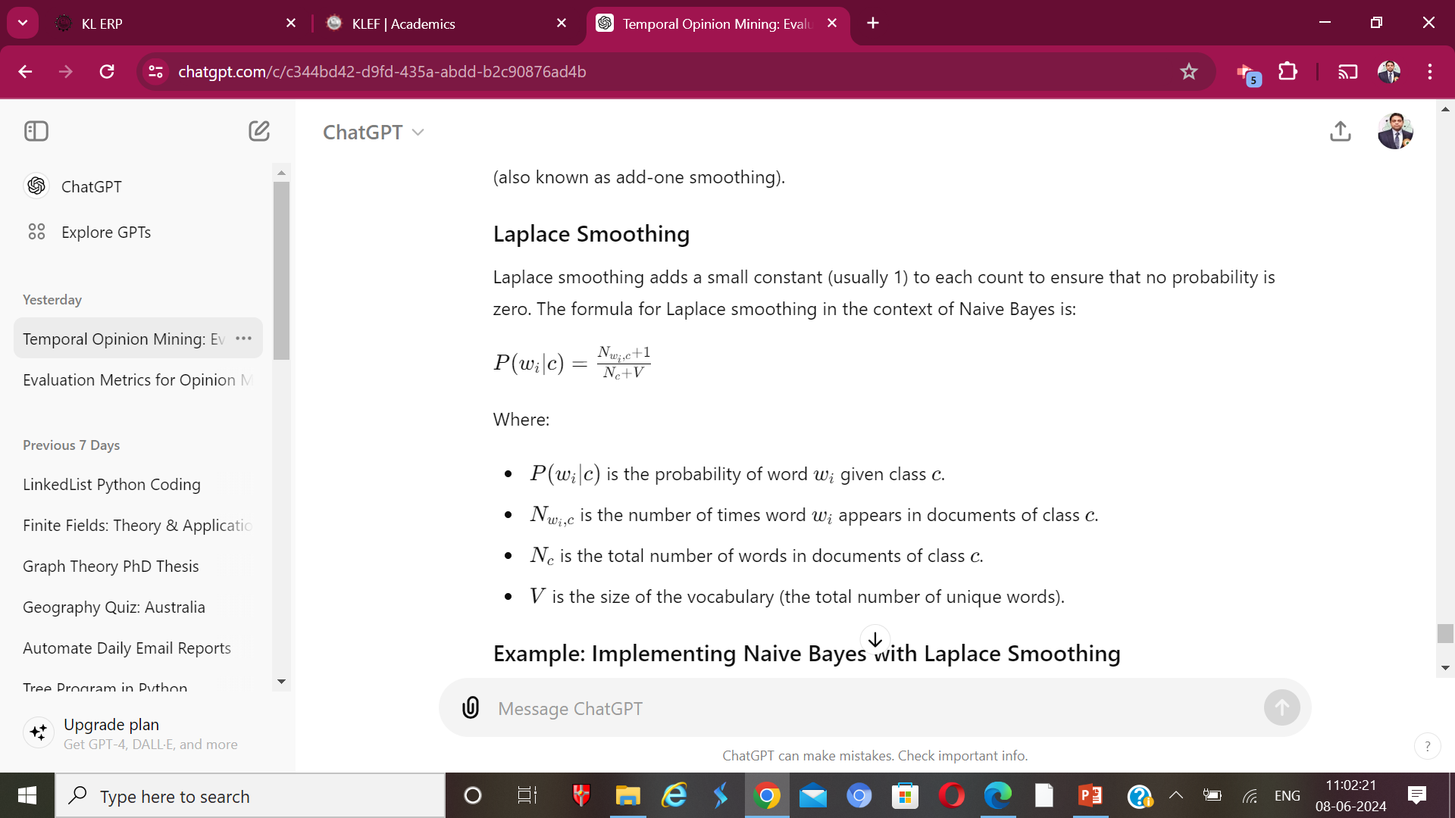
Smoothing in Naive Bayes
In the context of Naive Bayes classifiers, smoothing is essential to ensure that no probability is ever zero, which can otherwise result in the entire probability product being zero when classifying new data. There are several smoothing techniques, but the most commonly used is Laplace Smoothing (also known as add-one smoothing).
Laplace Smoothing
Laplace smoothing adds a small constant (usually 1) to each count to ensure that no probability is zero. The formula for Laplace smoothing in the context of Naive Bayes is:

Slide 12
Example: Implementing Naive Bayes with Laplace Smoothing
Let's walk through a simple implementation of a Naive Bayes classifier with Laplace smoothing using Python.
Step-by-Step Implementation
Data Preparation: Prepare the dataset and split it into training and testing sets.
Feature Extraction: Convert text data into a matrix of token counts.
Training the Naive Bayes Model with Smoothing: Train the model using Laplace smoothing.
Prediction and Evaluation: Predict the sentiments of the test data and evaluate the model's performance.

Slide 13
Model Selection in Machine Learning
Model selection involves choosing the best model from a set of candidate models based on their performance on a given task. This process is crucial because different models may perform differently depending on the nature of the data and the specific problem at hand. Model selection helps in finding the most suitable model that generalizes well to unseen data.
Steps in Model Selection
Define the Problem and Goals
Prepare the Data
Select Candidate Models
Split the Data
Train and Evaluate Models
Compare Models Using Evaluation Metrics
Perform Cross-Validation
Select the Best Model

Slide 14
Step-by-Step Guide to Model Selection
1. Define the Problem and Goals
Clearly define the problem you are trying to solve and the goals of your analysis. This could be classification, regression, clustering, or another type of machine learning problem.
2. Prepare the Data
Prepare and preprocess the data, including handling missing values, encoding categorical variables, normalizing or scaling features, and splitting the data into training and testing sets.
3. Select Candidate Models
Choose a set of candidate models to evaluate. For instance, if you are working on a classification problem, you might consider logistic regression, decision trees, random forests, support vector machines, and neural networks.

Slide 15
4. Split the Data
Split the dataset into training and testing sets to evaluate the performance of each model. An additional validation set or using cross-validation can provide a more robust evaluation.
5. Train and Evaluate Models
Train each candidate model on the training data and evaluate their performance on the testing data using appropriate metrics.
6. Compare Models Using Evaluation Metrics
Compare the models based on relevant evaluation metrics. For classification problems, common metrics include accuracy, precision, recall, F1-score, and ROC-AUC. For regression problems, metrics like mean squared error (MSE), root mean squared error (RMSE), mean absolute error (MAE), and R-squared are commonly used.

Slide 16
7. Perform Cross-Validation
Cross-validation, such as k-fold cross-validation, helps in assessing the model's performance more reliably by averaging the results across multiple training and testing splits.
8. Select the Best Model
Based on the evaluation metrics and cross-validation results, select the model that performs the best on the validation set and shows good generalization ability.

Slide 17
TERMINAL QUESTIONS
1.What are Common Algorithms Used in Supervised Learning?
2.What are the Main Steps in Supervised Learning?
3.What are Common Algorithms Used in Unsupervised Learning?
4.How Do You Evaluate Models in Supervised and Unsupervised Learning?

Slide 18
REFERENCES FOR FURTHER LEARNING OF THE SESSION
Reference Books:
1. “Opinion Mining”, Greame Hrist, Bing Liu, Morgan Publications, 2012.
2. “Recommender Systems”, C.C. Aggarwal, Springer, 2016.
“Temporal Opinion Mining”, Haishi Bai, Boris Scholl, CRC Press, 2010.
“Recommender systems handbook”, Federico Pozzi, Elisabetta Fersini, Enza Messina, Bing Liu, 2016.
“New Opportunities for Sentiment Analysis and Information Processing”, Aakansha Sharaff, G. R. Sinha, Surbhi Bhatia, IGI Global, 2021.
Sites and Web links:
https://link.springer.com/book/10.1007/978-3-031-02145-9
https://www.mdpi.com/journal/applsci/special_issues/Sentiment_Social_Media
https://nlp.stanford.edu/sentiment

Slide 19

THANK YOU
Team – OMRS

