Slide 1
Department of AI&DS
COURSE NAME: OPINION MINING & RECOMMENDeR SYSTEMS
COURSE CODE: 22SDM3202R
TOPIC :
INTRODUCTION TO TEST SET LIKELIHOOD
Session - 05

Slide 2



AIM OF THE SESSION
To familiarize students with the Test Set Likelihood
INSTRUCTIONAL OBJECTIVES
This Session is designed to:
Demonstrate the Test Set Likelihood
Describe the Model Evaluation
LEARNING OUTCOMES
At the end of this session, you should be able to:
Define Test Set Likelihood
Describe the Model Evaluation

Slide 3
Test Set Likelihood in Model Evaluation
Test set likelihood is a metric used to evaluate the performance of probabilistic models. It measures how well a model predicts the probability distribution of the test data. In essence, it assesses the model's ability to assign high probabilities to the actual outcomes observed in the test set.

Slide 4
Importance of Test Set Likelihood
Probabilistic Models: For models that predict probabilities (e.g., Naive Bayes, logistic regression), test set likelihood provides a way to evaluate how well the predicted probabilities match the true distribution of the data.
Overfitting Detection: It helps in detecting overfitting. A model that overfits the training data might show high likelihood on the training set but low likelihood on the test set.
Model Comparison: It allows for comparing different probabilistic models. Models with higher test set likelihood are generally better at predicting the test data.

Slide 5
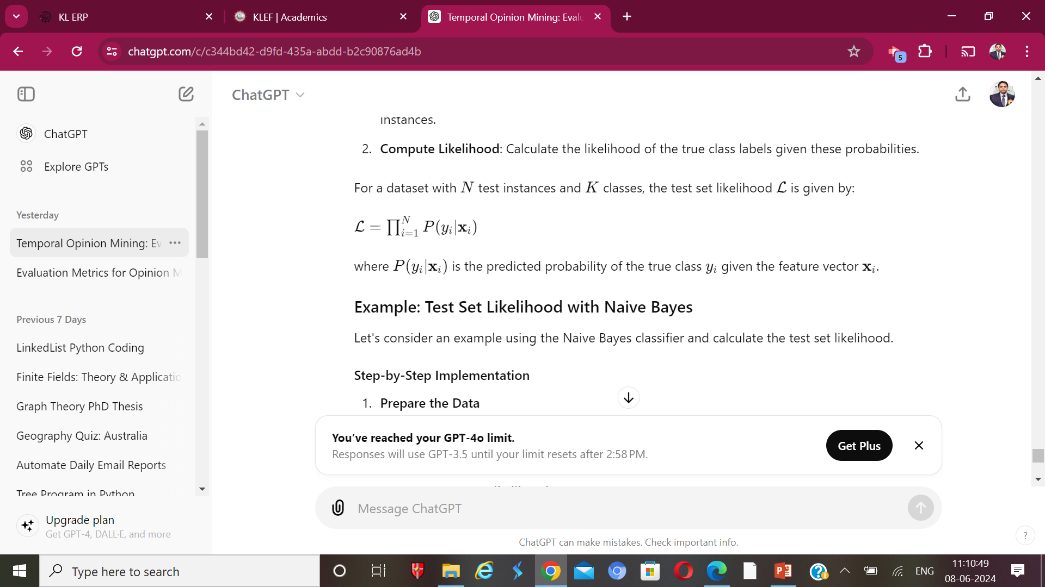
Calculating Test Set Likelihood
To calculate the test set likelihood, follow these steps:
Predict Probabilities: Use the model to predict the probabilities of each class for the test instances.
Compute Likelihood: Calculate the likelihood of the true class labels given these probabilities.

Slide 6
Example
Example: Test Set Likelihood with Naive Bayes
Let's consider an example using the Naive Bayes classifier and calculate the test set likelihood.
Step-by-Step Implementation
Prepare the Data
Train the Naive Bayes Model
Predict Probabilities for the Test Set
Compute Test Set Likelihood

Slide 7
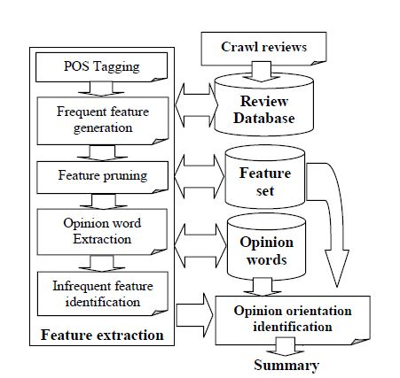
Aspect-based opinion mining
Aspect-based opinion mining aims to extract and analyze the different aspects or components of opinions expressed in text data. Latent Dirichlet Allocation (LDA) and its variants are commonly used in aspect-based opinion mining to identify latent topics (aspects) from a collection of text data. Here's how LDA models can be applied in aspect-based opinion mining:

Slide 8
Traditional LDA Approach
Data Preparation: Preprocess the text data by tokenizing, removing stopwords, and possibly stemming or lemmatizing.
Topic Modeling with LDA: Apply LDA to the preprocessed text data to identify latent topics. Each topic represents a distribution over words, and each document is represented as a mixture of these topics.
Aspect Identification: Analyze the identified topics to interpret them as aspects or themes in the text data. Topics with coherent sets of words related to specific concepts or categories can be considered as aspects.
Opinion Extraction: Once aspects are identified, extract opinions associated with each aspect from the text data. This may involve techniques such as sentiment analysis to determine the sentiment polarity of opinions expressed towards each aspect.

Slide 9
Enhancements and Variants
Supervised LDA (S-LDA): Incorporate supervised information, such as document labels or sentiment labels, into the LDA model to guide the discovery of aspects and opinions. This can improve the alignment between identified aspects and predefined categories of interest.
Dynamic LDA (D-LDA): Extend LDA to model the temporal evolution of aspects and opinions over time. This is useful for analyzing how opinions towards different aspects change over time, such as in product reviews or social media discussions.

Slide 10
Aspect-based Sentiment Analysis with LDA: Extend traditional LDA to jointly model aspects and sentiment. This involves identifying aspects and sentiment polarity simultaneously, allowing for a more integrated analysis of opinions.
Hierarchical LDA (H-LDA): Model hierarchical relationships between aspects. This can capture the hierarchical structure of topics in the text data, enabling a more nuanced understanding of relationships between different aspects.
Multi-modal LDA: Extend LDA to handle multi-modal data, such as text combined with images or user ratings. This allows for a more comprehensive analysis of opinions expressed across different modalities.

Slide 11
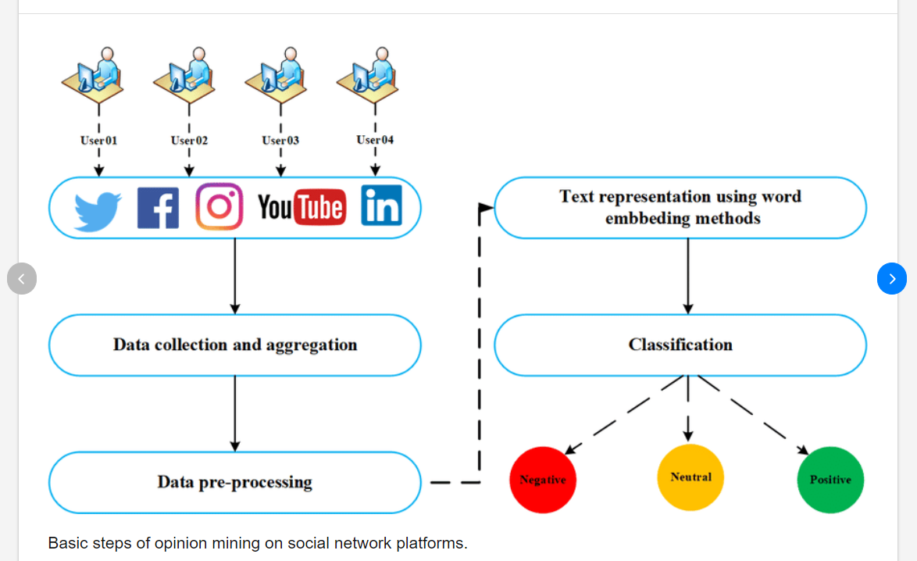
Evaluation and Validation
Evaluation of aspect-based opinion mining systems based on LDA models involves assessing the quality of aspect identification, opinion extraction, and sentiment analysis. This can be done using metrics such as precision, recall, F1-score, and accuracy for aspect extraction and sentiment classification tasks. Additionally, human judgment and qualitative analysis may be used to validate the relevance and coherence of identified aspects and opinions.

Slide 12
Conclusion
LDA and its variants provide powerful tools for aspect-based opinion mining by automatically identifying latent topics (aspects) from text data and extracting opinions associated with these aspects. By leveraging LDA models and their extensions, researchers and practitioners can gain valuable insights into the opinions expressed in large collections of textual data, enabling more informed decision-making and understanding of user preferences.

Slide 13
TERMINAL QUESTIONS
1.What are the primary metrics used to evaluate the performance of aspect-based opinion mining systems?
2.How does aspect-based opinion mining differ from general sentiment analysis, and what specific challenges does it present in evaluation?
3.How can aspect-based opinion mining systems be evaluated for their ability to handle domain-specific language and terminology?
4.What are the most effective evaluation metrics for aspect-based opinion mining, and how do they compare in terms of measuring system performance?
5.What methods can be used to evaluate the robustness of aspect-based opinion mining systems against noisy or unstructured text data?

Slide 14
REFERENCES FOR FURTHER LEARNING OF THE SESSION
Reference Books:
1. “Opinion Mining”, Greame Hrist, Bing Liu, Morgan Publications, 2012.
2. “Recommender Systems”, C.C. Aggarwal, Springer, 2016.
“Temporal Opinion Mining”, Haishi Bai, Boris Scholl, CRC Press, 2010.
“Recommender systems handbook”, Federico Pozzi, Elisabetta Fersini, Enza Messina, Bing Liu, 2016.
“New Opportunities for Sentiment Analysis and Information Processing”, Aakansha Sharaff, G. R. Sinha, Surbhi Bhatia, IGI Global, 2021.
Sites and Web links:
https://link.springer.com/book/10.1007/978-3-031-02145-9
https://www.mdpi.com/journal/applsci/special_issues/Sentiment_Social_Media
https://nlp.stanford.edu/sentiment

Slide 15

THANK YOU
Team – OMRS

