Slide 1
Department of AI&DS
COURSE NAME: OPINION MINING & RECOMMENDeR SYSTEMS
COURSE CODE: 22SDM3202R
TOPIC :
INTRODUCTION TO DATA MODELS
Session - 06

Slide 2



AIM OF THE SESSION
To familiarize students with the Data Models
INSTRUCTIONAL OBJECTIVES
This Session is designed to:
Demonstrate the Mining Opinion Models
Describe the Data models
LEARNING OUTCOMES
At the end of this session, you should be able to:
Define opinion Techniques
Describe the Data Models

Slide 3
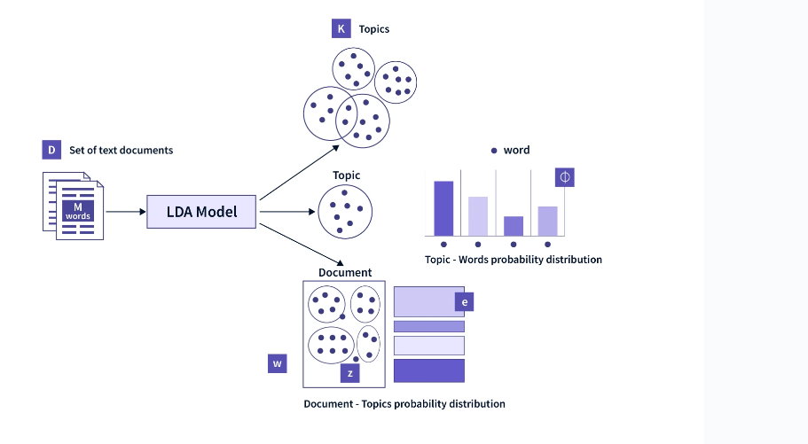
Latent Dirichlet Allocation (LDA)
Latent Dirichlet Allocation (LDA) is a popular topic modeling technique used in aspect-based opinion mining to identify latent topics (aspects) from a collection of text data. Several variations of LDA have been proposed to better suit specific tasks or address certain challenges. Here's an overview of some commonly used LDA models and their characteristics:

Slide 4
LDA (Latent Dirichlet Allocation)
Description: LDA is a generative probabilistic model that represents documents as random mixtures over latent topics. It assumes that each document is generated by a distribution over topics, and each topic is represented by a distribution over words.
Inference and Estimation: Inference in LDA typically involves algorithms like variational inference or Gibbs sampling to estimate the posterior distribution over latent variables (topics and topic proportions) given the observed data (documents).
Applications: LDA has been widely used for topic modeling in various domains, including opinion mining. It can be applied to identify latent aspects/topics in reviews or feedback data.

Slide 5
S-LDA (Supervised Latent Dirichlet Allocation)
Description: S-LDA extends LDA by incorporating supervised information (e.g., document labels or sentiment labels) into the model. It allows for modeling the relationships between topics and observed labels.
Inference and Estimation: Inference in S-LDA involves estimating both the latent topics and the supervised labels. Variational methods or Gibbs sampling can be used for inference.
Applications: S-LDA is useful when there is labeled information available, such as sentiment labels associated with documents. It can help in aspect-based sentiment analysis by jointly modeling topics and sentiment.

Slide 6
D-LDA (Dynamic Latent Dirichlet Allocation)
Description: D-LDA extends LDA to model the evolution of topics over time in a collection of documents. It allows topics to change over time, capturing temporal dynamics in the data.
Inference and Estimation: In D-LDA, inference involves estimating the topic distributions for each time period and how they evolve over time. Techniques like variational inference or Gibbs sampling can be used.
Applications: D-LDA is useful for analyzing temporal aspects in text data, such as tracking changes in opinions or topics over time in online reviews or social media data.

Slide 7
PLDA (Pachinko Allocation)
Description: PLDA is a hierarchical extension of LDA that allows for nested topic structures. It represents documents as a hierarchy of topics, where each level corresponds to different levels of granularity.
Inference and Estimation: Inference in PLDA involves estimating the posterior distribution over latent variables, considering the hierarchical structure of topics. Variational methods or Gibbs sampling can be used.
Applications: PLDA can capture complex relationships between topics at different levels of granularity, which can be useful in analyzing hierarchical structures in text data, such as categorizing product reviews into fine-grained aspects and broader categories.

Slide 8
S-PLDA (Supervised Pachinko Allocation)
Description: S-PLDA combines the hierarchical structure of PLDA with supervised information, allowing for the integration of labeled data into the model. It enables the joint modeling of hierarchical topics and observed labels.
Inference and Estimation: Inference in S-PLDA involves estimating both the hierarchical topic structure and the supervised labels. Variational methods or Gibbs sampling can be used for inference.
Applications: S-PLDA is beneficial when there is labeled information available and the data exhibit hierarchical relationships. It can be applied in aspect-based sentiment analysis to model fine-grained aspects and sentiment at different levels of granularity.

Slide 9
D-PLDA (Dynamic Pachinko Allocation)
Description: D-PLDA extends PLDA to incorporate temporal dynamics into the hierarchical topic structure. It allows for the modeling of evolving hierarchical topics over time.
Inference and Estimation: Inference in D-PLDA involves estimating the evolving hierarchical topic structure and how it changes over time. Variational methods or Gibbs sampling can be used.
Applications: D-PLDA is useful for analyzing hierarchical and temporal aspects in text data simultaneously, such as tracking the evolution of fine-grained aspects and sentiment over time in reviews or social media data.

Slide 10
Inference and Estimation
Inference and estimation in these LDA models typically involve probabilistic methods such as variational inference, Gibbs sampling, or expectation-maximization (EM) algorithms. These methods aim to approximate the posterior distribution over latent variables given the observed data and model parameters. The choice of inference method depends on the complexity of the model and the available computational resources.
Each of these LDA variants offers unique advantages and can be applied in different scenarios based on the specific requirements of the aspect-based opinion mining task and the characteristics of the text data being analyzed.

Slide 11
TERMINAL QUESTIONS
1.What is Latent Dirichlet Allocation (LDA) and how does it model the generative process of documents?
2. How can one determine the optimal number of topics (K) in LDA for a given corpus?
3.What inference techniques are commonly used in LDA, and how do they work?
4.How does D-PLDA extend the Pachinko Allocation Model to incorporate temporal dynamics
5.What inference techniques are used in D-PLDA to estimate time-evolving topic distributions
6.How does S-PLDA incorporate supervised information into the Pachinko Allocation Model

Slide 12
REFERENCES FOR FURTHER LEARNING OF THE SESSION
Reference Books:
1. “Opinion Mining”, Greame Hrist, Bing Liu, Morgan Publications, 2012.
2. “Recommender Systems”, C.C. Aggarwal, Springer, 2016.
“Temporal Opinion Mining”, Haishi Bai, Boris Scholl, CRC Press, 2010.
“Recommender systems handbook”, Federico Pozzi, Elisabetta Fersini, Enza Messina, Bing Liu, 2016.
“New Opportunities for Sentiment Analysis and Information Processing”, Aakansha Sharaff, G. R. Sinha, Surbhi Bhatia, IGI Global, 2021.
Sites and Web links:
https://link.springer.com/book/10.1007/978-3-031-02145-9
https://www.mdpi.com/journal/applsci/special_issues/Sentiment_Social_Media
https://nlp.stanford.edu/sentiment

Slide 13

THANK YOU
Team – OMRS

