Slide 1
Department of CSE
COURSE NAME: OPINION MINING & Recommender SYSTEMS
COURSE CODE: 22SDM3202
TOPIC :
INTRODUCTION TO OPINION MINING, ASPECT BASED OPINION MINING
Session - 01

Slide 2



AIM OF THE SESSION
To familiarize students with the basic concept of opinion mining and aspect based opinion mining
INSTRUCTIONAL OBJECTIVES
This Session is designed to:
Demonstrate the introduction to the opinion mining, aspect based opinion mining
Describe the opinion mining with an example
LEARNING OUTCOMES
At the end of this session, you should be able to:
Understand the opinion mining and aspect based opinion mining
Describe the opinion mining with an example

Slide 3
Introduction to Opinion Mining
Sentiment analysis, also called opinion mining, is the field of study that
analyzes people’s opinions, sentiments, evaluations, appraisals, attitudes,
and emotions towards entities such as products, services, organizations,
individuals, issues, events, topics, and their attributes.
There are also many names and slightly different tasks, e.g.,
sentiment analysis, opinion mining, opinion extraction, sentiment mining,
subjectivity analysis, affect analysis, emotion analysis, review mining, etc.
the term opinion to denote opinion, sentiment, evaluation, appraisal,
attitude, and emotion

Slide 4
Introduction to Opinion Mining
Opinion mining, also referred to as sentiment analysis, is a branch of natural language processing (NLP) that focuses on extracting and analyzing subjective information from text data.
The primary goal of opinion mining is to determine the sentiment, emotions, attitudes, and opinions expressed within textual content.
This process is crucial for understanding public opinion, customer feedback, social media sentiments, and more.

Slide 5
The field of opinion mining involves several key components and techniques:
Text Preprocessing: Before analyzing opinions, text data undergoes preprocessing steps such as tokenization, stemming, and removing stopwords to prepare it for analysis.
Sentiment Classification: Sentiment classification is the task of categorizing text into different sentiment categories such as positive, negative, or neutral. This classification can be performed using machine learning algorithms trained on labeled datasets.
Aspect-Based Sentiment Analysis: Aspect-based sentiment analysis goes beyond overall sentiment to identify sentiments associated with specific aspects or features mentioned in the text. For example, in a product review, aspect-based sentiment analysis can determine opinions about aspects like price, performance, design, and customer support.

Slide 6
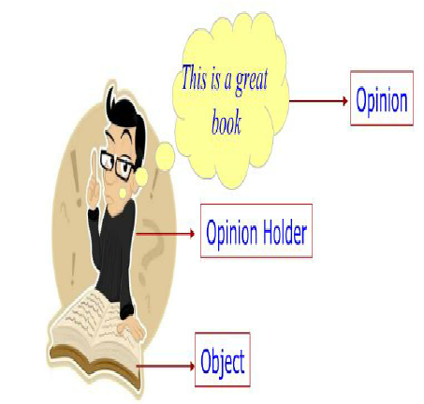
Opinion Summarization: Opinion mining also involves summarizing and aggregating opinions from multiple sources to generate insights and understand overall sentiment trends.

Slide 7
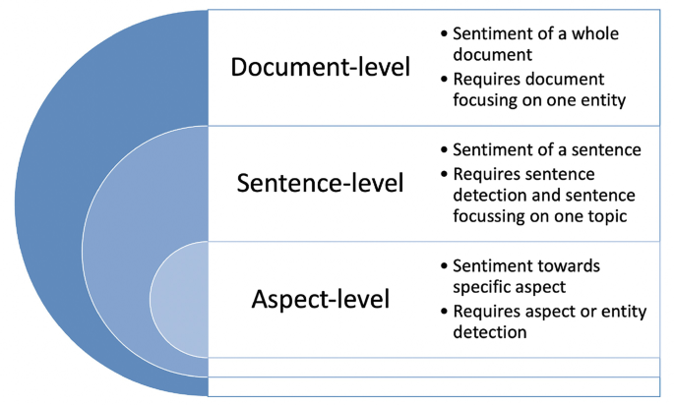
Types of Sentiment Analysis

Slide 8
Aspect-Based Opinion Mining (ABOM)
Aspect-Based Opinion Mining (ABOM) is a subfield of opinion mining (sentiment analysis) that focuses on extracting not just overall sentiment, but also the specific aspects of a product, service, or topic that users are commenting on, and the sentiment expressed towards those aspects.
Here's a breakdown of the key concepts:
Aspects: These are the features or characteristics of the target entity (product, service, etc.) that users discuss in their opinions. Examples include "battery life" for a phone, "comfort" for a hotel stay, or "plot" for a movie review.
Sentiment: This refers to the positive, negative, or neutral emotion or opinion expressed towards an aspect.

Slide 9
Why is ABOM Important?
ABOM goes beyond the limitations of traditional sentiment analysis, providing more granular insights. Here's why it's important:
Actionable Insights: ABOM allows businesses to understand user opinions on specific features, enabling data-driven decisions for product development, marketing strategies, and customer service.
Targeted Customer Service: By identifying aspects with negative sentiment, companies can provide targeted support and address user concerns more effectively.
Improved User Experience: Understanding user feedback on aspects allows companies to identify areas for improvement and enhance the overall user experience.

Slide 10
Key Tasks in ABOM:
Aspect Extraction: The process of identifying the specific aspects mentioned in text data. Techniques include rule-based approaches, machine learning, and deep learning models.
Sentiment Classification: Classifying the sentiment expressed towards each extracted aspect. This involves sentiment analysis techniques tailored to aspects.
Opinion Summarization: Conveying the overall sentiment and key opinions for each aspect in a concise format.
Visualization: Presenting the extracted information in charts, graphs, or other visual formats for easy interpretation.

Slide 11
Challenges in ABOM:
Aspect Ambiguity: Terms like "price" can have multiple interpretations (product cost vs. service fee).
Informal Language: Slang, abbreviations, and emojis can pose challenges for sentiment analysis algorithms.
Context Dependence: Accurately identifying aspects and sentiment often requires understanding the surrounding text.

Slide 12
Applications of ABOM:
Product Review Analysis: Analyze online reviews to understand customer sentiment towards various product features.
Social Media Monitoring: Track brand mentions and identify aspects driving positive or negative sentiment.
Market Research: Gain insights into user preferences and identify aspects crucial for product success.
Customer Service Improvement: Analyze customer feedback to identify areas for improvement in specific aspects of a service.

Slide 13
TERMINAL QUESTIONS
1. Define opinion mining (or sentiment analysis) in your own words.?
2. What is the primary goal of opinion mining?
3. How does opinion mining contribute to decision-making in businesses?
4. Describe the difference between subjective and objective text?

Slide 14
REFERENCES FOR FURTHER LEARNING OF THE SESSION
Reference Books:
“Opinion Mining and Sentiment Analysis”, Greame Hrist, Bing Liu, Morgan
Publications, 2012.
2. “Recommender Systems”, C.C. Aggarwal, Springer, 2016.
“Temporal Opinion Mining”, Haishi Bai, Boris Scholl, CRC Press, 2010.
“Recommender systems handbook”, Federico Pozzi, Elisabetta Fersini, Enza Messina, Bing Liu, 2016.
“New Opportunities for Sentiment Analysis and Information Processing”, Aakansha Sharaff, G. R. Sinha, Surbhi Bhatia, IGI Global, 2021.
Sites and Web links:
https://link.springer.com/book/10.1007/978-3-031-02145-9
https://www.mdpi.com/journal/applsci/special_issues/Sentiment_Social_Media
https://nlp.stanford.edu/sentiment

Slide 15

THANK YOU
Team – OMRS

