Slide 1
Department of CSE
COURSE NAME: OPINION MINING & Recommender SYSTEMS
COURSE CODE: 22SDM3202
TOPIC :
PLSI Model - Multinomial LDA, Parameter Estimation -Smoothing - Model Selection.
Session - 05

Slide 2



AIM OF THE SESSION
To familiarize students with the PLSI Model - Multinomial LDA, Parameter Estimation -Smoothing - Model Selection
INSTRUCTIONAL OBJECTIVES
This Session is designed to:
Demonstrate the PLSI Model - Multinomial LDA, Parameter Estimation -Smoothing - Model Selection
LEARNING OUTCOMES
At the end of this session, you should be able to:
Understand the PLSI Model - Multinomial LDA, Parameter Estimation -Smoothing - Model Selection

Slide 3
PLSI Model
PLSI (Probabilistic Latent Semantic Indexing) is a statistical model used for analyzing co-occurrence patterns in large datasets, particularly in the context of document analysis and information retrieval. PLSI is a precursor to more advanced topic modeling techniques like Latent Dirichlet Allocation (LDA).
Let's explore PLSI with an example:
Understanding PLSI Model:
Basic Concept:
PLSI is based on the idea that observed data (e.g., word occurrences in documents) are generated from hidden (latent) variables representing topics.

Slide 4
Components:
Documents: Collection of textual documents.
Words: Vocabulary of words present in the documents.
Topics: Latent variables representing underlying themes or topics in the corpus.
Objective:
PLSI aims to model the joint distribution of documents and words using a probabilistic framework based on the assumption of latent topics.

Slide 5
Key Concepts
Documents and Words:
Each document is represented as a collection of words.
The goal is to understand the underlying topic structure that gives rise to the observed words in the documents.
Latent Topics:
Latent topics are hidden variables that explain the correlations between words and documents.
Each topic is characterized by a distribution over words.
Probabilistic Model:
PLSI models the probability of a word appearing in a document as a mixture of conditionally independent multinomial distributions.

Slide 6

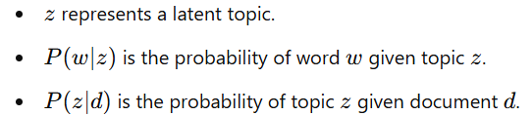
Mathematical Representation
The probability of a word www occurring in a document ddd is given by:
where:

Slide 7

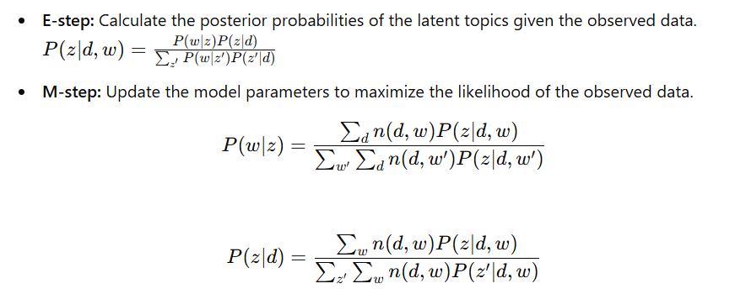
Steps in PLSI
Initialization:
Randomly initialize the probabilities
2. Expectation-Maximization (EM) Algorithm:

Slide 8
Iteration:
Repeat the E-step and M-step until convergence.
Applications of PLSI
Information Retrieval: Improve search engine results by identifying topics within documents and queries.
Document Clustering: Group similar documents based on their topic distributions.
Recommender Systems: Provide recommendations by understanding the latent interests of users based on the topics of the documents they interact with.
Advantages and Limitations
Advantages:
Provides a probabilistic framework for understanding document-term relationships.
More robust than simple latent semantic analysis (LSA) which uses singular value decomposition (SVD).

Slide 9
Limitations:
PLSI is prone to overfitting because it estimates a large number of parameters.
It does not provide a natural way to handle new documents not seen during training.
Latent Dirichlet Allocation (LDA) is often preferred as it introduces Dirichlet priors to mitigate overfitting and handle new documents better.

Slide 10
Multinomial LDA
Latent Dirichlet Allocation (LDA) is a generative probabilistic model for collections of discrete data, such as text corpora. LDA is often referred to as Multinomial LDA because it models the distribution of words in documents as multinomial distributions. It is widely used for topic modeling to discover the hidden thematic structure in a collection of documents.
Overview of Multinomial LDA
LDA posits that documents are mixtures of topics, and topics are distributions over words. Unlike PLSI, LDA introduces Dirichlet priors which provide a more robust framework and better generalization.

Slide 11
Key Concepts
Documents and Words:
A document is represented as a collection of words.
Each word in a document is associated with one of the latent topics.
Latent Topics:
Topics are distributions over a fixed vocabulary of words.
Each document exhibits multiple topics in different proportions.
Dirichlet Priors:
LDA uses Dirichlet distributions as priors for the topic distributions of documents and the word distributions of topics.
This helps in controlling the sparsity and smoothness of the distributions.

Slide 12
Applications of LDA
Topic Modeling: Identify and interpret topics in large text corpora.
Document Clustering: Group similar documents based on their topic distributions.
Information Retrieval: Enhance search engine results by understanding the topical content of documents.
Recommender Systems: Improve recommendations by analyzing user interactions with documents in terms of topics.
Advantages and Limitations
Advantages:
Incorporates Dirichlet priors to control topic sparsity and smoothness.
Provides a more principled way to handle new documents compared to PLSI.

Slide 13
Limitations:
Inference can be computationally intensive.
The number of topics KKK must be specified in advance.
Interpretability of topics can be subjective and may require domain knowledge.

Slide 14
Parameter Estimation
Parameter estimation in LDA involves determining the topic distributions for documents (θ\thetaθ) and word distributions for topics (ϕ\phiϕ). This can be done using various techniques:
1. Variational Inference:
Objective: Approximate the true posterior distribution with a simpler distribution that is easier to compute.
Method: Optimize the variational parameters by minimizing the Kullback-Leibler (KL) divergence between the variational distribution and the true posterior.
Process: Assume a variational distribution q(θ,z∣γ,ϕ)q(\theta, z | \gamma, \phi)q(θ,z∣γ,ϕ) and update the variational parameters γ\gammaγ and ϕ\phiϕ iteratively.

Slide 15
2. Gibbs Sampling:
Objective: Use Markov Chain Monte Carlo (MCMC) methods to sample from the posterior distribution.
Method: Iteratively sample each latent variable (topics for each word) conditioned on the current values of all other variables.
Process: Update the topic assignment zdnz_{dn}zdn​ for each word in the document and recompute the topic and word distributions.

Slide 16
Smoothing
Smoothing in LDA is essential to handle the sparsity in word distributions and to avoid overfitting. Dirichlet priors (α\alphaα and β\betaβ) are used for this purpose.
1. Dirichlet Priors:
α\alphaα (Document-Topic Dirichlet prior): Controls the distribution of topics in documents.
Small α\alphaα: Documents are likely to contain fewer topics (more specific topics).
Large α\alphaα: Documents can contain many topics (more mixed topics).
β\betaβ (Topic-Word Dirichlet prior): Controls the distribution of words in topics.
Small β\betaβ: Topics are likely to contain fewer words (more specific words).
Large β\betaβ: Topics can contain many words (more mixed words)

Slide 17
2. Laplace Smoothing:
A simple form of smoothing where a small constant is added to word counts to avoid zero probabilities.
Model Selection
Choosing the right number of topics KKK and other hyperparameters is critical for the performance of LDA. Model selection involves evaluating different models and selecting the best one based on certain criteria.
Perplexity:
Definition: A measure of how well a probabilistic model predicts a sample.
Lower perplexity: Indicates a better generalization of the model.
Calculation: Based on the likelihood of a held-out validation set.

Slide 18
3. Coherence Score:
Definition: Measures the interpretability of the topics by evaluating the degree of semantic similarity between high-scoring words in the topics.
Higher coherence: Indicates more interpretable and meaningful topics.
4. Cross-Validation:
Split the data into training and validation sets.
Train the model on the training set and evaluate on the validation set.
Use metrics like perplexity or coherence to compare models.

Slide 19
5. Bayesian Information Criterion (BIC) and Akaike Information Criterion (AIC):
BIC and AIC: Criteria based on the likelihood of the model with penalties for the number of parameters.
Purpose: Help prevent overfitting by balancing model fit and complexity.

Slide 20
TERMINAL QUESTIONS
1. What is the role of Laplace smoothing in LDA?
2. What metrics should you use to evaluate model performance?
3. How can LDA be integrated with other machine learning techniques??
4. What are the computational challenges associated with LDA?

Slide 21
REFERENCES FOR FURTHER LEARNING OF THE SESSION
Reference Books:
1. “Opinion Mining”, Greame Hrist, Bing Liu, Morgan Publications, 2012.
2. “Recommender Systems”, C.C. Aggarwal, Springer, 2016.
“Temporal Opinion Mining”, Haishi Bai, Boris Scholl, CRC Press, 2010.
“Recommender systems handbook”, Federico Pozzi, Elisabetta Fersini, Enza Messina, Bing Liu, 2016.
“New Opportunities for Sentiment Analysis and Information Processing”, Aakansha Sharaff, G. R. Sinha, Surbhi Bhatia, IGI Global, 2021.
Sites and Web links:
https://link.springer.com/book/10.1007/978-3-031-02145-9
https://www.mdpi.com/journal/applsci/special_issues/Sentiment_Social_Media
https://nlp.stanford.edu/sentiment

Slide 22

THANK YOU
Team – OMRS

