Slide 1
AI-8 • INFOSYS REVIEW – 2
TEAM & GUIDANCE
CONSENT-MANAGED DATA PIPELINES FOR ENTERPRISE AI (DEPA inspired)
DATA PIPELINES
FOR ENTERPRISE AI
01
Hritwik Rupesh
02
Likith Kumar
03
Venkata Satya Sai Teja
04
Pavan Kumar
DEPA-Inspired Consent Governance & Enforcement Platform
05
Prakash
CORE PRINCIPLE
DATA SHOULD FLOW ONLY WHEN VALID CONSENT EXISTS.
Department
CSE
Faculty Guide
Dr S. Mohan Krishna
HOD
Dr G. Srinivasarao
Review – 2 | 26 September 2026

Slide 2
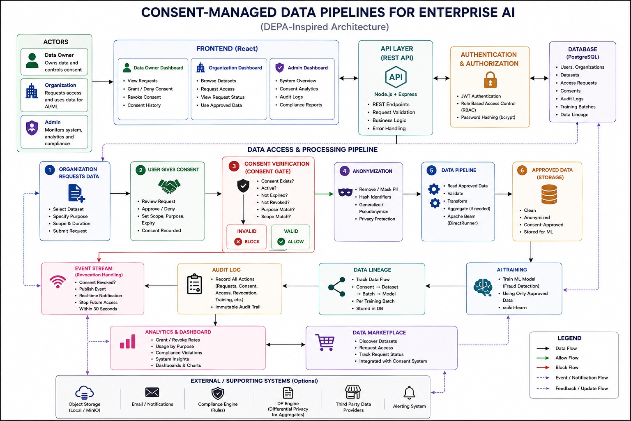
SYSTEM ARCHITECTURE
02
Consent-first enterprise data flow and policy enforcement
CONSENT GATE
Policy enforcement point

Slide 3
DATABASE DESIGN
03
Core entities supporting consent, access control and auditability
USER
ORGANIZATION
DATASET
PK id
PK id
PK id
name
name
scope
role
type
provider_id
ACCESS_REQUEST
CONSENT
AUDIT_LOG
PK id
PK id
PK id
consent_id
user_id • dataset_id
consent_id
requested_scope
status • purpose
event
expires_at
timestamp
RELATIONSHIP LOGIC
DATA_LINEAGE
TRAINING_BATCH
Consent → Access → Audit
Dataset → Training → Lineage
PK id
PK id
batch_id
dataset_id
model_ref
created_at

Slide 4
IMPLEMENTATION PROGRESS
04
Current working module vs. planned extensions
CURRENT IMPLEMENTATION
NEXT / PENDING
Core Consent Governance & Enforcement
→
AI Training Pipeline
✓
React dashboard & consent UI
Data → approved training batches
✓
REST APIs with PostgreSQL
→
Data Lineage
Consent → dataset → batch → model
✓
Consent creation / approval / denial
Anonymization
→
✓
Consent revocation & lifecycle states
PII masking / pseudonymization
✓
Consent Gate: purpose + scope + validity checks
→
Differential Privacy
Aggregate privacy controls
✓
Access blocking for invalid / revoked consent
→
Analytics & Marketplace
✓
Audit logging & registry
Usage insights + governed discovery
EXTENSION ROADMAP
Core module: IMPLEMENTED
Overall % intentionally left editable — advanced modules are still in progress.

Slide 5
NOVEL FEATURES
05
What makes the platform consent-aware rather than simply access-controlled
01
CONSENT GATE
02
PURPOSE BINDING
03
GRANULAR SCOPE
Central policy enforcement before data access.
Consent is tied to an approved use such as AI training.
Access is constrained to the authorized data scope.
IMPLEMENTED
IMPLEMENTED
IMPLEMENTED
04
REVOCATION-AWARE
05
AUDITABLE USAGE
06
PRIVACY EXTENSION
Revocation immediately changes the access decision.
Creation, approval and blocked access are recorded.
Anonymization and differential privacy are planned pipeline controls.
IMPLEMENTED
IMPLEMENTED
PLANNED

Slide 6
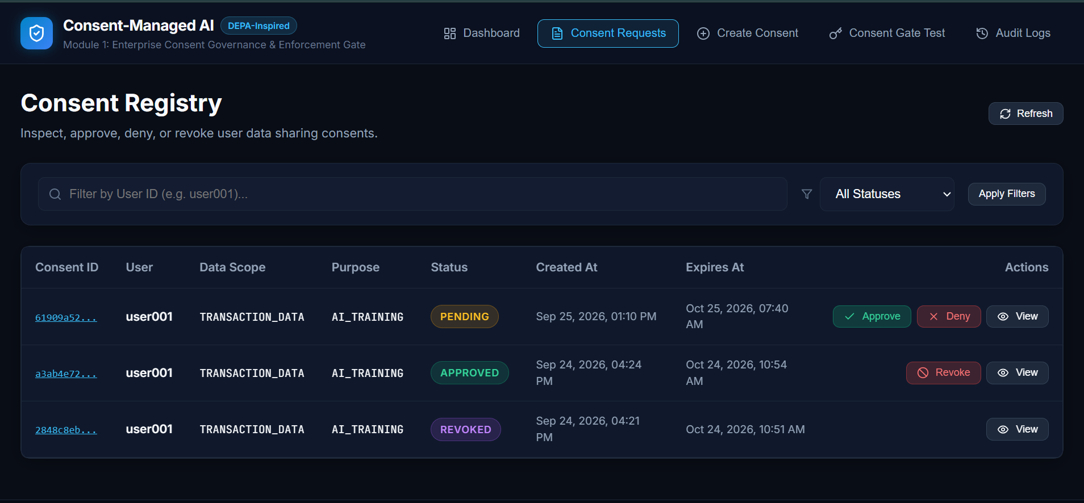
TESTING, VALIDATION & BUG RESOLUTION
06
Validation focuses on the policy decisions that protect data access
ID
TEST CONDITION
EXPECTED RESULT
STATUS
IMPLEMENTATION EVIDENCE
01
Valid active consent
Access allowed
PASS
02
Revoked consent
Access blocked
PASS
03
Purpose mismatch
Access blocked
PASS
04
Scope mismatch
Access blocked
PASS
05
Expired consent
Access blocked
VALIDATED
06
Pending consent
Access blocked
VALIDATED
07
Consent creation
Audit event generated
PASS
08
Consent approval
Status + audit updated
PASS
BUG RESOLUTION STATUS
API validation • database connectivity • consent state transitions • dashboard synchronization • audit logging
Issues were iteratively validated through API + UI testing during implementation.

Slide 7
FURTHER PLAN OF ACTION
07
Roadmap from the implemented governance core to a full consent-aware AI pipeline
PHASE 1
CURRENT
PHASE 2
NEXT
PHASE 3
EXTENSION
✓
Consent Management
→
Consent-aware ML pipeline
→
Differential privacy
✓
Consent Registry
→
Data lineage tracking
→
AI training pipeline
→
→
✓
Consent Gate
→
Anonymization
→
Data marketplace
✓
Approve / Deny / Revoke
→
Privacy controls
→
External data providers
✓
Audit Logging
→
Advanced analytics
→
Compliance automation
✓
Dashboard
CONSENT
→
POLICY
→
DATA
→
AI
→
AUDIT
A governed path from user consent to accountable AI.

