Slide 1
TLB Address Translation Simulator
OPERATING SYSTEMS · MODULE 5: MEMORY MANAGEMENT · MINI PROJECT #45
VA 300
VPN
1
OFFSET
44
An interactive approach to virtual-to-physical translation and TLB performance analysis
0000 0001 0010 1100
TLB HIT → PA 300 · 110 ns
Submitted by
P V Sai Likith (24BCI0174)
M V S Sujan (24BCE2294)
Shrijit (24BCE2469)
Rajnihil (24BCT0191)
Notes:
Introduce the team and the project: a simulator of the memory-management unit that converts virtual addresses to physical addresses using a TLB. The boxes on the right show the core idea: address 300 splits into page 1 and offset 44.

Slide 2
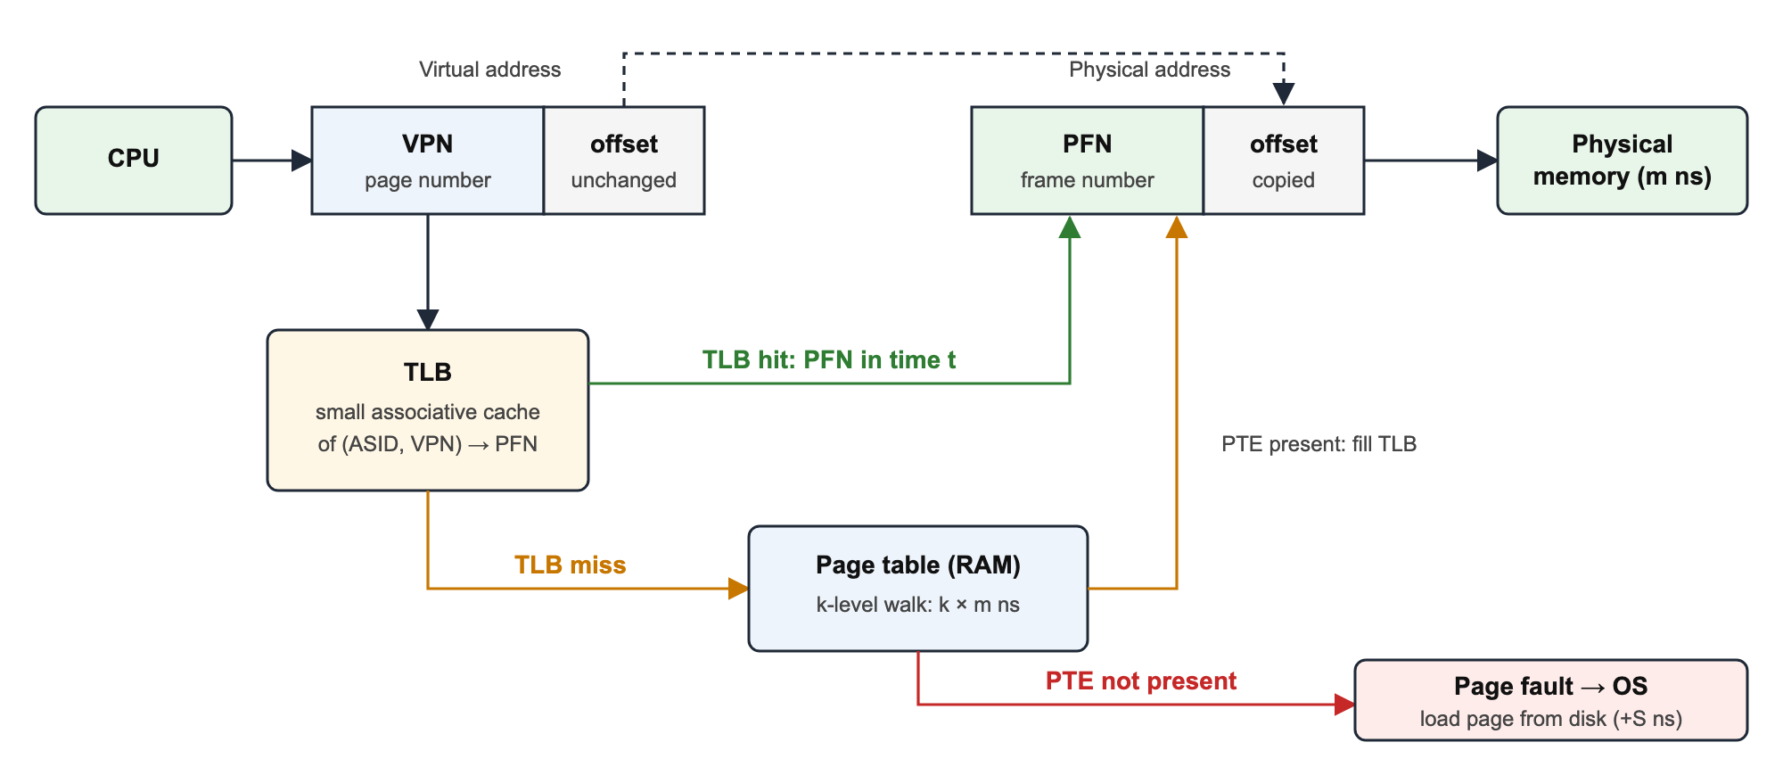
Problem statement
Paging: every virtual address is split into a page number (VPN) and an offset; the page table maps the VPN to a frame (PFN).
Cost: the page table is in RAM, so each access needs an extra memory read, or k extra reads for a k-level table.
TLB: a small, fast cache of recent translations removes most of that cost.
Gap: translation happens in hardware in nanoseconds, so students never see it; textbooks only show static figures.
How a TLB hit, a TLB miss and a page fault differ
Problem statement
Design and implement a simulator that models virtual-to-physical translation with a TLB and page table, shows every step of each translation, and measures how TLB size and replacement policy affect hit ratio and access time.
10 ns
100 ns
8000 ns
TLB lookup
each memory read
page fault (disk)
Notes:
Explain why translation is needed, why the TLB exists, and that the process is invisible to students. Then read the problem statement.

Slide 3
Objectives
1
2
3
4
5
Translate step by step
Simulate TLB and page table
Handle faults and protection
Measure performance
Compare and verify
Split any VA into VPN, offset, set and tag, and build the PA at bit level
Hits, misses, fills and evictions with six policies and three TLB layouts
Page faults (report or demand paging) and write-protection faults
Hit ratio and EAT: measured, textbook model and no-TLB baseline
All policies on one trace, Belady's anomaly, automated tests
Notes:
Five objectives, from translating a single address up to comparing policies and proving correctness.

Slide 4
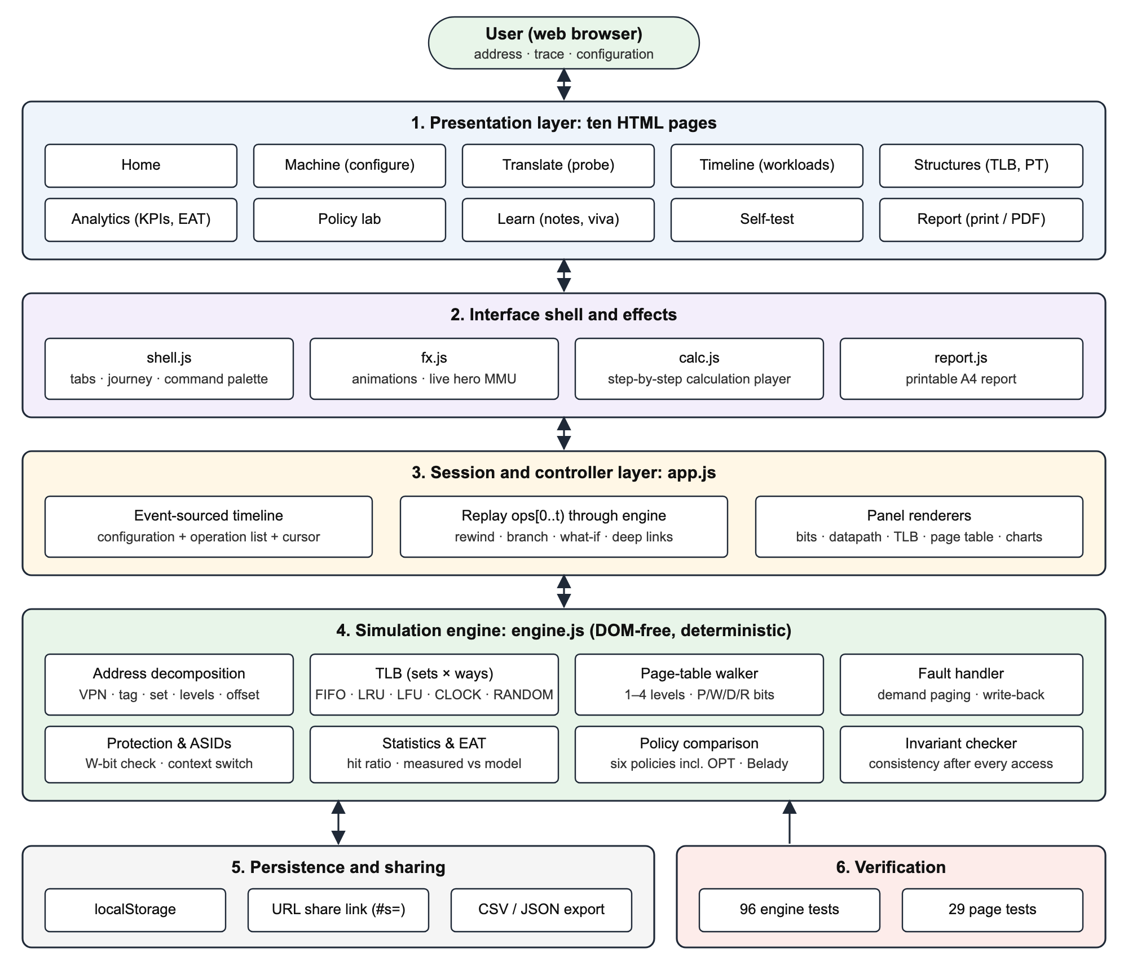
System architecture
Presentation
1
Ten pages, one job each: Machine, Translate, Timeline, Structures, Analytics, Policy lab, Learn, Self-test, Report
Session layer
2
Stores every action as an operation; the state at time t = replay of operations 0 … t
Simulation engine
3
Address split, TLB, page-table walk, faults, protection, statistics; no UI code
Verification
4
96 engine tests run in Node.js and in the browser; same logic re-implemented in Python
Notes:
Walk through the layers top to bottom. Stress the design decision: every action is stored as an operation and replayed through a deterministic engine, which gives rewind and what-if replay for free.

Slide 5
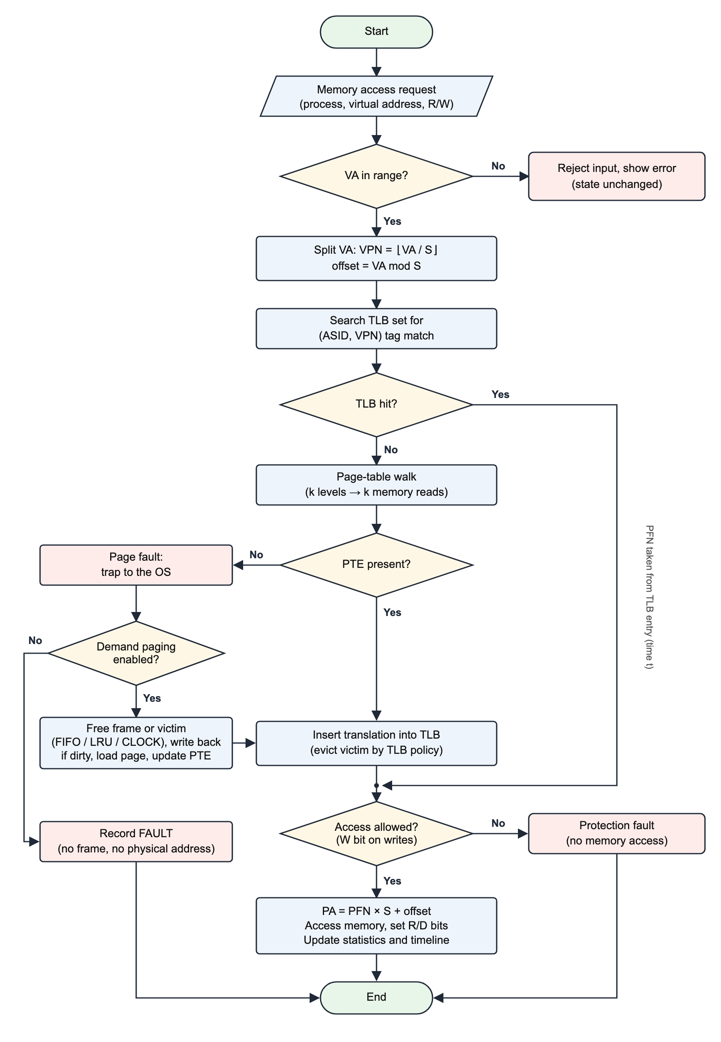
Flowchart: one memory access
1
Check the address
Out-of-range input is rejected; nothing changes
2
Split it
VPN = floor(VA / S), offset = VA mod S
3
Search the TLB
Hit: PFN in 10 ns. Miss: walk the page table (+100 ns per level)
4
Page fault?
PTE not present: report it, or load the page and evict a frame
5
Fill the TLB
Evict a victim chosen by FIFO, LRU, LFU, CLOCK, RANDOM or OPT
6
Check and finish
Read-only page + write = protection fault; else PA = PFN × S + offset
Notes:
Follow one address through the flowchart: range check, split, TLB lookup, then either the hit path or the miss path with a page walk, possibly a page fault, then the permission check and the physical address.

Slide 6
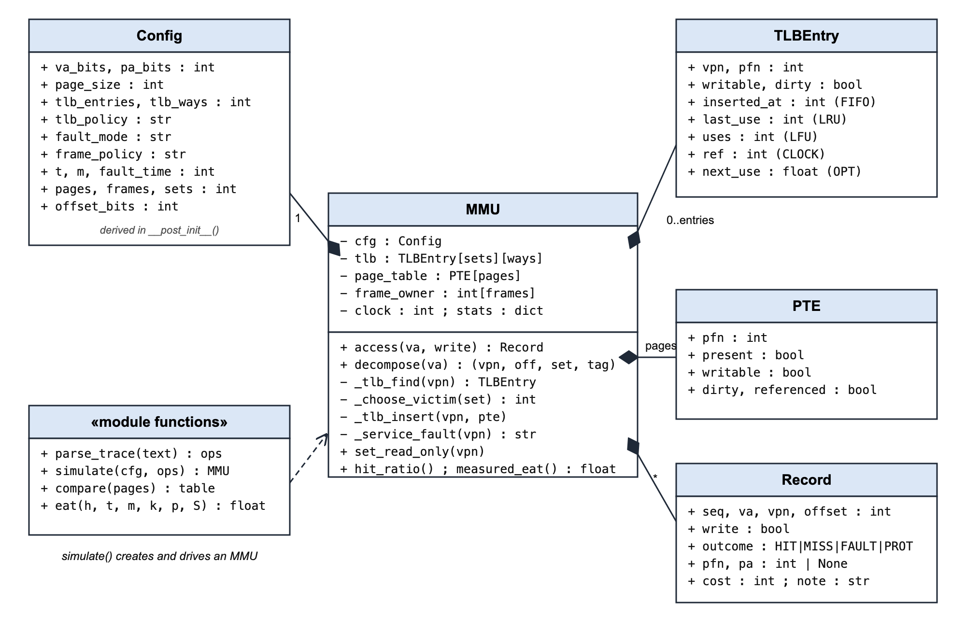
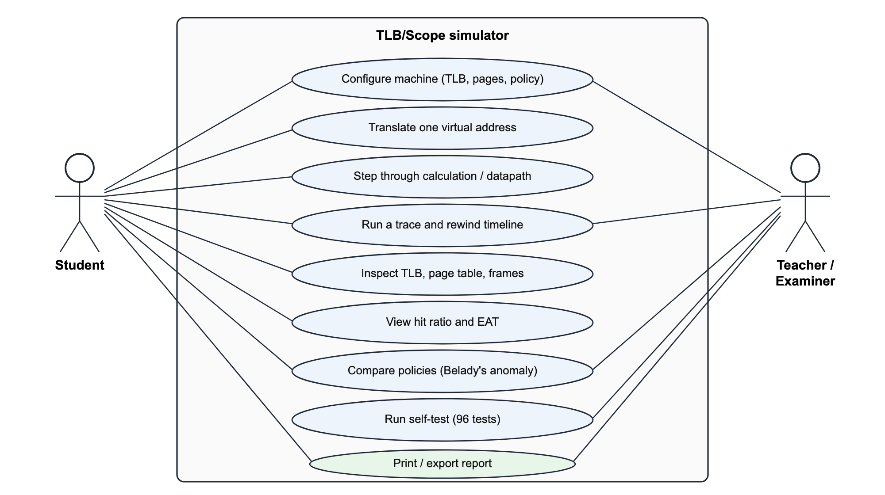
UML: use-case and class diagrams
Use-case diagram: Student and Teacher/Examiner
Class diagram: Config, MMU, TLBEntry, PTE, Record
Notes:
Left: what students and teachers can do. Right: the classes of the Python implementation. MMU owns the TLB entries, the page-table entries and the log of records.

Slide 7
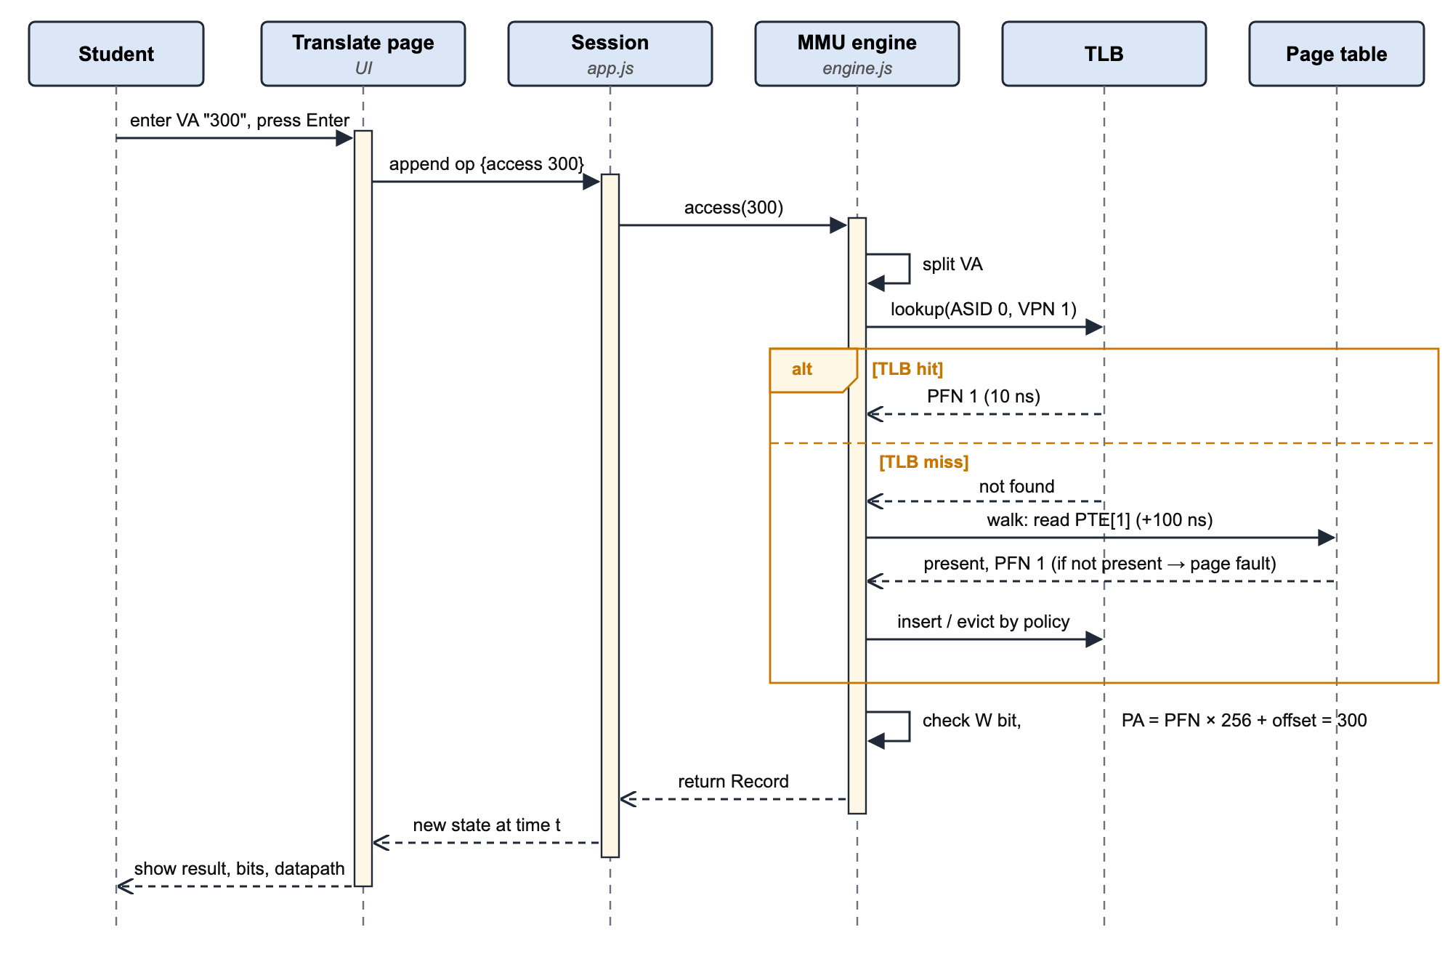
UML: sequence diagram for translating VA 300
TLB hit
TLB returns PFN 1 in 10 ns; the page table is not touched
TLB miss
Walk the page table (+100 ns) and insert the translation
Page fault
PTE not present: the OS must load the page from disk
Notes:
Show the message flow. The alt frame is the key: on a hit the TLB answers directly; on a miss the engine walks the page table and inserts the result into the TLB.

Slide 8
Algorithm and pseudocode
Page number
ACCESS(VA, write):
if VA out of range: reject
VPN <- VA div S ; offset <- VA mod S
cost <- t
if (VPN) in TLB: -> HIT
update lastUse / uses / ref
else: -> MISS
cost <- cost + k*m (page walk)
if PTE not present: -> FAULT
report it, or load page + evict frame
insert into TLB (victim by policy)
if write and read-only: -> PROT
PA <- PFN * S + offset
cost <- cost + m ; record result
VPN = floor(VA / S)
Offset
offset = VA mod S
Physical address
PA = PFN × S + offset
Hit / miss cost
t + m / t + k·m + m
Effective access time
h(t+m) + (1−h)(t+(k+1)m) + p·F
Notes:
Read the pseudocode line by line, then point at the formulas on the right. The worked example: 300 splits into page 1 and offset 44, so PA = 1 × 256 + 44 = 300.

Slide 9
Implementation
Python implementation
Interactive web app (TLB/Scope)
tlb_sim.py · Python 3, standard library only
HTML5 · CSS3 · JavaScript, no back end
Classes: Config, MMU, TLBEntry, PTE, Record
Six TLB policies; report or demand paging
simulate(), compare() and eat() functions
Command line: trace, policy and size options
16 unit tests in test_tlb_sim.py
Ten connected pages, one job each
Bit-level view, MMU datapath, timeline
Live TLB, page table and frame views
Analytics, policy lab and printable report
96 engine tests, also run in the browser
How to run
python3 tlb_sim.py --trace "300 300 0x1A2B 300:W" --policy LRU --entries 4
python3 -m http.server 5173 --directory tlb-simulator # then open localhost:5173
Notes:
The same logic was built twice: a Python command-line simulator that meets the C/C++/Java/Python requirement, and the interactive web app used in the demo. Both give identical results.

Slide 10
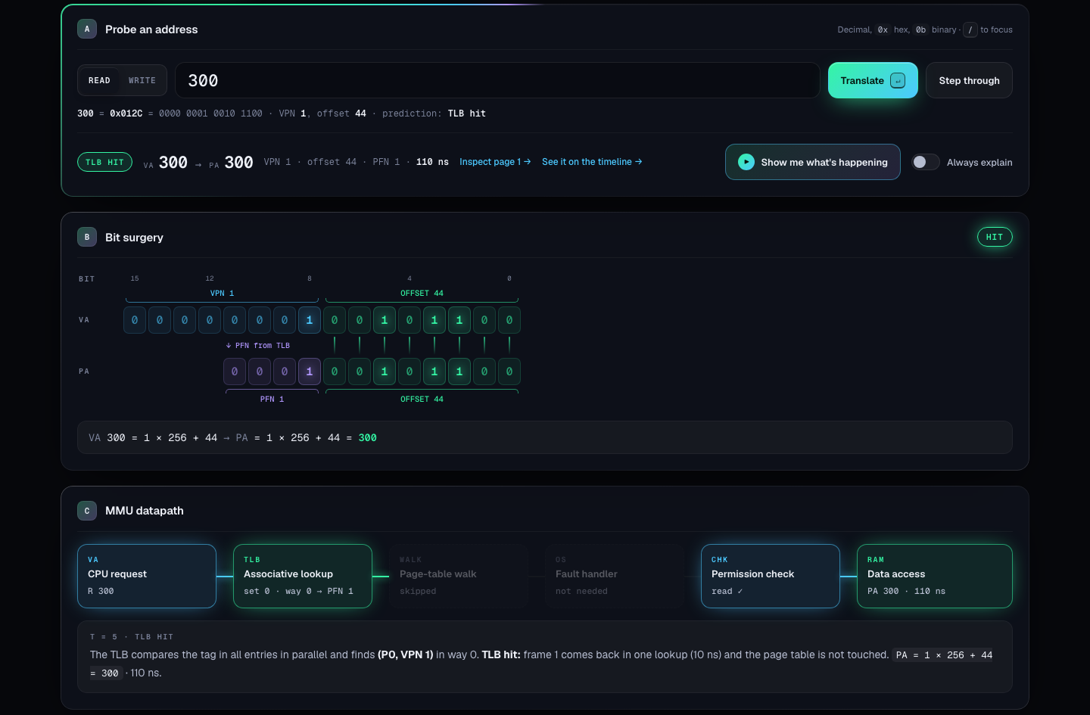
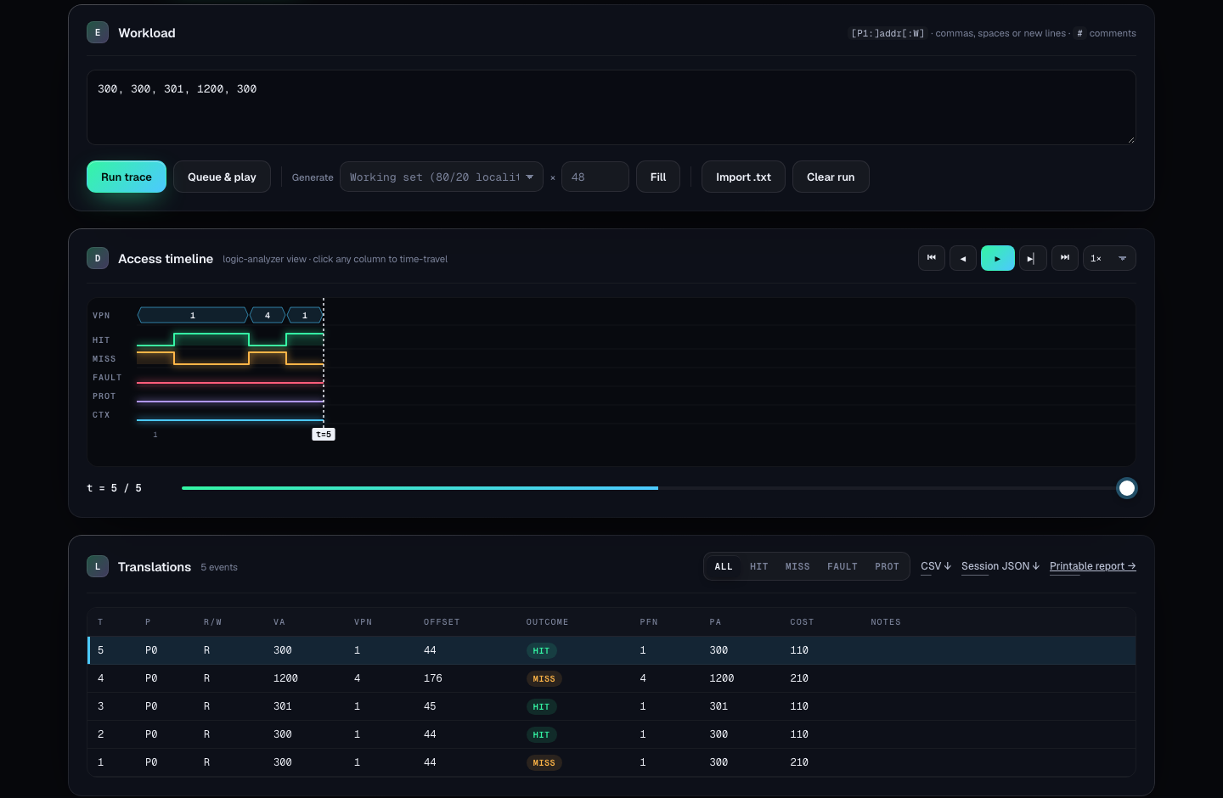
Screenshots: translating addresses
Translate: VA 300 → PA 300, TLB hit, 110 ns
Timeline: hit/miss lanes and the event table
What it shows: VA 300 = page 1 + offset 44 → frame 1 → PA 300. The first access misses (210 ns); every repeat hits (110 ns).
Notes:
Left: the Translate page for VA 300, showing the bit-level view and the datapath. Right: the Timeline page with the trace, the logic-analyzer lanes and the event table.

Slide 11
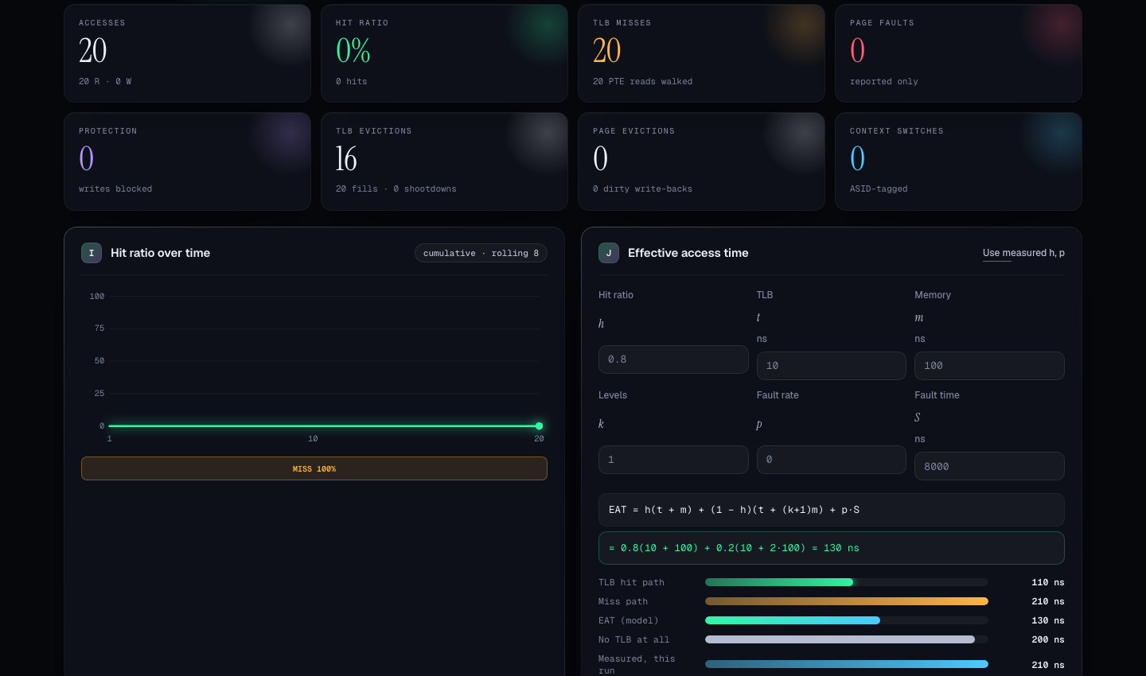
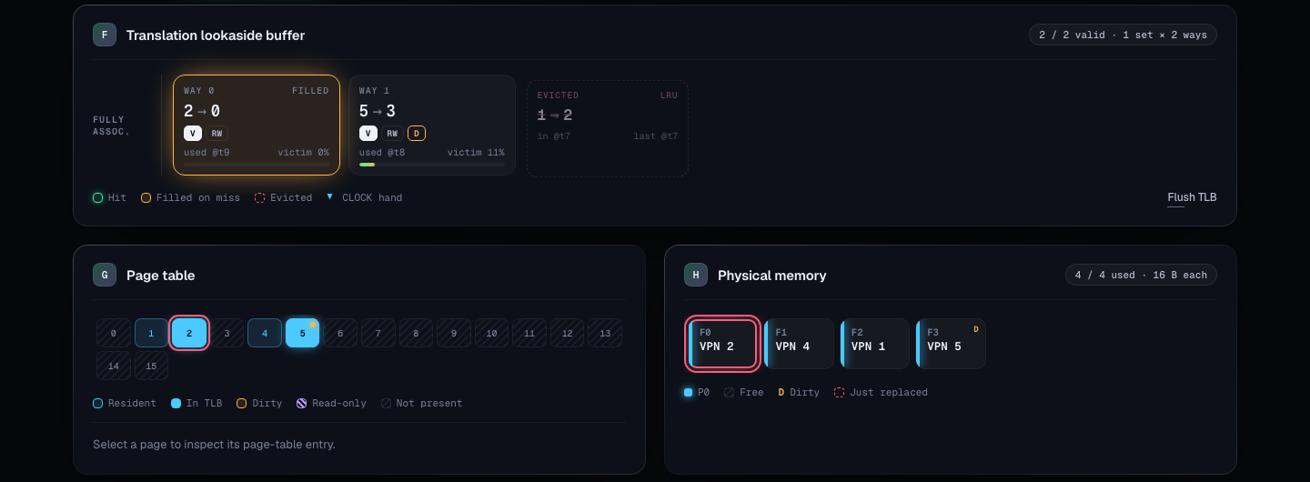
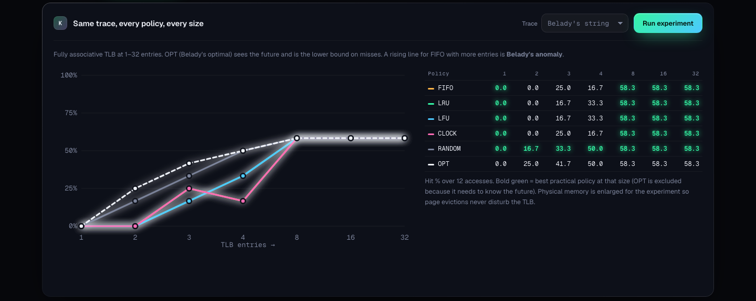
Screenshots: inside the machine and performance
Structures: TLB ways, page table, frames
Analytics: indicators, hit-ratio chart, EAT calculator
Policy lab: six policies on Belady's string
Notes:
Structures shows the TLB ways, page table and frames. Analytics shows the indicators and the EAT calculator. The policy lab compares six policies at seven TLB sizes.

Slide 12
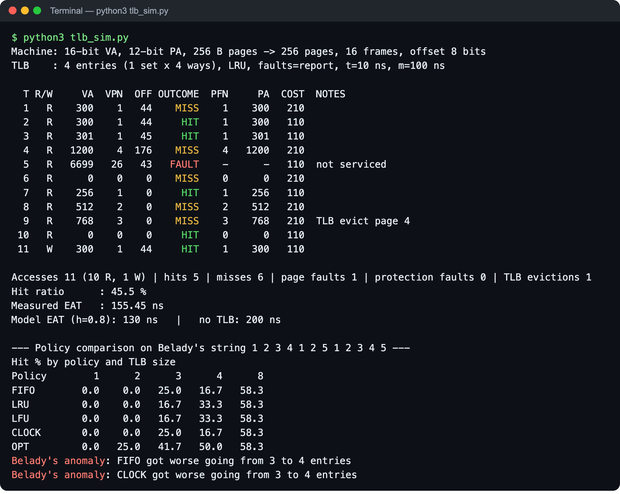
Python implementation output
T1 → T2
VA 300: MISS (210 ns), then HIT (110 ns)
T5
0x1A2B → page 26 not in memory: FAULT
T9
TLB full: LRU evicts page 4 (unused since T4)
Summary
5 hits, 6 misses, 1 fault; 45.5 % hit ratio; 155.45 ns average
Notes:
This is the real output of python3 tlb_sim.py. Point at the miss then hit for 300, the page fault for 0x1A2B, the LRU eviction of page 4 at T = 9, and the summary numbers.

Slide 13
Results
110 ns
45.5 %
155 ns
130 ns
TLB hit (vs 210 ns miss)
hit ratio of the 11-access trace
measured average (vs 200 ns, no TLB)
textbook EAT at h = 0.8
Belady's anomaly
FIFO: 3 entries → 9 misses, 4 entries → 10 misses. A bigger TLB did worse.
LRU and OPT are stack algorithms, so more entries never hurt them. OPT is always the best.
Notes:
Four headline numbers, then the chart. FIFO's hit ratio drops from 25 % to 16.7 % when the TLB grows from 3 to 4 entries: Belady's anomaly. LRU and OPT never get worse with more entries.

Slide 14
Testing and validation
16 / 16
96 / 96
100 %
Python unit tests pass
JavaScript engine tests pass (38 edge cases)
Python and web outputs match
Test case | Expected | Result
VA 300 twice | MISS 210 ns, then HIT 110 ns | Pass
FIFO, 3 entries, 1 2 3 1 4 1 | M M M H M M | Pass
Belady's string, FIFO 3 vs 4 | 9 vs 10 misses | Pass
Write to read-only page | PROT, no physical address | Pass
Address 65536 on 16-bit VA | Rejected, state unchanged | Pass
EAT, h = 0.8, t = 10, m = 100 | 130 ns | Pass
How we validated
Expected values from hand calculation and textbooks
Same inputs run in Python and the web app
Invariant checks after every access
Planted bugs to prove the tests catch them
Notes:
Three kinds of evidence: unit tests with textbook answers, the large JavaScript suite, and the fact that two independent implementations agree exactly.

Slide 15
Live demo plan
1
2
3
4
5
6
Machine
Translate
Timeline
Analytics
Policy lab
Self-test
Factory reset; default 16-bit machine, 4-entry LRU TLB
300 → MISS 210 ns, then 300 → HIT 110 ns, then 0x1A2B → FAULT
Run 0 256 512 768 0 300:W; watch LRU evict page 4
45.5 % hit ratio; 155 ns measured vs 200 ns with no TLB
Belady's string: FIFO gets worse at 4 entries
96 / 96 tests pass live in the browser
Start
python3 -m http.server 5173 --directory tlb-simulator → http://localhost:5173
Notes:
Follow these six steps in the live demo. Start the server first with the command at the bottom, and press Factory reset on the Machine page so the numbers match.

Slide 16
Conclusion and future enhancements
What we achieved
Every translation shown step by step, from bits to physical address
Six replacement policies, three TLB layouts, faults and protection
A hit costs 110 ns instead of 210 ns; at 80 % hits the average drops from 200 to 130 ns
Belady's anomaly reproduced; LRU and OPT never get worse
Python and web versions agree; 16 + 96 tests pass
Future enhancements
Huge pages (2 MiB / 1 GiB)
Two-level TLB (L1 + L2)
Page-walk caches
Multi-core TLB shootdowns
Inverted / hashed page tables
Real program traces
Nested paging for VMs
Quiz mode with grading
Notes:
Summarise what was achieved and the key numbers, then list the future enhancements.

Slide 17
References
[1] A. Silberschatz, P. B. Galvin, G. Gagne, Operating System Concepts, 10th ed., Wiley, 2018.
[2] R. H. and A. C. Arpaci-Dusseau, Operating Systems: Three Easy Pieces, 2018. pages.cs.wisc.edu/~remzi/OSTEP
[3] A. S. Tanenbaum, H. Bos, Modern Operating Systems, 4th ed., Pearson, 2015.
[4] J. L. Hennessy, D. A. Patterson, Computer Architecture: A Quantitative Approach, 6th ed., 2017.
[5] L. A. Belady, "A study of replacement algorithms for a virtual-storage computer," IBM Systems Journal 5(2), 1966.
[6] A. Bhattacharjee, D. Lustig, Architectural and Operating System Support for Virtual Memory, 2017.
[7] Python Software Foundation, The Python Standard Library. docs.python.org/3/library
[8] Mozilla, MDN Web Docs (HTML, CSS, JavaScript). developer.mozilla.org
[9] Object Management Group, UML Specification 2.5.1, 2017.
Notes:
Main sources for the concepts, formulas and test values.

Slide 18
Thank you
210 → 110 ns
one repeated access, thanks to the TLB
Questions?
P V Sai Likith · M V S Sujan · Shrijit · Rajnihil
Notes:
Thank the audience and invite questions.

