Slide 1
APPLIED NLP & TEXT MINING
Fake Product Review & Sentiment Detection
Supervised NLP Pipeline for E-Commerce Feedback Classification & Rating Discrepancy Auditing
Author / Portfolio: Case Study 02 • Natural Language Processing
Technologies: Python, Scikit-Learn, TF-IDF, Random Forest, Collaborative Filtering

Slide 2
INTRODUCTION & SCOPE
Business Problem & NLP Formulation
Combating fake reviews, sarcastic ratings, and marketplace trust degradation
1,469
Verified Reviews Analyzed
Product reviews from digital retail
3 Classes
Sentiment Taxonomy
Positive, Neutral, Negative
50,000
N-Gram Vocabulary Dimensions
Unigrams & Bigrams (1,2)
The Marketplace Integrity Challenge
• The Integrity Crisis: Consumer trust relies heavily on customer reviews. Deceptive 5-star ratings with negative text mislead shoppers and harm merchant credibility.
• Multi-Class Nuance: Reviews are rarely binary; they contain neutral observations ('arrived in 2 days') that must be distinguished from strong satisfaction or dissatisfaction.
• Text Preprocessing Needs: E-commerce text contains colloquial slang, misspellings, and concise fragments ('just wow', 'cheap quality').
Core Objectives & Analytical Scope
• Automated Classification Engine: Build a supervised text classification system to predict underlying sentiment directly from raw text.
• Inconsistency Flagging: Identify rating-sentiment contradictions where numerical stars clash with linguistic polarity.
• Model Benchmarking: Compare Logistic Regression against maximum-margin Linear Support Vector Classifiers (LinearSVC).

Slide 3
METHODOLOGY & ARCHITECTURE
NLP Pipeline & TF-IDF Feature Engineering
Transforming unstructured review prose into high-dimensional feature vectors
Text Cleaning
TF-IDF Vectorization
Class Balancing
• Sanitization: Lowercasing, punctuation removal
• Noise Reduction: Standard English stopword elimination
• Token Extraction: Regex-based word boundary tokenization
• N-gram Range (1, 2): Captures unigrams ('good') and contextual bigrams ('not good', 'bad quality')
• Sublinear TF: log(1 + tf) scaling mitigates high-frequency dominance
• Vocabulary Size: 50,000 features for granular phrase representation
• Imbalanced Data: Positive reviews dominate consumer corpora
• Inverse Weighting: class_weight='balanced' assigned to all models
• Stratified Split: 80% Train (1,175) / 20% Held-out Test (294)

Slide 4
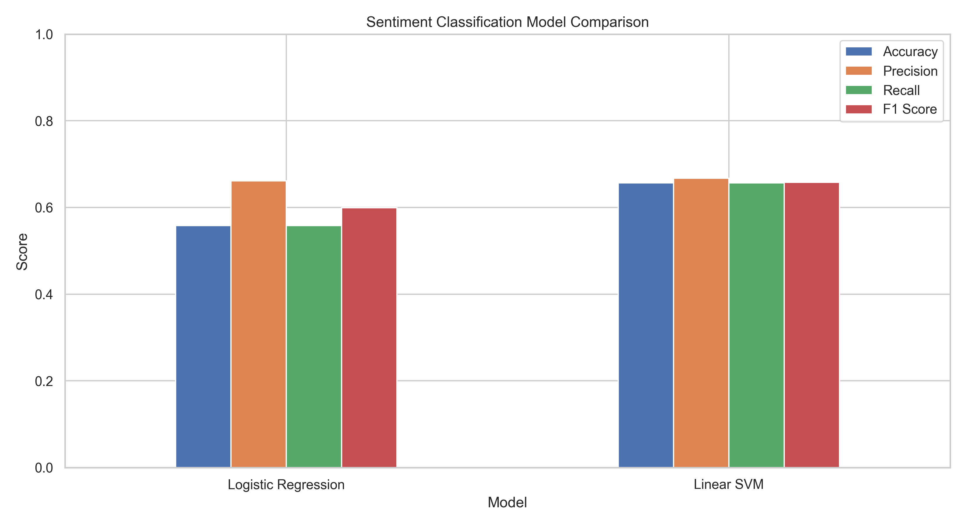
EXPERIMENTAL RESULTS
Model Evaluation: Logistic Regression vs Linear SVM
Linear SVM achieves a 9.87% accuracy advantage in high-dimensional text space
65.65%
Linear SVM Accuracy
+9.87% over Logistic Regression
65.77%
Weighted F1 Score
Superior precision/recall trade-off
66.75%
Precision Score
High fidelity in true sentiment detection
Model Architecture | Accuracy | Precision | Recall | F1 Score
Logistic Regression (Balanced) | 55.78% | 66.12% | 55.78% | 59.94%
Linear SVM (LinearSVC Balanced) | 65.65% | 66.75% | 65.65% | 65.77%
Theoretical Rationale
• Why Support Vector Machines Win: In 50,000-dimensional sparse space, data points are naturally separable. Linear SVM maximizes the margin between classes, avoiding overfitting without complex non-linear kernels.
• Logistic Regression Degradation: Logistic regression relies on calibrated probabilities, which can become blurred in sparse multi-class spaces, leading to misclassifications.

Slide 5
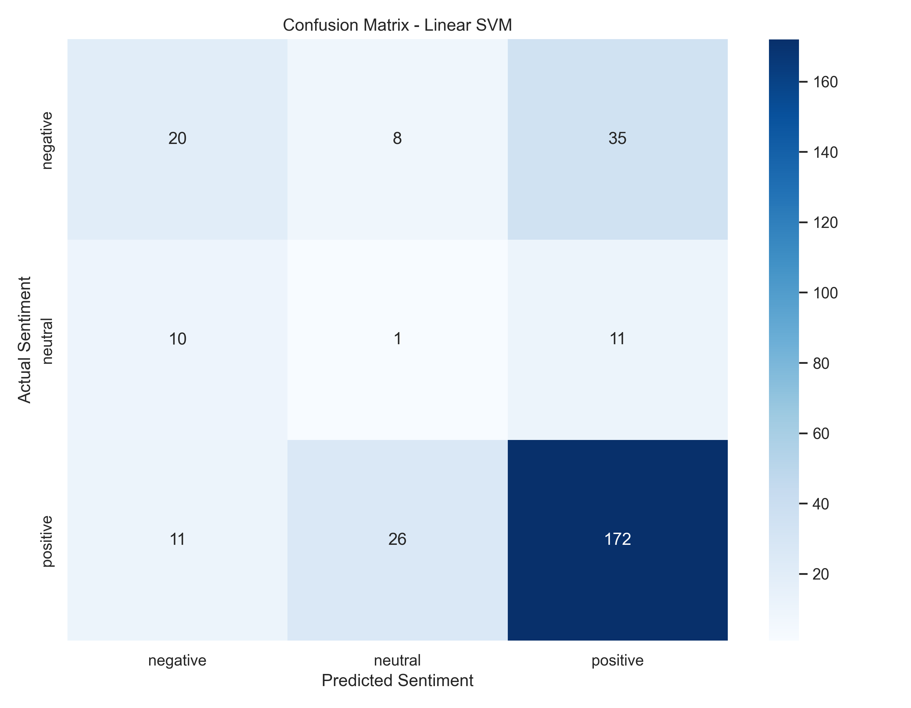
ERROR ANALYSIS & INCONSISTENCY
Confusion Matrix & Review Discrepancy Auditing
Pinpointing rating-text contradictions and deceptive product feedback
Review Snippet | Star Label | Model Pred | Audit Finding
'bad quality' | positive | negative | Fake positive / Star mismatch
'good till now' | positive | positive | Consistent positive
'not specified' | neutral | negative | Ambiguous text fragment
'working fine, but product quality very cheap' | positive | negative | Mixed review / Sarcasm detected
Commercial Value of Auditing
• Deceptive Rating Detection: The model caught cases where users gave 5-star ratings but wrote 'bad quality'. Flagging these allows marketplaces to invalidate fraudulent reviews.
• Handling Neutral Ambiguity: Short neutral statements remain challenging for bag-of-words pipelines; future iterations will leverage dense sentence transformers.

Slide 6
Case Study 2: Key Takeaways
• Linear SVM achieved 65.65% Accuracy and 65.77% F1 Score, outperforming Logistic Regression by nearly 10%.
• TF-IDF with bigrams captured key negation patterns and contextual sentiment cues.
• Successfully surfaced rating-text contradictions to detect fraudulent seller reviews.
• Serialized end-to-end pipeline ready for integration into automated moderation bots.

