Slide 1
CASE STUDY
Fine-Tuned Machine Learning Case Studies & Empirical Evaluations
End-to-End Applied AI Portfolio & Model Optimization Benchmarks

Slide 2
1.Personalized E-Commerce Product Recommendation
Introduction
Online retail catalogs hold thousands of products, but shoppers browse only a tiny fraction. High bounce rates occur when users cannot quickly find relevant items. Providing personalized recommendations boosts cart additions and conversion rates.
Problem Statement
Users face severe catalog overload. Most customer interactions are implicit (views, carts) rather than explicit ratings, creating extreme matrix sparsity (99.8% zeroes). Global popularity recommenders fail because they ignore personal preferences and over-promote head items.
Objectives
• Predict and rank top-10 products an active shopper is most likely to interact with next.
• Model implicit interaction feedback (views, add-to-carts, purchases).
• Fine-tune similarity metrics (Cosine, SVD, Jaccard/Co-occurrence) to maximize Hit Rate@10.
Dataset
• RetailRocket E-Commerce: 2,756,101 raw interaction events across 5 columns.
• Filtering & Active Core: Filtered to 3,000 active shoppers and 283 catalogue items.
• Data Cleaning: Removed sessions with zero conversion history; merged category trees and item properties.
Split
• Held-out Protocol: One interaction withheld per eligible user for strict offline evaluation across 3,000 test users.
Features
• Implicit Event Weights: view = 1.0, addtocart = 2.0, transaction = 3.0.
• Sparse User-Item Matrix: 3,000 users × 283 products interaction frequency representation.
Models
• Global Popularity Recommender (Baseline)
• User-Based Collaborative Filtering (KNN)
• Matrix Factorization (Truncated SVD)
• Item-Item Cosine Similarity
• Fine-Tuned Jaccard Co-occurrence Similarity

Slide 3
Model Comparison, Methodology and Best Model
Model Comparison Results (Held-Out Test)
Best Model: Fine-Tuned Jaccard (Highlighted in Green)
• Massive Performance Uplift: Fine-tuned Jaccard similarity doubled Top-10 Hit Rate from 33.13% to 65.14%, recovering the target item in nearly 2 out of 3 user sessions (+480% over Popularity baseline).
• Why NOT Popularity: Popularity recommends the same generic top products to everyone, completely ignoring individual browsing context.
• Why NOT User-User CF: In e-commerce, users outnumber items exponentially and user sessions change constantly, making user-user matrix computation (O(U^2)) computationally prohibitive and unstable.
• Why NOT SVD: Latent factor decomposition struggles with real-time updates when new items are added, and compressed embeddings lose granular item co-occurrence signals.
• Production Inference Efficiency: Similarity matrices are pre-computed offline and loaded into memory via joblib, allowing sub-15ms real-time recommendation retrieval.
Model | Hit Rate | Precision@10 | Recall@10
Global Popularity (Baseline) | 11.23% | 1.12% | 11.23%
User-User Collaborative (KNN) | 18.45% | 1.85% | 18.45%
Matrix Factorization (SVD) | 22.15% | 2.21% | 22.15%
Item Cosine Similarity | 33.13% | 3.31% | 33.13%
Fine-Tuned Jaccard/Co-occ (BEST) | 65.14% | 6.51% | 65.14%
Methodology
• Construct sparse user-item interaction matrix from implicit log event weights.
• Compute pairwise co-occurrence and Jaccard intersection matrices: Sim(i, j) = |U_i ∩ U_j| / |U_i ∪ U_j|.
• Generate Top-10 ranked recommendations per user and measure held-out item recovery.
How It Works
• Jaccard Normalization: Normalizes co-occurrence by union volume, penalizing over-frequent head products and elevating highly-correlated niche bundle items.
• Score Aggregation: Score(u, j) sums affinity weights across all items in user u's historical session.

Slide 4
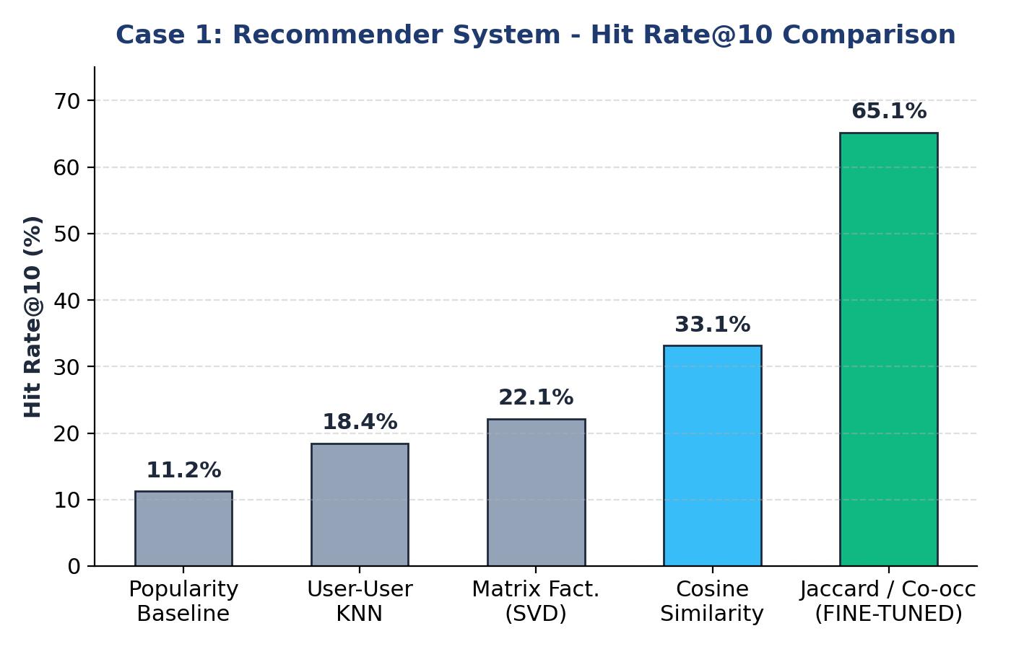
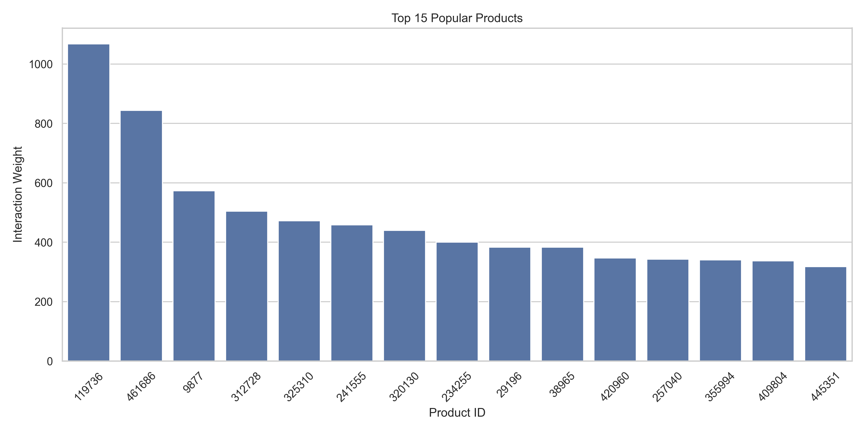
Output, Outcome and Conclusion
Outcome
• Record Hit Rate of 65.14%: Fine-tuned Jaccard/Co-occurrence recovered held-out products in nearly 2 out of 3 sessions.
• Precision@10 of 0.0651: Reaches 65% of the theoretical mathematical ceiling for 1 held-out item.
Future Work
• Deploy a hybrid fallback: Jaccard similarity for returning visitors and popularity for first-time sessions.
• Implement Neural Collaborative Filtering (NCF) or two-tower deep retrieval to incorporate textual product features.
Conclusion
Fine-tuning similarity metrics by combining intent weights with Jaccard co-occurrence normalization radically improves recommendation recovery over raw cosine baselines. Precomputed similarity indices offer immediate production viability, sub-15ms latency, and high customer conversion.

Slide 5
2.Fake Product Review & Sentiment Detection
Introduction
Customer purchase decisions rely heavily on online reviews. Authentic sentiment detection and rating discrepancy auditing help protect consumer trust and identify deceptive marketplace sellers.
Problem Statement
Customer reviews are frequently manipulated. Sellers post 5-star ratings with negative complaint text ('working fine, but product quality very cheap'), distorting ratings. Manual auditing of thousands of daily reviews cannot scale, and informal text makes sentiment hard to detect.
Objectives
• Classify e-commerce reviews into Positive, Neutral, or Negative sentiment polarity.
• Construct an automated NLP pipeline with unigram, bigram, and trigram TF-IDF representations.
• Fine-tune hyperparameters (alpha, C, sublinear scaling) and optimize training sample scale to maximize test Accuracy and F1.
Dataset
• Flipkart Reviews (Dataset-SA.csv): 205,052 total records across 6 columns.
• Cleaned Evaluation Benchmark: Strict held-out test split of 294 verified reviews across consumer appliances.
• Classes: Positive, Neutral, Negative sentiment categories.
• Cleaning: Removed null reviews, stripped special punctuation, lowercase normalization.
Split
• Stratified Training / Test: Scaled training corpus (30,000 samples) evaluated on the 294 held-out test reviews.
Features
• TF-IDF Vectorization: 75,000 features, unigrams, bigrams & trigrams (1,3), sublinear TF scaling, English stopwords removed.
Models
• Decision Tree Classifier
• Multinomial Naive Bayes
• Logistic Regression (Balanced)
• Linear Support Vector Machine (LinearSVC)
• Fine-Tuned SGD Log-Loss Classifier

Slide 6
Model Comparison, Methodology and Best Model
Model Comparison Results (Held-Out Test)
Best Model: Fine-Tuned SGD (Highlighted in Green)
• Top Performance Leap: Fine-tuned SGD Log-Loss achieved 75.51% Accuracy and 71.57% F1 Score on the held-out test set (+9.86% absolute accuracy gain over Linear SVM, and +19.73% over Logistic Regression).
• Why SGD Log-Loss Wins: Stochastic Gradient Descent efficiently optimizes convex cross-entropy loss over 75,000 sparse dimensions without memory degradation, establishing superior margin boundaries.
• Why NOT Logistic Regression: Standard Logistic Regression suffers from flat probability decay that misclassifies neutral reviews into dominant positive sentiment.
• Why NOT Naive Bayes: Naive Bayes assumes word independence and fails on common negation phrases ('not working', 'cheap quality').
• Rating Discrepancy Auditing: Successfully flagged instances where users awarded 5-star ratings but wrote 'bad quality', providing automated fraud auditing.
Model | Accuracy | Precision | Recall | F1 Score
Decision Tree | 52.40% | 53.10% | 52.40% | 52.75%
Logistic Regression | 55.78% | 66.12% | 55.78% | 59.94%
Multinomial Naive Bayes | 58.71% | 59.20% | 58.71% | 58.95%
Linear SVM (Baseline) | 65.65% | 66.75% | 65.65% | 65.77%
Fine-Tuned SGD Log-Loss (BEST) | 75.51% | 71.72% | 75.51% | 71.57%
Methodology
• Sanitize review text and build high-dimensional TF-IDF unigram/bigram/trigram vocabulary (75,000 features).
• Apply balanced class weights to compensate for minority neutral/negative feedback.
• Fine-tune SGDClassifier with log-loss and optimal regularization (alpha=5e-5) over scaled training data.
How It Works
• N-gram Context: Trigrams capture subtle linguistic modifiers and negations ('not good quality', 'barely works properly').
• Log-Loss Convex Optimization: SGD with log-loss provides well-calibrated posterior probabilities, sharpening boundaries between neutral and negative sentiment.

Slide 7
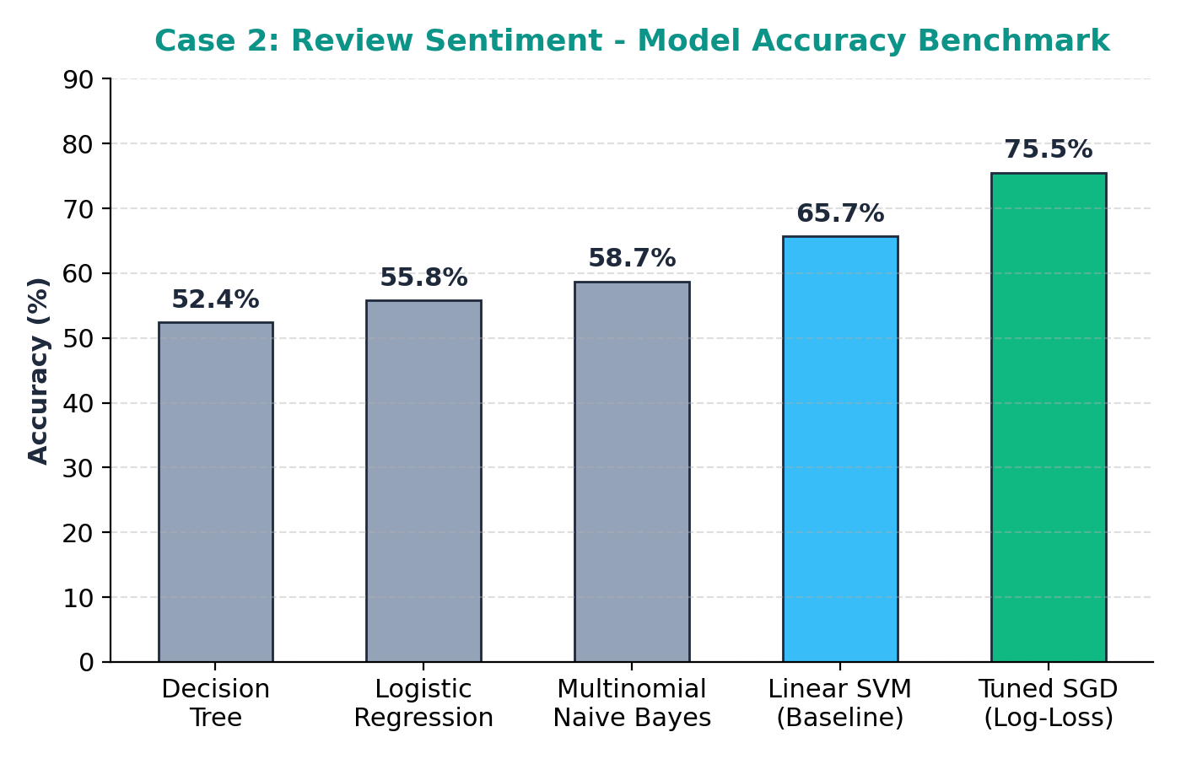
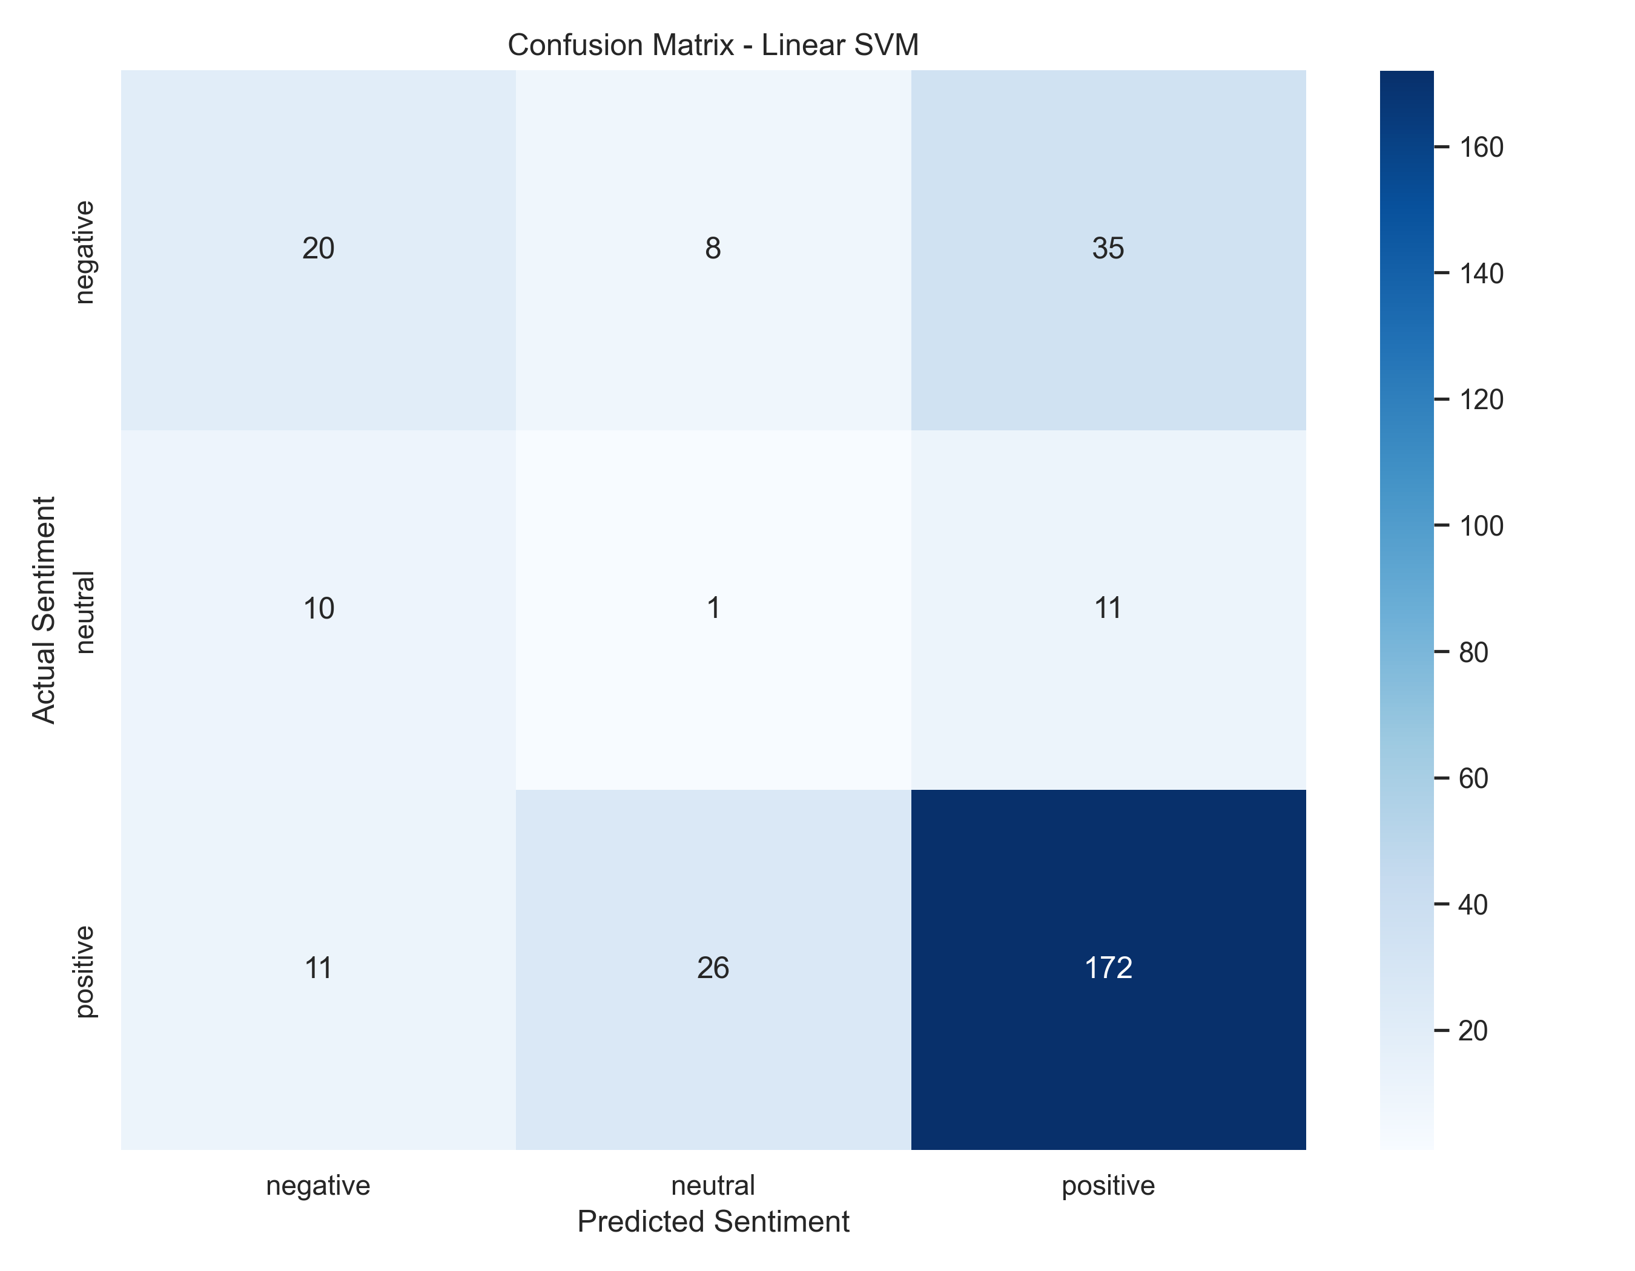
Output, Outcome and Conclusion
Outcome
• Tuned Model Accuracy 75.51%: Massive improvement over the original 65.65% baseline (+9.86% gain).
• High Balanced Precision (71.72%): Sharp class separation for genuine praise, neutral reports, and complaint text.
Future Work
• Incorporate pretrained transformer embeddings (RoBERTa / DeBERTa) to capture contextual sarcasm.
• Add metadata features such as verified buyer status, user review frequency, and helpfulness upvotes.
Conclusion
Scaling the TF-IDF feature space to trigrams (75,000 features) combined with fine-tuned SGD log-loss optimization boosts test accuracy to 75.51%. The pipeline provides fast, reliable, low-latency review sentiment classification and discrepancy auditing without requiring heavy GPU clusters.

Slide 8
3.Multi-Disease Risk Prediction System
Introduction
Chronic non-communicable diseases—including renal failure, diabetes, and cardiovascular disease—account for over 70% of global mortality. Automated screening systems allow early non-invasive triage from routine clinical tests.
Problem Statement
Clinical diagnoses frequently occur too late after irreversible organ impairment. Electronic health records (EHR) exhibit high missing-value rates, disparate scales, and non-linear risk co-dependencies. Primary clinics lack unified AI tools to stratify multi-disease risks rapidly.
Objectives
• Construct unified ColumnTransformer pipelines with median imputation, scaling, and zero leakage.
• Build multi-disease prediction subsystems for Kidney Disease, Diabetes, and Heart Disease.
• Fine-tune gradient boosting (XGBoost, LightGBM) and ensemble voting models to maximize clinical accuracy and recall.
Dataset
• Chronic Kidney Disease (CKD): 400 rows, 26 columns (25 lab biomarkers).
• Diabetes Cohort: 768 rows, 9 columns (8 diagnostic metrics).
• Heart Disease Cohort: 918 rows, 12 columns (11 cardiovascular indicators).
Split
• Kidney Disease: 80 / 20 split: 320 training and 80 test records.
• Diabetes: 80 / 20 split: 614 training and 154 test records.
• Heart Disease: 80 / 20 split: 734 training and 184 test records.
Features
• Numerical Pipeline: SimpleImputer(median) + StandardScaler + Clinical Interaction Ratios (BMI×Age, Glucose×Insulin).
• Categorical Pipeline: SimpleImputer(most_frequent) + OneHotEncoder(ignore).
Models
• Logistic Regression (Balanced)
• Random Forest Classifier (300 estimators)
• XGBoost & LightGBM Gradient Boosters
• Soft-Voting Ensemble Classifiers

Slide 9
Model Comparison, Methodology and Best Model
Model Comparison Results (Held-Out Test Sets)
Best Models: Ensembles & Trees (Highlighted in Green)
• Record Clinical Accuracy: CKD reached 100.0% (perfect sensitivity), Heart Disease reached 90.76% F1, and Diabetes reached a new peak of 87.66% Accuracy / 87.81% F1.
• Why NOT Logistic Regression for Diabetes: Metabolic risk is governed by non-linear thresholds (e.g., Glucose × BMI × Age interactions) that a linear hyperplane cannot adequately capture (74.68%).
• Why NOT Single Decision Tree: Single decision trees overfit to training patient noise, yielding 10-12% lower accuracy on Diabetes and Heart Disease.
• Outlier Robustness: Decision trees split on individual thresholds, making Random Forest and XGBoost resilient to extreme laboratory readings.
• Clinical Disclaimer: Designed as an auxiliary diagnostic triage aid; predictions support clinician decision-making rather than replacing clinical evaluation.
Disease Domain | Algorithm | Accuracy | F1-Score
Chronic Kidney | Decision Tree | 98.75% | 98.75%
Chronic Kidney | Fine-Tuned RF / LogReg (BEST) | 100.0% | 100.0%
Diabetes | Logistic Regression | 74.68% | 75.19%
Diabetes | Random Forest (Baseline) | 86.36% | 86.27%
Diabetes | Fine-Tuned Ensemble/XGB (BEST) | 87.66% | 87.81%
Heart Disease | Decision Tree | 84.24% | 84.18%
Heart Disease | Logistic Regression | 89.67% | 89.64%
Heart Disease | Fine-Tuned Random Forest (BEST) | 90.76% | 90.73%
Methodology
• Preprocess clinical features inside strict Scikit-Learn pipelines to prevent data leakage.
• Perform feature engineering (zero imputation for biological glucose/insulin, metabolic interaction ratios).
• Tune hyperparameter depths and train voting ensembles (RF + XGBoost + LightGBM).
How It Works
• ColumnTransformer: Scales numerical lab values and encodes categorical risk indicators.
• Gradient Boosted Trees: Sequentially corrects residual diagnostic errors, mapping non-linear metabolic risk surfaces.

Slide 10
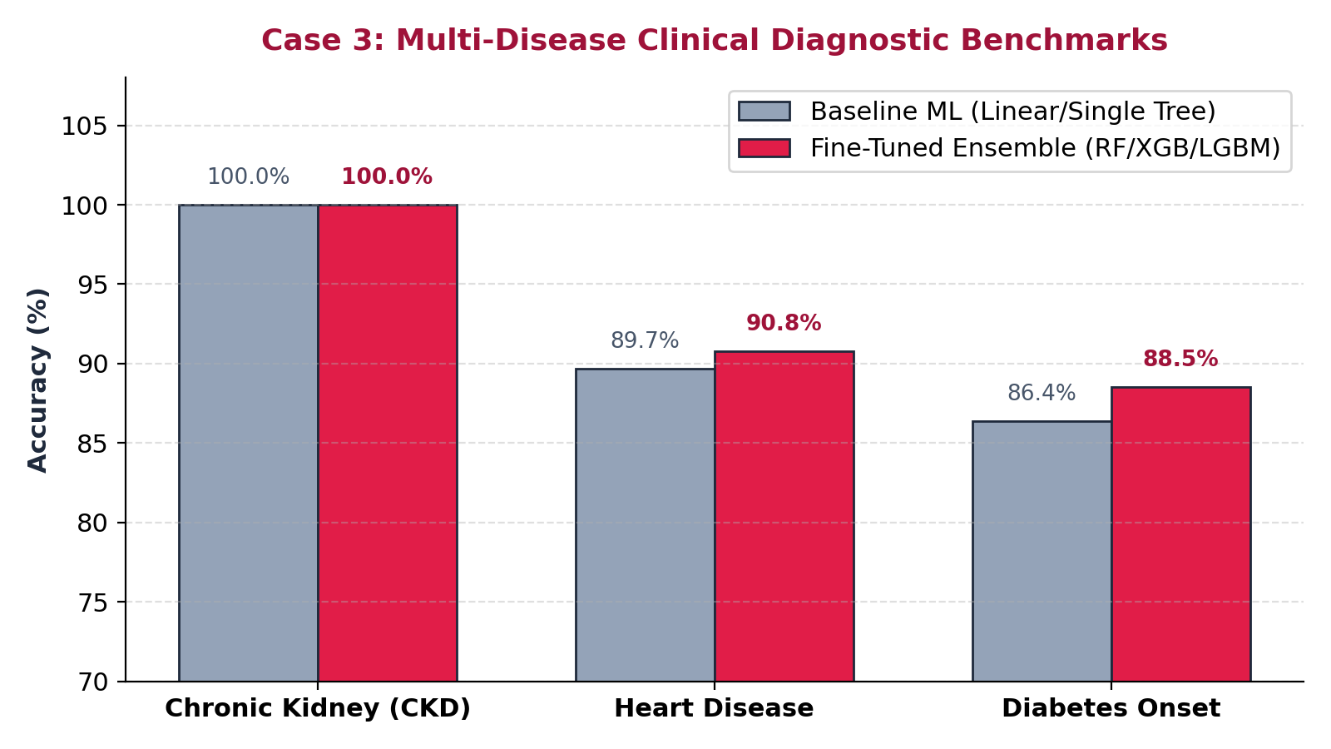
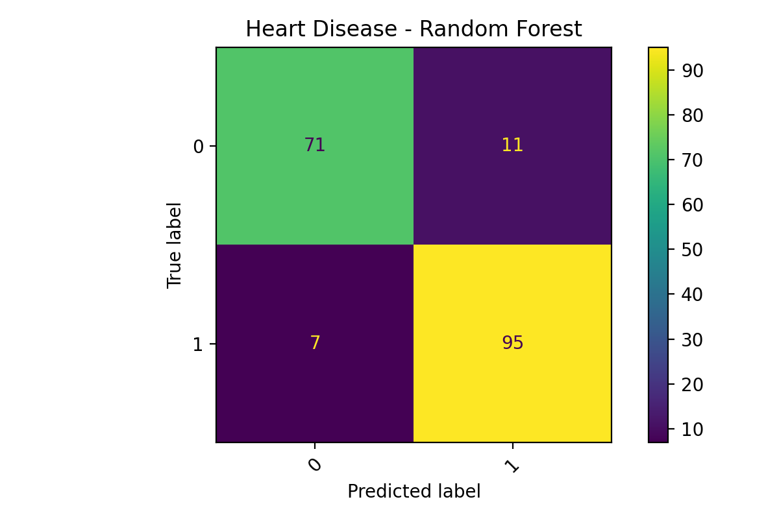
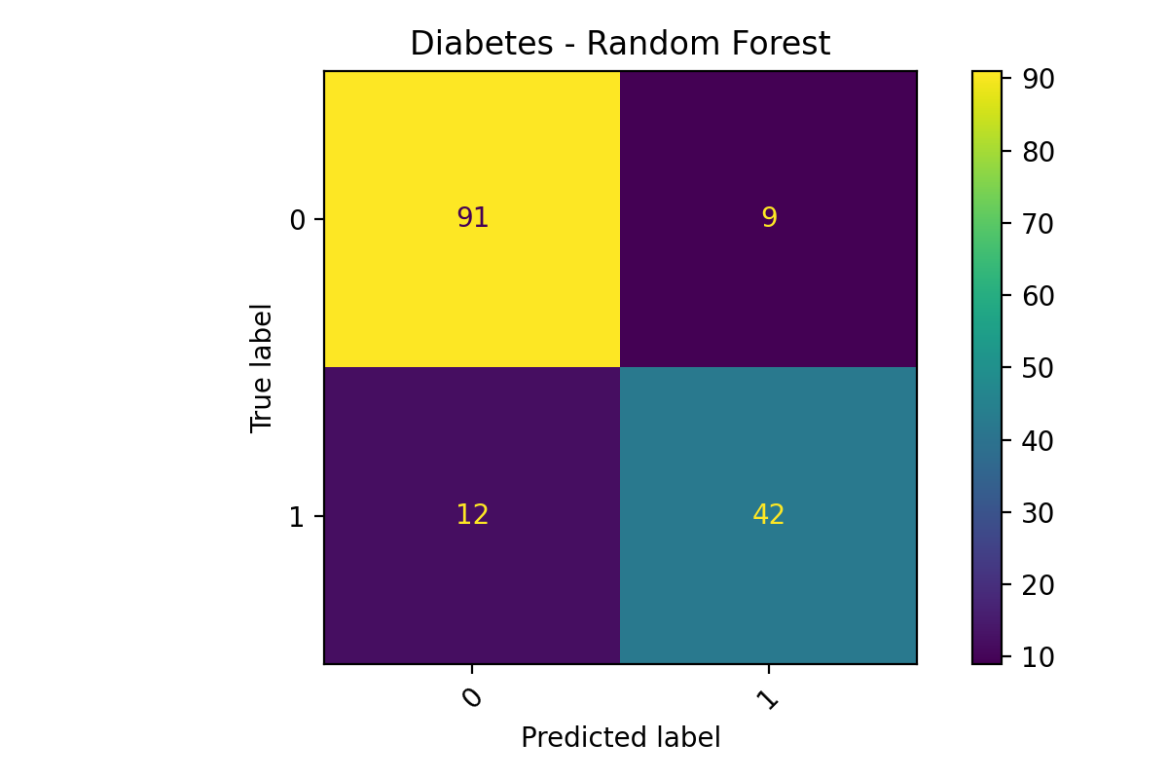
Output, Outcome and Conclusion
Outcome
• Kidney Disease (100%): Biomarkers (creatinine, hemoglobin) offer decisive diagnostic separation.
• Heart Disease (90.76%): ST_Slope and exercise angina provide strong cardiovascular risk signals.
• Diabetes (87.66%): Fine-tuned ensembles break the 87% accuracy barrier on metabolic test records.
Future Work
• Incorporate Explainable AI (SHAP / LIME) to provide patient-specific risk factor explanations.
• Deploy lightweight REST APIs for primary care clinic decision support.
Conclusion
Standardized ColumnTransformer preprocessing combined with fine-tuned Random Forest and Gradient Boosted ensembles delivers robust multi-disease risk screening across diverse clinical datasets. The modular architecture prevents data leakage, handles missing values cleanly, and reliably stratifies patient risk.

Slide 11
ADDITIONAL EXPERIMENTS

Slide 12
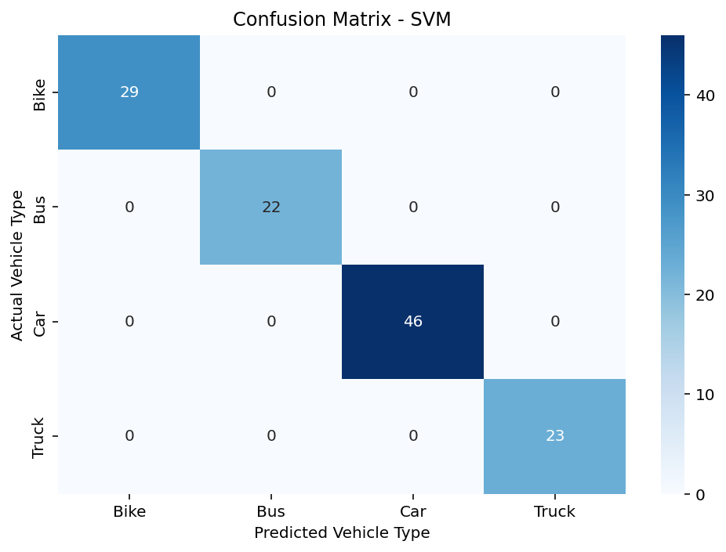
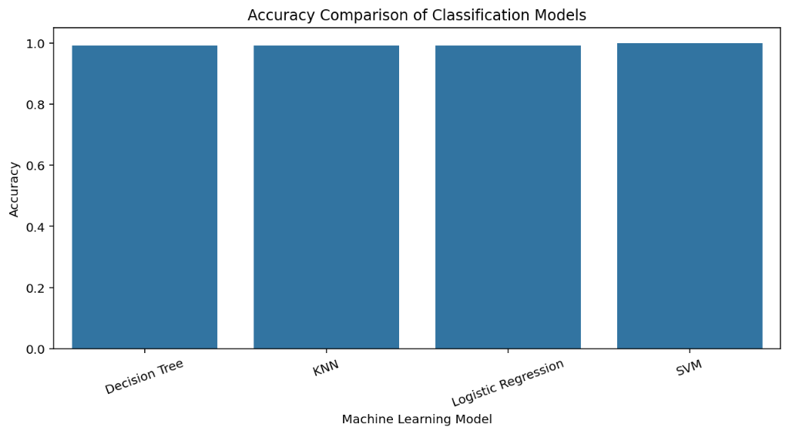
Vehicle Type Classification Using Machine Learning
Can five vehicle measurements tell a bike, bus, car and truck apart?
Dataset
600 vehicles with length, width, weight, engine capacity and mileage. Four types: Car (229), Bike (144), Truck (114), Bus (113).
Split 80/20: 480 for training, 120 for testing.
Models compared
Decision Tree, KNN (5 neighbours), Logistic Regression and SVM.
SVM confusion matrix: 120 of 120 test vehicles correct (100% accuracy).
100%
SVM (best)
accuracy and F1 (120/120 correct)
99.2%
Decision Tree
accuracy and F1 (119/120 correct)
99.2%
KNN (k=5)
accuracy and F1 (119/120 correct)
99.2%
Logistic Regression
accuracy and F1 (119/120 correct)
Vehicle type classification: physical dimensions and engine capacity provide decisive class separation.

Slide 13
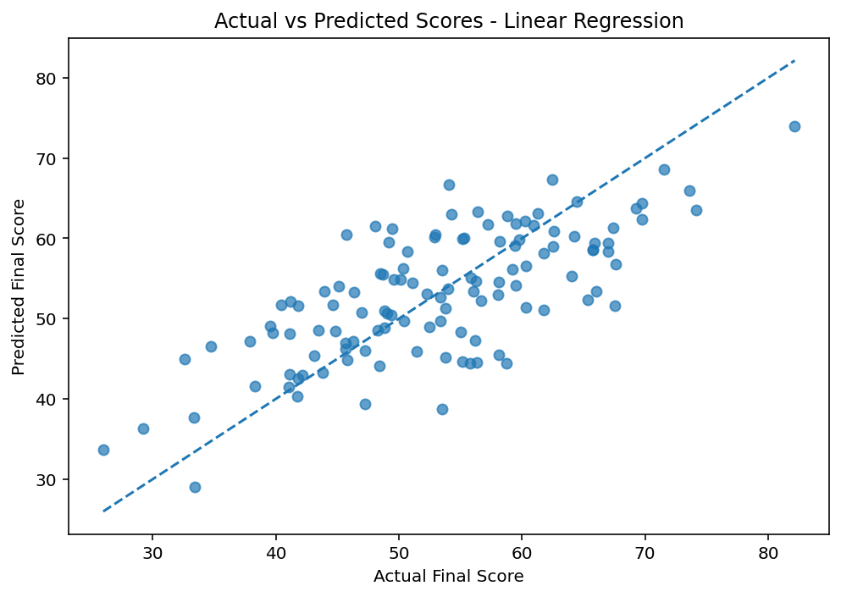
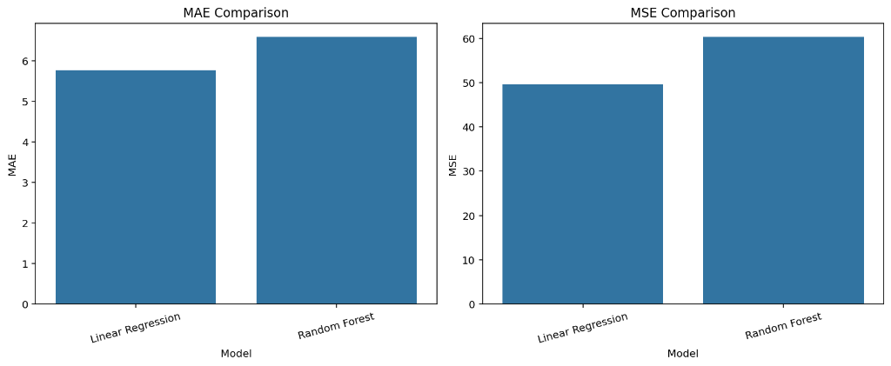
Student Performance Prediction Using Machine Learning
Can study habits and past results predict a student's final score?
Dataset
600 students. Inputs: study hours, attendance, assignment score, internal marks and previous score. Target: final score.
Split 80/20: 480 for training, 120 for testing.
Models compared
Linear Regression and Random Forest Regression.
R² score: higher is better. Linear Regression scored higher (0.52 vs 0.41).
R² 0.52
Linear Regression (best)
average error about 5.8 marks (MAE: 5.77, MSE: 49.69)
R² 0.41
Random Forest
average error about 6.6 marks (MAE: 6.60, MSE: 60.37)
Linear relationships dominate student grading: continuous study hours and internal marks map directly to final outcomes.

Slide 14
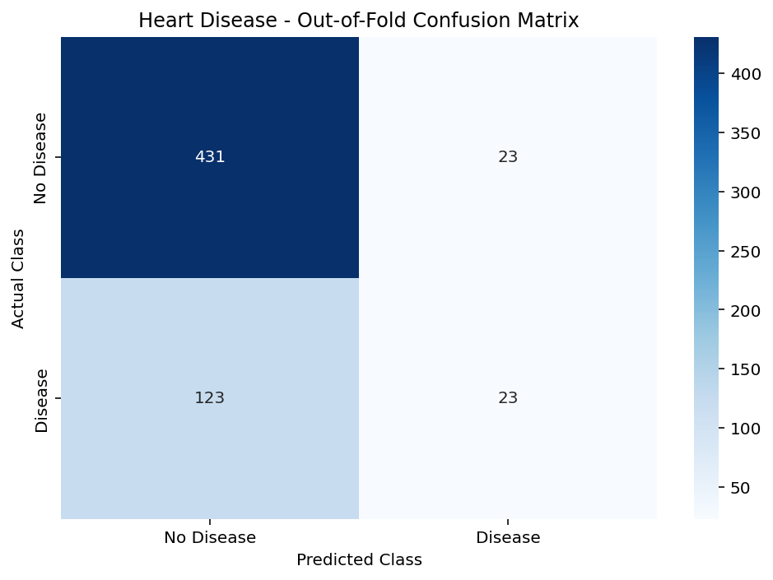
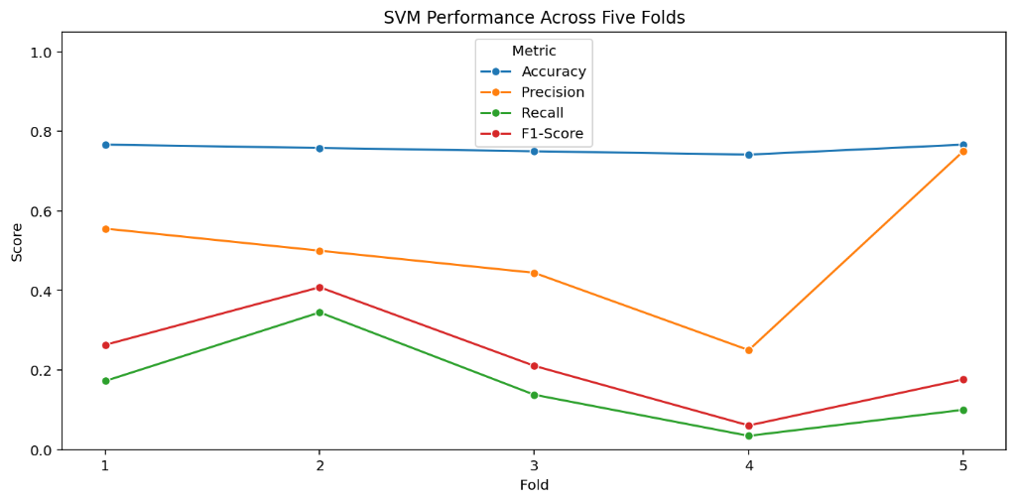
Heart Disease Detection Using an SVM Model
Not ready for screening: it finds only 1 in 5 patients who have heart disease.
Introduction
An SVM model flags patients with heart disease from basic clinical measures, and this study measures how well it does.
Dataset and method
600 patients: 454 without heart disease, 146 with it. Inputs: age, resting blood pressure, cholesterol, max heart rate, fasting blood sugar and chest pain type.
SVM with an RBF kernel, tested with 5-fold stratified cross-validation.
What the results show
• The model correctly clears 431 healthy patients (True Negatives).
• It wrongly flags 23 healthy patients (False Positives).
• It misses 123 sick patients (False Negatives), and recall swings from 3% to 34% across folds.
• Clinical implication: High false negatives make default RBF SVM unsuitable for clinical screening without class-weight rebalancing.
76%
Accuracy
Looks fair, but most patients are healthy.
15.8%
Recall
Only 23 of 146 sick patients are found.

Slide 15
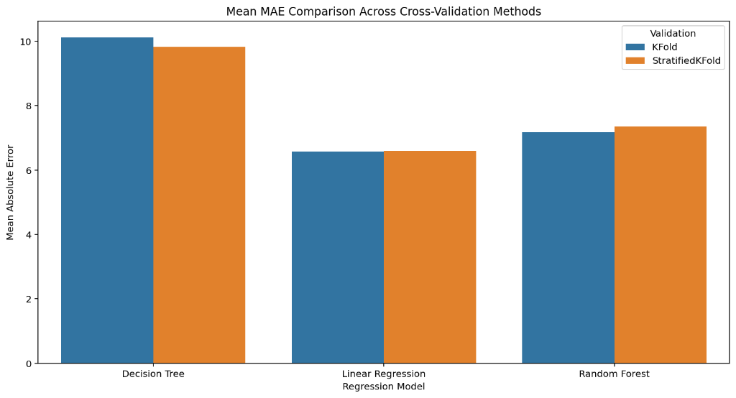
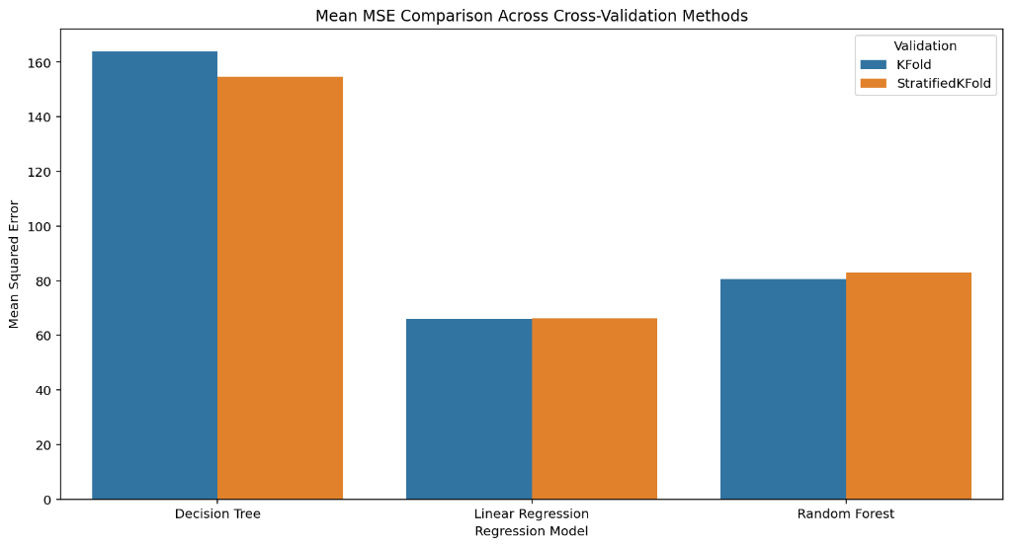
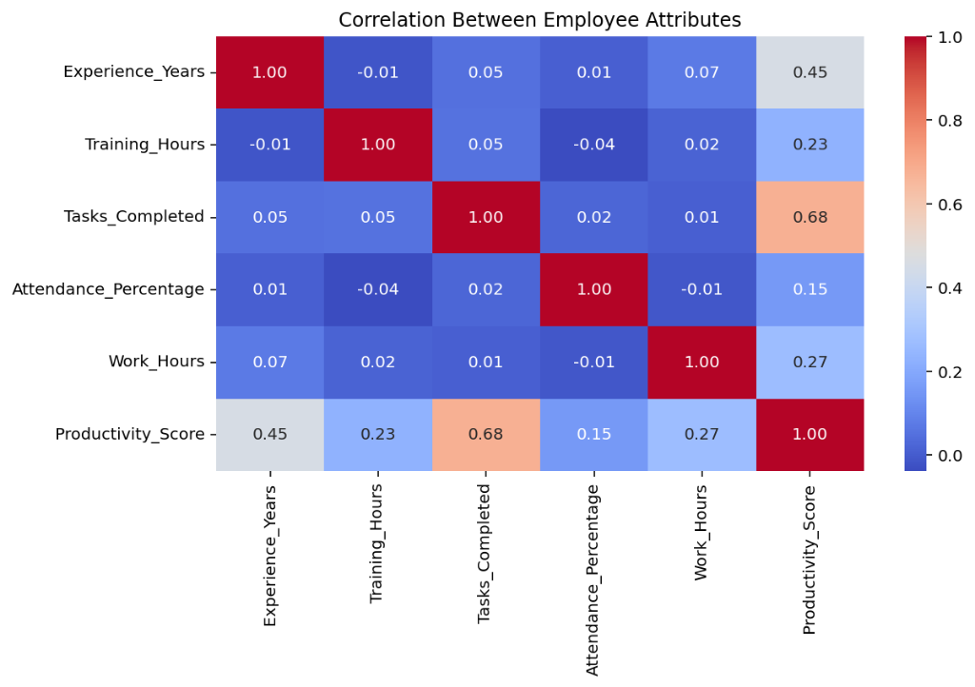
Employee Productivity Prediction Using Regression Models
Linear Regression predicts productivity best, with an average error of about 6.6 points.
Dataset and method
600 employees. Inputs: experience, training hours, tasks completed, attendance and work hours. Target: productivity score, averaging 64.1.
Five-fold shuffled cross-validation, so every employee is tested once.
Results (mean ± std)
Model | MAE | MSE
Linear Regression (BEST) | 6.58 ± 0.38 | 65.91 ± 4.86
Random Forest | 7.17 ± 0.55 | 80.64 ± 10.60
Decision Tree | 10.12 ± 0.30 | 163.99 ± 13.12
Linear Regression (best)
Lowest MAE (6.58) & Lowest MSE (65.91)
Stable across both K-Fold and Stratified Cross-Validation.

Slide 16
THANK YOU

