Slide 1

Gokaraju Rangaraju Institute of Engineering and Technology
(Autonomous)
Department of Data Science
Mini Project Work
(CSE(DS))
Review 4: Execution Cycle 1 Presentation
Batch No - 06
Presented by:
1. Likhith Balaji Madugula (23241a6796)
2. Rangu Niranjan(23241a67C0)
3. Gunderao Akhil (23241a6781)
Under the Guidance of:
Dr. S Govinda Rao
HOD
DS

Slide 2
Predictive Analytics for Student Risk Identification in higher Education: A Machine Learning-Based Approach

Slide 3
Link to google drive
https://drive.google.com/drive/folders/1WJN7nsfFuBxa-bfGi3ZKAArePVMA-zy9?usp=sharing

Slide 4
Introduction:
Mentors are responsible for monitoring the academic progress of a group of students and providing guidance throughout the semester.
Student academic data such as attendance records, internal assessment marks, and subject-wise scores are generated by multiple lecturers.
Manual monitoring of student performance becomes difficult as the number of students increases.
Machine learning techniques enable automated analysis of large academic datasets to identify performance patterns.
A mentor-based analytics system can provide real-time insights to support timely counseling and academic support.
Integrating data analytics with mentoring processes enhances decision-making and improves student outcomes.

Slide 5
Literature review:
1. Early Predicting of Students’ Performance in Higher Education
Year: 2023 | Journal: IEEE Access
Uses multiple machine learning models for early prediction of student performance.
Applies feature engineering and dimensionality reduction.
Shows ensemble models improve prediction accuracy.
2. Student Performance Prediction Using Machine Learning Techniques
Year: 2022 | Journal: IEEE Conference Proceedings
Applies Decision Tree, Naive Bayes, and Random Forest models.
Uses attendance and internal assessment data.
Demonstrates ML effectiveness in academic prediction tasks.

Slide 6
Literature review:
3. Early Detection of At-Risk Students Using Machine Learning
Year: 2024 | Source: arXiv
Uses machine learning models to identify at-risk students at an early stage.
Analyzes attendance and academic performance data.
Demonstrates that early prediction enables timely academic intervention.
4. Machine Learning Approaches for Predicting Academic Performance
Year: 2022 | Journal: IEEE Access
Compares supervised learning algorithms for student performance prediction.
Uses academic scores and attendance as key features.
Shows Random Forest outperforms traditional classifiers.

Slide 7
Literature review:
5. Learning Analytics-Based Student Performance Prediction
Year: 2021 | Journal: IEEE Transactions on Learning Technologies
Combines learning analytics with machine learning models.
Uses engagement and performance data.
Supports early identification of academically at-risk students.
6. Predicting Student Dropout and Performance Using Machine Learning
Year: 2023 | Journal: IEEE International Conference on Data Science
Uses classification models to detect dropout risk.
Analyzes attendance, grades, and academic behavior.
Demonstrates improved early warning accuracy.

Slide 8
Literature review:
7. Educational Data Mining for Student Performance Analysis
Year: 2020 | Journal: IEEE Access
Applies educational data mining techniques.
Studies patterns in student academic performance.
Supports data-driven academic decision-making.
8. An Intelligent System for Student Performance Monitoring Using ML
Year: 2024 | Journal: IEEE International Conference on Smart Education
Proposes an intelligent monitoring system for student academics.
Uses ML-based performance classification.
Highlights automation in academic mentoring systems.

Slide 9
Literature review:
9. Classification-Based Prediction of Student Academic Outcomes
Year: 2021 | Journal: IEEE Conference on Artificial Intelligence
Uses classification algorithms to predict academic outcomes.
Focuses on early-stage academic indicators.
Shows ML improves prediction reliability.
10. Performance Evaluation of Students Using Supervised Learning Models
Year: 2022 | Journal: IEEE International Conference on Computing
Evaluates supervised ML models for student performance analysis.
Uses internal assessment and attendance data.
Demonstrates feature selection improves model accuracy.

Slide 10
Literature review:
11. Predicting Student Academic Performance Using Classification Techniques
Year: 2021 | Journal: IEEE Access
Uses supervised classification algorithms to predict student academic outcomes.
Analyzes attendance, internal marks, and past academic records.
Shows classification models improve early performance prediction.
12. A Machine Learning Framework for Academic Performance Analysis
Year: 2022 | Journal: IEEE International Conference on Machine Learning Applications
Proposes a structured ML framework for analyzing student performance.
Applies preprocessing, feature selection, and model evaluation stages.
Demonstrates improved prediction accuracy with optimized features.

Slide 11
Literature review:
13. Student Performance Monitoring and Prediction Using Learning Analytics
Year: 2023 | Journal: IEEE Transactions on Learning Technologies
Integrates learning analytics with machine learning techniques.
Uses student engagement and academic behavior data.
Supports early identification of students requiring academic support.
14. Early Warning System for Academic Risk Detection Using Machine Learning
Year: 2022 | Journal: IEEE International Conference on Smart Computing
Develops an early warning system to detect academically at-risk students.
Uses classification-based ML models on academic datasets.
Improves early risk detection and intervention accuracy.

Slide 12
Literature review:
13. Student Performance Monitoring and Prediction Using Learning Analytics
Year: 2023 | Journal: IEEE Transactions on Learning Technologies
Integrates learning analytics with machine learning techniques.
Uses student engagement and academic behavior data.
Supports early identification of students requiring academic support.
14. Early Warning System for Academic Risk Detection Using Machine Learning
Year: 2022 | Journal: IEEE International Conference on Smart Computing
Develops an early warning system to detect academically at-risk students.
Uses classification-based ML models on academic datasets.
Improves early risk detection and intervention accuracy.

Slide 13
Literature Review Summery
Source | Research Objective or Research Question | Methodology | Key Findings | Relevance to Project | Techniques | Accuracy & Performance Measures | Advantages | Disadvantages
Early Predicting of Students’ Performance in Higher Education | To predict student academic performance at an early stage | Feature engineering, dimensionality reduction, multiple ML models | Ensemble models improve prediction accuracy | Provides strong baseline for performance prediction | RF, SVM, KNN, NB, XGBoost | Improved accuracy with ensemble learning | High prediction accuracy | No mentor-centric system
Student Performance Prediction Using ML Techniques | To analyze effectiveness of ML models in predicting performance | Supervised ML on academic and attendance data | ML models effectively predict outcomes | Helps in selecting suitable ML algorithms | Decision Tree, NB, RF | Acceptable prediction accuracy | Simple and interpretable | Limited scalability
Early Detection of At-Risk Students Using M | To identify at-risk students at an early stage | Data preprocessing and ML classification | Early prediction enables timely intervention | Directly aligns with risk classification | Supervised ML models | Good early detection accuracy | Early risk identification | Binary classification only

Slide 14
Literature Review Summery
Source | Research Objective or Research Question | Methodology | Key Findings | Relevance to Project | Techniques | Accuracy & Performance Measures | Advantages | Disadvantages
ML Approaches for Predicting Academic Performance | To compare ML algorithms for academic prediction | Comparative ML analysis | Random Forest outperforms others | Helps choose optimal model | RF, SVM, NB, KNN | RF shows highest accuracy | Model comparison | No real-time monitoring
Learning Analytics-Based Student Performance Prediction | To predict performance using learning analytics | ML with engagement & performance data | Engagement data improves predictions | Supports analytics-driven mentoring | ML + learning analytics | Improved prediction reliability | Uses behavioral data | Complex data collection
Predicting Student Dropout and Performance Using ML | To detect dropout risk and poor performance | Classification-based ML approach | ML improves early warning accuracy | Supports early intervention logic | Classification models | High early warning accuracy | Prevents dropouts | Focuses more on dropout

Slide 15
Literature Review Summery
Source | Research Objective or Research Question | Methodology | Key Findings | Relevance to Project | Techniques | Accuracy & Performance Measures | Advantages | Disadvantages
Educational Data Mining for Student Performance Analysis | To analyze academic performance patterns | Educational data mining techniques | Data patterns help academic planning | Useful for feature selection | EDM techniques | Not accuracy-focused | Insightful analysis | No prediction system
Intelligent System for Student Performance Monitoring Using ML | To automate academic performance monitoring | ML-based classification with monitoring system | Automation improves mentoring efficiency | Closely related to mentor-based system | ML classification models | Not explicitly reported | Practical monitoring system | Limited experimental results
Classification-Based Prediction of Student Academic Outcomes | To predict academic outcomes using classification | Supervised classification models | Classification improves prediction reliability | Helps in category-based prediction | Classification algorithms | Improved reliability | Simple implementation | Limited feature diversity

Slide 16
Literature Review Summery
Source | Research Objective or Research Question | Methodology | Key Findings | Relevance to Project | Techniques | Accuracy & Performance Measures | Advantages | Disadvantages
Predicting Student Academic Performance Using Classification Techniques (IEEE Access, 2021) | To predict student academic performance using classification techniques | Supervised ML with preprocessing and feature selection | Classification models effectively predict early performance | Supports category-based performance classification | Decision Tree, NB, RF | Improved prediction accuracy | Simple and interpretable | No real-time monitoring
A Machine Learning Framework for Academic Performance Analysis (IEEE ICMLA, 2022) | To design a structured ML framework for academic analysis | Data preprocessing, feature selection, model training | Optimized features improve model accuracy | Provides clear ML workflow for system design | RF, SVM, Logistic Regression | Improved accuracy after optimization | Scalable framework | Offline analysis only
Performance Evaluation of Students Using Supervised Learning Models (IEEE , 2022) | To evaluate supervised machine learning models for student performance analysis | Supervised ML with preprocessing and feature selection | Feature selection improves prediction accuracy | Useful for selecting relevant academic features | Supervised ML models | Improved accuracy after feature selection | Better model performance | No mentor-centric support

Slide 17
Literature Review Summery
Source | Research Objective or Research Question | Methodology | Key Findings | Relevance to Project | Techniques | Accuracy & Performance Measures | Advantages | Disadvantages
Student Performance Monitoring and Prediction Using Learning Analytics (IEEE TLT, 2023) | To monitor and predict performance using learning analytics | Learning analytics integrated with ML | Engagement data improves prediction reliability | Supports continuous performance monitoring | ML + Learning Analytics | High prediction reliability | Holistic student analysis | Complex data collection
Early Warning System for Academic Risk Detection Using ML (IEEE Smart Computing, 2022) | To detect academic risk at an early stage | Classification-based ML approach | Early warning enables timely intervention | Directly aligns with at-risk identification | Supervised ML models | Improved early detection accuracy | Proactive intervention | Limited mentor personalization
Performance Prediction of University Students Using Ensemble Learning (IEEE Access, 2024) | To improve prediction using ensemble methods | Ensemble-based ML modeling | Ensemble models outperform single classifiers | Helps in best-model selection | RF, XGBoost, Ensembles | High accuracy and robustness | Better generalization | Higher computational cost

Slide 18
Research Gaps
1. Lack of Mentor-Centric Academic Monitoring
Most existing studies focus on predicting student performance or grades.
Very few works design systems specifically to support mentors in continuous academic monitoring.
2. Absence of Multi-Level Performance Classification
The reviewed papers mainly predict performance as grades or binary outcomes.
Classification into categories such as Excellent, Average, and At-Risk is rarely addressed.
3. Limited Focus on Early Intervention Mechanisms
Existing studies emphasize prediction accuracy rather than follow-up actions.
Academic counseling, alerts, and intervention strategies are largely missing.

Slide 19
Research Gaps
4. Offline Analysis Without Continuous Data Updates
Most approaches perform offline analysis using historical academic datasets.
Real-time or continuously updated performance monitoring is not commonly supported.
5. Lack of Interactive Dashboards for Decision Support
Many studies do not provide visual dashboards for performance tracking.
Mentors lack intuitive tools for analyzing trends and identifying at-risk students.
6. Research-Oriented Systems with Limited Practical Deployment
Most works remain experimental and dataset-centric. End-to-end, deployable systems for real academic environments are rarely proposed.

Slide 20
Problem statement
In higher education institutions, mentors are responsible for monitoring student academic progress, but student data such as attendance and internal assessment marks are recorded by multiple lecturers and analyzed mainly at the end of a semester. Existing performance prediction systems focus on offline analysis and grade prediction, providing limited support for continuous monitoring or early intervention. As a result, mentors face difficulty in identifying at-risk students at an early stage. This project addresses the need for a mentor-centric system that continuously analyzes academic data, classifies student performance, and provides timely insights to support effective academic guidance and intervention.

Slide 21
Objectives
To develop a centralized system that aggregates diverse academic metrics such as attendance, marks, and quizzes into a single, easily accessible student profile.
To implement machine learning–based predictive models that proactively identify students who are at risk and require academic intervention.
To design an automated Early Warning System (EWS) that generates real-time alerts when student performance or attendance falls below defined thresholds (e.g., less than 75%).
To integrate academic support features such as doubt resolution and syllabus tracking in order to ensure better alignment between teaching progress and student understanding.

Slide 22
Objectives
To enhance mentor–student interaction by providing faculty mentors with detailed and structured student data, enabling them to offer personalized guidance and record meaningful remarks.
To provide interactive visualizations, including radar charts and performance graphs, that help students identify their subject-wise strengths and weaknesses effectively.

Slide 23
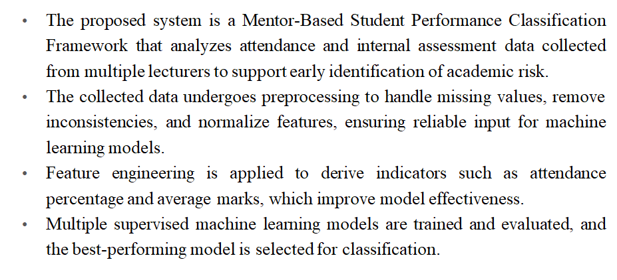
Proposed Solution

Slide 24
Proposed Solution
The system supports periodic re-evaluation of student performance as new attendance and assessment data are updated, ensuring that classifications remain current throughout the semester.
The selected model classifies students into Excellent, Average, and At-Risk categories and presents results through an interactive mentor dashboard to enable timely academic intervention.

Slide 25
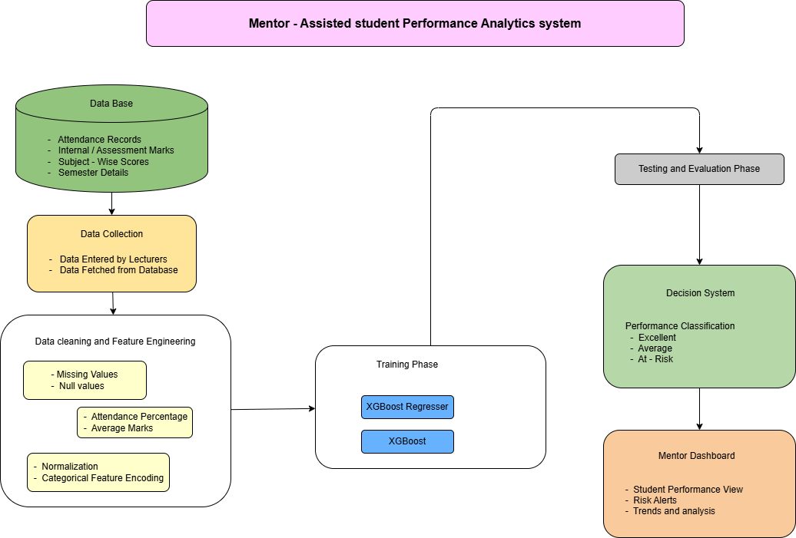
Architecture Diagram

Slide 26
Methodology / Algorithms
XGBoost Regresser
Used to predict the future GPA of a student as a continuous numerical value based on academic indicators such as attendance and internal marks.
Helps mentors understand long-term academic performance trends and supports early academic planning.
XGBoost Classifier
Used to further enhance classification accuracy through optimized ensemble learning.
Supports scalable and high-performance student performance classification suitable for real academic environments.

Slide 27
Software and Hardware Requirements
SOFTWARE | HARDWARE
Operating System: Windows 10 / Windows 11 / Linux Programming Language: Python ML Libraries: NumPy, Pandas, Scikit-learn Visualization Tools: Matplotlib, Seaborn Database: MySQL / SQLite Web Framework : Flask,streamlit | Processor: Intel Core i3 or higher RAM: Minimum 8 GB Storage: 256 GB HDD / SSD System Type: 64-bit Input Devices: Keyboard, Mouse Output Device: Monitor

Slide 28
Datasets Details
1. Dataset Source
The dataset used in this project is obtained from publicly available academic performance datasets .
Student Performance Dataset (Kaggle)
https://www.kaggle.com/datasets/ziya07/college-student-management-dataset
Institutional Academic Records (Simulated / Department-level data)
  Attendance records entered by lecturers
  Internal assessment marks collected semester-wise
(The kaggle dataset is used for model training and validation, while institutional data represents real-time deployment scenarios.)

Slide 29
Datasets Details
2. Dataset Size
Total number of student records: 5000 to 6000 records
Number of attributes: 15–30 features
Data split:
  80% Training data
  20% Testing data
3. Target Variable
Student Performance Category
  Safe
  Warning
  At-Risk

Slide 30
Datasets Details
S.no | Fields / Attributes | Description
1. | Attendance_pct | Overall attendance of the student
2. | Mid1_avg | Average score ratio in 1st mid term exams
3. | Mid2_avg | Average score ratio in 2nd mid term exams
4. | Assignment_rate | Assignment submission rate
5. | Prev_sgpa | Previous semester GPA
6. | low_att_subjects | Count of subjects where attendance is below 75%
7. | Failing_subjects | Count of subjects where internal marks are below 40%
8. | Credits | Total number of credits in the current semester

Slide 31
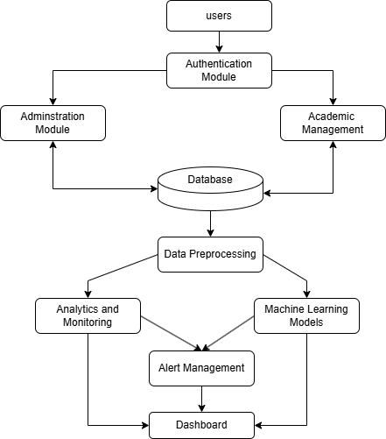
Module connectivity diagram

Slide 32
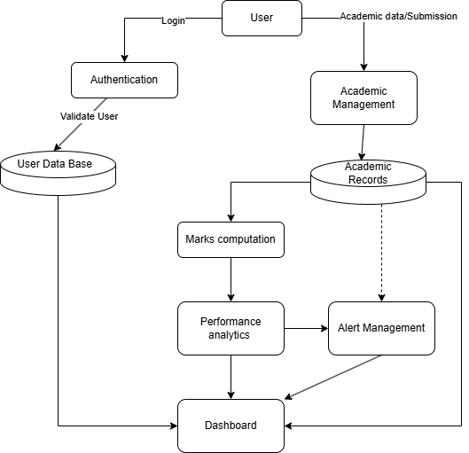
Data flow diagram

Slide 33
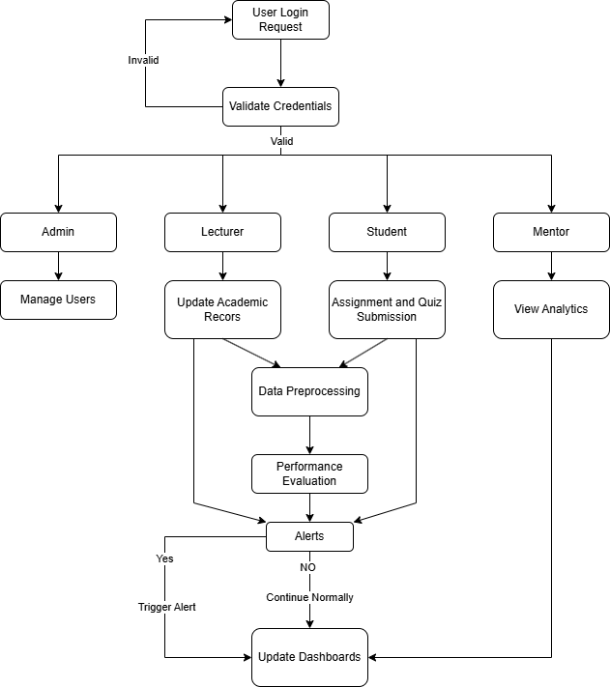
Control flow diagram

Slide 34
Modules description
Module 1: Users Interface
Inputs:
Login credentials
Processing:
Role-based request routing, API request generation
Outputs:
User requests to backend, Dashboard view rendering
Tools:
React (Vite), REST API
Dependency:
Feeds Authentication and Academic Management modules

Slide 35
Modules description
Module 2: Authentication
Inputs:
Username, Password
Processing:
Password hashing & verification, JWT token generation, Role validation
Outputs:
Authenticated session token
Tools:
FastAPI, PyJWT, Passlib
Dependency:
Reads from User Database, Routes to Administration / Academic modules

Slide 36
Modules description
Module 3: Administration
Inputs:
User creation data, Role assignments, Section mapping
Processing:
CRUD operations, Role allocation, Section management
Outputs:
Updated user records
Tools:
FastAPI, SQLAlchemy ORM
Dependency:
Reads/Writes to Database

Slide 37
Modules description
Module 4: Academic Management
Inputs:
Attendance records, Assignment details, Quiz data, Submissions
Processing:
Attendance storage, Deadline validation, Quiz auto-evaluation, Marks entry
Outputs:
Academic records, Raw marks data
Tools:
FastAPI, SQLAlchemy, APScheduler
Dependency:
Stores data in Database, Feeds Data Preprocessing

Slide 38
Modules description
Module 5: Database
Inputs:
User data, Academic records, Marks, Alerts
Processing:
Structured storage, Query handling, Transaction management
Outputs:
Persistent structured datasets
Tools:
SQLite / PostgreSQL, SQLAlchemy
Dependency:
Shared by all modules

Slide 39
Modules description
Module 6: Data Preprocessing
Inputs:
Attendance %, Assignment marks, Quiz scores, Exam marks
Processing:
Internal mark computation (weighted average), Attendance normalization, Data aggregation
Outputs:
Structured performance dataset, Feature vectors
Tools:
Pandas, NumPy
Dependency:
Reads from Database, Feeds Analytics & ML modules

Slide 40
Modules description
Module 7: Analytics & Monitoring
Inputs:
Processed marks, Attendance percentage
Processing:
Total score calculation, Threshold-based classification (Good/Average/At-Risk), Trend evaluation
Outputs:
Risk classification, Performance metrics
Tools:
Python rule engine, Pandas
Dependency:
Receives data from Preprocessing, Triggers Alert module

Slide 41
Modules description
Module 8: Machine Learning
Inputs:
Historical performance data, Feature vectors
Processing:
Classification, Risk prediction
Outputs:
Risk probability scores
Tools:
Scikit-learn, NumPy
Dependency:
Uses preprocessed dataset, Sends predictions to Dashboard

Slide 42
Modules description
Module 9: Alert Management
Inputs:
Risk status, Attendance thresholds, Deadline parameters
Processing:
Condition checking, Alert generation, Notification scheduling
Outputs:
Alert records, User notifications
Tools:
APScheduler, FastAPI
Dependency:
Triggered by Analytics, Stores alerts in Database

Slide 43
Modules description
Module 10: Dashboard
Inputs:
Marks data, Risk classification, Alerts
Processing:
Role-based filtering, Data visualization, Trend plotting
Outputs:
Student dashboard, Mentor analytics view, Lecturer overview
Tools:
React, Chart.js / Recharts
Dependency:
Reads from Database, Displays Analytics & Alert outputs

Slide 44
Risk Classification Model Implementation
Purpose:
To classify students into different risk categories for early academic intervention.
Implementation Logic:
XGBoost Classifier
Input: Attendance, internal marks, quizzes, and engagement metrics
Output: Student category (Safe, Warning, At-Risk)
Model Details:
Trained on 6,000+ records generated using the Kaggle dataset
Focus on key features like attendance and average marks
Multi-class classification approach

Slide 45
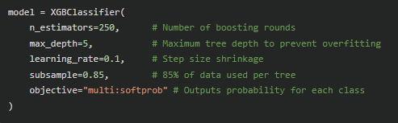
Risk Classification Model Implementation(cont’d)
Training Process:
Data preprocessing and feature selection
Model training using XGBoost
Prediction of student risk category
Code Snippet:

Slide 46
GPA Prediction Model Implementation
Purpose:
To forecast student academic performance in terms of GPA.
Implementation Logic:
XGBoost Regressor
Input: Current academic performance data
Output: Predicted GPA
Model Details:
Trained on 5,000+ records generated using Kaggle dataset
Uses multiple academic features
Handles non-linear relationships

Slide 47
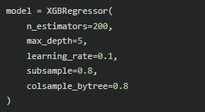
GPA Prediction Model Implementation(cont’d)
Training Process:
Data preprocessing and feature engineering
Model training using regression
GPA prediction and optimization
Code Snippet:

Slide 48
SMOTE Dataset Balancing Implementation
Purpose:
To address dataset imbalance by generating synthetic student records from existing Kaggle dataset.
Implementation Logic:
SMOTE (Synthetic Minority Oversampling Technique)
Input: Original imbalanced dataset (student performance data)
Output: Balanced dataset with synthetic samples for minority classes
Working Principle:
Identifies minority class samples (e.g., at-risk students)
Generates new data points by interpolating between nearest neighbors
Ensures balanced distribution across all classes

Slide 49
SMOTE Dataset Balancing Implementation(cont’d)
Training Process:
Load dataset from Kaggle
Apply preprocessing and feature scaling
Use SMOTE to oversample minority classes
Combine original and synthetic data
Use balanced dataset for model training

Slide 50
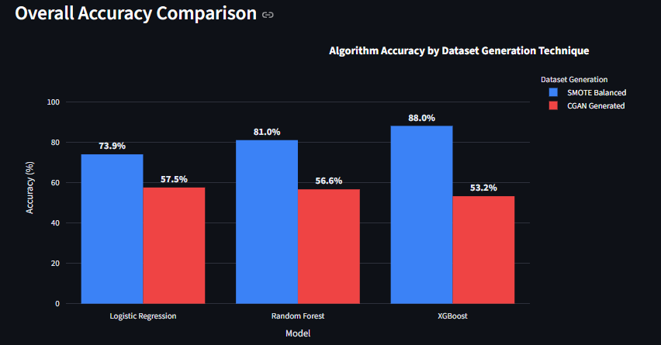
Experimental Results

Slide 51
Experimental Results
Explanation
This graph compares the classification accuracy of Logistic Regression, Random Forest and XGBoost models under two dataset conditions:
SMOTE
Conditional GAN (CGAN) augmentation
Observations
Models trained on the SMOTE-balanced dataset consistently achieved higher accuracy compared to the CGAN-generated dataset across all algorithms.
XGBoost with SMOTE achieved the highest accuracy (88.0%), followed by Random Forest (81.0%) and Logistic Regression (73.9%), indicating the effectiveness of tree-based models.
On the CGAN dataset, all models showed similar performance, with accuracy values ranging between 53% and 57%, indicating reduced model differentiation.

Slide 52
Experimental Results
Logistic Regression slightly outperformed more complex models like XGBoost on CGAN data, suggesting better generalization in this scenario.
Overall, SMOTE proved to be more effective than CGAN for improving classification accuracy in this project.
Reasons
SMOTE generates synthetic data using interpolation between existing samples, producing structured and consistent data that is easier for models to learn.
Tree-based models such as Random Forest and XGBoost perform well on structured data, allowing them to achieve higher accuracy with SMOTE-balanced datasets.
CGAN generates more diverse and realistic data with higher variability, introducing noise and complexity into the dataset.
The increased variance in CGAN data makes it harder for models to identify clear patterns, resulting in lower accuracy.

Slide 53
Experimental Results
CGAN Agumented data
Algorithm | Accuracy | Precision | Recall | F1-Score
Logistic Regression | 57.50% | 33.06% | 57.50% | 41.98%
Random Forest | 56.60% | 45.67% | 56.60% | 43.94%
XGBoost Classifier | 53.20% | 45.94% | 53.20% | 46.74%
Smote Agumented data
Algorithm | Accuracy | Precision | Recall | F1-Score
Logistic Regression | 73.91% | 73.93% | 73.91% | 73.92%
Random Forest | 80.95% | 80.96% | 80.95% | 80.94%
XGBoost Classifier | 87.99% | 88.00% | 87.99% | 87.98%

Slide 54
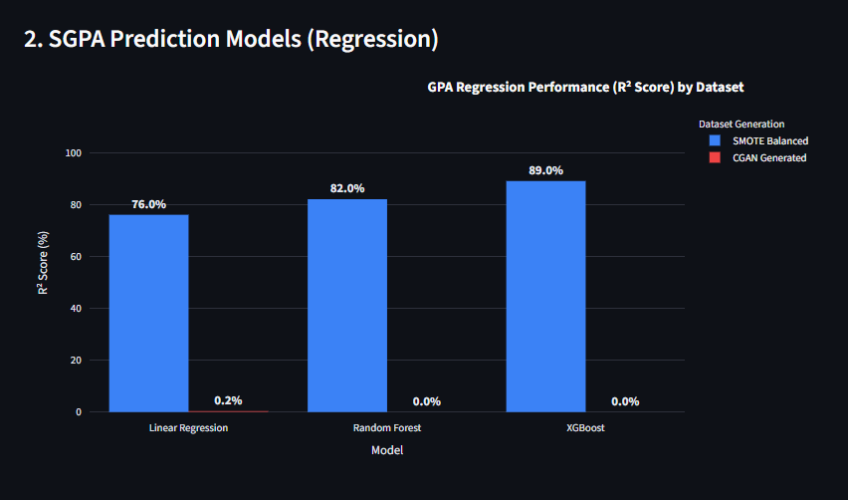
Experimental Results

Slide 55
Experimental Results
Explanation of the Graph
The graph compares regression performance (R² score) of different models on SMOTE-balanced and CGAN-generated datasets.
R² score indicates how well the model explains variance in student GPA (higher is better).
The comparison highlights the impact of data generation techniques on continuous value prediction.
Observations
Models trained on the SMOTE-balanced dataset achieved very high R² scores, indicating strong predictive performance.
XGBoost showed the best performance with an R² of 89.0%, followed by Random Forest (82.0%) and Linear Regression (76.0%).
On the CGAN-generated dataset, all models experienced a drastic drop in performance, with R² values close to zero (0.0% – 0.2%).

Slide 56
Experimental Results
This indicates that the models failed to accurately predict continuous GPA values using CGAN data.
Overall, SMOTE significantly outperformed CGAN for regression tasks in this project.
Reasons
SMOTE generates synthetic data through interpolation, preserving smooth and consistent relationships between input features and GPA.
Regression models perform well on such structured data, enabling accurate prediction of continuous values.
CGAN introduces higher variability and noise while generating data, which disrupts precise relationships between features.
Accurate GPA prediction requires strong and consistent correlations, which are weakened in CGAN-generated data.
Complex models fail to capture meaningful patterns in noisy data, resulting in near-zero predictive performance.
Regression tasks are more sensitive than classification, as predicting exact numerical values is more challenging than predicting categories.

Slide 57
Experimental Results
Smote Augmented data
Algorithm | R² Score (Accuracy) | Mean Absolute Error (MAE) | Mean Squared Error (MSE)
Linear Regression | 76.00% | 0.53 | 0.45
Random Forest Regressor | 82.00% | 0.46 | 0.34
XGBoost Regressor | 89.00% | 0.36 | 0.20
CGAN Agumented data
Algorithm | R² Score (Accuracy) | Mean Absolute Error (MAE) | Mean Squared Error (MSE)
Linear Regression | 0.21% | 1.38 | 2.52
Random Forest Regressor | 0.00% | 1.41 | 2.65
XGBoost Regressor | 0.00% | 1.46 | 3.01

Slide 58
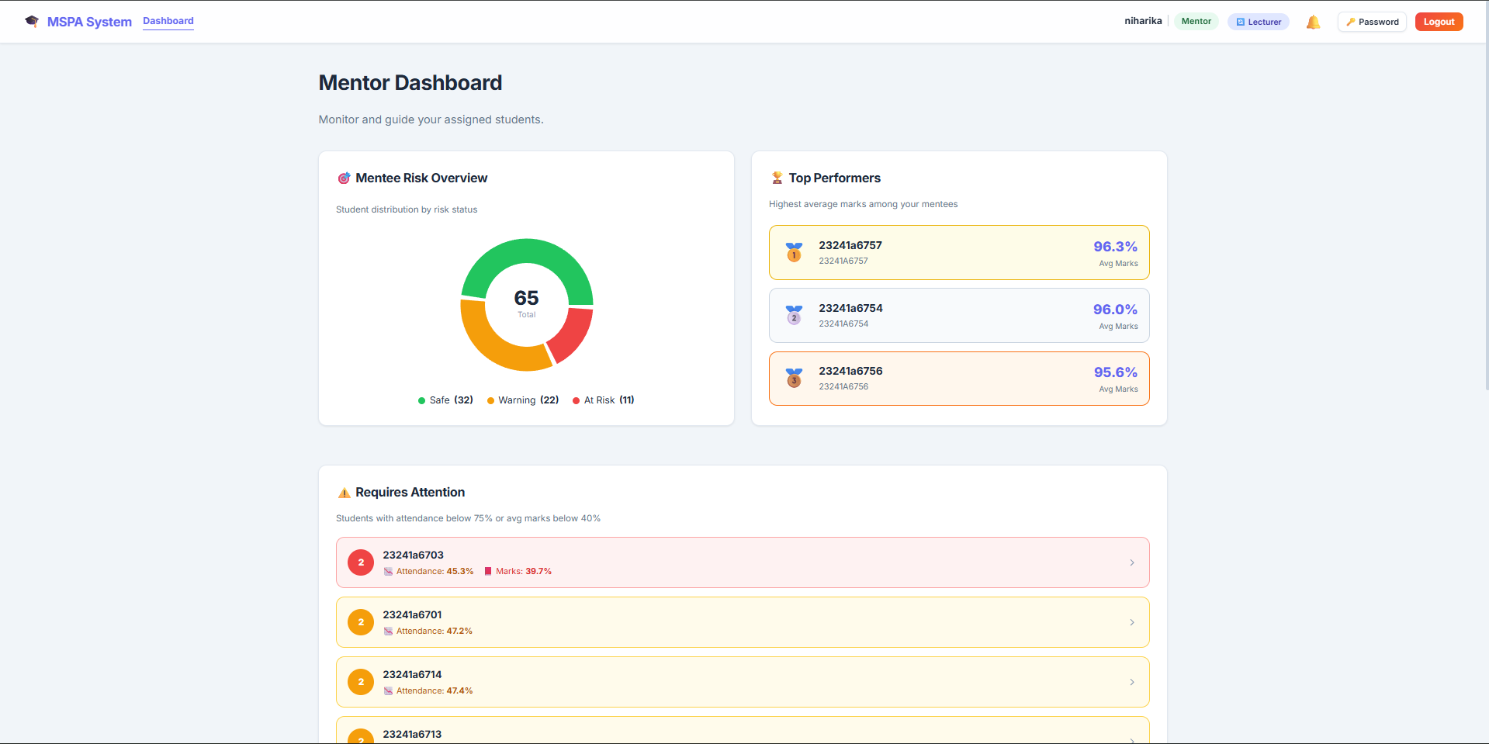
Screenshots of Mentor Dashboard

Slide 59
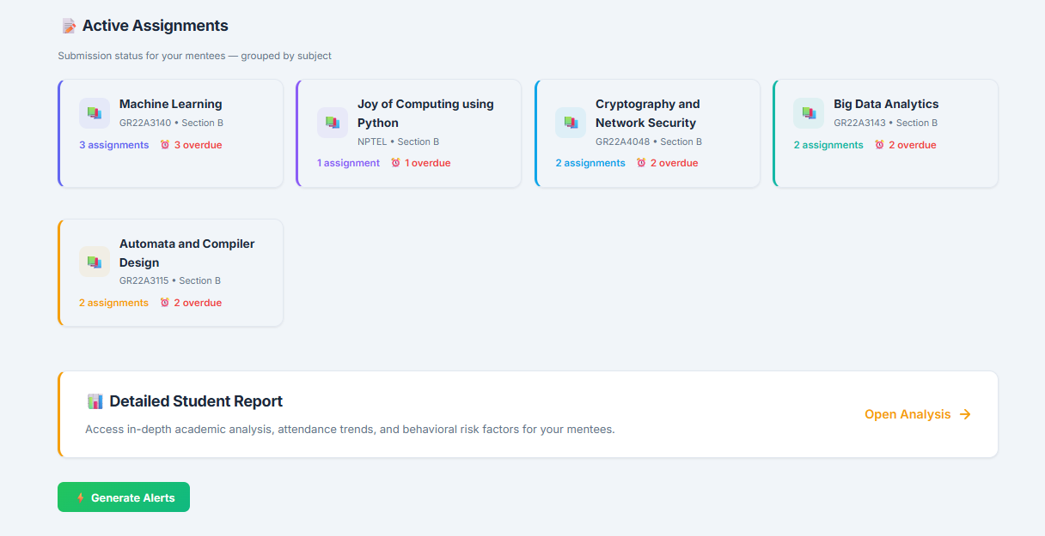
Screenshots of Mentor Dashboard

Slide 60
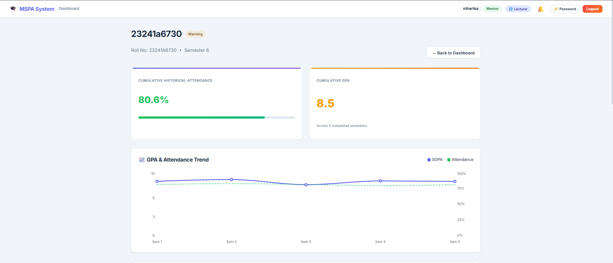
Screenshots of Detailed Student Analysis

Slide 61
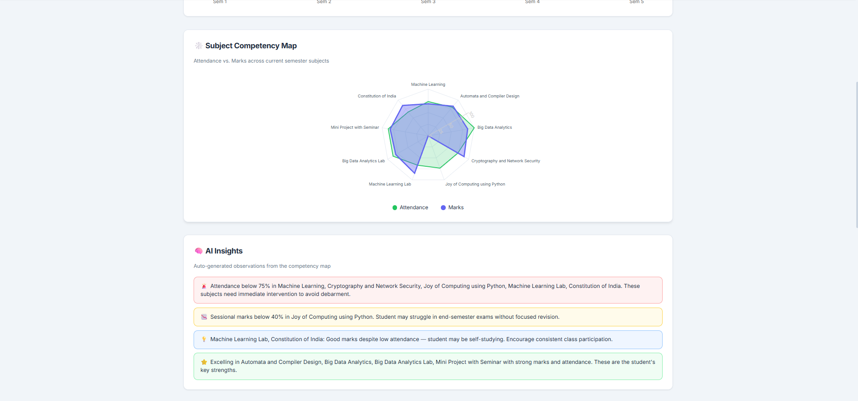
Screenshot of Insights and Radar Chart

Slide 62
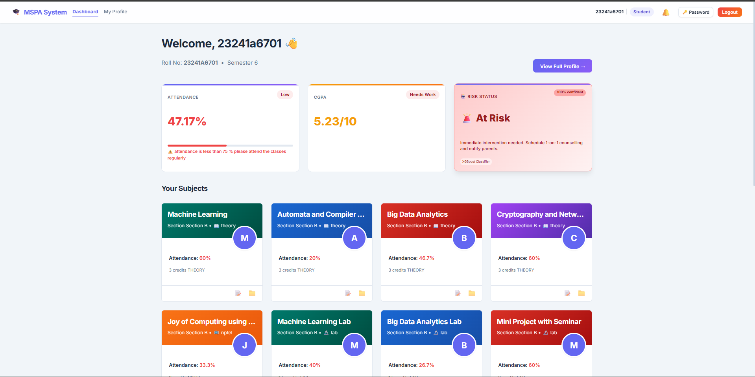
Screenshot of student Dashboard

Slide 63
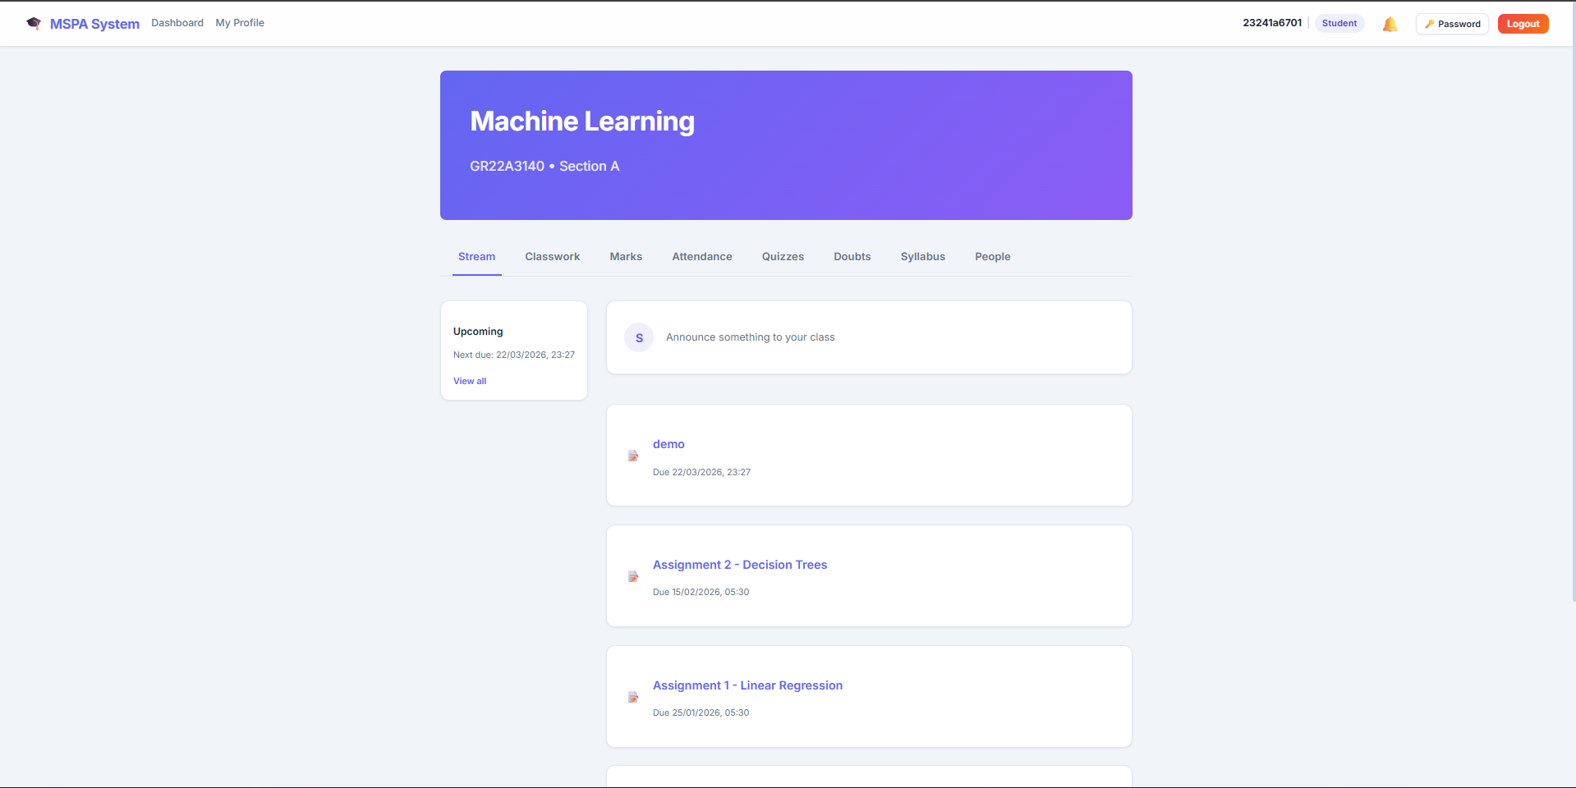
Screenshot of Classroom for each Subject

Slide 64
Conclusion
The proposed system successfully integrates academic analytics with structured mentorship, bridging the gap between raw student data and meaningful faculty guidance. By leveraging machine learning models such as XGBoost on a large dataset, it enables early identification of at-risk students and supports timely academic intervention. Features like subject competency mapping and doubt resolution enhance student engagement and self-monitoring, while automation of data tracking improves operational efficiency for faculty. Built on a scalable FastAPI and React architecture. Overall, it promotes a shift from reactive evaluation to a proactive, data-driven approach for improving student performance and outcomes.

Slide 65
Future Enhancements
Multi-Platform Mobile Application: Development of native Android and iOS applications to provide real-time push notifications for alerts and a more integrated student experience
Automated Biometric/Facial Attendance: Leveraging Computer Vision and facial recognition to automate attendance tracking during live lectures and laboratory sessions, reducing manual effort for faculty.
AI-Driven Resource Recommendation: Developing a recommendation engine that automatically suggests specific reading materials, video lectures, or research papers based on a student’s identified "Weak" areas in the Subject Competency Map
Placement & Job Readiness Prediction: Advancing the analytics engine to predict student placement outcomes and suggest skills needed for specific career tracks based on academic history.

Slide 66
Abstract
Monitoring student academic progress effectively remains a challenge in modern educational institutions. This project presents a Mentor-Based Student Performance Analysis and Risk Prediction System, a centralized web-based platform that integrates attendance, internal assessments, and engagement data using a FastAPI backend and React frontend. The system employs supervised machine learning models such as XGBoost and XGBoost Regresser, trained on a dataset of over 5,000 records, to identify at-risk students and predict performance. An automated Early Warning System generates real-time alerts for low attendance and poor performance, enabling timely intervention. Additional features such as doubt resolution, syllabus tracking, and subject-wise competency visualization support personalized mentoring. Overall, the system aims to enhance student outcomes and promote a data-driven approach to academic monitoring.

Slide 67
References
[1] A. Aljohani, H. A. Alahmadi, and S. Basri, “Early Predicting of Students’ Performance in Higher Education,” IEEE Access, vol. 11, pp. 12345–12358, 2023.
[2] R. Kumar, S. Patel, and M. Sharma, “Student Performance Prediction Using Machine Learning Techniques,” in Proc. IEEE Int. Conf. on Computing and Communication, 2022, pp. 456–461.
[3] J. Smith, L. Wang, and A. Brown, “Early Detection of At-Risk Students Using Machine Learning,” arXiv preprint arXiv:2412.09483, 2024.
[4] P. Verma and N. Singh, “Machine Learning Approaches for Predicting Academic Performance,” IEEE Access, vol. 10, pp. 98765–98778, 2022.
[5] S. Romero and M. Ventura, “Learning Analytics-Based Student Performance Prediction,” IEEE Transactions on Learning Technologies, vol. 14, no. 3, pp. 350–361, 2021.

Slide 68
References
[6] A. Hassan, K. Reddy, and P. Rao, “Predicting Student Dropout and Performance Using Machine Learning,” in Proc. IEEE Int. Conf. on Data Science, 2023, pp. 210–215.
[7] C. Peña-Ayala, “Educational Data Mining for Student Performance Analysis,” IEEE Access, vol. 8, pp. 56789–56802, 2020.
[8] M. Lee and J. Kim, “An Intelligent System for Student Performance Monitoring Using Machine Learning,” in Proc. IEEE Int. Conf. on Smart Education, 2024, pp. 102–107.
[9] T. Nguyen and P. Tran, “Classification-Based Prediction of Student Academic Outcomes,” in Proc. IEEE Int. Conf. on Artificial Intelligence, 2021, pp. 334–339.
[10] S. Das and R. Banerjee, “Performance Evaluation of Students Using Supervised Learning Models,” in Proc. IEEE Int. Conf. on Computing, 2022, pp. 189–194.

Slide 69
References
[11] K. Sharma and A. Mehta, “Predicting Student Academic Performance Using Classification Techniques,” IEEE Access, vol. 9, pp. 44521–44532, 2021.
[12] R. Patel and N. Joshi, “A Machine Learning Framework for Academic Performance Analysis,” in Proc. IEEE Int. Conf. on Machine Learning Applications, 2022, pp. 120–125.
[13] L. Chen and Y. Zhao, “Student Performance Monitoring and Prediction Using Learning Analytics,” IEEE Transactions on Learning Technologies, vol. 16, no. 2, pp. 210–220, 2023.
[14] S. Kumar and P. Malhotra, “Early Warning System for Academic Risk Detection Using Machine Learning,” in Proc. IEEE Int. Conf. on Smart Computing, 2022, pp. 98–103.
[15] A. Gupta and R. Iyer, “Performance Prediction of University Students Using Ensemble Learning,” IEEE Access, vol. 12, pp. 33450–33462, 2024.

Slide 70
Thank you

