Slide 1
OBE Implementation
Module-1: Programs
Submitted By
Likkith Reddy Chirasani [AP22110010179]
Surya Teja Mannava [AP22110010154]
Abhilash Thota [AP22110010140]
Vignesh Maddela [AP22110010185]
Manoj Chandu [AP22110010085]
Akbar Sherif [AP22110010113]

Slide 2
Introduction to Project
SRM University-AP is adopting the Outcome Based Education (OBE) framework to enhance the quality and effectiveness of its academic programs. As part of this initiative, a dedicated software system is required to manage and maintain academic program details in a structured and efficient manner.
To support this transformation, I have been assigned the task of developing a CRUD (Create, Retrieve, Update, and Delete) application using Java for the Windows platform and Android Studio for mobile devices. This application allows administrators and academic coordinators to efficiently manage the university's program records such as department IDs, program codes, names, statuses, and associated semesters.
The project leverages Java Swing for the desktop application with SQLite as the backend database to ensure a lightweight and responsive experience. The mobile version developed in Android Studio aims to provide similar CRUD functionality on the go, ensuring accessibility and usability across devices.
By combining a structured approach with modern UI practices, this system lays a foundational step toward digital transformation in line with SRM-AP’s goal of successfully implementing the OBE model.

Slide 3
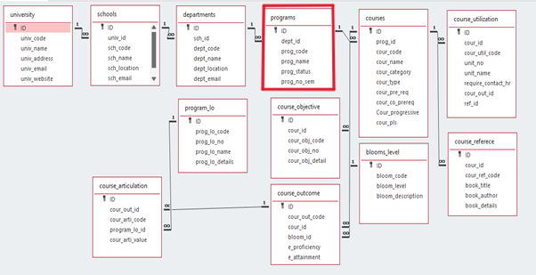
Architecture Diagram

Slide 4
Module Description : University Setting
This module is designed to perform Create, Update, Retrieve, and Delete (CRUD) operations on academic program details as part of the Outcome Based Education (OBE) system implementation at SRM University-AP. The module allows users to manage key information such as Department ID, Program Code, Program Name, Program Status, and Number of Semesters associated with each program.
The application is developed using Java (Swing) for the Windows platform and is integrated with a MySQL database to ensure reliable and efficient data storage. Users can interact with a user-friendly graphical interface to perform CRUD operations, and all updates made through the application are directly reflected in the MySQL table.
This module serves as a core component of the larger academic management system, providing a structured and consistent way to handle program-related data and supporting SRM-AP's transition to a more outcome-oriented education model.

Slide 5
University Setting:Field/table details
Field Name | Data type
id | integer
dept_id | integer
prog_code | String
porg_name | String
prog_status | String
prog_no_sem | integer

Slide 6
University Setting:Programming Details
File name: Legends_Programs
Function/method name
Create:AP22110010140_Programs_create
Update:AP22110010179_Programs _update
Retrieve:AP22110010154_Programs _retrive
Delete:AP22110010185_Programs _delete
GUI: AP22110010085 and AP22110010113

Slide 7
Sample Source Code
Creating a Program:
private void AP22110010140_Programs_create(int deptId, String progCode, String progName, String progStatus, int progNoSem) {
try (PreparedStatement ps = conn.prepareStatement(
"INSERT INTO programs (dept_id, prog_code, prog_name, prog_status, prog_no_sem) VALUES (?, ?, ?, ?, ?)")) {
ps.setInt(1, deptId);
ps.setString(2, progCode);
ps.setString(3, progName);
ps.setString(4, progStatus);
ps.setInt(5, progNoSem);
ps.executeUpdate();
} catch (SQLException e) {
JOptionPane.showMessageDialog(frame, "❌ Error inserting program.");
e.printStackTrace();
}
}

Slide 8
Sample Source Code
Retrieving the data:
private void AP22110010154_Programs_retrieve() {
model.setRowCount(0);
try (Statement stmt = conn.createStatement(); ResultSet rs = stmt.executeQuery("SELECT * FROM programs")) {
while (rs.next()) {
model.addRow(new Object[]{
rs.getInt("ID"), rs.getInt("dept_id"), rs.getString("prog_code"),
rs.getString("prog_name"), rs.getString("prog_status"), rs.getInt("prog_no_sem")
});
}
} catch (SQLException e) {
e.printStackTrace();
}
}

Slide 9
Sample Source Code
Updating a Program:
private void AP22110010179_Programs_update() {
int row = table.getSelectedRow();
if (row == -1) {
JOptionPane.showMessageDialog(frame, "❌ Select a program to update.");
return;
} int id = (int) table.getValueAt(row, 0);
JTextField deptField = new JTextField(table.getValueAt(row, 1).toString());
JTextField codeField = new JTextField((String) table.getValueAt(row, 2));
JTextField nameField = new JTextField((String) table.getValueAt(row, 3));
JTextField statusField = new JTextField((String) table.getValueAt(row, 4));
JComboBox<Integer> semCombo = new JComboBox<>();
for (int i = 1; i <= 8; i++) semCombo.addItem(i);
semCombo.setSelectedItem(table.getValueAt(row, 5));

Slide 10
Sample Source Code
JPanel panel = new JPanel(new GridLayout(6, 2, 5, 5));
panel.add(new JLabel("Dept ID:")); panel.add(deptField);
panel.add(new JLabel("Code:")); panel.add(codeField);
panel.add(new JLabel("Name:")); panel.add(nameField);
panel.add(new JLabel("Status:")); panel.add(statusField);
panel.add(new JLabel("Semester:")); panel.add(semCombo);
int result = JOptionPane.showConfirmDialog(frame, panel, "Update Program", JOptionPane.OK_CANCEL_OPTION);
if (result == JOptionPane.OK_OPTION) {
try (PreparedStatement ps = conn.prepareStatement(
"UPDATE programs SET dept_id=?, prog_code=?, prog_name=?, prog_status=?, prog_no_sem=? WHERE ID=?")) {
ps.setInt(1, Integer.parseInt(deptField.getText().trim()));
ps.setString(2, codeField.getText().trim());
ps.setString(3, nameField.getText().trim());
ps.setString(4, statusField.getText().trim());

Slide 11
Sample Source Code
ps.setInt(5, (int) semCombo.getSelectedItem());
ps.setInt(6, id);
ps.executeUpdate();
JOptionPane.showMessageDialog(frame, "✅ Program Updated!");
AP22110010154_Programs_retrieve();
} catch (Exception ex) {
JOptionPane.showMessageDialog(frame, "❌ Error updating program.");
}
}
}

Slide 12
Sample Source Code
Deleting a Program:
private void AP221100101185_Programs_delete() {
int row = table.getSelectedRow();
if (row == -1) {
JOptionPane.showMessageDialog(frame, "❌ Select a row to delete.");
return;
} int id = (int) table.getValueAt(row, 0);
int confirm = JOptionPane.showConfirmDialog(frame, "Are you sure?", "Delete Program", JOptionPane.YES_NO_OPTION);
if (confirm == JOptionPane.YES_OPTION) {
try (PreparedStatement ps = conn.prepareStatement("DELETE FROM programs WHERE ID=?")) {
ps.setInt(1, id);
}

Slide 13
Sample Source Code
ps.executeUpdate();
JOptionPane.showMessageDialog(frame, "✅ Program Deleted!");
AP22110010154_Programs_retrieve();
} catch (SQLException e) {
e.printStackTrace();
}
}

Slide 14
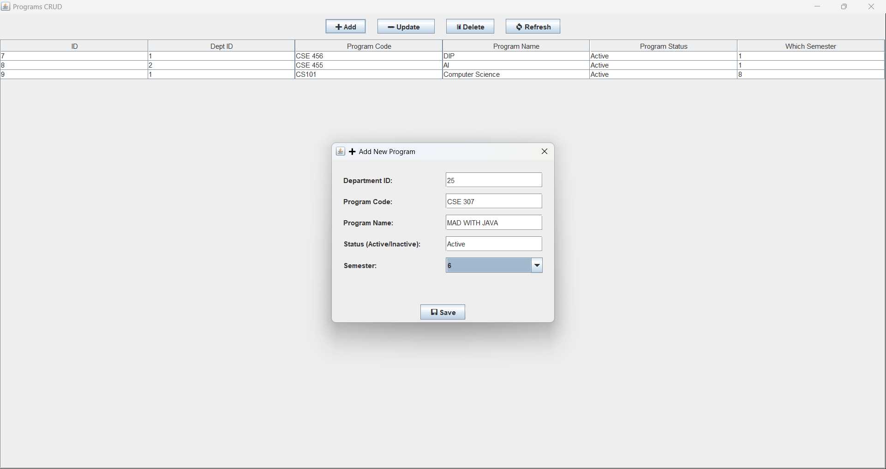
Sample Screen Shots[*Screenshot of CRUD)]
Adding or creating a Program:

Slide 15
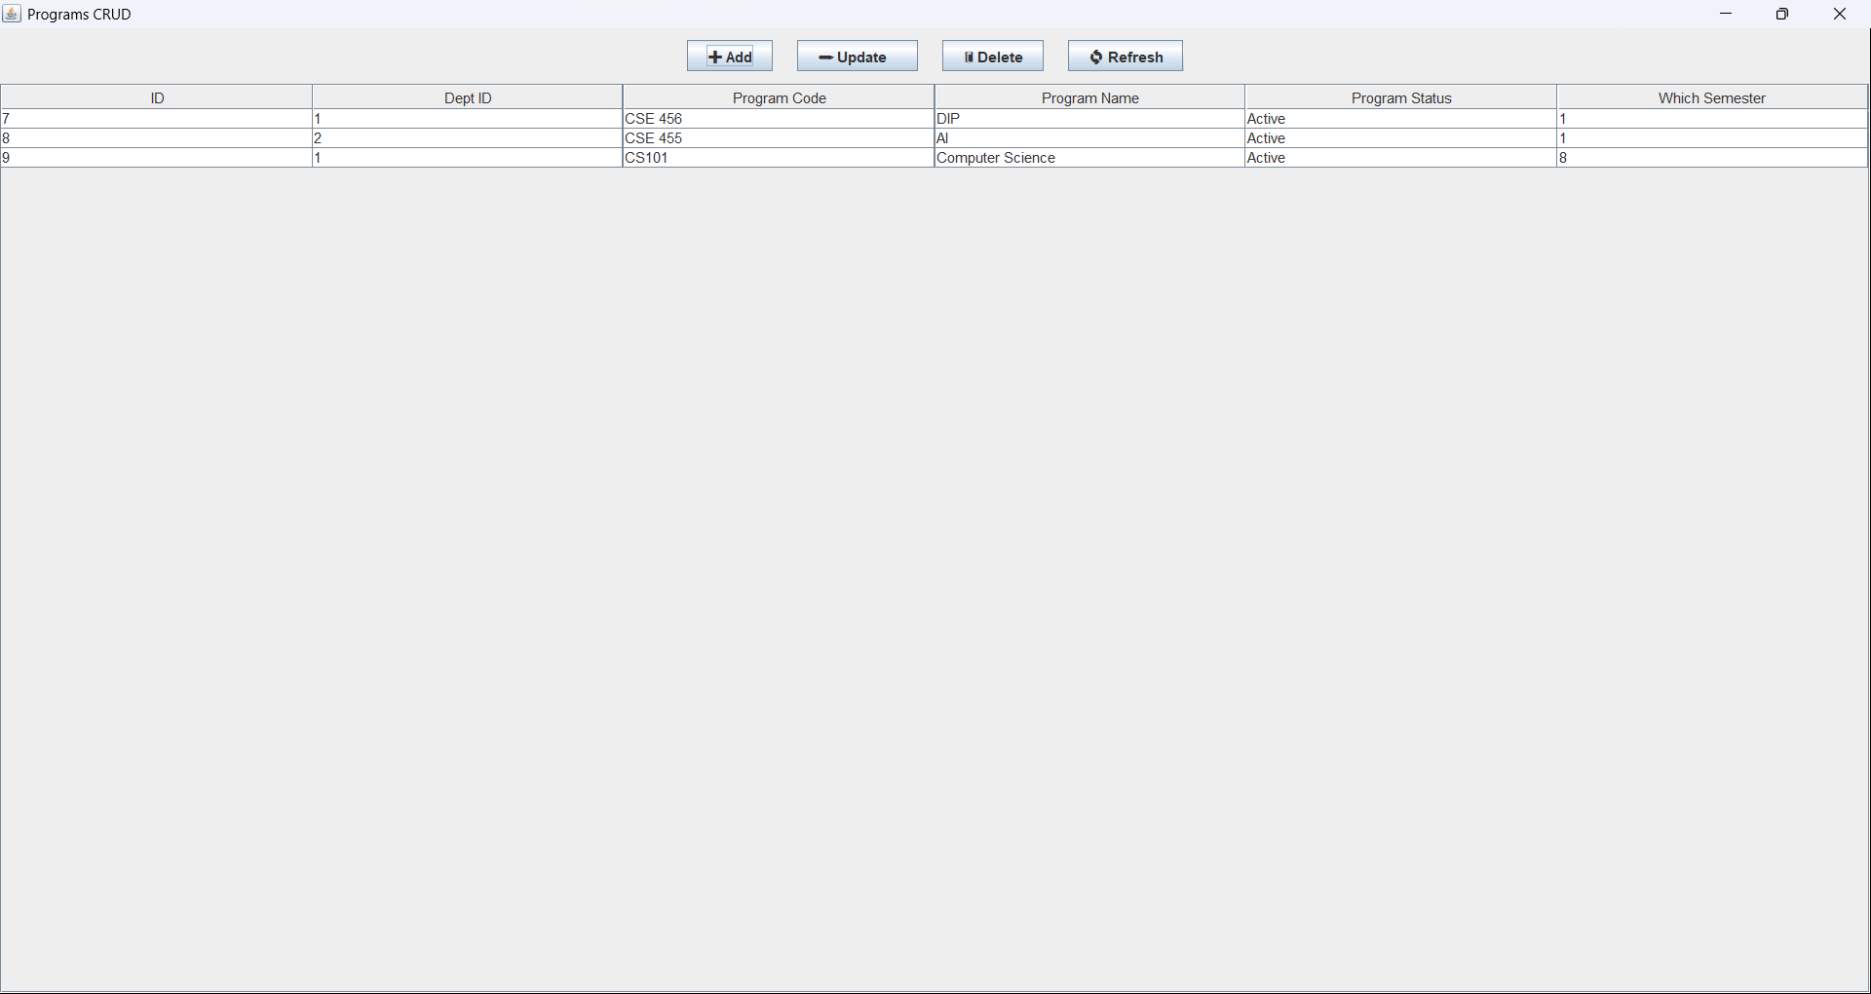
Sample Screen Shots[*Screenshot of CRUD)]
Retrieving all the Programs data from database:

Slide 16
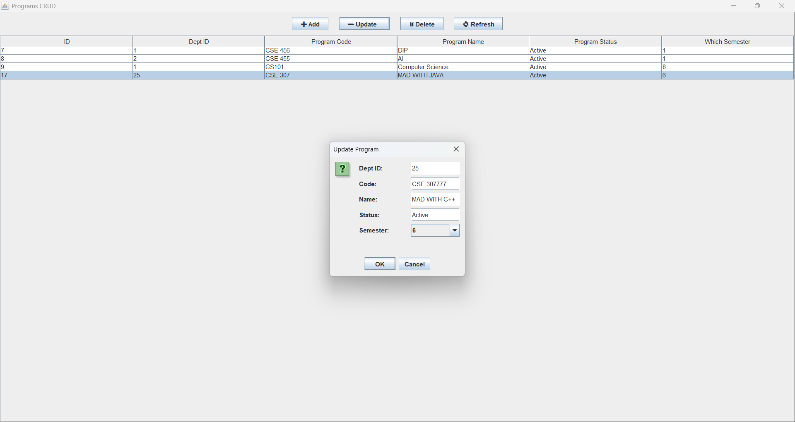
Sample Screen Shots[*Screenshot of CRUD)]
Updating a Program:

Slide 17
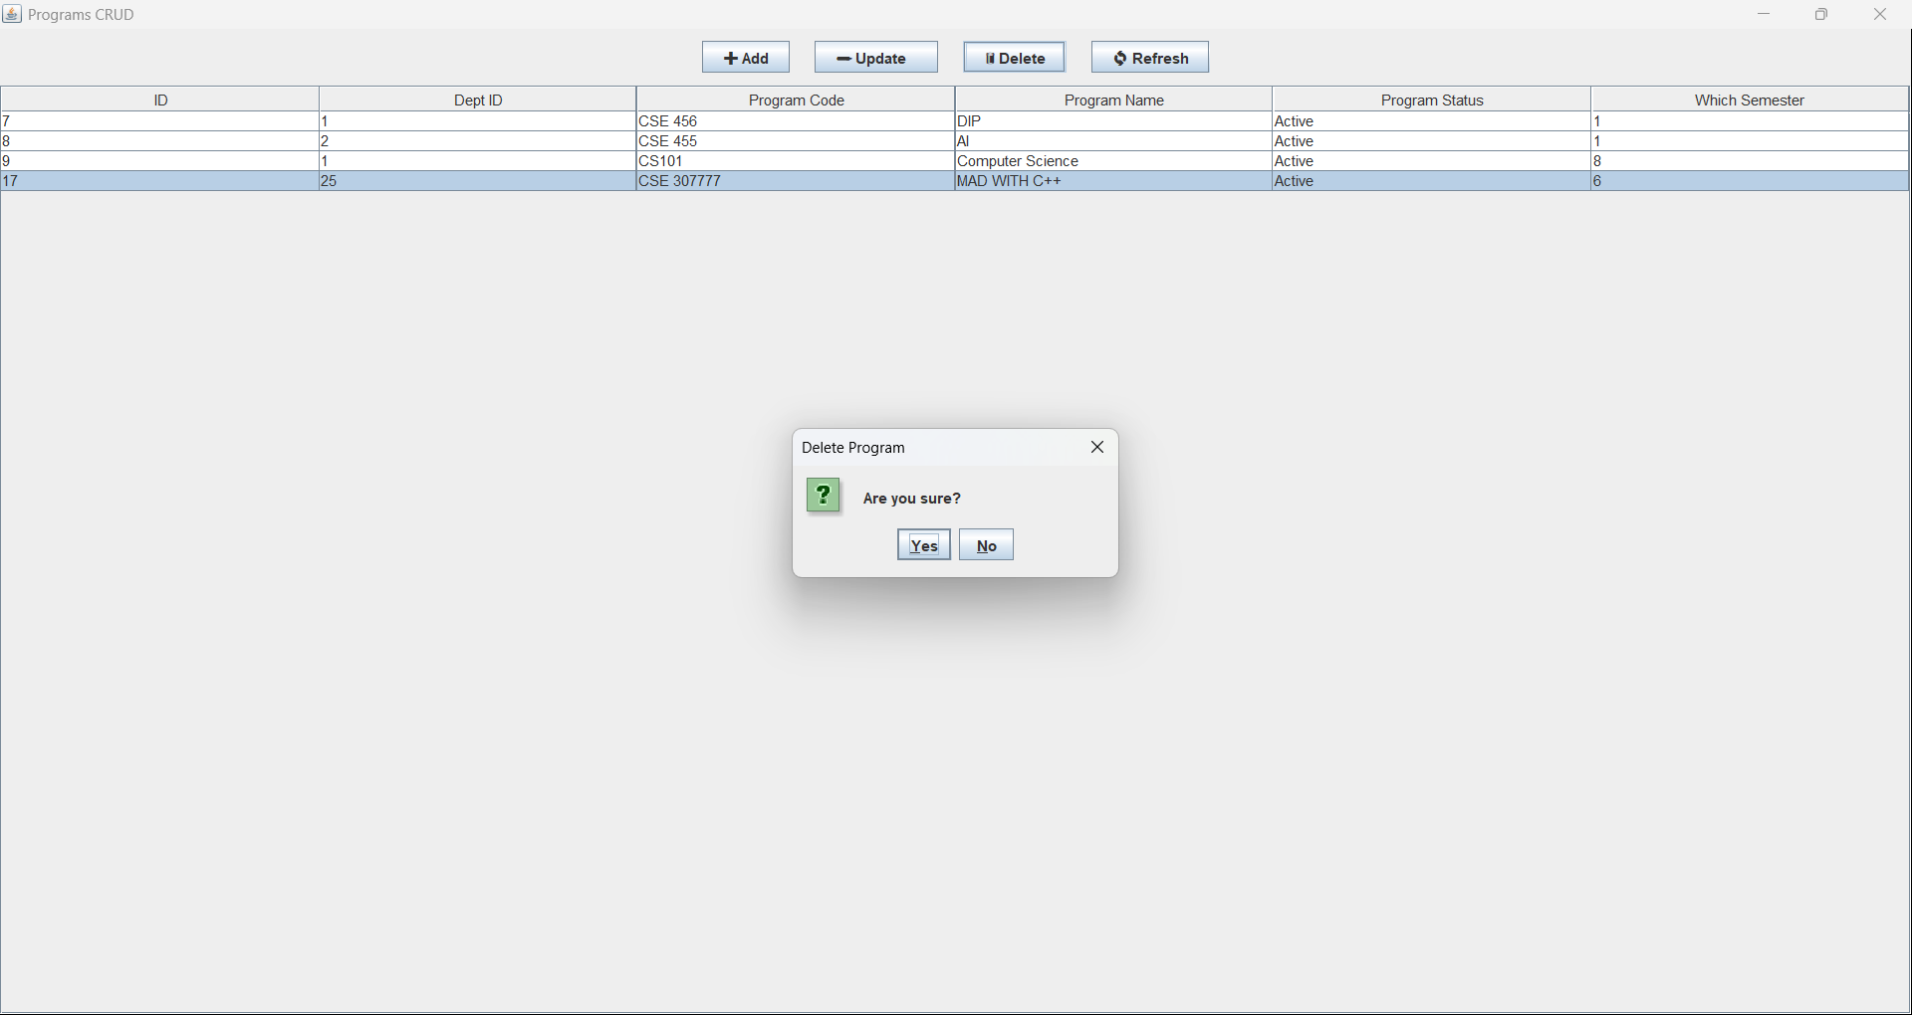
Sample Screen Shots[*Screenshot of CRUD)]
Deleting a Program:
ps.executeUpdate();
JOptionPane.showMessageDialog(frame, "✅ Program Deleted!");
AP22110010154_Programs_retrieve();
} catch (SQLException e) {
e.printStackTrace();
}
}

Slide 18
Conclusion
The Programs CRUD Management System has been successfully developed as a robust and user-friendly desktop application using Java Swing and SQLite. It enables efficient management of academic programs by providing core functionalities such as creating, reading, updating, and deleting program records.
This project demonstrates practical implementation of GUI design, database connectivity using JDBC, and structured modular coding practices. By integrating intuitive user interfaces with backend operations, the system offers a seamless experience for administrators to manage program data with accuracy and ease.

Slide 19
Thank You

