Slide 1
CHAPTER 6:
INTRODUCTION TO SQL
Essentials of Database Management
Jeffrey A. Hoffer, Heikki Topi, V. Ramesh
Copyright © 2014 Pearson Education, Inc.

Slide 2
OBJECTIVES
Define terms
Interpret history and role of SQL
Define a database using SQL data definition language
Write single table queries using SQL
Establish referential integrity using SQL
Discuss SQL:1999 and SQL:2008 standards

Slide 3
SQL OVERVIEW
Structured Query Language
The standard for relational database management systems (RDBMS)
RDBMS: A database management system that manages data as a collection of tables in which all relationships are represented by common values in related tables

Slide 4
HISTORY OF SQL
1970–E. F. Codd develops relational database concept
1974-1979–System R with Sequel (later SQL) created at IBM Research Lab
1979–Oracle markets first relational DB with SQL
1981 – SQL/DS first available RDBMS system on DOS/VSE
Others followed: INGRES (1981), IDM (1982), DG/SGL (1984), Sybase (1986)
1986–ANSI SQL standard released
1989, 1992, 1999, 2003, 2006, 2008–Major ANSI standard updates
Current–SQL is supported by most major database vendors

Slide 5
PURPOSE OF SQL STANDARD
Specify syntax/semantics for data definition and manipulation
Define data structures and basic operations
Enable portability of database definition and application modules
Specify minimal (level 1) and complete (level 2) standards
Allow for later growth/enhancement to standard (referential integrity, transaction management, user-defined functions, extended join operations, national character sets)

Slide 6
BENEFITS OF A STANDARDIZED RELATIONAL LANGUAGE
Reduced training costs
Productivity
Application portability
Application longevity
Reduced dependence on a single vendor
Cross-system communication

Slide 7
SQL ENVIRONMENT
Catalog
  A set of schemas that constitute the description of a database
Schema
  The structure that contains descriptions of objects created by a user (base tables, views, constraints)
Data Definition Language (DDL)
  Commands that define a database, including creating, altering, and dropping tables and establishing constraints
Data Manipulation Language (DML)
  Commands that maintain and query a database
Data Control Language (DCL)
  Commands that control a database, including administering privileges and committing data

Slide 8
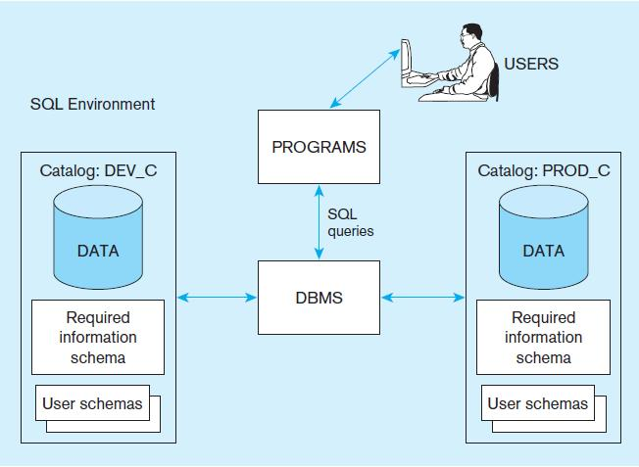
Figure 6-1
A simplified schematic of a typical SQL environment, as described by the SQL: 2008 standard
Chapter 6
Copyright © 2014 Pearson Education, Inc.

Slide 9
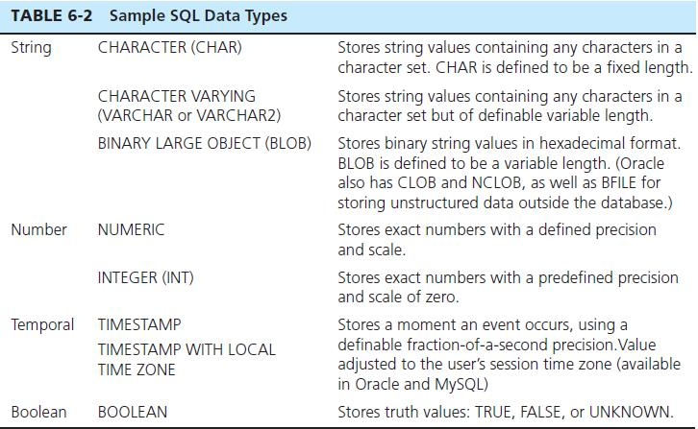
SQL DATA TYPES

Slide 10
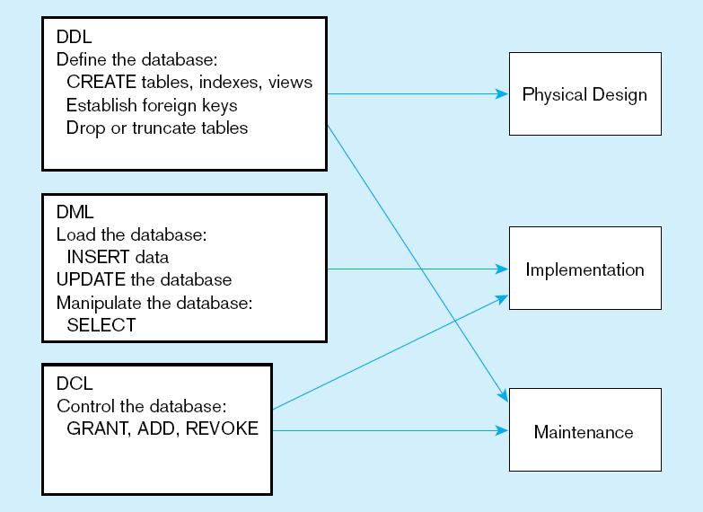
Figure 6-4
DDL, DML, DCL, and the database development process
Chapter 6
Copyright © 2014 Pearson Education, Inc.

Slide 11
SQL DATABASE DEFINITION
Data Definition Language (DDL)
Major CREATE statements:
  CREATE SCHEMA–defines a portion of the database owned by a particular user
  CREATE TABLE–defines a new table and its columns
  CREATE VIEW–defines a logical table from one or more tables or views
Other CREATE statements: CHARACTER SET, COLLATION, TRANSLATION, ASSERTION, DOMAIN

Slide 12
STEPS IN TABLE CREATION
Identify data types for attributes
Identify columns that can and cannot be null
Identify columns that must be unique (candidate keys)
Identify primary key–foreign key mates
Determine default values
Identify constraints on columns (domain specifications)
Create the table and associated indexes

Slide 13
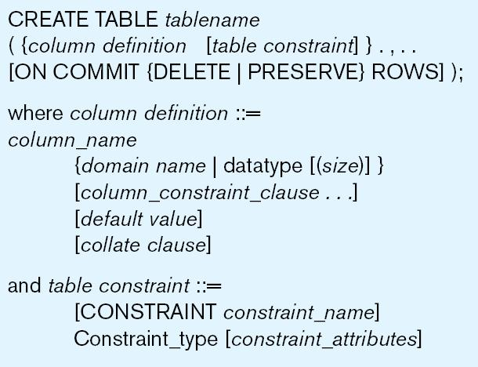
Figure 6-5 General syntax for CREATE TABLE statement used in data definition language

Slide 14
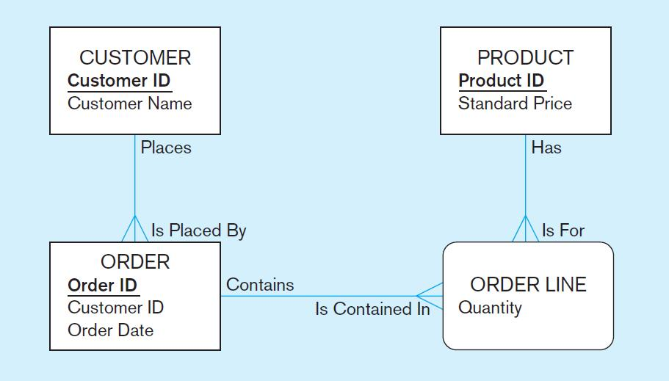
THE FOLLOWING SLIDES CREATE TABLES FOR THIS ENTERPRISE DATA MODEL
(from Chapter 1, Figure 1-3)

Slide 15
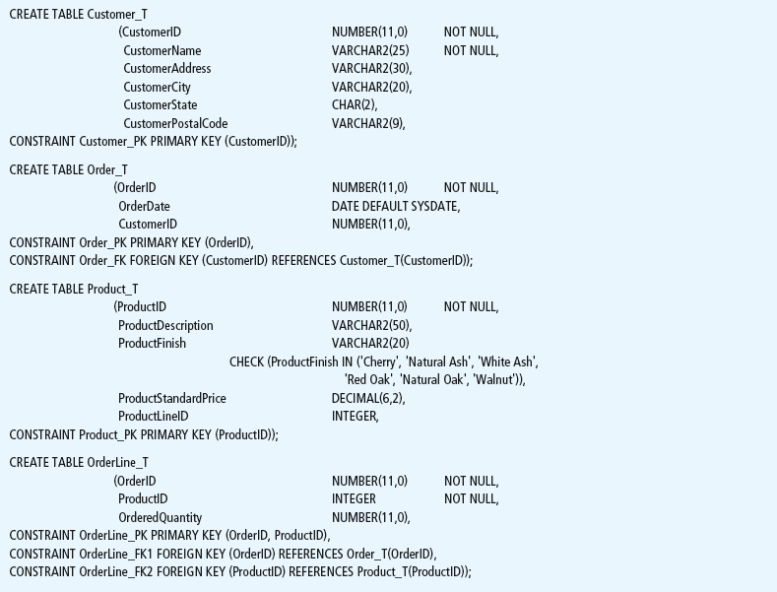
Figure 6-6 SQL database definition commands for Pine Valley Furniture Company (Oracle 11g)
Overall table definitions

Slide 16
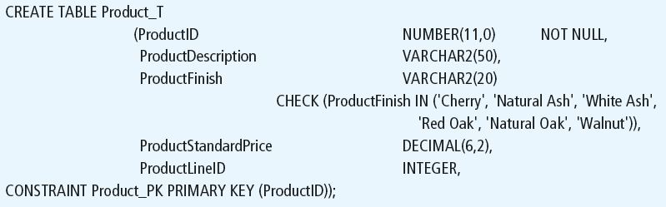
Defining attributes and their data types
Chapter 6
Copyright © 2014 Pearson Education, Inc.

Slide 17
Non-nullable specification
Primary keys can never have NULL values
Identifying primary key
Chapter 6
Copyright © 2014 Pearson Education, Inc.

Slide 18
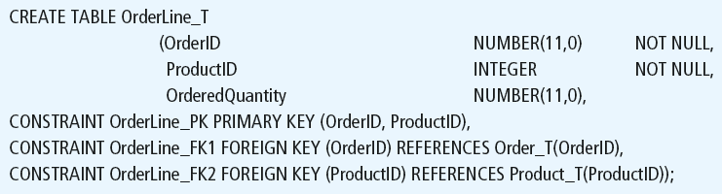
Non-nullable specifications
Primary key
Some primary keys are composite– composed of multiple attributes
Chapter 6
Copyright © 2014 Pearson Education, Inc.

Slide 19
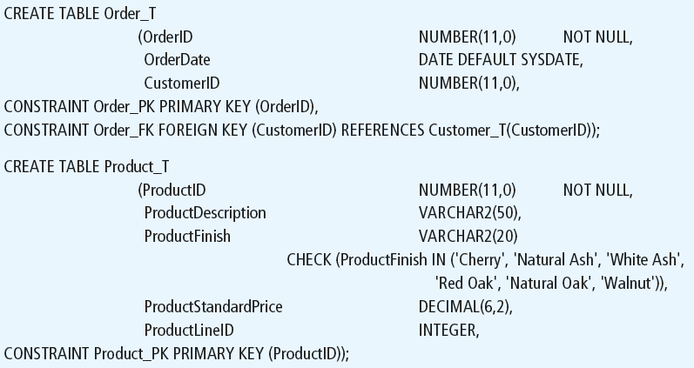
Controlling the values in attributes
Default value
Domain constraint
Chapter 6
Copyright © 2014 Pearson Education, Inc.

Slide 20
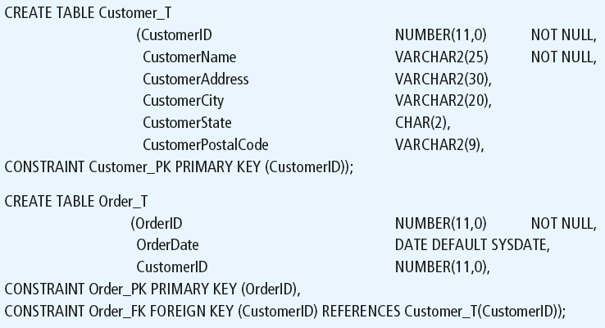
Identifying foreign keys and establishing relationships
Primary key of parent table
Foreign key of dependent table
Chapter 6
Copyright © 2014 Pearson Education, Inc.

Slide 21
DATA INTEGRITY CONTROLS
Referential integrity–constraint that ensures that foreign key values of a table must match primary key values of a related table in 1:M relationships
Restricting:
  Deletes of primary records
  Updates of primary records
  Inserts of dependent records

Slide 22

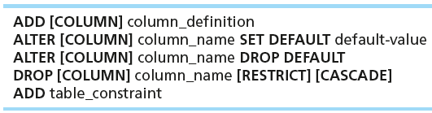

CHANGING TABLES
ALTER TABLE statement allows you to change column specifications:
Table Actions:
Example (adding a new column with a default value):

Slide 23
REMOVING TABLES
DROP TABLE statement allows you to remove tables from your schema:
  DROP TABLE CUSTOMER_T

Slide 24



INSERT STATEMENT
Adds one or more rows to a table
Inserting into a table
Inserting a record that has some null attributes requires identifying the fields that actually get data
Inserting from another table

Slide 25
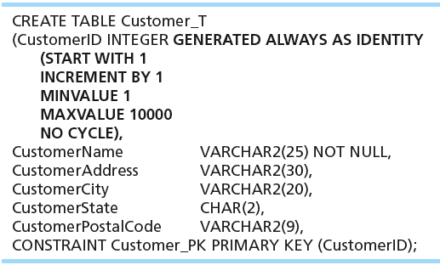
CREATING TABLES WITH IDENTITY COLUMNS
Introduced with SQL:2008
Inserting into a table does not require explicit customer ID entry or field list
  INSERT INTO CUSTOMER_T VALUES ( ‘Contemporary Casuals’, ‘1355 S. Himes Blvd.’, ‘Gainesville’, ‘FL’, 32601);

Slide 26
DELETE STATEMENT
Removes rows from a table
Delete certain rows
  DELETE FROM CUSTOMER_T WHERE CUSTOMERSTATE = ‘HI’;
Delete all rows
  DELETE FROM CUSTOMER_T;

Slide 27

UPDATE STATEMENT
Modifies data in existing rows

Slide 28
SCHEMA DEFINITION
Control processing/storage efficiency:
  Choice of indexes
  File organizations for base tables
  File organizations for indexes
  Data clustering
  Statistics maintenance
Creating indexes
  Speed up random/sequential access to base table data
  Example
    CREATE INDEX NAME_IDX ON CUSTOMER_T(CUSTOMERNAME)
    This makes an index for the CUSTOMERNAME field of the CUSTOMER_T table

Slide 29
SELECT STATEMENT
Used for queries on single or multiple tables
Clauses of the SELECT statement:
  SELECT
    List the columns (and expressions) to be returned from the query
  FROM
    Indicate the table(s) or view(s) from which data will be obtained
  WHERE
    Indicate the conditions under which a row will be included in the result
  GROUP BY
    Indicate categorization of results
  HAVING
    Indicate the conditions under which a category (group) will be included
  ORDER BY
    Sorts the result according to specified criteria

Slide 30
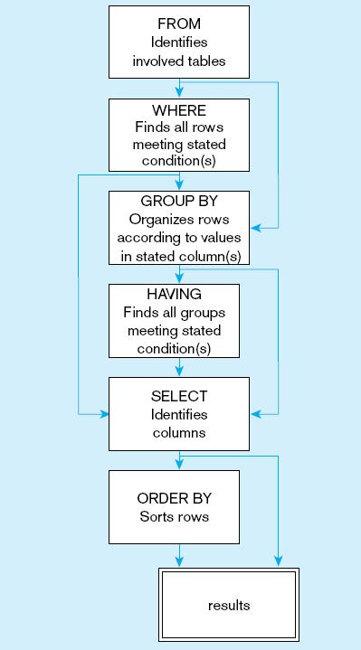
Figure 6-9
  SQL statement processing order (based on van der Lans, 2006 p.100)
Chapter 6
Copyright © 2014 Pearson Education, Inc.

Slide 31
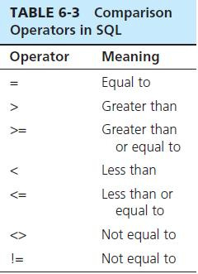

SELECT EXAMPLE
Find products with standard price less than $275
Table 6-3: Comparison Operators in SQL

Slide 32
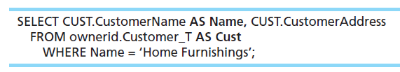
SELECT EXAMPLE USING ALIAS
Alias is an alternative column or table name
Here, CUST is a table alias and Name is a column alias

Slide 33
SELECT EXAMPLE USING A FUNCTION
Using the COUNT aggregate function to find totals
  SELECT COUNT(*) FROM ORDERLINE_T
  WHERE ORDERID = 1004;
  Note: with aggregate functions you can’t have single-valued columns included in the SELECT clause, unless they are included in the GROUP BY clause.

Slide 34
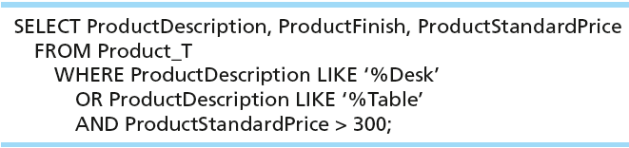
SELECT EXAMPLE–BOOLEAN OPERATORS
AND, OR, and NOT Operators for customizing conditions in WHERE clause
Note: the LIKE operator allows you to compare strings using wildcards. For example, the % wildcard in ‘%Desk’ indicates that all strings that have any number of characters preceding the word “Desk” will be allowed.

Slide 35
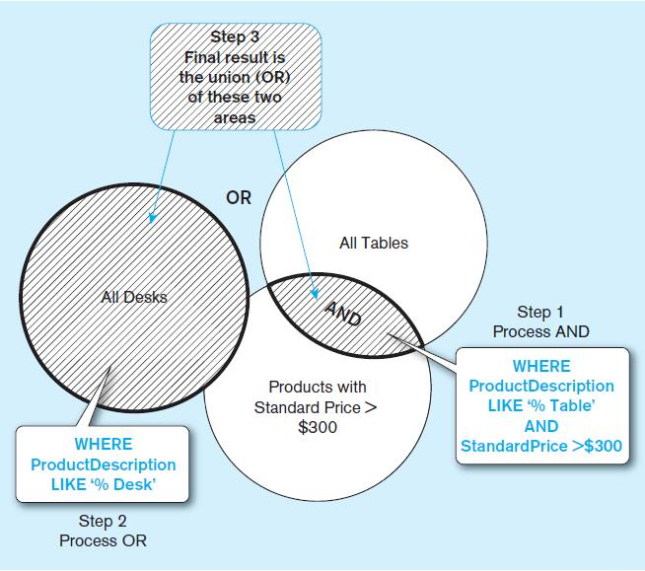
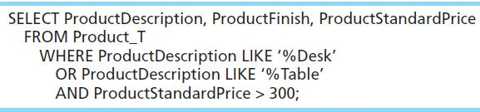
Figure 6-7 Boolean query A without use of parentheses
By default, processing order of Boolean operators is NOT, then AND, then OR

Slide 36
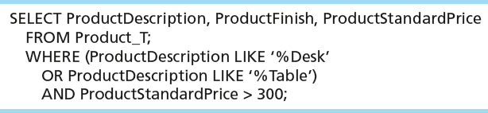
SELECT EXAMPLE–BOOLEAN OPERATORS
With parentheses…these override the normal precedence of Boolean operators
With parentheses, you can override normal precedence rules. In this case parentheses make the OR take place before the AND.

Slide 37
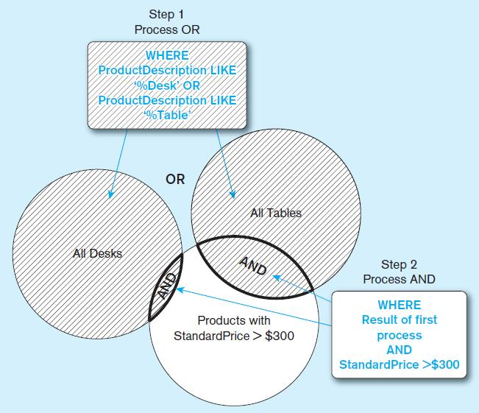
Figure 6-8 Boolean query B with use of parentheses

Slide 38
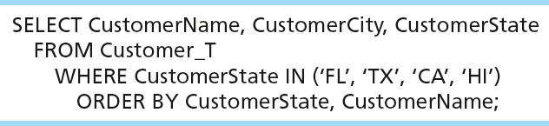
SORTING RESULTS WITH ORDER BY CLAUSE
Sort the results first by STATE, and within a state by the CUSTOMER NAME
Note: the IN operator in this example allows you to include rows whose CustomerState value is either FL, TX, CA, or HI. It is more efficient than separate OR conditions.

Slide 39

CATEGORIZING RESULTS USING GROUP BY CLAUSE
For use with aggregate functions
  Scalar aggregate: single value returned from SQL query with aggregate function
  Vector aggregate: multiple values returned from SQL query with aggregate function (via GROUP BY)
  You can use single-value fields with aggregate functions if they are included in the GROUP BY clause.

Slide 40
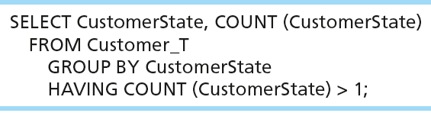
QUALIFYING RESULTS BY CATEGORIES
USING THE HAVING CLAUSE
For use with GROUP BY
Like a WHERE clause, but it operates on groups (categories), not on individual rows. Here, only those groups with total numbers greater than 1 will be included in final result.

Slide 41
USING AND DEFINING VIEWS
Views provide users controlled access to tables
Base Table–table containing the raw data
Virtual Table–constructed automatically as needed; not maintained as real data
Dynamic View
  A “virtual table” created dynamically upon request by a user
  No data actually stored; instead data from base table made available to user
  Based on SQL SELECT statement on base tables or other views
  Contents materialized as a result of a query

Slide 42
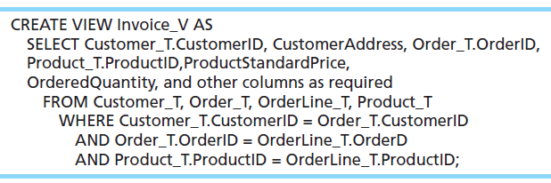
SAMPLE CREATE VIEW
Query: What are the data elements necessary to create an invoice for a customer?
Save this query as a view named Invoice_V.

Slide 43
ADVANTAGES OF VIEWS
Simplify query commands
Assist with data security (but don't rely on views for security, there are more important security measures)
Enhance programming productivity
Contain most current base table data
Use little storage space
Provide customized view for user
Establish physical data independence

Slide 44
DISADVANTAGES OF VIEWS
Use processing time each time view is referenced
May or may not be directly updateable

Slide 45

All rights reserved. No part of this publication may be reproduced, stored in a retrieval system, or transmitted, in any form or by any means, electronic, mechanical, photocopying, recording, or otherwise, without the prior written permission of the publisher. Printed in the United States of America.
Copyright © 2014 Pearson Education, Inc.

