Slide 1
Connect 4 Architecture
By: IOSers

Slide 2
Introduction:
The Connect 4 project was a project aimed to create a simple, yet thorough program to allow users to play Connect 4 either with a friend or with a CPU.
Although simple in design, much of the moving parts required heavy use of arrays, pointers, and mathematical operations, therefore we are proud of it.

Slide 3
UML Chart
-visual
- startup()
-Draw()
- Plot(Point2d, char)
Provides locational information
-Point2D
-point2D()
-point2D(int, int)
Player();
~Player();
void Nameask(int);
void Charask(int);
void GiveName();
void GivePiece(char);
char GetChar();
string GetName();
int GamesWon(int);
int move;
int MakeMove();
int getMoveConut();
int AIMove(Board* b);
Allows change in Player status
Provides foundation for board
Board
- Board()
-winCheck()
- getMovePoint2d, char)
-placePiece
-getStatus
-moveup
Provides locational information
Provides location information’
Provides move information

Slide 4
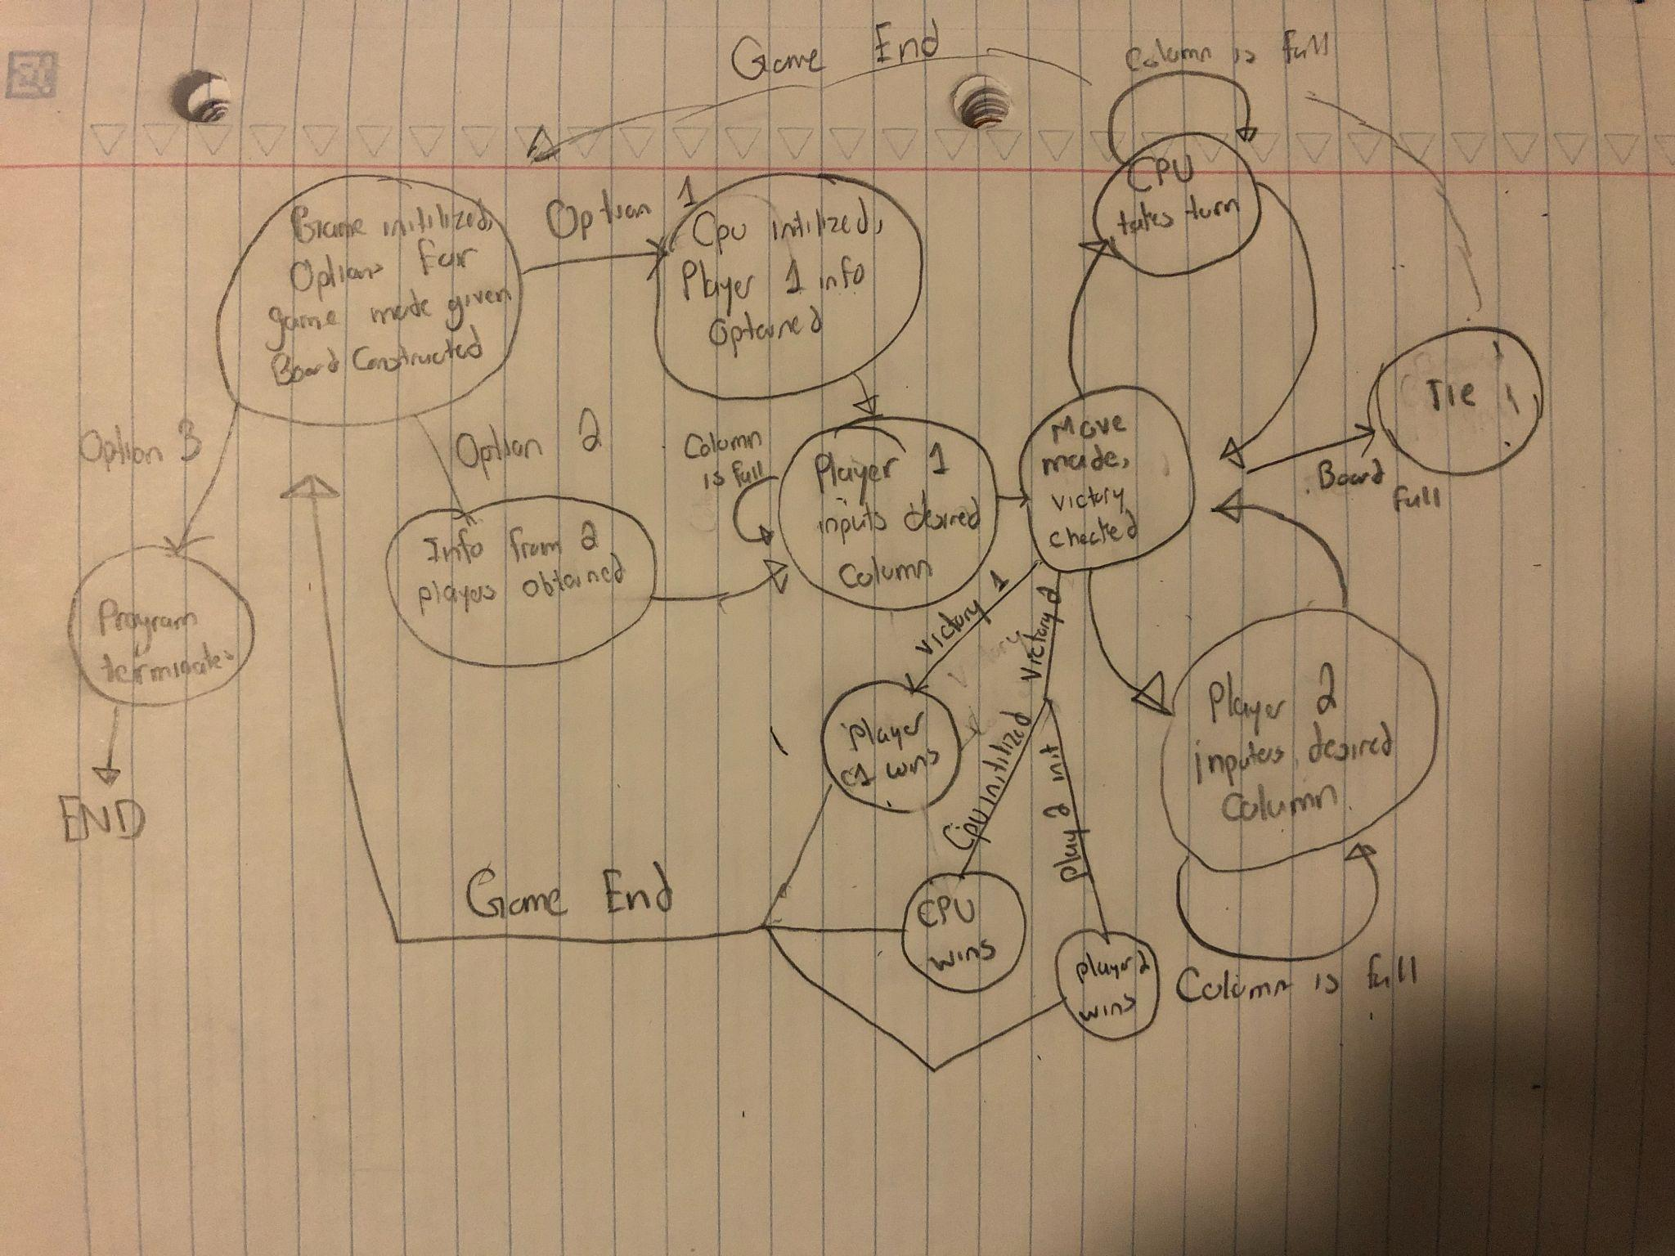
Program Flowchart
Handwritten for better understanding.

Slide 5
State Chart
Although there are 2 states, they are the backbone of the whole code
Empty = 0: if a correct column is selected, state turns to empty, and the game runs as normal.
Full = 1: the program starts in this phase, and returns to this phase if a column in the board is full, or before the next user.. Retains this phase until a proper column is picked.
State changes according to what purpose is needed.

