Slide 1


Dissertation Presentation
On
DETECTION TO CONTAINMENT: MITIGATING EXPLOITS IN SMART CONTRACTS, ORACLE SYSTEMS, AND CROSS-CHAIN BRIDGES
Supervisors:
Dr. Deepak Kumar Mishra
Assistant Professor, Computer Science
College of Vocational Studies
Dr. Jatin Sharma
Assistant Professor, Computer Engineering
Faculty of Technology
Presented by:
Harshit Nishad
Roll No: 22013570019
Bachelor of Computer Science
(Honours with Research)
Semester VIII
Department of Computer Science
College of Vocational Studies, University of Delhi
2025–2026
1

Slide 2
Outline
1. Introduction
2. Motivation
3. Literature Review
Research Gaps
Research Questions
6. Research Objectives
Methodology
Case Studies
9. Results
10. Boundary Cases
11. Discussion: Authority Gap and Limitations
12. Conclusion
13. Future Work
14. Thesis Organisation
15. References
2

Slide 3
1. Introduction (1/3): Blockchain
Blockchain is a distributed, append-only ledger maintained by a peer-to-peer network. Each block holds a cryptographic hash of the previous block, which makes tampering with historical data computationally infeasible.
Smart contracts are programs deployed on the ledger. Once deployed, their code executes deterministically against on-chain inputs without a central operator.
Two reference architectures cover the bulk of public deployment:
Ethereum and EVM-compatible chains (BSC, Polygon, Avalanche, Arbitrum) run Solidity contracts with global state.
Solana uses a programs-and-accounts model with a different transaction format.
The on-chain transaction record is public, ordered, and replayable. That property is what makes empirical reconstruction of attacks possible in this thesis.
3

Slide 4
1. Introduction (2/3): Decentralized Finance
DeFi rebuilds lending, trading, derivatives, and asset issuance as smart contracts.
Three architectural surfaces matter for this thesis:
Contract surface : protocol contracts that hold collateral, mint or burn tokens, and route value.
Oracle surface : price-feed contracts (Pyth, Chainlink, Keep3r TWAP) that bring off-chain reference prices on-chain.
Bridge surface : cross-chain messaging contracts (Wormhole, Nomad, PolyNetwork, THORChain Bifrost) that authorise value transfer between chains.
Real attacks routinely thread across more than one surface. Defender systems usually monitor only one surface at a time.
4

Slide 5
1. Introduction (3/3): Cross-surface Gap
Mango Markets 2022 as the canonical example
October 2022, an attacker spent roughly ten million dollars to push the spot price of MNGO from $0.03 to over $0.91 across three exchanges feeding the Pyth oracle [9].
The inflated price flowed into Mango Markets within seconds. The attacker borrowed against the new collateral and drained $117 million.
Each component behaved as designed. The Mango contract correctly read its oracle. The oracle correctly aggregated its inputs. Each input correctly reported the price its exchange was quoting.
The exploit was made possible by cross-surface correlation that no single component could check in isolation. Whether detection requires that same correlation is a separate empirical question. Case Study 1 returns to this point.
5

Slide 6
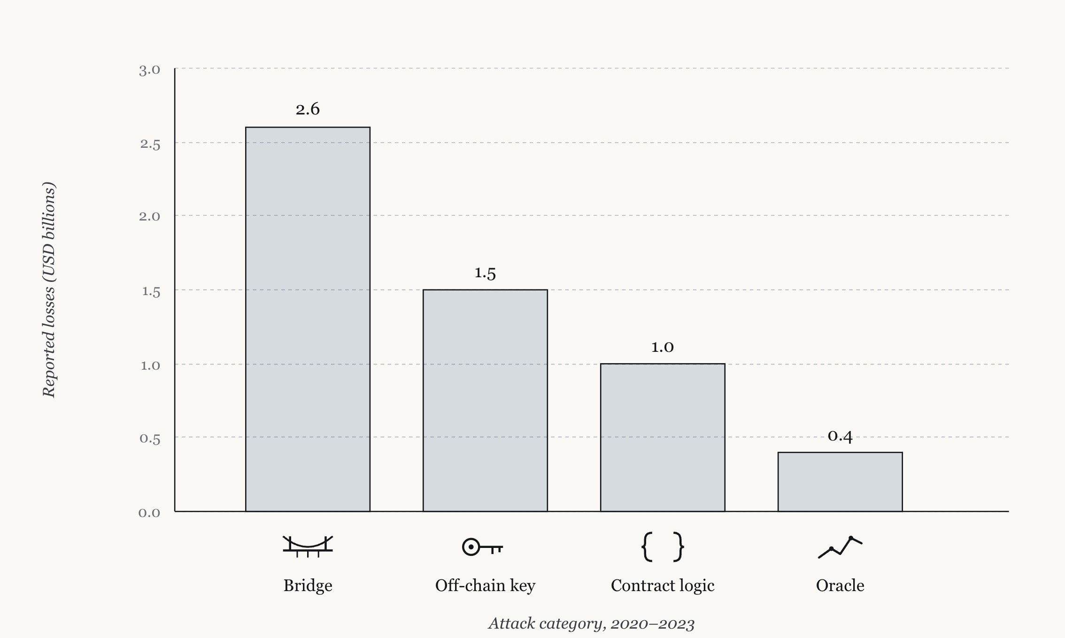
2. Motivation (1/2): Scale of the Problem
• Between 2020 and 2023, DeFi protocols lost more than $5B to on-chain exploits.
• Loss distribution by category:
– Bridge: $2.6B
– Off-chain key compromise: $1.5B
– Contract logic: $1.0B
– Oracle: $0.4B
• Largest events thread across surfaces:
– Wormhole 2022, $320M, forged guardian signature [10]
– Nomad 2022, $190M, message validation [11]
– PolyNetwork 2021, $611M, keeper replacement [16]
– Inverse Finance 2022, $15M, oracle manipulation [14]
Figure 1.1: Reported DeFi exploit losses 2020–2023 by attack category.
6

Slide 7
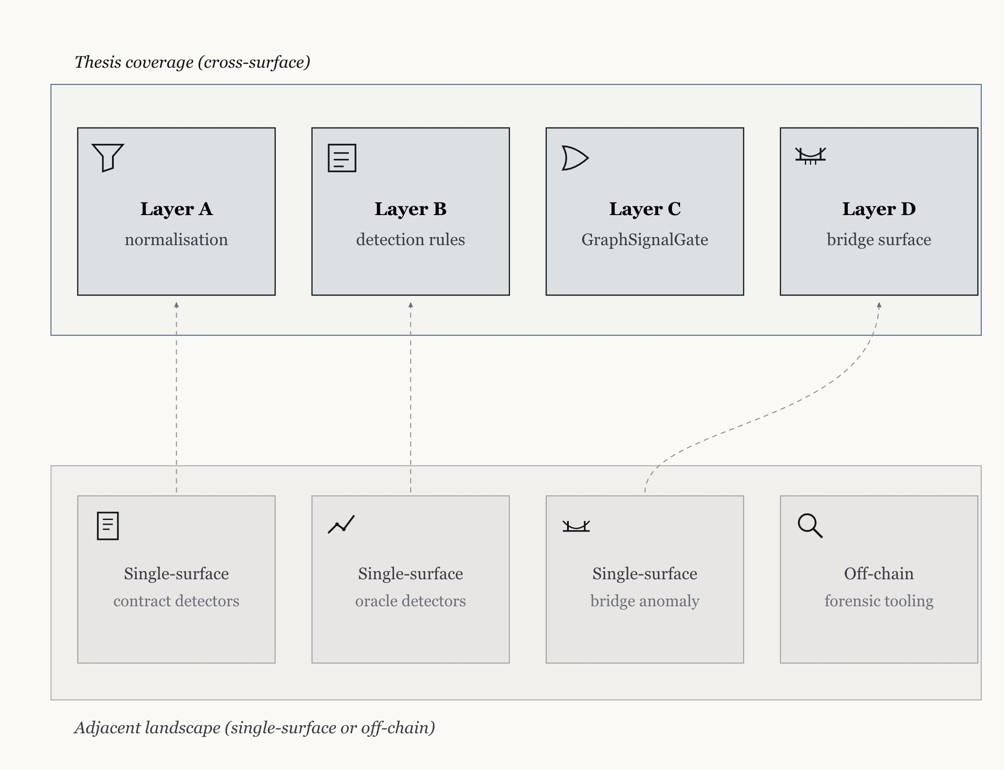
2. Motivation (2/2): What Defenders See
• Existing detectors are surface-specific.
– Oracle deviation detectors watch oracle prices.
– Taint analysers watch contract flows.
– Bridge anomaly detectors watch bridge events.
• Each tool is competent on its own surface and structurally blind to cross-surface context.
• Asymmetry: Attacker scope is cross-surface. Defender scope is single-surface.
• This thesis targets that asymmetry directly.
Figure 1.2: Thesis coverage (Layers A–D) against the adjacent single-surface and off-chain landscape.
7

Slide 8
3. Literature Review (1/4): Foundational Surveys
Zhou et al. (2023) - SoK: Decentralized Finance (DeFi) Attacks [1]
Key contribution / findings | Limitations / notes
Catalogue of 181 DeFi incidents under the P/A/O taxonomy. Establishes the cross-surface attack pattern as a first-class object of study. Anchor reference for incident-level granularity in DeFi exploit research. | Incident-level survey, not a runtime detection system. No quantitative cross-domain detection metric proposed. Bridge surface coverage is narrative, not rule-based.
Li et al. (2025) - Cross-Chain Bridge Security: Survey [2]
Key contribution / findings | Limitations / notes
Four-class bridge vulnerability taxonomy (signature forgery, message validation, replay, committee attestation). Structured threat model for cross-chain bridges across trust architectures. Foundation for the Layer D rule set CR-B1 to CR-B4 in this thesis. | Architecture-centric; no calibrated on-chain rule set for the four classes. Payload-embedding and value-handling anomaly are not isolated as distinct classes. Operational containment workflow is out of scope.
[1] L. Zhou et al., 'SoK: Decentralized Finance (DeFi) Attacks,' IEEE S&P, 2023.
[2] N. Li et al., 'Blockchain Cross-Chain Bridge Security: Challenges, Solutions, and Future Outlook,' ACM DLT, 2025.
8

Slide 9
3. Literature Review (2/4): Single-surface Detection
Wu et al. (2024) - DeFiRanger: Oracle-side detection [3]
Key contribution / findings | Limitations / notes
Recovers price-manipulation attacks from oracle-side cash-flow signals. Demonstrates effectiveness on real-world DeFi price manipulation cases. Detection signals that could trigger downstream containment. | Cannot distinguish coordinated manipulation from organic market moves without contract-side context. Single-surface scope; no formal cross-domain detection metric. Containment integration and response policy remain open.
Wang et al. (2021) - BlockEye: Contract-side monitoring [5]
Key contribution / findings | Limitations / notes
Contract-side suspicious-pattern monitor over EVM transactions. Recovers 17 DeFi attack cases from on-chain behavioural signals. Early demonstration of practical contract-surface anomaly detection. | Contract surface only; oracle and bridge events are not coupled. Pattern catalogue is curated; no calibration discipline against benign windows. Reported FPR is not held out from the calibration corpus.
[3] S. Wu et al., 'DeFiRanger: Detecting Price Manipulation Attacks on DeFi Applications,' IEEE TDSC, 2024.
[5] B. Wang et al., 'BlockEye: Hunting for DeFi Attacks on Blockchain,' ICSE Companion, 2021.
9

Slide 10
3. Literature Review (3/4): Cross-surface Analysis
Kong et al. (2023) - DeFiTainter: Contract + oracle taint flow [4]
Key contribution / findings | Limitations / notes
Cross-surface taint-flow framework at per-transaction granularity. Couples contract and oracle events under a common dataflow abstraction. Early precursor to formal cross-domain reasoning in DeFi exploit detection. | Bounded to two surfaces; bridge surface is out of scope. Single-block scope; cannot reach Nomad-style 48-hour copycat drains. No off-chain attestations (Wormhole forged VAA falls outside the model).
Eshghie et al. (2024) - HighGuard: Cross-domain business-logic monitoring [7]
Key contribution / findings | Limitations / notes
Contract and oracle correlation on a four-protocol benchmark. Demonstrates cross-domain reasoning at the policy layer. Closest prior precursor to the GraphSignalGate aggregator of this thesis. | Limited cross-domain reasoning; no formal CDG-style metric. Bridge surface is not modelled. Containment policy is not parameter-free; thresholds carry through the aggregator.
[4] Q. Kong et al., 'DeFiTainter: Detecting Price Manipulation Vulnerabilities in DeFi Protocols,' ISSTA, 2023.
[7] M. Eshghie et al., 'HighGuard: Cross-Chain Business Logic Monitoring of Smart Contracts,' ASE, 2024.
10

Slide 11
3. Literature Review (4/4): Production Monitoring and MEV Context
Meng et al. (2026) - HOUSTON: Production anomaly detection [6]
Key contribution / findings | Limitations / notes
Single-surface anomaly detector deployed in production on Ethereum DeFi protocols. Six real-time anomaly cases reported on live deployments. Live operational evidence that calibrated rules can run at production cadence. | Single surface; cross-surface correlation is absent. Live evaluation, no formal CDG metric. Bridge surface is not in scope.
Daian et al. (2020) - Flash Boys 2.0: MEV as cross-surface signal [8]
Key contribution / findings | Limitations / notes
Cross-surface analysis in the MEV setting (mempool, contract, DEX state). Demonstrates the value of correlating order-flow signals across surfaces. Established cross-surface observation as a research method, not just a detection tool. | Bounded to the MEV context; not generalised to oracle manipulation or bridges. No calibrated rule set; detection is descriptive rather than operational. Cross-domain detection-gain question is not framed.
[6] D. Meng et al., 'HOUSTON: Real-time Anomaly Detection of Attacks against Ethereum DeFi Protocols,' NDSS, 2026.
[8] P. Daian et al., 'Flash Boys 2.0: Frontrunning, MEV, and Consensus Instability,' IEEE S&P, 2020.
11

Slide 12
4. Research Gaps
RG1. No quantitative cross-domain metric:
Existing tools couple evidence implicitly or by case study. No published metric measures the marginal recall a multi-surface configuration adds over each single-surface baseline.
RG2. Containment uses per-rule thresholds:
Deployed SlowMode and circuit-breaker primitives fire on independently-calibrated per-surface thresholds. No parameter-free witness condition over fired Layer B outputs exists at the policy layer.
RG3. Bridge taxonomy without on-chain detection:
Li et al. [2] catalogue four bridge-attack classes, but no calibrated rule set targets the payload-embedding or value-handling subclasses.
12

Slide 13
5. Research Questions
RQ1: Does correlating evidence across three monitored surfaces (contract, oracle, bridge) produce a measurable detection gain over single-surface baselines, and how should that gain be defined so it is comparable across cases and rule sets?
RQ2: Does the same cross-surface correlation, repurposed as a containment-policy aggregator, fire SlowMode protections on attack windows without introducing false benigns on benign data, and at what calibration cost?
RQ3: What is the taxonomy of bridge-surface attacks, and which sub-classes are reachable by on-chain rule-based detection at all?
13

Slide 14
6. Research Objectives (mapped to RQs and Contributions)
RO1. Define and measure CDG over a documented corpus.
A 35-case curated corpus with explicit selection criterion, a Tier 1 versus Tier 2 reconstruction-depth split, per-case and corpus-level CDG with a five-bucket partition.
Answers RQ1; produces C1 and C2.
RO2. Build a parameter-free containment policy and evaluate it.
GraphSignalGate as the policy-layer reformulation of the CR-5 cross-surface witness; canonical GSG-witness-inclusive evaluated against single-surface baselines with a two-axis comparison.
Answers RQ2; produces C3.
RO3. Extend the witness apparatus to the bridge surface.
Four-rule bridge taxonomy CR-B1 to CR-B4 plus Policy 3B-bridge-terminal. Two CALIBRATED rules against Dune-empirical benign data; two HYPOTHESIS rules under explicit qualifiers; identification of the payload-embedding class.
Answers RQ3; produces C4 and C5.
14

Slide 15
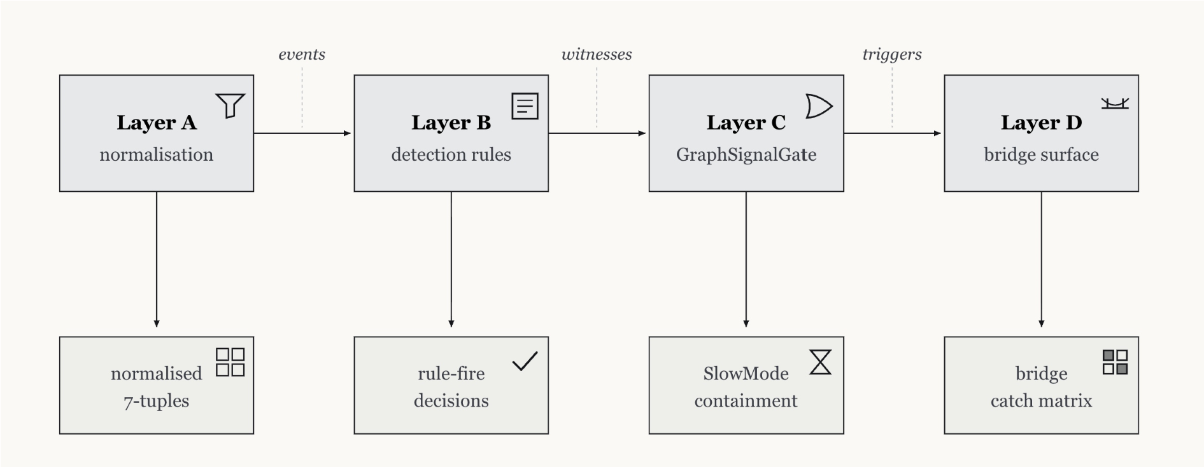
7. Research Methodology (1/8): Four-layer Pipeline
Layer A: Normalises events from contract, oracle, and bridge surfaces onto a single 7-tuple schema.
Layer B: Rule set. Five rule slots CR-1..CR-5 on contract and oracle, four bridge rules CR-B1..CR-B4 on bridge. Conservative 10x calibration against pre-attack benign data.
Layer C: GraphSignalGate, parameter-free containment-policy aggregator that fires SlowMode when at least two distinct surfaces register a Layer B firing within a defined window.
Layer D: Extends GSG to the bridge surface with a terminal-trigger policy.
Figure 3.1: End-to-end pipeline: Layer A normalisation, Layer B rules, Layer C GraphSignalGate, Layer D bridge surface.
15

Slide 16
7. Research Methodology (2/8): Corpus Construction (Layer A)
35 catalogued DeFi exploits between January 2020 and April 2023, roughly $2.98B reported losses across six chains (Ethereum, BSC, Solana, Avalanche, Fantom, Arbitrum).
Selection criterion (Definition 3.1): On-chain causal exploit, loss > $1M, contract or oracle or bridge surface materially involved, attack date in window.
Out-of-scope cases (off-chain key compromise): Multichain, Mixin, Atomic Wallet, Heco, Poloniex.
Cutoff before April 2023 defends against retroactive corpus tuning.
Stratum | Cases | Reconstruction
Tier 1 (in scope) | 9 | per-tx + Dune
Tier 2 (in scope) | 21 | YAML depth
Out of scope (off-chain) | 5 | not reconstructed
Total catalogued | 35 | see Table 3.1
16

Slide 17
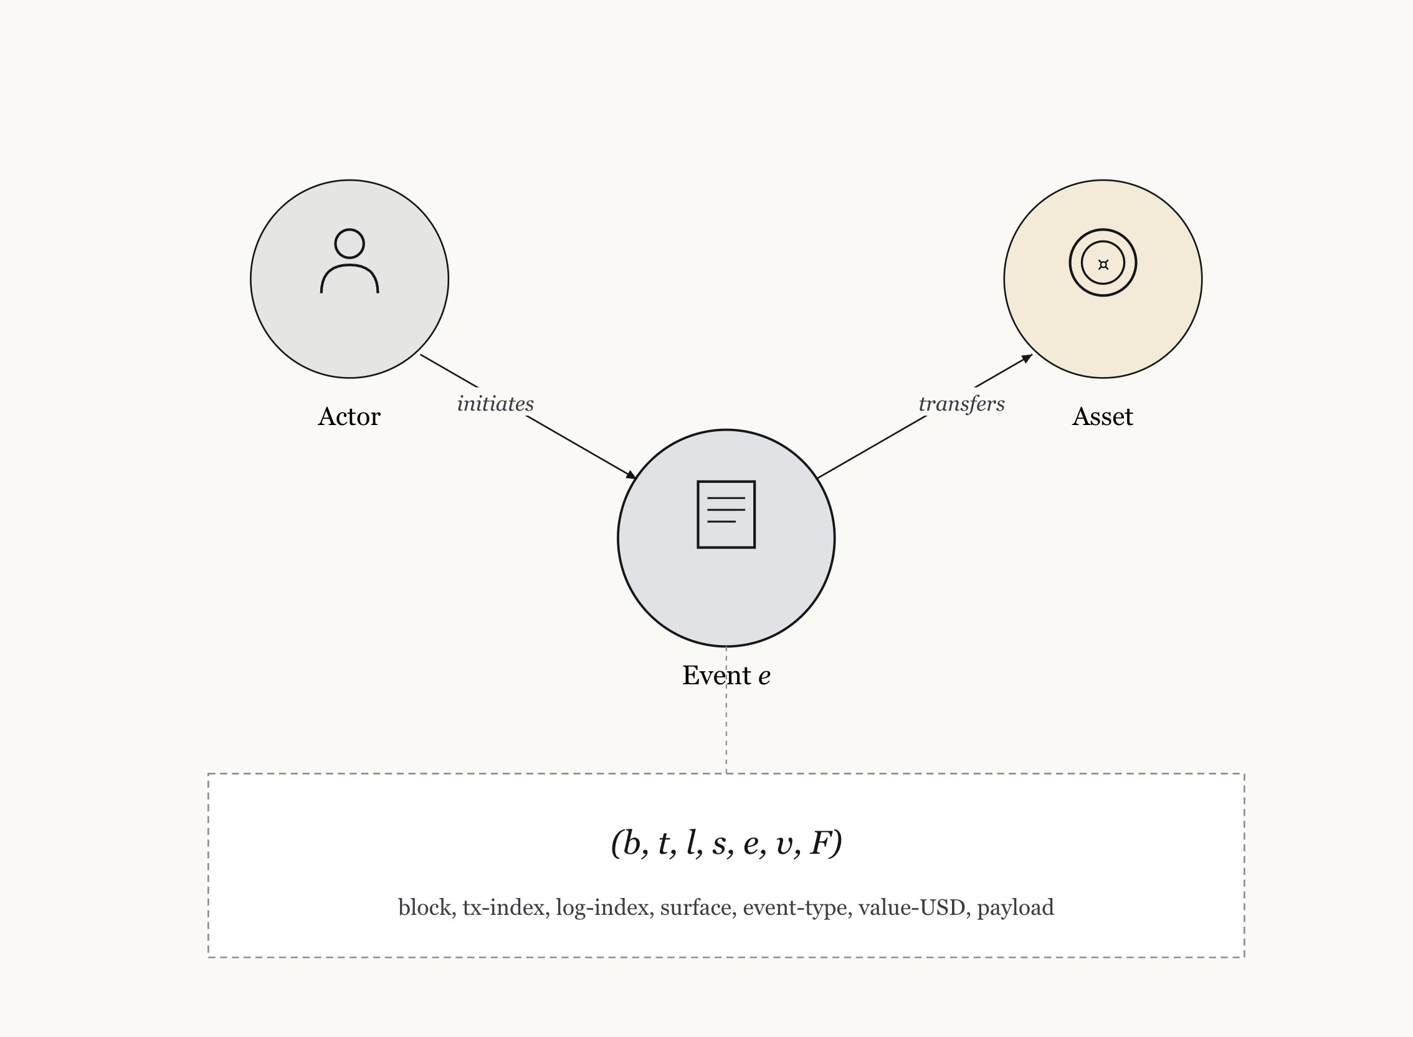
7. Research Methodology (3/8): Normalized Event Schema
Every event reduced to a 7-tuple before any rule evaluation:
e = (b, t, l, s, e, v, F)
Fields:
b block height
t transaction index
l log index
s surface (contract / oracle / bridge)
e event type
v USD value at emission, zero where N/A
F map of rule identifiers to boolean flags
388 invariants verified across the corpus (386 confirmations, 2 documented exceptions, 0 failures).
Figure 3.2: Heterogeneous event graph schema with the 7-tuple event attributes.
17

Slide 18
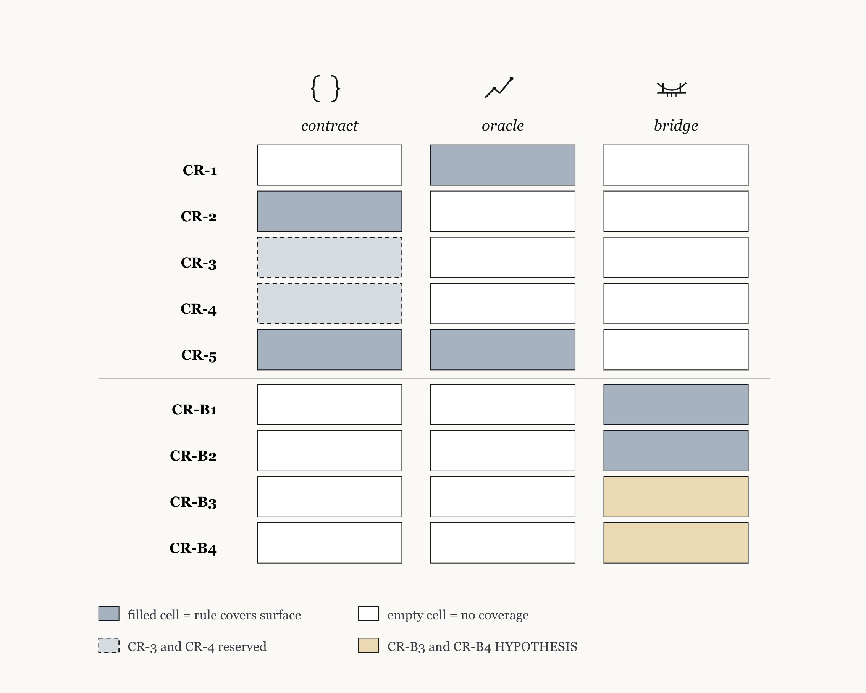
7. Research Methodology (4/8): Layer B Detection Rules
CR-1 oracle deviation: Per-update relative magnitude against per-pair benign baseline. 10x operating point.
CR-2 contract per-tx volume: Per-transaction USD value against per-protocol benign max. 10x.
CR-3 flash loan: Reserved, not implemented.
CR-4 liquidity drain: Reserved, not implemented.
CR-5 cross-corpus full-graph: Binary cross-surface witness over already-fired CR-1 and CR-2 outputs.
Bridge surface (Layer D):
CR-B1, CR-B2 CALIBRATED.
CR-B3, CR-B4 HYPOTHESIS.
Figure 3.3: Surface-rule coverage matrix.
18

Slide 19
7. Research Methodology (5/8): Cross-Domain Detection Gain (CDG)
Per-case CDG vector:
CDG(c) = ( R(full)(c) − R(contract)(c), R(full)(c) − R(oracle)(c) )
∈ { −1, 0, 1 }²
R(X)(c) ∈ {0, 1} is the binary recall indicator on case c under configuration X.
First component: gain over contract-only baseline.
Second component: gain over oracle-only baseline.
Corpus-level CDG against baseline b is the per-case mean:
CDG(F, b) = (1/|C|) · Σ_c [ R(full)(c) − R(b)(c) ]
The metric isolates the marginal value of cross-surface correlation from gains driven by stronger per-surface rules.
19

Slide 20
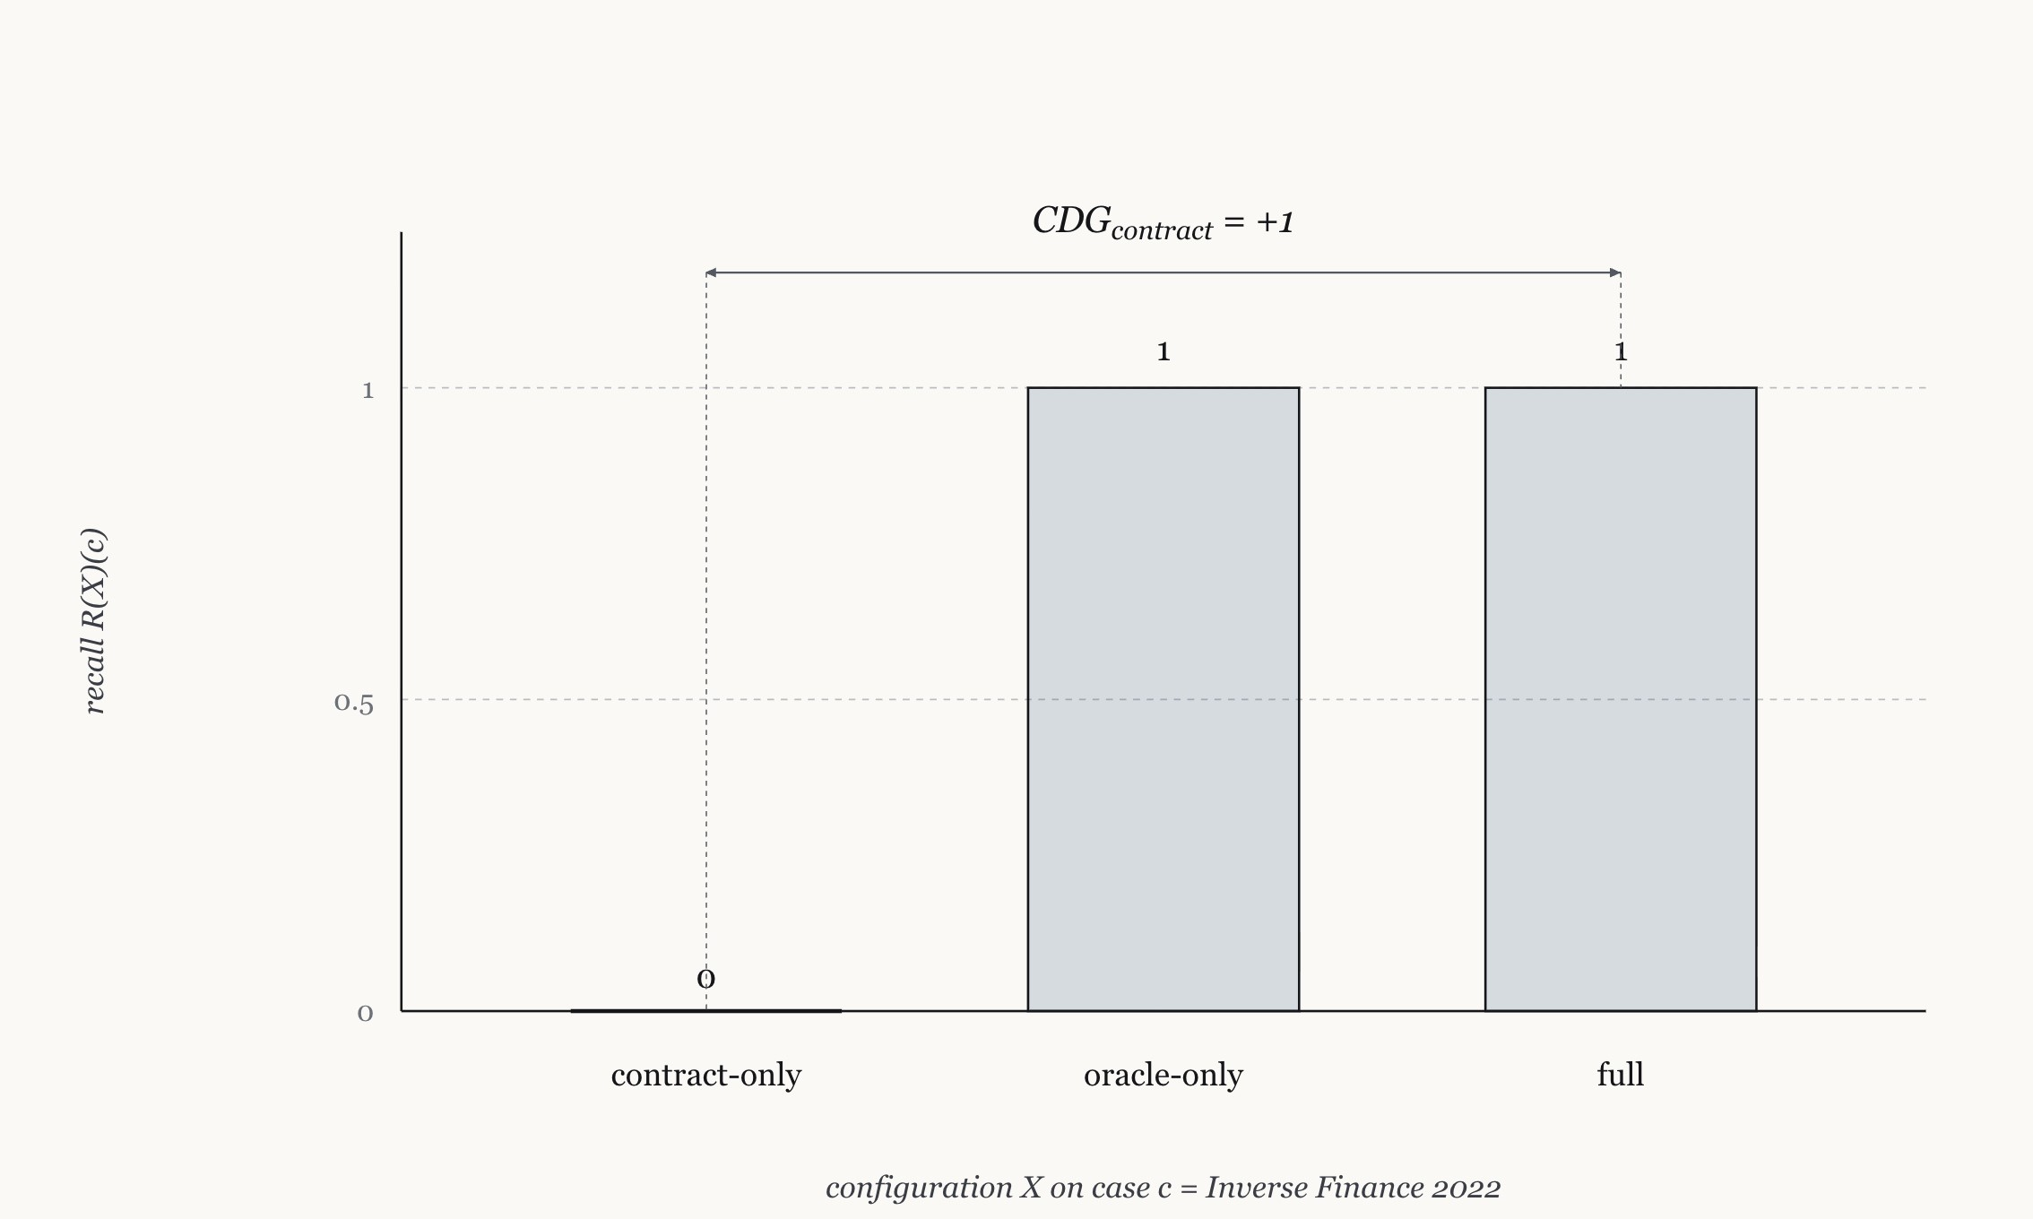
7. Research Methodology (6/8): Five CDG Buckets
Partition by recall triple (R_contract, R_oracle, R_full):
positive_zero = (1, 1, 1). Both single surfaces fire; CDG = (0, 0). Active-detection equilibrium. (Mango Markets 2022)
one_zero = (0, 1, 1). Oracle catches, contract sub-threshold; CDG = (1, 0). (Inverse Finance 2022)
zero_one = (1, 0, 1). Contract catches, oracle blind; CDG = (0, 1). (Harvest 2020, Euler 2023)
one_one = (0, 0, 1). Neither single surface fires; full catches through cross-surface correlation. (Bridge cases)
detection_gap = (0, 0, 0). No rule fires anywhere; reported as a coverage finding. (Alpha Homora v2 2021)
Figure 1.3: Per-case CDG on Inverse Finance 2022.
20

Slide 21
7. Research Methodology (7/8): Calibration Discipline
Five anchor rules carried through every calibration:
1. Binary recall: R = 1 iff at least one attack event exceeds threshold; sensitivity sweeps compare against max-attack-value, not first-hit.
2. Conservative 10x operating point: Numeric rules calibrate at 10x the rule's natural benign statistic in the pre-attack window.
3. Empirical FPR check: Structural, temporal, and trace-level rules require a Dune-empirical FPR verification, not just a derivation argument.
4. CDG = (0, 0) reported with mechanism: Distinguish positive_zero (both single surfaces catch) from detection_gap (no rule catches).
5. Anti-circularity: Threshold selection anchored on benign data first, never on attack outcome. Wording avoids the form, select the threshold that fires on the attack.
21

Slide 22
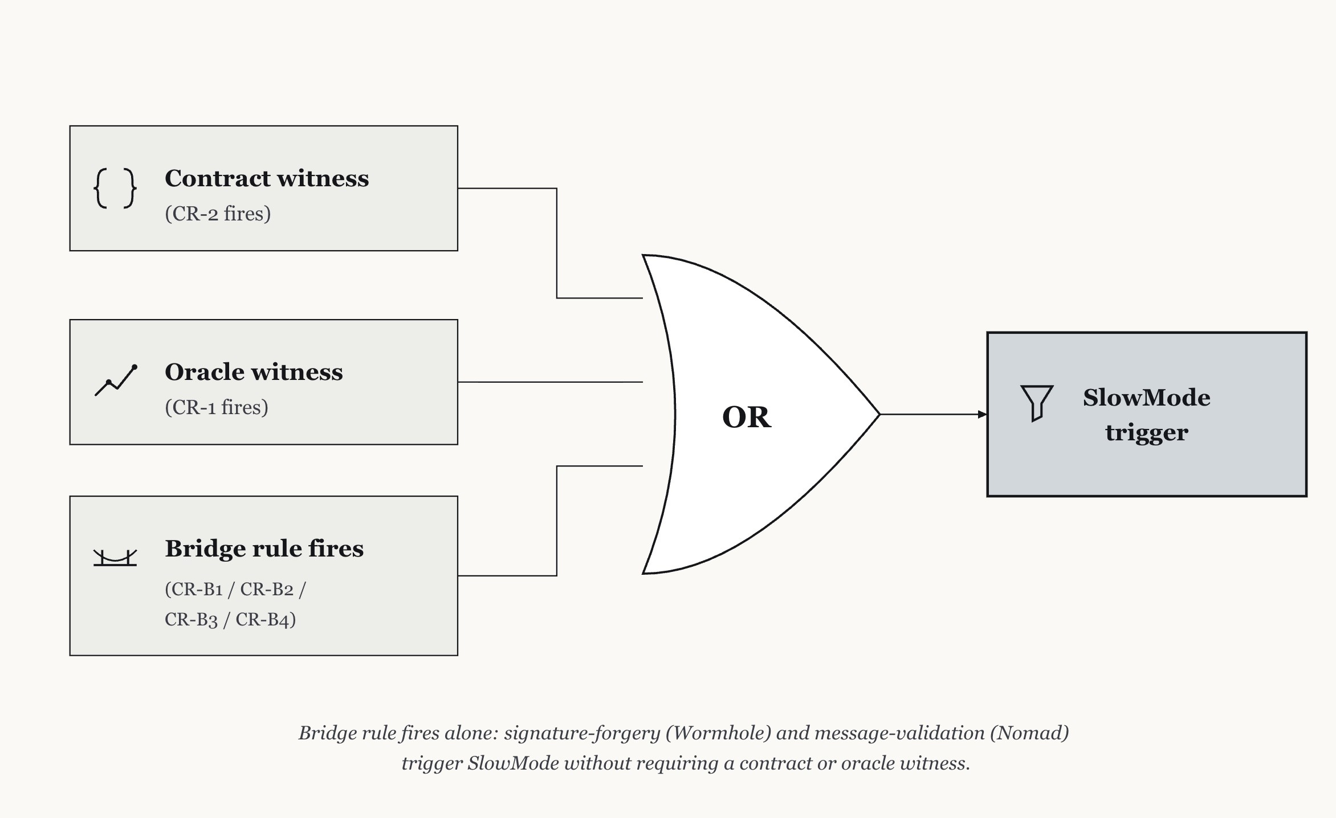
7. Research Methodology (8/8): GraphSignalGate + Layer D
GSG-witness-inclusive:
SlowMode fires when at least two surfaces in {contract, oracle} register a Layer B firing within an inclusive window. Parameter-free at the policy layer: no per-rule numeric threshold.
Policy 3B (bridge-terminal):
Each calibrated bridge rule (CR-B1, CR-B2) is an independent terminal trigger. SlowMode fires on bridge alone with no contract or oracle witness required.
Why asymmetric:
Cross-chain message-validation bugs and signature-forgery attacks need not touch any contract or oracle on the destination chain. Requiring a witness misspecifies the threat model.
Figure 3.6: GSG-3 bridge-terminal policy.
22

Slide 23
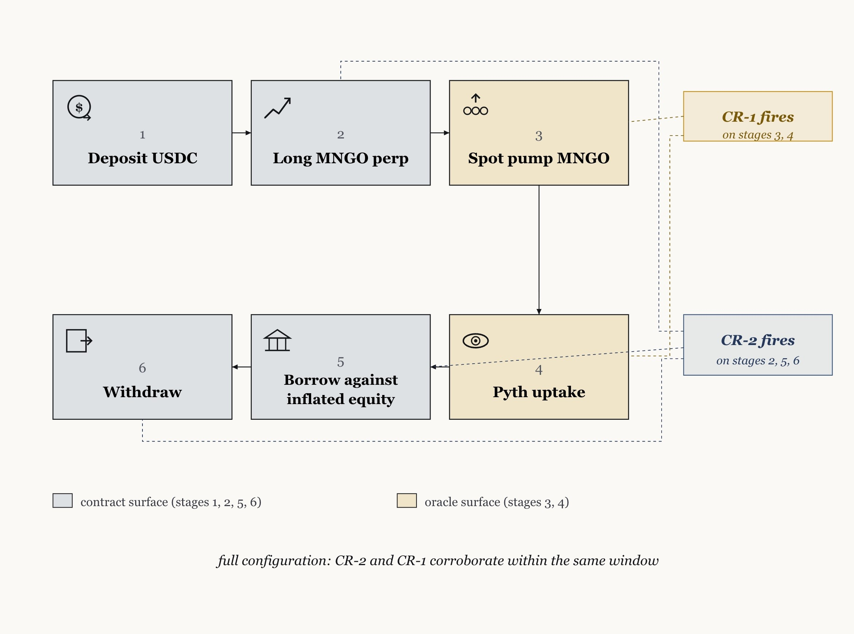
8. Case Study 1: Mango Markets 2022
positive_zero bucket; CDG = (0, 0) is the active-detection equilibrium
Chain: Solana Loss: $117M [9]
Mechanism: MNGO spot pump from $0.03 to over $0.91 across three exchanges feeding Pyth. Inflated collateral used to borrow the treasury.
Contract surface: CR-2 fires on oversized borrow.
Oracle surface: CR-1 fires at 4.48x benign max under the legacy 2x Mango oracle threshold.
CDG = (0, 0): Both single surfaces and the full configuration catch. Cross-domain configuration confirms but does not exceed.
Figure 3.4: Mango Markets 2022 attack mechanism.
23

Slide 24
8. Case Study 2: Inverse Finance 2022
one_zero bucket; oracle corroboration is the only detection path
Chain: Ethereum On-chain borrow: $13.57M [14]
Mechanism: 901 ETH pre-funded via Tornado Cash. Two ETH buys on Uniswap inflate INV/ETH spot. Inverse Keep3r TWAP reads the inflated price. Attacker mints xINV, presents inflated collateral, and borrows across four markets in one transaction.
Calibrated thresholds:
Contract: 10x $1.65M = $16.49M. Attack borrow $13.57M is below threshold.
Oracle: Keep3r TWAP bridge detected structurally at 11:03:54 UTC.
Contract-only: MISSED (R = 0). Oracle-only: CAUGHT (R = 1). Full: CAUGHT.
CDG = (1, 0): Attacker borrowed just below the contract threshold. Oracle corroboration is the only path to detection.
24

Slide 25
8. Case Study 3: Harvest Finance 2020
zero_one bucket; contract catches, oracle is blind
Chain: Ethereum Loss: approximately $34M Rounds: 9 [15]
Mechanism: Flash loan, USDC to USDT swap in Curve y-pool depegs USDC by approximately 1% (below Harvest's 3% circuit breaker). Vault NAV computed from Curve price is understated. Attacker deposits at deflated NAV and withdraws at restored NAV.
Calibrated thresholds:
Oracle: 2x 3.3% benign max = 6.6%. Attack 1.0% deviation is structurally below the noise floor.
Contract: 10x $16.16M = $161.57M. Attack max single-tx deposit $166.68M crosses threshold.
Full graph: catches via CR-2 on the $166.68M deposit.
CDG = (0, 1): no gain over contract, +1 gain over oracle.
25

Slide 26
8. Case Study 4: Bridge Surface (Layer D)
Four bridge cases; CALIBRATED versus HYPOTHESIS distinction preserved
Case | Rule | Status | Prevented | Lead time
Wormhole 2022 ($320M) [10] | CR-B1 | CALIBRATED | $320M (1/1 event) | 0 blocks
Nomad 2022 ($190M agg.) [11] | CR-B2 | CALIBRATED | $25.7M (representative) | 0 blocks
PolyNetwork 2021 ($611M) [16] | CR-B3 | HYPOTHESIS | $273M (counterfactual) | 0 blocks
THORChain July 22 ($8M) [17] | CR-B4 | HYPOTHESIS | $8M (counterfactual) | 0 blocks
Payload-embedding class (this work): PolyNetwork's keeper replacement routes a malicious instruction inside the cross-chain message data, not the function selector. A 30-day pre-attack benign window contains 4,505 transactions with the same trace-level fingerprint. On-chain selector-level rule-based detection cannot resolve this class in principle.
26

Slide 27
9. Results (1/5): Detection Rate by Stratum and CDG bucket
29 of 30 in-scope cases detected at the canonical 10x calibration.
Single miss: Alpha Homora v2 2021.
Reentrancy through HomoraBank.work. Sub-threshold for CR-1, CR-2, and CR-5. Reported as a coverage gap, not relaxed away.
Five one_one cases: Wormhole and Nomad (CALIBRATED), PolyNetwork and THORChain July 22 (HYPOTHESIS), and one Tier 2 case via the temporal cumulative correlation pathway.
Stratum | Detected | Cases | Rate (Wilson 95%)
Tier 1 (per-tx) | 8 | 9 | 88.89% [56.5, 98.0]
Tier 2 (YAML depth) | 21 | 21 | 100% [85.1, 100]
Combined in-scope | 29 | 30 | 96.67% [83.3, 99.4]
Bucket | Cases
positive_zero | 12
one_zero | 1
zero_one | 11
one_one | 5
detection_gap | 1 (Alpha Homora v2)
27

Slide 28
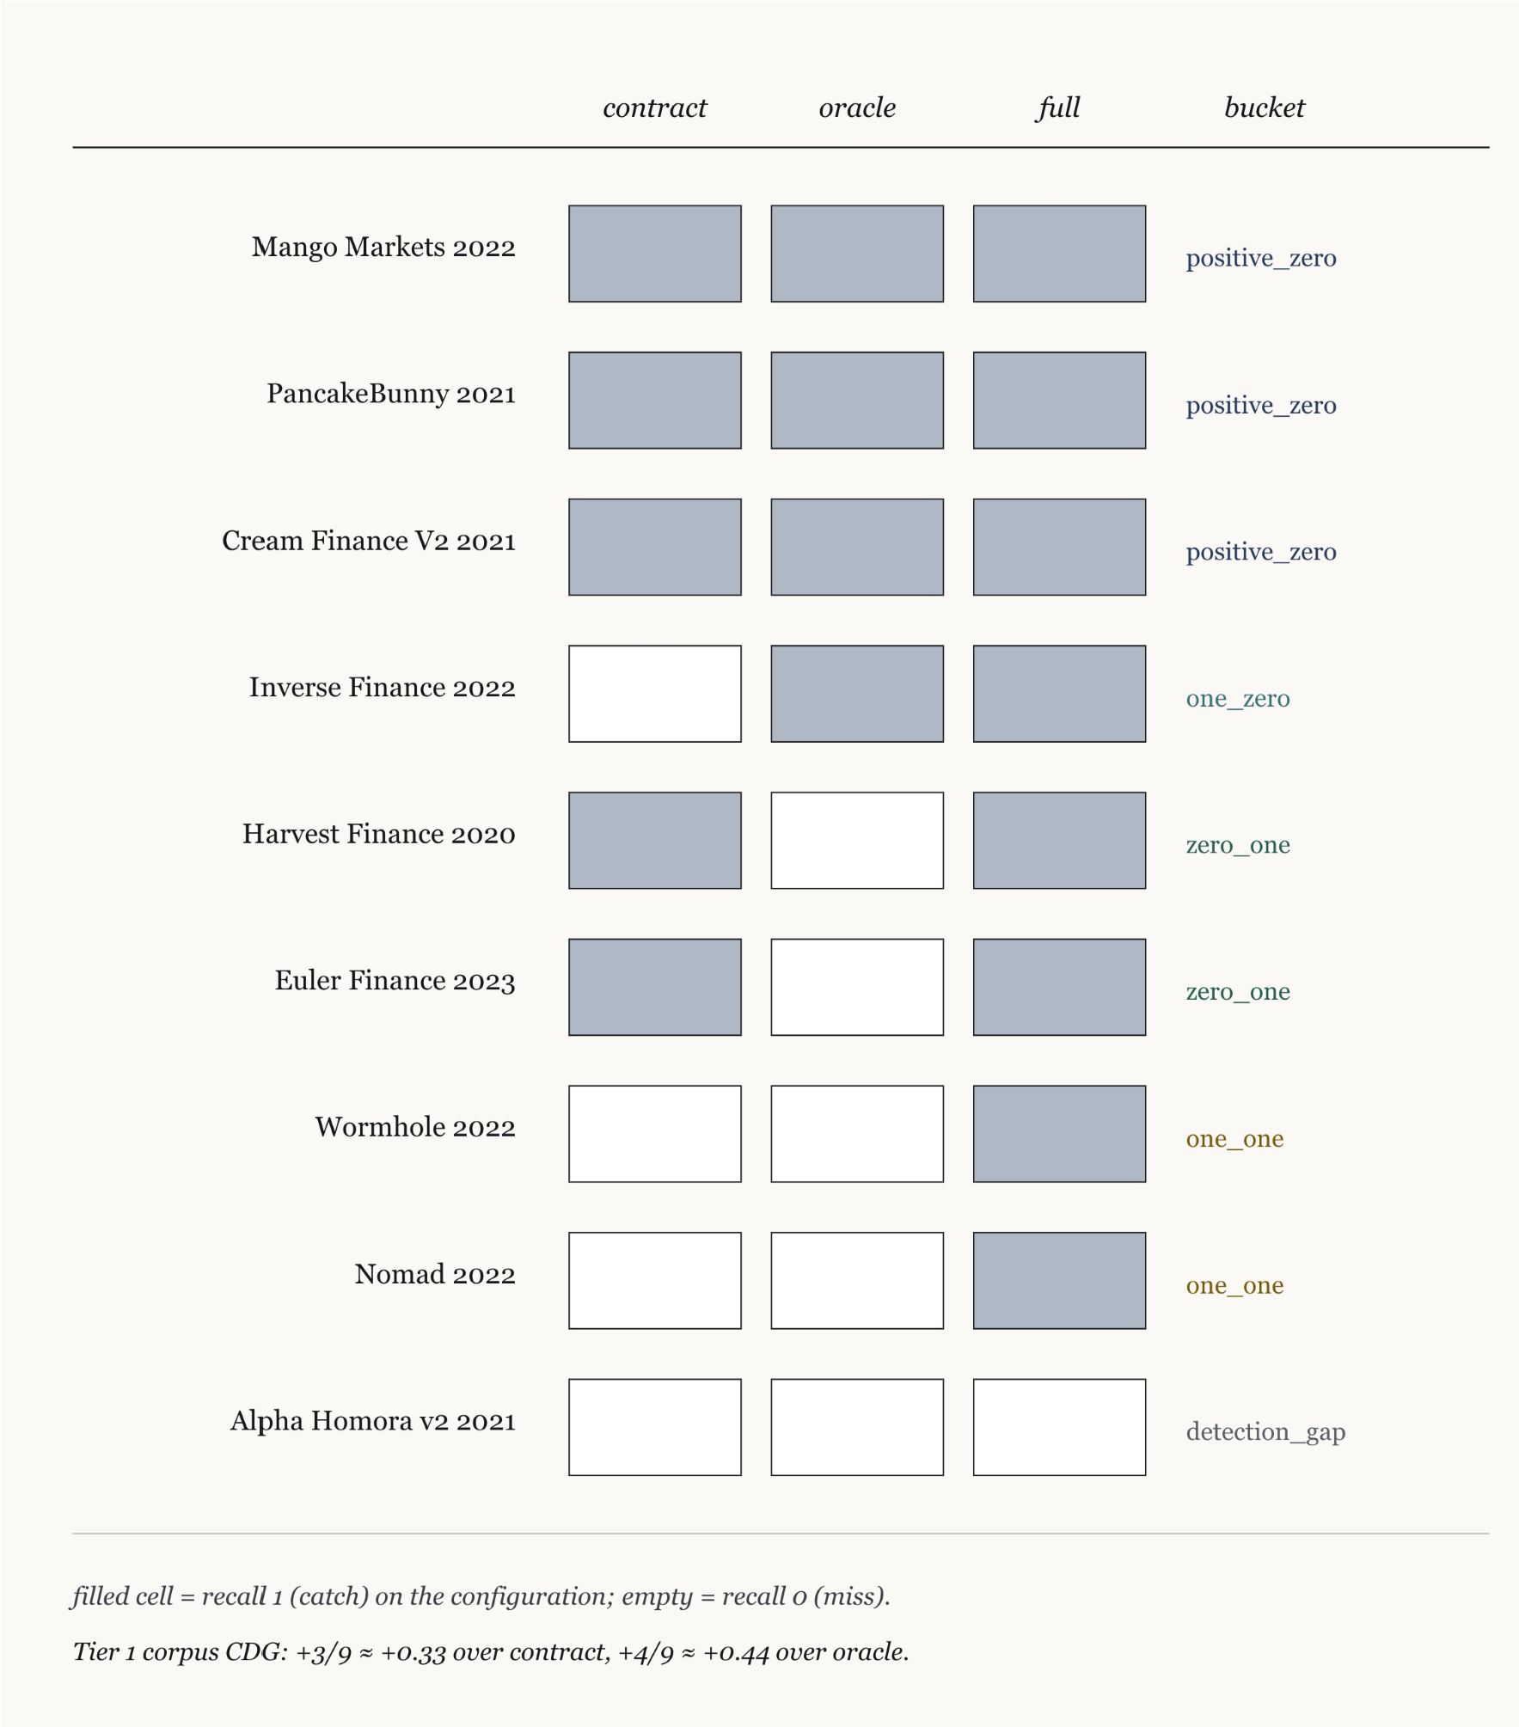
9. Results (2/5): Per-case CDG vector, Tier 1
Tier 1 corpus-level CDG:
vs contract baseline: +0.33 (3 of 9 cases contribute +1)
vs oracle baseline: +0.44 (4 of 9 cases contribute +1)
Asymmetry:
The oracle baseline is blind on two zero_one cases (Harvest, Euler) in the Tier 1 sample, so the marginal recall over oracle-only is larger than over contract-only.
Reported as a property of this sample, not as a general claim about contract versus oracle detection.
28
Figure 4.2: Per-case recall triple and CDG bucket for the nine Tier 1 cases at K = 10.

Slide 29
9. Results (3/5): Layer C Policy Comparison
Policy | Catches (of 12) | FBR clean | FBR USDC stress
freshness_only | 0 | high | 0.31
deviation_only | 3 | 0 | 0.615
oracle_circuit_breaker | 3 | 1.0 | 0.846
GSG-strict (threshold, exclusive) | 1 | 0 | 0
GSG-witness-strict (witness, exclusive) | 1 | 0 | 0
GSG-witness-inclusive (canonical) | 5 | 0 | 0
Catches: Cheese Bank, Cream Finance V2, Inverse Finance, Mango Markets, PancakeBunny.
Pareto dominance: GSG-WI strictly dominates deviation_only on the (catches, FBR-stress) two-axis comparison (5 versus 3 catches at clean-window FBR = 0; 0 versus 0.615 FBR under USDC depeg stress).
29

Slide 30
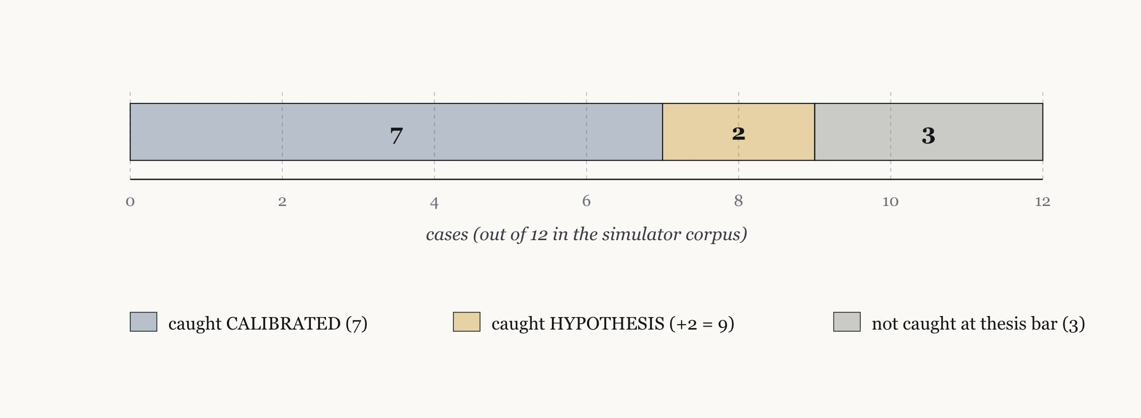
9. Results (4/5): Combined Layer C + Layer D Coverage
CALIBRATED coverage:
7 of 12 attack cases (58%). Zero false-benign rate on clean and USDC-stress windows. Zero false-positive observations on the held-out CR-5 corpus.
HYPOTHESIS extension:
9 of 12 (75%). Conditional on CR-B3 (payload parser) and CR-B4 (Bifrost calibration data) being implemented.
Three not caught:
Alpha Homora (detection_gap). Euler Finance (zero_one; witness condition correctly does not fire on a pure-logic bug). Harvest (Path B drop, mechanism caveat).
Figure 4.4: Combined Layer C + Layer D coverage over the 12-attack-case simulator corpus.
30

Slide 31
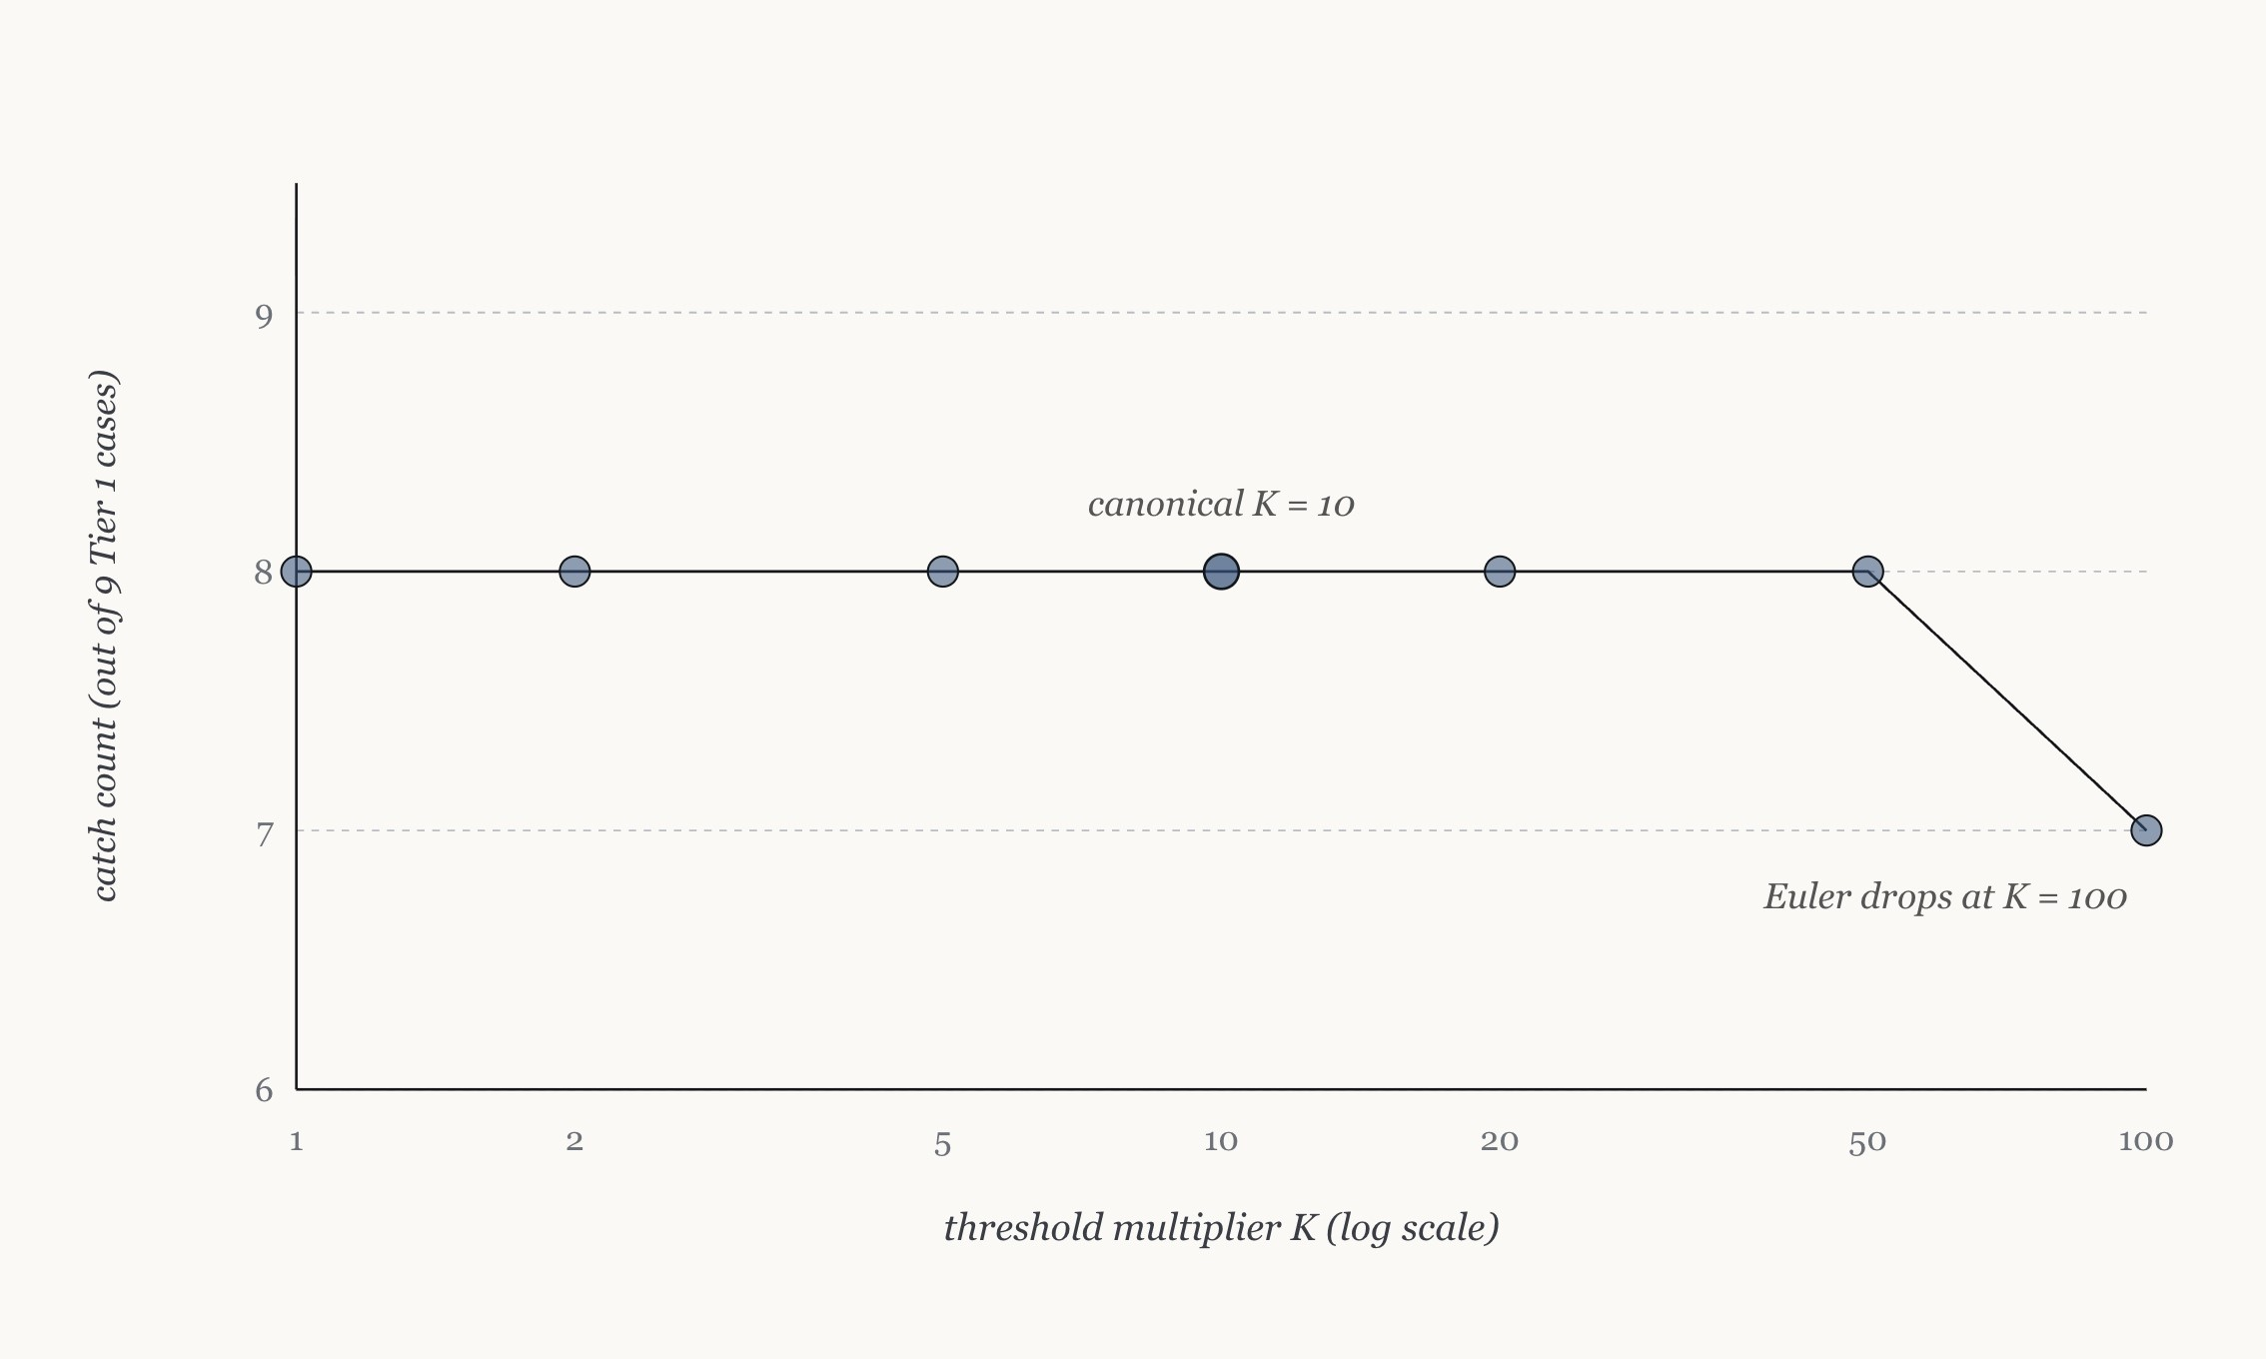
9. Results (5/5): Cross-corpus FPR and sensitivity
Cross-corpus FPR:
Zero false positives across 217,892 held-out decision units in 10 case+signal pairs across 6 decision-unit families.
Caveat: Finite-replay observation on the calibration corpus, not a production-deployment guarantee. Single-replication on one preregistered held-out window per signal.
Threshold sensitivity:
Catch count holds at 8 of 9 across K from 1 to 50 on the nine-case Tier 1 scope. Drops by one at K = 100 (Euler).
The 10x operating point is one entry from a broad stable plateau, not a fragile point estimate.
Figure 4.6: Sensitivity grid across K.
31

Slide 32
10. Boundary Cases
Ronin Bridge (March 2022, approximately $617M):
173,600 ETH outflow = 28.9x the Wormhole-calibrated benign maximum. The on-chain symptom is unambiguously above CR-B1. Out of scope by the causal versus symptomatic boundary: five of nine Sky Mavis validator keys compromised off-chain via spear-phishing. A signature from compromised keys is cryptographically valid; on-chain rules cannot distinguish it from a legitimate withdrawal.
THORChain Bifrost July 15 2021 (approximately $8M): [17]
Single-event msg.value override loop in the chain observer. Mechanism is consistent with CR-B4 (value-handling anomaly). Excluded from the primary catch matrix at medium confidence, because the exact router-interaction transaction hashes were not isolated during corpus reconstruction. July 22 (in the catch matrix) is a distinct multi-event handling failure on the same router.
Two independent boundaries: Ronin is excluded by causal mechanism. THORChain July 15 is excluded by reconstruction confidence. We keep both as narrative entries rather than retroactively enrich them into the headline catch counts.
32

Slide 33
11.1 Discussion: Authority Gap and Annotation Reliability
Authority gap as substantive finding:
The four simulated bridge containment actions (BRIDGE_HALT, BRIDGE_DELAY, BRIDGE_CIRCUIT_BREAKER, BRIDGE_FLAG_ADMIN) quantify counterfactual containment value.
They are not enforceable on the live bridges of the corpus. No admin-pause role, no on-chain timelock, no human-in-the-loop authority is addressable from the simulator.
Reported as a finding, not a limitation. Oracle-aware bridge governance is the operational research that would close the gap.
Inter-annotator agreement:
Stratified seven-case, 35-event subset spanning all five in-scope CDG buckets.
Cohen's κ [12] surface_assignment: 1.000 (100%, almost perfect)
Cohen's κ attack_step_role: 0.788 (82.86%, substantial)
Six disagreements all lie between adjacent attack-chain steps where the schema does not provide a bright-line rule for atomic multi-step transactions.
Pre-specified threshold of 0.70 cleared. Landis and Koch (1977) [13] interpretation scale.
33

Slide 34
11.2 Limitations
L1: Single-pass labelling QA on attack_step_role. Fleiss kappa over a larger event subset is reserved.
L2: HYPOTHESIS status of CR-B3 and CR-B4. Calibration prerequisites not yet collected.
L3: Authority gap on bridges. Simulated actions are not enforceable on live bridges.
L4: Tier 2 reconstruction confidence floor. 21 of 21 Tier 2 detection rate should not be read as proof of Tier 1-equivalent rule firing.
L5: Nine-case Tier 1 sensitivity scope. Cheese Bank (tenth Tier 1 extension) not in the sensitivity grid.
L6: Replay versus live evaluation. All results measured on retrospective historical replay, not live deployment.
L7: Finite-window FPR and FBR. Every reported zero is a finite-replay observation, not an asymptotic guarantee.
Caveats line: CALIBRATED, HYPOTHESIS, and finite-replay qualifiers are preserved on every catch-matrix and FPR sentence in the thesis.
34

Slide 35
12. Conclusion
C1. CDG metric: Per-case recall vector with five-bucket mechanism partition.
C2. 35-case corpus with explicit boundaries: Tier 1 / Tier 2 split; causal-versus-symptomatic exclusion criterion.
C3. GraphSignalGate as parameter-free containment: 5 of 12 catches at FBR = 0; Pareto-dominates deviation_only on two-axis comparison.
C4. Layer D bridge surface: Four-rule taxonomy CR-B1..CR-B4; Policy 3B-bridge-terminal.
C5. Payload-embedding attack class: Identified as a class on-chain selector-level rules cannot resolve in principle.
C6. Annotation reliability evidence: Cohen's κ = 0.788 substantial agreement on attack_step_role.
C7. Authority gap as substantive finding: Bridge containment authority absent on live deployments; closure is operational research.
Headline: 29 of 30 in-scope cases detected (96.67%, Wilson 95% CI [83.3, 99.4]) at zero observed false positives across 217,892 held-out decision units.
35

Slide 36
13. Future Work
Bifrost calibration for CR-B4: (L2, L5)
Collect contract addresses and a benign event-versus-trace ratio distribution at the granularity Dune supports. Move CR-B4 from HYPOTHESIS toward CALIBRATED. Re-run the sensitivity grid over the ten-case Tier 1 corpus including Cheese Bank.
Multi-pass labelling QA: (L1, L4)
Replicate the labelling QA with two additional independent annotators, compute Fleiss kappa, and run the per-pass disagreement-pattern analysis at higher statistical power. Lift a subset of Tier 2 cases to Tier 1 reconstruction depth.
Live bridge testbed evaluation: (L3, L6)
Pair the simulator with one bridge fork on a controlled testnet. Execute the four containment actions on rule fire. Turn the authority-gap finding into a quantified observation rather than a counterfactual claim.
36

Slide 37
14. Thesis Organisation
Chapter 1 Introduction: Problem context, approach overview, research questions, objectives, gaps, contributions, thesis organisation.
Chapter 2 Literature Review: DeFi corpora, single-surface detectors, multi-surface and cross-domain, bridge security, containment, annotation reliability.
Chapter 3 Methodology: Corpus construction, event normalisation, Layer B rules, CDG metric, calibration discipline, GraphSignalGate, Layer D bridge surface, containment authority.
Chapter 4 Results: Detection rate, CDG matrices, Layer C catch matrix, Layer D catch matrix, cross-corpus FPR, combined coverage, lead-time and policy stability, boundary cases.
Chapter 5 Conclusion: Contributions revisited, seven limitations, three journal-extension targets.
Chapter 6 Appendix: Calibration tables, sample case packages and normalised event schema, labelling quality assurance, reproducibility paths, boundary case full narratives.
37

Slide 38
15. References (1/2)
[1] L. Zhou et al., "SoK: Decentralized Finance (DeFi) Attacks," IEEE S&P, 2023.
[2] N. Li et al., "Blockchain Cross-Chain Bridge Security: Challenges, Solutions, and Future Outlook," ACM DLT, 2025.
[3] S. Wu et al., "DeFiRanger: Detecting Price Manipulation Attacks on DeFi Applications," IEEE TDSC, vol. 21, no. 4, 2024.
[4] Q. Kong et al., "DeFiTainter: Detecting Price Manipulation Vulnerabilities in DeFi Protocols," ISSTA, 2023.
[5] B. Wang et al., "BlockEye: Hunting for DeFi Attacks on Blockchain," ICSE Companion, 2021.
[6] D. Meng et al., "HOUSTON: Real-time Anomaly Detection of Attacks against Ethereum DeFi Protocols," NDSS, 2026.
[7] M. Eshghie et al., "HighGuard: Cross-Chain Business Logic Monitoring of Smart Contracts," ASE, 2024.
[8] P. Daian et al., "Flash Boys 2.0: Frontrunning in Decentralized Exchanges, MEV, and Consensus Instability," IEEE S&P, 2020.
[9] CFTC, "Charges Avraham Eisenberg with Manipulation of MNGO Perpetual Swaps," Press Release 8647-23, 2023.
[10] Wormhole Foundation, "Wormhole Incident Report: 2022-02-02," 2022.
38

Slide 39
15. References (2/2)
[11] Nomad Foundation, "Nomad Bridge Incident: Post-mortem and Recovery," 2022.
[12] J. Cohen, "A Coefficient of Agreement for Nominal Scales," Educational and Psychological Measurement, 1960.
[13] J. R. Landis and G. G. Koch, "The Measurement of Observer Agreement for Categorical Data," Biometrics, 1977.
[14] Inverse Finance, "INV Price Manipulation Incident Post-mortem," Medium, 2022.
[15] Harvest Finance, "Harvest Flashloan Economic Attack Post-Mortem," Medium, 2020.
[16] PolyNetwork, "PolyNetwork Cross-Chain Bridge Incident Report," 2021.
[17] THORChain, "THORChain Bifrost Incident Analyses (July 2021)," 2021.
39

Slide 40
THANK YOU!
40

