Slide 1

THE MUSIC INDUSTRY: past and future directions
A case study of music formats over the last five decades
and of streaming services in recent years
Alvise Dei Rossi, Elisa Tremolada

Slide 2

Context
The music industry, like many others, has changed completely in the last four decades due to technological advancements.
Record labels need to keep up with ever-changing music formats and corresponding shifts in consumer preferences.
That’s where we come in!
Using three different datasets and four different classes of statistical models, we will give our clients and overview of future industry directions, market leaders and even consumers’ song choices.
Notes:
We imagined to be the financial consultants of a big record label. The CEOs have decided to invest part of their revenue into partner companies who produce music formats, in order to lower future production costs. To this aim, they asked us to answer three research questions, shown in the next slide.

Slide 3
Research Questions
Which music format will dominate the market in the next 2 or 3 years?
Diffusion models, UCRCD models
Who is a potential market leader among the producers of this format? Will they keep growing in the coming years?
Simple linear regression, ARIMA
What makes a song popular among consumers who buy that particular format?
Multiple linear regression, GAM, GBM
Notes:
First of all, the investors are interested in understanding which music format will be dominant in the foreseeable future. Our analysis, as was predictable, indicate streaming services as the music format which will prevail on the market in the next 2 or 3 years.
Secondly, the CEOs of the record label wanted identify a company who is likely to be a lead player in the streaming services market in the near future, in order to wisely choose their potential business partner. Unsurprisingly, we find that this company is likely to be Spotify, which is also likely to maintain their position as market leader in future years.
Lastly, we analysed Spotify data in order to assess what makes a song popular on the Spotify streaming platform. This could help our clients focalize their investments on the artists who have more chances of becoming popular for this specific format and company.

Slide 4
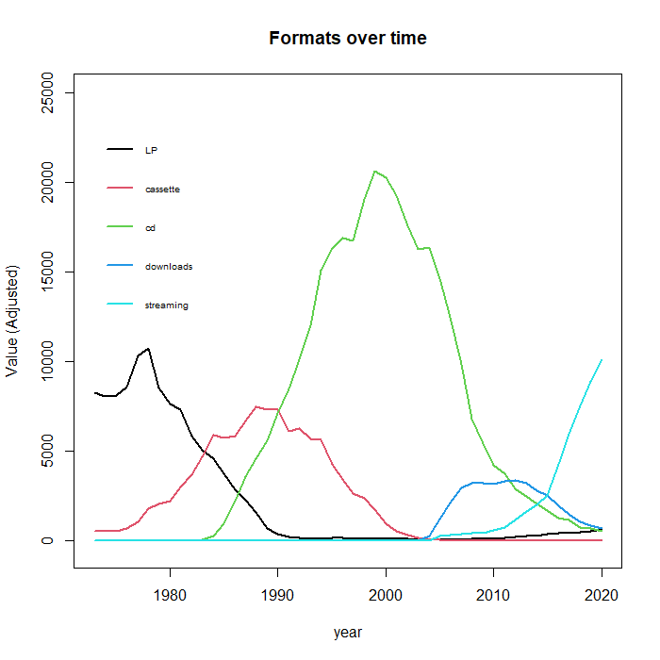
Question 1: Which music format will dominate the market in the next 2 or 3 years?
EDA: For this analysis, we worked on a dataset provided by the Recording Industry Association of America (RIAA) . This dataset contains U.S. sales of recorded music from 1973 to 2020, measured both in units sold/year and in yearly revenue. In the dataset, music formats are divided into 23 categories. We merged similar categories for simplicity*, obtaining 5 categories: LPs, cassettes, CDs, downloads and streaming services. In order to avoid difficulties due to the different meaning of “unit” for the various formats, we use as a metric the revenue (adjusted for inflation), measured in millions of dollars.
Notes:
*It is to be noted that we preliminarly dropped 2 of the 23 categories: kiosk and synchronization. We did this because we don’t consider these as “real” music formats: kiosks are physical places where one could listen to music, while synchronization refers to royalties due to the usage of music tracks in other media and is of little relevance to our project.
As is clear from the graph on the right, 2 out of 5 categories of music formats have already reached the end of their product life cycle: the CD and the cassette formats. While LPs show a very mild growth in recent years, we can also argue that they have reached the end of their life cycle and are now “starting” a new one.
Even if the graph already clearly shows that streaming services are the only format whose life cycle is in the “growing” phase, we applied diffusion models to all 5 formats in order to substantiate our claims and to understand the dynamics of music formats life cycle.

Slide 5
Overview: diffusion of music formats up until 2020
We developed a diffusion model for each single format – both as a simple BASS model and with a SARIMAX refinement.
Approximate parameter values for the BASS models (m, p, q) can be observed in the table below.
Note that all values shall be multiplied by 1 million in order to get the real value in USD.
Category / Model parameters | m | P | q
LP | 106362 | 0.0613 | 0.2318
Cassette | 108629 | 0.0032 | 0.2704
CD | 320583 | 0.0034 | 0.2514
Downloadable formats | 38452 | 0.0233 | 0.3246
Streaming services | 163694 | 0.0004 | 0.3452
Notes:
For our preliminary analysis, we used the simple BASS model.
On the slide, you can see a table reporting all parameter values for the BASS models we ran on each of the 5 formats.
Two observations about market potential m immediately come to mind:
The CD format has a considerably higher market potential wrt the other 4 categories. This may be due to the fact that, as the CD format came out in the 80s, technological advancements significantly dropped the price of music format supports, thus making this format much more available to the general public wrt LPs or cassette (which also had the disadvantage of being more exposed to the damages of time).
Downloadable formats show a considerably lower market potential wrt the other 4 categories. This may be due to the fact that downloadable formats did not actually appear on the market, as this dataset would suggest, around 2005, but actually around 1995 with the release of MP3 formats on the internet. Thus, the data for legal downloadable formats is actually underestimating the market potential for this category. More on this later on.
** Other observations:
Why is the p of LP so high? Because we are not considering the start of the life cycle, but a period in which LPs were already present on the market.
Why is the p of Downloads so high? Because of big innovation factor wrt previous formats (beginning of Internet era)
Why is the p of streaming so low? They took a lot of time to get dominant on the market
Should we comment on the fact that qs are all similar, and increasing with time? Maybe faster communication in modern times

Slide 6
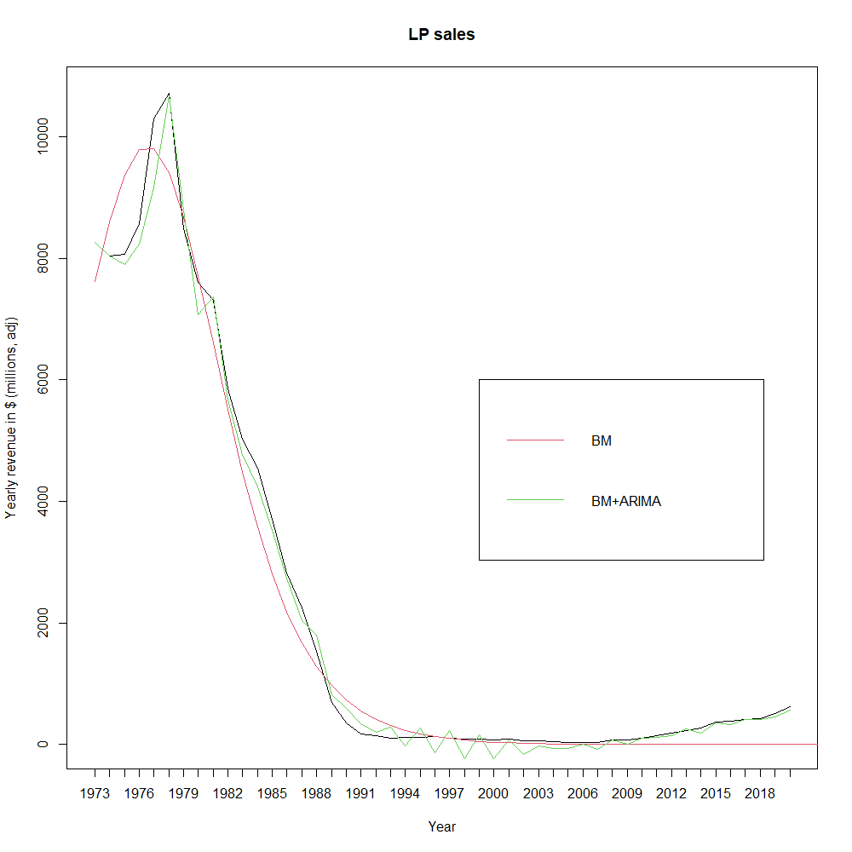
Diffusion of the LP
All parameters resulted significant for a simple BASS model.
Category / Model parameters | m | P | q
LP | 106362 | 0.0613 | 0.2318
Notes:
It is worth noting that LPs are the format for which p in the highest – this is probably due to a technical problem, i.e. the fact that we are missing the beginning of the life cycle for LPs since the time series starts in 1973. This leads the model to “believe” that LPs were bought mainly by innovators, but no one could be an actual “innovator” when buying LPs in the 1970s, since they had been widespread for decades.

Slide 7
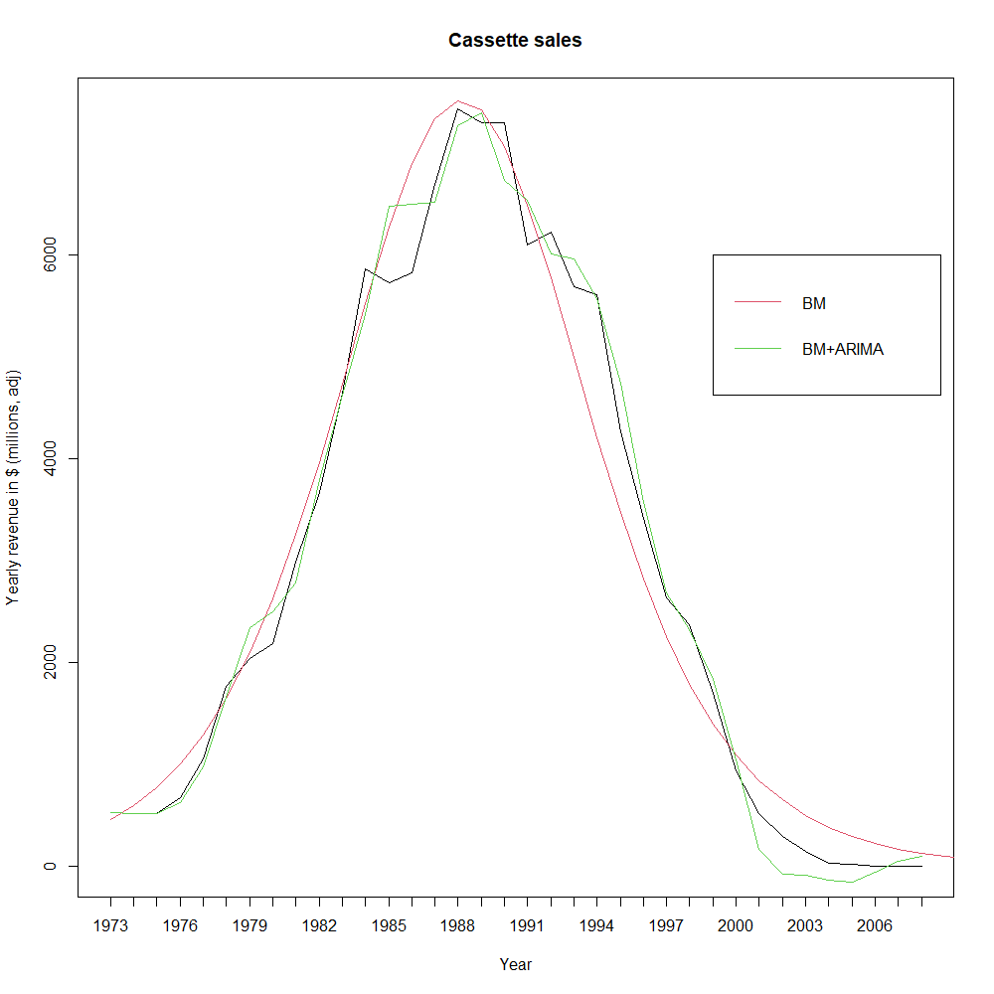
Diffusion of the cassette
All parameters resulted significant for a simple BASS model.
Category / Model parameters | m | P | q
Cassette | 108629 | 0.0032 | 0.2704

Slide 8
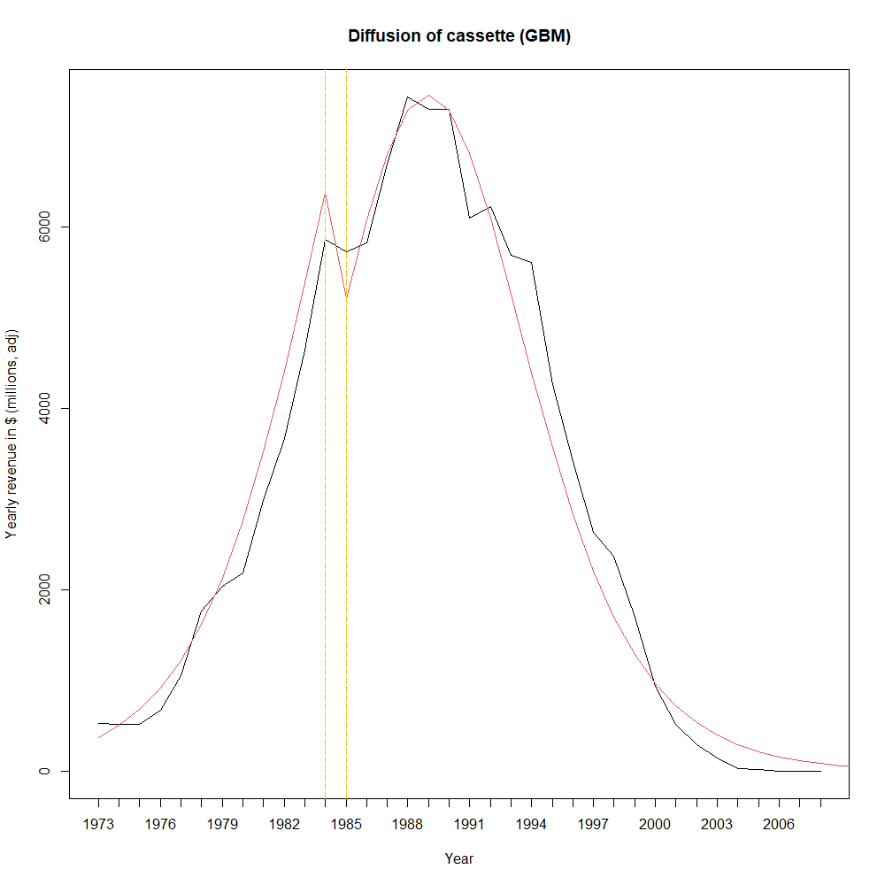
Cassette diffusion - GBM
Type of shock: Exponential
Note that all values shall be multiplied by 1 million in order to get the real value in USD.
Parameters | Values
Adjusted R-squared | 0.48
m | 107990
p | 0.0026
q | 0.3066
a1 | 12
b1 | - 0.2381
c1 | - 0.3107
Notes:
Here, we can observe that GBM does improve performance wrt a simple BASS model (Adjusted R-squared (Rt) > 0.3). We can also see that the market potential m is very similar to that of the simple BM.
Moreover, we can see that the starting time of the shock is placed in 1984 (a1=12), which is exactly 2 years after the CD format started to be introduced (1982). The actual decline of the cassette format happens a couple years later, as CD-player ownership becomes more widespread in the 1990s.

Slide 9
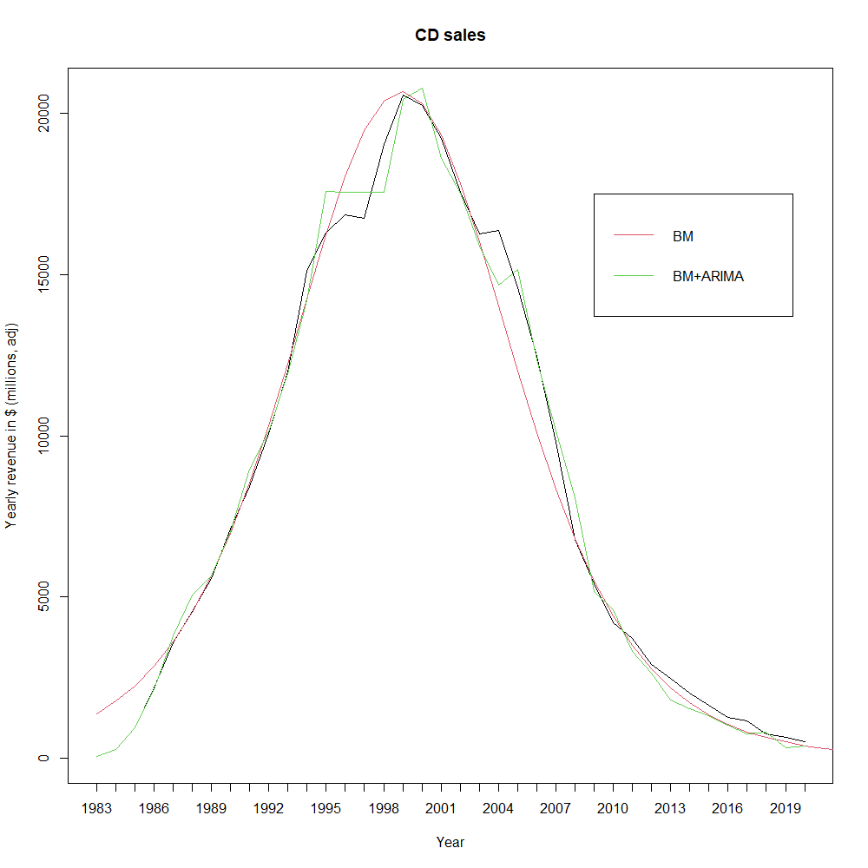
Diffusion of the CD
All parameters resulted significant for a simple BASS model.
Category / Model parameters | m | P | q
CD | 320583 | 0.0034 | 0.2514

Slide 10
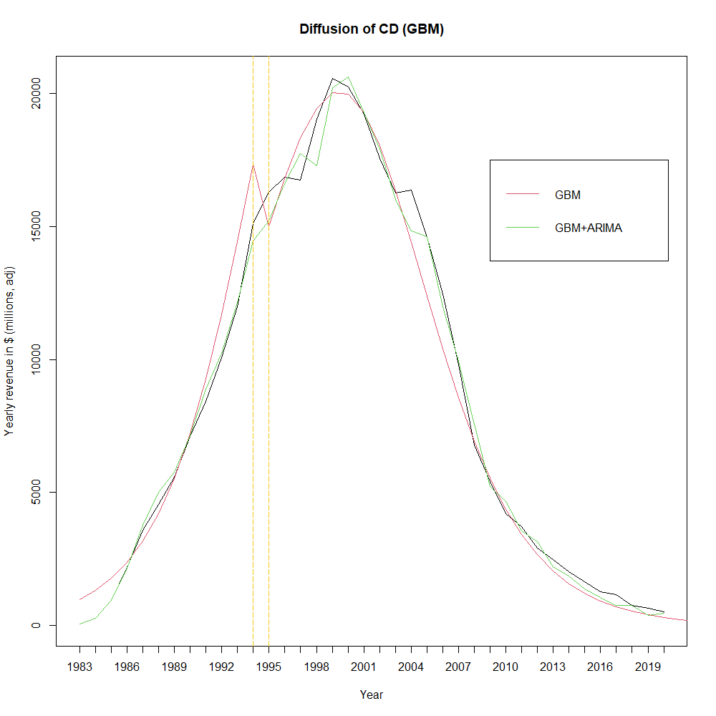
CD diffusion - GBM
Type of shock: Exponential
Note that all values shall be multiplied by 1 million in order to get the real value in USD.
Parameters | Values
Adjusted R-squared | 0.69
m | 319541
p | 0.0022
q | 0.3048
a1 | 12
b1 | - 0.0594
c1 | - 0.2486
Notes:
Here, we can observe that GBM does improve performance wrt a simple BASS model (Adjusted R-squared (Rt) > 0.3). We can also see that the market potential m is very similar to that of the simple BM.
Moreover, we can see that the starting time of the shock is placed in 1994 (a1=12), which is exactly 3 years after the MP3 format started to be introduced (1991). At this time, only few consumers actually switched to MP3, as computer ownership was not as widespread as today. Hence the weakness of the shock, represented by c1=-0.25). However, this is the origin of the CD’s decline, more evident after 2000.

Slide 11
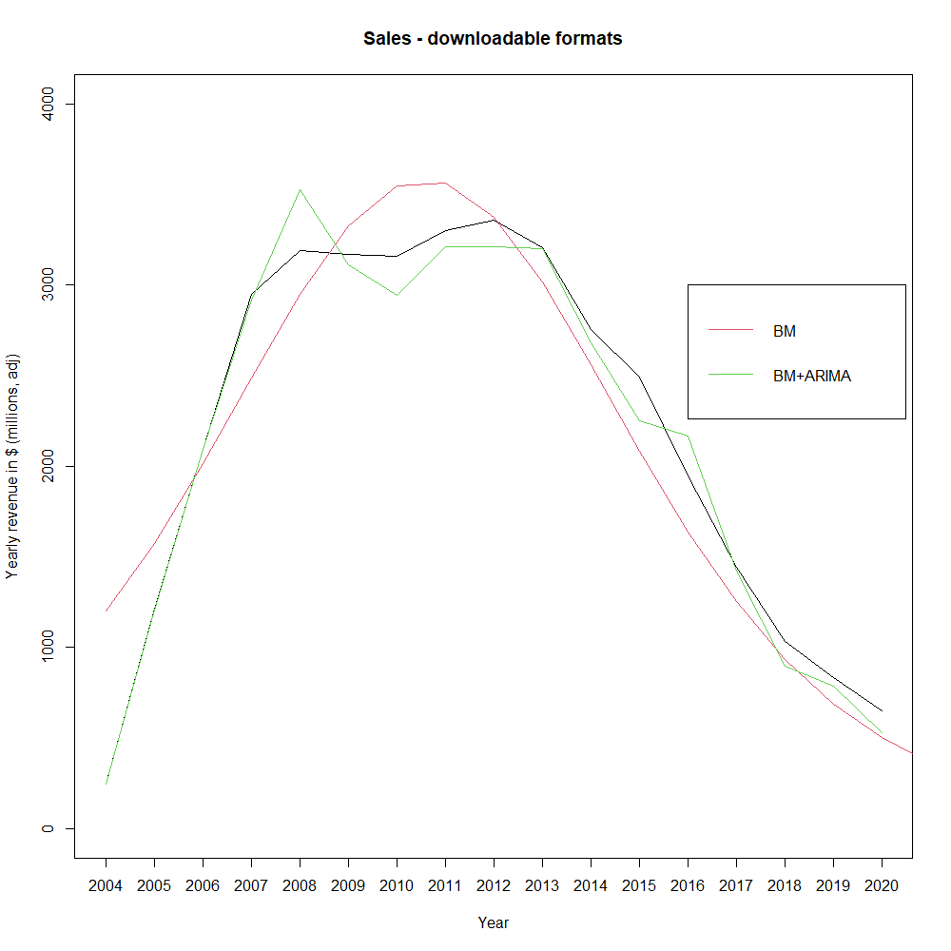
Diffusion of downloadable formats (legal)
All parameters resulted significant for a simple BASS model.
Category / Model parameters | m | P | q
Downloadable formats | 38452 | 0.0233 | 0.3246

Slide 12
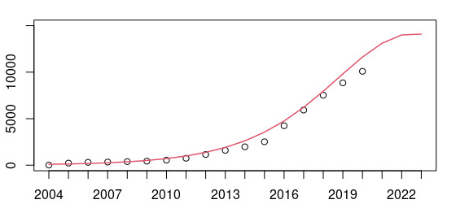
Diffusion of streaming services
All parameters resulted significant for a simple BASS model.
The graph also shows the predicted values for the next 3 years.
Streaming services – Sales
Yearly revenue in $ (millions, adj)
Category / Model parameters | m | P | q
Streaming services | 163694 | 0.0004 | 0.3452
Year
Notes:
It is worth nothing that streaming services are the format for which p and q have the highest difference – meaning that very few consumers bought streaming services according to personal beliefs (p=0.0004), while a considerable amount bought streaming services as “imitators” (q=0.3452).
A proof of this interpretation is the fact that Spotify was actually launched in 2010, but only became popular around 2015-2016.

Slide 13

Overview: competition between music formats
After exploring the nature of product diffusion for the 5 different music formats considered, we move on to analysing their competition dynamics.
Competitions between formats was modeled, by pairs, using the UCRCD (Unbalanced Competition Regime Change Diachronic) model.
In this context, we noticed the incumbent format gradually gets replaced by the entrant format.
As evident from the graph on the right, the duopolistic assumption is only partially respected. Yet, we can still gain some insights from the study of the parameters.
Notes:
We decided to analyse competition dynamics between formats, in order to better predict whether streaming services would actually go on to dominate the market in the coming years. However, since UCRCD models only allow us to compare 2 products at a time, we decided to create pairs in chronological order. Thus, we developed 3 models:
Cassette vs CD
CD vs Downloadable formats
Downloadable formats vs streaming services
While the market, as clear from the plot, is not duopolistic, we impose this assumption in order to be able to use UCRCD models.

Slide 14
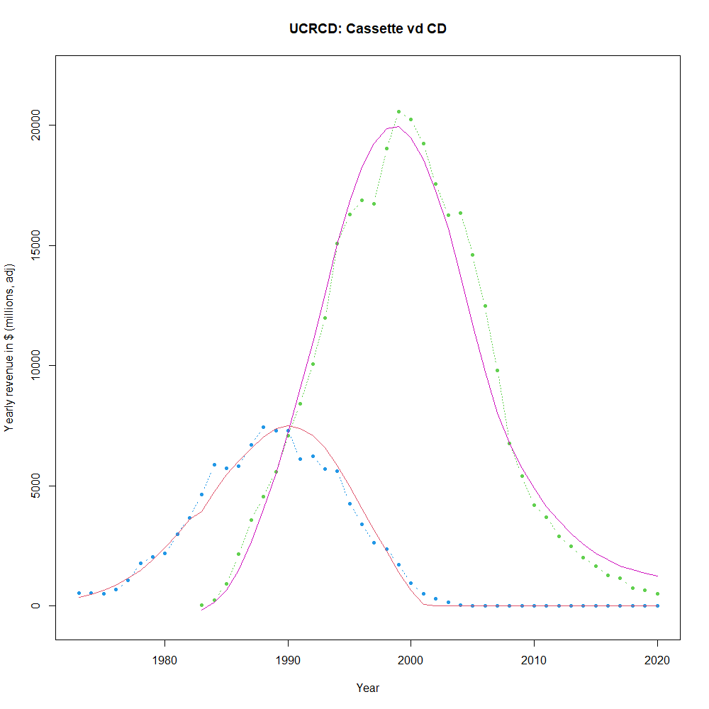
Competition example: Cassette vs CD (UCRCD)
Parameter | Interpretation | Values
m1 | Market potential product 1 | 67775
p1a | Innovation coefficient product 1 (before competition) | 0.0046
q1a | Imitation coefficient product 1 (before competition) | 0.3010
mc | Combined market potential (after competition) | 415414
p1c | Innovation coefficient product 1 (after competition) | 0.0078
q1c + δ | Within – imitation (product 1) | 0.1581
q1c | Cross – imitation (product 1) | -0.0868
p2c | Innovation coefficient product 2 | -0.0009
q2c | Within – imitation (product 2) | 0.2888
q2c -ɣ | Cross – imitation (product 2) | 0.0439
Notes:
Example of (almost) complete duopolistic cycle
Parameters δ and ɣ are assumed equal in this case
Parameter p2c non significant, may indicate initial resistance to adoption
Parameters p1a, q1a and q2c coherent to those observed for standard BM
Cross-imitation parameters indicate two different contributions between formats: competition for CDs w.r.t. cassettes, while a positive effect is suggested for cassettes w.r.t. CDs.

Slide 15
Competition example: Cassette vs CD (UCRCD)
The competition model between CD and cassettes constitutes an example of an almost-complete duopolistic cycle.
Observations:
Parameters δ and ɣ are assumed equal in this case
Parameter p2c non-significant, may indicate initial resistance to adoption
Parameters p1a, q1a and q2c coherent to those observed for standard BM
Cross-imitation parameters indicate two different contributions between formats: competition for CDs w.r.t. cassettes, while a positive effect is suggested for cassettes w.r.t. CDs.
Parameter | Interpretation | Values
m1 | Market potential product 1 | 67775
p1a | Innovation coefficient product 1 (before competition) | 0.0046
q1a | Imitation coefficient product 1 (before competition) | 0.3010
mc | Combined market potential (after competition) | 415414
p1c | Innovation coefficient product 1 (after competition) | 0.0078
q1c + δ | Within – imitation (product 1) | 0.1581
q1c | Cross – imitation (product 1) | -0.0868
p2c | Innovation coefficient product 2 | -0.0009
q2c | Within – imitation (product 2) | 0.2888
q2c -ɣ | Cross – imitation (product 2) | 0.0439

Slide 16

Competition between CDs and downloads: the issue of piracy
Officially the first legal revenue for downloads is reported by RIAA for 2004 by ITunes.
The MP3 format was released to the public in the early ‘90s and gained traction in the late ‘90s, initially through small forums/websites.
In the second half of 1999 the first large peer-to-peer filesharing network, Napster, is launched. Widespread adoption rapidly takes off.
Numerous clones and imitators of Napster quickly appeared online and had a huge impact throughout the first part of 00’s (e.g. LimeWire, Torrent).
Reaction to the phenomenon by major record companies was slow and inadequate, resulting in huge and prolonged losses.
Appropriate laws and sanctions were put into effect around 2005.

Slide 17
Competition between CDs and downloads: the issue of piracy
Models trained on official data fail to capture the real implications and behaviour of the market in the decade between between 1997-2007.
Studies conducted on the true effect of piracy and copyright policy suggest that:
“ The estimated displacement rates range up to 30 percent in some studies, but an average number of these estimated rates can be set to 20 percent.” (N. Muller, 2014)
“The results suggest that p2p usage reduces the probability of buying music by 30 percent.” (A. Zentner., 2006)
“...the average number of files available from each search (each album) decreased by almost 30 percent following recent legal action against individual file sharers…” (S. Bhattacharjee et Al. 2006)
“Following the announcement of the RIAA to sue P2P users during the summer of 2003, most file-sharing networks have seen their number of users drop by 10 to 30 percent. “ (M. Peitz, P. Waelbroeck, 2005)
Piracy still remains, although in smaller proportion, an open issue.

Slide 18
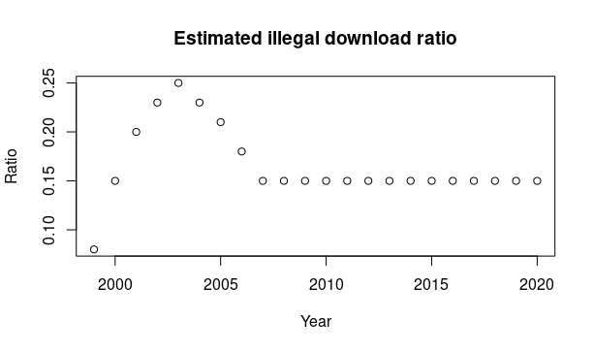
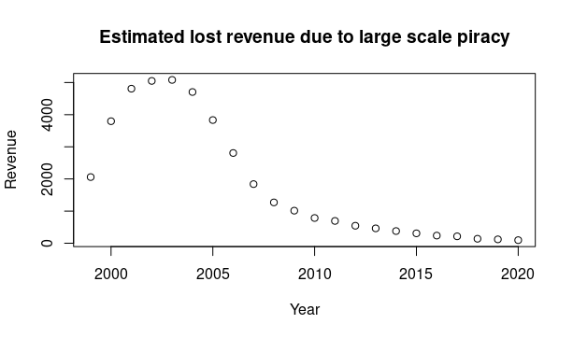
Competition between CDs and downloads: an estimation of the scale of piracy
We employed an estimate of illegal downloads ratio, starting from the introduction of large peer-to-peer networks. This was derived from research papers (see previous slide).
Thus, we were also able to create an estimate of the CD revenue which was lost to piracy over the period considered.
With this integrated data it was then possible to appropriately study the relationship between downloadable format and other recent formats.

Slide 19
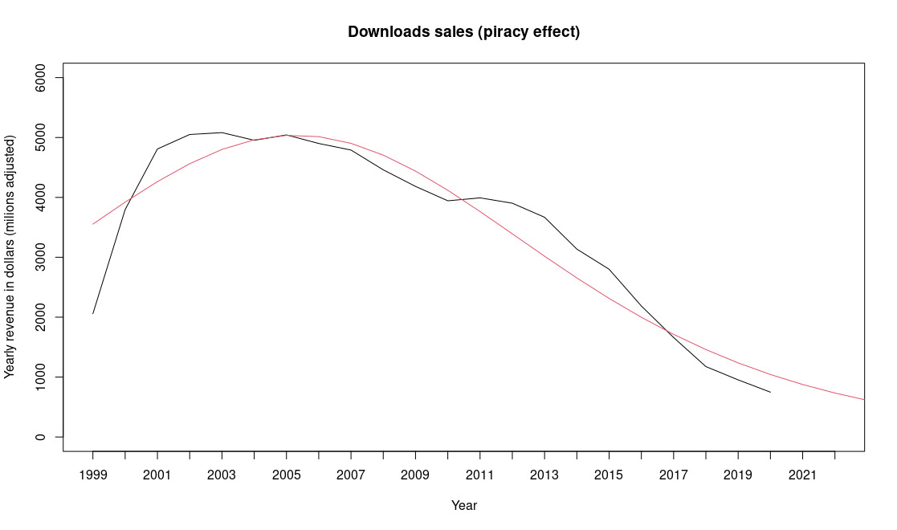
Diffusion of downloadable formats (legal + piracy effect)
All parameters resulted significant for a simple BASS model.
Category / Model parameters | m | p | q
Downloadable formats | 83683 | 0.0380 | 0.1556
Notes:
m, p coefficients result much higher than the previously estimated BM for downloadable formats.

Slide 20
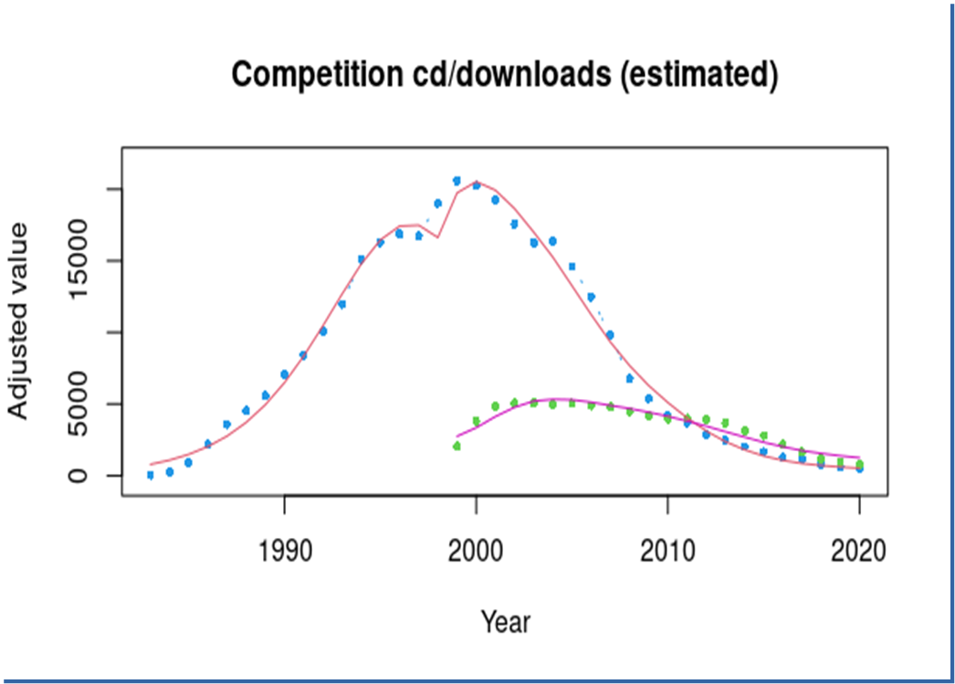
CD vs Downloadable formats (UCRCD)
Parameter | Interpretation | Values
m1 | Market potential product 1 | 211183
p1a | Innovation coefficient product 1 (before competition) | 0.0031
q1a | Imitation coefficient product 1 (before competition) | 0.3274
mc | Combined market potential (after competition) | 268292
p1c | Innovation coefficient product 1 (after competition) | 0.0628
q1c + δ | Within – imitation (product 1) | 0.3045
q1c | Cross – imitation (product 1) | -0.7571
p2c | Innovation coefficient product 2 | 0.0103
q2c | Within – imitation (product 2) | 0.4583
q2c -ɣ | Cross – imitation (product 2) | -0.0341
Notes:
All parameters are significant
p2c significant and larger than usual
Cross-imitation coefficients both negative, competition between formats
Combined m coefficients in line with BMs and added data
The model appropriately captures the beginning of the shock to the CD market before the appearance of large-scale download platforms on the market (aka before 1999)

Slide 21
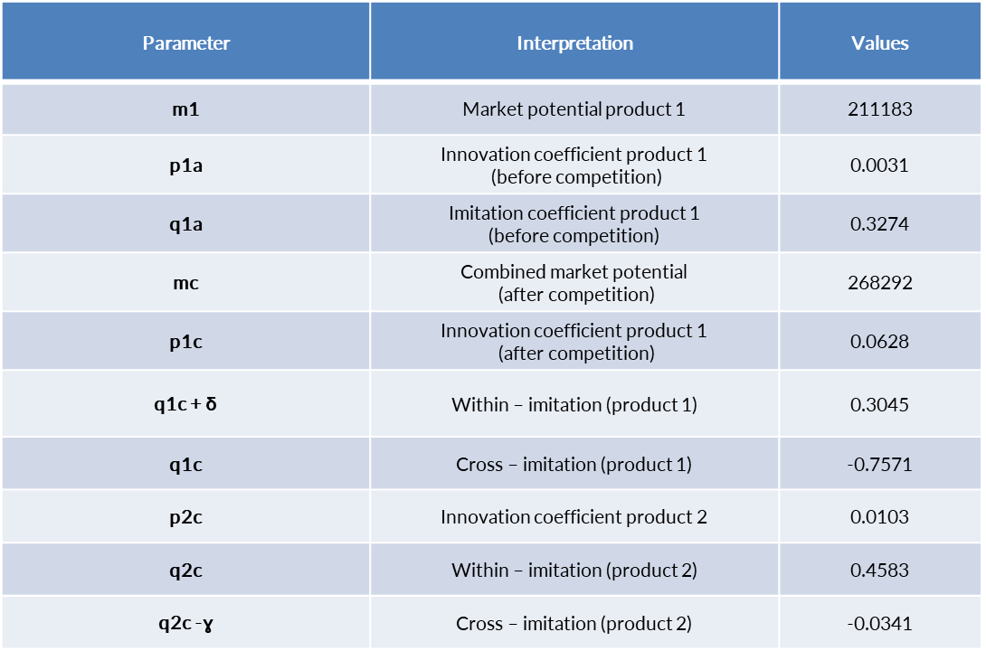
CD vs Downloadable formats (UCRCD)
All parameters are significant
p2c significant and larger than usual
Cross-imitation coefficients both negative, competition between formats
Combined m coefficients in line with BMs and added data
The model appropriately captures the beginning of the shock to the CD market before the appearance of large-scale download platforms on the market (aka before 1999)

Slide 22
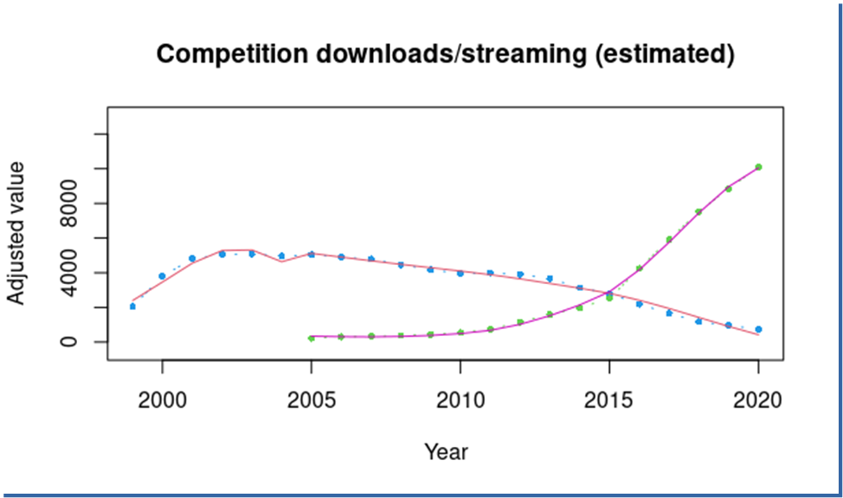
Downloadable formats vs streaming services (UCRCD)
Parameter | Interpretation | Values
m1 | Market potential product 1 | 35794
p1a | Innovation coefficient product 1 (before competition) | 0.0540
q1a | Imitation coefficient product 1 (before competition) | 0.4927
mc | Combined market potential (after competition) | 168121
p1c | Innovation coefficient product 1 (after competition) | 0.0317
q1c + δ | Within – imitation (product 1) | -0.0064
q1c | Cross – imitation (product 1) | -0.0850
p2c | Innovation coefficient product 2 | 0.0025
q2c | Within – imitation (product 2) | 0.5505
q2c -ɣ | Cross – imitation (product 2) | -0.0382
Notes:
All parameters are significant.
Cross-product wom coefficients both negative.
p2c significant but lower than previous model for downloads.
Parameters essentially in line with BMs.
Streaming format doesn’t appear to have reached peak yet.

Slide 23
Downloadable formats vs streaming services (UCRCD)
All parameters are significant.
Cross-imitation coefficients both negative.
p2c significant but lower than previous model for downloads.
Parameters essentially in line with BMs.
Streaming format doesn’t appear to have reached peak yet.
Parameter | Interpretation | Values
m1 | Market potential product 1 | 35794
p1a | Innovation coefficient product 1 (before competition) | 0.0540
q1a | Imitation coefficient product 1 (before competition) | 0.4927
mc | Combined market potential (after competition) | 168121
p1c | Innovation coefficient product 1 (after competition) | 0.0317
q1c + δ | Within – imitation (product 1) | -0.0064
q1c | Cross – imitation (product 1) | -0.0850
p2c | Innovation coefficient product 2 | 0.0025
q2c | Within – imitation (product 2) | 0.5505
q2c -ɣ | Cross – imitation (product 2) | -0.0382

Slide 24
What does the history of music industry tell us?
The growth of the revenue from a product is usually stopped by the entrance in the market of a competitor.
Piracy had a huge effect in the past on total sales in the music market. Its effect is reduced nowadays but it’s still a factor to consider.
Music became much cheaper in terms of money per song/album in recent years.
Adjusted revenue has not caught up to the 90’s levels, possibly suggesting there’s margin for future growth in the market.
Today the dominant products in the market are streaming services.
Streaming doesn’t appear to have peaked yet, and no clear competitor is present in the market either.

Slide 25
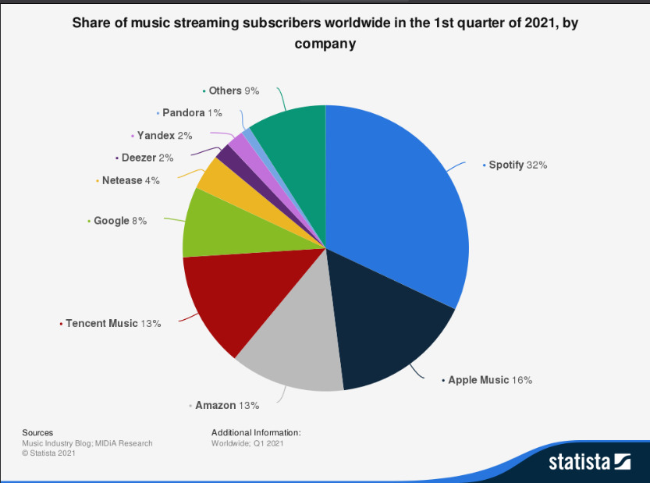
Question 2: Who is a potential market leader, among producers of this format?
Once streaming services have been identified as the current dominant music format, we were interested in understanding who are the lead players on the streaming market – and identifying a potential business partner for our clients.
As shown in the pie chart to the right, Spotify is currently the market leader for paid streaming services. Moreover, they release their data to the public quarterly.
For the analysis of Spotify’s future growth prospects, we worked on 2 datasets:
Dataset 1: Quarterly revenue (measured in million of €)
Dataset 2: Number of subscribers (with paid subscription) for each quarter
Both datasets regard the period 2015-2021

Slide 26
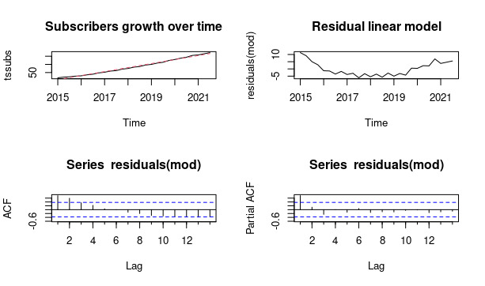
Spotify overview: Number of subscribers
Below you can observe a linear regression model for the growth of Spotify subscribers and the relative residual plot. Parameters regarding seasonality were added, but they resulted non-significant.
Although the R-squared shows a good fit, the presence of structure in the residuals suggested to use an ARIMA model in order to improve performance.
Parameter | Value
Intercept | 0.5499
Trend | 6.1459
R2 | 0.9904

Slide 27
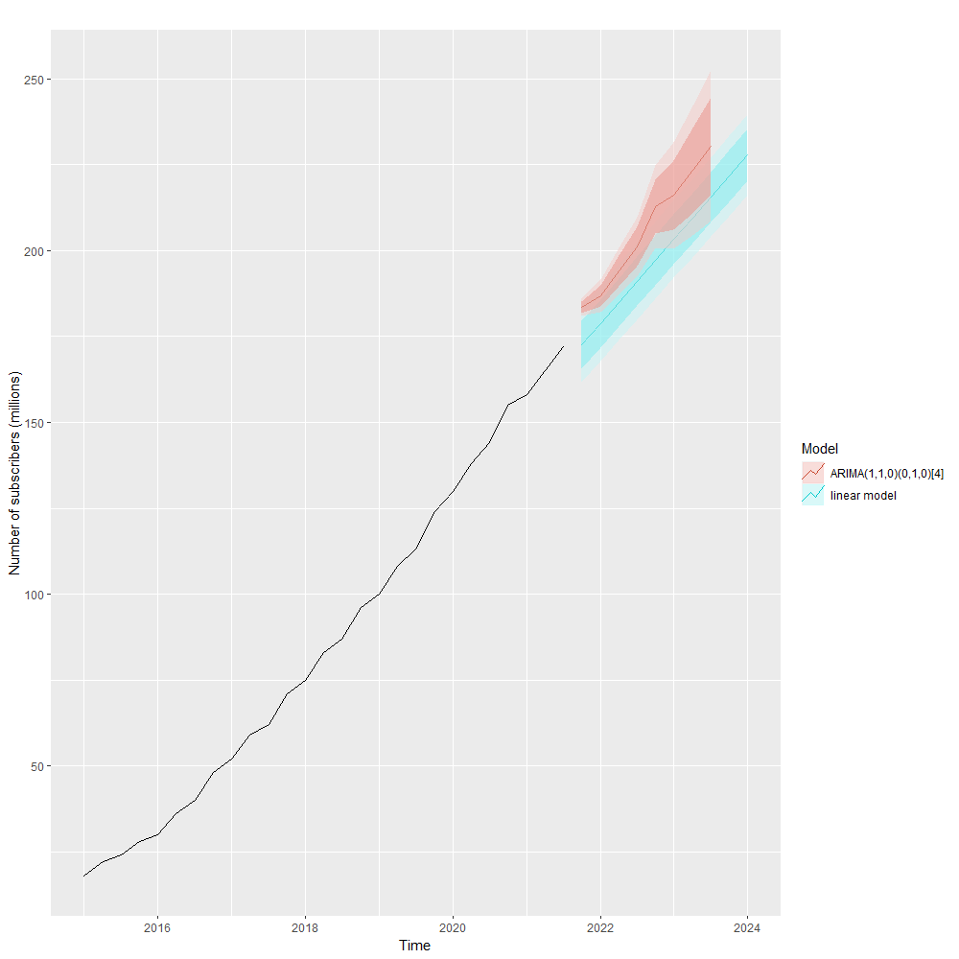
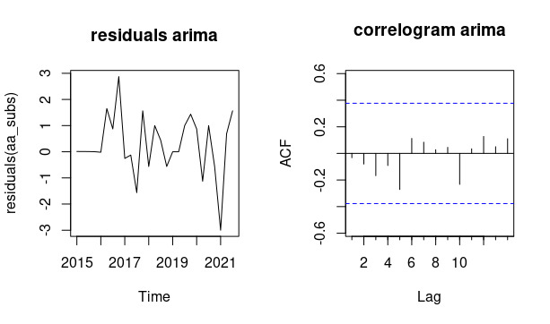
…will Spotify’s user base keep growing in the coming years?
In order to obtain reliable predictions for Spotify’s future growth, we applied an ARIMA(1,1,0)(0,1,0)₄ model, selected via AIC and RMSE comparison. Both show significant improvement wrt the linear model.
This model suggests even faster growth compared to the linear one, implying Spotify will keep increasing its subscribers in coming years.
*RMSE was calculated over the last 7 observations (test set).
Metric/Model | Linear | ARIMA
AIC | 166.33 | 78.18
RMSE* | 86.9 | 13.80

Slide 28
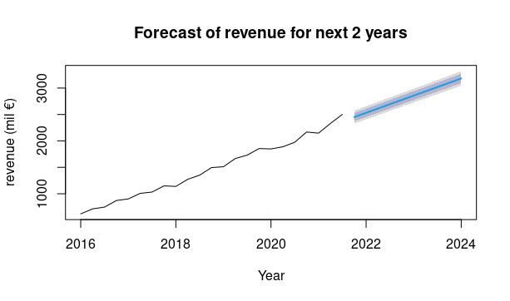
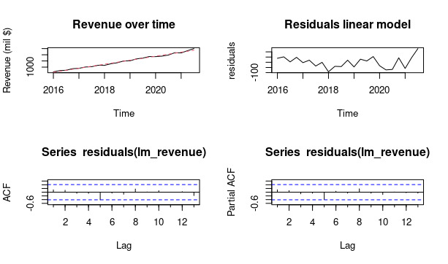
Spotify overview: Revenue
Below you can observe a linear model for the growth of Spotify revenue and the relative residual plot. Parameters regarding seasonality were added, but they resulted non-significant. The residuals show no structure, hence we conclude a linear regression model is sufficient for prediction, shown at the bottom-right of the slide.
Parameter | Value
Intercept | 499.42
Trend | 81.29
R2 | 0.9908

Slide 29

Conclusions: who is a potential market leader in the streaming services area?
Spotify is the dominant market player for streaming services nowadays. Data shows we can expect it to continue its fast-paced growth for the next 2 or 3 years.
Hence, we decide to suggest Spotify as a business partner for our clients.

Slide 30
Question 3: What makes a song popular among consumers who use Spotify?
Following the identification of streaming services as the leading format on the market, and of Spotify as a potential business partner, we move on to investigate the popularity trends of songs released on the Spotify platform.
To this aim, we employed a dataset of 2000 songs provided by Spotify API, which reports all variables relative to each song, used by Spotify to construct playlists. Many of these variables had no relevance for our purposes, so they were removed in the preliminary phase. Below, you can find a list of the variables used and their interpretation.
Genre: Genre of the track*
Year: Release Year of the track
Beats per Minute(BPM): The tempo of the song
Energy: The energy of a song - the higher the value, the more energetic the song
Danceability: The higher the value, the easier it is to dance to this song.
Loudness: The higher the value, the louder the song.
Valence: The higher the value, the more positive mood for the song.
Length: The duration of the song.
Acoustic: The higher the value the more acoustic the song is.
Speechiness: The higher the value the more spoken words the song contains
Liveness: probability that the song was recorded with a live audience
Popularity: The higher the value the more popular the song is.
* The Genre variable contained approximately 150 possible genres for each song. For simplicity, we converted these into 12 genres: pop, indie, rock, country, dance, hip-hop, metal, electronica, folk, soul, blues, other
Notes:
As the last part of our study, since Spotify was shown to be a potantially good business parter for the future, we tried to investigate also consumers' preferences using the Spotify API. In particular, the dataset we employed was composed on 2000 songs and the attributes shown in the list below here. So we can see we have for every song in the dataset its genre, which actually was pre-processed since the API provided a lot of slightly different genres (over 150!) which were clustered into 12 more broad gernes like pop, rock, dance, blues etc.. Then we have the year of release of the track, the tempo of the song, how energetic it is, its danceability, loudness, its valence (which is a easure of the mood of the song), the length, acosticness, speechiness (which is a measure of how many words are contained per minute in the song), liveness which is the probability of the song being recorded live and finally popularity, which has been our target variable, which we want to explain given the other attributes. In this study we proceeded under the assumption that popularity may be a proxy for the revenue of a song.

Slide 31
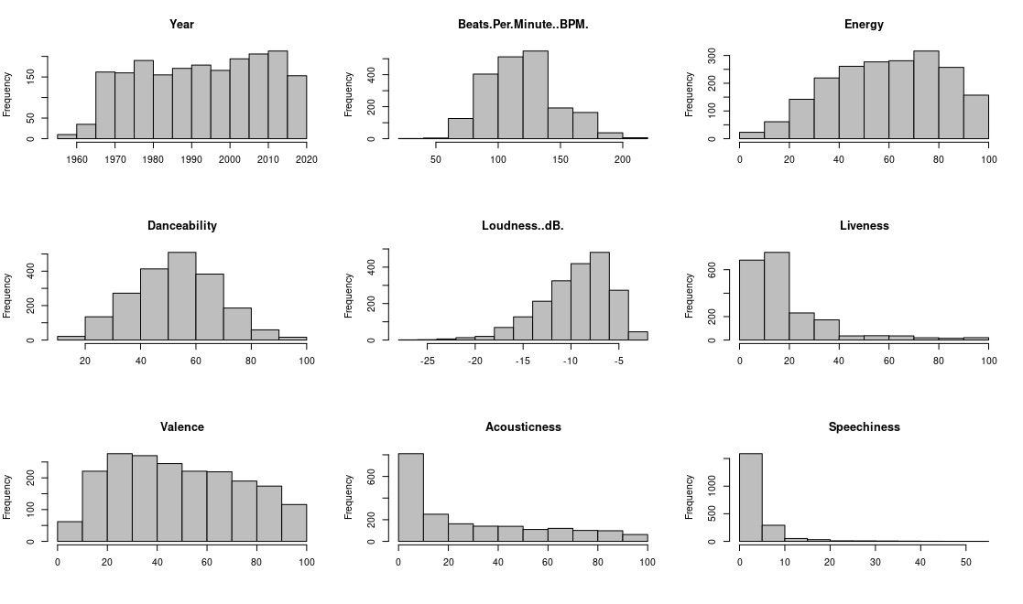
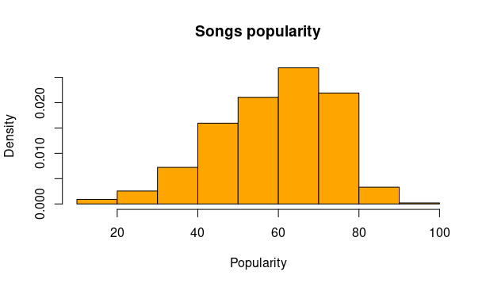
Spotify songs dataset - EDA
Explanatory variables:
Target variable:
Speechiness: the distribution is clearly skewed to the left, hence we perfomed a logarithmic transformation on this variable
Notes:
We quickly show a distribution of the variables mentioned. Some of them we can see resemble uniform distributions, others are closer to being normally distributed. Our target variable, popularity is slightly left-skewed, but overall we can see that we have many different levels of popularity well represented. The only pre-processing step, except the genres clustering mentioned, is the transformation of the speechiness variable using a logarithmic transformations. We felt that the distribution being so heavily skewed called for this step before modelling.

Slide 32
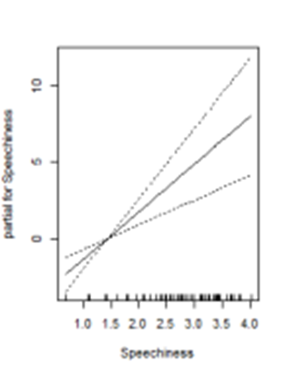
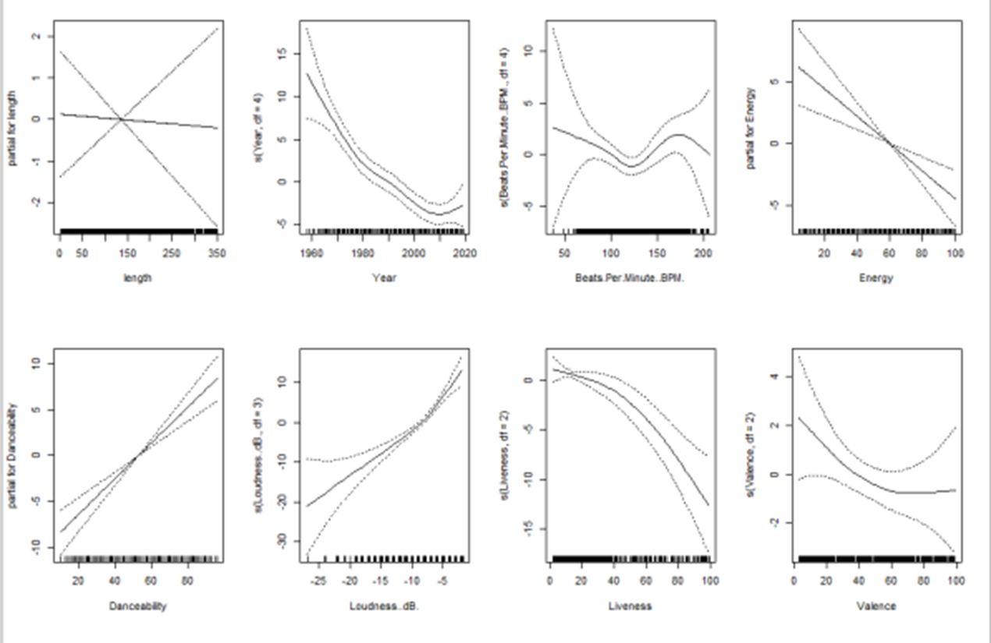
Generalized Additive Model (GAM)
We divided the dataset with a 80%-20% split between training and test set.
After fitting a multiple regression model on the data, which will be used as a benchmark, we fitted a GAM on the dataset.
We used an automated step procedure in order to select the best model.
Model / Metric | AIC | Deviance
MLR | 12705 | 60329
GAM | 12679 | 59876
* Variables “length” and “BPM” resulted non-significant both in MLR and GAM
Notes:
AIC and Deviance show a mFirst of all, the dataset was split 80-20 between training and test set. A simple multiple regression model was fitted, using also stepwise selection, in order to have a benchmark for the more complex models. Hence, a generalized additive model was fitted on the training set, by means of the step.gam automatic procedure and in terms of AIC and Deviance we can notice a mild improvement for the GAM wrt multiple linear regression. The GAM model fitted shown that significant effects were due to almost every variable, except length and beats per minute. Given that the model is additive, we can examine the effect of each explainatory variable for our target variable, popularity, while holding all other variables fixed. Looking at the plots on the right we can see for example that older songs seems actually to preferred to new ones; that the louder and danceable a song is, the better; that recording songs live, probably due to lower quality in the recording, results in poorer popularity for the track and that songs with a negative mood seems to be in general more popular.
ild improvement of the model for GAM wrt MLR.

Slide 33
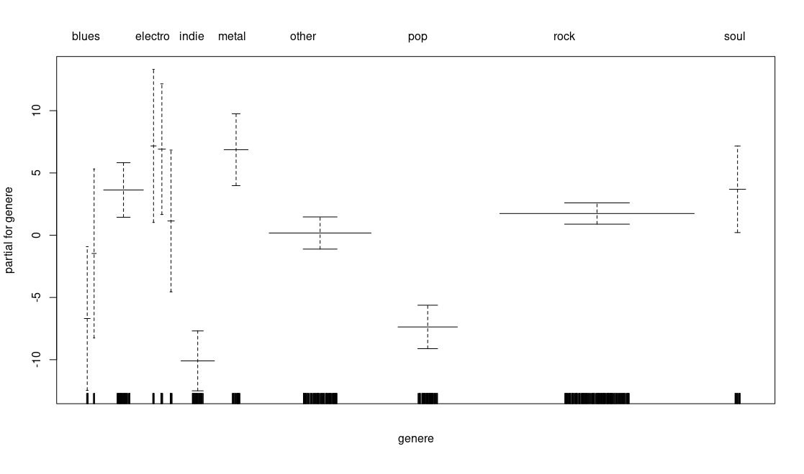
Marginal effect plot – “genre” variable: we were particularly interested in the interpretation of this plot, since it could be useful in order to suggest artist choices to our clients at the hypothetical record label.
electro
folk
metal
hip-hop
soul
country
dance
other
rock
blues
pop
indie
Notes:
The plot shows marginal effects of variables on the target variable “popularity”, used as a proxy for future revenue.
Another important aspect which strongly relates to the popularity of a song is its genre. We can see from the boxplots here that some genres tend to be more popular than others. In particular electro and metal / hard rock music seems to be quite popular. We have also to observe, though, that the confidence variability associated to these two genres is rather large due to the small sample of songs of this genre in the dataset. Even so, we can observe interesting patterns in the data nonetheless: for example we're pretty sure that rock music tends to be more popular than pop.

Slide 34
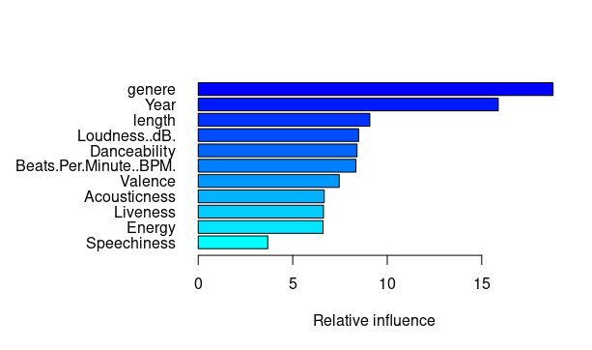
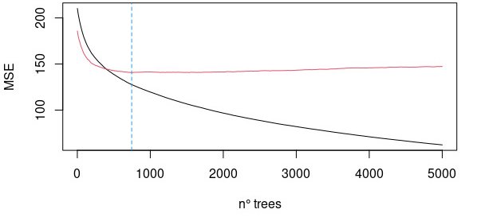
Gradient Boosting Machine
Since GAM didn’t much improve performance from our benchmark model, we decided to fit a GBM model to our dataset.
Below you can observe the relative influence plot and training error plot for our model, alongside a table which indicates that GBM has the best performance wrt both the benchmark and the GAM model.
We tried GBM with 2 different loss functions: absolute (1) and quadratic (2). Best performance was obtained with quadratic loss function (2) and this is the one for which we show graphs.
Par | Value
Max depth | 4
shrinkage | 0.01
Loss function | Quadratic
N of trees | 789
Loss
Metric/Model | MLR | GAM | GBM_1 | GBM_2
Deviance | 60329 | 59876 | 58617 | 55862
Notes:
Residual plots show no structure for GAM and GBM
While we obtained some interesting information from the interpretation of the GAM model, the improvement over a simple multiple regression model was mild. So tried to fit also a Gradient Boosting model. Different settings for the hyperparameters were tested:

Slide 35
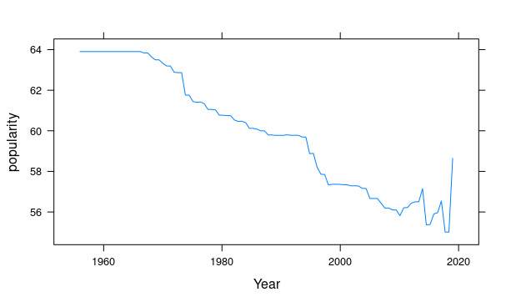
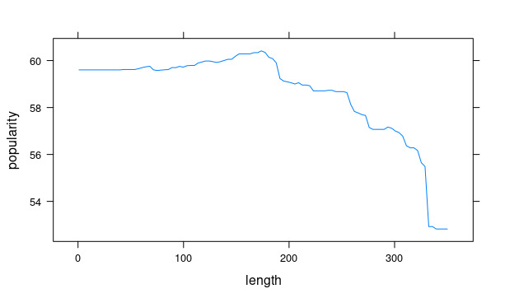
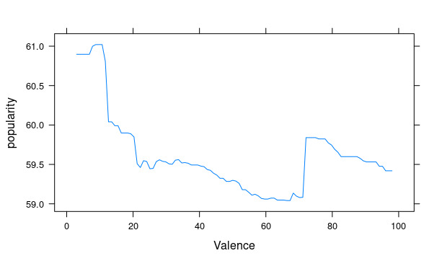
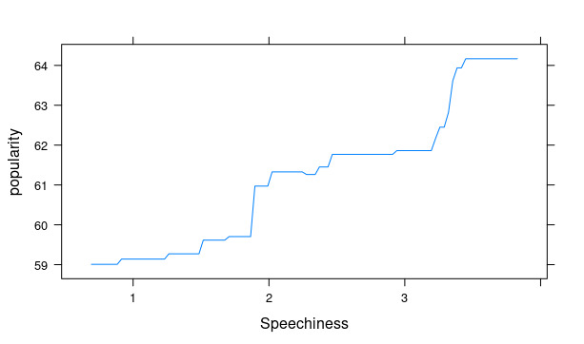
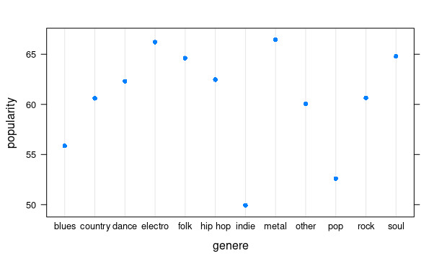
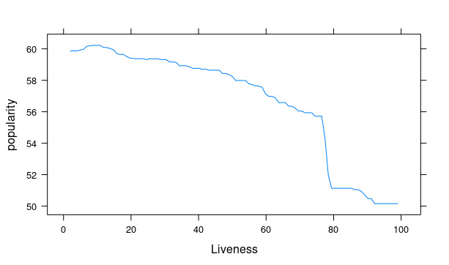
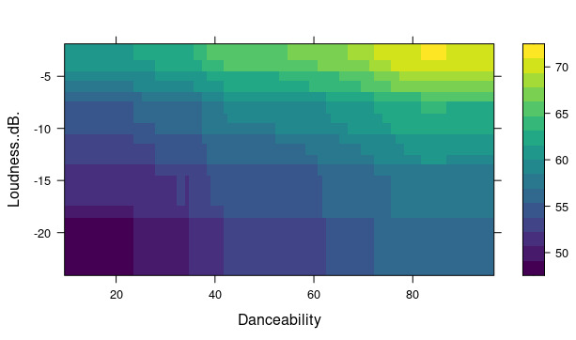
Partial dependence plots (GBM)
Genre: in line with GAM results, we see the most popular genres are electro, metal and soul.
Year: it negatively influences popularity, with the exception of very recent releases
Length: over a certain length, a drop in popularity is observed
Valence: songs with a negative mood are more popular
Speechiness: as the number of words goes up, popularity increases
Liveness: live recording decreases popularity
(Bivariate) Danceability + Loudness: the louder and more danceable a song is, the more popular

Slide 36
Conclusions: What makes a song popular among consumers who use Spotify?
Our analysis indicated that the factors which relate the most to the popularity of a song on Spotify are its genre, its length (when >3mins), its valence (i.e. mood) and its loudness/danceability.
Hence, we would suggest our clients to focus on buying rights to songs with those qualities, or even signing artists who share these traits.
Here, we assume popularity is a proxy for the number of times a song is listened to on the platform (an easily satisfied assumption, since Spotify API documentation affirms that the value of the variable is calculated on the basis of the number of times the track is listened to).

Slide 37
Conclusions
Which music format will dominate the market in the next 2 or 3 years?
All diffusion models applied suggest streaming is set out to be the dominant format in the coming years, even considering the problem of piracy.
Who is a potential market leader among the producers of this format? Will they keep growing in the coming years?
Spotify is already the market leader for streaming services and analysis via ARIMA and linear model suggests it will continue to be a relevant player in the market.
What makes a song popular among consumers who buy that particular format?
Both GAM and GBM models suggest that the factors which relate the most to the popularity of a song on Spotify are its genre, its length (when >3mins), its valence (i.e. mood) and its loudness/danceability.

