Slide 1
Coral Bleaching Classification with Machine Learning

Slide 2
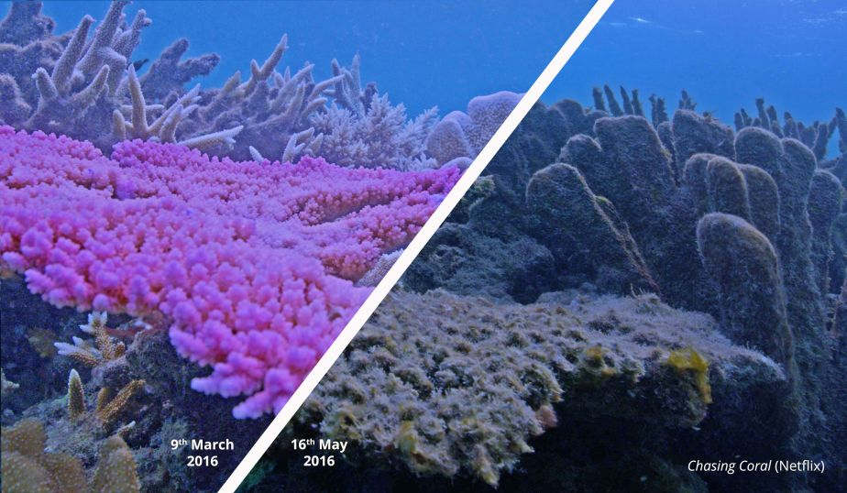
What is Coral Bleaching? Why do we care?
Coral reefs are critical to marine life, housing diverse sea life
Coral bleaching damages the reefs and biodiversity
Occurs in changing water conditions and rising temperatures
Currently experiencing a global bleaching event¹
Bleaching can be reversable if monitored and managed
¹ Source: “NOAA Confirms 4th Global Coral Bleaching Event.” National Oceanic and Atmospheric Administration, 15 Apr. 2024.

Slide 3
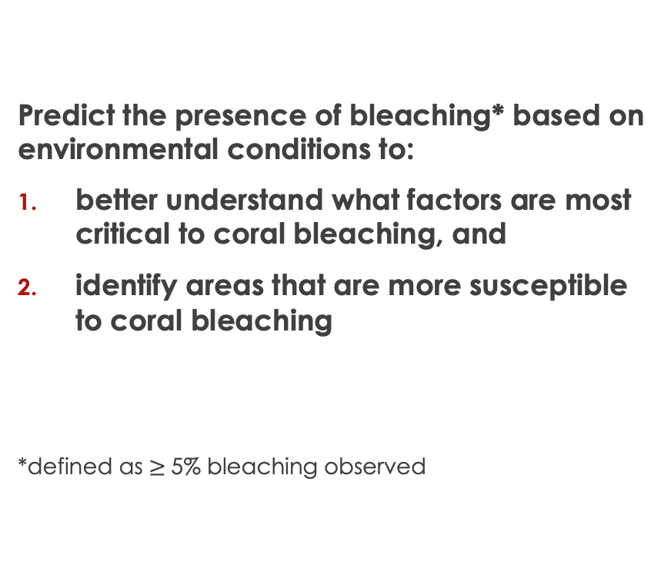
Goals
Predict the presence of bleaching* based on environmental conditions to:
better understand what factors are most critical to coral bleaching, and
identify areas that are more susceptible to coral bleaching
*defined as $≥$5% bleaching observed

Slide 4
Methodology & Approach
Data Wrangling
EDA
Preprocess
Model
Future Development
Evaluation & Selection
Review and clean the dataset. Understand where missing values occur
Identify patterns and trends that appear in the data.
Prepare for modeling (sampling methods, handle missing data, scaling, and dummy variables)
Compare performance and fine tune hyper-parameters
Determine the best performing model (F1 score)
Consider further analyses that could supplement or improve the model

Slide 5
The Data
The Global Coral-Bleaching Database (GCBD) was compiled from seven data sources
34,846 coral bleaching records from 14,405 sites in 93 countries, from 1980–2020
Observations include:
Percent coral bleaching observed
Temperature: sea surface temp., frequency and anomaly metrics
Environment: site exposure, depth, distance to land, turbidity, windspeeds, cyclone frequency
Global regions
Data Wrangling
EDA
Preprocess
Model
Future Development
Evaluation & Selection

Slide 6
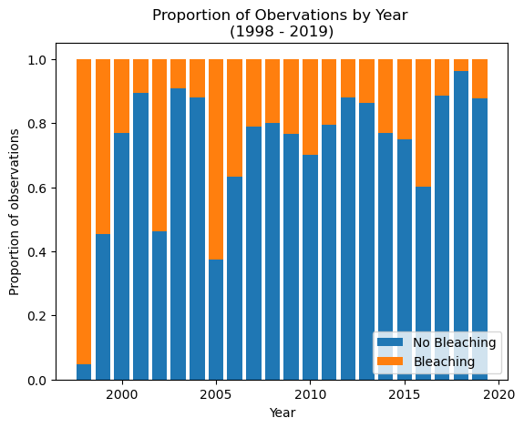
When & where bleaching occurred?
Global bleaching events:
First major event recorded in 1998
Subsequent global events in 2010, 2014-17, and most recently 2023-24
Notable local events:
Australia in 2002 and 2006
Caribbean in 2005
Source: “Coral bleaching events.” Australian Institute of Marine Science.
Data Wrangling
EDA
Preprocess
Model
Future Development
Evaluation & Selection

Slide 7
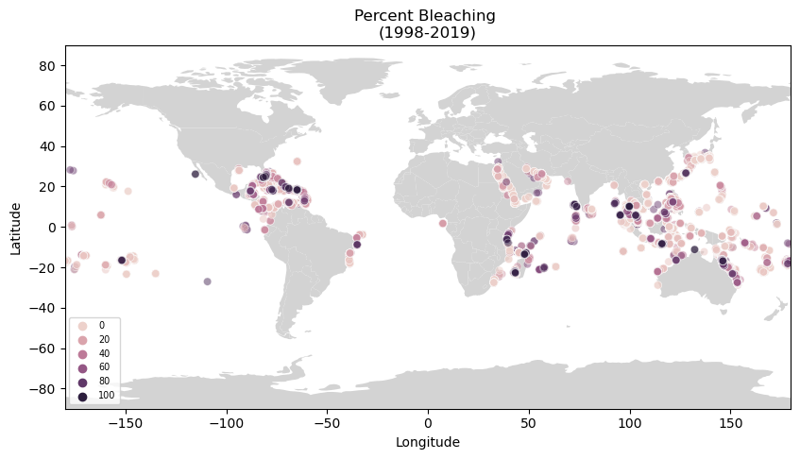

Slide 8
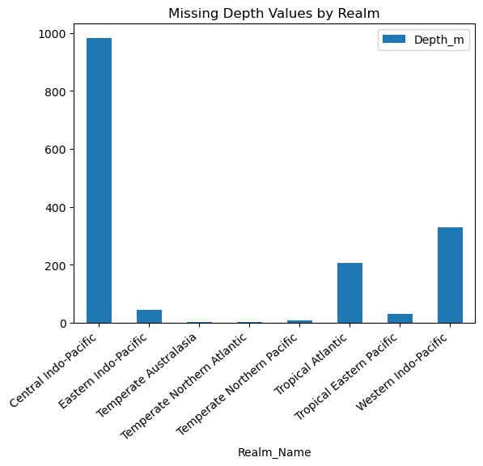
Preparing data for modeling
Sampling methods to mitigate imbalanced data
Random under sampling
SMOTE (over sampling)
Train/Test split (80/20)
Handling missing data and categorical variables
Scale for logistic regression
Data Wrangling
EDA
Preprocess
Model
Future Development
Evaluation & Selection

Slide 9
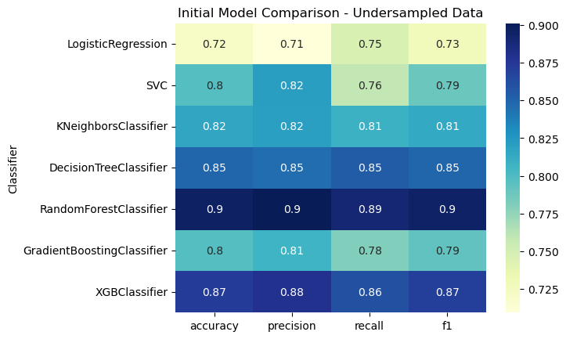
Modeling
Consider various classification algorithms:
Logistic regression
Support vector machine
K-nearest neighbors
Tree-based algorithms
Data Wrangling
EDA
Preprocess
Model
Future Development
Evaluation & Selection

Slide 10
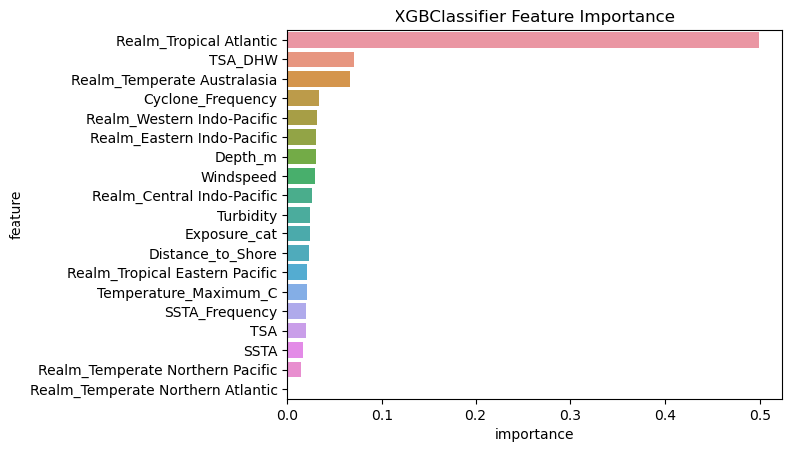
What are the best indicators?
Regions/Realms
Tropical Atlantic (Caribbean)
Australasia (Great Barrier Reef)
Thermal Stress Anomaly Degree Heating Week
How frequently a thermal anomaly occurred in the previous 12 weeks
Data Wrangling
EDA
Preprocess
Model
Future Development
Evaluation & Selection

Slide 11
Final Performance
Extreme Gradient Boost (XGBoost) with full features performed the best overall amongst all metrics, including the above cross validated F1, as well as checking for overfitting
 | Cross Validation mean F1-score | Cross Validation STD | Train/Test Score Differential
Decision Tree (full) | 0.8472 | 0.0064 | 0.1338
Decision Tree (reduced) | 0.8257 | 0.0018 | 0.1409
Random Forest (full) | 0.8978 | 0.0036 | 0.0883
Random Forest (reduced) | 0.8701 | 0.0030 | 0.1149
XGBoost (full) | 0.8987 | 0.0042 | 0.0817
XGBoost (reduced) | 0.8477 | 0.0091 | 0.1044
Data Wrangling
EDA
Preprocess
Model
Future Development
Evaluation & Selection

Slide 12
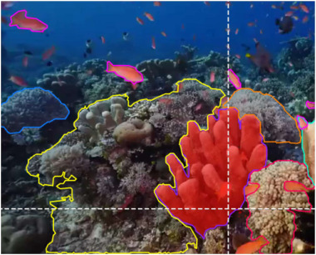
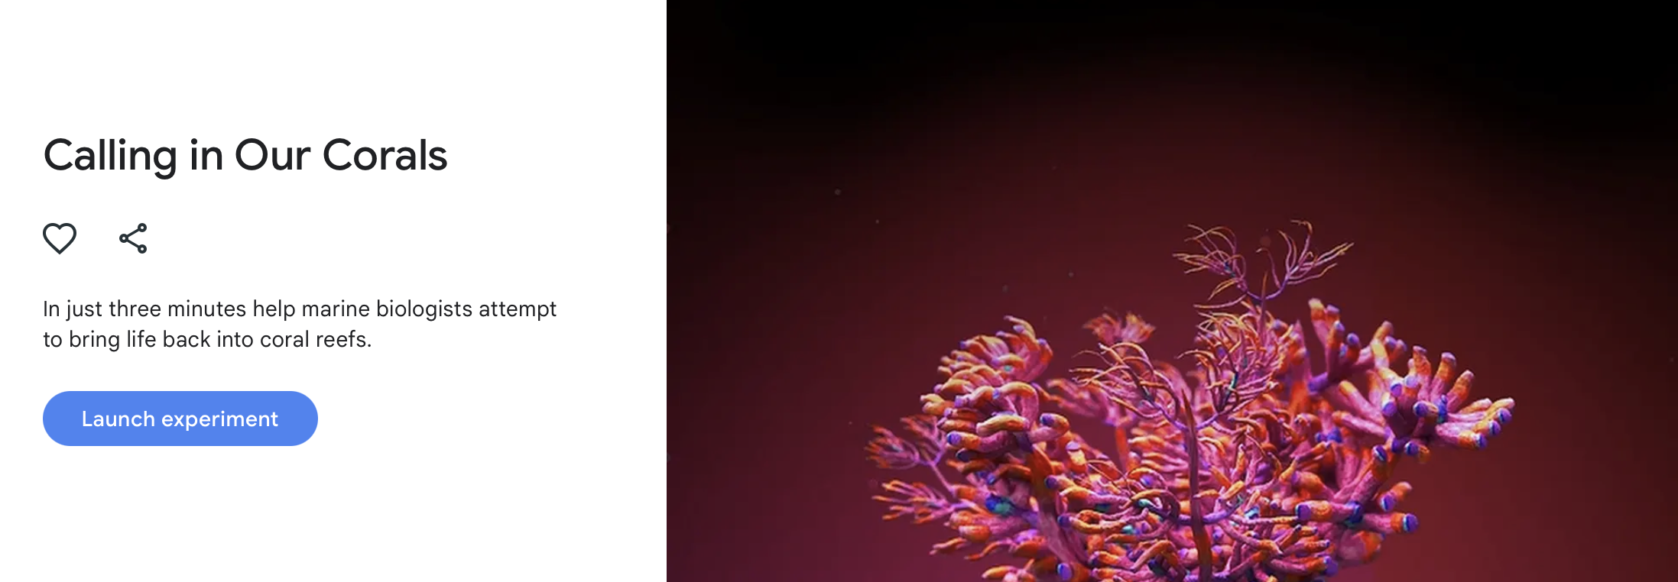
Future Developments
Improve current model:
Feature engineering to reduce the number of features
Unsupervised learning – uncover unseen clusters/patterns
Combine with other coral health data formats (images and audio)
Data Wrangling
EDA
Preprocess
Model
Future Development
Evaluation & Selection

Slide 13
Questions

