Slide 1
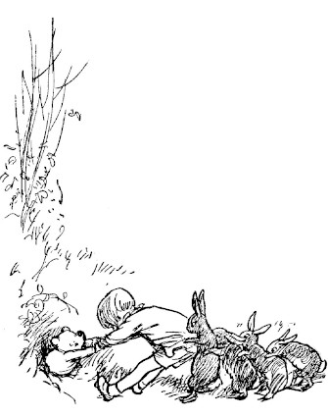
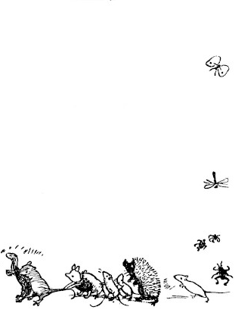
Winnie the Pooh Story Generator
November 2024

Slide 2
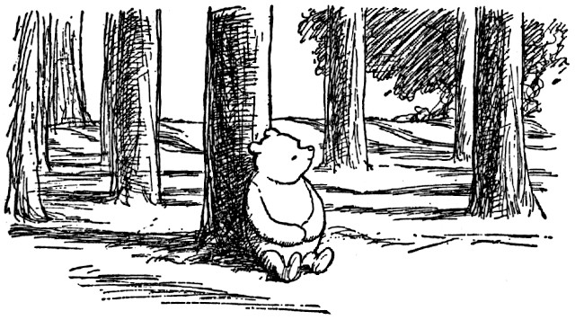
The Problem
Bedtime stories are an integral part of many children's routine
Some children – like my niece – become bored with the same stories repeated night after night
Solution:
Build a program that generates new, customized stories that are appropriate for young children and based on classic Winnie-the-Pooh characters.

Slide 3
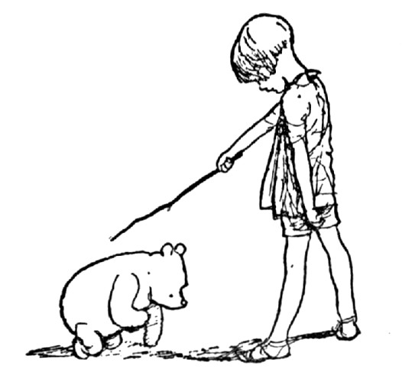
Approach & Components
Vector Database – Chroma DB
Sample texts embedded and stored
RAG Framework – DSPy
Retrieves context from database and generates story with LLM
Metric Evaluation – DeepEval
Define and evaluate readability score
User Interface – Gradio

Slide 4

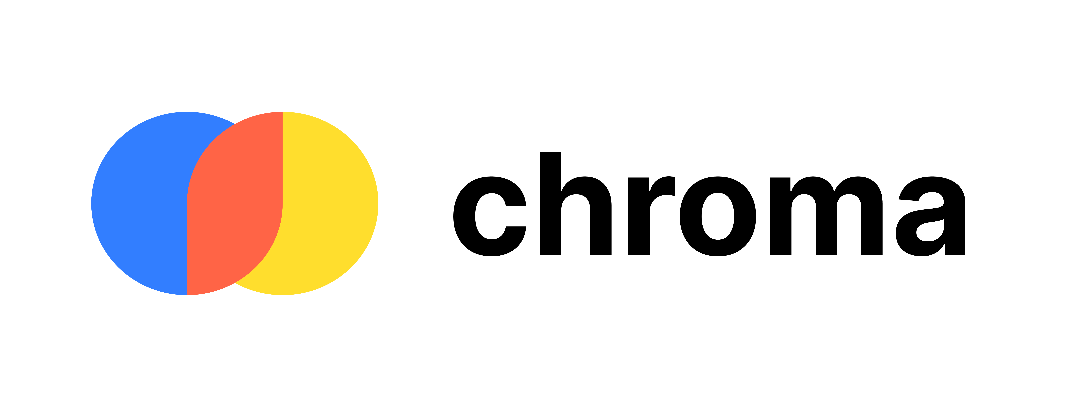

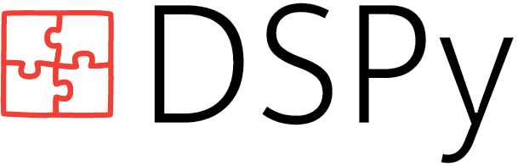

RAG Process Overview
Documents
(Winnie the Pooh texts)
Vector Database
context
RAG Framework
Signature:
name, prompt, context → story
Metric Evaluation
Readability Score
User Input
name & prompt
generated
story
User Interface
PASS
Final Story
FAIL – modify prompt

Slide 5
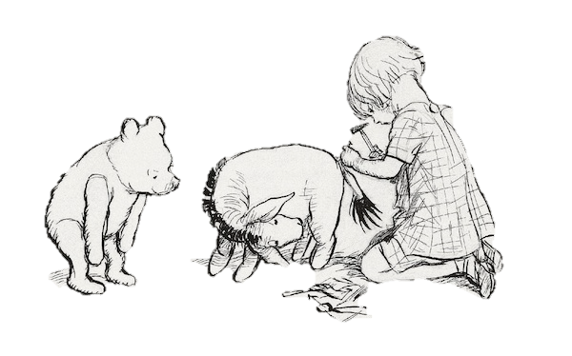
The Data
The original Winnie the Pooh text is in the public domain
Available on various digital libraries
Cleaning – remove whitespace and nonessential symbols, such as * and _
Split each story into chunks (200 char. length)
Langchain’s RecursiveCharacterTextSplitter
Save metadata pertaining to each chunk
Title, author, chapter , chunk #

Slide 6
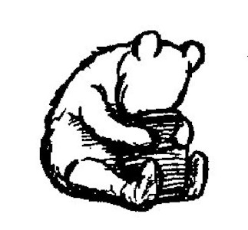
Vector Database (Chroma DB)
Default embeddings to vectorize text chunks
Sentence Transformers all-MiniLM-L6-v2
Querying DB → returns closest vectors by cosine similarity
Top 3 results from querying “honey”:
Chapter: 1, Chunk: 17, Cosine Distance: 1.084
… then he got up, and said: "And the only reason for making honey is so as I can eat it." So he began to climb the tree. He climbed and he climbed and he climbed …
Chapter: 5, Chunk: 29, Cosine Distance: 1.093
… so as not to hurt myself, and I would get to the Jar of Honey, and I should lick round the edges first of all, pretending that there wasn't any more …
Chapter: 5, Chunk: 51, Cosine Distance: 1.101
… A full jar, full of honey right up to the top, and it had HUNNY written on it, so that I should know it was honey. That's very funny.”…

Slide 7
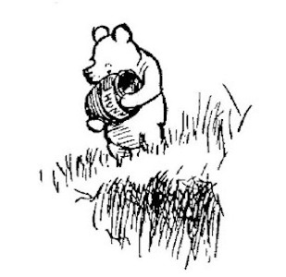
RAG framework with DSPy
OpenAI’s GPT-4o mini
Signature: GenerateStory
Inputs: name, prompt, context → Output: story
Name and prompt from user input
Context retrieved from the database based on prompt similarity
Module: StoryGenerator
ChainOfThought using GenerateStory signature
Returns generated story

Slide 8
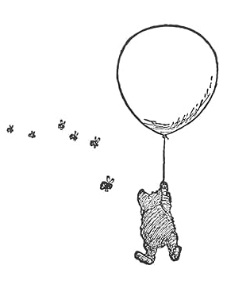
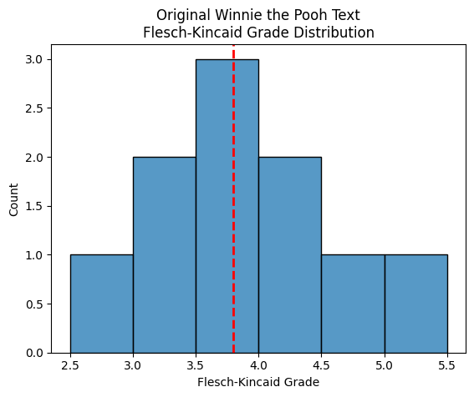
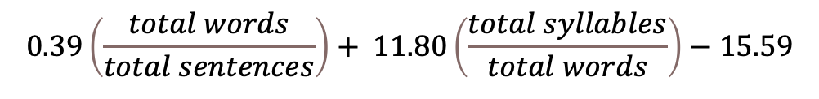
Readability Metrics
To generate text that is appropriate for children, a readability metric is necessary
Flesch–Kincaid readability test measures complexity based on word and sentence length:
Original Winnie the Pooh stories grade levels
Mean = 3.8
Standard Deviation = 0.8
$$0.39\left(\frac{total words}{total sentences}\right)+ 11.80\left(\frac{total syllables}{total words}\right)−15.59$$

Slide 9
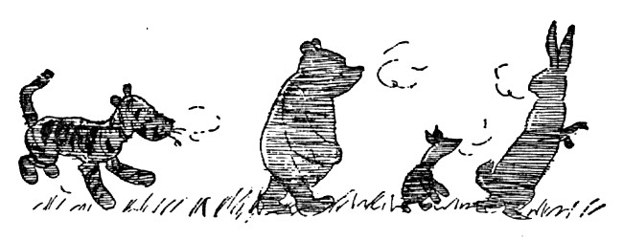
Evaluating LLM Results with DeepEval
Define new DeepEval class ReadabilityMetric
High and low thresholds to maintain a child-appropriate reading level
Target below 4.6 Flesch-Kincaid grade level (< original mean + 1 standard dev.)
If generated story fails to fall within the thresholds, modify prompt
“… use simple words and sentences”
Failing twice returns message to user to try a different story prompt
If passes metric, returns the generated story

Slide 10
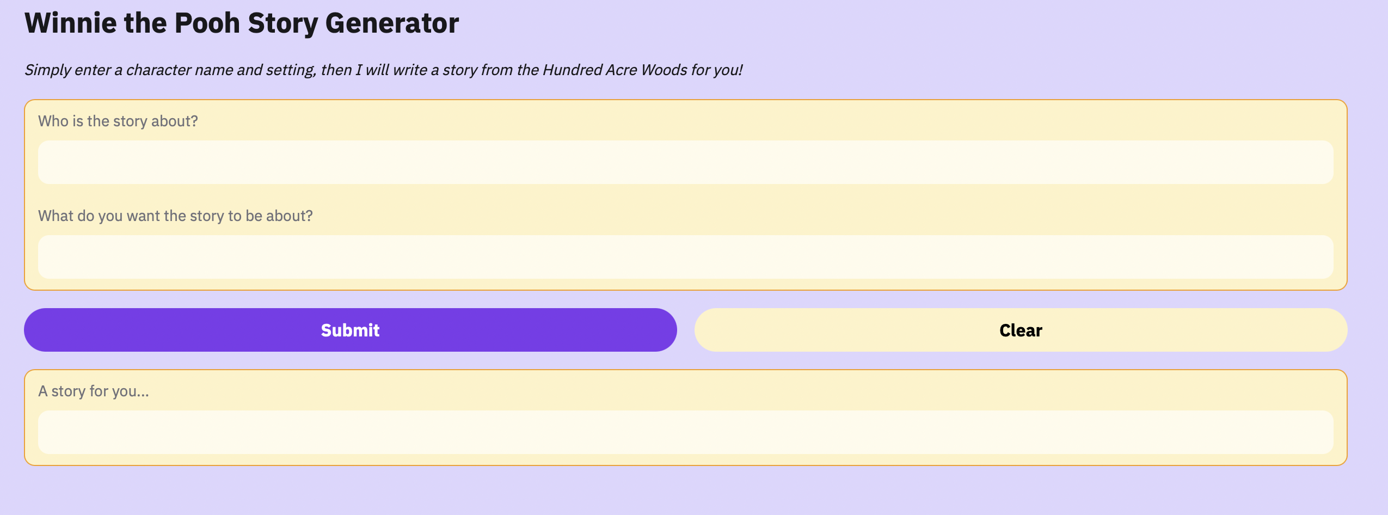
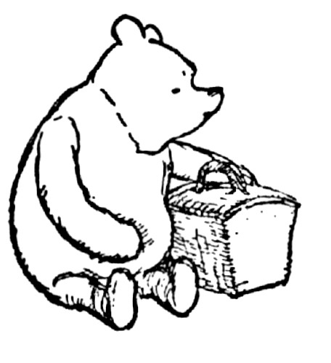
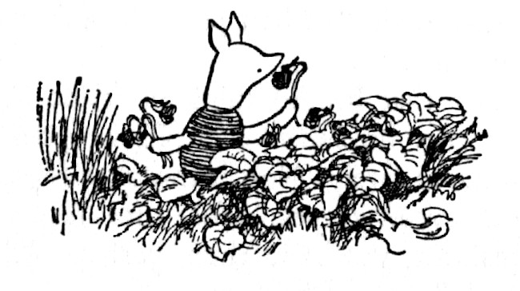
User Interface with Gradio

Slide 11
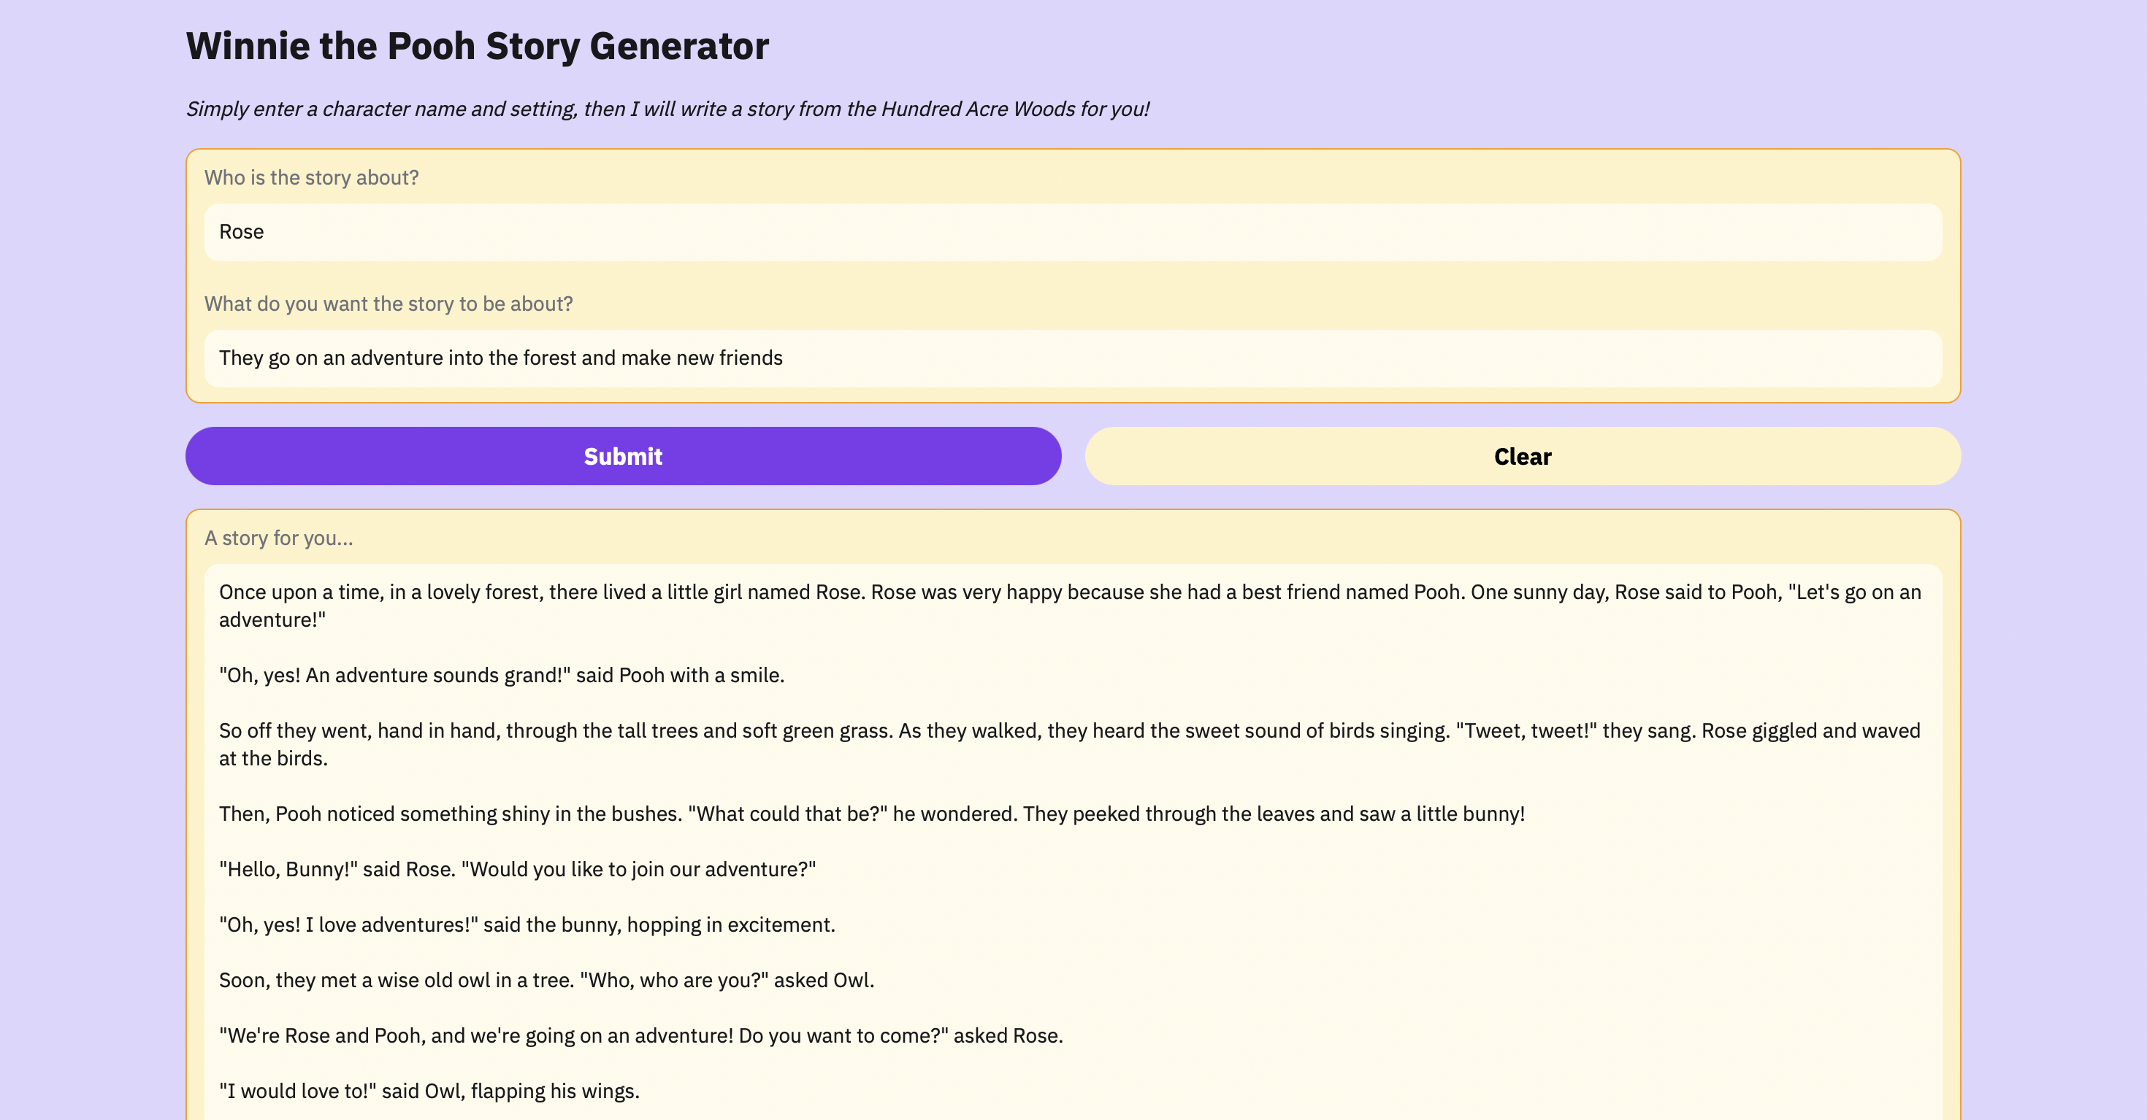
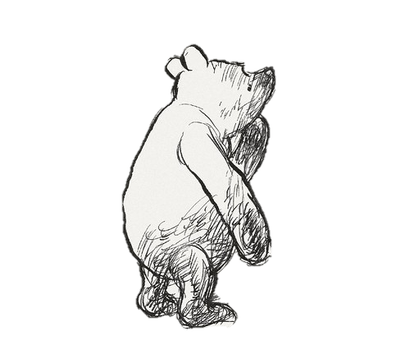
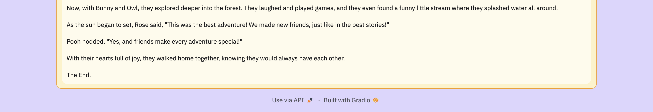

Slide 12
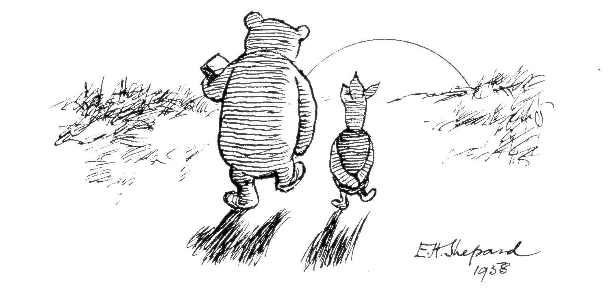
Thank you

