Slide 1
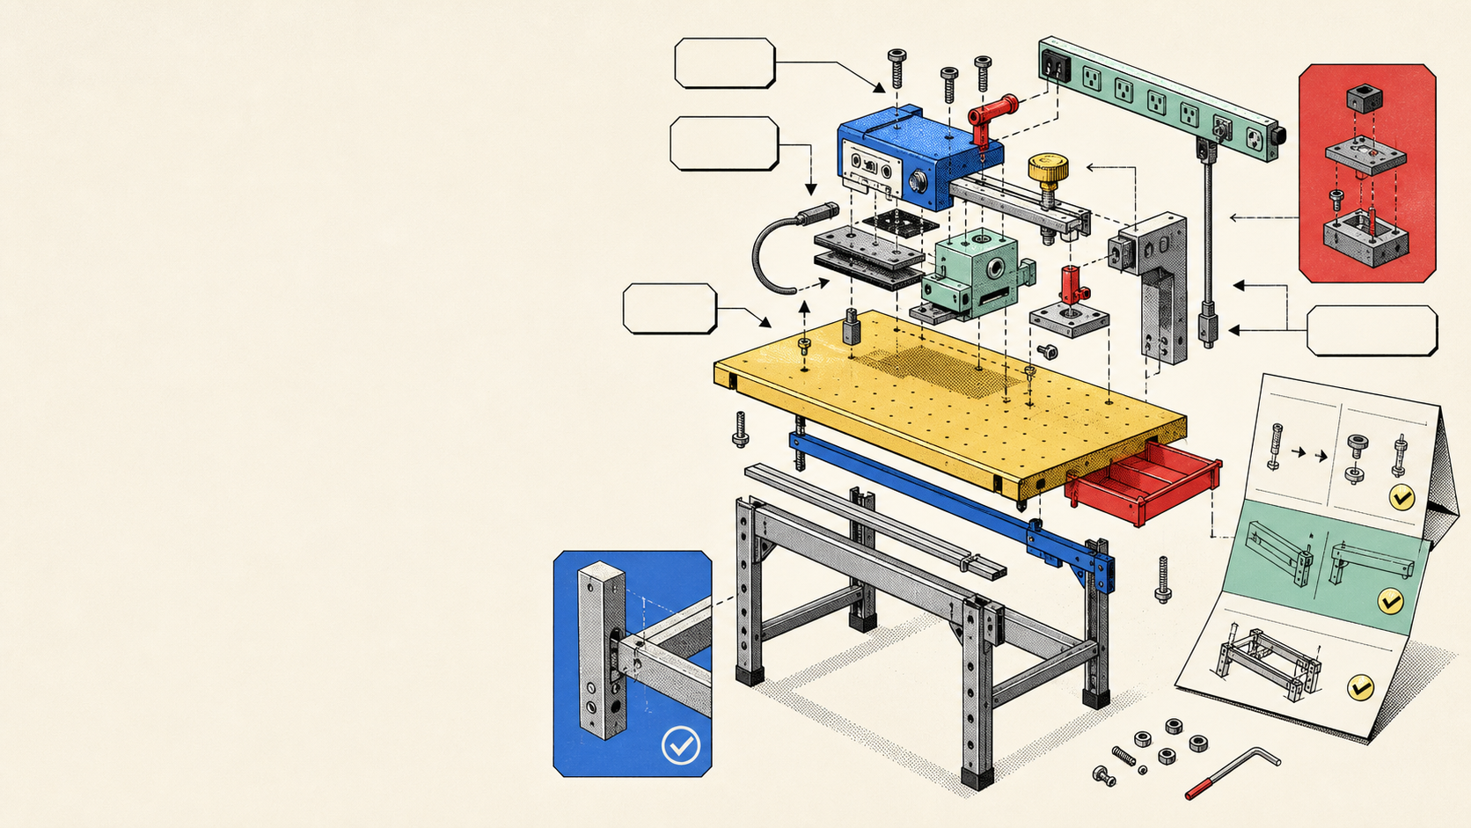
STARTUP PORTFOLIO PITCH DECK
Revolutionising Life Since 1982™
Five named product rails, one founder brand, and a practical Azure credit case for July and August launches.
Founder Above the Fold | FlatFinder | No More Hieroglyphics | Thrifty | Rube.works
July 2026
Notes:
Opening: position the deck as a founder portfolio and Azure workload case. Visual generated locally for this deck; no external logos or marks.

Slide 2
MISSION BOARD
One founder brand ties the launch bench together
The story is not four disconnected experiments. It is one operating system for turning messy real-life workflows into usable AI-native products.
A
B
C
D
Personal brand
Product bench
Launch window
Visible outcome
A long-running invention posture with a clear voice.
Apps, MCP rails, workflows, and manuals built together.
July products now; Rube.works follows in August.
Azure-backed products with measured launch tests.
Goal -> shared system -> visible launches -> credit-worthy growth workload
Revolutionising Life Since 1982™
02
Notes:
Narrative arc: personal brand to product portfolio to Azure workload. Uses AGENTS manual language: Mission Control Board.

Slide 3
BOX CONTENTS
The named product rails are ready to label
Each part has a launch slot and a practical job. Unknowns stay labelled until customer tests confirm them.
A
Founder Above the Fold
LinkedIn profile MCP app and app
B
FlatFinder Housing Revolutionized
Housing-search workflow, launching July 2026
C
No More Hieroglyphics
Legal gibberish to English translator
D
Thrifty
"I may be thrifty, but I'm not frugal."
Launching July 2026
E
Mega Awesome Agent Creator
Rube.works, a digital Rube Goldberg machine
Launching August 2026
F
Additional launches
Coming soon, with space left on the rail
Revolutionising Life Since 1982™
03
Notes:
User gave product names, launch timing, and Thrifty tagline. FlatFinder/Rube position is framed directly from names supplied by user.

Slide 4
PART A
Founder Above the Fold makes LinkedIn presence controllable
This is the most defined product today: a safe single-owner LinkedIn operating workbench that keeps posting, profile copy, voice, and analytics aligned.
Place
Lock
Inspect
Queue and schedule posts
Voice gate before launch
Profile drift stays manual
Draft posts move into a visible queue, then publish through permitted LinkedIn APIs when the owner has connected the app.
British English and Prototype Cafe voice rules check copy before it can be queued.
Headline, About, and Experience copy are tracked as canonical panels, with a clear manual paste flag.
NO SCRAPING
NO AUTO-DMS
NO PROFILE EDITS
OWNER-ONLY V1
Revolutionising Life Since 1982™
04
Notes:
Based on tasks/prd-dispatch-linkedin-mcp.md. LinkedIn safety boundaries are explicit: no scraping, no auto-DMs, no profile editing, no automating likes/follows/comments.

Slide 5
PART B
FlatFinder turns the housing hunt into an inspection loop
Working thesis: housing search gets less chaotic when every option can be captured, compared, checked, and followed up from one repeatable rail.
1
Capture
2
Compare
3
Test
Place listings, requirements, viewings, and notes into one housing workbench.
Align affordability, commute, availability, and fit so choices are not trapped in scattered tabs.
Turn the July launch into proof: can a user make a better shortlist faster?
Evidence label
Known now
Name and July 2026 launch timing are provided. Product mechanics should be validated through the first search workflow test.
Revolutionising Life Since 1982™
05
Notes:
Only the product name and July launch were provided. Product mechanics are framed as working thesis and validation target.

Slide 6
PART C
No More Hieroglyphics translates legal fog into English
This is the anti-gatekeeping rail: leases, contracts, terms, privacy policies, and other dense documents become readable enough to inspect before signing.
Insert
Inspect
Label
Documents in
Traps out
English, not legalese
PDFs, images, or pasted text can be placed into the tool for review.
Buried obligations, fee escalations, auto-renewals, arbitration, and ambiguity get flagged.
The product shows what the document says and what it means without gatekeeping.
NOT ATTORNEYS
NOT LEGAL ADVICE
PART OF FLATFINDER
Revolutionising Life Since 1982™
06
Notes:
Based on user correction plus /Users/hella.crypto/Documents/Claude/Projects/NMH/README.md. Avoid the user's forbidden gatekeeping phrasing; deck uses English.

Slide 7
PART D
Thrifty makes careful spending feel sharp, not small
The brand starts with a memorable line and a July launch slot. The product should make cost-conscious decisions feel designed, not apologetic.
"I may be thrifty, but I'm not frugal."
Working job
First test
Launch rail
Separate value from cheapness
Can people repeat the line?
July 2026
Thrifty can own the space between saving money and lowering standards.
The tagline is already sticky. The launch test is whether users understand the product promise underneath it.
Keep the first release narrow enough to ship, measure, and revise quickly.
Revolutionising Life Since 1982™
07
Notes:
Tagline supplied by user. Product shape remains a working positioning until launch collateral or prototype evidence exists.

Slide 8
PART E
Rube.works turns agent creation into a visible machine
Mega Awesome Agent Creator is the playful power tool: a digital Rube Goldberg machine for assembling agent workflows without hiding the mechanism.
Insert
Fasten
Test
Prompts and tools
Agent chain
Finished run
Users place templates, connectors, files, and actions onto a visible build rail.
The product locks steps together so a workflow can be inspected and repeated.
The machine runs, shows what happened, and leaves a manual panel behind.
RUBE.WORKS
AUGUST 2026
COMING NEXT
Revolutionising Life Since 1982™
08
Notes:
User described Mega Awesome Agent Creator / Rube.works as a digital Rube Goldberg machine launching next month. Current date context makes that August 2026.

Slide 9
POWER RAIL
One Azure backbone can power the whole bench
The products can share the same cloud pattern: web apps, databases, queues, storage, AI calls, monitoring, and cost controls.
Founder Above the Fold
FlatFinder
Shared rail
Azure cabinet
No More Hieroglyphics
Reusable platform
Credit-backed build room
Thrifty
Auth, app hosting, database, queues, file storage, AI inference, analytics, logs, and privacy controls.
A single measured environment can host prototypes, staging, launch traffic, experiments, and cost alerts.
Rube.works
Revolutionising Life Since 1982™
09
Notes:
Azure service mapping is a planning assumption, not a final architecture. It supports the grant/workload narrative without committing to untested services.

Slide 10
CREDIT CASE
The credit request is a runway and workload request
Microsoft should see the ask as practical: reduce launch friction, fund real AI/data experiments, and keep cost controls visible while the portfolio proves demand.
Why now
What credits unlock
Evidence guardrail
Multiple launches share one month
More tests before cash burn
Exact tier must be verified
July and August create real hosting, testing, data, and AI demand instead of a vague future infrastructure wish.
Credits buy room for staging, telemetry, AI-assisted workflows, privacy checks, and realistic launch traffic.
Microsoft public pages describe credits up to $150,000; review and referral paths affect the tier.
Ask for the highest eligible Azure credit path, not a promised amount.
Revolutionising Life Since 1982™
10
Notes:
Sources checked 2026-07-07: https://www.microsoft.com/en-us/startups and https://learn.microsoft.com/en-us/startups/microsoft-for-startups/application. Official pages state up to $150,000 in credits; no confirmed $250,000 public figure was found in this pass.

Slide 11
SAFETY STICKERS
Launch discipline lowers programme risk
The portfolio is strongest when it shows controlled build habits: privacy, consent, budget alerts, official APIs, and clear setup states.
1
Privacy and cookies
2
Official API rails
3
Build checks
Live public routes, consent setup, and plain setup states before production traffic.
Founder Above the Fold avoids scraping, unsafe LinkedIn automation, and hidden profile-edit claims.
Lint, typecheck, build, link checks, browser checks, and manual panels travel with each surface.
Manual rule
Every product ships with the manual beside it
The same pass that builds a feature must also produce the assembly panel, warning labels, and finished-build test.
Revolutionising Life Since 1982™
11
Notes:
Based on repo AGENTS instructions and docs/13-product-delivery-backlog.md launch-readiness contract.

Slide 12
FINISHED-BUILD TEST
July and August are the first proof rails
The next evidence is not more description. It is working links, measured usage, and a clean Azure setup that can scale without surprise bills.
July 2026
August 2026
Coming soon
Launch the July rails
Launch Rube.works
Leave the spare rail open
Founder Above the Fold, FlatFinder, Thrifty, and the FlatFinder-linked NMH surface move into public or beta-ready use.
Mega Awesome Agent Creator becomes the visible machine for assembling and testing agent workflows.
Additional launches can be added without derailing the deck or pretending all details are known today.
Disproving test: if users cannot complete the first workflow without live coaching, fix the product or the manual before scaling spend.
Revolutionising Life Since 1982™
12
Notes:
Uses IKEA beta-test rule: tester outside the domain, no live coaching, capture breakpoints, fix app/manual/expectation/access gaps.

Slide 13
THE ASK
Fit the Azure credit rail to the launch bench
Revolutionising Life Since 1982™ is ready to turn a crowded invention bench into measured software launches. The immediate need is credit support sized to the real workload.
Review the portfolio for the highest eligible Azure startup-credit path and pair it with architecture guidance, cost controls, and launch support.
Approve
Align
Open
Azure credits
Architecture
Partner path
Fund prototypes, staging, launch traffic, and AI/data tests.
Pick the first Azure services and clamp down cost alerts.
Check Microsoft startup, investor, Marketplace, or co-sell routes.
Revolutionising Life Since 1982™
Revolutionising Life Since 1982™
13
Notes:
Close with a concrete ask. Evidence gaps still to fill before application: legal startup name, primary website/domain, cost estimate, registered address, Microsoft account/Azure eligibility, and any investor referral code.

