Slide 1
DEV MVP RESULTS
AWS public change
alerting is working
RECORDED RUN
M1 closed
Captured
2026-08-29
Source revision
04370df
Public AWS announcements are matched against configured services and risk phrases, mapped to Slack routes, stored in DynamoDB, and delivered through SQS.
Public portfolio edition
Private account and channel details omitted
Repository results · public edition
© 2026 LILA BROOKS · APACHE-2.0
Notes:
This is AWS Public Change Alerting. I built it to match public AWS announcements against configured services and risk phrases, map each result to a Slack route, and deliver it through DynamoDB and SQS. This walkthrough records the dev MVP after the first milestone closed.
[Sources]
- /Users/lilabrooks/Documents/aws-public-change-feed/README.md
- /Users/lilabrooks/Documents/aws-public-change-feed/docs/GOAL.md

Slide 2
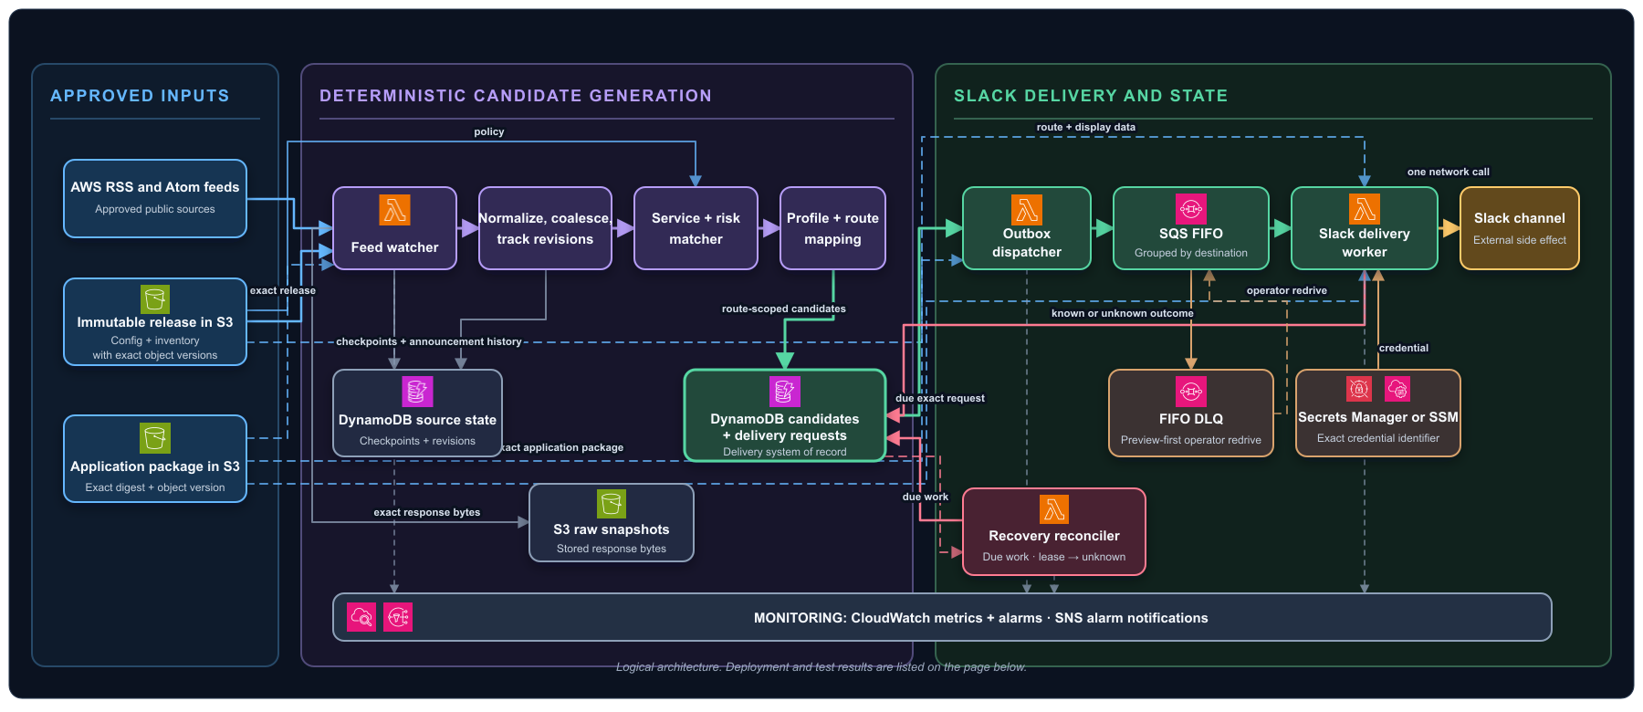
SYSTEM PATH
02
One announcement crosses the full path
Architecture source and export are checked for drift
© 2026 LILA BROOKS · APACHE-2.0
Notes:
Here’s the whole trip. A watcher reads approved RSS and Atom feeds, saves the raw response, and works out which service and risk rule fired. The candidate is tied to configured environments, then written to DynamoDB. SQS carries the delivery request to Slack, and the result comes back to the same DynamoDB delivery record.
[Sources]
- /Users/lilabrooks/Documents/aws-public-change-feed/site/architecture.svg
- /Users/lilabrooks/Documents/aws-public-change-feed/docs/assets/readme-overview.svg
- /Users/lilabrooks/Documents/aws-public-change-feed/README.md

Slide 3
DEPLOYED SURFACE
03
Four AWS runtimes share one delivery system
Feed watcher
Outbox dispatcher
Slack worker
Recovery reconciler
RSS + Atom acquisition
15-minute schedule
Due-work claim
1-minute schedule
SQS FIFO trigger
known outcome write
Lease repair
5-minute schedule
S3
DynamoDB
SQS FIFO
CloudWatch + SNS
releases · snapshots · packages
source · candidate · delivery
route ordering · DLQs
metrics · alarms · receipt
ENABLED TRIGGERS
PACKAGE DIGEST
STATE OWNER
SLACK TRANSPORT
4 enabled
same SHA-256 digest
DynamoDB
SQS FIFO
Live M1 state recorded in README; private console capture unavailable
© 2026 LILA BROOKS · APACHE-2.0
Notes:
Under that path are four small Lambda jobs. The watcher gathers and matches. The dispatcher claims due work. The Slack worker makes the network call. The reconciler picks up work that got stuck or became uncertain. They share one exact package, while DynamoDB owns the state and SQS owns ordering.
[Sources]
- /Users/lilabrooks/Documents/aws-public-change-feed/README.md
- /Users/lilabrooks/Documents/aws-public-change-feed/docs/architecture/specification/01-overview.md
- /Users/lilabrooks/Documents/aws-public-change-feed/docs/architecture/specification/05-security-and-operations.md

Slide 4
INFRASTRUCTURE AS CODE
04
Terraform separates persistent and exercise state
01
02
03
Bootstrap
Central
Preflight
ACCOUNT FOUNDATION
PERSISTENT DEV SERVICE
ISOLATED LIVE EXERCISES
Private versioned state bucket
Native S3 lockfile
Scoped S3 test identity
4 Lambda runtimes
2 DynamoDB tables
S3, SQS, EventBridge, CloudWatch
Separate tables, queues, logs, and alarms
Private Slack destination
Saved destroy plan
SAME IMMUTABLE APPLICATION PACKAGE
Central and preflight bind the same S3 VersionId and SHA-256 digest.
PERSISTENT ROOT
EXERCISE ROOT
STATE LOCKING
RUNTIME CODE
central
preflight
native S3
exact object version
Root boundaries: infra/bootstrap · infra/central · infra/preflight
© 2026 LILA BROOKS · APACHE-2.0
Notes:
I kept the infrastructure in three Terraform roots, each with a different job. Bootstrap owns remote state and its locking boundary. Central owns the persistent dev service. Preflight spins up an isolated copy for recovery and load exercises, points it at the same immutable package, then tears down against a saved destroy plan.
[Sources]
- /Users/lilabrooks/Documents/aws-public-change-feed/infra/bootstrap/main.tf
- /Users/lilabrooks/Documents/aws-public-change-feed/infra/central/locals.tf
- /Users/lilabrooks/Documents/aws-public-change-feed/infra/central/lambda.tf
- /Users/lilabrooks/Documents/aws-public-change-feed/infra/preflight/main.tf
- /Users/lilabrooks/Documents/aws-public-change-feed/docs/adr/024-isolated-live-runtime-exercises.md

Slide 5
MATCH QUALITY
05
The matcher passes its current promotion gate
47
1.000
1.000
labeled announcements
precision
recall
gate ≥ 0.950
gate ≥ 0.800
32 historical
15 synthetic
29
0
0
true positives
false positives
false negatives
Historical text comes from the runtime acquisition path.
CURRENT LIMIT
4 of 10 service/risk pairs have only 1–2 positives. More labeled historical examples are needed.
PROMOTION RESULT
SCORED PAIRS
CORPUS SIZE
GATE OWNER
pass
10 reported
47 items
repository promotion
Fresh run: make evaluate-corpus · thresholds from accepted ADR-018
© 2026 LILA BROOKS · APACHE-2.0
Notes:
Delivery only matters if the matcher is worth listening to. The current corpus has forty-seven labeled announcements: thirty-two historical and fifteen synthetic. This run produced twenty-nine true-positive service and risk pairs with zero false positives and zero false negatives. The global gate passes. Four of ten pairs still have only one or two positive examples, so that limit stays visible.
[Sources]
- /Users/lilabrooks/Documents/aws-public-change-feed/corpus/announcements.json
- /Users/lilabrooks/Documents/aws-public-change-feed/corpus/thresholds.json
- /Users/lilabrooks/Documents/aws-public-change-feed/scripts/evaluate_corpus.py
- /Users/lilabrooks/Documents/aws-public-change-feed/docs/adr/018-corpus-evaluation-and-matching-thresholds.md

Slide 6
CANONICAL CONTRACT FIXTURE
06
The candidate records why the item matched
ANNOUNCEMENT
ROUTE-SCOPED AUDIENCE
Amazon EKS Kubernetes version 1.34 available
3 configured environments
Acme · production
Amazon EKS now supports Kubernetes version 1.34 in all configured Regions.
Globex · production
MATCHED SERVICE
MATCHED TERM
Globex · staging
Amazon EKS
Kubernetes version
DECISION IDENTITY
RISK / PRIORITY
a9ba064df89aa4365e6fd3e4267c656678b6fcbf0605c2044d63f927ad88ee70
service-version-update · medium
FIXTURE TYPE
ROUTE
RELEASE
contract example
shared-alerts
880fb7af3388…
Canonical fixture · exact values committed in examples/alert-candidate.json
© 2026 LILA BROOKS · APACHE-2.0
Notes:
This is one candidate in full. You can see the original announcement, the exact service alias and phrase that matched, the route, and the three environments that may need review. The candidate ID commits those inputs, which makes a replay land on the same decision.
[Sources]
- /Users/lilabrooks/Documents/aws-public-change-feed/examples/alert-candidate.json
- /Users/lilabrooks/Documents/aws-public-change-feed/docs/architecture/specification/04-alert-processing.md
- /Users/lilabrooks/Documents/aws-public-change-feed/tests/test_identity.py

Slide 7
DELIVERY STATE
07
One request keeps its identity end to end
REQUEST
3caa23409f0af34d22d6200c67f6010a72486e5a521734659d46b08020582149
pending_queue
queued
sending
posted
DynamoDB
SQS FIFO accepted
worker lease
Slack success response
The candidate payload, release, application version, route, and destination key remain attached to the same request.
Known duplicates after posted make no Slack call. An ambiguous network outcome remains delivery_unknown for operator review.
CANDIDATE
REQUEST
FIFO GROUP
TERMINAL STATE
a9ba064df89a…
3caa23409f0a…
shared-aws-change-alerts
posted
State names and outcome rules come from the owned delivery contract
© 2026 LILA BROOKS · APACHE-2.0
Notes:
That identity stays with the delivery request. The dispatcher moves it from pending to queued. The worker claims a lease, makes the Slack call, and writes the outcome. When Slack returns a success response, the worker writes posted. An ambiguous result stays delivery unknown for an operator to examine.
[Sources]
- /Users/lilabrooks/Documents/aws-public-change-feed/examples/delivery-request.json
- /Users/lilabrooks/Documents/aws-public-change-feed/docs/architecture/specification/02-platform.md
- /Users/lilabrooks/Documents/aws-public-change-feed/docs/architecture/specification/04-alert-processing.md

Slide 8
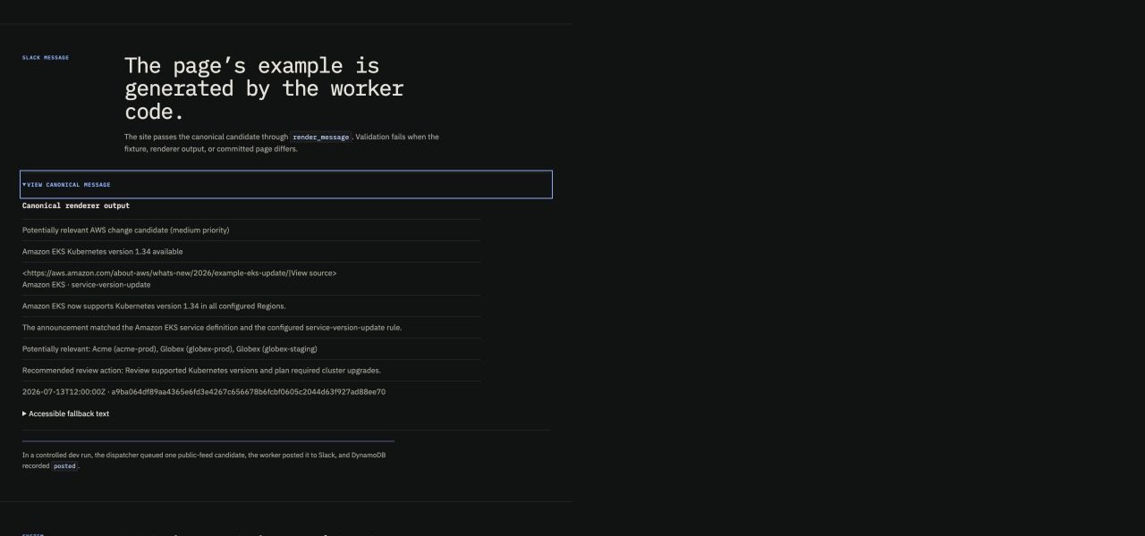
RECORDED DELIVERY RESULT
08
Slack accepted the cohort; DynamoDB recorded posted
12
recorded Slack posts
1 network attempt each
HTTP 200 response each
Live cohort result recorded in ADR-024. The message visual documents the exact renderer contract.
RENDERER-GENERATED CANONICAL MESSAGE
Private Slack channel capture omitted from the public edition
© 2026 LILA BROOKS · APACHE-2.0
Notes:
The panel on the left is the message generated by the real renderer. The live exercise is recorded separately: twelve posts reached Slack, each with one network attempt and an HTTP two hundred response. DynamoDB recorded posted for the same cohort.
[Sources]
- /Users/lilabrooks/Documents/aws-public-change-feed/site/index.html
- /Users/lilabrooks/Documents/aws-public-change-feed/docs/adr/024-isolated-live-runtime-exercises.md
- /Users/lilabrooks/Documents/aws-public-change-feed/README.md

Slide 9
RECORDED MVP RESULT
09
M1 closed on Slack, recovery, load, and alarm results
4
12
2
50
✓
runtime triggers
enabled
public-feed posts
reached Slack
recovery cases
passed
load messages
at 5 per minute
alarm email
confirmed
M2
Lifecycle, replay, and watcher or dispatcher correctness work
M3
Production policy, rollback proof, recovery objectives, and the final gate
The Slack, recovery, load, and alarm results close the dev MVP. Production readiness remains a later decision.
Status source: README project table · accepted ADR-024 · github.com/lilabrooks/aws-public-change-feed
© 2026 LILA BROOKS · APACHE-2.0
Notes:
So, what closed the milestone? Four runtime triggers were enabled. Twelve public-feed posts reached Slack. Both recovery cases passed. The isolated load run created fifty messages at five per minute, and the alarm email arrived. Those Slack, recovery, load, and alarm results close the dev MVP. Production readiness stays a later gate.
[Sources]
- /Users/lilabrooks/Documents/aws-public-change-feed/README.md
- /Users/lilabrooks/Documents/aws-public-change-feed/docs/adr/024-isolated-live-runtime-exercises.md
- /Users/lilabrooks/Documents/aws-public-change-feed/docs/architecture/specification/06-acceptance-and-generation.md

