Slide 1




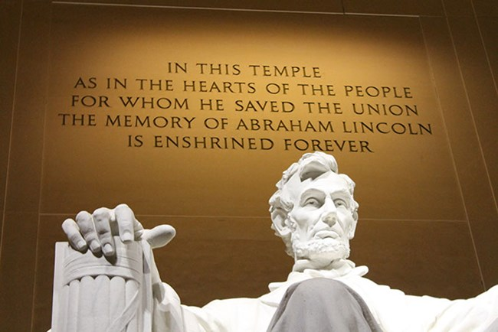



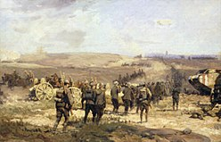
(a)
How many words is the writing behind the statue of the president who served with Vice President Hannibal Hamlin
24
Retrieval Plan
Multimodal Documents
Hannibal
Hamlin
Abraham Lincoln
Lincoln Memorial
Who is the president who served with Hannibal Hamlin?
Hannibal Hamlin served from 1861 to 1865, during President Abraham Lincoln's first term
In August 16, 1837, he wrote Owens a letter
The Lincoln Memorial is a U.S. national memorial honoring Abraham Lincoln
What the number of words for the writing written behind him?
Office | Name | Term
President | Abraham Lincoln | 1861-1865
Secretary of State | Willim Seward | 1861-1865
According to my vector search, I can only find that Abraham Lincoln wrote a letter to Owens!
How about using advanced reasoning in your retrieval process to locate the image of Lincoln’s Memorial?
Graph
Retriever
(b)
Was the Taifun rocket system used at the Battle of Amiens?
No
Retrieval Plan
Multimodal Documents
What battles were the Taifun rocket system used in?
Taifun Rocket
Shepard Fairey
Taifun (German for "typhoon") was a German World War II anti-aircraft unguided rocket system.
The Battle of Amiens was the opening phase of the Allied offensive, and happened during the World War I.
Is there Battle of Amiens in such battles?
I can’t find what such battles are! What are they?
How about adjusting your plan using retrieved components to retrieve more information about the Battle of Amiens first?
Graph
Retriever

