Slide 1
Tables and Figures
Figure 1: Map to measure energy/nutrient inadequacy for individuals and inequality using household survey data:
Based on age, sex, and life stage, with
Adjustments for bioavailability and retention factors
adjustments for activity level
4. Individual requirements
Energy
Nutrients
IOM (US/Canada)
WHO/FAO
Regional
START
1. Household Survey Data
Household Expenditure
Household Recall Diary
2. Food Composition Table
USDA Database
Regional Survey
Private data
5. Adult Equivalents (AE)
Ratio of individual energy or nutrient requirements to requirements for base individual
Pre-generated AE
Per capita
3. Reported household
consumption of
the nutrient
6. Individual_i’s Share (%)
= individual_i’s AE
sum of all household AE
8. Inadequacy Measure for Individual_j
8. Inadequacy Measure for
individual_i for
allocated nutrient consumption
7. Allocated individual
consumption of
the nutrient
9. Measure of inequality between individual_i and
individual_j
END

Slide 2
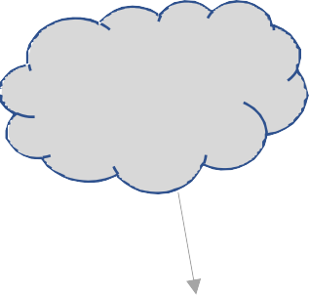
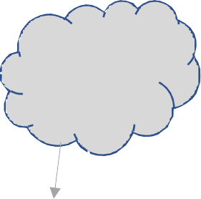

Figure 2: Map to measure energy/nutrient inadequacy for individuals and inequality staring with individual‐level survey data:
Adjustments for bioavailability and retention factors
Based on age, sex, and life stage, with adjustments for activity level
4. Individual requirements
Energy
Nutrients
IOM (US/Canada)
WHO/FAO
Regional (India)
1. Individual Survey Data
Individual Consumption Diary or Recall
Observed Food Weight Record
2. Food Composition Table
USDA Database
Regional Survey
Private data
START
8. Inadequacy Measure for Individual_j
3. Reported individual
consumption of
the nutrient
8. Inadequacy Measure for
Individual_i for
reported nutrient consumption
9. Measure of inequality between individual_i and
individual_j
END

