Slide 1
Fin Lit Quest
Hagglers
A Financial Literacy Game
Notes:
Victor

Slide 2
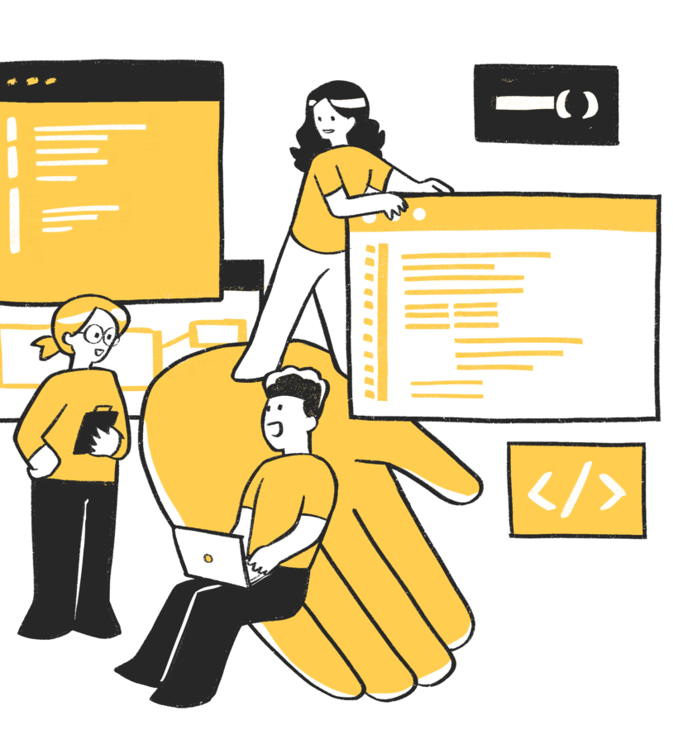
Teamup
Teamup is a non profit organization based in Texas focused on STEM education. This project is part of the Apps for Good program where students like us get hands on experience building real projects that solve real world issues.
Notes:
Victor

Slide 3
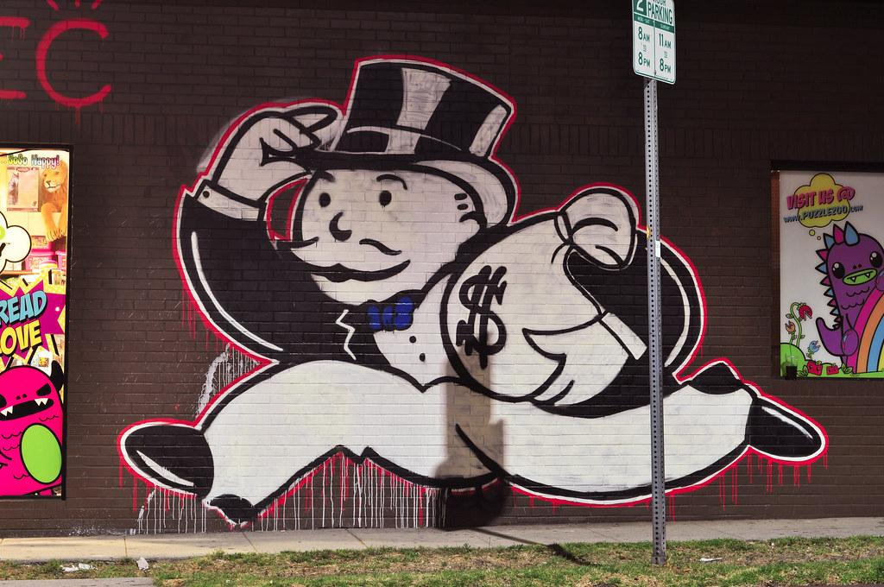
Financial Literacy
There are not many resources available for students to learn financial literacy.
Solution:
Gamifying financial literacy
Approachable
Simulated Practice
Gradual Increase in Complexity
Notes:
Griffith
The main problem our client provided is that there are not many resources for financial literacy:
Schools will rarely teach topics such as consumer finances and taxes
Most educational resources are focused on a specific practical application, such as taxes, rather than a holistic financial literacy education
Students are also often not very interested in financial literacy, especially if they have to learn these concepts on their own time
Our solution:
Create the financial literacy education that is missing, and fill this gap
Gamify the learning
Makes it approachable, and gives students a way to get interested to spend time on learning
It provides a low-consequence simulated environment where students can try different things, take risks, and experience failure without real-world consequences. This allows students to experiment more while learning and to not get stuck or stressed by the experience.
We can also provide a gradual increase in complexity as players progress through the game. This allows us to target a wider audience of players, as they can begin with a set of simple topics, and move on to more challenging ones after mastering the basics.

Slide 4
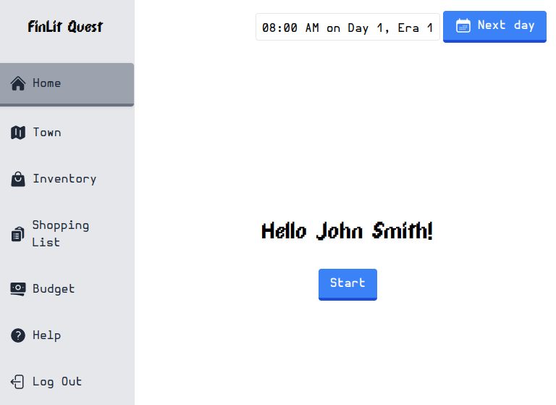
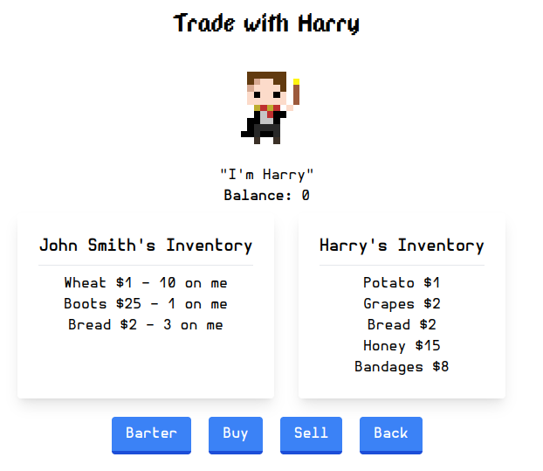
Introduction to the app
You are a farmer in a small town
Bartering to pay expenses
Collect enough to move to another town
Introduction of currency
Tutorial
Notes:
Griffith
On the player side, each player starts as a farmer in a small town. In this town, they have an income from their farm, and can barter with the local townsfolk. They will need to make successful trades for other goods to be able to pay certain recurring expenses, and will have a final goal of completing a shopping list to move to a new town. In this next town, the player will be introduced to currency, allowing them to purchase items instead of bartering them.
To give the players an introduction to the world and mechanics, they will first be provided with a short tutorial that walks them through taking actions and paying their expenses in the first town. If the players ever are unable to pay their expense, they will be shown a game over screen explaining how they lost, and given the opportunity to restart with a fresh set of items.

Slide 5
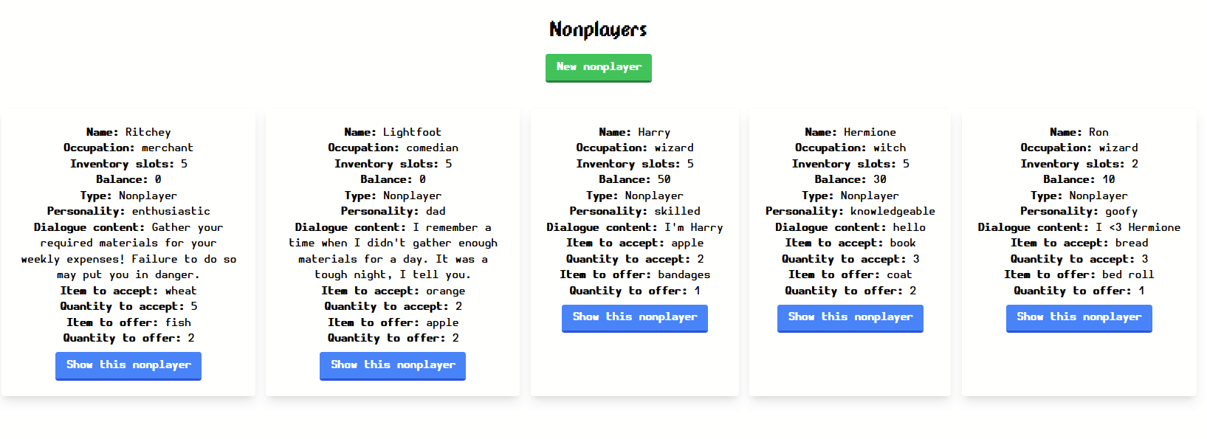
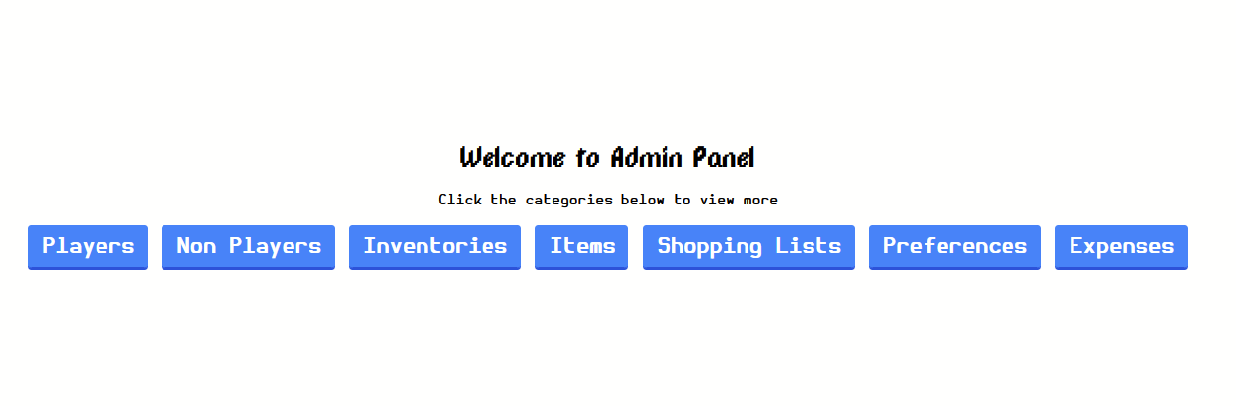
Introduction to the app
Admin privileges to add custom characters and items
Fix any inventory issues for players via admin portal
Notes:
Justin
The next part of the application that we created was non-user facing, a admin portal that are given to users with admin privileges.
All the routes that lead to these pages are protected to lock any non-privileged users out
With this, you are able to alter characters and items, add new characters and items, and fix any issues a player has - incase they are bugged, softlocked or something is wrong with their inventory.
Gives access to the admin to make changes on all aspects of the game.

Slide 6

Major Use Case: Intro to Finance
Young kids who have no financial knowledge
Introduction to basic concepts:
Trade
Currency
Value
Notes:
Jackson
Teaching the core of finance in general to a younger audience
Concept of money, and how it relates to bartering and the advantages it provides
The value of items differ from person to person, depending on need which drives trade

Slide 7


Major Use Case 2
Young Adults who would like to learn more about money management
Practice saving resources and only purchasing what's necessary
Understanding consequences of poor financial decisions
Notes:
Nick

Slide 8

Major Use Case 3
Education Curriculum Developers who would like to make a custom financial education game targeted towards their audience with our engine
We Provide:
Custom NPCs, dialogues, and professions
Custom items and value
Notes:
Stella

Slide 9
Design Decision 1
Keeping a simple pixel art style to not distract they user away from the goal of the game
Utilize basic colors such as blue green and red.
Blue for normal actions
Green for confirm/positive actions
Red for reject/negative actions
Use two fonts to distinguish between headers and normal body text.
DPComic for headers and important information
HermitFont for normal/body text
Notes:
Emmie
Since our app is going to be

Slide 10
Design Decision 2
Introduce each phase slowly and in a level gated way so that users can fully understand a concept before moving onto the next phase. Each in game day will require users to acquire certain resources to survive.
We implemented:
World 1: Users are limited to only trading goods for goods and they do not see the values of the items
World 2: Introduction of currently to the users and they can now see the value of how much each item cost
Notes:
Emmie

Slide 11
Future Plans
World 3: Banking and the ability to utilize debt, both good and bad
Introduce a banking system
Allow the player to take out different types of loans (auto, mortgage, etc.)
World 4 and beyond: Investing, advanced financial concepts
Introduce a market that allows players to invest in stocks
Allow players to purchase and sell futures to hedge risk as a farmer
Notes:
Jackson

Slide 12

Challenges
Getting used to a new programming environment
Making a “game” in ruby on rails with tests
Translating client requests into features
Pivoting from the clients original plans for the class
Splitting up tasks evenly and getting blocking tasks done quickly
Reading and fully understanding teammate’s code
Notes:
Justin
The first challenge we faced was learning a brand new programming environment that none of us had experience with. This meant learning how to include login features, a backend, and customizing the frontend.
Making a game while just using Ruby on Rails was also a challenge especially with it being a very unconventional way to develop a game. And including a Test driven development focus

Slide 13

Lessons
Get the whole team’s approval before adding a new library
Have frequent meetings with team so that everyone understands the tasks at hand and what is currently complete
Don’t let branches live for too long (2 developer days max)
Ask for help when stuck!
Notes:
Nick

Slide 14
Thank You!

