Slide 1
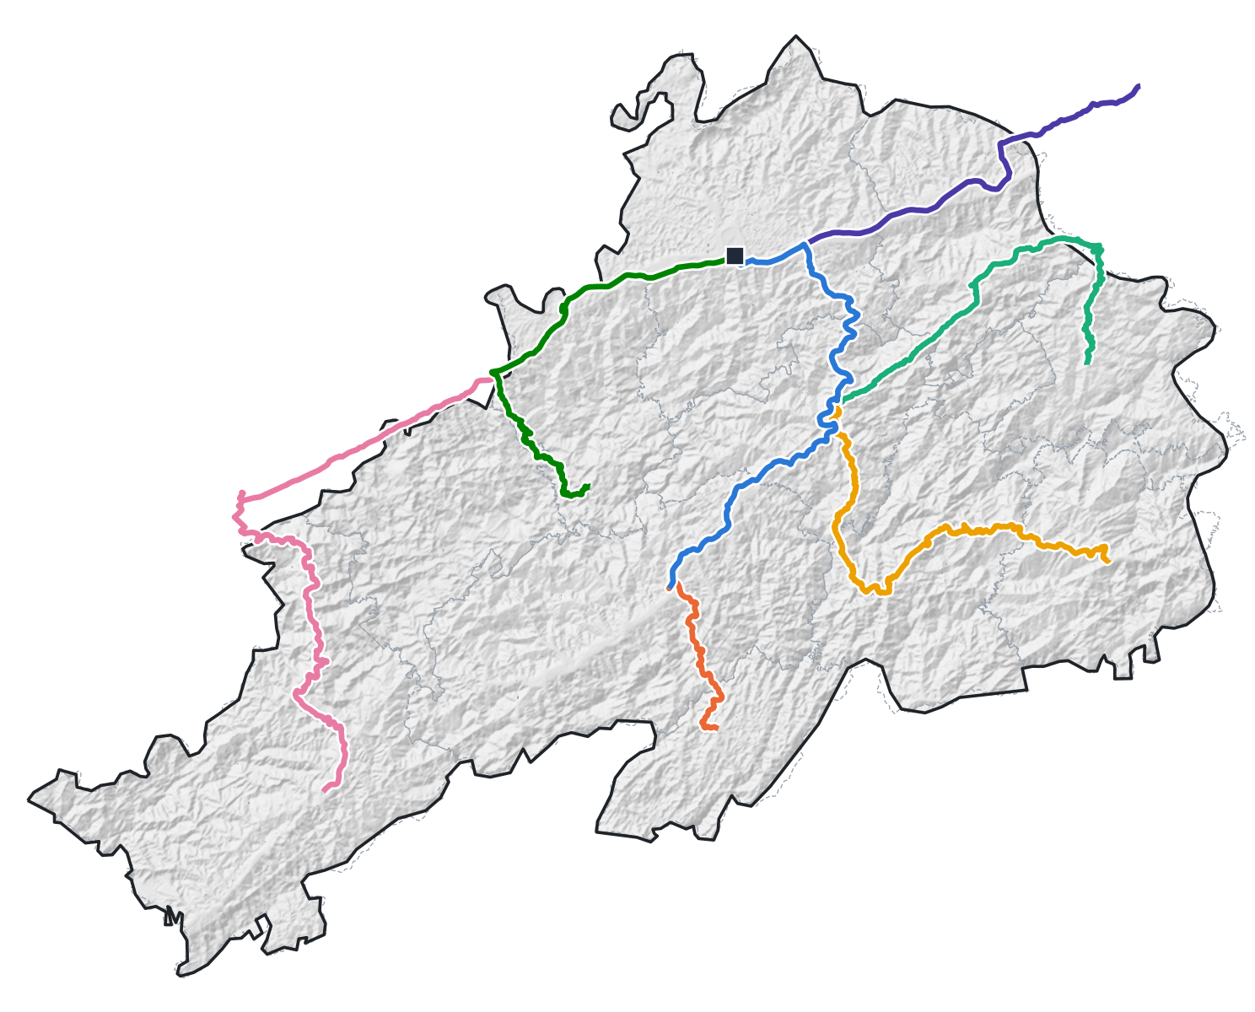
WORK IN PROGRESS · RESEARCH DESIGN
Research on Urban–Rural Public Transport in Xinhuang County
Run-level demand, overlapping calendar rhythms, and forecast-informed service planning in a mountainous county of western Hunan, China
Lilac
National University of Singapore
Seven urban–rural bus routes radiating from the county bus station (■), on terrain from Copernicus GLO-30 DEM
Notes:
Opening (≈30 s). This talk presents a research design, not results. I will first show the county and the data I have, then what the literature establishes and where it stops, and finally the framework and next steps. All model outputs you will see are synthetic tests of the method; real ledger results come after the methods are frozen on 1 January 2027.

Slide 2
OVERVIEW
From a local service problem to a testable research design
I
II
III
Study area and data
What prior research tells us
Framework and next steps
Xinhuang's seven radial bus routes
Terrain, periodic markets and access
Data in hand, data structure, public calendars
Six themes: consensus, methods, limitations
From prior practice to design choices
Five gaps → four research questions
Five-step research logic and how it evolved
Surveys, calendar factors, run-level model
Forecasting, service planning, timeline
Guiding question When rural calendar rhythms (school weeks, work weeks, holidays, Spring Festival) overlap, how much demand does each add to a single bus run — and how can forecasts of that demand make a fixed rural timetable more responsive?
Status: design stage. Every model result shown is a SYNTHETIC test of whether the method recovers known effects; no Xinhuang ridership results are reported yet.
Lilac · National University of Singapore · Urban–rural public transport in Xinhuang County
2 / 39
Notes:
Roadmap. Part I sets the empirical scene; Part II is the literature review organised by themes, each ending with how this study responds; Part III explains the framework, the reasoning behind it, and the work plan. Emphasise the status box: design stage, synthetic tests only.

Slide 3
I
I Study area and data
II What prior research tells us
Study area and data
III Framework and next steps
Where the problem sits: a mountainous border county, seven radial routes, and the data assembled so far.
3 / 39
Notes:
Part I: the county, its bus service, spatial access, and the data in hand.

Slide 4
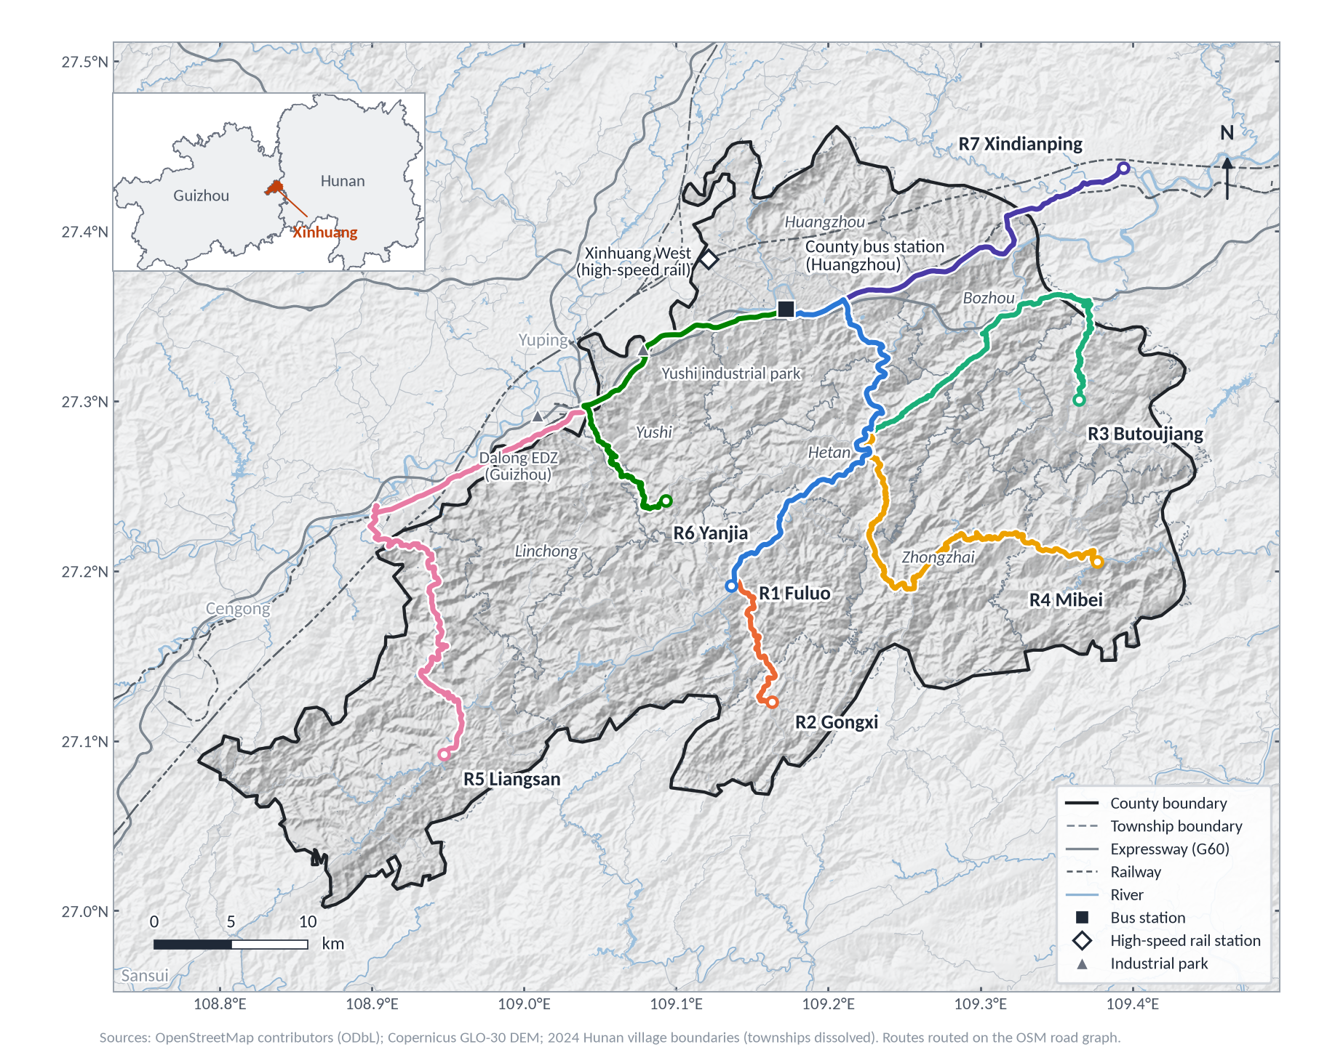
I · STUDY AREA
Xinhuang: a mountainous border county served by seven radial routes
≈1,500 km²
Xinhuang Dong Autonomous County, western Hunan, bordering Guizhou
11 + 1
townships plus one forest farm; 145 administrative villages
≈244,700
residents (WorldPop 2020 model estimate — not a census count)
7 routes
all radiating from the county bus station in Huangzhou, 26–61 km long
136 runs/day
one-way scheduled runs; hail-and-ride, no stop-level counts
Lilac · National University of Singapore · Urban–rural public transport in Xinhuang County
4 / 39
Notes:
The county sits on the Hunan–Guizhou border, on the Shanghai–Kunming high-speed railway and G60 expressway. All seven rural routes start at the county bus station in Huangzhou; R5 to Liangsan runs partly through Guizhou. Population is a WorldPop model estimate used only for sampling weights, not a census figure.

Slide 5
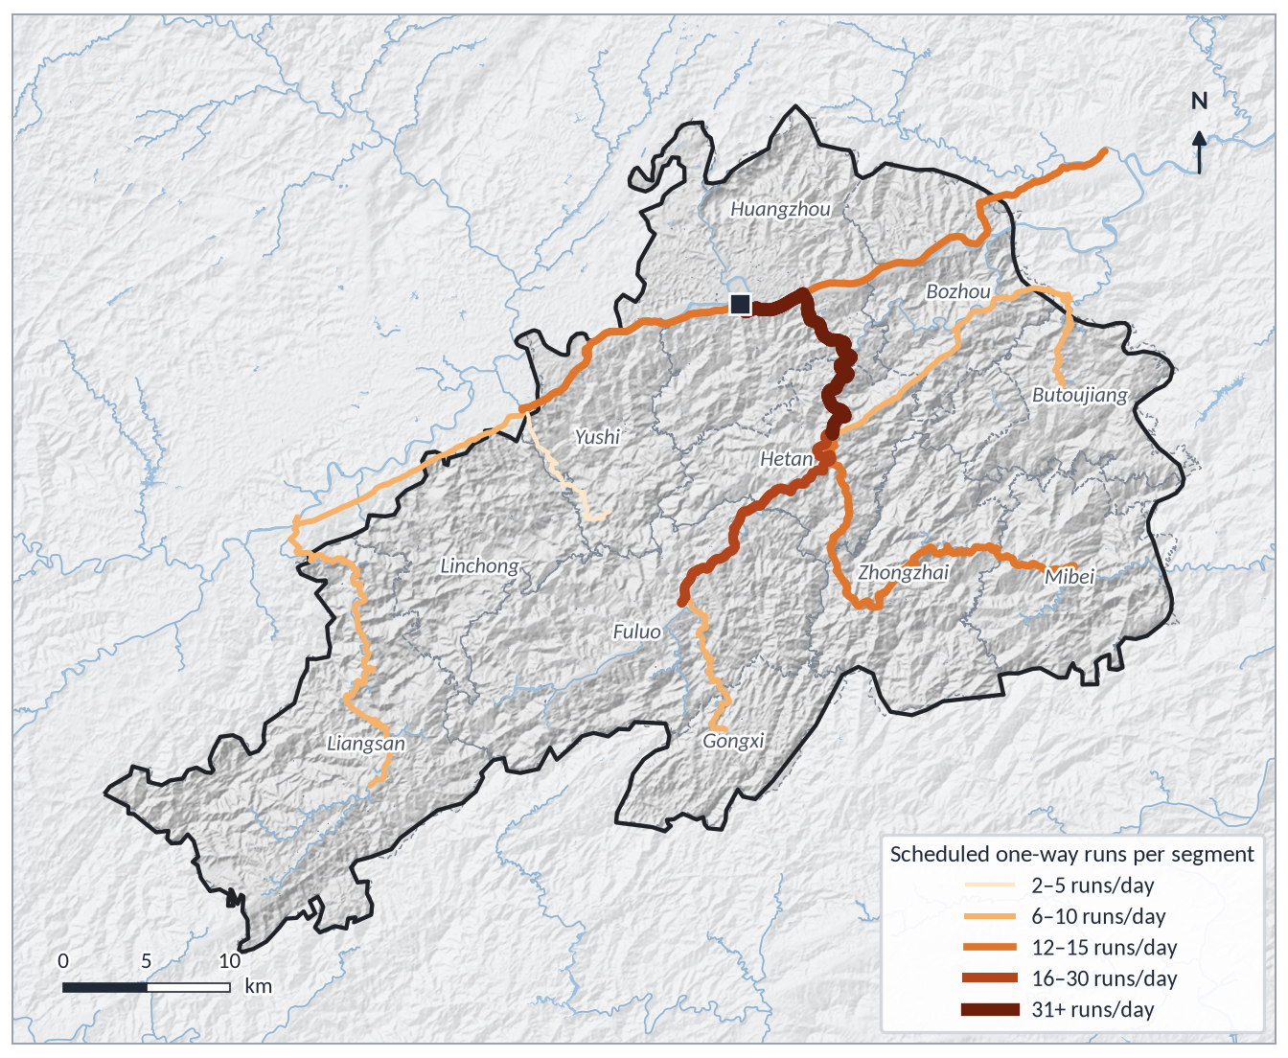
I · CURRENT SERVICE
A fixed timetable that thins out quickly beyond the trunk corridor
Route | Terminus | km | Drive min | Runs/day* | Outbound first–last | Inbound first–last
R1 | Fuluo | 33 | 45 | 13 | 7:00–17:00 | 7:00–17:00
R2 | Gongxi | 45 | 58 | 10 | 6:50–16:30 | 7:00–16:00
R3 | Butoujiang | 46 | 74 | 6 | 8:00–16:00 | 6:30–14:30
R4 | Mibei | 50 | 79 | 12 | 7:00–16:00 | 6:10–15:00
R5 | Liangsan | 61 | 95 | 10 | 7:10–16:20 | 6:30–15:00
R6 | Yanjia | 27 | 47 | 2 | 10:30–15:30 | 6:50–12:30
R7 | Xindianping | 26 | 34 | 15 | 6:40–16:30 | 7:00–17:00
* one-way runs per day in each direction. km and drive time from Gaode Maps; timetable from the operator's route document.
WHAT THE TIMETABLE ALREADY SHOWS (TO BE VERIFIED IN SURVEYS)
Supply is concentrated: the 17-km Huangzhou–Hetan trunk carries 41 runs/day (R1–R4 overlap); branch ends see 2–10.
Early last buses into town: on 4 of 7 routes the last inbound run leaves by 15:00 (R6 by 12:30), so an afternoon trip to the county town is impossible.
Same-day round trips are constrained by outbound last runs at 15:30–17:00.
Data grain: the ledger records total boardings per one-way run — no stop-level boardings, no origin–destination.
Scheduled one-way runs per road segment. This is supply, not demand: who fills these runs, and when, is what the ledger and surveys must reveal.
Lilac · National University of Singapore · Urban–rural public transport in Xinhuang County
5 / 39
Notes:
Read the table right to left: the red inbound last-run times are the most visible service gap. The map shows segment supply: the shared trunk to Hetan has 41 runs a day, while branch ends such as Yanjia have two. This is supply, not demand; the ledger and surveys tell us who fills these runs and when.

Slide 6
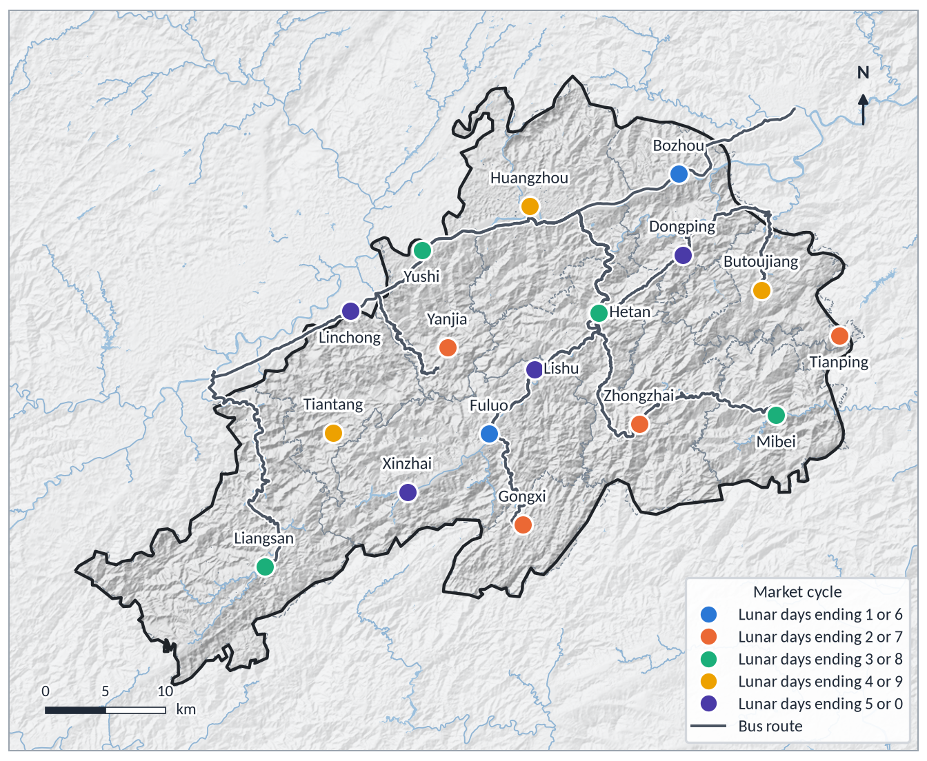
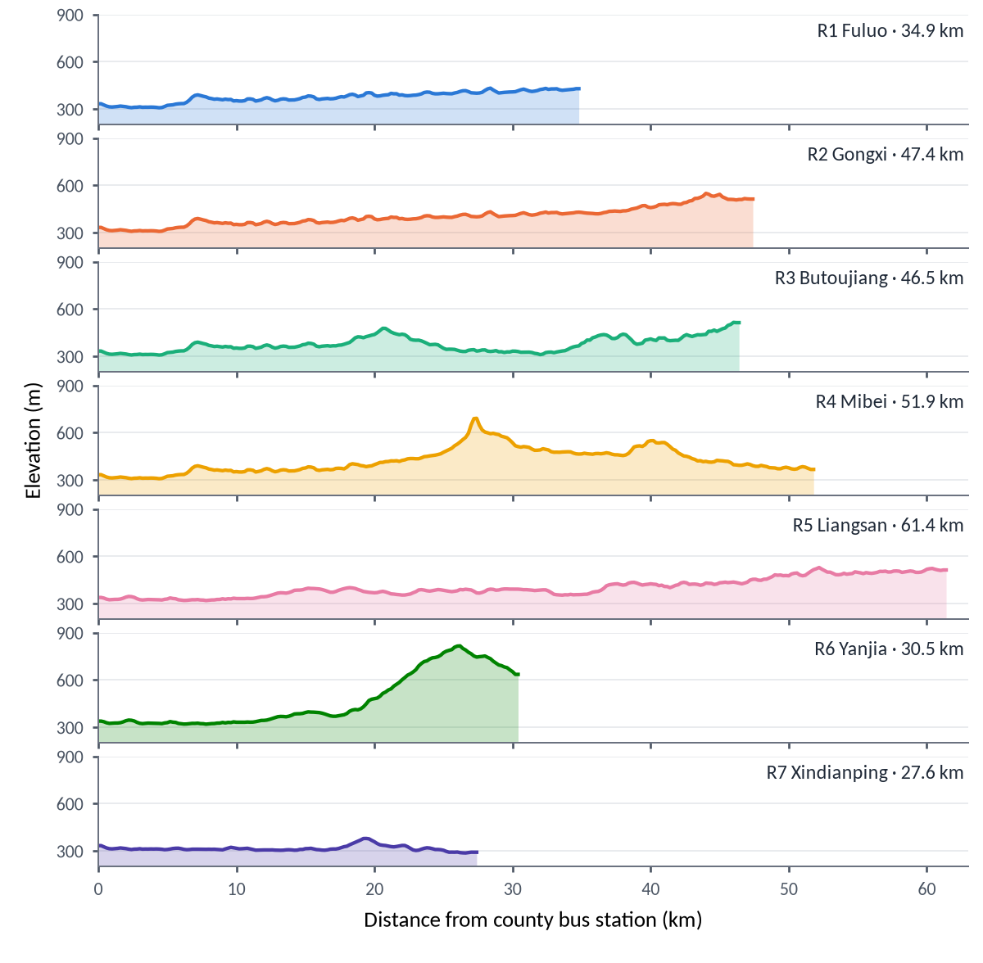
I · SPATIAL CONTEXT
Terrain and periodic markets shape when and how villagers travel
Route | Climb m | Curvy % | km/h
R1 | 419 | 1 | 44.0
R2 | 613 | 1 | 46.6
R3 | 672 | 16 | 37.3
R4 | 762 | 18 | 38.0
R5 | 667 | 7 | 38.5
R6 | 576 | 28 | 34.5
R7 | 191 | 0 | 45.9
Cumulative climb, share of km in tight-curve sections, and navigation speed (v4 route analysis). Curvy, climbing routes are where on-board fieldwork observed motion sickness — now recorded per run (item Z4).
17 MARKETS ON A 5-DAY LUNAR CYCLE
Neighbouring markets are staggered, so on every lunar day some route has a market within 2 km (R2: all ten day-digits; R7: four). Market days therefore enter the model as a route-specific baseline control, not as a core driver.
Elevation along each route (Copernicus GLO-30 DEM, 200 m sampling)
Lilac · National University of Singapore · Urban–rural public transport in Xinhuang County
6 / 39
Notes:
Two spatial rhythms. Left: 17 periodic markets meet on lunar days ending in a fixed pair of digits; neighbouring markets are staggered. Because some market is always open along some route, market days are modelled as a route-specific control. Right: R6 climbs to about 800 m and R3/R4 have many tight curves; summer fieldwork observed motion sickness on long routes, which the survey now records.

Slide 7
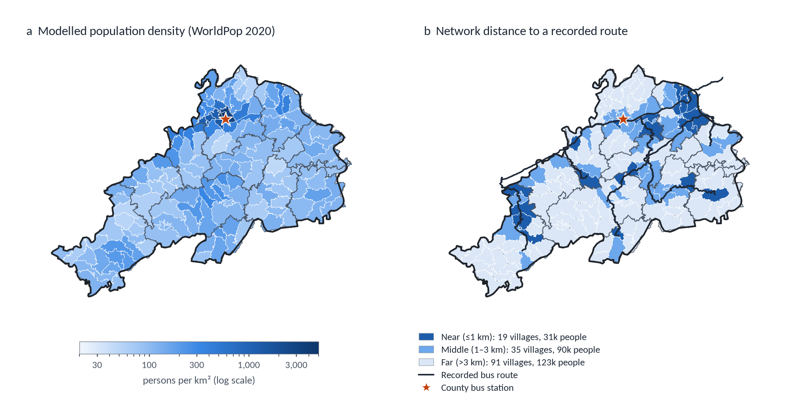
I · ACCESS
Half of the modelled population lives >3 km by road from a recorded route
13%
Near (≤1 km)
19 villages · 31k people
37%
Middle (1–3 km)
35 villages · 90k people
50%
Far (>3 km)
91 villages · 123k people
CAVEATS BUILT INTO THE DESIGN
“Recorded routes” = alignments confirmed so far; the route list will be checked with the operator.
Network distance includes a snap segment, so strata lean “far”: 88% of villages keep their stratum without it, 69% with straight-line distance.
Sampling stays unbiased (known inclusion probabilities); access models will densify the road graph and report all three definitions.
Villages are the 2024 Hunan administrative-village polygons (145). Population: WorldPop 2020, 1 km, UN-adjusted, summed per village.
Implication: much rural demand never reaches the ledger. Unmet demand must be measured in villages, stratified by access.
Lilac · National University of Singapore · Urban–rural public transport in Xinhuang County
7 / 39
Notes:
Left: density is concentrated in Huangzhou. Right: 91 of 145 villages, about half of the modelled population, are more than 3 km by road from a recorded route. The distance definition matters, and I report its sensitivity. The household survey is designed around these three access strata.

Slide 8
I · DATA
Data assembled so far — and what each source can and cannot tell us
Source | Content and grain | Coverage / status | Role
Run-level ridership ledger (county bus station) | Total boardings per one-way run: date × route × direction × departure. No stop-level or OD data. | Exploration: 1 Jun 2024–30 Sep 2026 (852 days). Sealed test: Oct 2026–Feb 2027, released only after methods are frozen. | Outcome for S2–S5
Timetable and seat capacity | 7 routes, 136 one-way runs/day → 115,872 run slots on the real calendar | Timetable in hand; per-run seat counts to be confirmed | Sampling frame; censoring threshold
Public calendar | Holidays & make-up workdays, lunar calendar, Spring Festival window, school terms, gaokao | Daily, Jun 2024–Feb 2027; each date graded by source reliability | Five calendar factors + controls
Weather | Precipitation and max. temperature in each run's time window; forecasts | Public reanalysis / station data | Control; forecast input
GIS | 145 village polygons (2024), WorldPop 2020, OSM roads & facilities, GLO-30 DEM | Assessed file by file; townships rebuilt from villages | Sampling frame, access, maps
Summer on-board survey | Passengers aged ≥16 on sampled runs | Completed 15 Jul–31 Aug 2026 | RQ1; linked to runs
Survey instruments (next waves) | 4 questionnaires from a 47-item bank in 13 indicator groups | Designed (v5); pre-test pending | RQ1, RQ4, diagnostics
Literature base | 250 English studies (incl. 25 method papers); 10 verified Chinese journal papers | Screened and depth-coded; CNKI search pending | Part II
Deliberately excluded: industrial-park shift rosters, hospital clinic schedules and macro market cycles — they cannot be obtained reliably day by day. If they matter, their effect falls into weekday or residual terms (a stated limitation).
Lilac · National University of Singapore · Urban–rural public transport in Xinhuang County
8 / 39
Notes:
The ledger is the backbone: one row per one-way run with the total number of people who boarded. Note the split into an exploration period and a sealed test period that I will not open until the methods are frozen. Every other source either explains runs (calendar, weather), frames sampling (GIS), or measures what the ledger cannot see (surveys).

Slide 9
I · DATA STRUCTURE
Three keys link every source: run key, date, and village code
Ridership ledger
one row = one one-way run (y = total boardings)
On-board questionnaires
item Z1 records the run key; rider type (A3)
RUN KEY
date × route × direction × scheduled departure
Timetable & seat capacity
run slots; effective capacity C = κ × seats
Boarding/alighting tally sheet
turnover κ, full-bus denials, under-16 counts
run date
Calendar factors
S, W, T, R, CY + weekday, market day
DATE
one row per calendar day
Weather
precipitation in run window; forecasts
survey dates (H2–H4, O5–O6)
Household survey (H0)
30 sampled villages; unmet demand, reasons
GIS village frame
population, network distance, access stratum
VILLAGE CODE
statistical division code of 145 villages
Online survey (O2)
home village; holiday return timing
Boarding places (A1, A12)
place names matched to village codes
Lilac · National University of Singapore · Urban–rural public transport in Xinhuang County
9 / 39
Notes:
The data model is deliberately simple. Everything about a bus run joins through the run key; everything about days through the date; everything about places through the village code. No personal identifiers are used for linkage. Summer 2026 questionnaires without departure times are matched to the nearest scheduled run within ±15 minutes, otherwise used at route × day level.

Slide 10
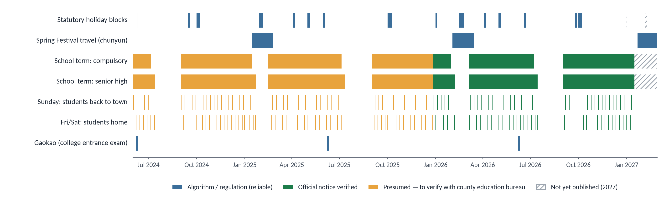
I · PUBLIC CALENDARS
Most demand drivers can be known days in advance from public calendars
RELIABLE BY RULE
NEEDS VERIFICATION
NOT YET PUBLISHED
Statutory holidays and make-up workdays (State Council notices), lunar calendar, Spring Festival travel window, gaokao dates.
School terms before December 2025 are presumed from provincial practice and must be confirmed with the county education bureau and the three county-town secondary schools.
2027 winter-vacation and holiday dates. Winter survey strata are drawn now for planning and re-drawn with the same random seed once dates are announced.
Lilac · National University of Singapore · Urban–rural public transport in Xinhuang County
10 / 39
Notes:
This is the real calendar, not synthetic. Blue items are fixed by regulation or algorithm; green school terms are verified from official notices; orange ones are presumed and flagged for verification. Because the drivers are known ahead, the same variables serve both explanation and 1–7 day forecasting.

Slide 11
II
I Study area and data
II What prior research tells us
What prior research tells us
III Framework and next steps
Six themes. For each: what is established, which methods are used, what remains unresolved — and how this study responds.
11 / 39
Notes:
Part II. The literature is organised in six themes that follow the research chain: riders and surveys, drivers, unit of analysis, overlapping factors, forecasting, and service design.

Slide 12
II · EVIDENCE BASE
How the evidence base was built
ENGLISH LITERATURE (OPENALEX, 26 SEP 2026)
CHINESE-LANGUAGE SUPPLEMENT
33 structured queries across four themes
1,650 records
7 compliant retrieval routes (no access controls bypassed): OpenAlex 16,448 + Crossref 8,800 records → 12,565 unique.
Concept tagging (bus · rural · calendar time · method): 140 A-tier, 284 B-tier; 21 in core journals.
10 papers verified against publisher pages (e.g., Progress in Geography, Human Geography, J. Highway & Transportation R&D).
Finding: none studies run-level ridership of county urban–rural buses — within publicly reachable sources.
Pending: seven CNKI search strings, run under an institutional account, before conclusions are final.
De-duplication
1,423 records
+ 84 previously read core studies
1,507 screened (301 without abstracts)
Rule-based pre-screen → full manual review; 378 relaxed-rule recalls re-read, 86 kept
Included (25 of them method papers retrieved separately)
250 studies
By theme: surveys & rider groups 48 · drivers 44 · forecasting 68 · service design 90; 60 explicitly rural or low-demand.
Rule vs. manual agreement was low (Cohen's κ = 0.41, recall 0.46), so rules only narrowed reading; inclusion was decided manually.
METHOD SOURCES
Traced to originals and DOI-checked: interaction scale, GA2M, boosting, ridge, demand unconstraining, GAMLSS, forecast reconciliation, chance constraints, SAA, integrated population models.
Lilac · National University of Singapore · Urban–rural public transport in Xinhuang County
12 / 39
Notes:
Transparency about the evidence base. The English corpus came from OpenAlex with manual screening; rules were too weak to trust alone. The Chinese supplement used only compliant routes; the honest conclusion is limited to what is publicly reachable, and a CNKI search is still required.

Slide 13
II · THEME 1 OF 6 · RIDERS AND SURVEYS
Who rides rural buses — and what surveys can and cannot see
WHAT IS ESTABLISHED
Rural riders are concentrated among older adults, students, car-less and low-income households; trips serve health care, shopping, school and errands. [1–3]
Survey mode decides who is visible: household surveys reach non-riders; on-board surveys tie answers to a specific run. [4]
Non-response is selective (frequent travellers are hard to reach) but can be partly corrected by calibration weighting / raking. [5, 6]
METHODS IN USE
On-board intercept, household and online surveys; mixed-mode designs need checks for mode effects. [4, 6]
Rider typologies from smart-card regularities or latent-class analysis; satisfaction and service-quality scales. [7]
LIMITATIONS AND UNRESOLVED PROBLEMS
Surveys are used to describe riders; their results rarely enter ridership models, and counts rarely calibrate surveys.
Suppressed demand — trips not made for lack of a suitable bus — is invisible in boarding data. [8]
Long attitude batteries overload older respondents on moving, winding buses (satisficing). [9]
KEY STUDIES BEHIND THE SYNTHESIS
[1] Pucher & Renne (2005) Transportation
Rural mobility and mode choice from the 2001 US NHTS: rural households are highly car-dependent; those without cars are disadvantaged.
[2] Berg & Ihlström (2019) Social Sciences
Public transport matters for everyday activities of rural residents without car access (Sweden).
[3] Yang & Cherry (2016); Espeland & Rowangould (2024) TPT; JTG
Rural riders skew older and lower-income; rural travel burdens and unmet need in the US.
[4] Stopher & Greaves (2007); Newmark (2014) TR-A; JPT
Household vs. transit-agency (on-board) survey practice and coverage.
[5] Kuhnimhof, Chlond & Zumkeller (2006) TRR
Non-response and selectivity bias in travel surveys.
[6] Deville & Särndal (1992); Kolenikov (2014) JASA; Stata J.
Calibration estimators; raking (iterative proportional fitting).
[7] Kieu, Bhaskar & Chung (2014) QUT ePrints
Passenger segmentation by travel regularity from smart-card data.
[8] Church, Frost & Sullivan (2000); Lucas (2012) Transport Policy
Transport and social exclusion: activities forgone for lack of transport.
[9] Krosnick (1991) Appl. Cognitive Psychology
Satisficing under cognitive burden degrades survey answers.
[10] Schaub & Abadi (2011) J. Ornithology
Integrated population models: counts and individual data share one likelihood.
→ HOW THIS STUDY RESPONDS
Surveys and ledger share a run key. On-board rider-type counts enter the joint model as a multinomial likelihood — used to diagnose the model's decomposition (idea borrowed from integrated population models [10]). Household surveys measure non-riders' unmet demand. Behaviour questions replace Likert batteries; on-board interviews are capped at 5 minutes.
Lilac · National University of Singapore · Urban–rural public transport in Xinhuang County
13 / 39
Notes:
Theme 1. Consensus on who rides and on survey modes is strong. The gap is the disconnect: surveys describe, ledgers count, and the two rarely meet. My response is to join them by the run key and to reserve the household survey for what no ledger can see: trips that never happened.

Slide 14
II · THEME 2 OF 6 · DEMAND DRIVERS
What drives ridership: weather, seasons, holidays — and rural rhythms
WHAT IS ESTABLISHED
Weather is the best-studied driver: rain and cold reduce ridership, non-linearly, varying by place, season and trip purpose; non-urban evidence is scarce. [1–5]
Ridership carries layered seasonality — weekly, annual and holiday cycles superimposed. [6]
Holidays and the Spring Festival reshape mobility strongly, with clear spatio-temporal structure — measured at inter-provincial, inter-city or metro scale. [7–9]
METHODS IN USE
Holiday dummies in regression; group-mean comparisons; seasonal decomposition; day-of-week effects. [1, 6]
LIMITATIONS AND UNRESOLVED PROBLEMS
One holiday dummy treats a 3-day Qingming break like the 8-day National Day break, and ignores direction (out before, back after).
Weekly commuting is absorbed by day-of-week dummies: the model fits “Friday”, not “students going home”, and fails when school is out.
Periodic markets are studied for trip satisfaction, not run-level ridership; weekly student and worker commuting is not studied as a driver. [10, 11]
KEY STUDIES BEHIND THE SYNTHESIS
[1] Guo, Wilson & Rahbee (2007) TRR
Weather and Chicago bus/rail ridership; weekends and off-peak react more.
[2] Singhal, Kamga & Yazici (2014) TR-A
Hourly subway ridership in New York: weather effects differ by time of day and day type.
[3] Arana, Cabezudo & Peñalba (2014) TR-A
Smart-card study: rain and wind cut trips, especially leisure trips.
[4] Wei (2021); Wei & Liu (2022) JTG; TBS
Non-linear, threshold-like rainfall effects (“how wet is too wet?”).
[5] Stover & McCormack (2012) JPT
One of few non-urban studies: weather and bus ridership in Pierce County, WA.
[6] Kashfi, Bunker & Yiğitcanlar (2015, 2016) JTG
Complex seasonality plus weather in suburban daily ridership.
[7] Liu, Shi & Chen (2020); Huang, Liu & Zhao (2019) IJGI
Spring Festival changes metro, bus and taxi use in Shenzhen.
[8] Li et al. (2016); Wang et al. (2014); Zhou et al. (2020) Sustainability; arXiv; IJGI
National Spring Festival migration traced with big data.
[9] Zhao Z. et al. (2017, 2022) Progr. Geography; Human Geography (in Chinese)
Inter-provincial Spring Festival flows; festival inter-city travel.
[10] Hong, Liang & Zhu (2024) Front. Public Health
Rural periodic-market trips: satisfaction and road environment.
[11] Schönfelder & Axhausen (2010) Ashgate
Stable weekly and annual travel rhythms that differ between groups.
→ HOW THIS STUDY RESPONDS
Encode drivers as explicit, directional calendar factors built from public sources: boarding-student weekly commute (S), worker weekly commute (W), term start/end surges (T), holiday return trips graded by cultural importance × length (R) and Spring Festival travel (CY). Weather, weekday and market day stay as baseline controls.
Lilac · National University of Singapore · Urban–rural public transport in Xinhuang County
14 / 39
Notes:
Theme 2. Weather and seasonality are well studied in cities; Spring Festival studies are about national migration or metro systems. What is missing for a county like Xinhuang are the recurring, directional rhythms — boarding students and weekly commuters — and a finer treatment of holidays by importance and length.

Slide 15
II · THEME 3 OF 6 · UNIT OF ANALYSIS
Days and stations dominate the evidence; decisions are made per run
WHAT IS ESTABLISHED
Most ridership studies analyse network or line daily totals, station counts or cross-section loads. [1–4]
Short-term forecasting targets urban metro or bus stations at minute-to-hour resolution with LSTM-type models, in China as elsewhere. [1–5]
Station or section counts cannot simply be converted to whole-run totals; smart cards enable urban OD and segmentation. [6, 7]
Rural demand estimates are mostly annual or cross-sectional, driven by population and land use. [8]
METHODS IN USE
Count regression (Poisson, negative binomial) for small, over-dispersed counts; demand unconstraining when capacity censors observations. [9, 10]
LIMITATIONS AND UNRESOLVED PROBLEMS
Daily totals hide within-day contrasts: a full Friday-afternoon run and an empty morning run average out.
Supplementary runs are decided per run, yet evidence comes per day or per stop.
Moving to runs brings small counts and censoring: a full bus records its capacity, not its demand.
KEY STUDIES BEHIND THE SYNTHESIS
[1] Zhang, Chen & Shen (2019) IEEE Access
Cluster-based LSTM for short-term metro passenger flow.
[2] Han, Wang & Ren (2019) IJGI
Hybrid optimised LSTM for short-term bus passenger flow.
[3] Liyanage, Abduljabbar & Dia (2022) J. Urban Management
Neural networks for bus demand from smart-card data.
[4] Alexandre, Bernardini & Viterbo (2023) TRR
Systematic review of machine learning for bus transport.
[5] Xie et al. (2018); Li G. et al. (2019) in Chinese
IC-card and LSTM station-level forecasting in Chinese cities.
[6] Ma, Ai & Zhang (2018) J. Highway & Transp. R&D (in Chinese)
Estimating bus cross-section flows under incomplete information.
[7] Egu & Bonnel (2020) TR-A
OD matrices from fare data vs. surveys in Lyon.
[8] Painter et al. (2007); TRB (2013) TRR; TCRP Report 161
Rural demand forecasting from population and land use.
[9] Jang (2005) J. Transportation Engineering
Count-data models for trip generation.
[10] Weatherford & Pölt (2002) J. Revenue & Pricing Mgmt
Unconstraining censored demand improves forecasts and revenue.
→ HOW THIS STUDY RESPONDS
Unit = total boardings on one one-way run. Negative binomial counts with a censored likelihood (full bus ⇒ demand ≥ seats × turnover κ); daily totals are sums of runs. Real calendar evidence: boarding-student and worker commutes share 189 days but zero runs, so run-level VIFs are 1.28 versus 3.7 and 5.9 for daily totals.
Lilac · National University of Singapore · Urban–rural public transport in Xinhuang County
15 / 39
Notes:
Theme 3. The literature is rich at the level of days and stations but the operator's decision is a run. That choice creates two statistical problems — small counts and censoring — which have established tools. And the real calendar shows why the run level matters: two commuting groups that are inseparable in daily totals are perfectly separated by direction.

Slide 16
II · THEME 4 OF 6 · OVERLAPPING FACTORS
When peaks coincide: interaction, scale and identifiability
WHAT IS ESTABLISHED
Calendar effects are usually estimated one factor at a time; co-occurring factors are treated as controls. Whether two peaks add, amplify or offset is rarely an estimand in transport research.
Whether an interaction exists depends on the scale: no interaction on the multiplicative (log) scale implies interaction on the additive scale, and vice versa. [1]
METHODS IN USE
Log-linear count models with interaction terms: coefficients live on the ratio scale. [2]
Additive (passenger-count) models: directly operational, but need non-negativity and are harder to fit.
Gradient boosting + SHAP; explainable boosting (GA2M) with pairwise shape functions. [3–5]
Shrinkage (ridge) and distributional regression (GAMLSS) for many or unstable parameters. [6, 7]
LIMITATIONS AND UNRESOLVED PROBLEMS
A main-effects log model assumes effects multiply, which itself creates additive-scale interaction.
SHAP splits effects arbitrarily among correlated factors and gives no intervals; GA2M ignores censoring and collinearity.
No approach first checks whether the data can identify an interaction at all.
KEY STUDIES BEHIND THE SYNTHESIS
[1] VanderWeele & Knol (2014) Epidemiologic Methods
Tutorial on interaction: additive vs. multiplicative scales.
[2] Jang (2005) J. Transportation Engineering
Poisson / negative binomial models for trip counts.
[3] Friedman (2001) Annals of Statistics
Gradient boosting machine.
[4] Ke et al. (2017) NeurIPS
LightGBM: efficient gradient-boosted trees.
[5] Lou, Caruana, Gehrke & Hooker (2013) KDD
GA2M: intelligible models with pairwise interactions.
[6] Hoerl & Kennard (1970) Technometrics
Ridge regression for non-orthogonal problems.
[7] Rigby & Stasinopoulos (2005) JRSS-C
GAMLSS: covariates for location, scale and shape.
[8] Weatherford & Pölt (2002) J. Revenue & Pricing Mgmt
Unconstraining capacity-censored demand.
→ HOW THIS STUDY RESPONDS
Define effects by counterfactual switches in passengers per run: independent effect, combined effect, and overlap = combined − Σ independent. Screen identifiability first (≥200 shared runs and ≥200 solo runs per factor). Choose among 12 candidate estimators by synthetic backtesting against known truth, not by preference.
Lilac · National University of Singapore · Urban–rural public transport in Xinhuang County
16 / 39
Notes:
Theme 4 is the methodological heart. The epidemiology literature tells us interaction is scale-dependent; operators care about extra passengers, which is the additive scale. None of the common tools asks first whether an interaction is even identifiable from the calendar. That is the step I add.

Slide 17
II · THEME 5 OF 6 · FORECASTING
Forecasting for decisions: distributions, calibration and fair evaluation
WHAT IS ESTABLISHED
Decisions need predictive distributions: maximise sharpness subject to calibration, and evaluate with strictly proper scores (CRPS, log score); randomised PIT for counts. [1–3]
Complex models do not reliably beat simple baselines; evaluation must roll forward in time to avoid leakage. [4, 5]
METHODS IN USE
Intermittent-demand methods (Croston-type) for sparse series. [6]
Conformal intervals around any point model, including adaptive versions for drifting series. [7, 8]
Deep probabilistic models for many related series; hierarchical reconciliation for coherent totals. [9, 10]
LIMITATIONS AND UNRESOLVED PROBLEMS
Transit forecasting is dominated by urban, short-term point forecasts; rural run-level distributions are rare.
Run and daily forecasts are built separately and do not add up; daily intervals are too narrow because runs share county-wide shocks.
Deep models need far more data than a county ledger provides.
KEY STUDIES BEHIND THE SYNTHESIS
[1] Gneiting, Balabdaoui & Raftery (2007) JRSS-B
Probabilistic forecasts: calibration and sharpness.
[2] Gneiting & Raftery (2007) JASA
Strictly proper scoring rules (CRPS, log score).
[3] Czado, Gneiting & Held (2009) Biometrics
Predictive model assessment for count data (PIT).
[4] Makridakis, Spiliotis & Assimakopoulos (2019) IJF
M4 competition: complexity does not guarantee accuracy.
[5] Hewamalage, Ackermann & Bergmeir (2022) DMKD
Forecast-evaluation pitfalls and best practice.
[6] Croston (1972); Petropoulos et al. (2013) JORS; IMDS
Forecasting intermittent demand.
[7] Lei et al. (2017); Romano et al. (2019); Angelopoulos & Bates (2023) JASA; NeurIPS; FnT ML
Distribution-free conformal prediction.
[8] Gibbs & Candès (2021); Barber et al. (2023) NeurIPS; Ann. Stat.
Conformal inference under distribution shift.
[9] Salinas, Flunkert & Gasthaus (2019) IJF
DeepAR: autoregressive recurrent probabilistic forecasts.
[10] Wickramasuriya, Athanasopoulos & Hyndman (2019) JASA
Optimal reconciliation (MinT) needs the error covariance.
→ HOW THIS STUDY RESPONDS
One run-level model with a county-wide day shock: daily totals are sums of run-level forecast samples, so their intervals carry the correlation between runs. Evaluate CRPS and 90% coverage overall and by route, time and event against seasonal-naïve and pipeline baselines — on rolling origins and one sealed winter.
Lilac · National University of Singapore · Urban–rural public transport in Xinhuang County
17 / 39
Notes:
Theme 5. Forecasting theory is mature; the gap is application to rural runs and, crucially, coherence between run forecasts and daily totals. The day-shock design is my answer: it is what makes the daily interval honest.

Slide 18
II · THEME 6 OF 6 · SERVICE DESIGN
Fixed, flexible or hybrid service under uncertain demand
WHAT IS ESTABLISHED
Classical planning sets frequencies and timetables to balance ridership and cost; newer work adds robust or stochastic demand. [1–4]
Rural demand-responsive transport (DRT) is widely trialled, but many schemes fail on cost and low use; there is an efficiency–equity dilemma, and older users struggle with booking. [5–8]
Research is moving toward hybrid fixed + flexible designs. [9, 10]
METHODS IN USE
Frequency-setting and timetabling optimisation; chance-constrained programming solved by sample average approximation; simulation. [1, 11]
LIMITATIONS AND UNRESOLVED PROBLEMS
Hybrid designs usually assume idealised or urban demand rather than actual probabilistic forecasts.
Rural DRT evidence is mostly European; demography, roads and operating institutions differ from a Chinese mountain county run by a single bus station.
Point forecasts fed into optimisation ignore risk on high-demand days.
KEY STUDIES BEHIND THE SYNTHESIS
[1] Newell (1971); Ceder (1984) Transp. Science; TR-A
Dispatching policies; frequency setting from passenger counts.
[2] Hadas & Shnaiderman (2012) TR-B
Minimum-cost frequencies with stochastic demand and travel time.
[3] Durán-Micco & Vansteenwegen (2021) Public Transport
Survey of network design and frequency setting.
[4] Gkiotsalitis et al. (2021); Xia et al. (2023) TR-C
Frequencies and timetables under demand uncertainty.
[5] Mageean & Nelson (2003); Laws et al. (2009); Vansteenwegen et al. (2022) JTG; JPT; TR-C
DRT evaluations and review.
[6] Currie & Fournier (2020) Res. Transp. Economics
Why most DRT / micro-transit schemes fail.
[7] Schasché, Sposato & Hampl (2022) Transport Policy
Rural DRT: conflicting expectations, weak acceptance.
[8] Jittrapirom et al. (2019); Knierim & Schlüter (2021) RTBM; JTG
Older and less-mobile people's attitudes to DRT.
[9] Nourbakhsh & Ouyang (2011); Zhao, Sun & Cats (2021); Calabrò et al. (2023) TR-B; Transportmetrica A; TR-A
Structured flexible and joint fixed + DRT designs.
[10] Sörensen et al. (2020) Transport Policy
How much flexibility does rural public transport need?
[11] Charnes & Cooper (1959); Kleywegt et al. (2002) Mgmt Science; SIAM J. Optim.
Chance constraints; sample average approximation.
→ HOW THIS STUDY RESPONDS
Keep a fixed core timetable (no booking needed). Add a day-ahead reserve sized from the daily-total forecast, and forecast-triggered supplementary runs when Pr(demand > effective capacity) > α. Report a cost–denied-boarding frontier instead of one “optimal” plan; triggers come from calendar information known days ahead, not from bookings.
Lilac · National University of Singapore · Urban–rural public transport in Xinhuang County
18 / 39
Notes:
Theme 6 connects to my step 5. The evidence against pure DRT in rural areas is sobering, and older riders do not book. Hybrid designs are promising but rarely driven by real probabilistic forecasts. In Xinhuang the key drivers are knowable days ahead, which allows supplementary service without a booking system.

Slide 19
II · SYNTHESIS
From prior practice to this study's design choices
Prior practice | Why it falls short for Xinhuang | Design choice in this study
Daily or station totals | Opposite-direction flows on the same day blur together; decisions are per run | Run-level unit: total boardings per one-way run
One holiday dummy | 3-day and 8-day holidays differ in return-trip volume and direction | Holiday intensity by type × length (hierarchical type effect)
Day-of-week dummies | Fit “Friday”, not “students going home”; break down in vacations | Directional student (S) and worker (W) factors switched by the school calendar
Log-scale interaction terms | Answer a ratio-scale question; operators need extra passengers | Passenger-scale overlaps; scale chosen by likelihood
All interactions / ML + SHAP | Unidentifiable pairs; arbitrary attribution; no intervals | Identifiability screen (≥200 runs) before estimation
Full buses read as demand | Peaks underestimated (−14% in synthetic tests) | Censored likelihood; capacity = seats × turnover κ
Pipeline: effects → point forecast → optimisation | Uncertainty lost between steps; daily intervals too narrow | One joint model; decisions drawn from forecast samples
Surveys as description only | Never checked against ridership; unmet demand unseen | Composition likelihood as diagnostic; household survey for unmet demand
Lilac · National University of Singapore · Urban–rural public transport in Xinhuang County
19 / 39
Notes:
This table is the bridge between Parts II and III: each row is a common practice, why it does not fit Xinhuang's data and decisions, and the concrete design choice I make instead. The −14% refers to the synthetic backtest in step 3.

Slide 20
II · GAP EVIDENCE
Are these gaps real? A three-step check beyond keyword counts
1 Correct hit counts for precision
“Transit ridership forecasting”: ≈1,602 relevant studies (95% CI 1,220–1,919). “Rural transit × ridership forecasting”: ≈16 (11–23). “Rural transit × probabilistic forecasting”: 1 hit, not relevant.
2 Read narrow searches in full
Holidays or Spring Festival × ridership: 6 relevant, all rail or urban. Rural DRT demand forecasting: 3, all cross-sectional. Market days × buses: 4, none on run-level ridership.
3 Code research depth, not mentions
72 stratified studies scored 0–2 on six dimensions (rider surveys, driver effects, time grain, uncertainty, link to operations, rural setting).
What can — and cannot — be concluded. Each theme is well developed, but deep links between adjacent steps are rare. This is not a claim that “no study exists”: the CNKI search is pending and depth coding had one coder (a second coder will check a sample).
95% Wilson intervals: 1.4% (0.2–7.5) · 6.9% (3.0–15.2) · 4.2% (1.4–11.5).
Lilac · National University of Singapore · Urban–rural public transport in Xinhuang County
20 / 39
Notes:
Keyword co-occurrence alone is weak evidence of a gap, so I used three steps: precision-corrected counts, full reading of narrow searches, and depth coding. The pattern is consistent: each topic is mature, but the combinations this study needs are rare. I state explicitly what cannot be claimed.

Slide 21
II · RESEARCH QUESTIONS
Five gaps lead to four research questions
Gap |  | RQ1 | RQ2 | RQ3 | RQ4
G1 | Unit stuck at day or station; no whole-run measure |  | ● | ●
G2 | Drivers dominated by weather; predictable rural calendar rhythms understudied | ● | ●
G3 | Single-factor estimates; independent vs. combined effects of overlapping factors not separated |  | ●
G4 | Stages modelled separately; uncertainty not passed downstream |  |  | ● | ●
G5 | Surveys disconnected from ridership records | ● | ●
RQ1 · S1
Which rider groups use the county's urban–rural buses, and where does the current timetable leave demand unmet — by group and by village?
RQ2 · S2–S3
When predictable rural calendar factors overlap, how large are their independent and combined effects on a single run — additive, amplifying or offsetting?
RQ3 · S4
Can run-level predictive distributions be well calibrated, and stay calibrated when summed to daily totals?
RQ4 · S5
The questions chain: RQ1's rider groups explain RQ2's effects; RQ2's effects drive RQ3's forecasts; RQ3's distributions are RQ4's inputs.
With capacity-censored demand, how should forecast distributions set chance-constrained supplementary runs, trading cost against denied boardings?
Lilac · National University of Singapore · Urban–rural public transport in Xinhuang County
21 / 39
Notes:
The questions are derived, not assumed. G3 is the core methodological gap and maps to RQ2, which is highlighted. Stages S1–S5 are the uses of a single model, as Part III shows.

Slide 22
III
I Study area and data
II What prior research tells us
Research framework and next steps
III Framework and next steps
Five linked steps — from surveys to service planning — implemented as one run-level model, with methods chosen by backtest and frozen before testing.
22 / 39
Notes:
Part III. I will show the research logic, how the framework evolved, the integrated model, and then each step in turn, ending with the timeline.

Slide 23
III · RESEARCH LOGIC
Five linked steps from surveys to service planning
1 Observe
2 Explain
3 Quantify
4 Forecast
5 Plan
S1 · RQ1
S2 · RQ2
S3 · RQ2
S4 · RQ3
S5 · RQ4
Who rides on which days? Do volumes and rider groups differ by day type in recurring ways? What problems do riders and non-riders report?
Do market days, weather, public and lunar holidays, and school vacations change demand — and by how much?
Which factors move demand on an individual run, and how large are independent and combined effects?
Can tomorrow's factors predict each run's demand 1–7 days ahead — with honest uncertainty?
How should service adapt: fixed core plus flexible runs scaled to the day's forecast and to survey-identified problems?
DATA · METHOD
On-board (summer, fall weekends, winter), household and online surveys; tally sheets
DATA · METHOD
Public calendars, school terms, weather, timetable
DATA · METHOD
Run ledger + factors; censored count model, passenger scale
DATA · METHOD
Fitted model + calendar and weather forecasts
DATA · METHOD
Forecast samples, seats, costs, survey preferences
OUTPUT
Rider groups by day type; problem ranking; unmet demand; turnover κ
OUTPUT
Daily factor calendar; identifiability table
OUTPUT
Independent, combined and overlap effects with intervals
OUTPUT
Run and daily-total predictive distributions
OUTPUT
Reserve and triggered-run rules; cost–denial frontier
Feedback: supplementary-run results decide where the next survey wave samples more densely and which ledger fields are added (e.g., full-bus denials).
Lilac · National University of Singapore · Urban–rural public transport in Xinhuang County
23 / 39
Notes:
This is the research logic as I originally framed it, now mapped to stages S1–S5 and research questions. Step 2 includes all the factors I started with — market days, weather, Gregorian and lunar holidays, and school vacations — but, as the next slides show, they are encoded more precisely and some serve as controls.

Slide 24
III · REASONING
How the design evolved: six revisions and the evidence behind them
Earlier design | Current design | Why the change
Stages 2–5 as a sequential pipeline | One run-level joint model; stages are its uses | Pipelines drop uncertainty. Synthetic test: daily 90% intervals cover 0.39 (pipeline) vs 0.87 (joint)
Drivers incl. industrial-park shifts and clinic schedules | Only reliably obtainable variables (21 kept, 3 dropped); worker weekly commute added | Rosters cannot be obtained day by day; the commute of park and township staff can be encoded from calendars
Market day as a core driver | Market day as a baseline control | Advisory review; the survey's shopping/market purpose checks whether a control is enough
“Which factors matter?” | “How large are independent and combined effects when factors overlap?” | The real timetable × calendar shows heavy overlap by day but separation by run and direction
Worker commute coded in the students' direction | Workers leave town Sunday p.m., return Friday p.m. / Saturday a.m. | Correction raised student-only runs from 33 to 5,104; the earlier “inseparable” conclusion was withdrawn
Surveys as the main source for effects | Surveys for description, diagnosis and external constraints | Synthetic test: adding 400–600 questionnaires left overlap-effect error unchanged (0.038 → 0.038); ≈5,500 would be needed to detect misspecification
Lesson from the direction error: a mis-coded factor still fits well — it just assigns effects to the wrong group. Encodings are therefore checked against survey-reported departure times and dispatcher experience before estimation.
Lilac · National University of Singapore · Urban–rural public transport in Xinhuang County
24 / 39
Notes:
This slide shows the reasoning process. Each revision came from evidence: synthetic validation, data availability, advisory review, or an error I found and corrected. The direction error is worth dwelling on: the model fitted well while being wrong, which is why the survey now includes 'which bus do you usually take out and back'.

Slide 25
III · FRAMEWORK
One run-level model links effects, forecasts and decisions
DATA KNOWN IN ADVANCE
ONE JOINT RUN-LEVEL MODEL
FORECASTS AND DECISIONS
Run ledger
total boardings per one-way run
S3 Effect decomposition
independent · combined · overlap (add / amplify / offset)
S4 Run-level forecasts
1–7 days ahead, drawn run by run; daily intervals from the same draws
Timetable & seats
run slots, seat capacity
Shared structure
negative binomial counts + seat-capacity censoring + route × direction × period intercepts + county-wide day shock
Calendar
school terms, holidays, make-up days, Spring Festival, market days
S5 Supplementary runs
(1) day-ahead reserve of buses and drivers; (2) add a run if Pr(demand > capacity) > α; α chosen on the cost–denial frontier
S2 Daily totals
= sums of run forecasts (not modelled separately)
Weather
history for fitting; forecasts for prediction
sets censoring point; checks group decomposition
feedback: next survey windows; new ledger field (full-bus denials)
S1 Surveys
on-board (boarding points, rider type), household (trips not made and why), online
Effective capacity = seats × turnover κ
rider-group composition likelihood (model vs. survey)
Lilac · National University of Singapore · Urban–rural public transport in Xinhuang County
25 / 39
Notes:
The integrated framework. Left: all inputs are known in advance. Centre: one model whose parameters are the effects (S3) and whose sums are the daily totals (S2). Right: its predictive distribution is the forecast (S4), and decisions (S5) are computed directly on forecast samples, so uncertainty flows from parameters to decisions. The surveys supply the censoring point through the turnover coefficient and check the rider-group decomposition.

Slide 26
III · STEP 1 · OBSERVE
Four surveys, each assigned a job the ledger cannot do
Survey | Sample design | Window | Planned n | Main job
On-board, summer 2026 | Passengers ≥16 on sampled runs (legacy instrument) | 15 Jul–31 Aug 2026 · done | collected | RQ1; linked to runs by bridging rules
On-board, fall-term weekends | 6 strata: calendar factor × direction (A1–A6), 30 runs, systematic sampling | 16 Oct–20 Dec 2026 | 240 | Test student vs. worker encodings
On-board, winter & Spring Festival travel | 5 strata (B1–B5), 129 runs; re-drawn when 2027 dates are published | 1 Jan–28 Feb 2027 | ≈1,030 | Composition check; holiday timing
Household (village) | 3 access strata; PPS villages (30 + 6 reserve); 15 addresses per village; no substitution | With the fall wave | 360 households | Non-riders; unmet demand; reasons
Online | Out-migrant workers, students' parents; channel quotas (non-probability) | Around holidays | per quota | Return timing; cross-checks
On-board, summer 2027 | Redesigned instrument, factor strata | Jul–Aug 2027 | per design | Robustness
TALLY SHEET ON EVERY SAMPLED RUN
SHORT, BEHAVIOUR-BASED INSTRUMENTS
EVERY ITEM EARNS ITS PLACE
Stop-by-stop boardings and alightings give turnover κ, full-bus denials, and counts of under-16 students who are not interviewed.
56 respondent items from a 47-item bank in 13 groups. Rule-based length: on-board 4.8 / 4.7 min (cap 5), household 5.7 (cap 15), online 3.5 (cap 10).
Each item must enter a stage and serve an RQ: of 53 earlier items, 33 kept or rewritten, 11 merged, 9 dropped; 10 added.
Lilac · National University of Singapore · Urban–rural public transport in Xinhuang County
26 / 39
Notes:
Each survey has one job. The fall weekend wave is targeted at the strata that distinguish students from workers, with a control stratum on Tuesday–Thursday afternoons. The winter wave covers Spring Festival travel, the hardest period to forecast. The household survey is the only way to see non-riders. The tally sheet is filled on every sampled run regardless of how many interviews are completed.

Slide 27
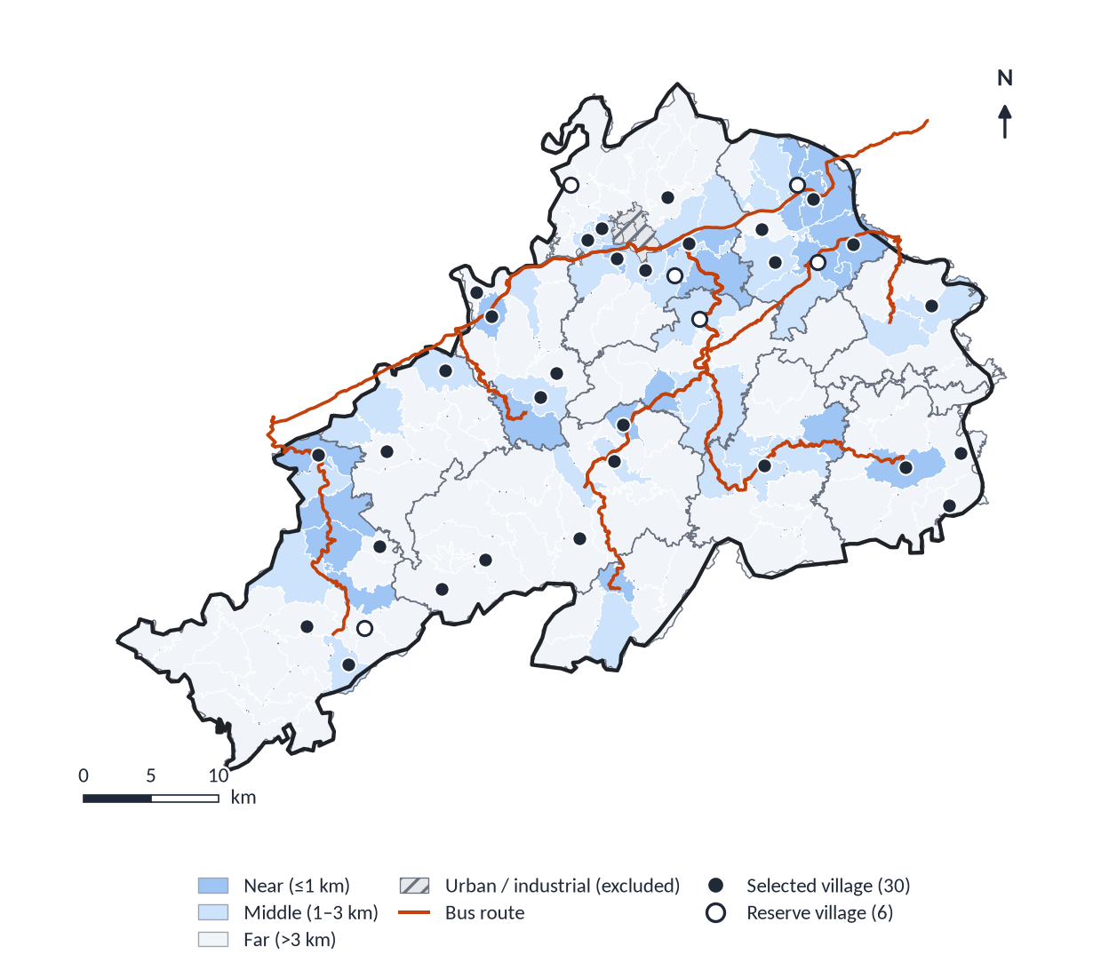
III · STEP 1 · OBSERVE
Identifying current problems — riders and non-riders, by village access
SAME PROBLEM QUESTION IN ALL THREE SURVEYS
“Which one of these affects your bus use most?” — forced single choice replaces an 11-item Likert battery:
Too few runs
Last bus too early
First bus too late
Don't know when the bus comes
Bus full, could not board
Long, winding ride / motion sickness
Home too far from the boarding point
No obvious problem
UNMET DEMAND, MEASURED AS BEHAVIOUR
On-board: trips given up or postponed in the past month; what you would do if this run did not operate.
Household: household bus trips in the past 7 days; reasons for rarely riding; trips not made for lack of a bus.
Online: arrived in the county town but no bus home; preferred departure times around holidays.
Pre-registered checks: boarding-student share on in-term Friday/Sunday runs exceeds vacation runs; far villages report higher unmet demand. County-wide 95% CI half-width ≈ 6.3 pp (p = 30%, ICC 0.05).
Villages drawn by systematic PPS within access strata (seed 20261001); one certainty village (Shawan).
Lilac · National University of Singapore · Urban–rural public transport in Xinhuang County
27 / 39
Notes:
Problem identification uses the same forced-choice question in all three surveys so riders and non-riders can be compared, and unmet demand is measured as behaviour in a recall window, which can be checked against ledgers. The household sample is stratified by the access strata shown in Part I, with more villages near routes than proportional allocation would give, so each stratum can be estimated.

Slide 28
III · STEP 2 · EXPLAIN
Turning holidays, school calendars, markets and weather into run-level factors
Driver in the original plan | Encoding on each run (date × time × direction) | Role
School term: boarding students' weekly trip | S — Sunday p.m. inbound (back to school); last school day p.m. outbound (home); zero in vacations | Core factor
Weekly commute of park and township workers | W — Sunday p.m. outbound; Friday p.m. inbound; first rest day a.m. inbound (weight 0.5); not tied to school terms | Core factor
Winter and summer vacations: start and end | T — eve of term inbound, first vacation day outbound (next day 0.4–0.5); vacations also switch S off | Core factor
Gregorian holidays (New Year, Qingming, Labour Day, National Day) and lunar holidays (Dragon Boat, Mid-Autumn) | R — out before, back after; intensity by holiday type × √(days / 7), estimated with a hierarchical type effect | Core factor
Spring Festival (lunar new year) | CY — days −20…0 and +2…+20; bell-shaped peaks 3 days before and around day 7 | Core factor
Market days (lunar 5-day cycle) | Market-day indicator for towns along the route | Control
Weather | Precipitation in the run window, max. temperature, extreme-weather flag | Control
Weekday, make-up workdays, year | Day-of-week and adjusted-workday indicators; year terms | Control
OPPOSITE DIRECTIONS ON THE SAME DAYS
Friday afternoon
Town
students
Village
workers
Sunday afternoon
Town
students
Village
workers
Same day, opposite buses: the two commuting groups share 189 days but never the same run — the key to separating their effects.
Lilac · National University of Singapore · Urban–rural public transport in Xinhuang County
28 / 39
Notes:
This is how the five temporal drivers I started with are operationalised. Holidays are split by importance and length; the Spring Festival has its own factor; vacations switch the student factor off and create term start/end surges. Market days and weather remain in the model as controls, so their effects are still estimated. The schematic shows why directions matter: students go home on Friday afternoon while workers come back to town.

Slide 29
III · STEP 2 · EXPLAIN
Real timetable × calendar: factors overlap by day but separate by run
a Runs affected by both factors
b Days on which both occur
 | S | W | R | CY | T
S | 6,210 | 0 | 845 | 229 | 32
W | 0 | 12,286 | 69 | 437 | 298
R | 845 | 69 | 3,536 | 0 | 0
CY | 229 | 437 | 0 | 5,440 | 816
T | 32 | 298 | 0 | 816 | 2,040
 | S | W | R | CY | T
S | 191 | 189 | 26 | 12 | 6
W | 189 | 354 | 38 | 30 | 16
R | 26 | 38 | 51 | 0 | 0
CY | 12 | 30 | 0 | 80 | 12
T | 6 | 16 | 0 | 12 | 30
Separated by direction. Students and workers co-occur on 189 of 191 student-commute days but on 0 runs; VIF drops from 3.7 / 5.9 (daily) to 1.28 (run).
Some pairs never meet. Holiday returns never coincide with Spring Festival travel or term surges: no interaction exists to estimate.
Support screen before estimation. A pair gets an overlap term only with ≥200 shared runs and ≥200 solo runs each: 5 of 10 pairs pass (S×R, S×CY, W×CY, W×T, CY×T); the rest are reported as sums of main effects, flagged “low support”.
Lilac · National University of Singapore · Urban–rural public transport in Xinhuang County
29 / 39
Notes:
This evidence uses only the real timetable and calendar — no ridership numbers, so it does not depend on synthetic data. It justifies both the run-level unit and the identifiability screen. S = boarding students, W = workers, R = holiday returns, CY = Spring Festival travel, T = term start and end.

Slide 30
III · STEP 3 · QUANTIFY
A censored count model on the passenger scale
Y_{i} ~ NegBin(μ_{i}, θ), y_{i} = min(Y_{i}, C_{i}), C_{i} = κ_{r} × seats_{i}
μ_{i} = exp(α_{r×dir×period} + γx_{i} + u_{d}) × [1 + Σ ρ_{g}f_{gi} + Σ_{Π} δ_{pq}f_{pi}f_{qi} + Σ ρ_{gt}f_{gi}1_{year=t}]
EFFECTS AS COUNTERFACTUAL SWITCHES
(illustrative, passengers per run above baseline)
overlap < 0 (offset)
Baseline: hierarchical route × direction × period intercepts; controls x (weekday, market day, weather, year); county-wide day shock u_{d} ~ N(0, σ²).
ρ_{g}: extra passengers, as a share of baseline, when group g's factor is fully on; δ_{pq}: overlap, only for screened pairs Π; ρ_{gt}: ridge-shrunk drift for 2025–26.
Full buses contribute Pr(Y ≥ C) to the likelihood; turnover κ comes from tally sheets and is resampled in every draw.
S only
R only
Sum
S + R on
Why the passenger scale: each term is “an extra group of people”, maps one-to-one to survey rider types, and is what supplementary-run decisions need. Ratio-scale results are reported alongside.
Independent: switch on one factor only.
Combined: switch on all factors in an overlap cell.
Overlap = combined − Σ independent: >0 amplify; <0 offset (e.g., students ride once on a holiday Sunday); ≈0 additive.
Lilac · National University of Singapore · Urban–rural public transport in Xinhuang County
30 / 39
Notes:
The model in one line: a negative binomial for latent demand, censored at effective capacity, with a multiplicative baseline and an additive bracket of calendar effects. Effects are defined by switching factors on and off, so they are comparable across methods. Every effect is reported per cell with a 95% interval and the number of runs; cells below 200 runs are flagged low support.

Slide 31
III · STEP 3 · QUANTIFY
SYNTHETIC DATA · tests the method, not Xinhuang ridership
Choosing the estimator by synthetic backtest, not by preference
Method | Combined-effect error |  |  |  | Independent-effect error
 | A | B | C | D | A | B | C | D
M1 Log · main effects | 0.10 | 0.08 | 0.16 | 0.10 | 0.21 | 0.06 | 0.20 | 0.21
M2 Count · main effects | 0.06 | 0.14 | 0.12 | 0.05 | 0.08 | 0.11 | 0.08 | 0.08
M3 Log · interactions | 0.08 | 0.10 | 0.11 | 0.08 | 0.16 | 0.06 | 0.16 | 0.16
M4 Count · overlaps | 0.06 | 0.11 | 0.10 | 0.06 | 0.08 | 0.09 | 0.07 | 0.07
M5 Log · inter. · censored | 0.05 | 0.07 | 0.06 | 0.06 | 0.12 | 0.04 | 0.12 | 0.11
M6 Count · overl. · censored | 0.05 | 0.09 | 0.09 | 0.06 | 0.03 | 0.13 | 0.03 | 0.04
M7 Gradient boosting | 0.15 | 0.18 | 0.14 | 0.15 | 0.14 | 0.18 | 0.15 | 0.15
M8 GA2M (EBM) | 0.15 | 0.18 | 0.15 | 0.16 | 0.11 | 0.12 | 0.11 | 0.12
M9 M6 + yearly drift | 0.05 | 0.09 | 0.09 | 0.05 | 0.04 | 0.13 | 0.04 | 0.04
M10 M9 + screen (penalised) | 0.05 | 0.09 | 0.09 | 0.05 | 0.04 | 0.13 | 0.04 | 0.04
M11/12 Screened, unpenalised | 0.07 | 0.09 | 0.06 | 0.07 | 0.04 | 0.05 | 0.04 | 0.04
Forecast scores cannot pick the method: CRPS differs by ≤1% across count models, yet effect estimates differ several-fold.
Right scale beats more interactions: independent-effect error 0.034 (count scale) vs 0.117 (log scale) in world A.
Censoring removes bias: Spring Festival cell −14.2% → −0.8%.
Penalising overlaps hides real absorption: combined-effect bias +7.1% vs −0.5% unpenalised.
Frozen choice (1 Jan 2027): M11/12
Best worst case on both criteria (≤0.09 combined, ≤0.05 independent). Intervals widened ×2.3 after backtest; leave-one-world-out coverage ≥0.93. M10, M6 and M2 kept as sensitivity checks. Testing also exposed a worker-direction coding error (slide 24).
Relative RMSE on two-factor cells; 50 synthetic ledgers per world on the real timetable × calendar (115,872 runs). Worlds: A additive with absorption · B log-scale synergy · C sparse-cell synergy · D effects drift by year. M11/12 = identifiability screen, unpenalised overlaps, censoring, yearly drift, scale chosen by likelihood.
Lilac · National University of Singapore · Urban–rural public transport in Xinhuang County
31 / 39
Notes:
Synthetic backtest: I generate ridership on the real timetable and calendar with known effects, under four different 'true worlds', and ask which estimator recovers them. The main lessons: predictive scores cannot choose among methods; the scale matters most; censoring matters; and penalising overlap terms shrinks real absorption. The choice is frozen before any real test data are opened.

Slide 32
III · STEP 4 · FORECAST
SYNTHETIC DATA · tests the method, not Xinhuang ridership
Forecasting every run 1–7 days ahead — and keeping daily totals honest
HOW A FORECAST IS DRAWN (REPEATED 300 TIMES)
1
Draw model parameters
2
Draw one county-wide shock per forecast day
3
Draw turnover κ per route
4
Draw each run's latent demand; cap at capacity
5
Sum runs within the same draw → daily total
EVALUATION
Rolling origins on exploration data (Jun 2025, Dec 2025, Jun 2026); CRPS, 90% coverage overall and by route, time of day and event; daily-total MAPE.
Baselines: seasonal naïve (same weekday and run, past four weeks) and the separate-stage pipeline.
One sealed test: the Oct 2026–Feb 2027 ledger (incl. Spring Festival 2027) is opened once, after freezing.
World A, 8 replicates. Daily intervals average 566 passengers (joint) vs 194 (pipeline): the pipeline's narrower interval is wrong, because runs on the same day share shocks. Run-level CRPS is almost identical (2.82 vs 2.84).
Lilac · National University of Singapore · Urban–rural public transport in Xinhuang County
32 / 39
Notes:
The forecast is a set of simulated futures. Because all runs on a day share one county shock in each draw, the daily total automatically carries their correlation. In the synthetic test both approaches forecast single runs equally well; only the joint model gives daily intervals that are close to their nominal coverage — which is what the day-ahead reserve decision needs.

Slide 33
III · STEP 5 · PLAN
SYNTHETIC DATA · tests the method, not Xinhuang ridership
From forecasts to a fixed-core, flexible-supplement service
THREE SERVICE LAYERS (TOP LAYERS VARY DAY BY DAY)
Forecast-triggered runs
Add a run next to scheduled run i if Pr(demand > κ × seats) > α — a chance constraint solved on forecast samples.
Day-ahead reserve
Buses and drivers held for tomorrow, sized from an upper quantile (e.g., 90%) of the daily-total forecast beyond core capacity.
Fixed core timetable
Stable, no booking; guarantees basic service on every route — essential for older riders.
SURVEY INPUTS TO THE PLAN
Both approaches lie on nearly the same frontier; at equal α the joint model adds more runs and catches more overloads (α = 0.05: 85% vs 76%). Its real advantage is a trustworthy α and a calibrated reserve. The county chooses α from the cost of an extra run vs. the social cost of a denied rider. Plans are compared with the current timetable and a simple calendar rule.
Preferred departure times (schedule delay) · what denied riders do — wait, switch mode, give up — which weights the cost of denial · how riders learn of extra runs (village WeChat groups, notices, drivers).
Lilac · National University of Singapore · Urban–rural public transport in Xinhuang County
33 / 39
Notes:
Service planning keeps the fixed timetable as the base layer because older riders do not book. On top of it: a reserve decided the day before from the daily-total forecast, and supplementary runs triggered where the forecast says the run is likely to overflow. I do not claim one optimal plan; I give the transport bureau a frontier and let the cost ratio decide. Synthetic results, world A.

Slide 34
III · PRE-REGISTRATION
Hypotheses and how results will be read — written before the data
Hypothesis | If supported | If not supported
H1 (RQ1) Boarding students and weekly workers dominate in-term weekend runs; far villages give up more trips | Design core runs and triggers around these groups; prioritise far villages | Revise rider groups and encodings; unmet demand has other causes
H2 (RQ2) All five factors have positive independent effects, separable at run level | Group-, direction- and time-specific supplementary rules | Group small or shifted to other modes — explained with surveys
H3 (RQ2) S×R and CY×T overlaps are negative (the same people travel once) | Do not add factor effects on overlap days | Positive: extra capacity needed; ≈0: add effects
H4 (RQ2) Holiday returns grow with holiday length; type effects follow prior importance | Tier holiday supplements by type × length | Use data-estimated type effects
H5 (RQ3) Run and daily 90% coverage ≈0.90; CRPS beats seasonal naïve | Forecasts usable 1–7 days ahead for both layers | Add route-level shocks; else calendar rules only
H6 (RQ4) At equal extra runs, the two-layer plan denies fewer riders than the current timetable | Recommend fixed core + reserve + triggered runs | Recommend the simple calendar rule; report limited value
Rules: report null and non-significant results with intervals; distinguish “no effect” (narrow interval around zero) from “not identifiable” (wide interval, low support); if main and sensitivity methods disagree, report both.
Lilac · National University of Singapore · Urban–rural public transport in Xinhuang County
34 / 39
Notes:
Hypotheses and interpretation rules are written down before the data are analysed, and will be time-stamped with the frozen methods, so the results cannot be reinterpreted after the fact.

Slide 35
III · WORK PLAN
Timeline: October 2026 – April 2028
1 Jan 2027: methods & rules frozen
30 Jun 2027: RQ2 results frozen
31 Dec 2027: analyses complete
Oct 2026
Jan 2027
Apr 2027
Jul 2027
Oct 2027
Jan 2028
Apr 2028
PREPARATION
Ethics review, consent forms
Ledger, seats, timetable changes
Calendars, holiday notices, weather archive
Pre-test and enumerator training
Re-draw winter strata when dates published
SURVEYS
Fall-term weekend on-board
Household (village) survey
Online survey (around holidays)
Winter & Spring Festival on-board
Summer on-board (redesigned)
ANALYSIS
Real ledger replaces synthetic; S2–S5 end-to-end
S1 rider groups, κ, unmet demand
S2–S3 calendar effects
S4 rolling-origin forecasting
S5 supplementary plans, frontier
Summer re-check, robustness
WRITING
Paper 1 (RQ1–RQ2)
Paper 2 (RQ3–RQ4)
Dissertation
Lilac · National University of Singapore · Urban–rural public transport in Xinhuang County
35 / 39
Notes:
Two hard constraints drive the plan: seasonal windows (the fall term is the only in-term window for testing student and worker encodings before winter; winter/Spring Festival cannot be postponed without losing a year) and freeze-then-test (methods and interpretation rules are frozen on 1 January 2027 before the sealed data are opened).

Slide 36
III · NEXT STEPS
Immediate next steps (Oct–Dec 2026) and main risks
CHECKLIST
Risk | Consequence | Mitigation
Ledger only as daily totals | RQ2–RQ4 cannot be answered per run | Secure first; else daily model, run level as scenarios
2027 winter dates announced late | Winter strata drawn on assumed dates | Re-draw with the same seed; non-winter strata unchanged
Too few enumerators in the Spring Festival peak | Peak strata under-sampled | Peak strata first; adjust weights
Poor tally-sheet quality | κ wrong → censoring and decisions wrong | Daily balance checks; κ at 10th/90th percentiles
Sealed test disappoints | H5 not supported | Report by pre-set rules; no re-testing on the same data
Costs and spare buses unverifiable | S5 plans not implementable | Frontier under two cost scenarios
Confirm ledger fields with the county bus station; obtain exploration-period ledger and per-run seat counts; add a “full bus, riders left behind” tick box
Submit ethics review; prepare consent script and enumerator manual
Pre-test each instrument on 1–2 routes (20–30 each): comprehension, timing, skip logic
Run the fall-term weekend on-board wave and the village household survey
Swap synthetic for real ledger; run S2–S5 end-to-end; confirm the frozen method
Re-draw winter strata once 2027 holiday dates are published
Freeze methods and interpretation rules by 31 Dec 2026 with a time-stamped registration
Lilac · National University of Singapore · Urban–rural public transport in Xinhuang County
36 / 39
Notes:
The immediate critical path is the ledger: without run-level records, RQ2 to RQ4 fall back to daily models. Everything else has a fallback written down in advance.

Slide 37
III · CONTRIBUTIONS
Expected contributions and outputs
Substantive
Methodological
Practical
First run-level evidence on how rural calendar rhythms — boarding-student and worker weekly trips, term surges, holiday returns, Spring Festival — shape county bus demand.
Where and for whom the fixed timetable leaves demand unmet, by village accessibility.
Identifiability-screened estimation of independent vs. combined effects on the passenger scale, with capacity censoring.
A joint model whose run forecasts add up to calibrated daily totals.
Estimator chosen by synthetic backtest and frozen before testing.
A fixed-core + reserve + forecast-triggered rule with a cost–denial frontier for the county transport bureau.
Reproducible code and data pipeline that other counties can adapt.
PLANNED OUTPUTS
Paper 1 (RQ1–RQ2): independent and overlap effects of calendar rhythms on rural bus runs — Journal of Transport Geography / Travel Behaviour and Society / Transportation Research Part A.
Paper 2 (RQ3–RQ4): run-level probabilistic forecasting and chance-constrained supplementary runs — Public Transport / Transportation Research Record / TR Part A.
Dissertation: nine chapters, including the full method comparison and failures.
Lilac · National University of Singapore · Urban–rural public transport in Xinhuang County
37 / 39
Notes:
Three kinds of contribution. The two papers use the same data and model but answer different questions: paper 1 reports parameters (effects), paper 2 reports their use (forecasts and decisions).

Slide 38
DISCUSSION
Limitations — and questions I would value your input on
KNOWN LIMITATIONS
QUESTIONS FOR THE AUDIENCE
Synthetic results show that the method recovers known truth; they are not findings about Xinhuang.
Three years of calendar give limited support for some overlaps (W×R: 69 runs); only a longer ledger fixes this.
Turnover κ from sampled tally sheets propagates into censoring and decisions.
Unobtainable drivers (industrial shifts, clinic rosters) may leak into weekday or residual terms.
The sealed test contains one winter and one Spring Festival.
Chinese literature: the systematic CNKI search is still to be run.
Is the passenger (additive) scale the right primary estimand for operators, with the ratio scale as secondary?
Is ≥200 runs a sensible identifiability threshold — or should support be judged by interval width?
Beyond forecast-triggered extra runs, which supplementary service types (route deviation to far villages, scheduled on-call runs) merit testing in a Chinese mountain county?
How can latent demand be validated when denied boardings are only partly recorded?
Lilac · National University of Singapore · Urban–rural public transport in Xinhuang County
38 / 39
Notes:
I close with the limitations I already know and four questions where the audience's experience would help most, especially on supplementary service types beyond extra runs.

Slide 39
Thank you
Run-level, direction-aware calendar factors separate rider groups that daily totals conflate.
Overlapping effects are estimated only where the calendar can identify them, on the passenger scale, with censoring.
One joint model turns effects into calibrated forecasts and a transparent cost–denial choice for supplementary service.
Lilac
National University of Singapore
Notes:
Three take-aways, then open for questions. Appendix slides hold the questionnaire structure, the sampling strata and full references.

Slide 40
APPENDIX
A1 · Questionnaire indicator groups and the questions they serve
Group | Indicator group | Items | Serves
G0 | Run key and non-response record | Z1–Z4, H0 | RQ1, RQ2
G1 | Trip origin–destination and trip chain | A1, A2, A5, H7, O8 | RQ1, RQ4
G2 | Rider type and periodic rhythm (maps to S, W, T, R/CY) | A3 | RQ2
G3 | Trip purpose | A4 | RQ1
G4 | Time constraints and preferred departure | A6, H11, O10 | RQ4
G5 | Dependence and alternatives | A8, H8 | RQ4
G6 | Unmet demand | A9, H6, H9, H10, O9 | RQ1, RQ4
G7 | Service-gap priority (forced choice) | A10, H12, O12 | RQ1
G8 | Demographics and weights | A7, A11–A13, H14, O2, O3 | RQ1, RQ2
G9 | Household structure and group exposure | H1–H5 | RQ2
G10 | Holiday return timing | S15, W15, O4–O7 | RQ2, RQ3
G11 | Acceptance of extra runs; information channels | A14, H13, O11 | RQ4
G12 | Channel and duplicate responses | O1 | RQ1
Prefixes: A on-board, H household, O online, S/W summer/winter on-board, Z enumerator record.
Not included, with reasons: theory-of-planned-behaviour scales (no RQ needs intentions; behaviour is observed directly), SERVPERF batteries (burden), shift and clinic rosters (unobtainable), waiting time (reflects departure choice on hail-and-ride routes).
Reliability and validity without multi-item scales: test–retest κ ≥ 0.6 on A3, A4, A7; inter-coder κ on field-coded items; tally-sheet totals vs. ledger; pre-registered construct checks.
Lilac · National University of Singapore · Urban–rural public transport in Xinhuang County
A1
Notes:
Appendix A1: how the 47-item bank is organised.

Slide 41
APPENDIX
A2 · On-board sampling strata (runs, days and planned questionnaires)
Wave | Stratum | Runs in stratum | Days | Sampled runs | Planned questionnaires
Fall 2026 | A1 Last school day p.m. · outbound (students home) | 330 | 10 | 5 | 40
Fall 2026 | A2 Last workday p.m. · inbound (workers to town) | 320 | 10 | 5 | 40
Fall 2026 | A3 Eve of school week p.m. · inbound (students back) | 320 | 10 | 5 | 40
Fall 2026 | A4 Eve of work week p.m. · outbound (workers out) | 330 | 10 | 5 | 40
Fall 2026 | A5 First rest day a.m. · inbound (workers to town) | 360 | 10 | 5 | 40
Fall 2026 | A6 Tue–Thu p.m. · both directions (control) | 1,755 | 27 | 5 | 40
Winter 2027 | B1 Spring Festival pre-peak · outbound (going home) | 680 | 10 | 39 | 312
Winter 2027 | B2 Spring Festival post-peak · inbound (returning) | 816 | 12 | 39 | 312
Winter 2027 | B3 New Year holiday first/last days · both | 204 | 3 | 13 | 104
Winter 2027 | B4 Weekly-commute windows outside Spring Festival · both | 675 | 18 | 23 | 184
Winter 2027 | B5 Tue–Thu p.m. · both directions (control) | 943 | 23 | 15 | 120
Equal allocation across fall strata (each is a separate check); winter allocation follows research priority (Spring Festival peaks 30% each). About 8 questionnaires per run is an assumption to be checked in the pre-test. 98 of 129 winter runs fall on dates marked unverified and will be re-drawn.
Lilac · National University of Singapore · Urban–rural public transport in Xinhuang County
A2
Notes:
Appendix A2: on-board strata for the fall and winter waves, from the v5 sampling workbook.

Slide 42
APPENDIX
A3 · References cited on the slides (1 of 3)
Alexandre, T. d. S., Bernardini, F., & Viterbo, J. (2023). Machine learning applied to public transportation by bus: A systematic literature review. Transportation Research Record.
Angelopoulos, A. N., & Bates, S. (2023). Conformal prediction: A gentle introduction. Foundations and Trends in Machine Learning, 16(4), 494–591.
Arana, P., Cabezudo, S., & Peñalba, M. (2014). Influence of weather conditions on transit ridership: A statistical study using data from smartcards. Transportation Research Part A, 59, 1–12.
Barber, R. F., Candès, E. J., Ramdas, A., & Tibshirani, R. J. (2023). Conformal prediction beyond exchangeability. Annals of Statistics, 51(2).
Berg, J., & Ihlström, J. (2019). The importance of public transport for mobility and everyday activities among rural residents. Social Sciences, 8(2), 58.
Calabrò, G., Araldo, A., Oh, S., et al. (2023). Adaptive transit design: Optimizing fixed and demand responsive multi-modal transportation via continuous approximation. Transportation Research Part A.
Ceder, A. (1984). Bus frequency determination using passenger count data. Transportation Research Part A, 18(5–6), 439–453.
Charnes, A., & Cooper, W. W. (1959). Chance-constrained programming. Management Science, 6(1), 73–79.
Church, A., Frost, M., & Sullivan, K. (2000). Transport and social exclusion in London. Transport Policy, 7(3), 195–205.
Croston, J. D. (1972). Forecasting and stock control for intermittent demands. Journal of the Operational Research Society, 23(3), 289–303.
Currie, G., & Fournier, N. (2020). Why most DRT/micro-transits fail — What the survivors tell us about progress. Research in Transportation Economics, 83, 100895.
Czado, C., Gneiting, T., & Held, L. (2009). Predictive model assessment for count data. Biometrics, 65(4), 1254–1261.
Deville, J.-C., & Särndal, C.-E. (1992). Calibration estimators in survey sampling. Journal of the American Statistical Association, 87(418), 376–382.
Durán-Micco, J., & Vansteenwegen, P. (2021). A survey on the transit network design and frequency setting problem. Public Transport.
Egu, O., & Bonnel, P. (2020). How comparable are origin–destination matrices estimated from automatic fare collection, OD surveys and household travel survey? Transportation Research Part A.
Espeland, S., & Rowangould, D. (2024). Rural travel burdens in the United States: Unmet need and travel costs. Journal of Transport Geography, 104016.
Friedman, J. H. (2001). Greedy function approximation: A gradient boosting machine. Annals of Statistics, 29(5), 1189–1232.
Gibbs, I., & Candès, E. J. (2021). Adaptive conformal inference under distribution shift. NeurIPS 34.
Gkiotsalitis, K., Schmidt, M. E., & van der Hurk, E. (2021). Subline frequency setting for autonomous minibusses under demand uncertainty. Transportation Research Part C.
Gneiting, T., Balabdaoui, F., & Raftery, A. E. (2007). Probabilistic forecasts, calibration and sharpness. JRSS Series B, 69(2), 243–268.
Gneiting, T., & Raftery, A. E. (2007). Strictly proper scoring rules, prediction, and estimation. JASA, 102(477), 359–378.
Guo, Z., Wilson, N. H. M., & Rahbee, A. B. (2007). Impact of weather on transit ridership in Chicago, Illinois. Transportation Research Record, 2034.
Hadas, Y., & Shnaiderman, M. (2012). Public-transit frequency setting using minimum-cost approach with stochastic demand and travel time. Transportation Research Part B, 46(8), 1068–1084.
Han, Y., Wang, C., Ren, Y., et al. (2019). Short-term prediction of bus passenger flow based on a hybrid optimized LSTM network. ISPRS Int. J. Geo-Information, 8(9), 366.
Hewamalage, H., Ackermann, K., & Bergmeir, C. (2022). Forecast evaluation for data scientists: Common pitfalls and best practices. Data Mining and Knowledge Discovery.
Hoerl, A. E., & Kennard, R. W. (1970). Ridge regression: Biased estimation for nonorthogonal problems. Technometrics, 12(1), 55–67.
Hong, X., Liang, P., & Zhu, H. (2024). The impact of road environments on rural periodic market travel satisfaction. Frontiers in Public Health.
Huang, J. W., Liu, X., & Zhao, P. (2019). Interactions between bus, metro, and taxi use before and after the Chinese Spring Festival. ISPRS Int. J. Geo-Information, 8(10), 445.
Lilac · National University of Singapore · Urban–rural public transport in Xinhuang County
A3
Notes:
Reference list (APA-style, abbreviated). Full GB/T 7714 entries with DOIs are in documents 1–5 of the v5 package.

Slide 43
APPENDIX
A4 · References cited on the slides (2 of 3)
Jang, T. Y. (2005). Count data models for trip generation. Journal of Transportation Engineering, 131(6), 444–450.
Jittrapirom, P., van Neerven, W., Martens, K., et al. (2019). The Dutch elderly's preferences toward a smart demand-responsive transport service. Research in Transportation Business & Management.
Kashfi, S. A., Bunker, J. M., & Yiğitcanlar, T. (2015). Understanding the effects of complex seasonality on suburban daily transit ridership. Journal of Transport Geography.
Kashfi, S. A., Bunker, J. M., & Yiğitcanlar, T. (2016). Modelling and analysing effects of complex seasonality and weather on an area's daily transit ridership rate. Journal of Transport Geography.
Ke, G., Meng, Q., Finley, T., et al. (2017). LightGBM: A highly efficient gradient boosting decision tree. NeurIPS 30, 3146–3154.
Kieu, L. M., Bhaskar, A., & Chung, E. (2014). Transit passenger segmentation using travel regularity mined from smart card transactions data. QUT ePrints.
Kleywegt, A. J., Shapiro, A., & Homem-de-Mello, T. (2002). The sample average approximation method for stochastic discrete optimization. SIAM Journal on Optimization, 12(2), 479–502.
Knierim, L., & Schlüter, J. (2021). The attitude of potentially less mobile people towards demand responsive transport in a rural area in central Germany. Journal of Transport Geography.
Kolenikov, S. (2014). Calibrating survey data using iterative proportional fitting (raking). The Stata Journal, 14(1), 22–59.
Krosnick, J. A. (1991). Response strategies for coping with the cognitive demands of attitude measures in surveys. Applied Cognitive Psychology, 5(3), 213–236.
Kuhnimhof, T., Chlond, B., & Zumkeller, D. (2006). Nonresponse, selectivity, and data quality in travel surveys. Transportation Research Record, 1972, 29–37.
Laws, R., Enoch, M., Ison, S., et al. (2009). Demand responsive transport: A review of schemes in England and Wales. Journal of Public Transportation, 12(1).
Lei, J., G'Sell, M., Rinaldo, A., et al. (2017). Distribution-free predictive inference for regression. JASA, 113(523), 1094–1111.
Li, G., Peng, L., Li, X., et al. (2019). Short-term passenger flow prediction at urban bus stops based on LSTM [in Chinese]. Journal of Highway and Transportation Research and Development, 36(2), 128–135.
Li, J., Ye, Q., Deng, X., et al. (2016). Spatial-temporal analysis on Spring Festival travel rush in China based on multisource big data. Sustainability, 8(11), 1184.
Liu, J., Shi, W., & Chen, P. (2020). Exploring travel patterns during the holiday season — Shenzhen Metro during the Chinese Spring Festival. ISPRS Int. J. Geo-Information, 9(11), 651.
Liyanage, S., Abduljabbar, R., Dia, H., et al. (2022). AI-based neural network models for bus passenger demand forecasting using smart card data. Journal of Urban Management.
Lou, Y., Caruana, R., Gehrke, J., & Hooker, G. (2013). Accurate intelligible models with pairwise interactions. Proc. 19th ACM SIGKDD, 623–631.
Lucas, K. (2012). Transport and social exclusion: Where are we now? Transport Policy, 20, 105–113.
Ma, C., Ai, Q., & Zhang, J. (2018). Estimation model of bus cross-section passenger flow under incomplete information [in Chinese]. Journal of Highway and Transportation Research and Development, 35(5), 121–127.
Mageean, J., & Nelson, J. D. (2003). The evaluation of demand responsive transport services in Europe. Journal of Transport Geography, 11(4).
Makridakis, S., Spiliotis, E., & Assimakopoulos, V. (2019). The M4 Competition: 100,000 time series and 61 forecasting methods. International Journal of Forecasting.
Mauz, E., Hoffmann, R., Houben, R., et al. (2018). Mode equivalence of health indicators between data collection modes and mixed-mode survey designs. Journal of Medical Internet Research.
Newell, G. F. (1971). Dispatching policies for a transportation route. Transportation Science, 5(1), 91–105.
Newmark, G. L. (2014). Conducting visitor travel surveys: A transit agency perspective. Journal of Public Transportation, 17(4).
Nourbakhsh, S. M., & Ouyang, Y. (2011). A structured flexible transit system for low demand areas. Transportation Research Part B.
Painter, K. M., Jessup, E., Gossard, M. H., et al. (2007). Demand forecasting for rural transit. Transportation Research Record, 1997, 35–40.
Petropoulos, F., Nikolopoulos, K., Spithourakis, G. P., et al. (2013). Empirical heuristics for improving intermittent demand forecasting. Industrial Management & Data Systems.
Lilac · National University of Singapore · Urban–rural public transport in Xinhuang County
A4
Notes:
Reference list (APA-style, abbreviated). Full GB/T 7714 entries with DOIs are in documents 1–5 of the v5 package.

Slide 44
APPENDIX
A5 · References cited on the slides (3 of 3)
Pucher, J., & Renne, J. L. (2005). Rural mobility and mode choice: Evidence from the 2001 National Household Travel Survey. Transportation, 32.
Rigby, R. A., & Stasinopoulos, D. M. (2005). Generalized additive models for location, scale and shape. JRSS Series C, 54(3), 507–554.
Romano, Y., Patterson, E., & Candès, E. J. (2019). Conformalized quantile regression. NeurIPS 32, 3538–3548.
Salinas, D., Flunkert, V., & Gasthaus, J. (2019). DeepAR: Probabilistic forecasting with autoregressive recurrent networks. International Journal of Forecasting.
Schasché, S. E., Sposato, R. G., & Hampl, N. (2022). The dilemma of demand-responsive transport services in rural areas. Transport Policy.
Schaub, M., & Abadi, F. (2011). Integrated population models: A novel analysis framework for deeper insights into population dynamics. Journal of Ornithology, 152(S1), 227–237.
Schönfelder, S., & Axhausen, K. W. (2010). Urban rhythms and travel behaviour: Spatial and temporal phenomena of daily travel. Ashgate.
Singhal, A., Kamga, C., & Yazici, A. (2014). Impact of weather on urban transit ridership. Transportation Research Part A.
Sörensen, L., Bossert, A., Jokinen, J.-P., et al. (2020). How much flexibility does rural public transport need? Transport Policy.
Stopher, P. R., & Greaves, S. P. (2007). Household travel surveys: Where are we going? Transportation Research Part A, 41(5), 367–381.
Stover, V. W., & McCormack, E. D. (2012). The impact of weather on bus ridership in Pierce County, Washington. Journal of Public Transportation, 15(1).
Transportation Research Board (2013). Methods for forecasting demand and quantifying need for rural passenger transportation (TCRP Report 161). National Academies Press.
VanderWeele, T. J., & Knol, M. J. (2014). A tutorial on interaction. Epidemiologic Methods, 3(1), 33–72.
Vansteenwegen, P., Melis, L., Aktaş, D., et al. (2022). A survey on demand-responsive public bus systems. Transportation Research Part C.
Wang, X., Liu, C., Mao, W., et al. (2014). Tracing the largest seasonal migration on Earth. arXiv:1411.0983.
Weatherford, L. R., & Pölt, S. (2002). Better unconstraining of airline demand data in revenue management systems. Journal of Revenue and Pricing Management, 1(3), 234–254.
Wei, M. (2021). How does the weather affect public transit ridership? A model with weather-passenger variations. Journal of Transport Geography, 103242.
Wei, M., & Liu, X. (2022). How wet is too wet? Modelling the influence of weather condition on urban transit ridership. Travel Behaviour and Society.
Wickramasuriya, S. L., Athanasopoulos, G., & Hyndman, R. J. (2019). Optimal forecast reconciliation for hierarchical and grouped time series through trace minimization. JASA, 114(526), 804–819.
Xia, D., Ma, J., & Sharif Azadeh, S. (2023). Data-driven distributionally robust timetabling and dynamic-capacity allocation for automated bus systems with modular vehicles. Transportation Research Part C.
Xie, Z., Liu, X., Wu, J., et al. (2018). Passenger flow forecasting model based on bus IC-card data [in Chinese]. Journal of Guangdong University of Technology, 35(1), 16–22.
Yang, H., & Cherry, C. (2016). Use characteristics and demographics of rural transit riders: A case study in Tennessee. Transportation Planning and Technology, 40(2), 213–227.
Zhang, J., Chen, F., & Shen, Q. (2019). Cluster-based LSTM network for short-term passenger flow forecasting in urban rail transit. IEEE Access.
Zhao, J., Sun, S., & Cats, O. (2021). Joint optimisation of regular and demand-responsive transit services. Transportmetrica A.
Zhao, Z., Wei, Y., Pang, R., et al. (2017). Spatiotemporal and structural characteristics of interprovincial population flow during the Spring Festival travel rush in China [in Chinese]. Progress in Geography, 36(8), 952–964.
Zhao, Z., Zhao, S., Han, Z., et al. (2022). Impact of COVID-19 on festival inter-city travel in China [in Chinese]. Human Geography, 37(2), 141–149.
Zhou, T., Huang, B., Liu, X., et al. (2020). Spatiotemporal exploration of Chinese Spring Festival population flow patterns and their determinants. ISPRS Int. J. Geo-Information, 9(11), 670.
Lilac · National University of Singapore · Urban–rural public transport in Xinhuang County
A5
Notes:
Reference list (APA-style, abbreviated). Full GB/T 7714 entries with DOIs are in documents 1–5 of the v5 package.

