Slide 1
University Ahmed Daria - Adrar Faculty of Science and Technology Department of Mathematics and Computer Science
Theme :
A hybrid meta-heuristic for better localization of nodes in RCSFs
By :
Bensmail Moulay Ali Cherif
Lila Maotez Dr. Dahou Abdelghani
2020/2021

Slide 2
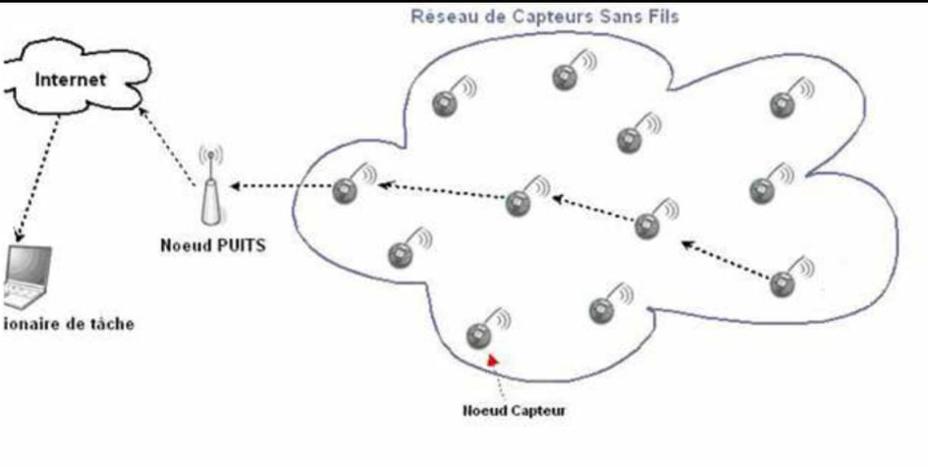
Introduction
Sensor networks have stimulated scientific and industrial societies, and they consist of a group of smart sensors capable of communicating with each other, whose mission is to collect and process information. It led to a great development in the medical, environmental, and military fields, etc. The areas of their use are clear, on the one hand, and on the other hand, cause several problems, and it is only responsible for receiving information from the middle and sending it from sensor to sensor until it reaches the main station.

Slide 3
Motivation
To estimate the location, we calculate the distance between the sensor and at least three anchors within its range of contact, we denote it d1, d2, d2. We estimate several locations for a sensor and every time we calculate the distances between them and the same anchors, we code them d'1,d'2 and d'3, and we take the sensor with the least distance, and we calculate the next phrase and whenever the output is The closer to zero, the closer the site is to reality

Slide 4
Related Work
GPS is the most used system around the world, but equipping all nodes in the network with GPS is very expensive, so we use positioning algorithms that depend on a group of well-known nodes called anchors. There are two methods, either estimating distances, we use technologies (RSSI, ToA, TDoA), and eager locations (Centroid, Dv hop), i.e. Approximate location, depending on the extent of the sensed communication..

Slide 5
Hypothesis and Objectives
Among the problems encountered: The problem of the location: It is represented in determining the geographic location of the sensor (real or estimated), for example, knowing the event will be useless if you do not know the location of its occurrence, for example: forest fires. This is why location is one of the main problems with this type of network.

Slide 6
Methodology
In this thesis, a recently developed méta heuristic algorithm, called the FoA algorithm, is proposed, and it relies on the patterns and behavior of flash fireflies. We are improving this algorithm to reduce site error. And we compare it with other algorithms based on error and change their settings.

Slide 7
Conclusion
We have presented a hybrid approach for optimizing the deployment of wireless sensor networks. The originality of this article is the fusion of fitness value between estimated value and classroom value.
Regarding the calculation time consumed, our algorithm displays better performance by dividing by five (05) the time required for the calculation. This explains the choice of the value estimate
fitness of individuals. Regarding the deployment of sensor nodes, our algorithm manages to find the same solutions as the genetic algorithm.

