Slide 1
Sketch Recognition
Big Data Content Analytics

Slide 2

The Team

Slide 3





Meet the Team
Tsopelakou Lila
Soukias Nikos
Koutsoukou Dimitra
Kosmidi Antonia
Charalampidou Eleni
Data Engineer
Data Engineer
Data Scientist
Business Analyst
Business Analyst

Slide 4

The Case

Slide 5
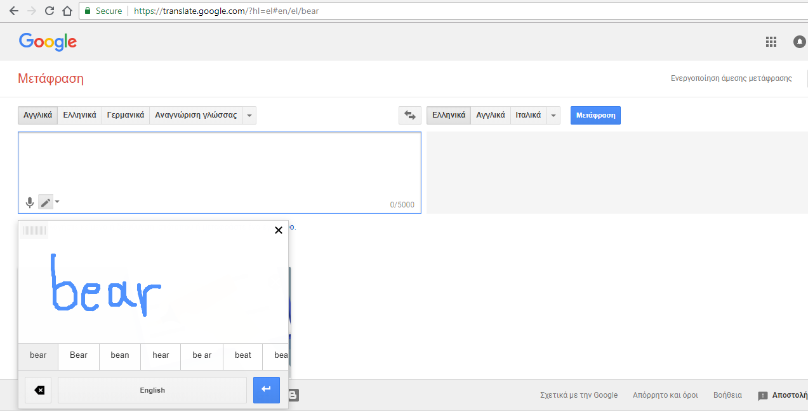
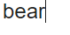
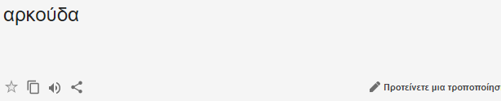
Google Translate-Draw Characters & Symbols

Slide 6
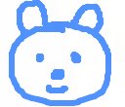
Google Translate-What If…

Slide 7

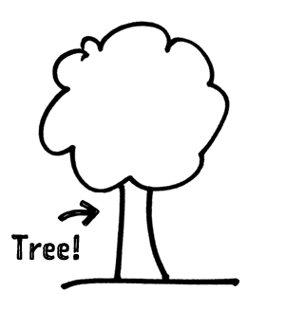

Learn Vocabulary by Drawing

Slide 8

The Dataset

Slide 9
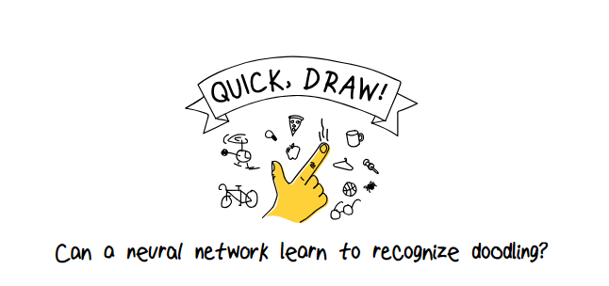

Slide 10
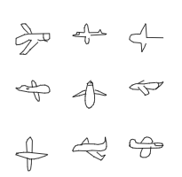
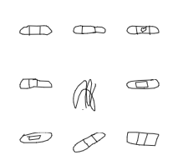
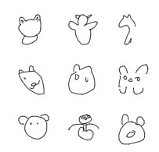
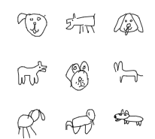
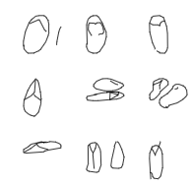
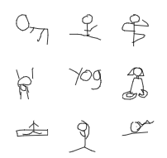
The Dataset
Airplane
Bandage
Bear
Quick Draw Dataset is a collection of 50 million drawings across 345 categories
For this case, the categories are ‘airplane’, ‘bandage’, ‘bear’, ‘dog’, ‘flip flops’, ‘yoga’
Dog
Flip Flops
Yoga
The final dataset consists of almost 1000000 images

Slide 11

The Methodology

Slide 12
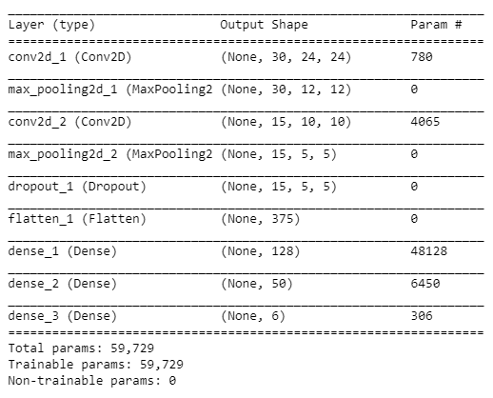
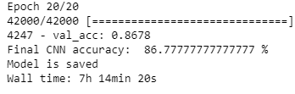
The Methodology
The epochs are 20
The training set was 70% and the test set was 30%

Slide 13
The Results

Slide 14
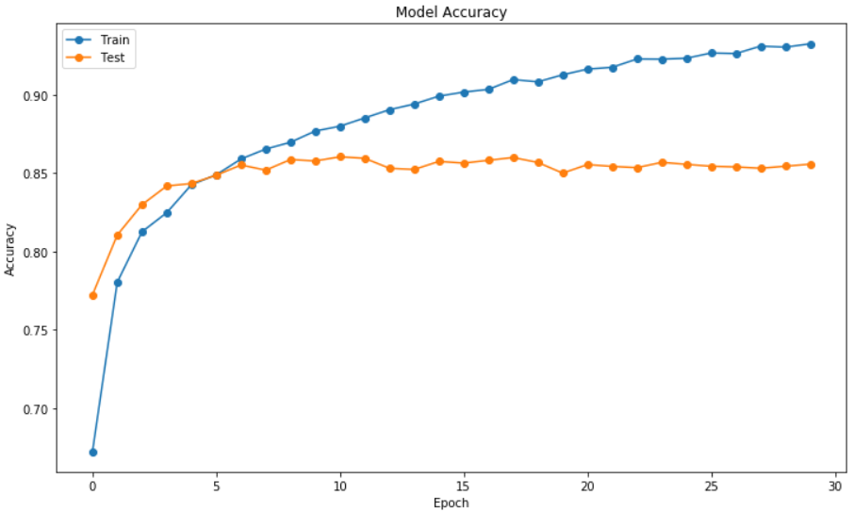
Model Accuracy
The peak performance of the accuracy of the train dataset is approximately 92%, while the same measure for the test dataset is 87%
For both datasets, the accuracy is increasing till epoch 5
After epoch 5, the accuracy of the train dataset is still increasing
After epoch 5, the accuracy of the test dataset remains stable with few fluctuations

Slide 15
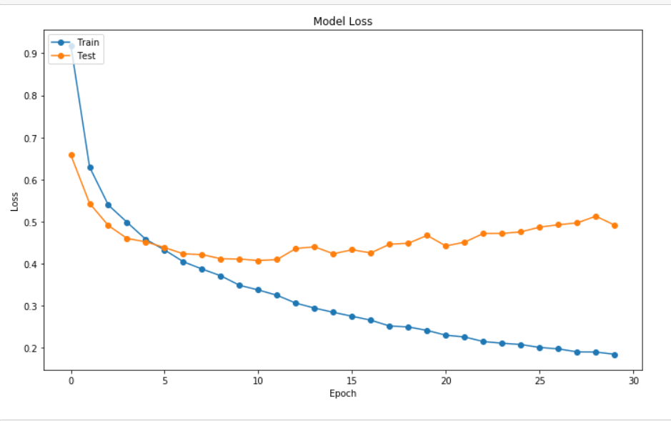
Model Loss
The loss of the train dataset is less than the loss of the test dataset
For both datasets, the accuracy is decreasing till the epoch 5
After epoch 5, the accuracy of the train dataset is decreasing with a lower rate
After epoch 5, the accuracy of the test dataset remains stable with few fluctuations

Slide 16
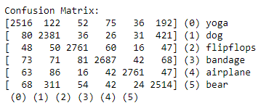
Confusion Matrix
Most of the elements are correctly classified
A small proportion of them is misclassified

Slide 17
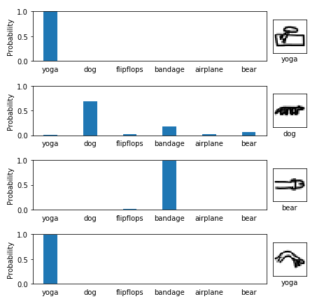
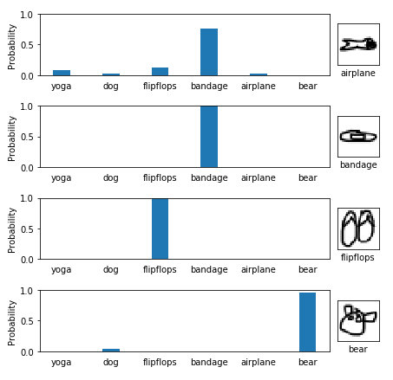
Testing the Model

Slide 18
Thank you!

