Slide 1
Nationwide Hackathon Pitch
AI Scheduling App for College Students
Fashad M. & Asher B.

Slide 2
Introduction
Team Members
Fashad Morrison - Team Lead & Program Developer
Asher Brown - Systems developers & Systems designers

Slide 3
TOC
Overview
Business Model
The Problem
Closing
Our Solution
Impact
Key Features
How It Works
Market Opportunity

Slide 4
Overview
SmartSchedule AI is an AI-powered scheduling application designed to help college students optimize their time, reduce stress, and improve academic performance. By using machine learning and predictive analytics, the platform creates personalized schedules based on a student’s classes, assignments, work commitments, and habits, while continuously adjusting in real time as changes occur. Unlike traditional planners, SmartSchedule AI acts as an intelligent assistant—prioritizing tasks, predicting workload, and providing actionable insights to enhance productivity. The solution empowers students to better manage their responsibilities, achieve higher academic outcomes, and maintain a healthier balance between school and personal life.

Slide 5
Understanding the problems
01
Time Management Issues
Students juggle classes, work, and life
Lack of structured planning tools
02
Missed Deadlines
Assignments overlooked or rushed
Poor prioritization of tasks
03
Lack of Planning
No clear overview of upcoming workload
Leads to last-minute stress and cramming

Slide 6
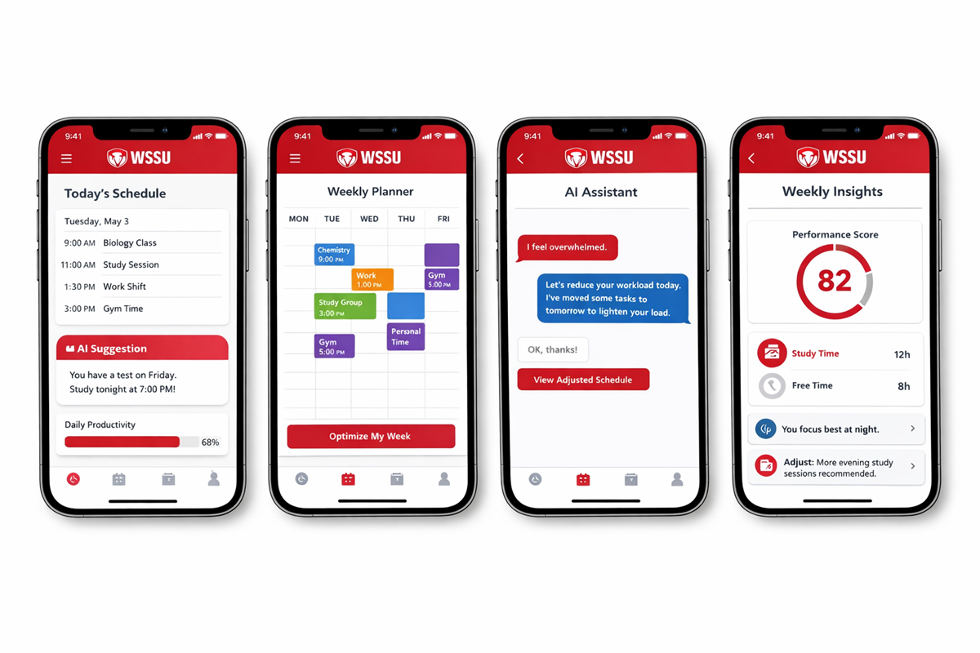
Our Solution
AI Scheduling System
Automatically builds optimized schedules
Adjusts in real-time based on changes
Personalized Experience
Adapts to student habits
Improves productivity over time

Slide 7
Key Features
Smart Scheduling
Creates daily and weekly plans
Balances workload efficiently
AI Assistant
Provides real-time suggestions
Responds to student

Slide 8



How It Works
•Machine Learning
Learns user behavior patterns
Continuously improves recommendations
Predictive Analytics
Estimates time for assignments
Prevents last-minute stress

Slide 9
Market Opportunity
Target Audience
College students nationwide
Expansion to high school and professionals
Scalability
Millions of potential users
Easy integration with universities

Slide 10
Cycle Diagram
04
Prototype
Refine
Freemium Model
Retest and include new components that will help the overall product.
01
03
Share
Get feedback
AI tools and subscriptions, share to beta testing as well.
Require a feedback sheet per use to see the overall rating.
02

Slide 11
Business Model
Freemium Model
Free version provides basic scheduling and calendar organization
Allows students to create and manage simple daily/weekly plans
Premium version unlocks full AI capabilities
Includes real-time schedule adjustments, predictive workload analysis, and personalized insights
Revenue Streams
Monthly subscription ($5–10/month) for premium features
Affordable pricing targeted toward college students University partnerships and licensing
Schools can offer SmartSchedule AI to students as part of academic support services Future expansion opportunities
Integration with academic platforms (Canvas, Blackboard)
Potential corporate partnerships for productivity tools

Slide 12
Impact
Academic Performance Improvement
Increases GPA by helping students stay ahead of deadlines
Encourages consistent study habits instead of last-minute cramming
Improves assignment completion rates and overall performance
Student Well-Being
Reduces stress and anxiety caused by poor time management
Prevents burnout by balancing workload with rest and personal time
Long-Term Success
Prepares students for real-world professional environments
Develops discipline, accountability, and self-management

Slide 13
Closing
Value Proposition
More than a planner
A personal success system
Vision
Empowering students through AI
Transforming academic

Slide 14

Thank you!

