Slide 1
Introduction to triangulations:
Terrain Analysis
Geometria Computacional
FIB - UPC
Rodrigo I. Silveira
Universitat Politècnica de Catalunya

Slide 2
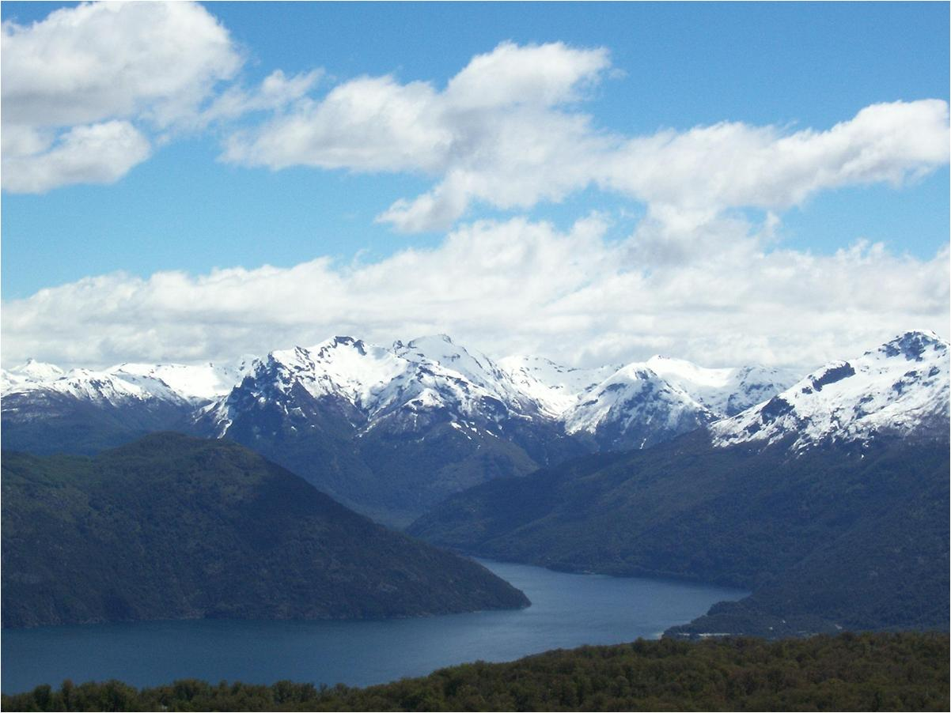
Notes:
Terrains are clearly interesting… this nice terrain is somewhere in the south of Argentina, for example. There are many interesting things you can do on a terrain like this. But, unfortunately, my talk is not exactly about terrains, but about terrain models.
But I hope you see that there are also interesting things you can do with terrain models!

Slide 3
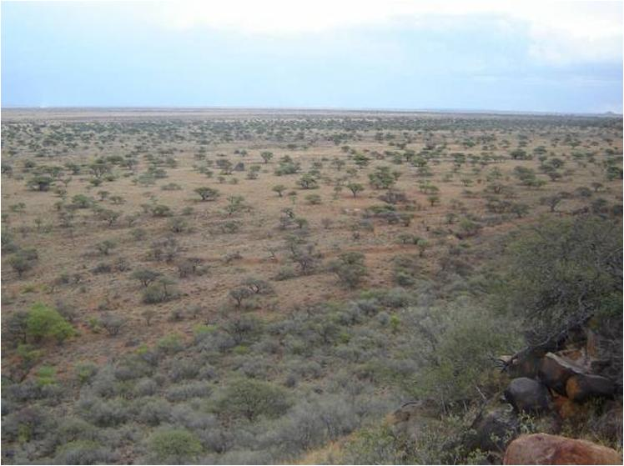
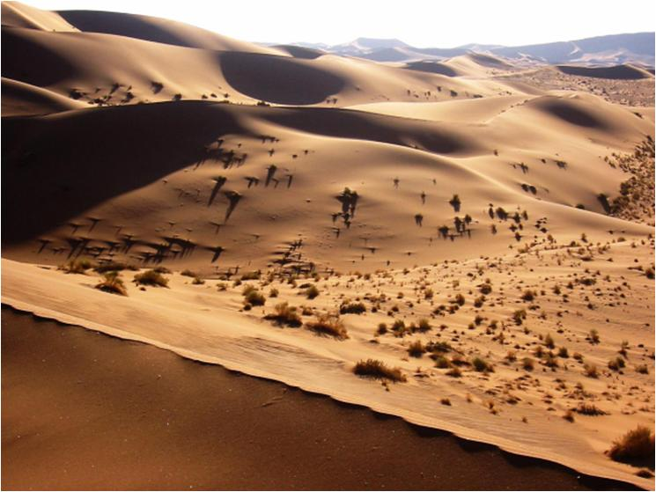
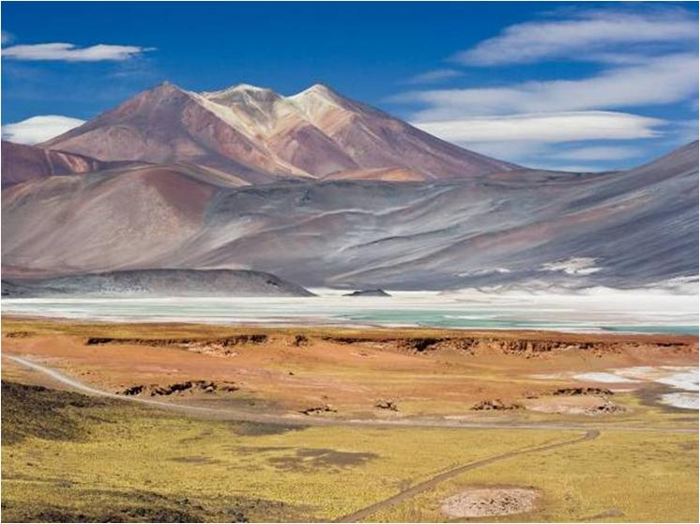
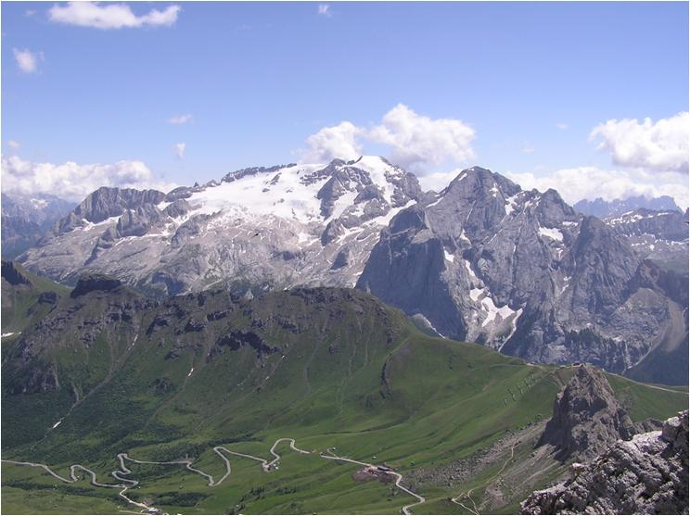
What’s a terrain?
“An area of land, when considering its natural features”
Continually
varying
surface
  What varies
  (for us) is
  elevation
Notes:
You know what a terrain is…
Terrains can be very different…
In many aspects, like vegetation, soil type, humidity, etc, but we will only consider elevation here.
Terrain 2: Italy
Terrain 4: Chile
Terrain 5: Savanna (somewhere in Africa)
Terrain 6: Dunes in Namibia (south west of africa).

Slide 4
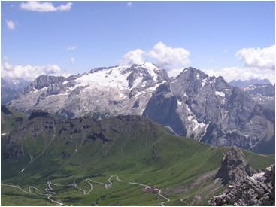

What’s a terrain for us?
Digital terrain model
Also: “digital elevation
model” or just DEM
Representation of the
variation of relief of a terrain
  That is… altitude
Notes:
Note that in a terrain, many other things, besides the altitude of the landsurface, vary (such as vegetation or temperature or humidity etc), but we will only look at elevation here.

Slide 5
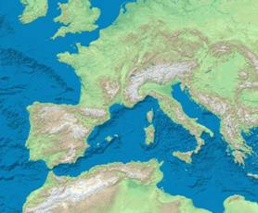
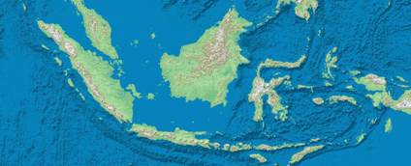
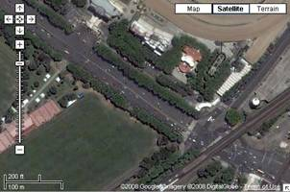
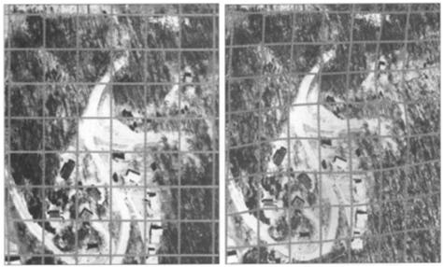
What do we want DEMs for?
Elevation data for map creation
Creation of orthophoto maps
Notes:
For constructing shaded relief maps.
----
What is the difference between an aerial photograph and an orthophoto?
A conventional perspective aerial photograph contains image displacements caused by the tilting of the camera and terrain relief (topography). It does not have a uniform scale. You cannot measure distances on an aerial photograph like you can on a map. It is not a map.
The effects of tilt and relief are removed from the aerial photograph by the rectification process to create an orthophoto.
An orthophoto is a uniform-scale photograph. It is a photographic map.
Since an orthophoto has a uniform scale, it is possible to measure directly on it like other maps.
---
Methods
There are two methods by which rectification of an aerial photograph can occur. In the first case, Ground Control Points (GCP) are determined either conventional ground surveys, from published maps, by Global Positioning System (GPS) surveys, or by aerotriangulation. These points are taken at visible physical features on the landscape. On the corresponding image, the x, y photo coordinates are then determined for each corresponding GCP. Depending on the type of algorithmic correction to be used, a minimum of 3 to 5 GCP must be established. The relationship of the x, y photo coordinates to the real world GCP is then used to determine the algorithm for resampling the image.
The second method of orthorectification is to use DEMs. These elevations are collected from stereoscopic models by photogrammetric methods to form a digital elevation model (DEM). As with using GCPs, the mathematical relationship between the real world coordinates and the scanned aerial photograph is determined and the digital image is resampled to create the rectified image.
For both cases, the resampling of the digital image involves warping the image so that distance and area are uniform in relationship to real world measurements. This means that with the resampled photo, an inch on the image now measures the same distance on steep terrain as it does in a field.

Slide 6
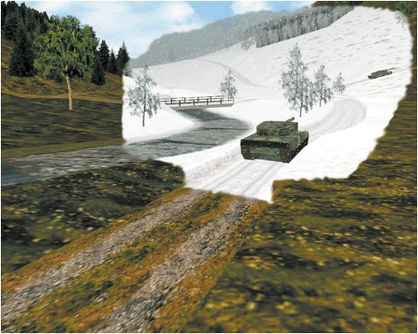
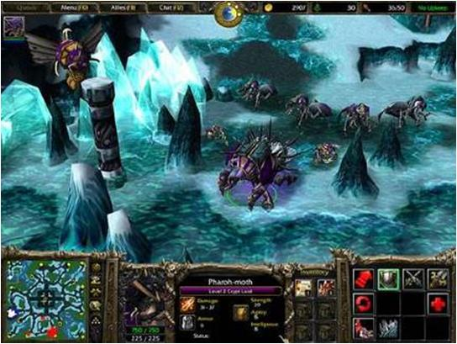
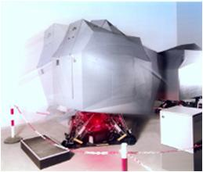
What do we want DEMs for?
3D Visualization
Source: Rheinmetall Defence
Notes:
For gaming and simulation.
For military purposes. This example is taken from the website of a german company (Rheinmetall Defence) that developed, among many other things, a tank driving simulator for the Norwegian army.
The game is Warcraft 3. Artificial terrain, but it’s still a terrain.

Slide 7
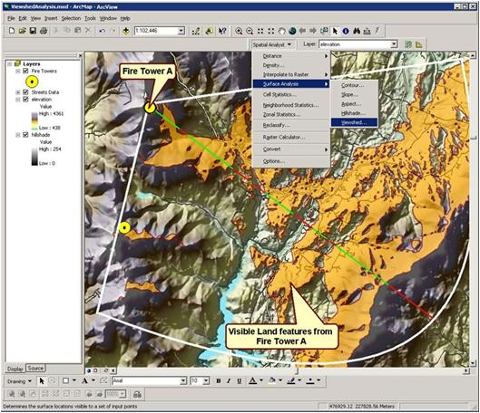
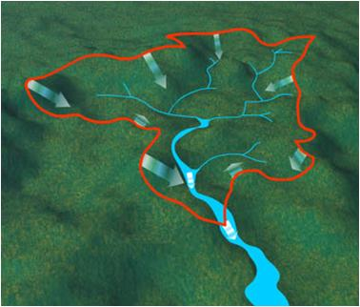
What do we want DEMs for?
Terrain analysis
  Planning support
    Cross-country visibility
    Road and dam planning
  Hydrology
    Watershed computation
    Rainfall runoff simulation
Notes:
Explain what the watershed computation is.
Also important is the rainfall runoff simulation. Why is it important. For many reasons, for example, for hydropower production.
Example from Norway: The effect of winter precipitation on hydropower production in Scandinavia is mainly related to the filling of the hydropower reservoirs in spring. Snow accumulated during winter feeds the reservoirs in spring and, thus, drives the energy production for the next year. A powerful monthly rainfall–runoff model is, consequently, an important part in understanding and managing the effects of climate variability and the availability of water for hydropower production.

Slide 8
How are DEMs produced?
Main ways to produce the data
  Digitizing from existing maps
  Land surveying
  Remote sensing

Slide 9
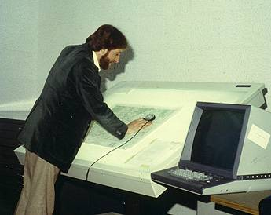
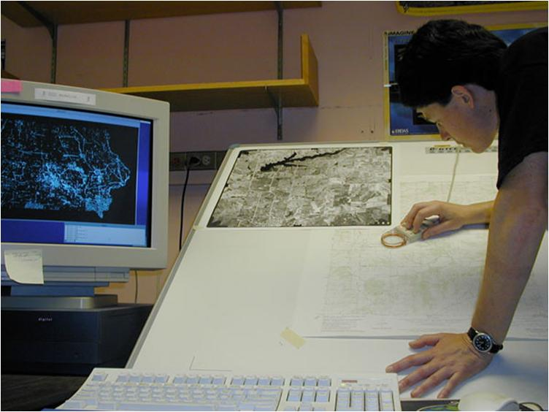
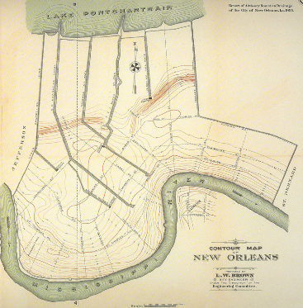
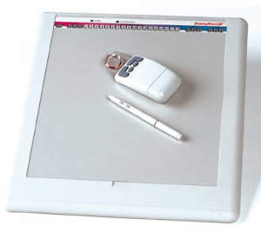
Getting data: digitizing
Digitize existing analog data
Notes:
You can see countour map of New Orleans from 1895. Say what a contour map is.
This is done by digitizing each contour using a digitizing tablet, a device attached to the computer that transmits very accurate coordinates of a map, drawing or curve. As the user traces each of the map’s contours, a series of (x,y) coordinates defining the contour are sent from the tablet to the computer. Digitizing the contours from simple maps is straightforward but for more complicated maps several rules should be followed.

Slide 10
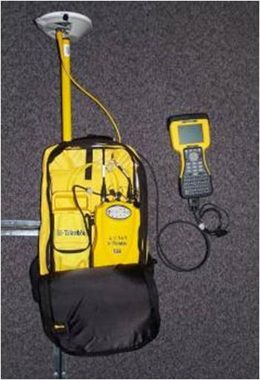
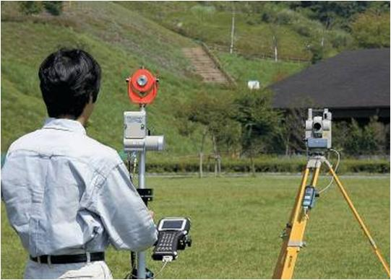
Getting data: surveying
Measure coordinates (x,y,z)
at a number of points
Using total station
or GPS receiver
Notes:
Total station:
A total station (Fig. 5) is a combination electronic transit and electronic distance measuring device (EDM).
A standard transit is basically a telescope with cross-hairs for sighting a target; the telescope is attached to scales for measuring the angle of rotation of the telescope (normally relative to north as 0 degrees) and the angle of inclination of the telescope (relative to the horizontal as 0 degrees). After rotating the telescope to aim at a target, one may read the angle of rotation and the angle of inclination from a scale. The electronic transit provides a digital read-out of those angles instead of a scale; it is both more accurate and less prone to errors arising from interpolating between marks on the scale or from mis-recording. The readout is also continuous; so angles can be checked at any time.
The other part of a total station, the electronic distance measuring device or EDM, measures the distance from the instrument to its target. The EDM sends out an infrared beam which is reflected back to the unit, and the unit uses timing measurements to calculate the distance traveled by the beam.
Even though surveying by using GPS is much easier, its precision sometimes it’s not enough (around 20m), and it can be severely affected by factors like vegetation, therefore for higher precision, total stations are still used.
The GPS in the picture looks different from the Tom-tom you’re probably used to… it’s a more “professional” one, with a better antenna, pole, to place exactly at the point you want to measure, and who knows how many other cool features.

Slide 11
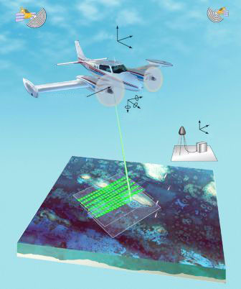
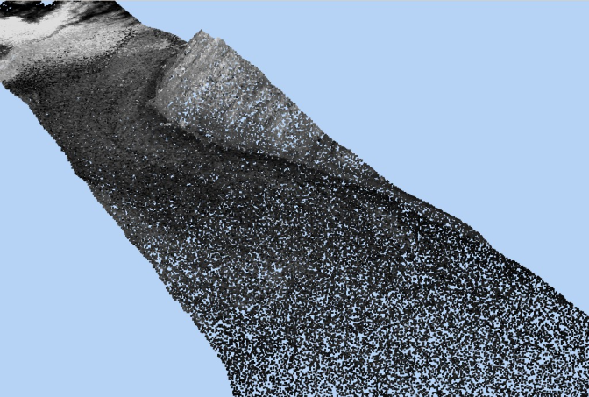
Getting data: remote sensing
Collecting data from an object, without coming into contact with it
Example: LIDAR
(LIght Detection
And Ranging)
  A.k.a. airborne
  laser scanning
Notes:
The LIDAR itself only measures the height of the point below, so it needs the help of a GPS to get the x,y coordinate of the points.
The airplane goes rather low, like 200-600m high.
An interesting thing is that LIDAR can detect both the terrain height and the canopy (vegetation) height, by choosing the first or last reflections of the beams (the first ones correspond to vegetation, the last ones to the terrain).
Another important remote sensing method is InSAR (interferometric synthetic aperture), it’s not optical as LIDAR, but based on microwave sensing principles.

Slide 12

Making a DEM… what’s next?
So we’ve got the data
  Probably a set of points
  in space (x,y,z)
  Not yet a DEM
We want a continuous model
  Meaning: able to compute the height
  of any point of the terrain

Slide 13
Two ways to represent DEMs
Grid or raster-based
Triangulated Irregular Networks (TINs)

Slide 14
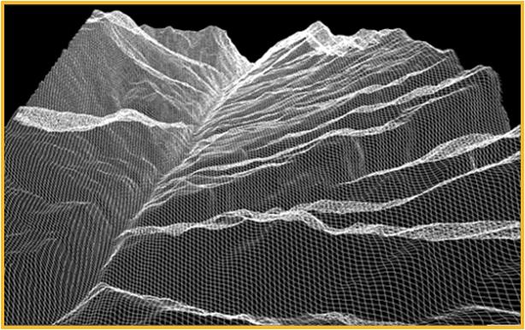
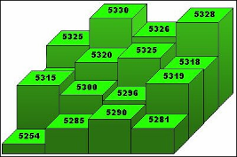
Grid terrains
Altitude matrix
The most common type
+ Very easy to manipulate
- Can be very redundant
- Fixed sampling rate
5325 | 5330 | 5326 | 5328
5298 | 5320 | 5325 | 5318
5315 | 5300 | 5296 | 5319
5254 | 5285 | 5290 | 5281
Elevation matrix
Notes:
Matrices are easy to handle by computers.
Many algorithms on grids are easy to code.
For example, just traversing the terrain (going through) every vertex / measurement once, is straightforward.

Slide 15
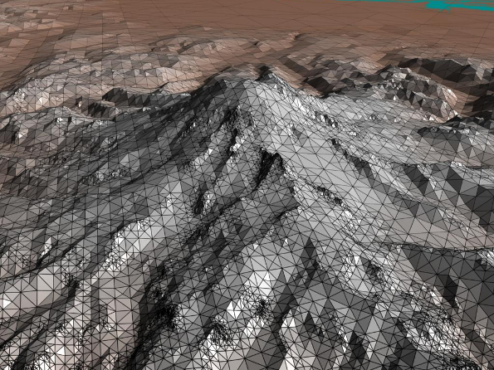
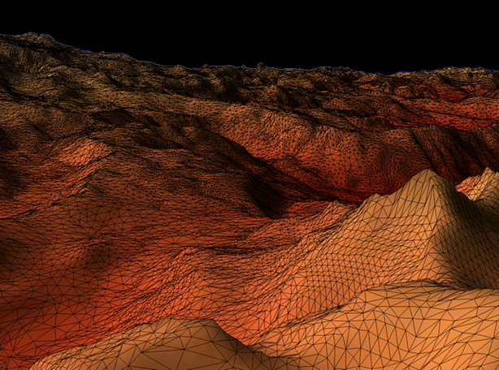
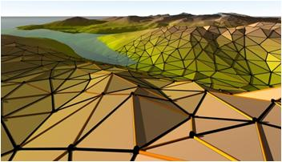
Triangulated Irregular Networks
Triangulated point set, with heights
+ Variable sampling rate
- More difficult to
handle
Notes:
Requires a more complicated data structure.
The algorithms also que more complicated. For example, traversing the terrain is not as simple as for grids.
Allows for variable resolution!
Many triangulations are possible, we’ll see later that which triangulation to choose is important.
Show variable resolution in picture

Slide 16
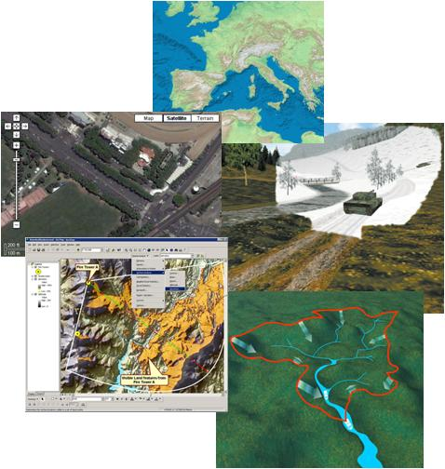
Let’s recap…
Terrains
  Digital terrains models
Many uses
Several ways to
obtain them
Two main ways to represent them
  Grids vs triangulated networks
Well-studied in Computational Geometry

Slide 17
Triangulations in CG
One of the most important topics in CG
Many things can be triangulated
  Polygons
  Points (in 2D, 3D,…)
    Actually, the space between points
  Surfaces

Slide 18
Triangulation problem
Input: a set of points in the plane
Output: subdivision into triangles

Slide 19
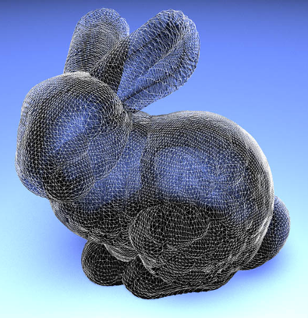
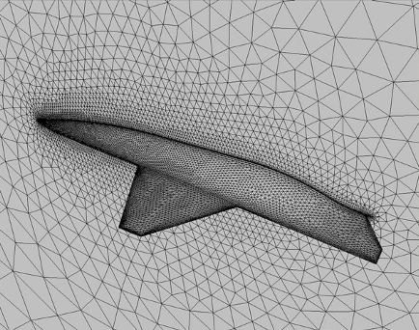
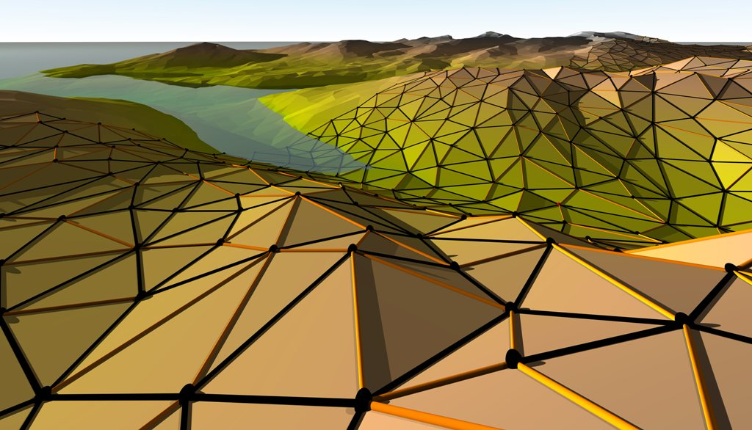
Triangulations
Applications
  Finite element methods
  Computer graphics
  Terrain modeling
Notes:
Finite element methods (método de los elementos finitos). They are widely used techniques to obtain approximate solutions to partial differential equations. The differential equations arising in physical simulation require numerical solution. Most numerical methods assume that the domain of interest
is divided into a mesh of small, simple elements. So the first step of this method is to divide the given problem region into simply-shaped elements creating a mesh. These methods discretize the simulated domain for example, the air around a wing|by dividing it into many small elements", typically triangles or quadrilaterals in two dimensions and tetrahedra (Spanish: tetraedros) or hexahedra in three dimensions.
(Mesh: malla)
Many times the points to be triangulated are not in the plane, but in space (3D). Then triangulations are used to represent surfaces or even volumes (when using tetrahedra). The provide continuous surface that interpolates the input points.
Computer graphics. It is standard to approximate complex surfaces by using a triangular or rectangular mesh. This makes several aspects of the rendering like shading and texture mapping easier, for example by allowing linear interpolation to be used within each triangle.
Terrain modeling.

Slide 20
Triangulations
Some basic facts
  Vertices (points), edges, and triangles
  It’s a planar graph
    n vertices, k of them in the convex hull
    2n-2-k triangles
    3n-3-k edges
vertex
edge
triangle

Slide 21
Triangulations
Many of them

Slide 22
Triangulations
Many… but how many?
If you have n points…
  How many triangulations are there?
n=3
n=4
Lower bound: Ω(2^{n})

Slide 23
Triangulations
Upper bound?
n points
Take a possible edge…
  either it is in your triangulation or not
There are ≈n²/2 possible edges
≤2^{((n^2)/2)} triangulations

Slide 24
Triangulations
If points in convex position, O(4^{n}n^{-3/2})
In general, it’s unknown
  Upper bound: O(30^{n} …)
  [Sharir & Sheffer, 2010]
  First bound was (10^13)^n [1982]
  Worst point set: Ω(8.65^{n})
Catalan number (C_{n})
Notes:
(10^13)^n (1982)
…
43^n (2006)
30^n (2010)
-----
The expression for the Catalan number Cn shown is asymptotic only (the exact expression is Choose(2n n) – Choose(2n n-1) or more standard: 1/(n+1) * Choose(2n n)

Slide 25
A point set with many triangulations
Worst point set known until 2010
[Aichholzer et al. (2005)]
“Double
zig-zag chain”
≈8.48^{n}
triangulations
Notes:
This construction is more subtle than what it seems.
All the edges drawn are fixed: the n/2 points on each of the chains are placed in a way such that all none of the edges can be crossed by another edge based on the point set.
On the other hand, both chains are far apart as to allow any connection between points on opposite chains.

Slide 26
Optimal triangulations
1 point set → many triangulations
Choice of triangulation important!

Slide 28
Optimal triangulations
Terrain modeling
  Height interpolation
29
25
29
25
24
24
77
77
19
19
78
78
73
73
15
15
75
75
12
12

Slide 29
Optimal triangulations
1 point set → many triangulations
Choice of triangulation important!
Choose the best one!
What shall we look at?
Triangle area
Smallest angle
Largest angle
Longest edge

Slide 30
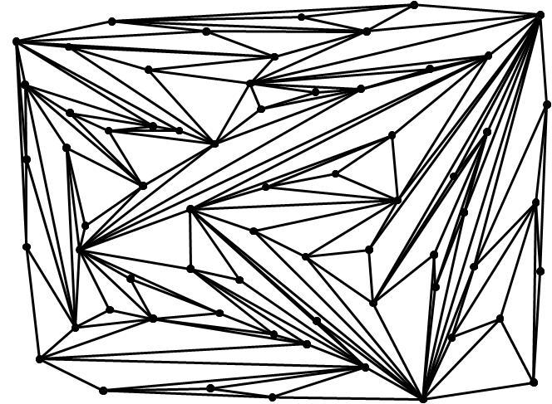
We want nice triangulations
To avoid the ones like this
Avoid
small angles!

Slide 31
How can we avoid small angles?
Simple answer:
Delaunay triangulation

