Slide 1
Applications of
Voronoi Diagrams to GIS
Geometria Computacional
FIB - UPC
Rodrigo I. Silveira
Universitat Politècnica de Catalunya

Slide 2
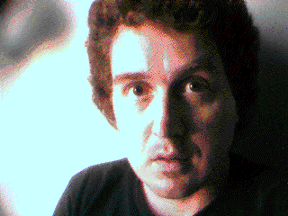
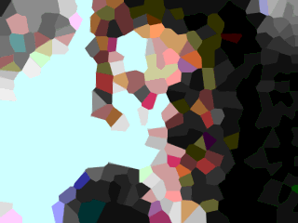

What can you do with a VD?
All sort of things!
Many related to GIS
Source: http://www.ics.uci.edu/~eppstein/vorpic.html
Notes:
Image processing / compression.

Slide 3
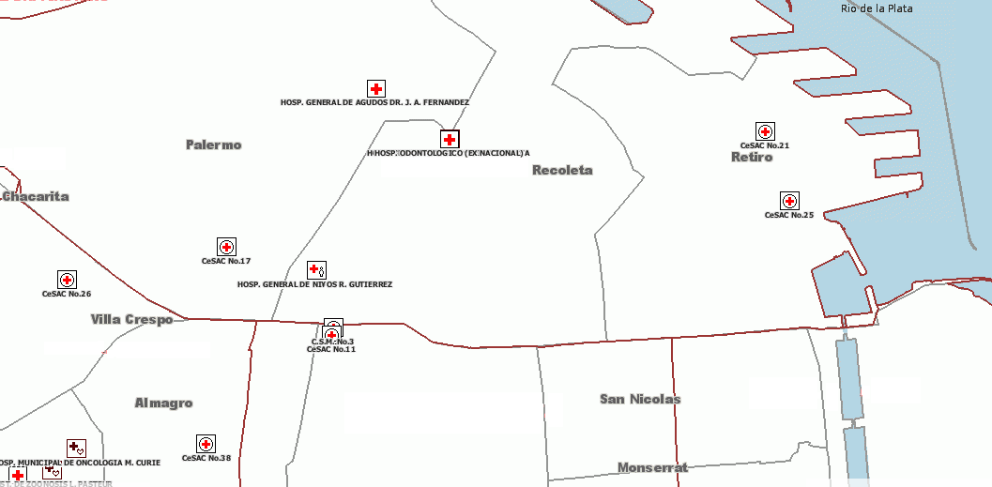
What can you do with a VD?
Already mentioned a few applications
    Find nearest… hospital, restaurant, gas station,...
Notes:
Most traditional motivation in CG literature: find nearest post office

Slide 4
More applications mentioned
Spatial Interpolation
  Natural neighbor method

Slide 5
Facility location
Application Example 1
Determine a location to maximize distance to its “competition”
Find largest empty circle
Must be centered
at a vertex
of the VD
Notes:
Ask how the VD can help us to find the largest empty circle?
Simplification: I am assuming the center lies inside in the hull of the sites.
Otherwise, if it can lie on the hull boundary, we also have to consider placing the center of the circle on Voronoi edges.
Note that the circle shown is the largest one with center in the part of the VD shown… there is actually a larger one on the top left, but its center falls outside the picture.

Slide 6
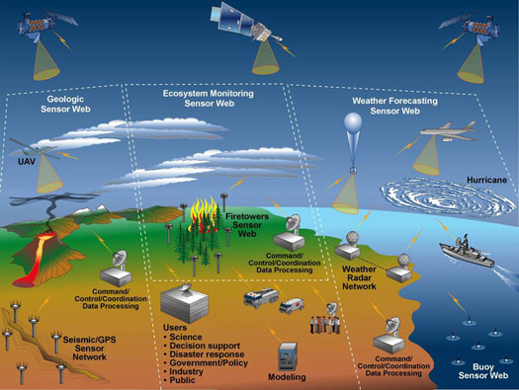
Coverage in sensor networks
Application Example 2
Sensor network
  Sensors
  distributed
  in an area to
  monitor some
  condition
Source: http://seamonster.jun.alaska.edu/lemon/pages/tech_sensorweb.html
Notes:
A wireless sensor network (WSN) consists of spatially distributed autonomous sensors to cooperatively monitor physical or environmental conditions, such as temperature, sound, vibration,pressure, motion or pollutants.^{[1][2]} The development of wireless sensor networks was motivated by military applications such as battlefield surveillance. They are now used in many industrial and civilian application areas, including industrial process monitoring and control, machine health monitoring^{[3]}, environment and habitat monitoring, healthcare applications, home automation, and traffic control.^{[1][4]}
^{About the picture:} A conceptual view of a large, multi-layer,multi-purpose, wireless sensor web.
UAV: Unmanned aerial vehicle

Slide 7
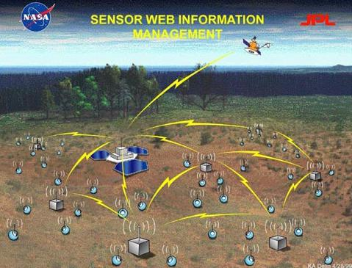
Coverage in sensor networks
Given: locations of sensors
Problem: Do they cover the whole area?
Assume sensors have a fixed coverage range
Solution: Look for largest empty disk, check its radius
Notes:
One important remark: in addition to checking the vertices of the VD, we must check:
Intersections of the VD with the black box (area of interset)
The corners of the black box
If sensors can have different range, we can use a weighted Voronoi diagram (the weight is the radius, or the squared radius, or something like that).
From Aurenhammer’s: These are also called power diagrams, and use the “distance function” pow(x,B(a, r)) = ||x − a||² − r².
A nice geometric interpretation is the following. For positive weights, a weighted site p can be viewed as a sphere with center p and radius
sqrt(w(p)). For a point x outside this sphere, pow(x; p) > 0, and Sqrt(pow(x; p)) expresses the distance of x to the touching point of a line tangent to the sphere and through x.

Slide 8
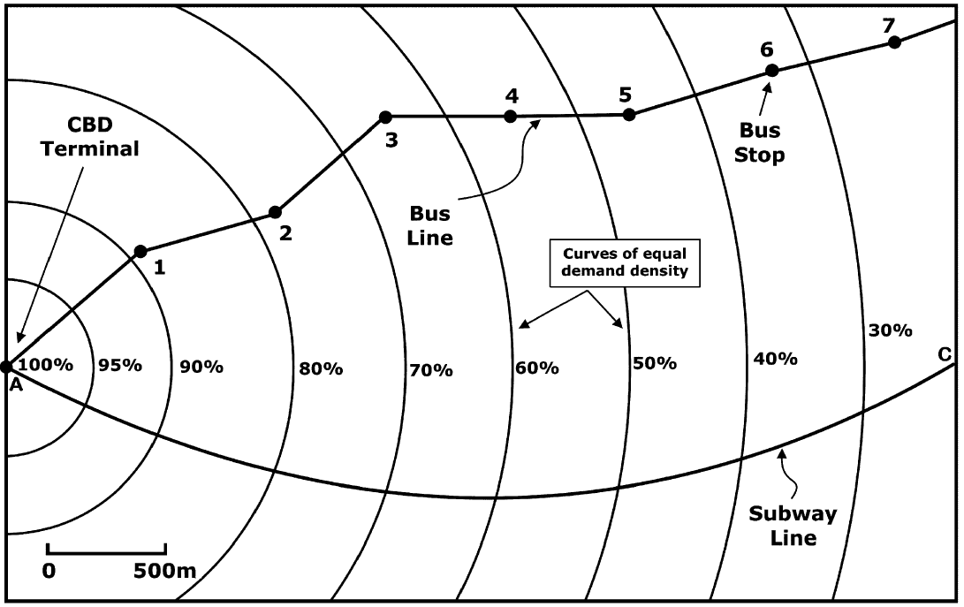
Building metro stations
Application Example 3
Where to place stations for metro line?
  People commuting to CBD terminal
People can also
  Walk
    4.4 km/h +
    35% correction
  Take bus
    Some avg speed
Source: Novaes et al (2009). DOI:10.1016/j.cor.2007.07.004
Notes:
The context is more complicated, they actually want to find the best locations in order to maximize the area of the city that will use the metro.
They take into account that the more stations you have, the longer the metro journey takes, so people may prefer to walk or take a bus if there are too many stations on the way to the CBD terminal.
CBD=Center Business District

Slide 9
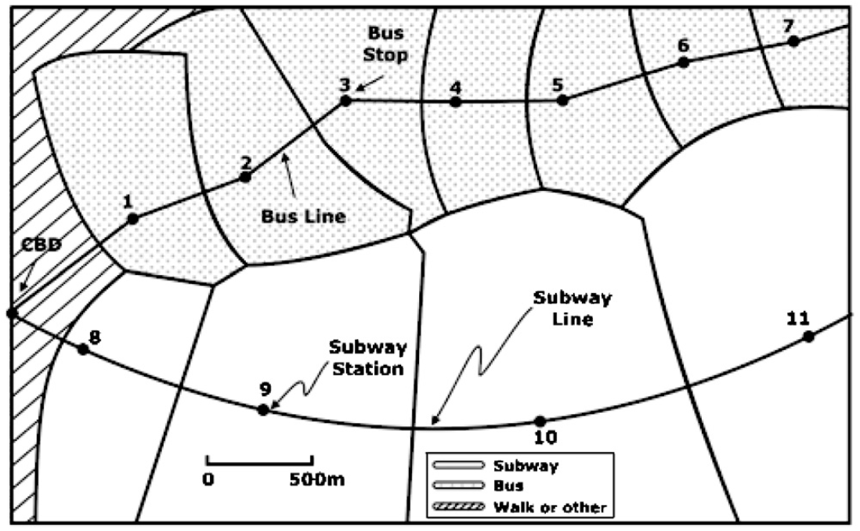
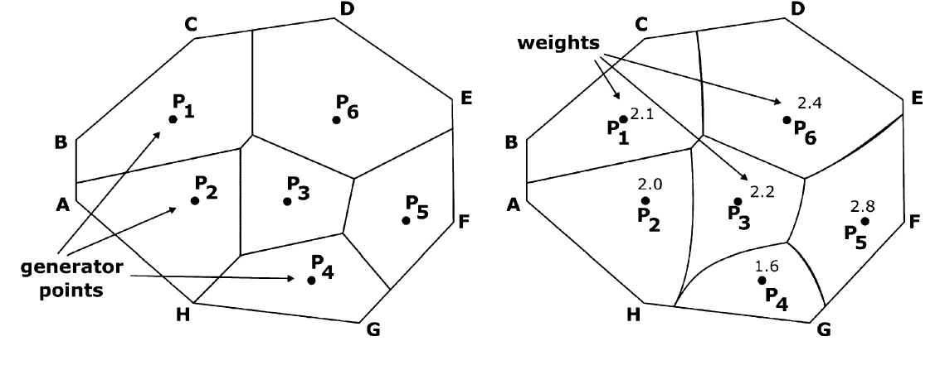
Building metro stations
Weighted Voronoi Diagram
  Distance function is not Euclidean anymore
  dist_{w}(p,site)=(1/w) dist(p,s)
Notes:
The higher the weight of a region, the heigher its dominance (the more points it attracts)
Recall that the region of a site s is all those points that have s as closest site.
Since in the problem setting all people are interested in traveling to the CBD, the distance between a site (bus or metro station) and a point is the walking distance to the station plus the time from that station to the CBD.

Slide 10
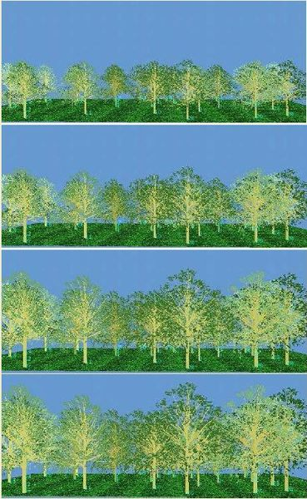
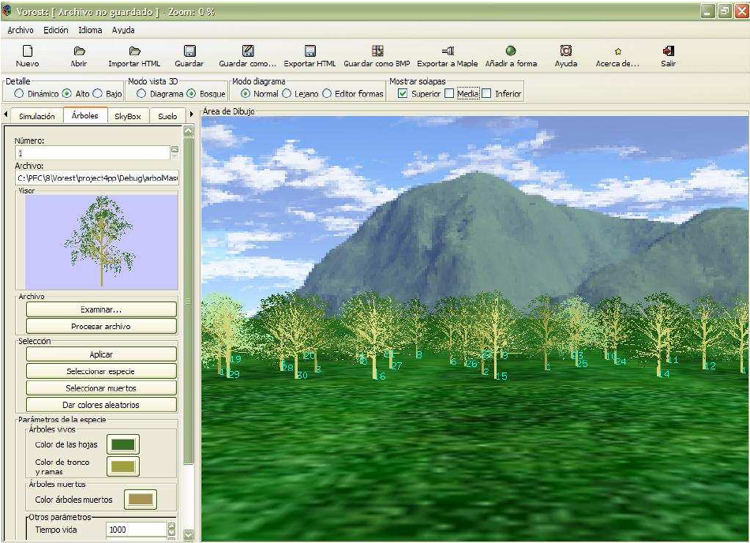
Forestal applications
Application Example 4
VOREST: Simulating how trees grow
More info: http://www.dma.fi.upm.es/mabellanas/VOREST/

Slide 11
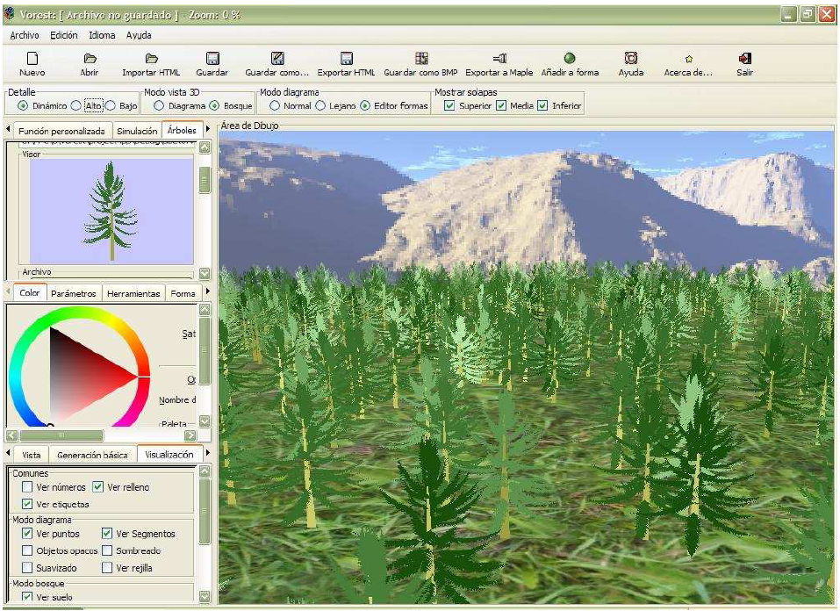
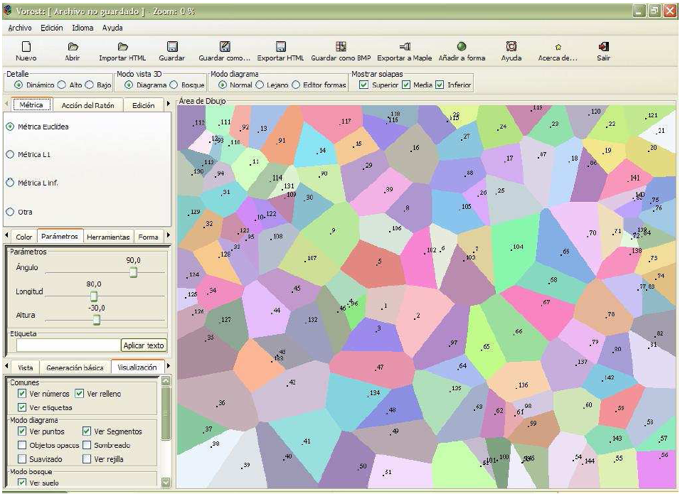
Simulating how trees grow
The growth of a tree depends on how much “free space” it has around it
Notes:
Not only the the space on the terrain, but also de space around its “copa”
“La competencia que se produce entre los ¶arboles por dominar el espacio para poder desarrollarse hace que estos sistemas biol¶ogicos est¶en directamente relacionados con los diagramas de Voronoi. En efecto, un diagrama de Voronoi puede verse como la partici¶on del espacio resultante de la expansi¶on de los sitios que lo generan”
Apparently this was modeled by biologists using Voronoi diagrams (although not using that name) something like 50 years ago.

Slide 12
Voronoi cell: space to grow
Metric defined by expert user
  Non-Euclidean
Area of the Voronoi cell is the main input to determine the growth of the tree
Voronoi diagram estimated based on image of lower envelopes of metric cones
  Avoids exact computation
Notes:
Existen multitud de modelos de crecimiento forestal. Los modelos de arbol individual simulan la evolucion de las variables que definen un arbol concreto
(fundamentalmente su tamaño). Entre estos destacan los modelos dependientes de la distancia o
con distribución espacial (single tree spatial models), en los cuales, además de las características
dendrométricas del árbol, se contempla su localización en el terreno a través de sus coordenadas, lo
que permite utilizar en el modelo relaciones de competencia entre vecinos.

Slide 13
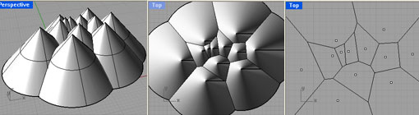
Lower envelopes of cones
Alternative definition of VD:
  2D projection of lower envelope of
  distance cones centered at sites

Slide 14
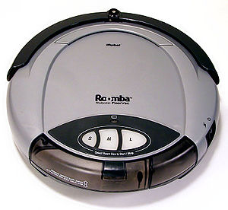
Robot motion planning
Application Example 5
  Move robot amidst obstacles
  Can you move a disk (robot) from one location to another avoiding all obstacles?
Most figures in this section
are due to Marc van Kreveld

Slide 15
Robot motion planning
Observation: we can move the disk if and only if we can do so on the edges of the Voronoi diagram
  VD edges are (locally) as far as possible from sites

Slide 16
Robot motion planning
General strategy
  Compute VD of obstacles
  Remove edges that get too close to sites
    i.e. on which robot would not fit
  Locate starting and end points
  Move robot center along VD edges
This technique is called retraction

Slide 17
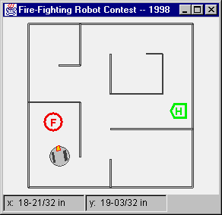
Robot motion planning
Point obstacles are not that interesting
  But most situations (i.e. floorplans) can be represented with line segments
Retraction just works
in the same way
  Using Voronoi diagram
  of line segments

Slide 18
VD of line segments
Distance between point p and segment s
  Distance between p and closest point on s

Slide 19
VD of line segments
Example

Slide 20
VD of line segments
Example

Slide 21
VD of line segments
Some properties
  Bisectors of the VD are made of line segments, and parabolic arcs
  2 line segments can have
  a bisector with up to 7 pieces

Slide 22
VD of line segments
Basic properties are the same

Slide 23
VD of line segments
Can also be computed in O(n log n) time
Retraction works in the same way

Slide 24
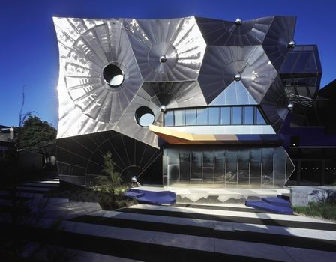
Questions?
Victorian College of the Arts (Melbourne, Australia)

