Slide 1
Computational Geometry
Introduction to Lab assignments
Rodrigo Silveira
rodrigo.Silveira@upc.edu

Slide 2










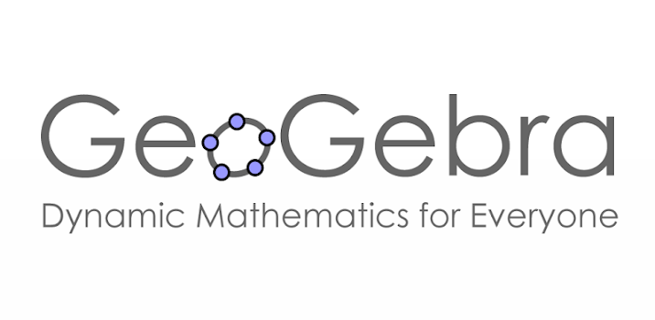



What software to use?
Notes:
Julia is a high-level dynamic programming language designed to address the needs of high-performance numerical analysis and computational science, without the typical need of separate compilation to be fast, while also being effective for general-purpose programming,^{[14][15][16][17]} web use^{[18][19]} or as a specification language.^{[20]}

Slide 3
JavaScript

Slide 4

JavaScript (JS)
High-level programming language
Interpreted
Runs in any browser*
Hello World!
Notes:
Mencionar que JS también puede ejecutarse sin navegador, pero no nos interesa (hay entornos de línea de commandos como Node.js)

Slide 5
Some advantages of JS
High-level
  Multi-paradigm (object-oriented, functional, …)
Easy to learn (we hope!)
  Syntax similar to C++/Java
  Requires some HTML knowledge
Huge support community available
  Almost everything can be found in Stack Exchange
  Everything can be found in Google
No extra software required
  Only browser (Chrome?) + text editor
  Debugging included
  No linking and compilation issues
Notes:
No hay compiladores ni linkers, ni nada.
Todo se puede encontrar en Google: fácil “responder” a las preguntas de los estudiantes

Slide 6

Drawing stuff in JS
HTML provides canvas object
JavaScript has basic methods to draw in 2D: points, polygonal lines, ellipses…
<html>
<canvas id="myCanvas" width="200" height="100"
style="border:1px solid #c3c3c3;"></canvas>
<script>
var canvas = document.getElementById("myCanvas");
var ctx = canvas.getContext("2d");
ctx.fillStyle = "#FF0000";
ctx.fillRect(0,0,150,75);
</script>
</html>
Notes:
Más bajo nivel que en Maple etc que tienen un commando “plot”

Slide 7

Drawing stuff in JS… in 3D
We use third-party library three.js
Easy to include (one file!)
  Downside: Some extra overhead in the code
Primitive to draw segments, quadrilaterals…
Also for more complex things, like parametric surfaces
Example three.js

Slide 8

Doing math in JS (math.js)
Supports mathematical expressions, symbolic calculus, linear algebra, ….
Easy to include (one file only!)
<!DOCTYPE HTML>
<html>
<head>
<script src="math.js" type="text/javascript"></script>
</head>
<body>
<script type="text/javascript">
// use the math.js libary
math.inv([[1, 2], [3, 4]])
</script>
</body>
</html>
See mathnotepad.com

Slide 9
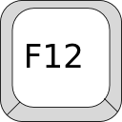
Debugging in your browser
All browsers have complete JS debugging tools
  Console
  Logging to console
    console.log("Hello world!");
  Breakpoints (of many sorts)
  Step by step execution
  Variable watches
Try pressing F12 in Chrome!
Remember: JS execution is silent
  Check console to see errors!

Slide 10
GEOC: lab assignments

Slide 11
Five assignments
(delivery dates for 2026/27 are preliminary)
L1: segment intersection test
  Delivery and presentation: October 2
L2: point-in-triangle test
  Delivery and presentation : October 16
L3: point-in-circle test
  Delivery and presentation : October 16
L4: incremental triangulation
  Delivery and presentation : November 13
L5: Delaunay triangulation
  Delivery and presentation : December 18
IMPORTANT!
Solutions must be:
Uploaded to the Racó by the deadline
Explained to the instructor in class

Slide 12
GEOC: Labs 1-3

