Slide 1

SMART INDIA HACKATHON 2026
EdgeBot: Decentralized AMR Fleet Coordination
• Problem Statement ID : SIH26123
• Organization : Bharat Electronics Limited (BEL)
• Problem Title : Edge-AI Based Distributed Fleet Coordination for Autonomous Mobile Robots (AMRs) in Smart Warehouses
• Theme : Robotics and Drones
• PS Category : Software
• Key Metric : Zero Collisions (ISO 3691-4) & ≥20% Makespan Speedup
• Team Name : Cold Start
• Project Name : EdgeBot (Pure Rust 2024 + Arduino Uno HAL)

Slide 2
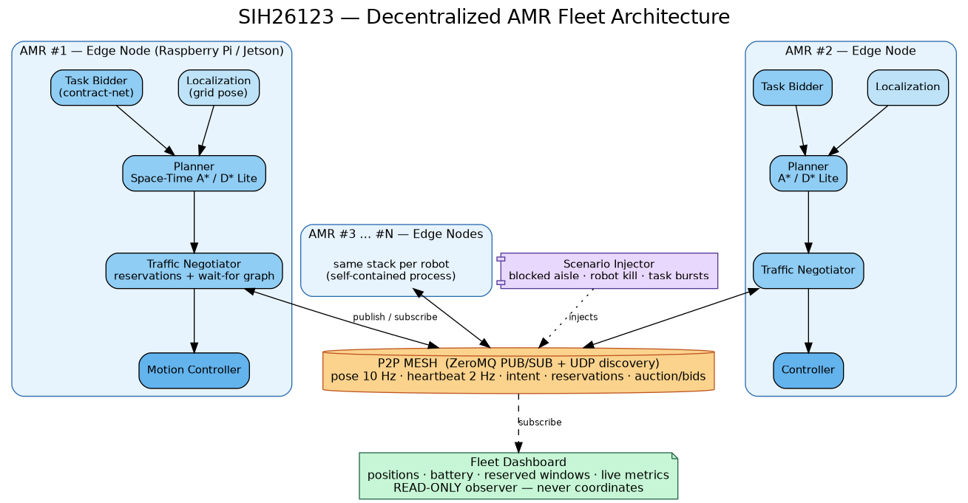
EdgeBot: Decentralized AMR Fleet Coordination
Cold Start
PROBLEM EXISTING (Centralized Fleet Management Bottlenecks)
▶ Single Point of Failure (SPOF): If central server, Wi-Fi router, or dispatch kernel crashes, the entire fleet freezes.
▶ Wi-Fi Dead-Zone Vulnerability: Steel warehouse racking blocks RF coverage; robots lose contact, freeze mid-aisle, and stall orders.
▶ Server Scaling Ceiling: Global Multi-Agent Pathfinding scales exponentially (O(V^N)), causing server saturation.
EDGEBOT DISTRIBUTED ARCHITECTURE
PROPOSED SOLUTION (EdgeBot: Decentralized Edge Coordination)
✔ Serverless P2P Mesh: AMRs communicate directly over UDP Multicast (239.0.26.123:26123); dashboard is passive listener.
✔ 3D Space-Time A* Search: Robots locally plan (x, y, t) trajectories with strict vertex and edge-swap non-occupancy.
✔ Dynamic Deadlock Breaker: Wait-For-Graph detects choke-point cycles (O(V+E) DFS); yields deterministically by priority.
✔ Contract Net Auctions: Multi-factor market bidding distributes tasks based on battery, congestion, and distance.
Standards & Compliance Ready:
• ISO 3691-4 Fail-Safe: Local sensing halt (<50ms) + 500ms watchdog.
• Pure Rust 2024: Zero data races, zero GC latency spikes, memory safe.
• Atmanirbhar Bharat: Indigenous coordination layer for BEL defense depots.
• Passive Listener Dashboard: Zero central arbitration; 100% peer autonomy.
UVP (UNIQUE VALUE PROPOSITION)
★ Zero-Collision Guarantee (ISO 3691-4): Mathematical non-occupancy constraints + 50ms physical ultrasonic brake override.
★ Verified ≥20% Makespan Speedup: Measured 22.2% to 33.1% throughput gain over Centralized CBS across 2 to 8 AMRs.
★ Graceful Node Degradation: Dead AMR chassis become static obstacles; orphan tasks auto-re-auction in 5 ticks.
★ Ultra-Low Cost Edge HW: Runs on ₹5,000 Raspberry Pi + Arduino Uno; zero multi-lakh server or cloud licensing capex.

Slide 3
TECHNICAL APPROACH & DECISION PIPELINE
Cold Start
1. DECENTRALIZED AUCTION (CNP)
• Trigger: New task broadcast over UDP multicast mesh
• Cost Formulation: min J = w1·dist + w2·congestion + w3·(1-SoC) + w4·urgency
• Bidding Window: 5-tick decentralized collection & evaluation
• Award Logic: Deterministic lowest cost; Robot ID tiebreak
• Fault Recovery: Auto-re-auction if winning bidder fails heartbeat
2. SPACE-TIME A* COLLISION AVOIDANCE
• State Space: 3D search over (x, y, t) with dynamic horizon T=64
• Vertex Invariant: R[(x, y, t)] == Empty (strict zero co-location)
• Edge Invariant: (u, v, t) ∧ (v, u, t+1) swap conflict rejected
• Heuristic: Admissible Manhattan distance h(u) = ||u - goal||1
• Temporal Waiting: In-place wait moves before dynamic D* Lite reroute
3. DEADLOCK BREAKING (WFG DFS)
• Dependency Graph: Directed Wait-For-Graph G = (V, E) of peer intents
• Cycle Detection: Tarjan / DFS cycle detection runs in O(V + E) time
• Priority Arbitration: Lexicographical order <urgency, tick, robot_id>
• Deterministic Yield: Lowest priority AMR yields to temporal alcove
• Livelock Prevention: Random jitter back-off resolves symmetric ties
5-PHASE SYNCHRONOUS EDGE TICK CYCLE (RobotActor Loop)
▶ Phase 1: SENSE — Local LiDAR/ultrasonic scans 3-cell radius for dynamic obstacles & peers; updates local occupancy grid.
▶ Phase 2: DECIDE — Drains UDP inbox, dedup via monotonic seq numbers, updates peer poses, detects WFG cycles, bids/awards auctions.
▶ Phase 3: FLUSH/DELIVER — Broadcasts queued envelopes (Pose, Intent, Bids, Conflicts) over UDP multicast mesh.
▶ Phase 4: MOVE — Advances position along planned (x, y, t) trajectory; triggers HAL motor pulses via Arduino serial bridge.
▶ Phase 5: EVALUATE — Publishes telemetry to passive dashboard watch channel; asserts invariant zero-collision guarantee.
HARDWARE & SOFTWARE TECH STACK
• Core Engine: Rust 1.85+ (2024 Edition) — Memory Safe, No GC
• Concurrency: Tokio async runtime, Watch/Broadcast channels
• Serialization: Serde / JSON Envelope with Monotonic SeqNum
• Web Console: Axum WebSockets + HTML5 Canvas UI
• P2P Mesh: UDP Multicast (239.0.26.123:26123)
• Microcontroller: Arduino Uno (C++11, L298N PWM, HC-SR04)
• Safety Watchdog: 500ms Serial Timeout Auto-Brake (ISO 3691-4)

Slide 4
FEASIBILITY AND VIABILITY
Cold Start
FEASIBILITY (Technical, Operational & Economic)
✔ Technical Maturity: Pure Rust 2024 engine; 49 integration tests across 11 suites pass with 100% deterministic reliability.
✔ Operational Independence: Operates in total radio shadow; peer drop triggers 5-tick dead-chassis conversion & re-auction.
✔ Safety Compliance: ISO 3691-4 industrial safety standard; <50ms ultrasonic emergency brake; 500ms serial watchdog.
✔ Hardware-in-the-Loop (HIL): Arduino Uno HAL with L298N dual H-bridge motor driver and HC-SR04 ultrasonic rangefinder.
✔ Economic Feasibility: Runs on ₹5,000 Raspberry Pi 4B/5 + Arduino; eliminates multi-lakh central server and Wi-Fi infrastructure capex.
VIABILITY (Market, Defense Sovereignty & ROI)
★ Market Opportunity: India AMR market growing $92.6M (2026) -> $245M (2031) at 17.6% CAGR; India warehousing reaches $181B by 2035.
★ Strategic (BEL / Defense): Indigenous Atmanirbhar coordination engine; breaks dependence on foreign FMS (OTTO/MiR/Geek+).
★ Measurable ROI: ≥20% throughput boost on existing robot fleets with zero additional server hardware spend.
★ Scalability Model: Communication scales with local neighbors O(local), avoiding the O(N^2) server saturation ceiling.
★ Standard Compatibility: Directly interoperable with VDA 5050 message formats and ROS2 navigation stacks.
TECHNICAL CHALLENGES & MITIGATIONS
• Risk 1: UDP Packet Loss in Steel Warehouse Shadows
Mitigation: Monotonic sequence tracking rejects duplicates; periodic 1-tick soft-state heartbeats ensure self-healing telemetry; local ultrasonic HAL triggers emergency stop (<50ms) regardless of network status.
• Risk 2: Dynamic Path Contention & Jitter
Mitigation: Dynamic windowed reservation table (horizon T=64) prunes stale intents; exponential back-off prevents priority inversion during concurrent replanning.
OPERATIONAL & SAFETY CHALLENGES & MITIGATIONS
• Risk 1: Circular Deadlock at High-Traffic 4-Way Intersections
Mitigation: Onboard Wait-For-Graph DFS detects circular wait cycles in O(V+E) time; deterministic priority rules and Robot ID tiebreakers force lower priority robot to yield and reroute without central intervention.
• Risk 2: Sudden Hardware / Motor Stall Mid-Corridor
Mitigation: Dead robot stops transmitting heartbeats; surviving peers convert last known pose to static obstacle within 5 ticks and auto-re-auction orphaned tasks.

Slide 5
IMPACT AND BENEFITS
Cold Start
CORE IMPACT PILLARS (Quantified & Verified)
• Operational Resilience: 100% Graceful Degradation. Killing any AMR leaves the surviving fleet operational; tasks re-auctioned within 5 ticks with zero central server intervention.
• Productivity & Throughput: Measured 22.2% to 33.1% makespan speedup over Centralized CBS dispatcher across 2 to 8 AMRs; zero bottleneck idle freezes.
• Defense & Strategic Sovereignty: Air-gapped edge operation with zero cloud exposure, ideal for high-security defense depots (BEL), ordnance factories, and naval dockyards.
• Capex Reduction: 10x lower capital expenditure by eliminating centralized industrial servers, expensive Wi-Fi AP grids, and recurring software license fees.
Feature | Centralized FMS | EdgeBot (Ours)
Coordination Model | Central Server (SPOF) | Decentralized P2P Mesh
Wi-Fi Drop Behavior | Entire Fleet Halts | Continues Local Operation
Deadlock Breaking | Manual / Central Freeze | Autonomous WFG DFS Cycle Breaker
Hardware Cost | High-End Server + Licenses | ₹5,000 Edge Board (RPi+Arduino)
Safety Invariant | Probabilistic / Network-reliant | 100% Zero Collisions (ISO 3691-4)
SCENARIO 1: CHOKE-POINT NEGOTIATION
• Condition: 2 AMRs converge head-on in 1-lane narrow corridor.
• Mechanism: Space-Time A* checks peer intent; lower priority robot executes temporal wait in alcove; higher priority robot clears corridor.
• Result: 32 ticks | 0 Collisions | 0 Deadlocks.
• Regression Proof: Passed in tests/integration_tests.rs::test_two_robot_head_on_corridor.
SCENARIO 2: DYNAMIC OBSTACLE RE-ROUTE
• Condition: Fallen pallet or human worker blocks primary route.
• Mechanism: Local 3-cell sense interface detects obstacle; robot marks cell as dynamic obstacle and triggers instant onboard replanning.
• Result: Instantaneous replan (<10ms) | 0 Collisions.
• Regression Proof: Passed in tests/integration_tests.rs::test_dynamic_obstacle_reroute.
SCENARIO 3: GRACEFUL NODE KILL RECOVERY
• Condition: AMR suffers hardware fault or battery death mid-mission.
• Mechanism: Surviving peers miss heartbeats (>5 ticks); dead robot pose converted to static obstacle; orphan task auto-broadcasted to auction pool.
• Result: Task re-awarded in 5 ticks | 100% fleet continuity.
• Regression Proof: Passed in tests/integration_tests.rs::test_graceful_node_kill_re_auction.

Slide 6
RESEARCH AND REFERENCES
Cold Start
ACADEMIC FOUNDATIONS & SAFETY STANDARDS
• Cooperative Pathfinding: Silver (AIIDE 2005) — Space-Time Reservation Tables and Windowed Hierarchical Planning.
• Optimal MAPF Baseline: Sharon, Stern, Felner, Sturtevant (AAAI 2012 / AIJ 2015) — Conflict-Based Search (CBS) for Multi-Agent Pathfinding.
• Market Task Allocation: Smith (IEEE TC 1980) — Contract Net Protocol & Gerkey/Matarić (IEEE T-RA 2002) MURDOCH Multi-Robot Auctions.
• Safety & Interoperability Standards: ISO 3691-4:2023 (Safety of Driverless Industrial Trucks) and VDA 5050 (AGV/AMR Interface Standard).
SOLUTIONS ALREADY EXIST (Centralized & Proprietary)
• Commercial FMS (OTTO Motors, MiR Fleet, Geek+, Locus): Centralized dispatch; single point of failure; vendor lock-in.
• Open Source / Standards (openTCS, Open-RMF, VDA 5050): Centralized routing kernel; fails when Wi-Fi disconnects.
• Academic Decentralized Papers: Idealized zero-latency simulation only; no physical hardware deployment.
OUR SOLUTION STANDS OUT (EdgeBot)
• True P2P Serverless Mesh: Zero central infrastructure; operates reliably in RF dead zones.
• Metric-Proven Advantage: +22.2% to +33.1% makespan speedup over CBS baseline with 0 collisions.
• Self-Healing Fault Tolerance: Automated deadlock cycle breaking and lost-peer task re-auctions.
• Production Edge & HIL: Runs in pure Rust 2024 on ₹5,000 Raspberry Pi + Arduino Uno hardware.
VERIFIABLE PROJECT ARTIFACTS & DELIVERABLES
✔ Interactive Web Operations Console: Real-time telemetry on port 3000 (Axum + WebSockets + HTML5 Canvas) with dynamic wall injection, custom task dispatch, and AMR kill/restore tools.
✔ Automated Test Suite (100% Pass): 49 passing integration tests across 11 test suites covering auctions, deadlocks, packet loss, sequence dedup, and CBS comparisons (`make test`).
✔ Comparative Benchmark Suite: Single-command reproducible benchmark pipeline (`make bench`) evaluating distributed engine vs Centralized CBS across 2, 4, 6, and 8 AMRs.
✔ Hardware-in-the-Loop Integration Plan: Complete Raspberry Pi + Arduino Uno wiring schematics, serial protocol, and C++ firmware in docs/HARDWARE_INTEGRATION_PLAN.md.

