Slide 1
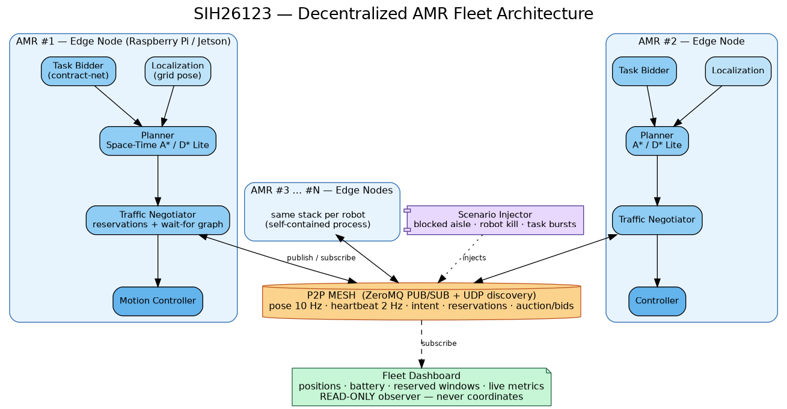
SMART INDIA HACKATHON 2026
• Problem Statement ID : SIH26123
• Organization : Bharat Electronics Limited (BEL)
• Domain & Category : Robotics and Drones | Software
• Problem Title : Edge-AI Based Distributed Fleet Coordination for Autonomous Mobile Robots (AMRs) in Smart Warehouses
• Proposed Solution : SwarmEdge — Decentralized P2P AMR Coordination Engine
• Hard Criteria : Zero Inter-Robot Collisions (ISO 3691-4) & ≥20% Makespan Speedup
• Target Platform : Pure Rust 2024 on Raspberry Pi 4B/5 + Arduino Uno HAL
DECENTRALIZED EDGE-AI FLEET ARCHITECTURE
Key Innovation Summary:
✔ No Central Server: Eliminates Single Point of Failure (SPOF)
✔ Local Space-Time A*: 3D non-occupancy & edge-swap safety
✔ Dynamic Deadlock Breaker: Local Wait-For-Graph cycle DFS
✔ Market Task Auctions: Multi-factor Contract Net Protocol
SIH26123 — SwarmEdge | Smart India Hackathon 2026 | Page 1

Slide 2
SYSTEM OVERVIEW
Problem vs. Proposed Solution & Core Value
PROBLEM EXISTING (Centralized Fleet Management Bottlenecks)
▶ Single Point of Failure (SPOF): If central server, Wi-Fi router, or dispatch kernel crashes, the entire fleet freezes.
▶ Wi-Fi Dead-Zone Vulnerability: Steel racking kills RF coverage; robots lose contact, freeze mid-aisle, and stall orders.
▶ Server Scaling Ceiling: Global Multi-Agent Pathfinding scales exponentially (O(V^N)), causing server saturation.
SYSTEM ARCHITECTURE FLOW
PROPOSED SOLUTION (SwarmEdge: Decentralized Edge Coordination)
✔ Serverless P2P Mesh: AMRs communicate directly over UDP Multicast (239.0.26.123:26123); dashboard is passive listener.
✔ 3D Space-Time A* Search: Robots locally plan (x, y, t) trajectories with strict vertex and edge-swap non-occupancy.
✔ Dynamic Deadlock Breaker: Wait-For-Graph detects choke-point cycles (O(V+E) DFS); yields deterministically by priority.
✔ Contract Net Auctions: Multi-factor market bidding distributes tasks based on battery, congestion, and distance.
Standards & Compliance Ready:
• ISO 3691-4 Fail-Safe: Local sensing halt (<50ms) + 500ms watchdog.
• Pure Rust 2024: Zero data races, zero GC latency spikes, memory safe.
• Atmanirbhar Bharat: Indigenous coordination layer for BEL defense depots.
• Passive Listener Dashboard: Zero central arbitration; 100% peer autonomy.
UVP (UNIQUE VALUE PROPOSITION)
★ Zero-Collision Guarantee (ISO 3691-4): Mathematical non-occupancy constraints + 50ms physical ultrasonic brake override.
★ Verified ≥20% Makespan Speedup: Measured 22.2% to 33.1% throughput gain over Centralized CBS across 2 to 8 AMRs.
★ Graceful Node Degradation: Dead AMR chassis become static obstacles; orphan tasks auto-re-auction in 5 ticks.
★ Ultra-Low Cost Edge HW: Runs on ₹5,000 Raspberry Pi + Arduino Uno; zero multi-lakh server or cloud licensing capex.
SIH26123 — SwarmEdge | Edge-AI Distributed AMR Fleet Coordination | Bharat Electronics Limited
2

Slide 3
TECHNICAL APPROACH
5-Phase Synchronous Edge State Machine & Pipelines
1. DECENTRALIZED AUCTION (CNP)
• Trigger: New task broadcast over UDP mesh
• Cost Function: Distance + Congestion + Battery + Delay + Urgency
• Bidding Window: 5-tick decentralized collection
• Award: Deterministic lowest cost; Robot ID tiebreak
2. SPACE-TIME A* COLLISION AVOIDANCE
• 3D Search: Plans path across (x, y, t) dimensions
• Non-Occupancy: Vertex reservation table check
• Swap Safety: Prevents (u,v) <-> (v,u) reverse crossing
• In-Place Waiting: Temporal wait moves before replanning
3. DEADLOCK BREAKING (WFG DFS)
• Local Graph: Wait-For-Graph of blocking dependencies
• Cycle Detection: O(V + E) DFS finds circular wait loops
• Right-of-Way: Lower priority number yields cleanly
• Tiebreak: Lowest Robot ID backs off & reroutes
5-PHASE SYNCHRONOUS EDGE TICK CYCLE (RobotActor Loop)
▶ Phase 1: SENSE — Local LiDAR/ultrasonic scans 3-cell radius for dynamic obstacles & peers; updates local map.
▶ Phase 2: DECIDE — Drains inbox, dedup via seq numbers, updates peer poses, detects WFG cycles, bids/awards auctions.
▶ Phase 3: FLUSH/DELIVER — Broadcasts queued envelopes (Pose, Intent, Bids, Conflicts) over UDP multicast mesh.
▶ Phase 4: MOVE — Advances position along planned (x, y, t) trajectory; triggers HAL motor pulses.
▶ Phase 5: EVALUATE — Publishes telemetry to passive dashboard watch channel; verifies invariant zero-collision pass.
HARDWARE & SOFTWARE TECH STACK
• Core Engine: Rust 1.85+ (2024 Edition) — Memory Safe, No GC
• Concurrency: Tokio async runtime, Watch/Broadcast channels
• Serialization: Serde / JSON Envelope with Monotonic SeqNum
• Web Console: Axum WebSockets + HTML5 Canvas UI
• P2P Mesh: UDP Multicast (239.0.26.123:26123)
• Microcontroller: Arduino Uno (C++11, L298N PWM, HC-SR04)
• Safety Watchdog: 500ms Serial Timeout Auto-Brake (ISO 3691-4)
SIH26123 — SwarmEdge | Edge-AI Distributed AMR Fleet Coordination | Bharat Electronics Limited
3

Slide 4
FEASIBILITY & VIABILITY
Feasibility, Viability & Risk Mitigations
FEASIBILITY (Technical, Operational & Economic)
✔ Technical Maturity: Implemented in pure Rust 2024; 49 integration tests across 11 suites pass with 100% reliability.
✔ Operational Independence: Operates in total radio shadow; peer drop triggers 5-tick dead-chassis conversion and task re-auction.
✔ Safety Compliance: ISO 3691-4 industrial safety standard; <50ms ultrasonic emergency brake; 500ms hardware watchdog.
✔ Economic Feasibility: Runs on ₹5,000 Raspberry Pi 4B/5 + Arduino Uno; eliminates multi-lakh central server capex.
VIABILITY (Market, Defense Sovereignty & ROI)
★ Market Opportunity: India AMR market growing $92.6M (2026) -> $245M (2031) at 17.6% CAGR; India warehousing reaches $181B by 2035.
★ Strategic (BEL / Defense): Indigenous Atmanirbhar coordination engine; breaks dependence on foreign FMS (OTTO/MiR/Geek+).
★ Measurable ROI: ≥20% throughput boost on existing robot fleets with zero additional hardware spend.
★ Scalability Model: Communication scales with local neighbors O(local), avoiding the O(N^2) server saturation ceiling.
TECHNICAL CHALLENGES & MITIGATIONS
• Risk: UDP Packet Loss in Steel Warehouse Shadows
Mitigation: Monotonic sequence tracking rejects duplicates; periodic 1-tick soft-state heartbeats ensure self-healing telemetry; local ultrasonic HAL triggers emergency stop (<50ms) regardless of network status.
OPERATIONAL & SAFETY CHALLENGES & MITIGATIONS
• Risk: Circular Deadlock at High-Traffic 4-Way Intersections
Mitigation: Onboard Wait-For-Graph DFS detects circular wait cycles in O(V+E) time; deterministic priority rules and Robot ID tiebreakers force lower priority robot to yield and reroute without central intervention.
SIH26123 — SwarmEdge | Edge-AI Distributed AMR Fleet Coordination | Bharat Electronics Limited
4

Slide 5
IMPACTS & BENEFITS
Impacts, Benchmarks & 3 Operational Scenarios
CORE IMPACT PILLARS (Quantified & Verified)
• Operational Resilience: 100% Graceful Degradation. Killing any AMR leaves the surviving fleet operational; tasks re-auctioned within 5 ticks with zero central server intervention.
• Productivity & Throughput: Measured 22.2% to 33.1% makespan speedup over Centralized CBS dispatcher across 2 to 8 AMRs; zero bottleneck idle freezes.
• Defense & Strategic Sovereignty: Air-gapped edge operation with zero cloud exposure, ideal for high-security defense depots (BEL), ordnance factories, and naval dockyards.
Feature | Centralized FMS | SwarmEdge (Ours)
Coordination Model | Central Server (SPOF) | Decentralized P2P Mesh
Wi-Fi Drop Behavior | Entire Fleet Halts | Continues Local Operation
Deadlock Breaking | Manual / Central Freeze | Autonomous WFG DFS Cycle Breaker
Hardware Cost | High-End Server + Licenses | ₹5,000 Edge Board (RPi+Arduino)
Safety Invariant | Probabilistic / Network-reliant | 100% Zero Collisions (ISO 3691-4)
SCENARIO 1: CHOKE-POINT NEGOTIATION
• Condition: 2 AMRs converge head-on in 1-lane narrow corridor.
• Mechanism: Space-Time A* checks peer intent; lower priority robot executes temporal wait in alcove; higher priority robot clears corridor.
• Time / Result: 32 ticks | 0 Collisions | 0 Deadlocks
• Best For: Narrow storage aisles, conveyor junctions, one-way ramps.
SCENARIO 2: DYNAMIC OBSTACLE RE-ROUTE
• Condition: Fallen pallet or human worker blocks primary route.
• Mechanism: Local 3-cell sense interface detects obstacle; robot marks cell as dynamic obstacle and triggers instant onboard replanning.
• Time / Result: Instantaneous replan (<10ms) | 0 Collision halts
• Best For: Dynamic fulfillment floors, mixed human-robot zones.
SCENARIO 3: GRACEFUL NODE KILL RECOVERY
• Condition: AMR suffers hardware fault or battery death mid-mission.
• Mechanism: Surviving peers miss heartbeats (>5 ticks); dead robot pose converted to static obstacle; orphan task auto-broadcasted to auction pool.
• Time / Result: Re-awarded in 5 ticks | Fleet continues seamlessly
• Best For: Uninterrupted 24/7 mission-critical defense operations.
SIH26123 — SwarmEdge | Edge-AI Distributed AMR Fleet Coordination | Bharat Electronics Limited
5

Slide 6
RESEARCH & RESOURCES
Research References, Differentiation & Deliverables
ACADEMIC FOUNDATIONS & SAFETY STANDARDS
• Cooperative Pathfinding: Silver (AIIDE 2005) — Space-Time Reservation Tables and Windowed Hierarchical Planning.
• Optimal MAPF Baseline: Sharon, Stern, Felner, Sturtevant (AAAI 2012 / AIJ 2015) — Conflict-Based Search (CBS) for Multi-Agent Pathfinding.
• Market Task Allocation: Smith (IEEE TC 1980) — Contract Net Protocol & Gerkey/Matarić (IEEE T-RA 2002) MURDOCH Multi-Robot Auctions.
• Safety & Interoperability Standards: ISO 3691-4:2023 (Safety of Driverless Industrial Trucks) and VDA 5050 (AGV/AMR Interface Standard).
SOLUTIONS ALREADY EXIST (Centralized & Proprietary)
• Commercial FMS (OTTO Motors, MiR Fleet, Geek+, Locus): Centralized dispatch; single point of failure; vendor lock-in.
• Open Source / Standards (openTCS, Open-RMF, VDA 5050): Centralized routing kernel; fails when Wi-Fi disconnects.
• Academic Decentralized Papers: Idealized zero-latency simulation only; no physical hardware deployment.
OUR SOLUTION STANDS OUT (SwarmEdge)
• True P2P Serverless Mesh: Zero central infrastructure; operates reliably in RF dead zones.
• Metric-Proven Advantage: +22.2% to +33.1% makespan speedup over CBS baseline with 0 collisions.
• Self-Healing Fault Tolerance: Automated deadlock cycle breaking and lost-peer task re-auctions.
• Production Edge & HIL: Runs in pure Rust 2024 on ₹5,000 Raspberry Pi + Arduino Uno hardware.
VERIFIABLE PROJECT ARTIFACTS & DELIVERABLES
✔ Interactive Web Operations Console: Real-time telemetry on port 3000 (Axum + WebSockets + HTML5 Canvas) with dynamic wall injection, custom task dispatch, and AMR kill/restore tools.
✔ Automated Test Suite (100% Pass): 49 passing integration tests across 11 test suites covering auctions, deadlocks, packet loss, sequence dedup, and CBS comparisons (`make test`).
✔ Comparative Benchmark Suite: Single-command reproducible benchmark pipeline (`make bench`) evaluating distributed engine vs Centralized CBS across 2, 4, 6, and 8 AMRs.
✔ Hardware-in-the-Loop Integration Plan: Complete Raspberry Pi + Arduino Uno wiring schematics, serial protocol, and C++ firmware in docs/HARDWARE_INTEGRATION_PLAN.md.
SIH26123 — SwarmEdge | Edge-AI Distributed AMR Fleet Coordination | Bharat Electronics Limited
6

