Slide 1



Week4 Recitation
Zoey Song
CS190I Deep Learning

Slide 2
Outline
Training & Inference
Gradient Descent
Regularization
Example for Forward & Backward propagation
Notes:
Remind that girl

Slide 3
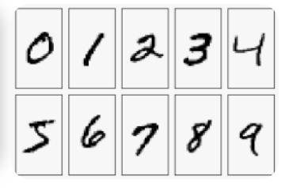
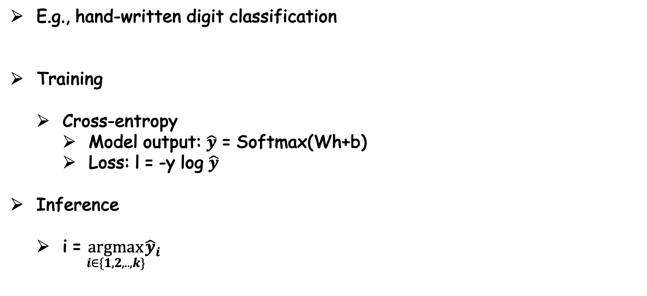
Classification Task
E.g., hand-written digit classification
Training
Cross-entropy
Model output: $\hat{y}$ = Softmax(Wh+b)
Loss: l = -y log $\hat{y}$
Inference
i = $\underset{i∈\{1,2,..,k\}}{argmax}{\hat{y}}_{i}{}$

Slide 4

Regression Task
E.g., predict stock price
Training
MSE-loss
Model output: $\hat{y}$ = f(Wh+b)
Loss: l = ½ (y - $\hat{y}$ )^2
Inference
$\hat{y}$ = f(Wh+b)

Slide 5
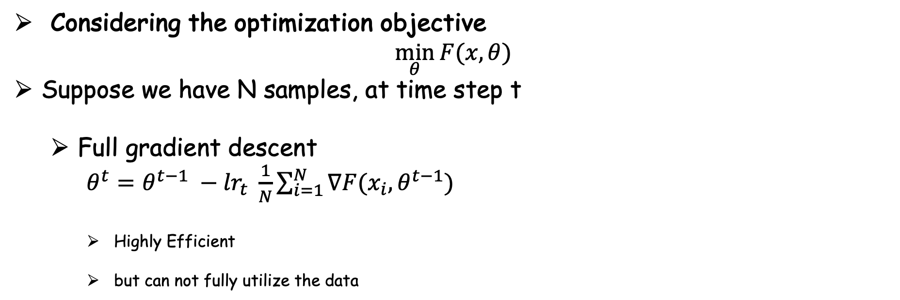
Gradient Descent
Considering the optimization objective
$$\min_{θ}{F(x, θ}{)}$$
Suppose we have N samples, at time step t
Full gradient descent
$θ^{t}=θ^{t−1} −{lr}_{t} \frac{1}{N}\sum_{i=1}^{N}{∇F(x_{i},θ^{t−1})}$
Highly Efficient
but can not fully utilize the data

Slide 6
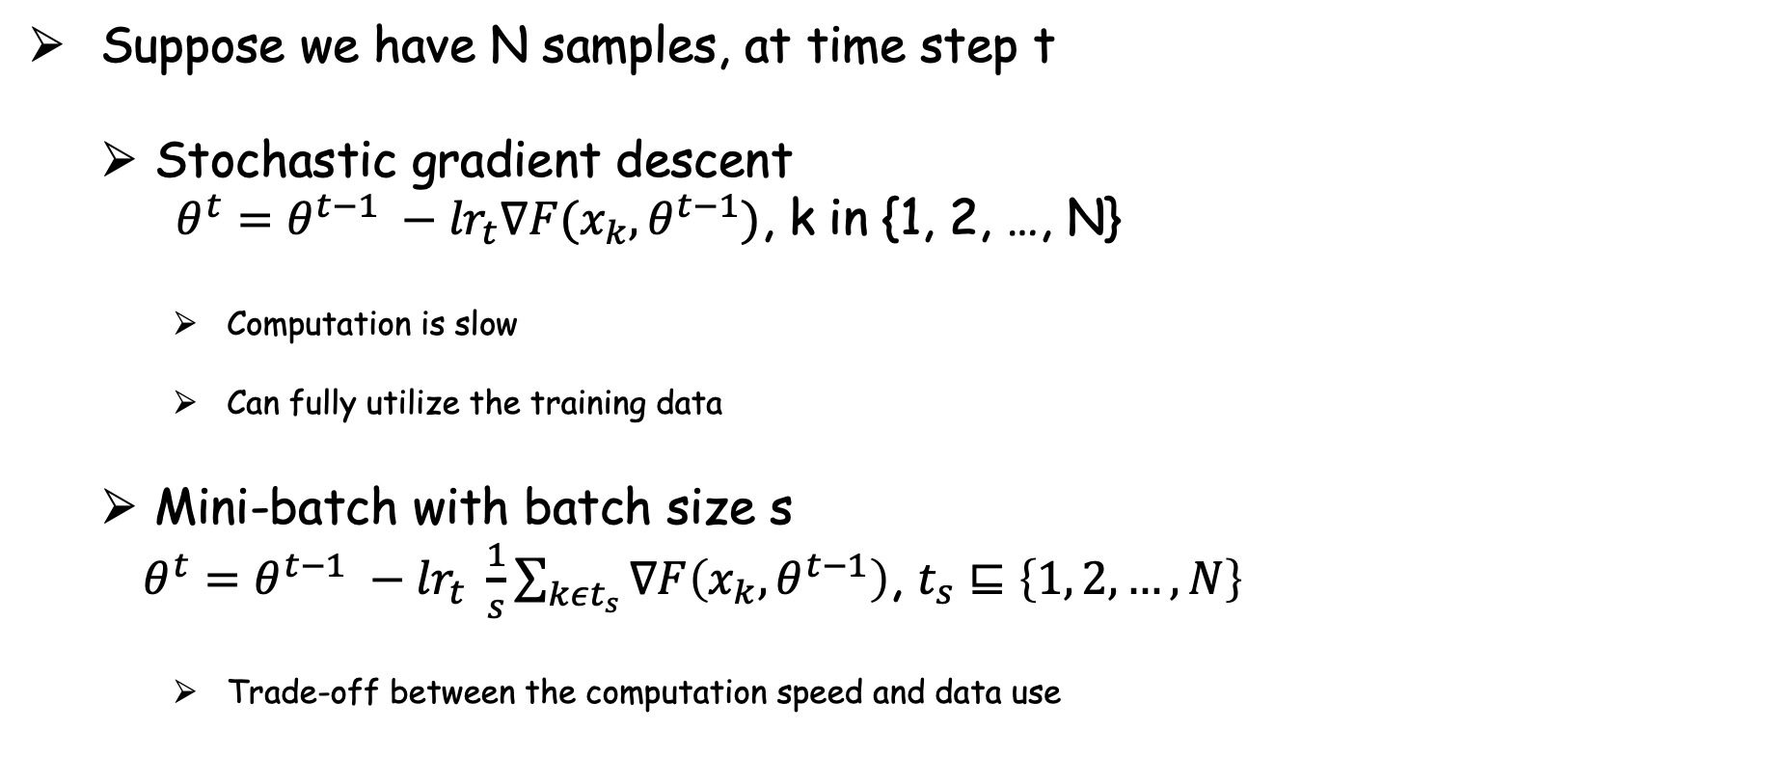
Gradient Descent
Suppose we have N samples, at time step t
Stochastic gradient descent
$θ^{t}=θ^{t−1} −{lr}_{t}∇F(x_{k},θ^{t−1})$, k in {1, 2, …, N}
Computation is slow
Can fully utilize the training data
Mini-batch with batch size s
$θ^{t}=θ^{t−1} −{lr}_{t} \frac{1}{s}\sum_{kεt_{s}}{∇F\left(x_{k},θ^{t−1}\right)}$, $t_{s}⊑\left\{1, 2, …, N\right\}$
Trade-off between the computation speed and data use

Slide 7
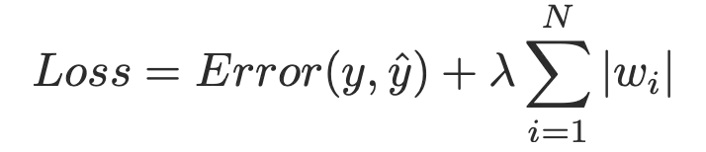
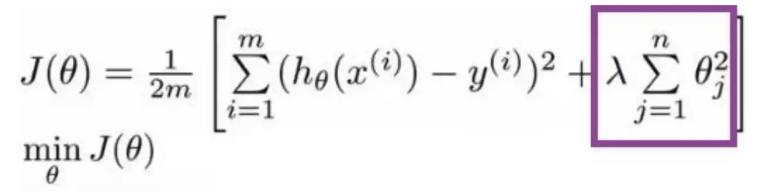
Regularization
Prevent overfitting
L1 regularizer (Lasso regularizer)
E.g., Alignment in machine translation, graph for social network
L2 regularizer (Ridge regularizer)
E.g. deep neural network training
Dropout
0.1 ~ 0.5

Slide 8
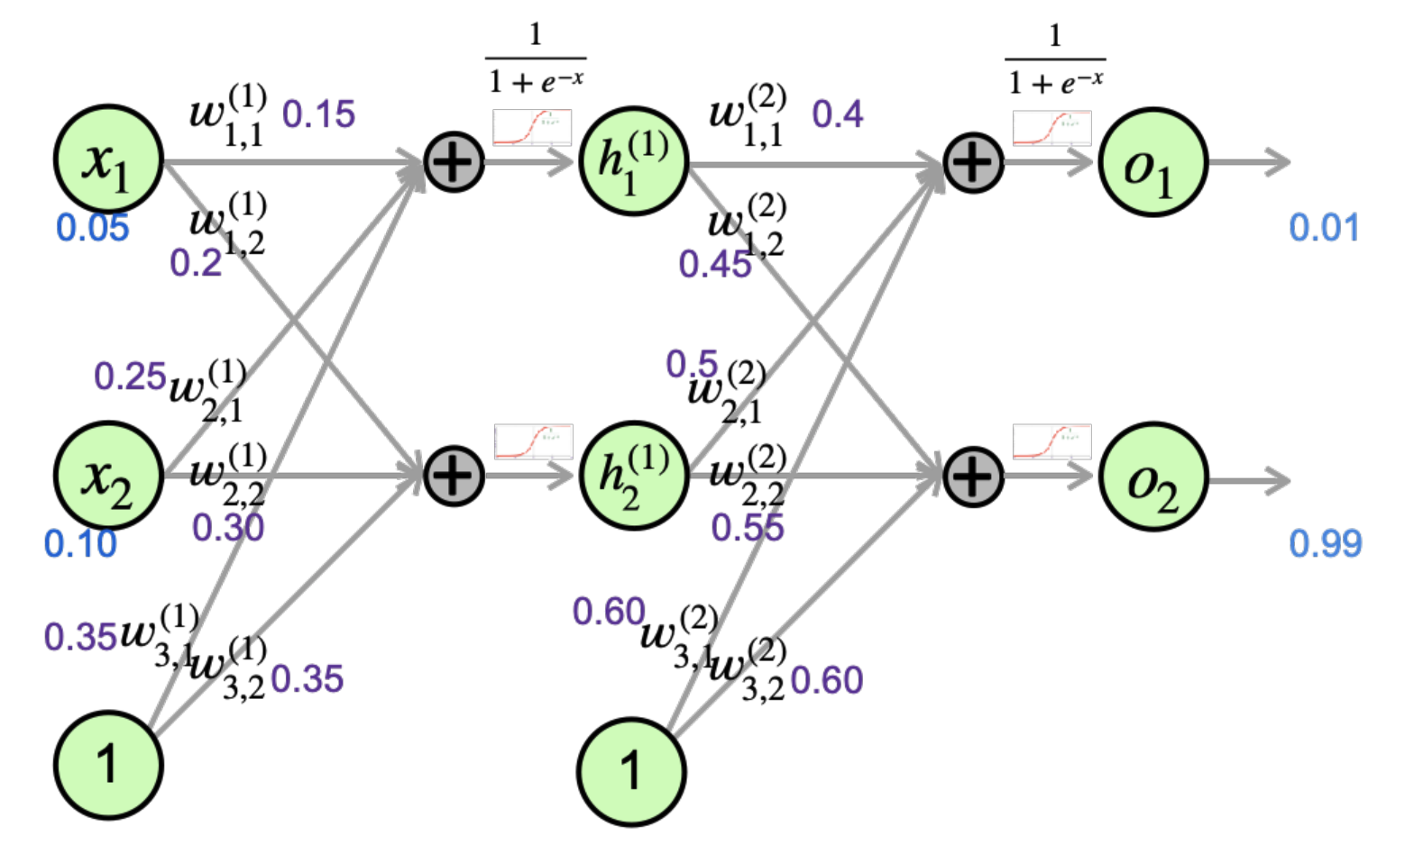
Quiz

Slide 9
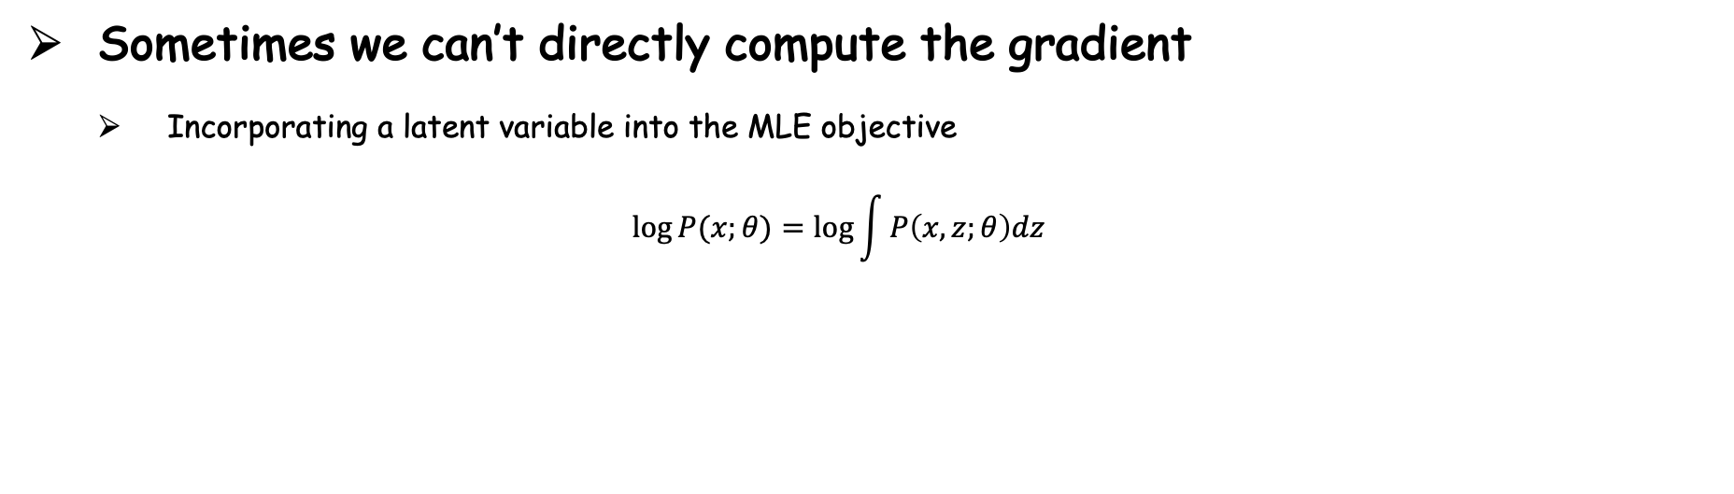
Why calculating gradient is necessary?
Sometimes we can’t directly compute the gradient
Incorporating a latent variable into the MLE objective
$$\log{P(x;θ)}=\log{\int{P\left(x, z;θ\right)dz}}$$

Slide 10
Any Question?
Notes:
A solid may help a simple paper

